Slide 1

Simple interest
5E
Notes:
2,4,5,8,9,12

Slide 2
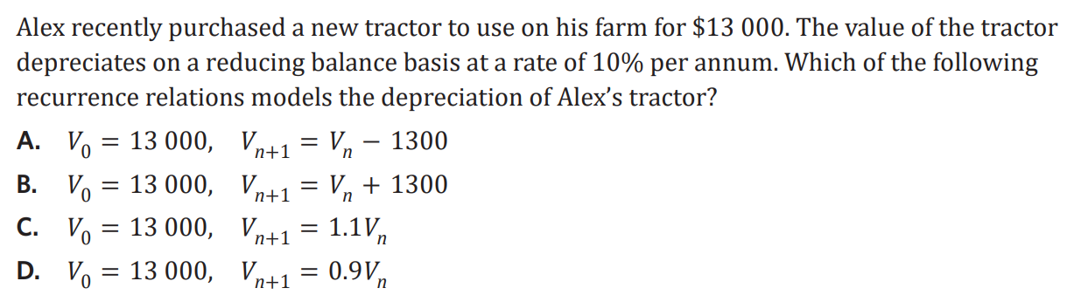
Starter =2 marks

Slide 3




5E: Simple Interest
Interest:
• the cost of borrowing money • loans: banks charge lenders a fee for borrowing their money • investments: investor receives interest/ payment as the bank is borrowing their money
simple interest:
• a constant amount of interest that is paid or earned each period • calculated as a percentage of the principal
recurrence relation: next value previous value
V₀ = principal, Vₙ₊₁ = Vₙ + D
D = $\frac{r}{100}$× V₀ interest
r = interest rate (%)
rule: any future value
Vₙ = V₀ + n × D
D = $\frac{r}{100}$× V₀
r = interest rate (%)
examples:
1. Joseph invests $12000 into a simple interest account earning 4.3% p.a.
a. write the recurrence relation: V₀ = 12000 , Vₙ₊₁ = Vₙ + 516
D = $\frac{4.3}{100}$ × 12000 = 516
b. write the rule: Vₙ = 12000 + n × 516
c. calculate the value after 3 years
using recurrence and the rule:
recurrence: step by step
V₀ = 12000
V₁ =V₀ + D =12000+516 = 12516
V₂ = V₁ + D =12516+516=13032
V₃ = V₂ + D= 13032+516=13548
rule: V₃ = 12000 + 3 × 516
= 13548
2. Lulu opens a simple interest loan to purchase a new laptop, the rule is: Vₙ = 2000+ n × 121
a. how much was borrowed?
$2000
b. what is the interest rate?
D= $\frac{r}{100}$× V₀
solve (121 = $\frac{r}{100}$× 2000, r)
r= 6.05%
c. when will the loan reach $2700?
rule, to find n using the given value
solve(2700=2000+n x 121, n)
n= 5.79
= 6 years
Notes:
Board notes

Slide 4
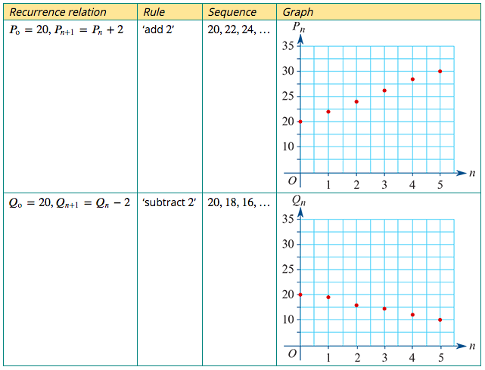
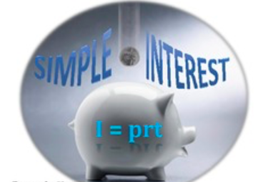
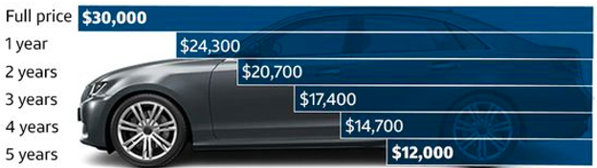
A recurrence model for linear growth and decay
The recurrence relations: $P_{0}$=20, $P_{n+1}$= $P_{n}$+ 2 $Q_{0}$=20, $Q_{n+1}$= $Q_{n}−$ 2
linear growth
Model and investigate simple interest loans and investments, as well as flat rate depreciation and unit cost depreciation of assets
linear decay

Slide 5
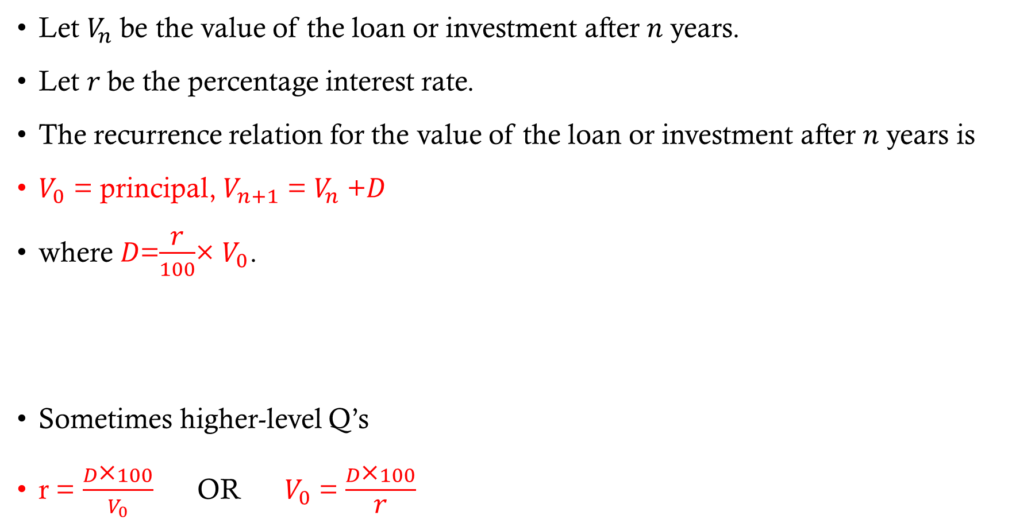
Simple interest growth
Let $V_{n}$ be the value of the loan or investment after 𝑛 years.
Let 𝑟 be the percentage interest rate.
The recurrence relation for the value of the loan or investment after 𝑛 years is
$V_{0}$ = principal, $V_{n+1}$ = $V_{n}$ +𝐷
where 𝐷=$\frac{\text{r}}{100}$× $V_{0}$.
Sometimes higher-level Q’s
r = $\frac{D\text{×}100}{V_{0}}$OR $V_{0}$ = $\frac{D\text{×}100}{\text{r}}$

Slide 6

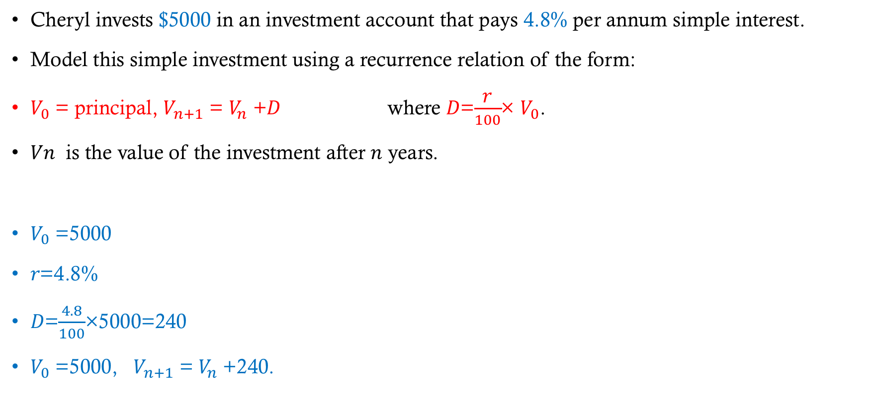
Modelling a simple interest with a recurrence relation
Cheryl invests $5000 in an investment account that pays 4.8% per annum simple interest.
Model this simple investment using a recurrence relation of the form:
$V_{0}$ = principal, $V_{n+1}$ = $V_{n}$ +𝐷 where 𝐷=$\frac{\text{r}}{100}$× $V_{0}$.
𝑉𝑛 is the value of the investment after 𝑛 years.
$V_{0}$ =5000
𝑟=4.8%
𝐷=$\frac{4.8}{100}$×5000=240
$V_{0}$ =5000, $V_{n+1}$ = $V_{n}$ +240.

Slide 7
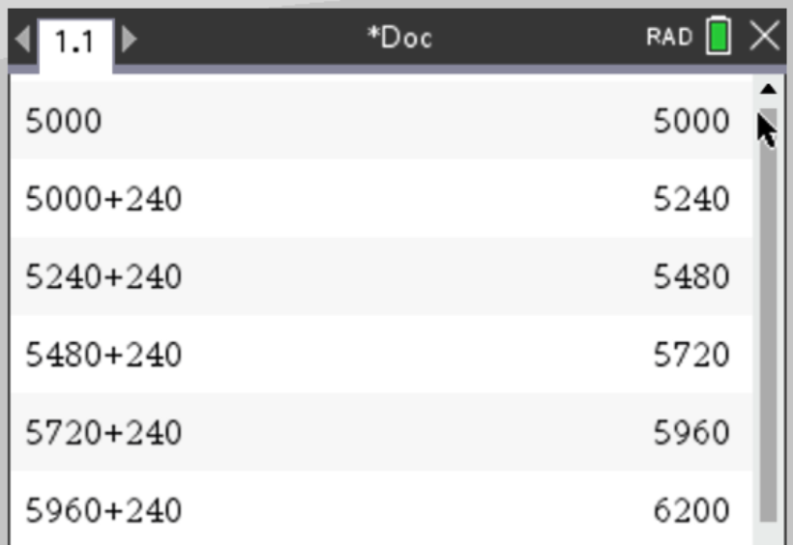
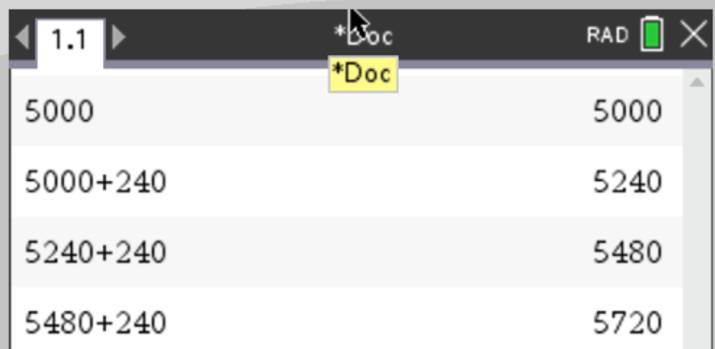

Using a recurrence relation to analyse a simple interest investment
Cheryl’s simple interest investment is modelled by
$V_{0}$ =5000, $V_{n+1}$ = $V_{n}$ +240.
where $V_{n}$ is the value of the investment after 𝑛 years.
a. Use the model to determine the value of Cheryl’s investment after 3 years.
b. When will Cheryl’s investment first exceed $6000, and what will its value be then?
CAS Notes 5.2
a. $5720
b. After 5 years; $6200.

Slide 8
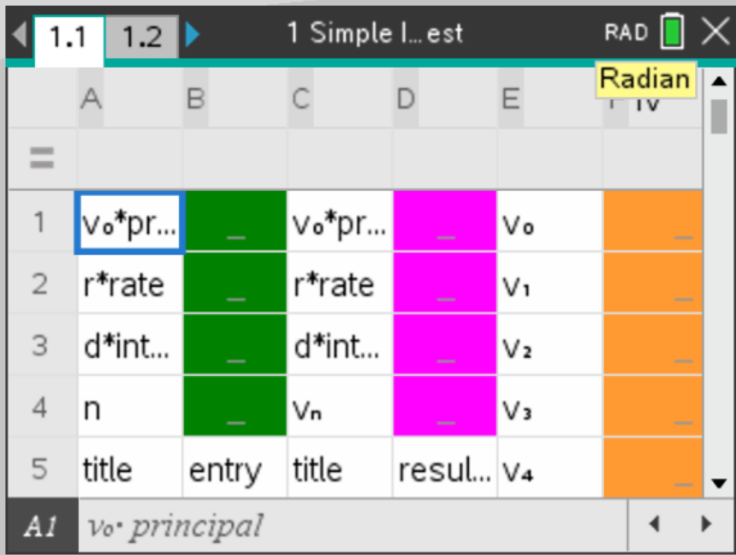
Using a recurrence relation to analyse a simple interest investment
Cheryl’s simple interest investment is modelled by
$V_{0}$ =5000, $V_{n+1}$ = $V_{n}$ +240.
where $V_{n}$ is the value of the investment after 𝑛 years.
a. Use the model to determine the value of Cheryl’s investment after 3 years.
b. When will Cheryl’s investment first exceed $6000, and what will its value be then?
CAS Notes 6.16.1
Green area=input
Pink & Orange= output
a. $5720
b. After 5 years; $6200.

Slide 9
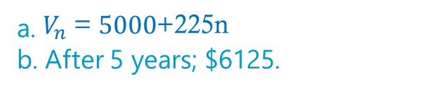

Modelling simple interest using a rule
Joan invests $5000 in an account paying a simple interest rate of 4.5% per year.
a. Construct a rule that will calculate the value of the investment, $V_{n}$, after n years.
D =$\frac{r}{100}×v_{0}$ = $\frac{4.5}{100}×5000$= 225
$V_{n}$ =5000+n*225 Or $V_{n}$ = $5000$+225n
b. Use the rule to calculate the value of the investment after five years.
$V_{5}$ = $5000$+225*5 = $ 6125.00
a. $V_{n}$ = $5000$+225n
b. After 5 years; $6125.

