Slide 1

Nominal and effective interest rates
Notes:
https://play.blooket.com/host?id=65370e6bac23c4cf0a3ac035
2,4,5.7

Slide 2
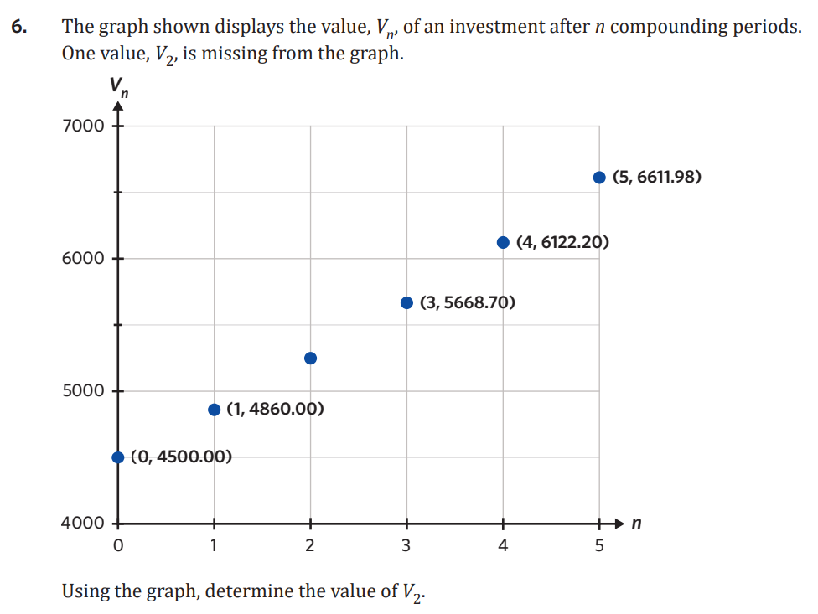
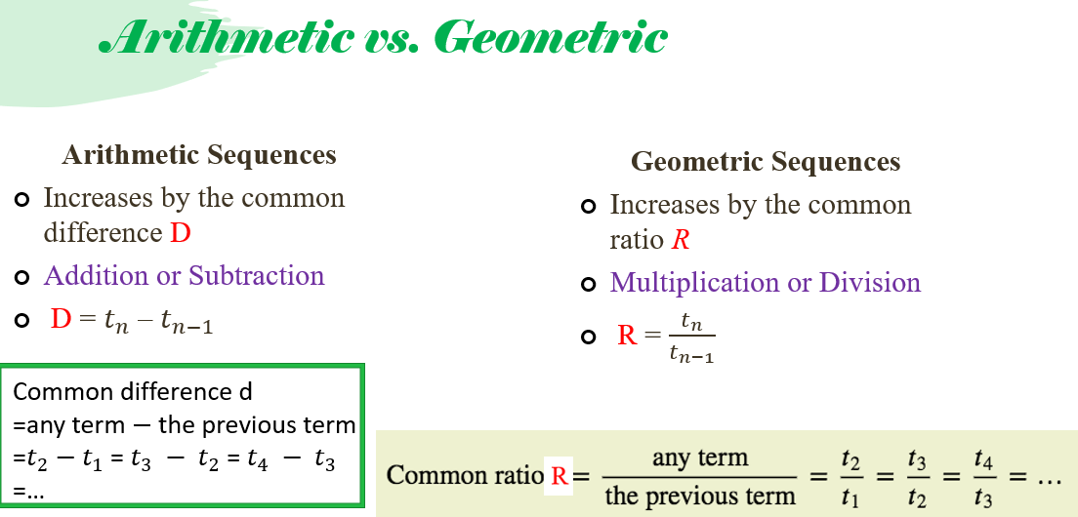

Slide 3



5G Nominal and Effective Interest Rates
Nominal: The quoted interest rate for a loan/investment, a.k.a. the annual interest rate
Effective: The adjusted or “real” rate, Takes into account the number of compounding periods
→Used to compare different loan/investment options
Changing Nominal to Effective
$$r_{\text{eff}}=({\left(1+\frac{r}{100n}\right)}^{n}−1)×100$$
Where:
$r$= nominal interest rate
$n$= compounding periods
CAS
Nominal → Effective
$eff(nominal, compound$)
$interest rate$ $periods$
menu → 8 → 5 → 2
If you have a loan:
Borrower wants the smallest effective interest rate
If you have an investment:
Investor wants the highest effective interest rate
Effective → Nominal
nom( % , n )
menu → 8 → 5 → 1
Examples
1. Harper takes out a loan. They have 2 options. Which is the best option?
1. 3.7% p.a. compounding biannually
2. 3.68% p.a. compounding weekly
eff(3.7, 2) = 3.74%
eff(3.68, 52) = 3.75%
∴ Option 1
2. Billy is planning to invest $10,000. Which option is best?
1. 8.4% p.a. compounding fortnightly
eff(8.4, 26) = 8.75%
2. 8.41% p.a. compounding quarterly
eff(8.41, 4) = 8.68%
∴ Option 1
Notes:
Board notes

Slide 4
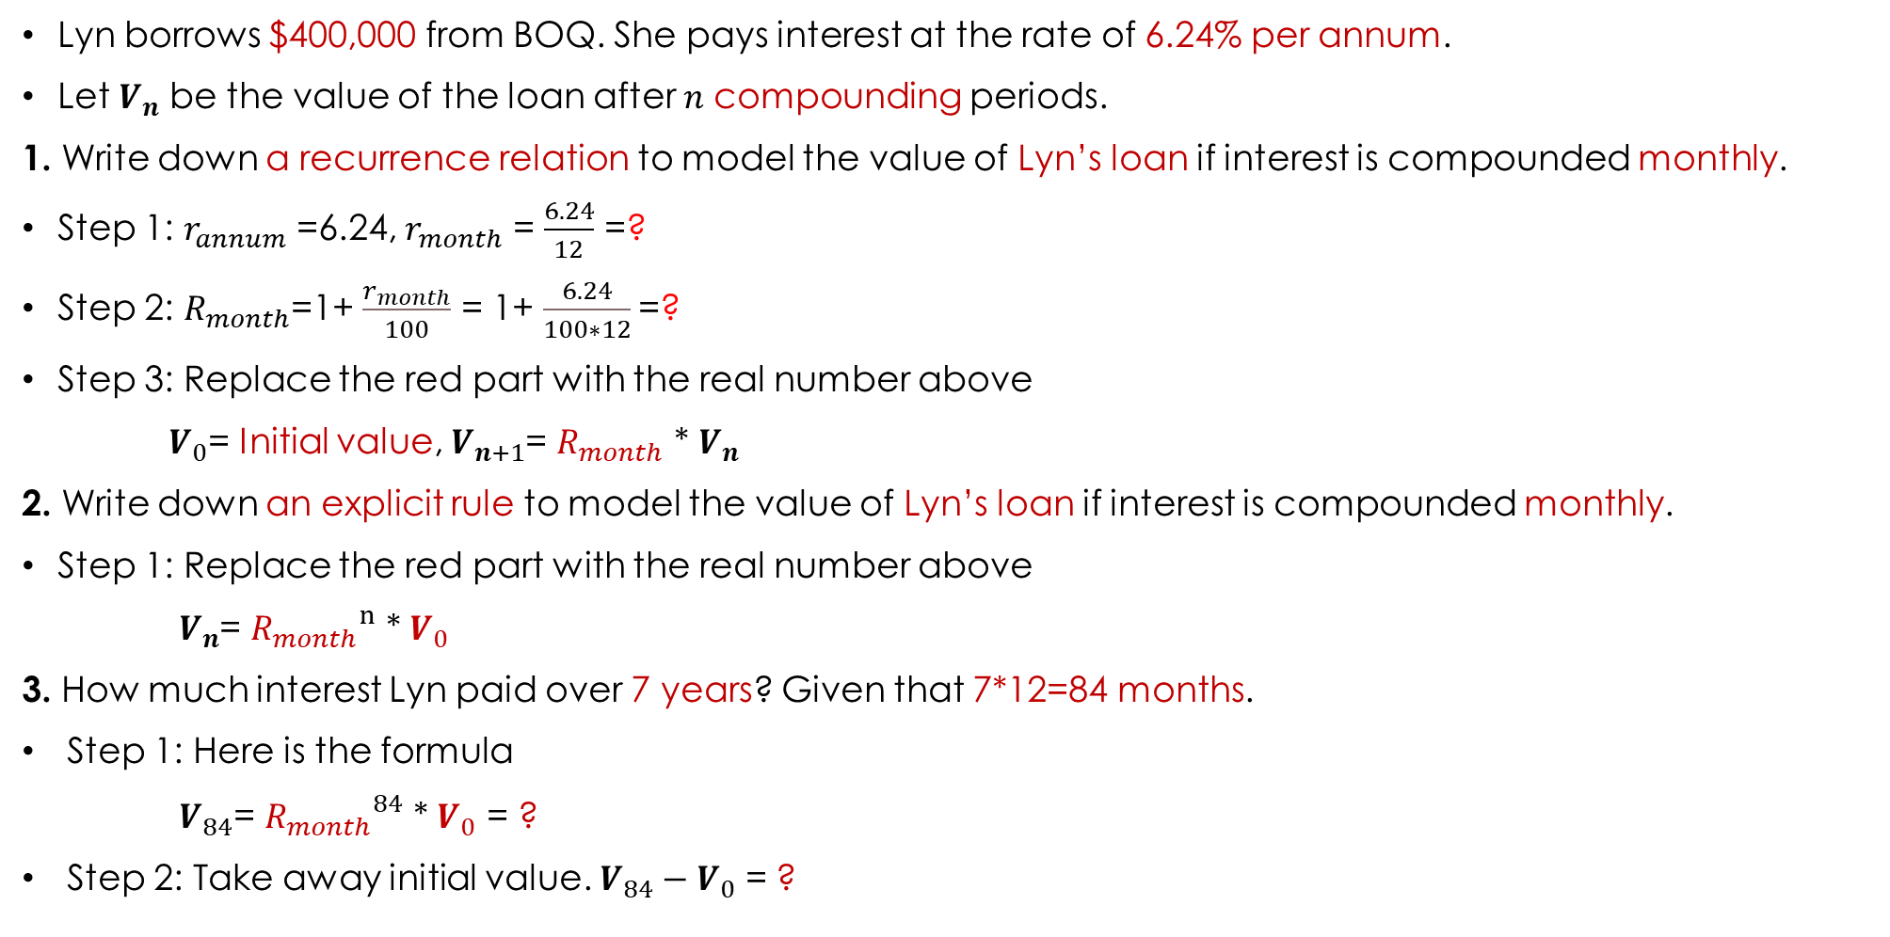
Lesson Starter
Lyn borrows $400,000 from BOQ. She pays interest at the rate of 6.24% per annum.
Let $V_{n}$ be the value of the loan after 𝑛 compounding periods.
1. Write down a recurrence relation to model the value of Lyn’s loan if interest is compounded monthly.
Step 1: $r_{annum}$ =6.24, $r_{month}$ = $\frac{6.24}{12}$ =?
Step 2: $R_{month}$=1+ $\frac{r_{month}}{100}$ = 1+ $\frac{6.24}{100∗12}$=?
Step 3: Replace the red part with the real number above
$V_{0}$= Initial value, $V_{n+1}$= $R_{month}$ * $V_{n}$
2. Write down an explicit rule to model the value of Lyn’s loan if interest is compounded monthly.
Step 1: Replace the red part with the real number above
$V_{n}$= ${R_{month}}^{n}$ * $V_{0}$
3. How much interest Lyn paid over 7 years? Given that 7*12=84 months.
Step 1: Here is the formula
$V_{84}$= ${R_{month}}^{84}$ * $V_{0}$ = ?
Step 2: Take away initial value. $V_{84}−V_{0}$ = ?

Slide 5
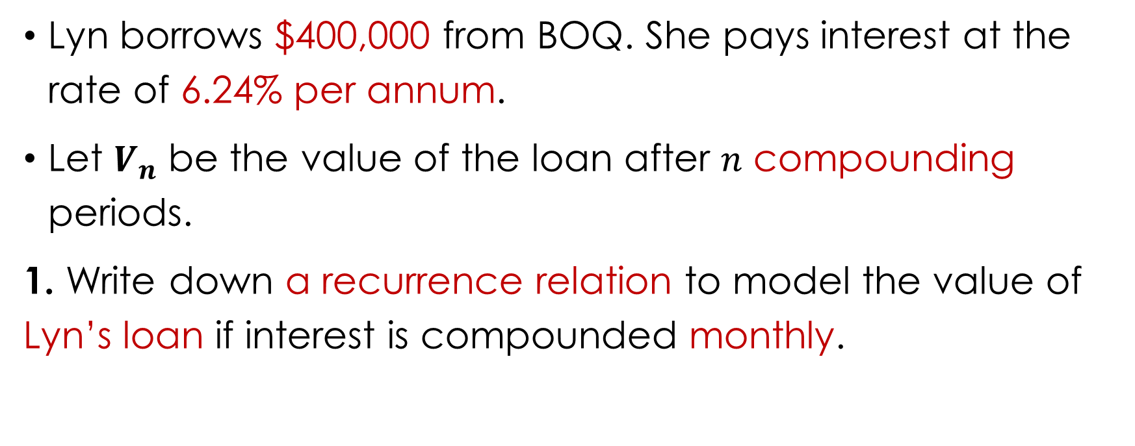
Starter
Lyn borrows $400,000 from BOQ. She pays interest at the rate of 6.24% per annum.
Let $V_{n}$ be the value of the loan after 𝑛 compounding periods.
1. Write down a recurrence relation to model the value of Lyn’s loan if interest is compounded monthly.

Slide 6
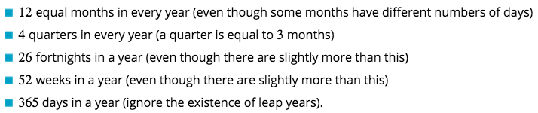
Nominal interest rate
Compound interest rates are usually quoted as annual rates, or interest rate per annum. This rate is called the nominal interest rate for the investment or loan.
The time period after which compound interest is calculated and paid is called the compounding period.

Slide 7


Converting nominal interest rates to compounding interest rates
An investment account will pay interest at the rate of 3.6% per annum. Convert this interest rate to
1. a monthly rate
2. a fortnightly rate
3. a quarterly rate.
1. Monthly interest rate= $\frac{3.6}{12}$=0.3%
2. Fortnightly interest rate= $\frac{3.6}{26}$=0.138% to 3 d.p.
3. Quarterly interest rate= $\frac{3.6}{4}$=0.9%

Slide 8
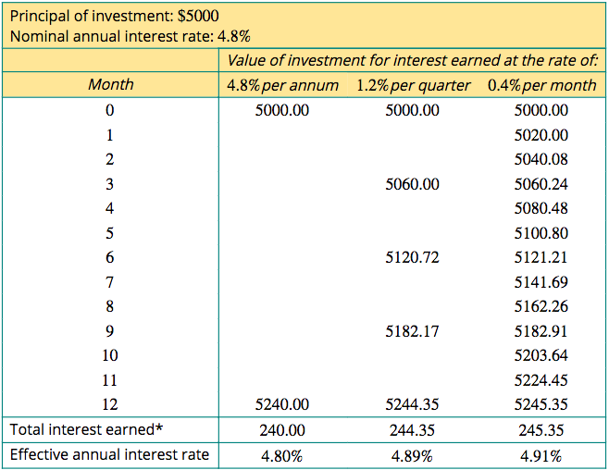
Effective interest rates
Earning compound interest:
More frequent compounding, higher effective interest rate.
Higher interest earned.

Slide 9
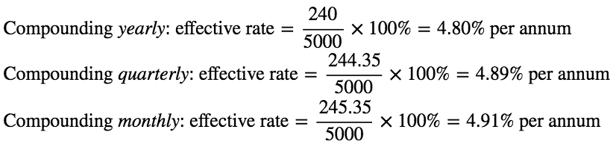
Effective interest rates
The interest earned can be expressed as a percentage of the original investments. This value, called the effective interest rate, can be used to compare the investment performance.

Slide 10



Effective interest rates
The effective interest rate of a loan or investment is the interest earned after one year expressed as a percentage of the amount borrowed or invested.
Let:
𝑟 be the nominal interest rate per annum
$r_{effective}$ be the effective annual interest rate
𝑛 be the number of times the interest compounds each year.
The effective annual interest rate is given by: $r_{effective}$ =(${\text{(1+}\frac{\text{r}\text{/}\text{n}}{100}\text{)}}^{n}$−1)×100%

Slide 11
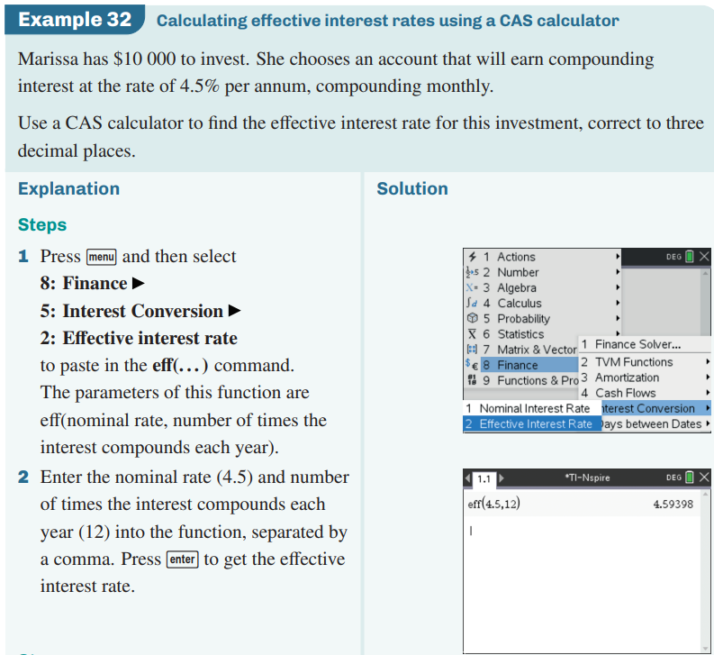

Calculating effective interest rates using CAS Calculator
CAS Notes 5.9
CAS Notes 6.18

Slide 12
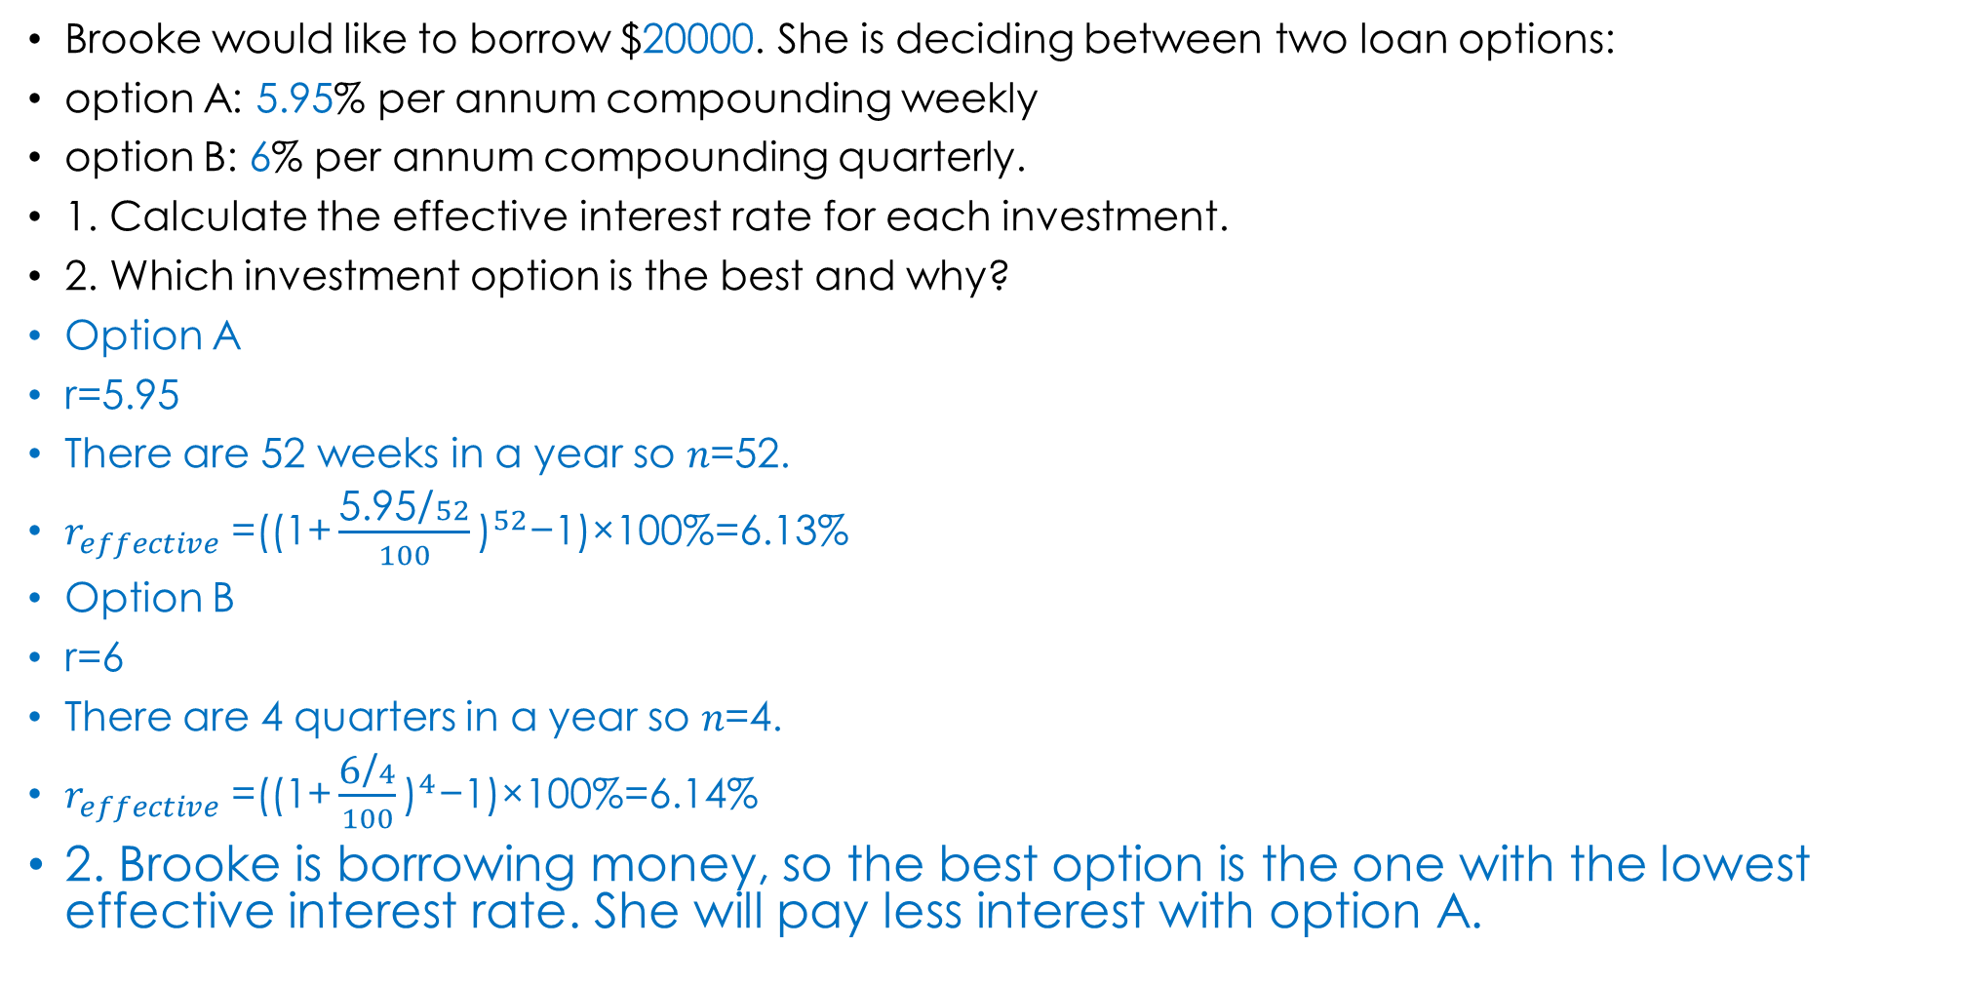
Comparing loans and investments with effective interest rates
Brooke would like to borrow $20000. She is deciding between two loan options:
option A: 5.95% per annum compounding weekly
option B: 6% per annum compounding quarterly.
1. Calculate the effective interest rate for each investment.
2. Which investment option is the best and why?
Option A
r=5.95
There are 52 weeks in a year so 𝑛=52.
$r_{effective}$ =(${\text{(1+}\frac{\text{5.95}\text{/}52}{100}\text{)}}^{52}$−1)×100%=6.13%
Option B
r=6
There are 4 quarters in a year so 𝑛=4.
$r_{effective}$ =(${\text{(1+}\frac{\text{6}\text{/}4}{100}\text{)}}^{4}$−1)×100%=6.14%
2. Brooke is borrowing money, so the best option is the one with the lowest effective interest rate. She will pay less interest with option A.

