Slide 1

Introducing financial applications
6A

Slide 2
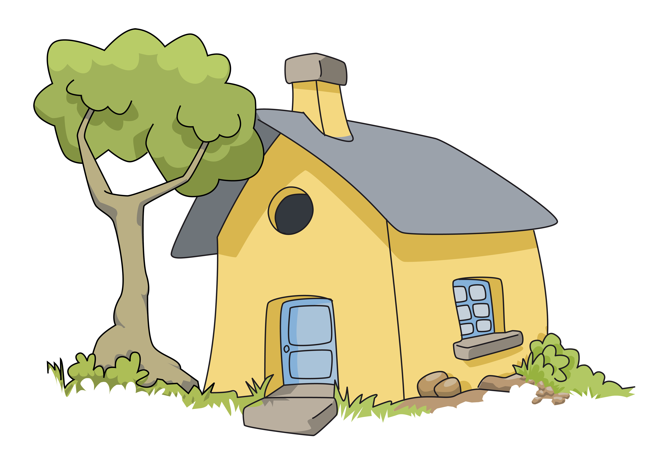
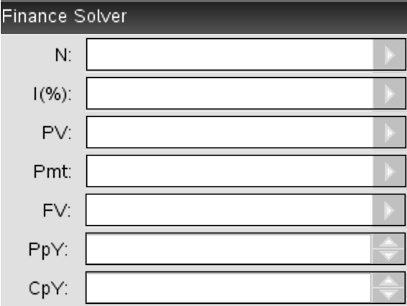



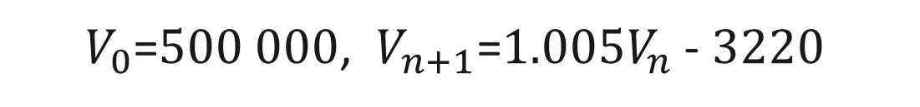
$V_{0}$=$500 000$, $V_{n+1}$=$1.005V_{n}$-$3220$

Slide 3
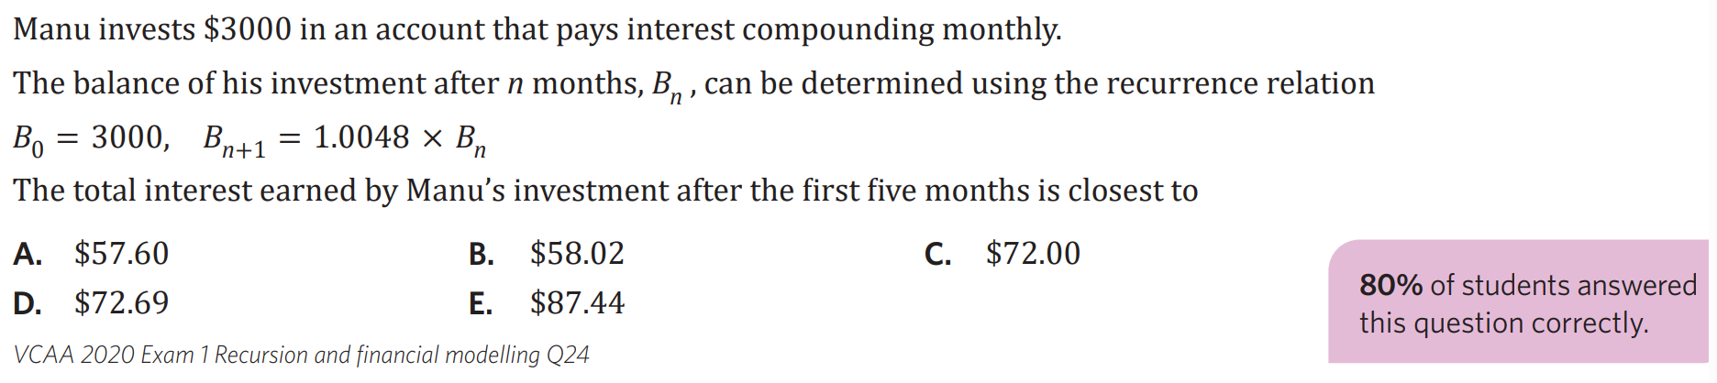

Slide 4
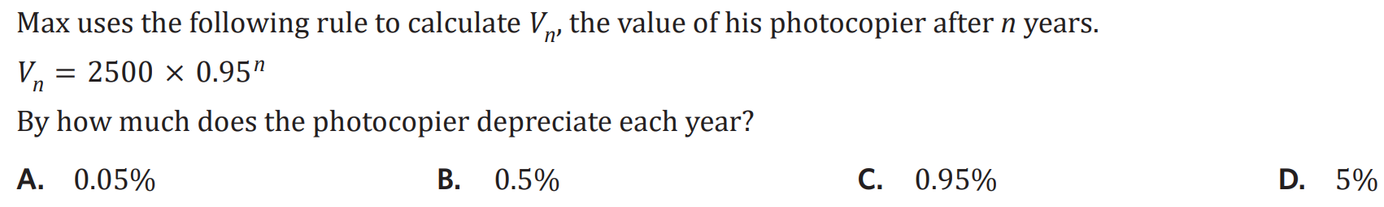

Slide 5

6A Financial Applications
Amortisation Tables:
shows step by step calculations for balances of loans or annuities
shows consecutive compound periods
example: can be: addition, total of annuity, investment
finance solver
CAS: menu > 8 > 1
N: number of payments (years x compound periods) I%: annual interest rate PV: present value (current value) Pmt: payment per compound period FV: future value, after n compound periods PpY: payments received per year CpY: compound periods per year (same) PmtAt: when the payment is made @ beginning or end; always END for us
the direction of money exchange must be specified when using finance solver:
the PV, Pmt and FV are either positive or negative
positive: individual receives money
negative: individual pays money
payment number | payment | interest | principal reduction | balance of loan/investment
number of payments been made/received | the amount paid to or from | amount added to loan or investment | change in balance from payment/interest | the balance from previous balance and principal red.
0 | 0 | 0 | 0 | V₀ (principal / starting value)
1

Slide 6
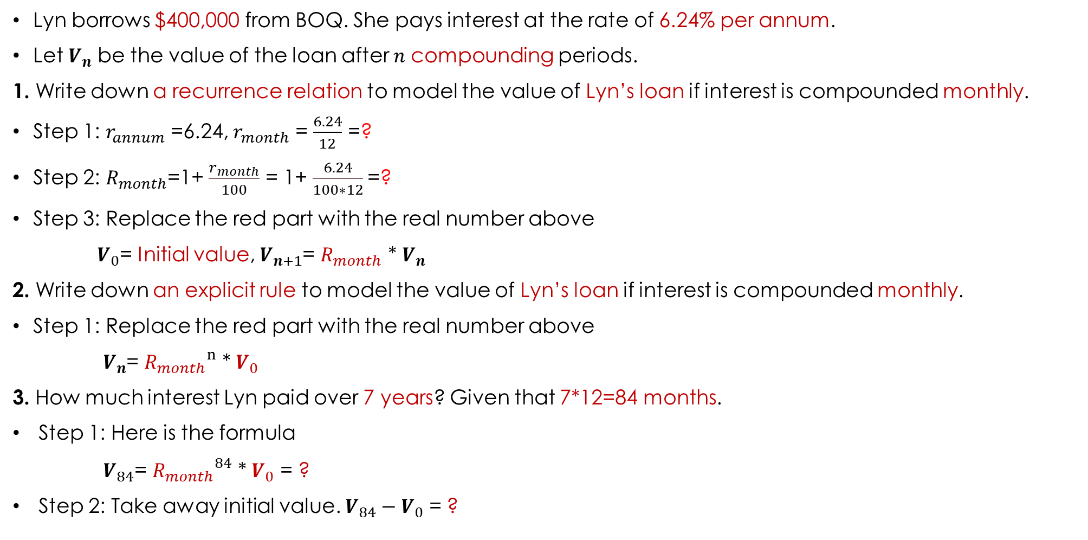
Lesson Starter
Lyn borrows $400,000 from BOQ. She pays interest at the rate of 6.24% per annum.
Let $V_{n}$ be the value of the loan after 𝑛 compounding periods.
1. Write down a recurrence relation to model the value of Lyn’s loan if interest is compounded monthly.
Step 1: $r_{annum}$ =6.24, $r_{month}$ = $\frac{6.24}{12}$ =?
Step 2: $R_{month}$=1+ $\frac{r_{month}}{100}$ = 1+ $\frac{6.24}{100∗12}$=?
Step 3: Replace the red part with the real number above
$V_{0}$= Initial value, $V_{n+1}$= $R_{month}$ * $V_{n}$
2. Write down an explicit rule to model the value of Lyn’s loan if interest is compounded monthly.
Step 1: Replace the red part with the real number above
$V_{n}$= ${R_{month}}^{n}$ * $V_{0}$
3. How much interest Lyn paid over 7 years? Given that 7*12=84 months.
Step 1: Here is the formula
$V_{84}$= ${R_{month}}^{84}$ * $V_{0}$ = ?
Step 2: Take away initial value. $V_{84}−V_{0}$ = ?

Slide 7
Introducing financial applications
Recurrence relations for the financial products
Amortisation & growth tables for financial products
Finance solver for financial products

Slide 8

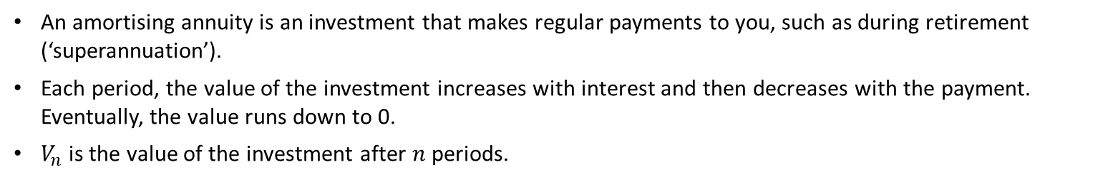
Recurrence relations for financial products
Amortising annuity (formula)
$V_{0}=$ $500 000$, $V_{n+1}=$ $1.005V_{n}$ $− 3220$
Deep dive
An amortising annuity is an investment that makes regular payments to you, such as during retirement (‘superannuation’).
Each period, the value of the investment increases with interest and then decreases with the payment. Eventually, the value runs down to 0.
$V_{n}$ is the value of the investment after $n$ periods.
Notes:
Annuities can typically be purchased from banks, brokers or insurance companies.

Slide 9

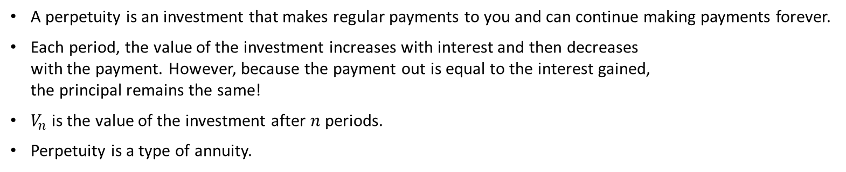


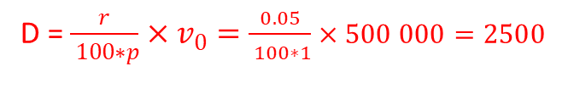


Recurrence relations for financial products
$V_{0}=500 000$, $V_{n+1} =1.005{ V}_{n}−2500$
Perpetuity (formula)
$V_{0}=$ $500 000$, $V_{n+1}=$ $1.005V_{n} −2500$
$$1.005=1+0.005$$
$− 2500:$ balance stays constant
$$1=100\%:principal$$
$$0.005=0.5\%:Interest rate$$
D = $\frac{r}{ 100∗p}×v_{0}=\frac{0.05}{ 100∗1}×500 000=2500$
Deep dive
A perpetuity is an investment that makes regular payments to you and can continue making payments forever.
Each period, the value of the investment increases with interest and then decreases with the payment. However, because the payment out is equal to the interest gained, the principal remains the same!
$V_{n}$ is the value of the investment after $n$ periods.
Perpetuity is a type of annuity.

Slide 10
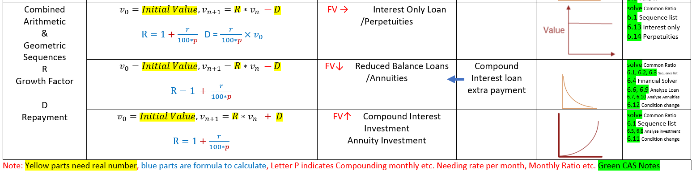
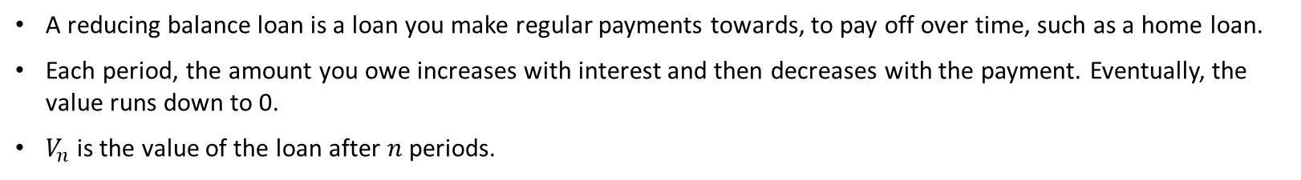

Recurrence relations for financial products
Reducing balance loan (formula)
$V_{0}=$ $500 000$, $V_{n+1}= 1.005V_{n} − 3220$
Deep dive
A reducing balance loan is a loan you make regular payments towards, to pay off over time, such as a home loan.
Each period, the amount you owe increases with interest and then decreases with the payment. Eventually, the value runs down to 0.
$V_{n}$ is the value of the loan after $n$ periods.

Slide 11
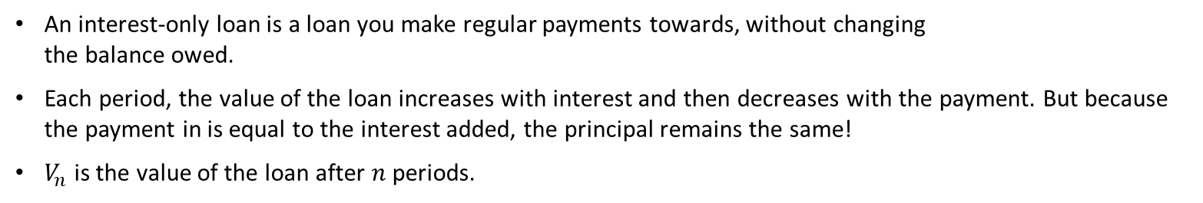

Recurrence relations for financial products
$V_{0}=500 000$, $V_{n+1} =1.005{ V}_{n}−2500$
Interest-only loan (formula)
$V_{0}$= $500 000$, $V_{n+1}$= $1.005V_{n} − 2500$
$$1.005=1+0.005$$
$− 2500:$ balance stays constant
$$1=100\%:principal$$
$$0.005=0.5\%:Interest rate$$
D = $\frac{r}{ 100∗p}×v_{0}=\frac{0.05}{ 100∗1}×500 000=2500$
Deep dive
An interest-only loan is a loan you make regular payments towards, without changing the balance owed.
Each period, the value of the loan increases with interest and then decreases with the payment. But because the payment in is equal to the interest added, the principal remains the same!
$V_{n}$ is the value of the loan after $n$ periods.

Slide 12
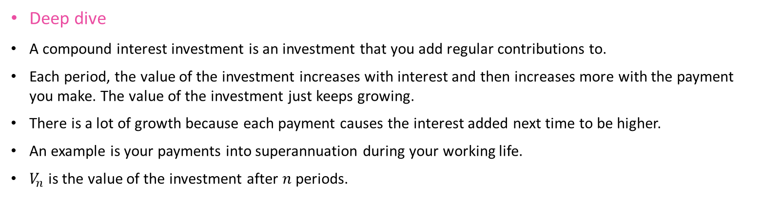
Recurrence relations for financial products
Compound interest investment (aka. annuity investment) (formula)
$V_{0}=$ $500 000$, $V_{n+1}=$ $1.005V_{n}+3200$
Deep dive
A compound interest investment is an investment that you add regular contributions to.
Each period, the value of the investment increases with interest and then increases more with the payment you make. The value of the investment just keeps growing.
There is a lot of growth because each payment causes the interest added next time to be higher.
An example is your payments into superannuation during your working life.
$V_{n}$ is the value of the investment after $n$ periods.

Slide 13
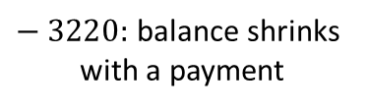
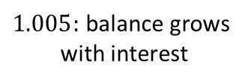
Recurrence relations for financial products
Key takeaway
$V_{0}=500 000$, $V_{n+1} =1.005{ V}_{n}−3220$
$1.005:$ balance grows with interest
$− 3220:$ balance shrinks with a payment
 | Type | Balance over time | Payments come
Reducing balance loan | Loan | Drops | From you
Interest only loan | Loan | Stays constant | From you
Amortising annuity | Investment | Drops | To you
Perpetuity | Investment | Stays constant | To you
Compound interest investment | Investment | Grows | From you

Slide 14

Amortisation tables for financial products
Key takeaway
 | Payment | Interest | Principal reduction | Balance
0 | 0.00 | 0.00 | 0.00 | 500 000.00
1 | 3222.00 | 2500.00 | 722.00 | 499 278.00
2 | 3222.00 | 2496.39 | 725.61 | 498 552.39
… | … | … | … | …
298 | 3222.00 | 46.17 | 3175.83 | 6057.74
299 | 3222.00 | 30.29 | 3191.71 | 2866.03
300 | 2880.36 | 14.33 | 2866.03 | 0.00
An amortisation table shows the change in the balance of a loan or investment over time.
It often includes:
payment number
payment
interest
principal change (reduction/addition)
balance
Examining how the balance changes over time (increase, decrease or remaining constant) can help identify the type of financial product.
$V_{0}=500 000$, $V_{n+1} =1.005V_{n} − 3222$

Slide 15

Amortisation tables for financial products
 | Payment | Interest | Principal reduction | Balance
0 | 0.00 | 0.00 | 0.00 | 500 000.00
1 | 3222.00 | 2500.00 | 722.00 | 499 278.00
2 | 3222.00 | 2496.39 | 725.61 | 498 552.39
… | … | … | … | …
298 | 3222.00 | 46.17 | 3175.83 | 6057.74
299 | 3222.00 | 30.29 | 3191.71 | 2866.03
300 | 2880.36 | 14.33 | 2866.03 | 0.00
This table represents the amortisation of a $500 000 reducing balance loan, at 6% p.a. with monthly repayments.
Calculations
$V_{0}=500 000$, $V_{n+1} =1.005V_{n} − 3222$

Slide 16
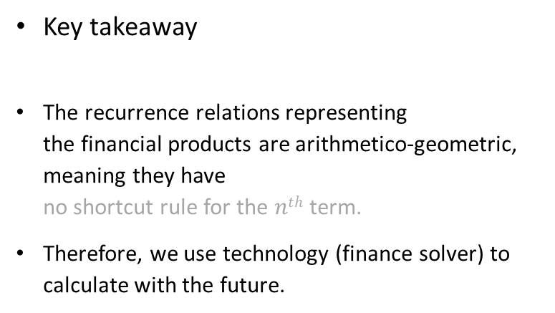

Finance solver for financial products
CAS Notes 6.4
Key takeaway
The recurrence relations representing the financial products are arithmetico-geometric, meaning they have no shortcut rule for the $nth$ term.
Therefore, we use technology (finance solver) to calculate with the future.
$V_{0}=500 000$, $V_{n+1} =1.005V_{n} − 3220$
Total number of periods
Annual interest rate
Present value
Payment
Future value
Payment periods per year
Compounding periods per year
Tip! For PV, Pmt, FV:
A value you RECEIVE is positive
A value you GIVE is negative

Slide 17
