Slide 1

Interest-only loans
8H
Notes:
1-5, 10,11

Slide 2
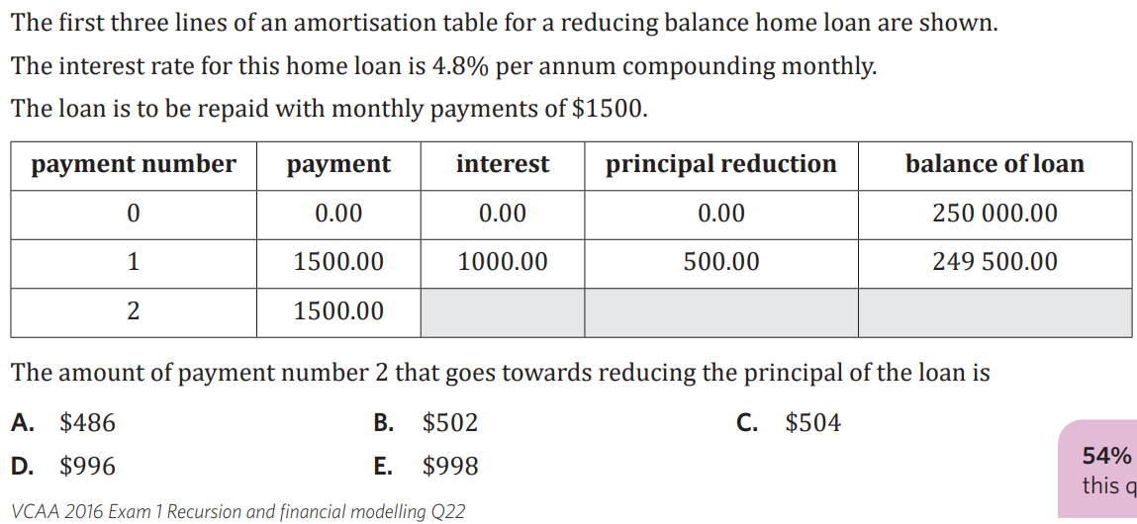

Slide 3
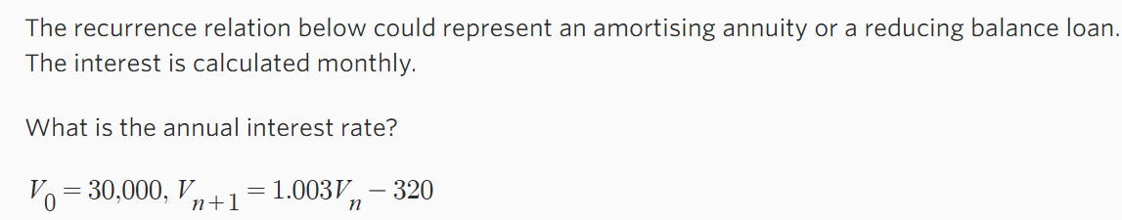



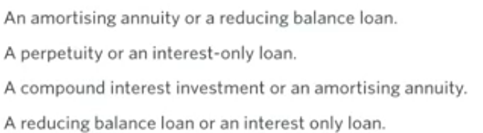
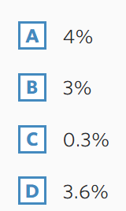
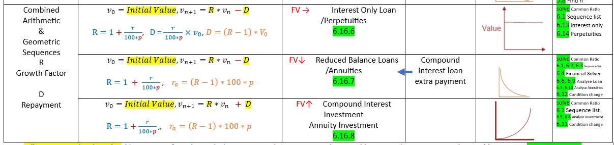

Slide 4




6C. Interest only loans
• borrower only repays the interest charged
• principal doesn’t change
• principal paid back @ termination of loan
• payment = interest charged
V₀ = $\boxed{principal}$,Vₙ₊₁ = $\boxed{R}$ Vₙ − $\boxed{D}$
R = 1 + $\frac{r}{100}$ interest / payment
D = $\frac{r}{100}$× V₀
r = interest rate per compounding period
finance solver
  N always 1
  PV POSITIVE
  Pmt NEGATIVE
  FV NEGATIVE
*PV and FV are the SAME number*
Example
1. Georgia borrows $100,000, if the interest rate is 7.35% compounding quarterly, what
are the quarterly repayments?
  N 1
  I 7.35
  PV 100,000
  Pmt $\boxed{\text{−}\text{1837.50}}$
  FV −100,000
  Cpy/Ppy 4
Finding V₀
If you are asked to find the
V₀ / starting value / amount borrowed
you MUST use the $\boxed{D Rule}$ and solve for V₀!!
D = $\frac{r}{100}$× V₀
Example:
2. Jamie takes out a loan that
requires them to pay $339.58 interest monthly.
The interest rate is 8.15% compounding monthly.
How much did Jamie borrow?
Solve(339.58 = $\frac{8.15/12}{100}$ * x, x)
x = $49,999.51
∴ Jamie borrowed $50,000
Notes:
Board notes

Slide 5
Defining an interest-only loan
Key takeaway
An interest only loan is one where the payment made is equal to the interest. Because of this, the principal is never reduced.
 | Payment | Interest | Principal reduction | Balance
0 | 0.00 | 0.00 | 0.00 | 620 000.00
1 | 1911.67 | 1911.67 | 0.00 | 620 000.00
2 | 1911.67 | 1911.67 | 0.00 | 620 000.00
3 | 1911.67 | 1911.67 | 0.00 | 620 000.00
… | … | … | … | …

Slide 6

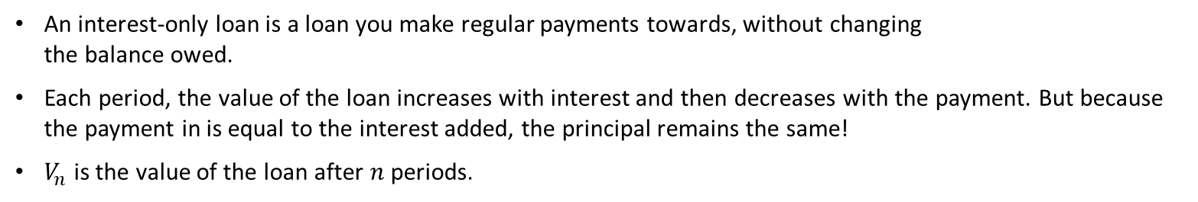




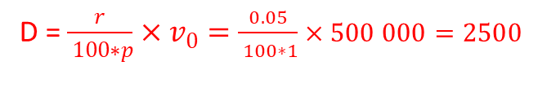
Recurrence relations for financial products
$V_{0}=500 000$, $V_{n+1} =1.005{ V}_{n}−2500$
Interest-only loan (formula)
$V_{0}$= $500 000$, $V_{n+1}$= $1.005V_{n} − 2500$
$$1.005=1+0.005$$
$− 2500:$ balance stays constant
$$1=100\%:principal$$
$$0.005=0.5\%:Interest rate$$
D = $\frac{r}{ 100∗p}×v_{0}=\frac{0.05}{ 100∗1}×500 000=2500$
Deep dive
An interest-only loan is a loan you make regular payments towards, without changing
the balance owed.
Each period, the value of the loan increases with interest and then decreases with the payment. But because the payment in is equal to the interest added, the principal remains the same!
$V_{n}$ is the value of the loan after $n$ periods.

Slide 7
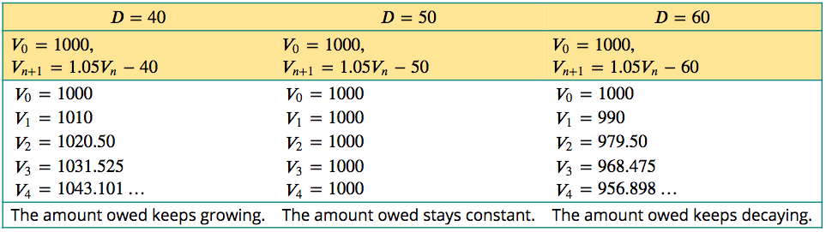
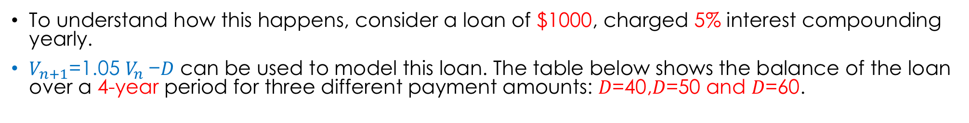
Interest-only loan
To understand how this happens, consider a loan of $1000, charged 5% interest compounding yearly.
$V_{n+1}$=1.05 $V_{n}$−𝐷 can be used to model this loan. The table below shows the balance of the loan over a 4-year period for three different payment amounts: 𝐷=40,𝐷=50 and 𝐷=60.

Slide 8
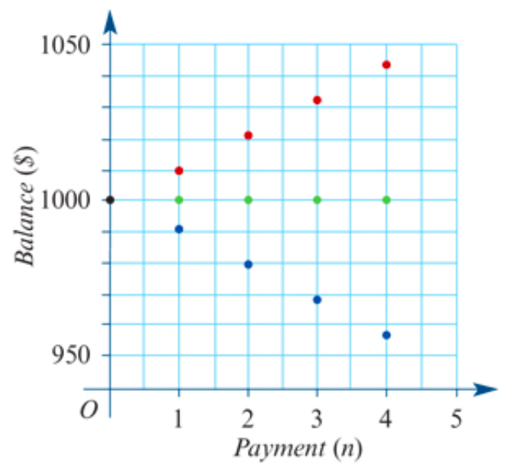

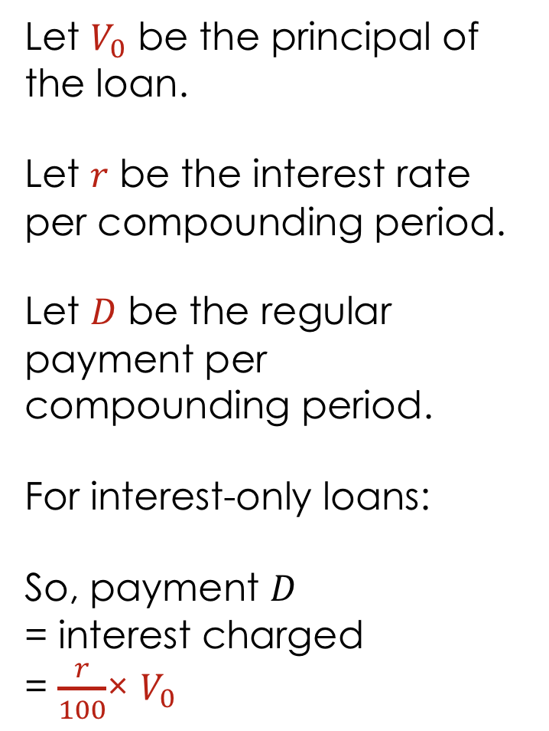


Interest-only loan
Let $V_{0}$ be the principal of the loan.
Let 𝑟 be the interest rate per compounding period.
Let 𝐷 be the regular payment per compounding period.
For interest-only loans:
So, payment 𝐷
= interest charged
= $\frac{r}{100}$× $V_{0}$
$V_{n+1}$=1.05 $V_{n}$−𝐷 𝐷=40
$V_{n+1}$=1.05 $V_{n}$−𝐷 𝐷=50
$V_{n+1}$=1.05 $V_{n}$−𝐷 𝐷=60

Slide 9
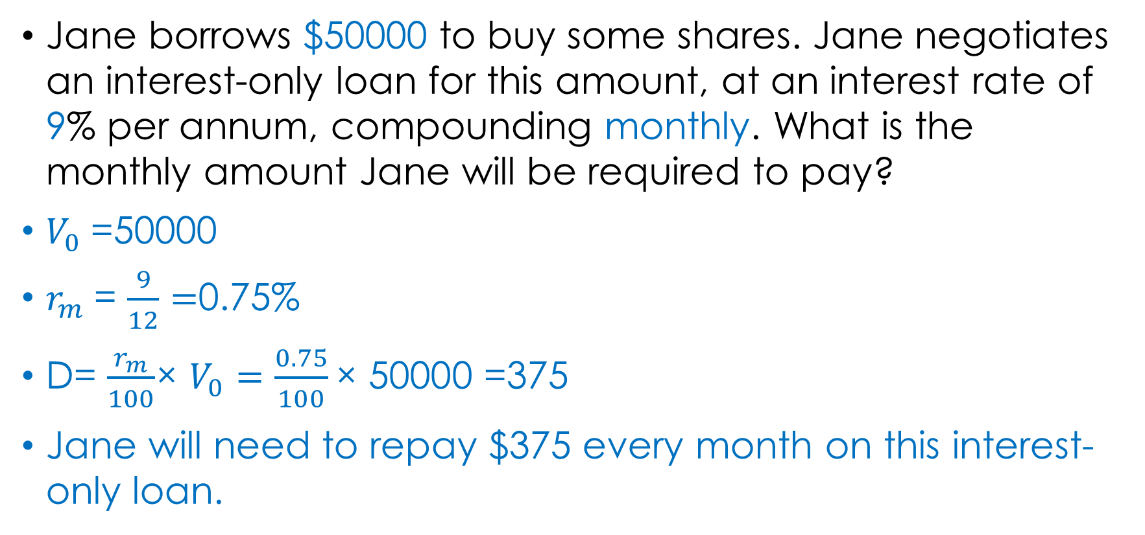
Repaying an interest-only loan
Jane borrows $50000 to buy some shares. Jane negotiates an interest-only loan for this amount, at an interest rate of 9% per annum, compounding monthly. What is the monthly amount Jane will be required to pay?
$V_{0}$=50000
$r_{m}$= $\frac{9}{12}=$0.75%
D= $\frac{r_{m}}{100}$× $V_{0}=\frac{0.75}{100}\text{× }\text{50000 }$=375
Jane will need to repay $375 every month on this interest-only loan.

Slide 10
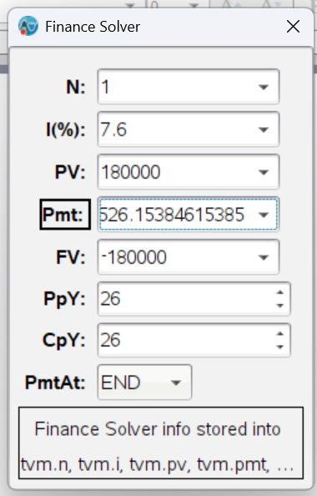
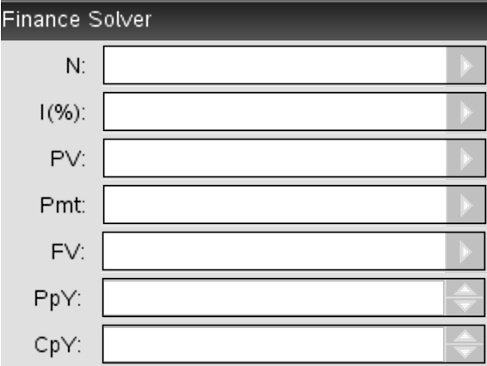
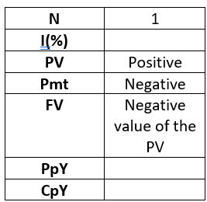
Repaying an interest-only loan using a financial solver
Stuart borrows $180000 to buy a house. He negotiates an interest-only loan for this amount, at an interest rate of 7.6% per annum, compounding fortnightly. What is the fortnightly payment, correct to the nearest cent?
Stuart will need to repay $526.15 every fortnight.
Total number of periods
Annual interest rate
Present value
Payment
Future value
CAS Notes 6.16.6
Payment periods per year
Compounding periods per year
CAS Notes 6.13

