Slide 1

Annuity investments
6F
Notes:
https://create.kahoot.it/details/312d4b93-6016-4c7c-a837-76ed8bd1e86a
1-3, 6,8,10,13,14

Slide 2
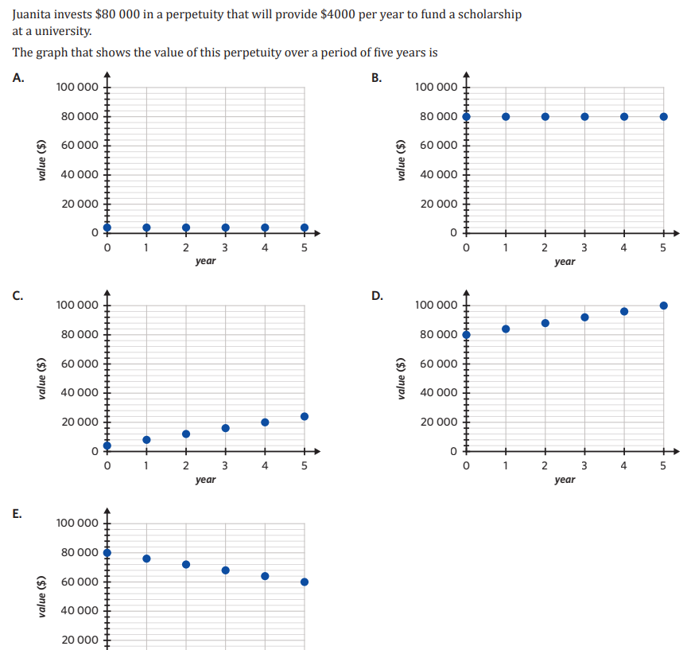

Slide 3
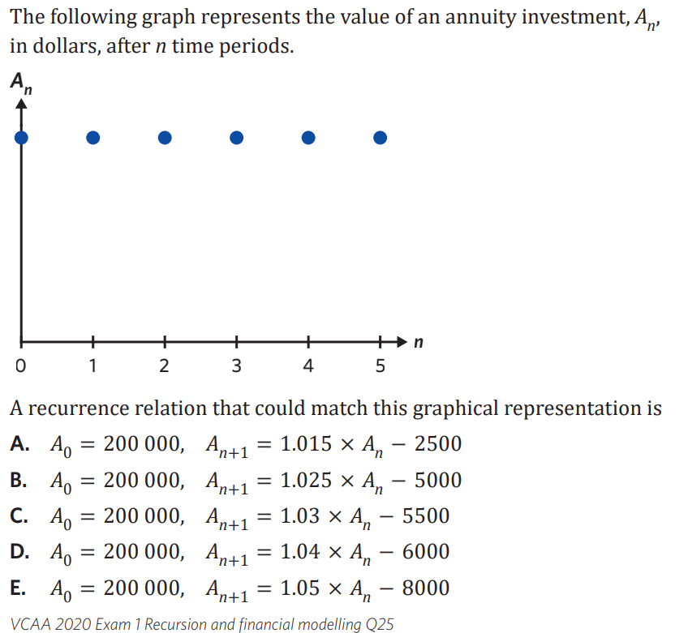

Slide 4

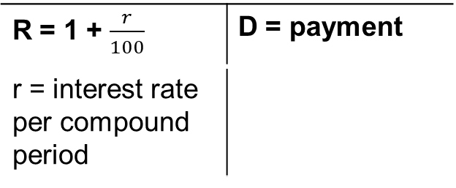



6F Annuity Investments
type of annuity
money is invested, it earns compound interest, investor adds an additional payment @ regular intervals
investment will continue to increase
V₀ = $\boxed{principal}$, Vₙ₊₁ = $\boxed{R}$ Vₙ + $\boxed{D}$
amortisation table
see handout
finance solver
PV NEGATIVE
Pmt NEGATIVE
FV POSITIVE
Example
1. Tony invests $35,000 into an annuity investment. He receives 4.6% p.a interest, compounding monthly. He makes a monthly payment of $500.
a. write the recurrence relation
R = 1 + $\frac{4.6/12}{100}$= 1.0038
V₀ = 35000,
Vₙ₊₁ = 1.0038 × Vₙ + 500
b. model the first 3 payments in an amortisation table
Pmt # Pmt $ interest Prin add.. balance
0 0 0 0 35000,00
1 500 $\boxed{134.17}$ 634.17 35634.17
2 500 $\boxed{136.60}$ 636.60 36270.77
3 500
$\frac{4.6/12}{100}$ × 35000 = $\boxed{134.17}$
$\frac{4.6/12}{100}$ × 35634.17 = $\boxed{136.60}$
c. after how many months will the account first reach $50,000?
FV
N $\boxed{22.68}$ → 23 months!
I 4.6
PV −35000
Pmt −500
FV 50,000
CPY/PPY 12/12
R = 1 + $\frac{r}{100}$ | D = payment
r = interest rate per compound period
+
+
=
=
Notes:
Board notes

Slide 5


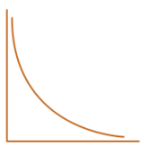
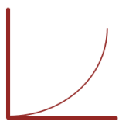
Reduced Balance Loan/ Mortgage
$7000/Month for 30 years term
FV↓
1 Million
$$v_{0}=Initial Value,v_{n+1}={R∗v}_{n} ― D$$
Annuity
$$R=1+\frac{r}{100∗p}$$
1 Million
$7000/Month for 30 years term
Annuity/Compound Investment
FV↑
Nil or Principal
$7000/Month for the whole term
$$v_{0}=Initial Value,v_{n+1}={R∗v}_{n} + D$$
$$R=1+\frac{r}{100∗p}$$

Slide 6
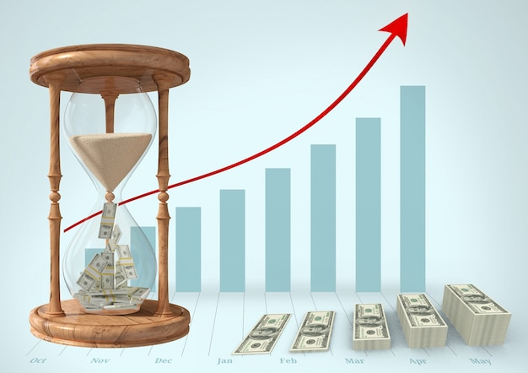
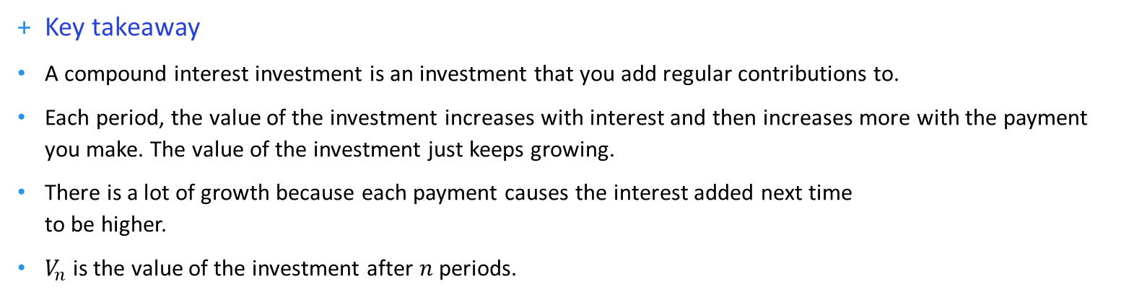

Annuity investment – recurrence relations
Compound interest investment (aka annuity investment)
$V_{0}=70 000$, $V_{n+1} =1.0045V_{n}+1000$
Key takeaway
A compound interest investment is an investment that you add regular contributions to.
Each period, the value of the investment increases with interest and then increases more with the payment you make. The value of the investment just keeps growing.
There is a lot of growth because each payment causes the interest added next time
to be higher.
$V_{n}$ is the value of the investment after $n$ periods.

Slide 7
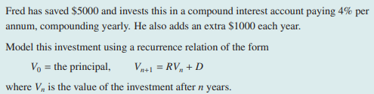

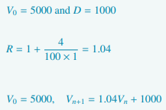
Modelling compound interest investments with additions to the principal

Slide 8
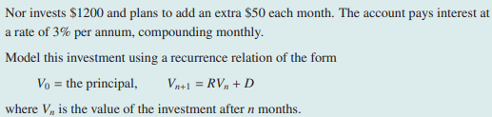
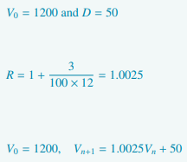
Modelling compound interest investments with additions to the principal

Slide 9
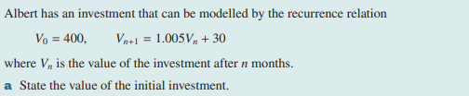

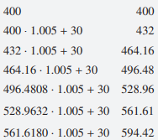


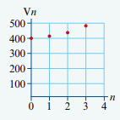
Using a recurrence relation to analyse compound interest investments with additions to the principal
CAS Notes 6.1
CAS Notes 6.16.8

Slide 10
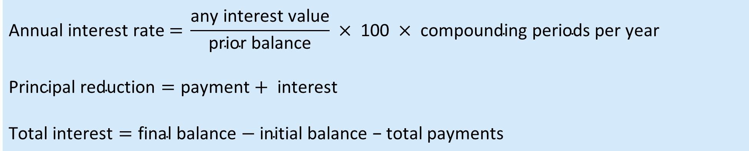
Annuity investment – amortisation table
Key takeaway
 | Payment | Interest | Principal addition | Balance
0 | 0.00 | 0.00 | 0.00 | 70 000.00
1 | 1000.00 | 315.00 | 1315.00 | 71 315.00
2 | 1000.00 | 320.92 | 1320.92 | 72 635.92
… | … | … | … | …
330 | 1000.00 | 4760.45 | 5760.45 | 1 063 638.10
331 | 1000.00 | 4786.37 | 5786.37 | 1 069 424.48
332 | 1000.00 | 4812.41 | 5812.41 | 1 075 236.89
An annuity investment’s amortisation table has these key features:
balance: increases over time.
payment: constant.
interest: increases over time (as the balance gets bigger, the interest earned grows as well).
$$\text{Annual} \text{interest} \text{rat}\text{e} \text{=} \frac{\text{any} \text{interest} \text{value}}{\text{prior} \text{balance}} × \text{100} × \text{compounding} \text{periods} \text{per} \text{year}$$
$$\text{Principal} \text{reduction}=\text{payment}+ \text{interest}$$
$$\text{Total} \text{interest}=\text{final} \text{balance}−\text{initial} \text{balance}\text{ − }\text{total} \text{payments}$$
CAS Notes 6.17

Slide 11
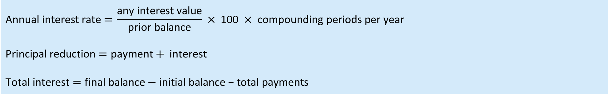
Annuity investment – amortisation table
 | Payment | Interest | Principal addition | Balance
0 | 0.00 | 0.00 | 0.00 | 70 000.00
1 | 1000.00 | 315.00 | 1315.00 | 71 315.00
2 | 1000.00 | 320.92 | 1320.92 | 72 635.92
… | … | … | … | …
330 | 1000.00 | 4760.45 | 5760.45 | 1 063 638.10
331 | 1000.00 | 4786.37 | 5786.37 | 1 069 424.48
332 | 1000.00 | 4812.41 | 5812.41 | 1 075 236.89
This table represents the growth of a
$70 000 compound interest investment, with interest of 5.4% p.a. and monthly payments of $1,000.
Calculations
$V_{0}=70 000$, $V_{n+1} =1.0045V_{n}+1000$
$$\text{Annual} \text{interest} \text{rat}\text{e} \text{=} \frac{\text{any} \text{interest} \text{value}}{\text{prior} \text{balance}} × \text{100} × \text{compounding} \text{periods} \text{per} \text{year}$$
$$\text{Principal} \text{reduction}=\text{payment}+ \text{interest}$$
$$\text{Total} \text{interest}=\text{final} \text{balance}−\text{initial} \text{balance}\text{ − }\text{total} \text{payments}$$

Slide 12
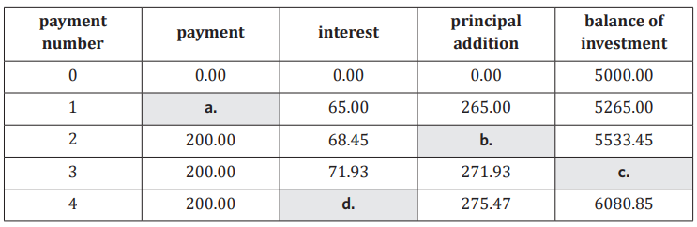
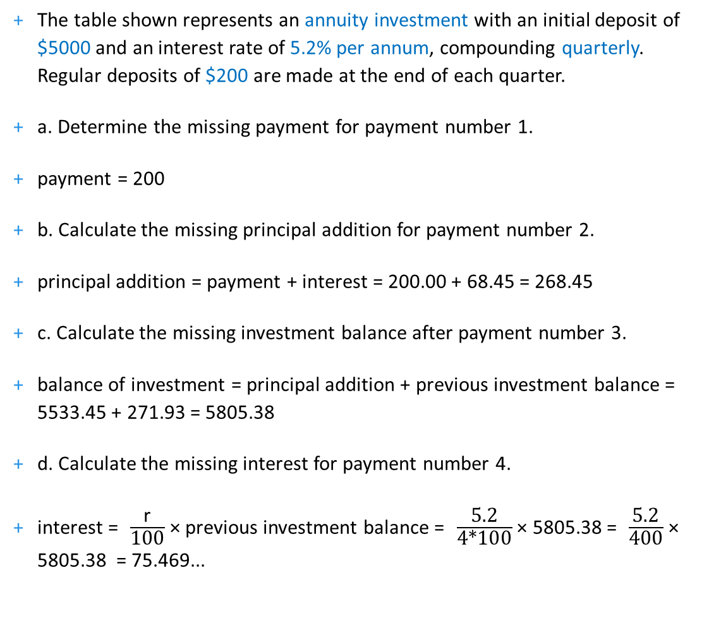
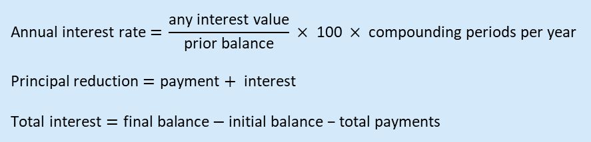
Annuity investment – amortisation table
The table shown represents an annuity investment with an initial deposit of $5000 and an interest rate of 5.2% per annum, compounding quarterly. Regular deposits of $200 are made at the end of each quarter.
a. Determine the missing payment for payment number 1.
payment = 200
b. Calculate the missing principal addition for payment number 2.
principal addition = payment + interest = 200.00 + 68.45 = 268.45
c. Calculate the missing investment balance after payment number 3.
balance of investment = principal addition + previous investment balance = 5533.45 + 271.93 = 5805.38
d. Calculate the missing interest for payment number 4.
interest = ​ $\frac{\text{r}}{\text{100}}$ × previous investment balance = ​ $\frac{\text{5.2}}{\text{4∗}\text{100}}$ × 5805.38 = ​ $\frac{\text{5.2}}{\text{400}}$ × 5805.38 = 75.469...
$V_{0}=5000$, $V_{n+1} =1.013V_{n}+200$
$$\text{Annual} \text{interest} \text{rat}\text{e} \text{=} \frac{\text{any} \text{interest} \text{value}}{\text{prior} \text{balance}} × \text{100} × \text{compounding} \text{periods} \text{per} \text{year}$$
$$\text{Principal} \text{reduction}=\text{payment}+ \text{interest}$$
$$\text{Total} \text{interest}=\text{final} \text{balance}−\text{initial} \text{balance}\text{ − }\text{total} \text{payments}$$

Slide 13
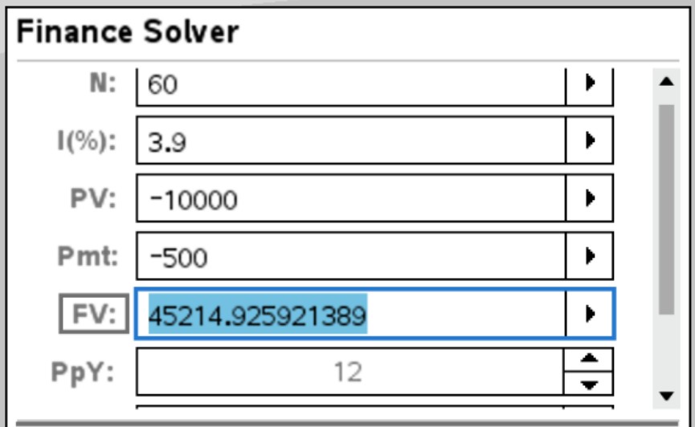
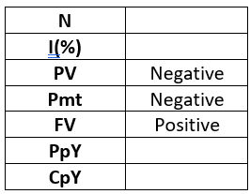
Annuity investment – finance solver
Steve is saving up for a cruise holiday by investing $10 000 in an account that earns interest at a rate of 3.90% per annum, compounding monthly. He deposits $500 at the end of each month.
After 5 years, how much is in Steve’s account? $45,214.93
How much interest has the account earned after 5 years?
growth = 45 214.93 − 10 000 = 35 214.93
total amount paid= 500 × 60 = 30 000
interest = 35 214.93 − 30 000 = 5214.93
Tip!
For PV, Pmt, FV:
A value you receive is positive
A value you give is negative
CAS Notes 6.5 & 6.8

Slide 14
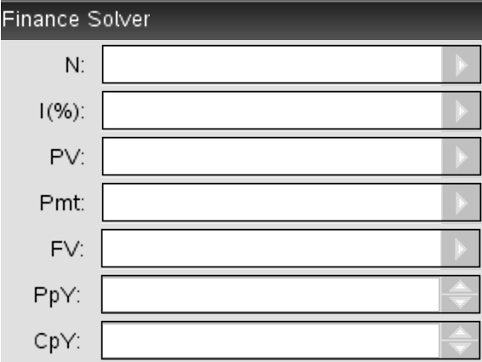

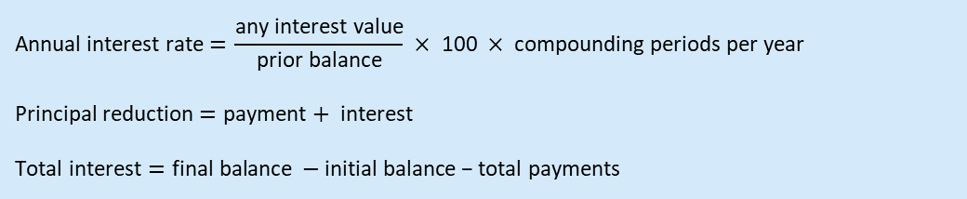
A compound interest investment is an investment that you add regular contributions to.
Each period, the value of the investment increases with interest and then increases more with the payment you make.
There is a lot of growth because each payment causes the interest added next time to be higher.
$V_{0}=70 000$, $V_{n+1} =1.0045V_{n}+1000$
What’s coming next
Chapter 6 −
Progress check 1
Total number of periods
 | Payment | Interest | Principal addition | Balance
0 | 0.00 | 0.00 | 0.00 | 70 000.00
1 | 1000.00 | 315.00 | 1315.00 | 71 315.00
2 | 1000.00 | 320.92 | 1320.92 | 72 635.92
… | … | … | … | …
330 | 1000.00 | 4760.45 | 5760.45 | 1 063 638.10
331 | 1000.00 | 4786.37 | 5786.37 | 1 069 424.48
332 | 1000.00 | 4812.41 | 5812.41 | 1 075 236.89
Annual interest rate
Present value
Payment
Future value
Payment periods per year
Compounding periods per year
$$\text{Annual} \text{interest} \text{rat}\text{e} \text{=} \frac{\text{any} \text{interest} \text{value}}{\text{prior} \text{balance}} × \text{100} × \text{compounding} \text{periods} \text{per} \text{year}$$
$$\text{Principal} \text{reduction}=\text{payment}+ \text{interest}$$
$$\text{Total} \text{interest}=\text{final} \text{balance} −\text{initial} \text{balance}\text{ − }\text{total} \text{payments}$$

Slide 15




Determining the annual interest rate from a recurrence relation
CAS Notes solve

Slide 16
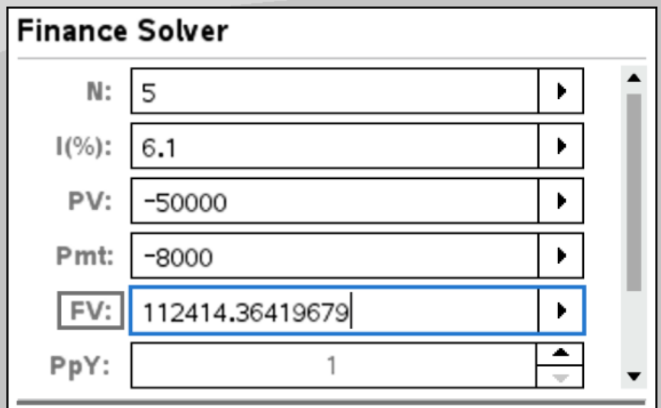
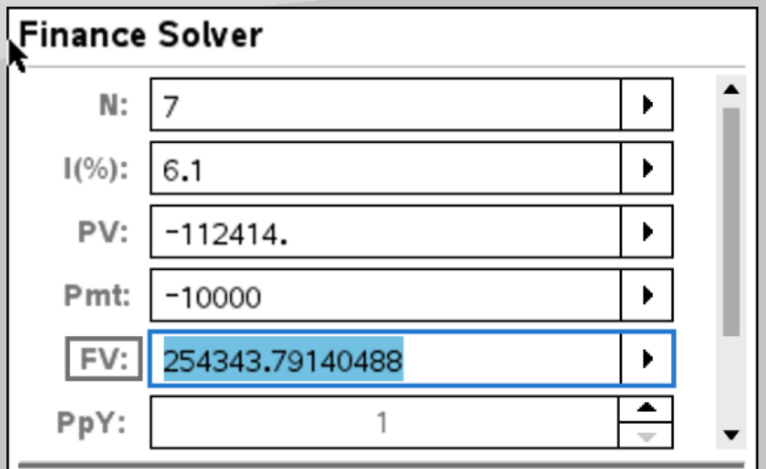

Finding the value of an investment when the regular payment changes
Derek invests $50 000 into a compound interest investment paying 6.1% per annum, compounding annually. Derek invests an additional $8000 per year immediately after interest is calculated.
After five years, Derek increases his additional investment to $10 000 per year.
Calculate the value of Derek’s investment after twelve years (in total).
CAS Notes 6.5 & 6.8
The value of Derek’s investment is $254 343.79

