Slide 1

Displaying numerical data
1C
Notes:
3,5,7-9,11,13,14

Slide 2
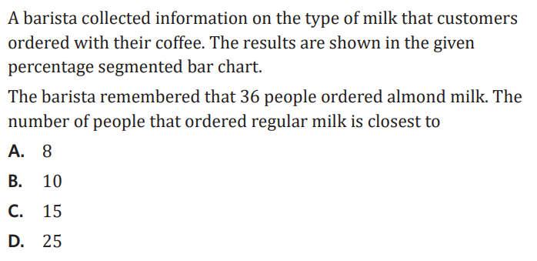
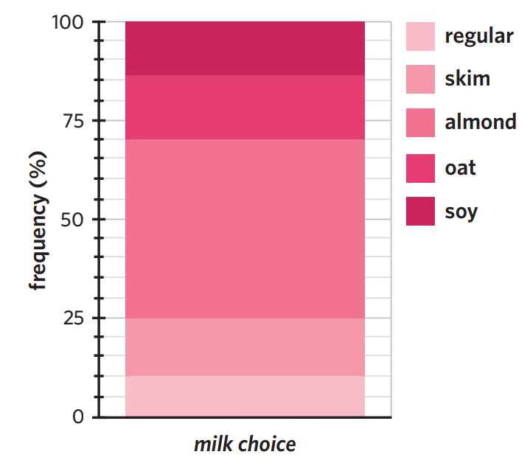

Slide 3
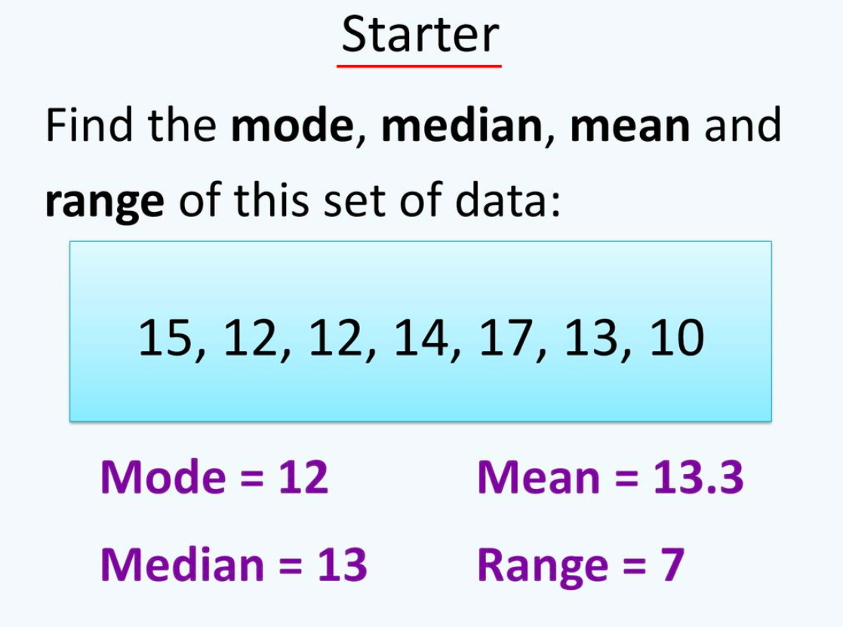


Slide 4

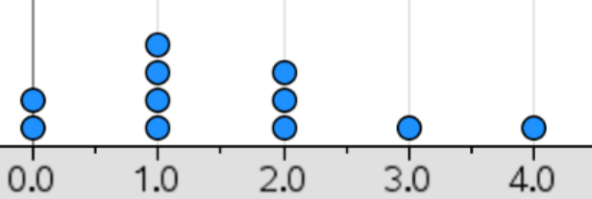
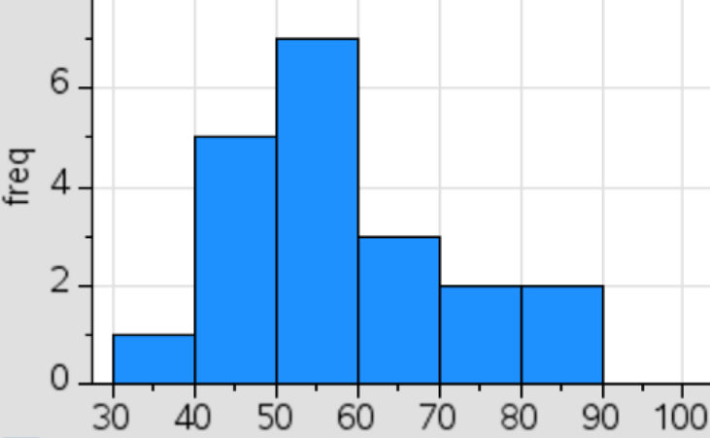
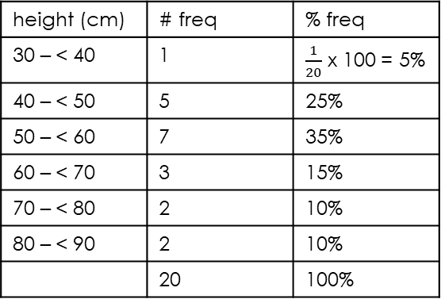
Eg 2: class intervals
15 | 1 1 4
15 | 5 6 7 8 9
16 | 0 1 2 3 4
16 | 5 6 7 8 9
17 | 0 2
17 | 8 8
Key = 15|4 = 154
1C Displaying Numerical Data
Dot Plot:
-simple
-small data sets
-mode
Stem Plots:
-numerical order
-leading digits in stem
-trailing digit in leaf
-key!!
-class intervals: helps keep leaves small
a.k.a “stem intervals”
Eg 1
0 | 2 3 4
1 | 5 5 9
2 | 0 1
3 | 7
4 | 5
Key = 0|2 = 2
or 0|2 = 0.2
0|2 = 2%
Grouped Frequency Tables
-intervals
-intervals don’t overlap
-lower bound is inclusive
-turns into histogram
Eg: Plant height data:
32.0 40.2 40.5 45.1 47.0 49.1
50.1 53.7 54.2 55.3 56.9 57.2
58.2 67.2 68.9 69.0 72.3 77.6
82.1 88.5
grouped frequency table:
Histogram:
-no spaces between bars
-displays numerical continuous data
Eg: Plant height Histogram
*class intervals of 5
First interval 0–4
second interval 5–9
height (cm) | # freq | % freq
30 – < 40 | 1 | $\frac{1}{20}$ x 100 = 5%
40 – < 50 | 5 | 25%
50 – < 60 | 7 | 35%
60 – < 70 | 3 | 15%
70 – < 80 | 2 | 10%
80 – < 90 | 2 | 10%
 | 20 | 100%
mode
lower bound
• x axis on histogram.
# siblings
Height (cm)
Notes:
Board notes

Slide 5
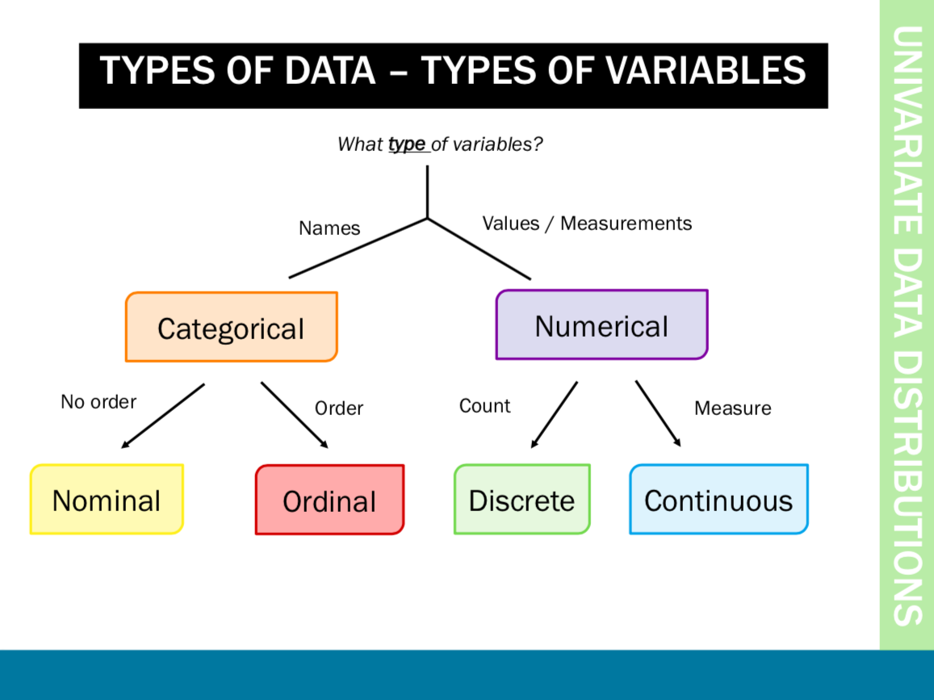

Slide 6

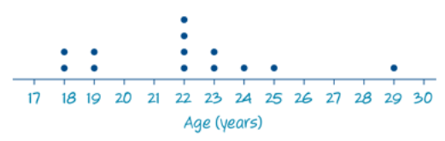

The dot plot
A statistical graph that uses dots to display individual data values on a number line. Suitable for small sets of data only.
N=13

Slide 7
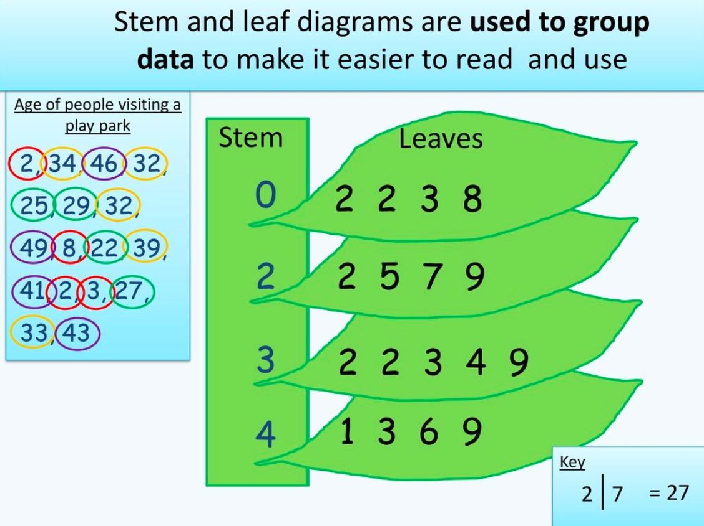

Slide 8
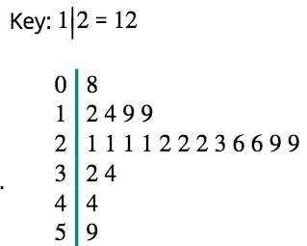

Stem Plot / Stem and Leaf Plot
A method for displaying data in which each observation is split into two parts, a ’stem’ and ‘leaf’.
An alternative display to a histogram.
Suitable for small to medium sized data sets.
N=21

Slide 9
We can now answer various questions about the data.
Stem Leaf Plots
Construction of Stem and Leaf
Example : Construct a stem and leaf graph for the following
weights in (kgs) :
Weight (kgs)
1
2
2
3
5
5
12 | 12 | 13 | 15 | 15
21 | 23 | 29 | 32 | 32
40 | 40 | 41 | 41 | 51
54 | 55 | 55 | 55 | 57
12 | 40 | 57 | 54 | 55
13 | 55 | 15 | 32 | 55
32 | 15 | 41 | 21 | 40
23 | 41 | 29 | 51 | 12
2
1
3
9
3
2
2
4
0
0
1
1
5
1
4
5
5
5
7
stem
leaves
Key : 2 3
N=20

Slide 10
Stem Leaf Plots
Construction of Stem and Leaf
A Stem – Leaf graph is another way of displaying information :
Ages
This stem and leaf graph shows
the ages of people waiting in a
queue at a post office
2
4
6
8
3
0
1
3
4
4
4
5
6
7
9
How many people in the queue?
20
5
0
3
4
9
6
1
4
5
6
How many people in their forties?
6
stem
leaves
n = 20 Key : 2 4

Slide 11
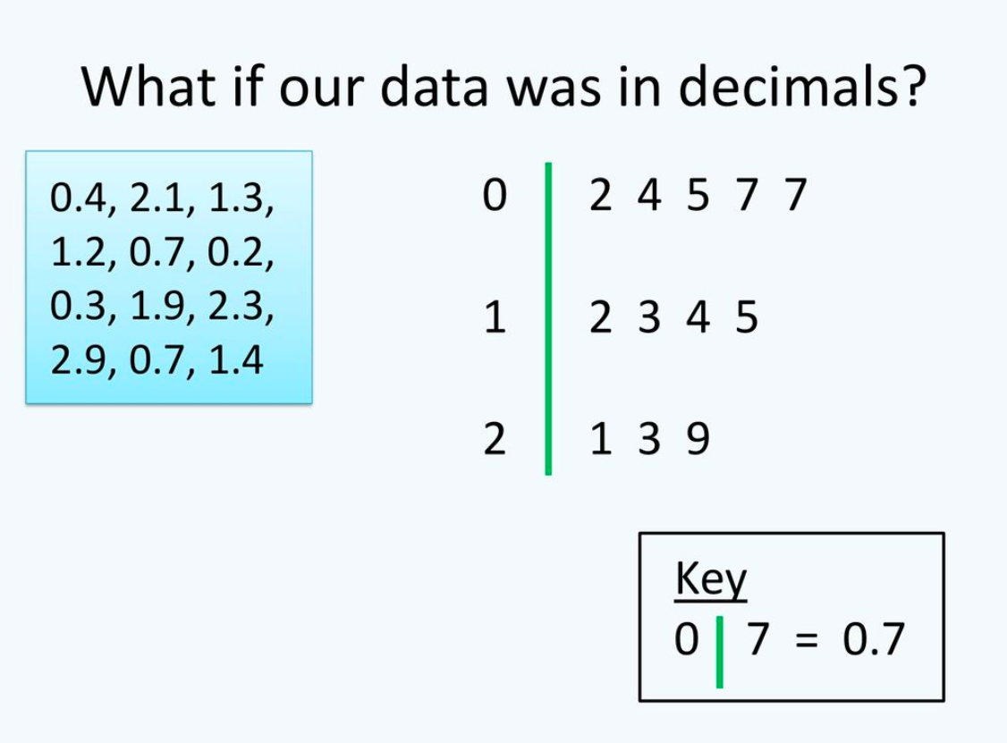

Slide 12
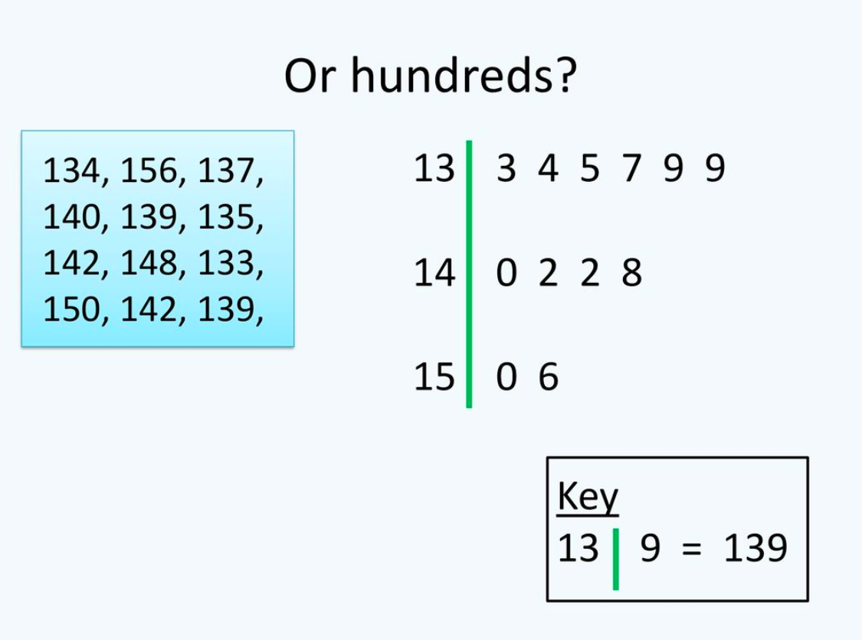

Slide 13
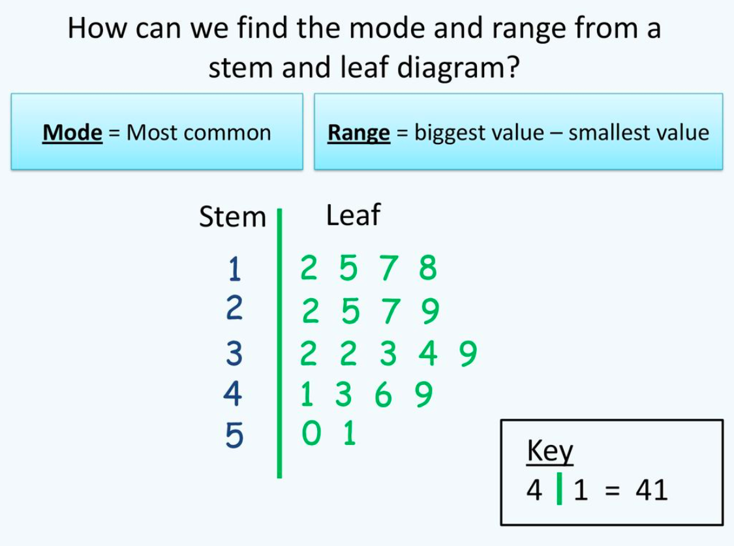

Slide 14
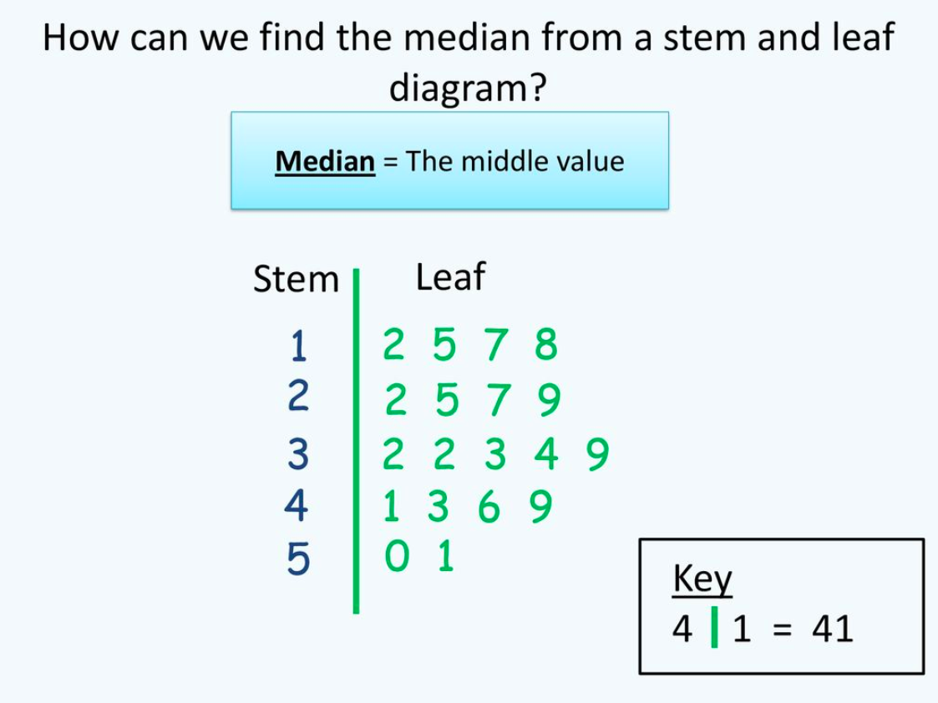
N=19

Slide 15
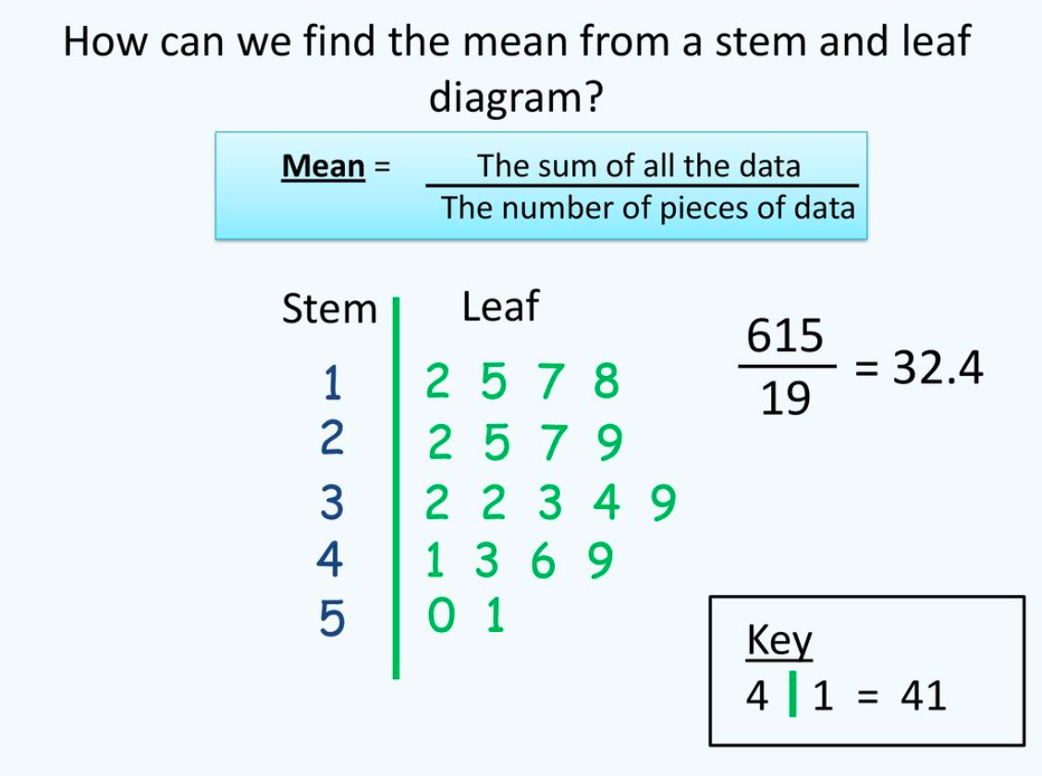
N=19

Slide 16
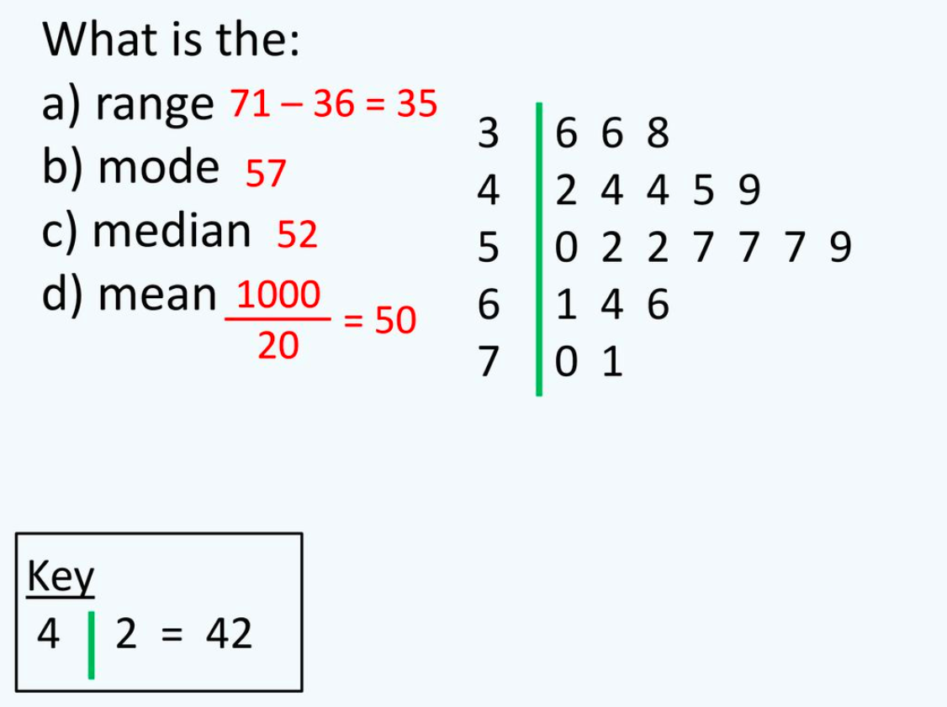

N=20

Slide 17
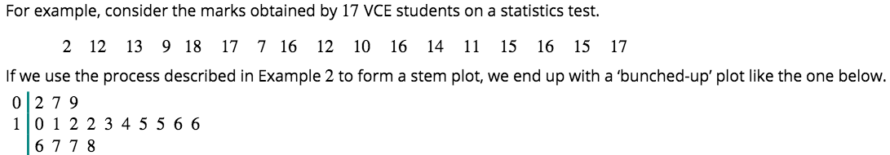
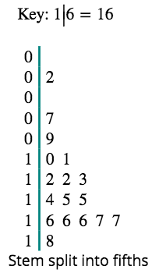
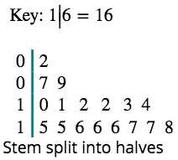
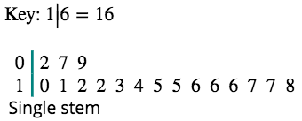
Stem plots with split stems

Slide 18
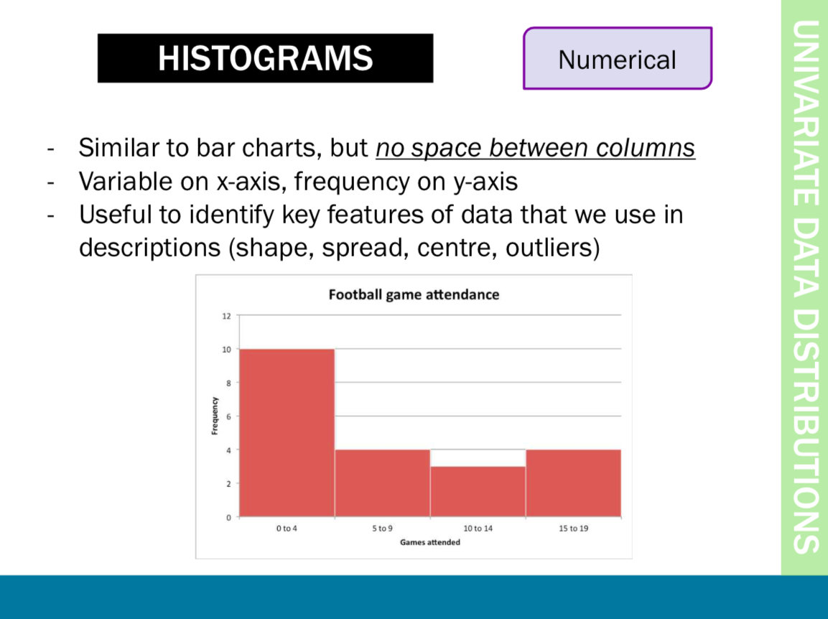

Slide 19


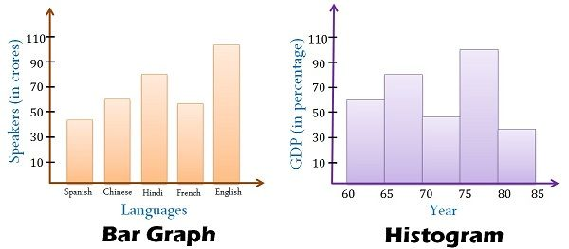


Difference between Histogram & Bar Chart

Slide 20
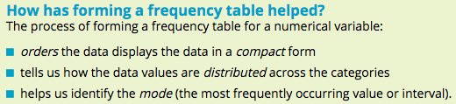
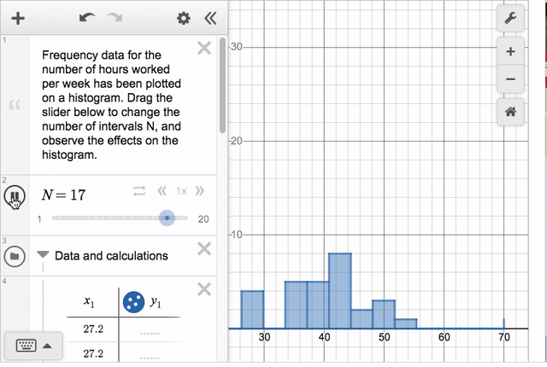
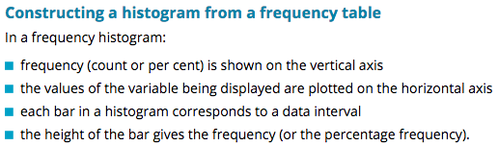
Histogram
A statistical graph used to display the frequency distribution of a numerical variable; most suitable for medium to large sized data sets.

Slide 21
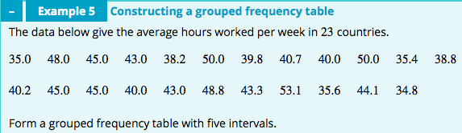





The grouped frequency distribution: a large range of values
Average hours worked | Frequency
 | Number | Percentage
30.0−34.9 | 1 | 4.3
35.0−39.9 | 6 | 26.1
40.0−44.9 | 8 | 34.8
45.0−49.9 | 5 | 21.7
50.0−54.9 | 3 | 13.0
Total | 23 | 99.9
Set up a table as shown. Use five intervals: 30.0−34.9, 35.0−39.9, …, 50.0−54.9.
List these intervals, in ascending order, under ‘Average hours worked’.
Count the number of countries whose average working hours fall into each of the intervals. Record these values in the ‘Number’ column.
Convert the counts into percentages and record in the ‘Percentage’ column.
Total the number and percentage columns, which may not total 100% because of rounding.
$$\frac{1}{23}×100\%=4.3\%$$
$$\frac{6}{23}×100\%=26.1\%$$
$$\frac{8}{23}×100\%=34.8\%$$
$$\frac{5}{23}×100\%=21.7\%$$
$$\frac{3}{23}×100\%=13.0\%$$

Slide 22

Average hours worked | Frequency
30.0–34.9 | 1
35.0–39.9 | 6
40.0–44.9 | 8
45.0–49.9 | 5
50.0–54.9 | 3
Total | 23
Label the horizontal axis with the variable name, ‘Average hours worked’. Mark the scale using the start of each interval: 30, 35, …
Label the vertical axis ‘Frequency’. Scale allowing for the maximum frequency, 8.
Finally, for each interval draw a bar, making the height equal to the frequency.

Slide 23

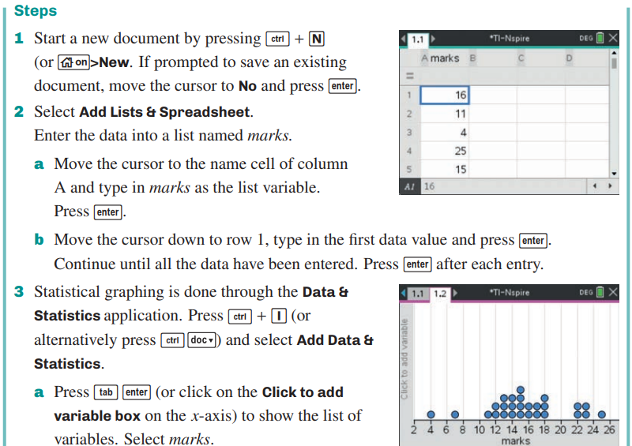
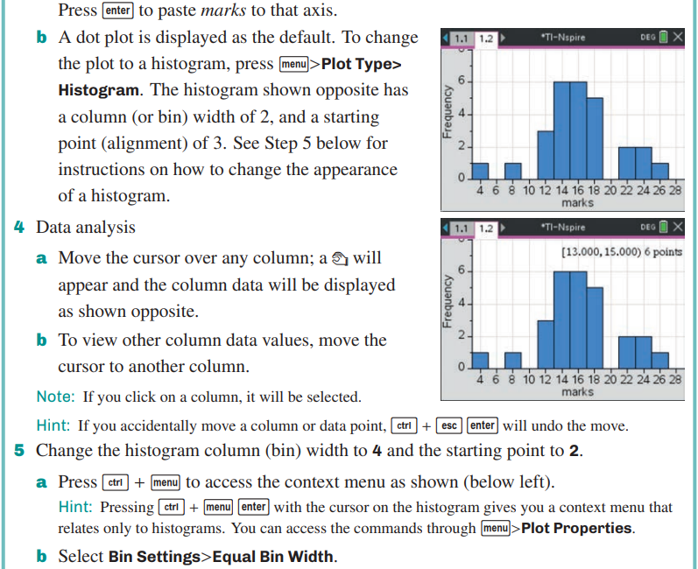
Constructing a histogram from raw data
CAS Notes 1.1

Slide 24
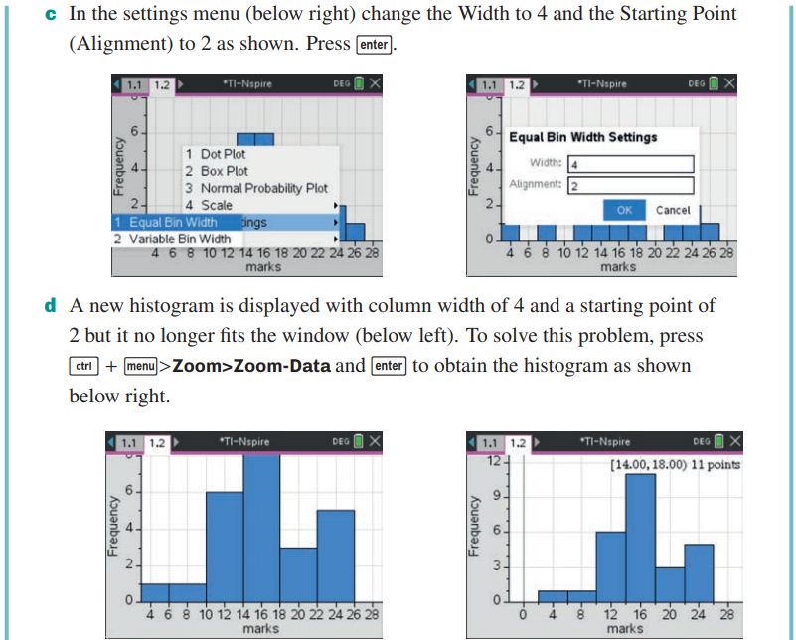
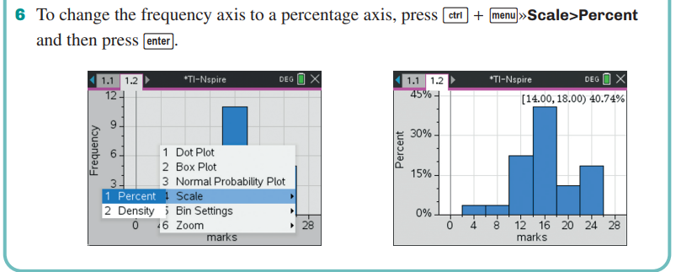
Constructing a histogram from raw data
CAS Notes 1.1

Slide 25
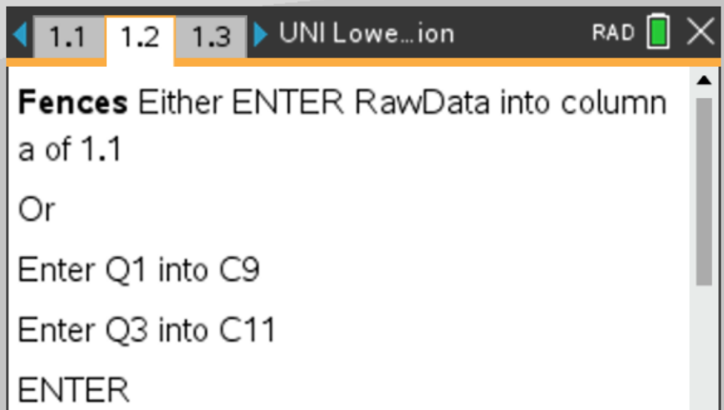
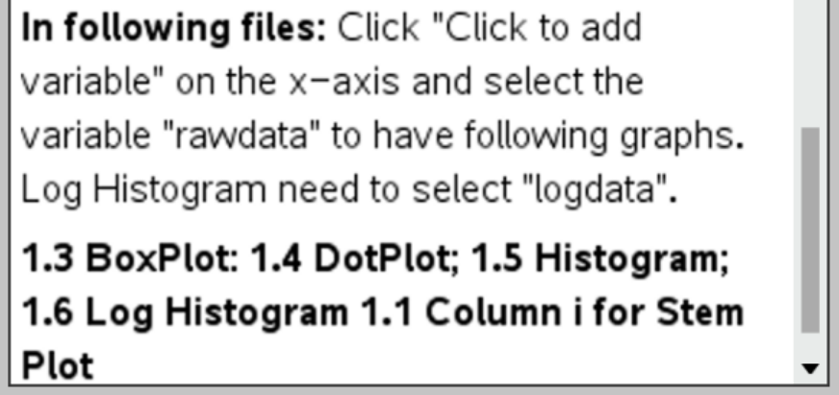
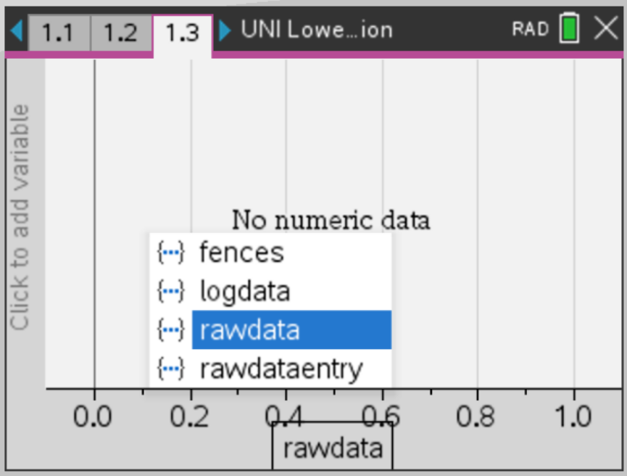
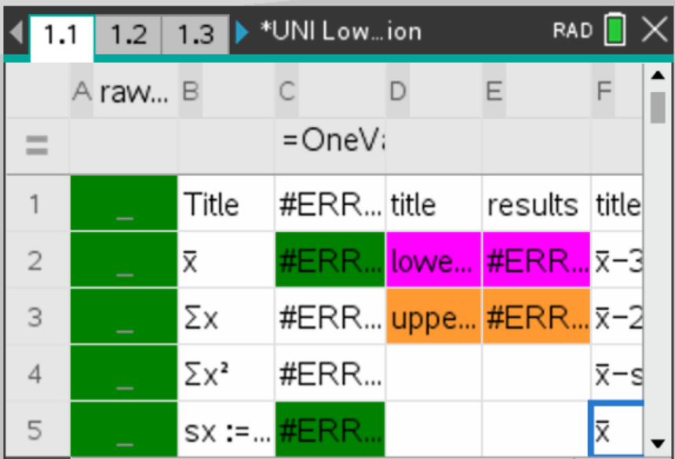
Using “UNI Lower Upper Fences Normal Distribution” template
CAS Notes 1.6

Slide 26
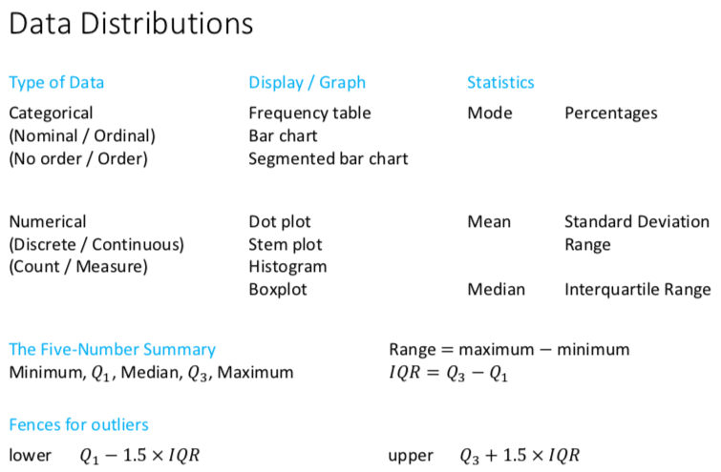

Slide 27
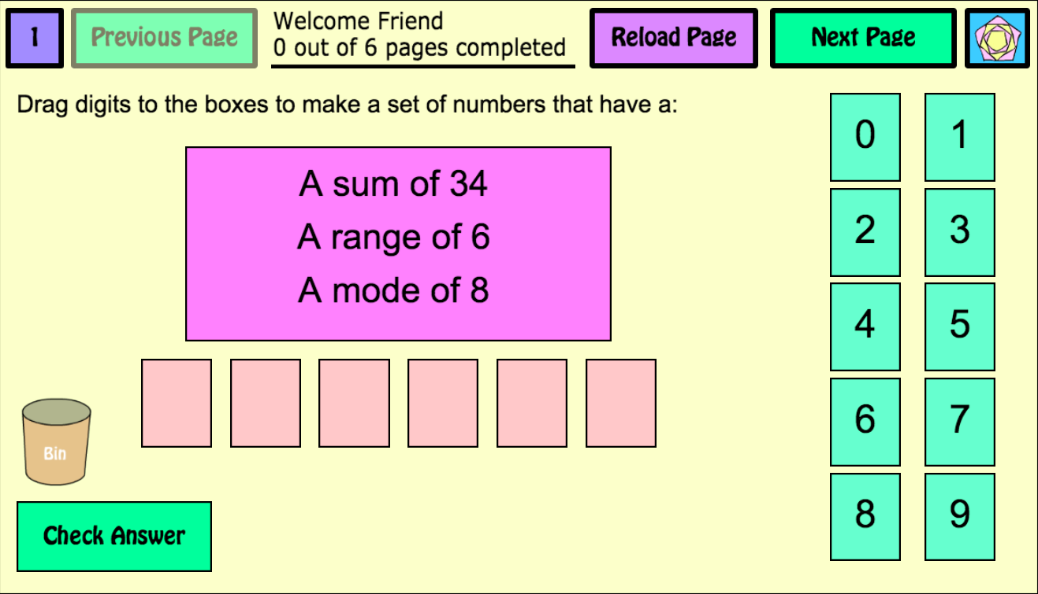
Notes:
https://www.mathspad.co.uk/interactives/averages/averages.php

Slide 28
exercises & Summary Book
1. Ex page 1C
2. Summary notes

