Slide 1


The five-number summary and the box plot
1E

Slide 2
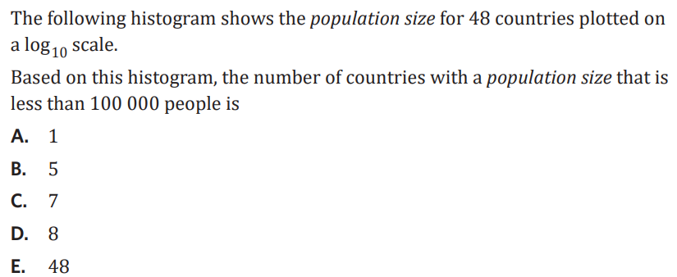
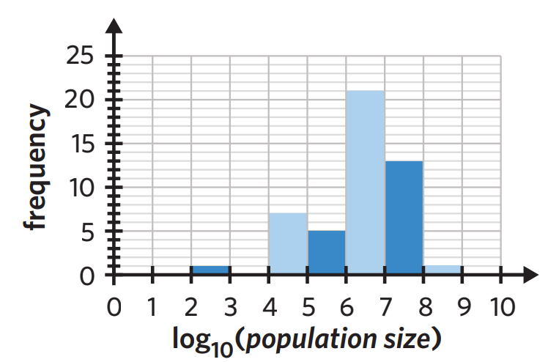

Slide 3
Starter
Unscramble these key words for today’s lesson
Can you work out the title?
dome
nademi
Mode
Median
grean
Range

Slide 4

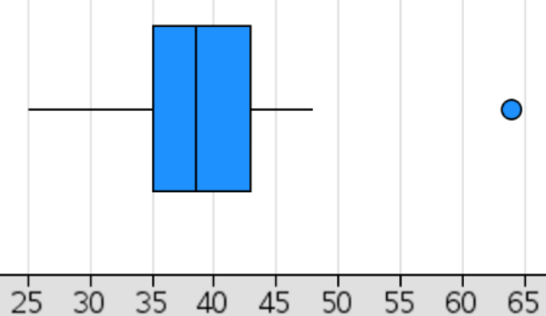


IE: 5 number summary + boxplots
5 number summary and statistics:
minimum, Q1, median, Q3, maximum
median = middle number (Q2)
↓ to locate position of median: $\frac{n+1}{2}$
range = maximum − minimum
Interquartile range (IQR) = Q3 − Q1
identifying outliers:
– outliers are extreme values, that fall outside of what is “reasonable”
– calculate fences to determine outliers
• outliers can be the min or max value *
upper fence = Q3 + 1.5 × IQR
lower fence = Q1 − 1.5 × IQR
↓ a data value greater than the upper fence or lower than the lower fence is an outlier.
constructing a boxplot:
example: 25, 30, 31, 34, 35, 35, 35, 36, 38, 39, 40, 40, 42, 43, 44, 46, 48, 64
min 25
Q1 35
med 38.5
Q3 43
max 64
UF = 43 + 1.5 × (43 − 35) = 55
LF = 35 − 1.5 × (43 − 35) = 23
$\frac{n+1}{2}=\frac{18+1}{2}$= 9.5 → 9th – 10th data point → $\frac{38+39}{2}$ = 38.5
$\frac{9+1}{2}=$5th
5th
9th | 10th
5th
Q1
Q3
LF
UF
35
38.5
43
64
25
25%
25%
48
25%
25%
outlier
box
outlier
whisker
whisker
50%
IQR
Percentage Freq.
Key
Favourite season
Notes:
Board notes

Slide 5


Slide 7
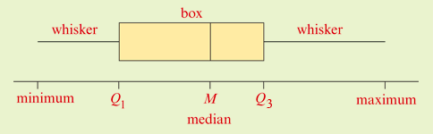
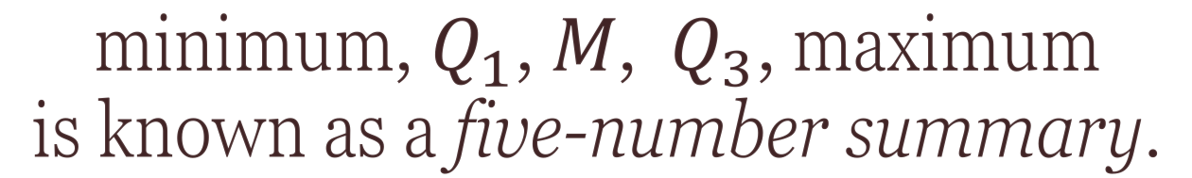
Five-number summary
minimum, $Q_{1}$, 𝑀, $Q_{3}$, maximum
is known as a five-number summary.
The box plot
The box-and-whisker plot
The box plot is a graphical display of a five-number summary of a data set showing outliers if present.

Slide 8
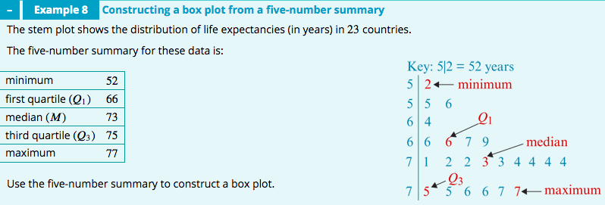
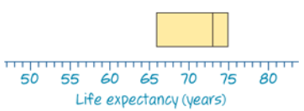
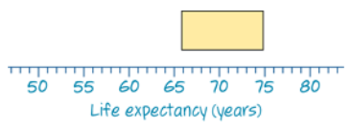
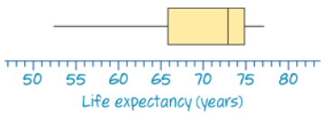

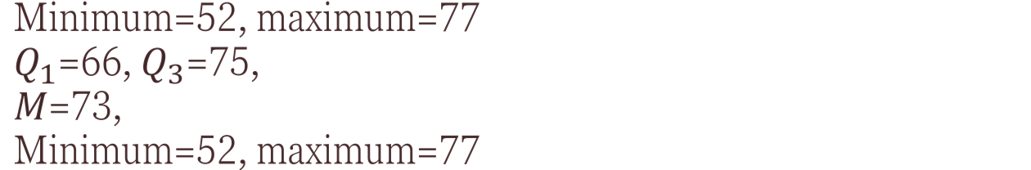
Minimum=52, maximum=77
$Q_{1}$=66, $Q_{3}$=75,
𝑀=73,
Minimum=52, maximum=77

Slide 9
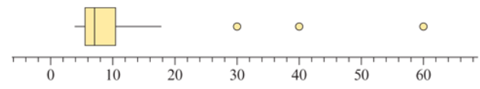
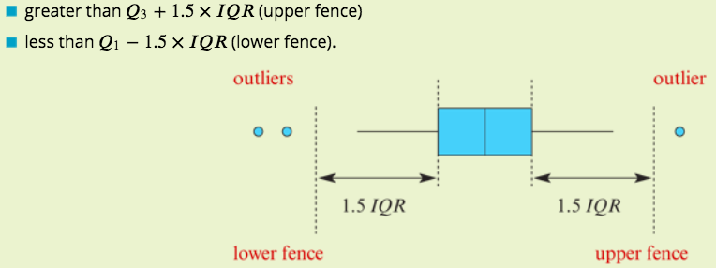
Box plots with outliers

Slide 10
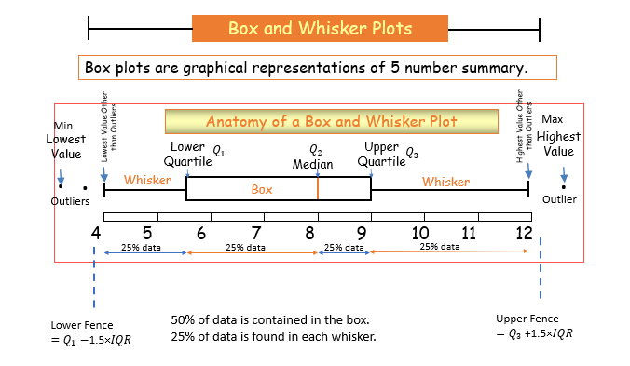

Slide 11
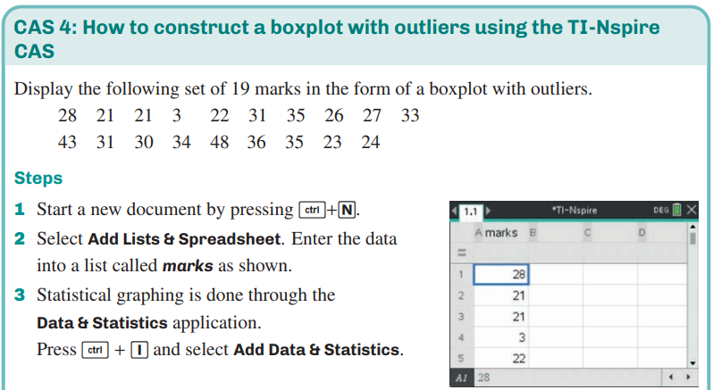
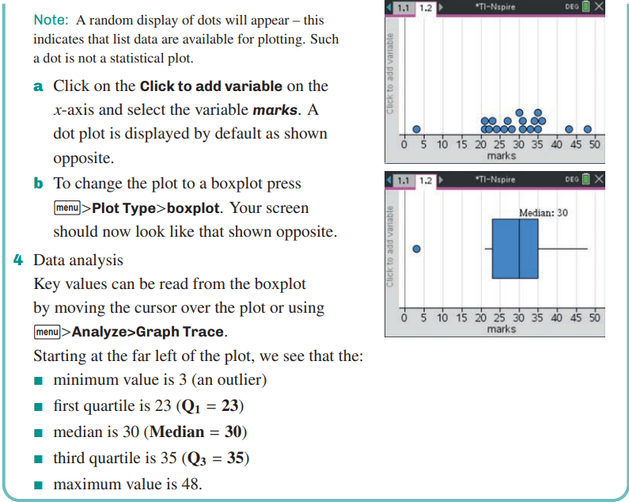
How to construct a box plot with outliers
CAS Notes 1.5

Slide 12
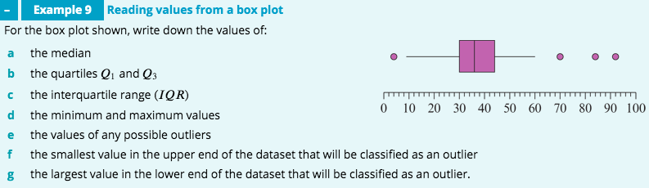
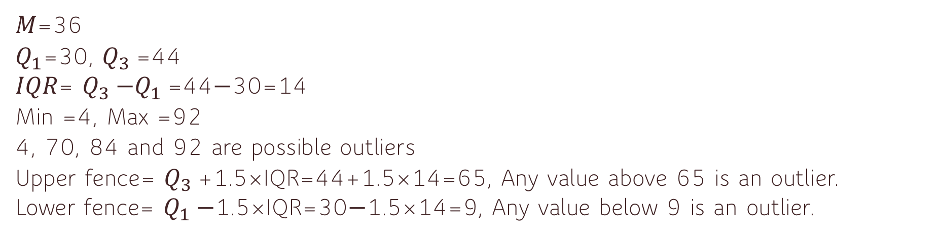
𝑀=36
$Q_{1}$=30, $Q_{3}$=44
𝐼𝑄𝑅= $Q_{3}$−$Q_{1}$=44−30=14
Min =4, Max =92
4, 70, 84 and 92 are possible outliers
Upper fence= $Q_{3}$+1.5×IQR=44+1.5×14=65, Any value above 65 is an outlier.
Lower fence= $Q_{1}$−1.5×IQR=30−1.5×14=9, Any value below 9 is an outlier.

Slide 13
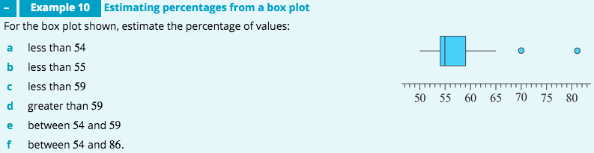
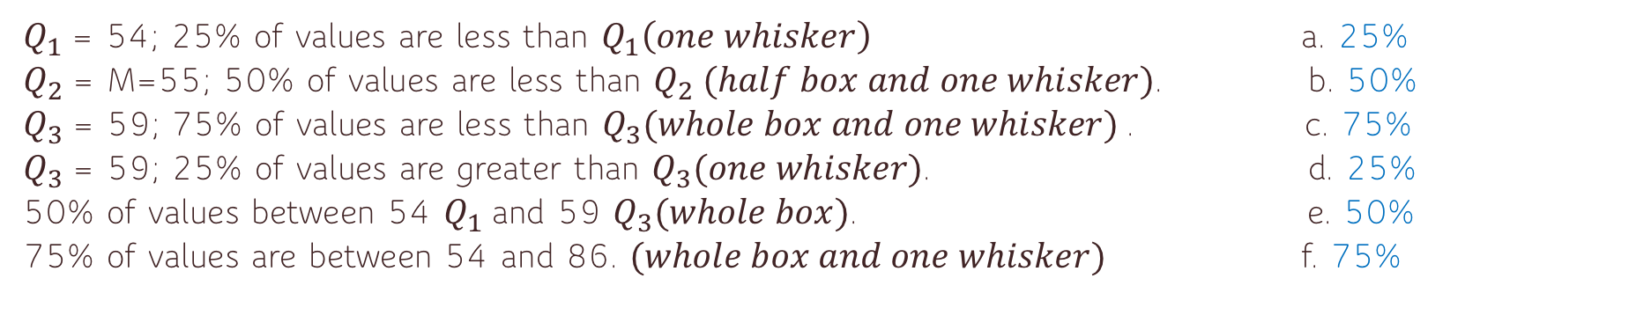
$Q_{1}$= 54; 25% of values are less than $Q_{1}\left(one whisker\right)$ a. 25%
$Q_{2}$= M=55; 50% of values are less than $Q_{2} (half box and one whisker)$. b. 50%
$Q_{3}$= 59; 75% of values are less than $Q_{3}(whole box and one whisker)$. c. 75%
$Q_{3}$= 59; 25% of values are greater than $Q_{3}(one whisker)$. d. 25%
50% of values between 54 $Q_{1}$and 59 $Q_{3}(whole box)$. e. 50%
75% of values are between 54 and 86. $(whole box and one whisker)$ f. 75%

Slide 14
Mode, Median, Mean & Range
Hint: Start with the median!
Finisher
Use the information given to work out the set of data:
___ ___ ___ ___ ___
Mode = 3 Range = 7
Median = 5 Mean = 6
3
3
5
9
10
Keywords
Average, mean, median, mode, range, data, frequency

Slide 15
    exercises & Summary Book
1. Ex page 1E
2. Summary notes

