Slide 1

Log scales and graphs
1D
Notes:
https://create.kahoot.it/details/8503689f-5537-4188-96d5-58f81716a202
https://create.kahoot.it/details/482c4b74-a6b0-46a3-b3e8-a1b08f378329
1-4,6,7,11

Slide 2
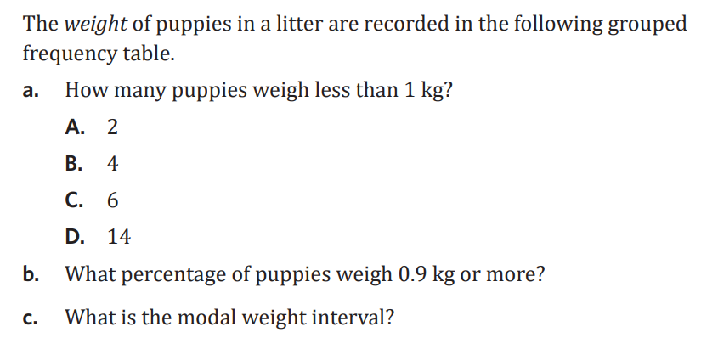
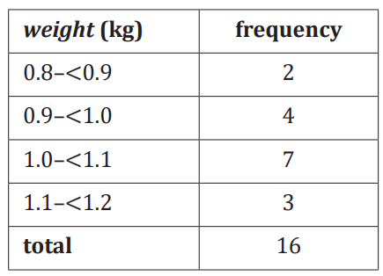

Slide 3

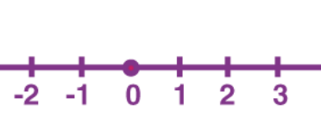
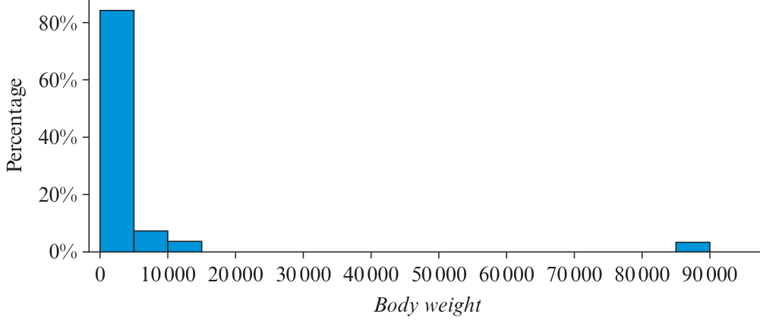
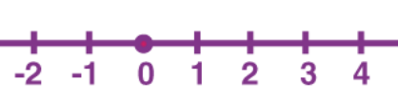
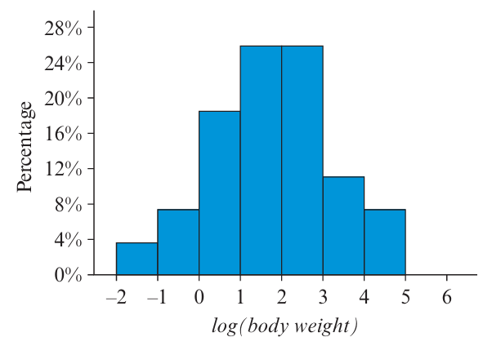
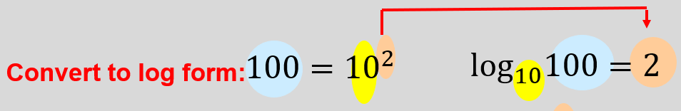


1D Logs → we only use log₁₀ base 10!
purpose: using a log scale compresses the data, making a more even spread of data.
eg:
understanding the log scale:
to undo a log scale, you do
${10}^{\boxed{D} }$ power of the scale
10⁻² 10⁻¹ 10⁰ 10¹ 10² 10³ 10⁴
0.01 0.1 1 10 100 1000 10000
↓ these numbers are what a log scale represents!
calculating a log value
eg: what is the log value of 12,456 and 0.82
a. log₁₀ (12456) = 4.1
b. log₁₀ (0.82) = −0.086
calculating the value from a log scale
eg: what is the value for a log of 4.7 and −3.2
a. ${10}^{4.7}$ = 50118.72
b. ${10}^{̶\text{−}\text{3.2}}$ = 0.00063
*log₁₀ (x) = y ↔ 10ʸ = x *
Log scale
-large range
-potential outliers
normal scale
freq.
-smaller range
-no longer a visible outlier
log scale
freq.
Notes:
Board notes

Slide 4
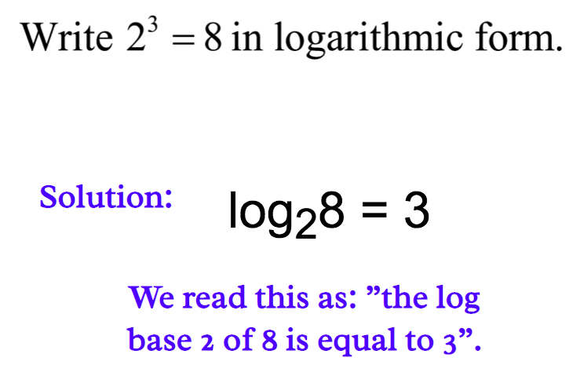
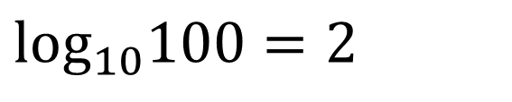
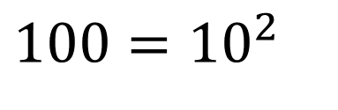

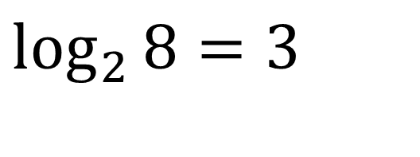
https://www.youtube.com/watch?v=zzu2POfYv0Y
Logarithm
$$100={10}^{2}$$
$$\text{lo}{\text{g}}_{10}100=2$$
Convert to log form:
Convert to exponential form:
$$2^{3}=8$$
$$\log_{2}{8}=3$$

Slide 5
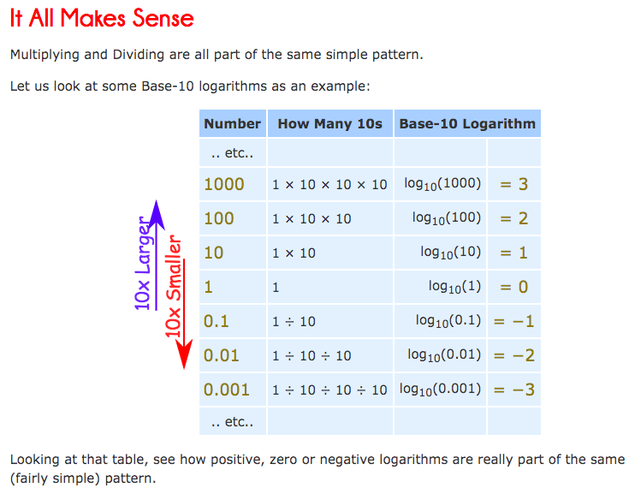
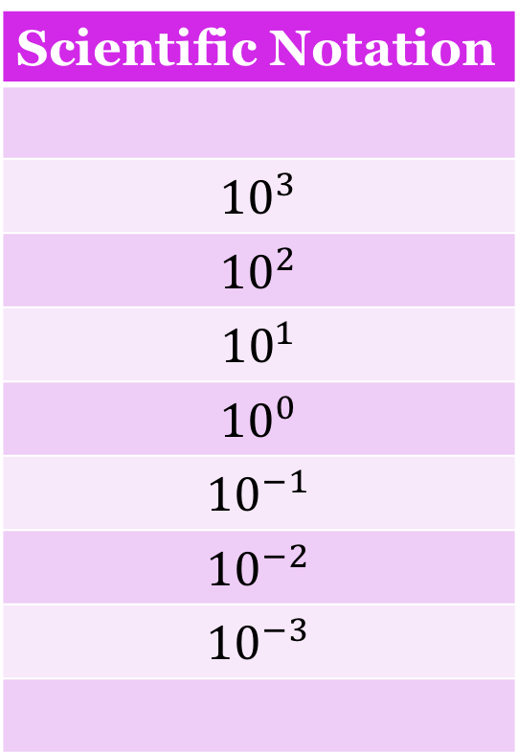
Scientific Notation
$${10}^{3}$$
$${10}^{2}$$
$${10}^{1}$$
$${10}^{0}$$
$${10}^{−1}$$
$${10}^{−2}$$
$${10}^{−3}$$

Slide 6
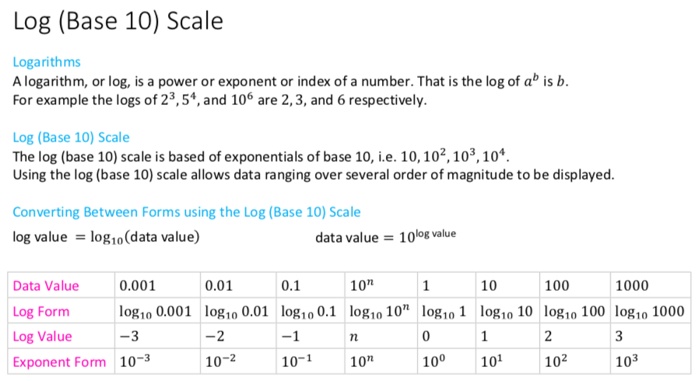

Slide 7
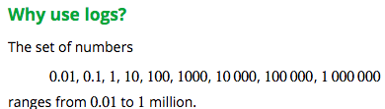
Properties of logs to the base 10
If a number is greater than one, its log to the base 10 is greater than zero.
If a number is greater than zero but less than one, its log to the base 10 is negative.
If the number is zero, then its log is undefined.

Slide 8
Why use logarithm?
The histogram below displays the body weights (in kg) of a number of animal species. Because the animals represented in this dataset have weights ranging from around 1 kg to 90 tonnes (a dinosaur), most of the data are bunched up at one end of the scale and much detail is missing. The distribution of weights is highly positively skewed, with an outlier.

Slide 9

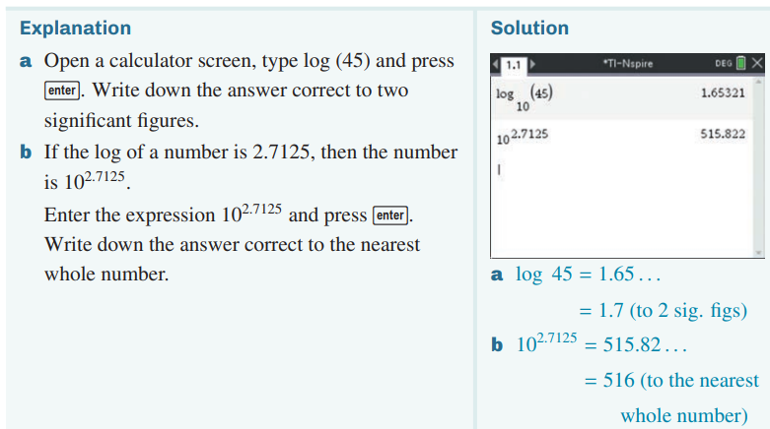
Working with logs
CAS Notes 1.1

Slide 10
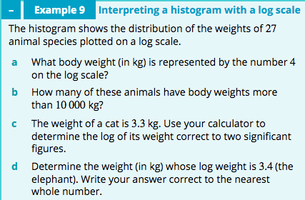
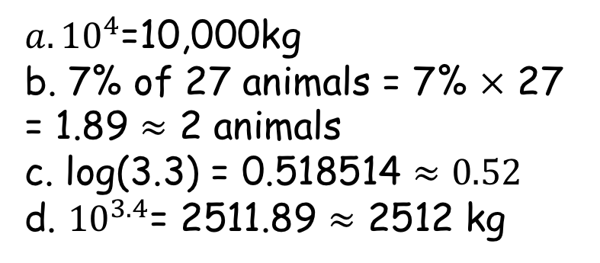
Analysing data displays with a log scale
${a. 10}^{4}$=10,000kg
b. 7% of 27 animals = 7% $×$ 27 = 1.89 $≈$ 2 animals
c. log(3.3) = 0.518514 $≈0.52$
d. ${10}^{3.4}$= 2511.89 $≈$ 2512 kg

Slide 11
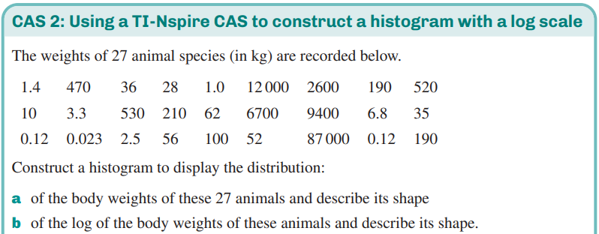
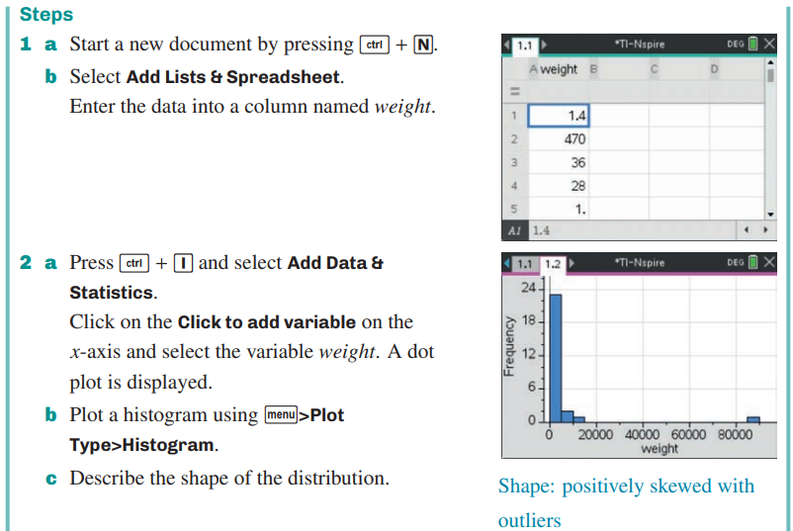
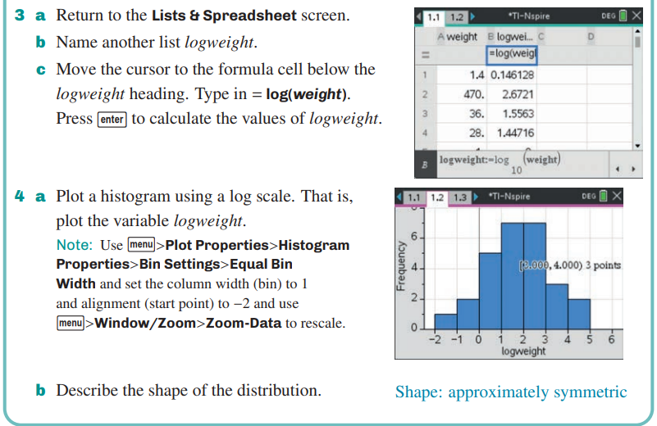
Constructing a histogram with a log scale
CAS Notes 1.3

Slide 12
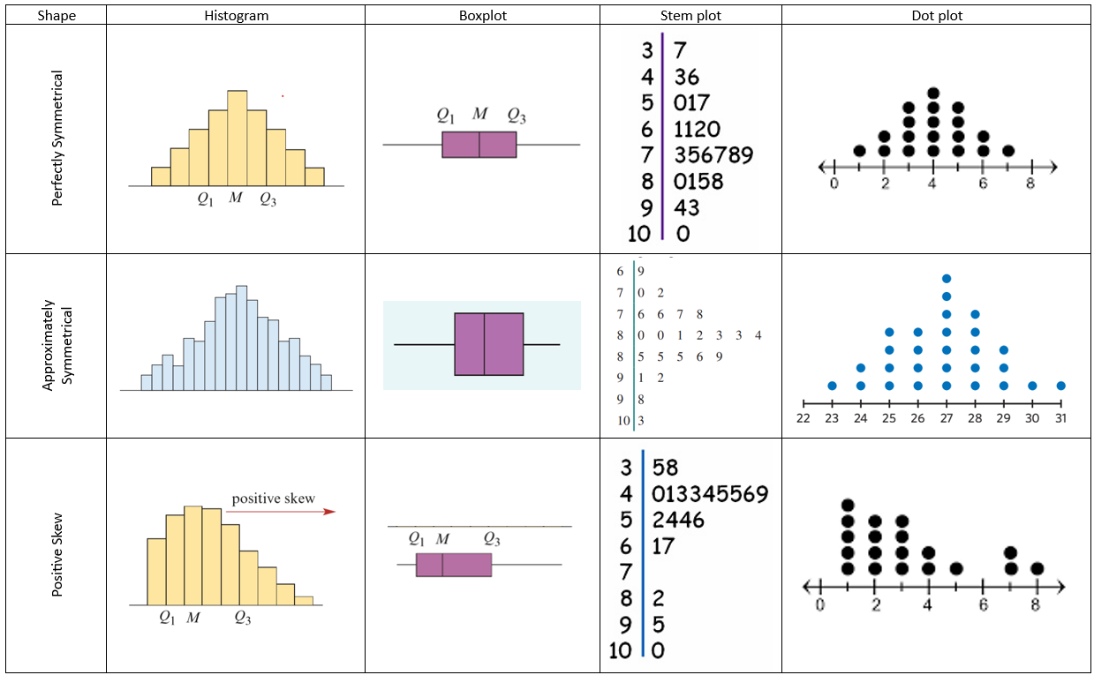
Constructing a histogram with a log scale

Slide 13
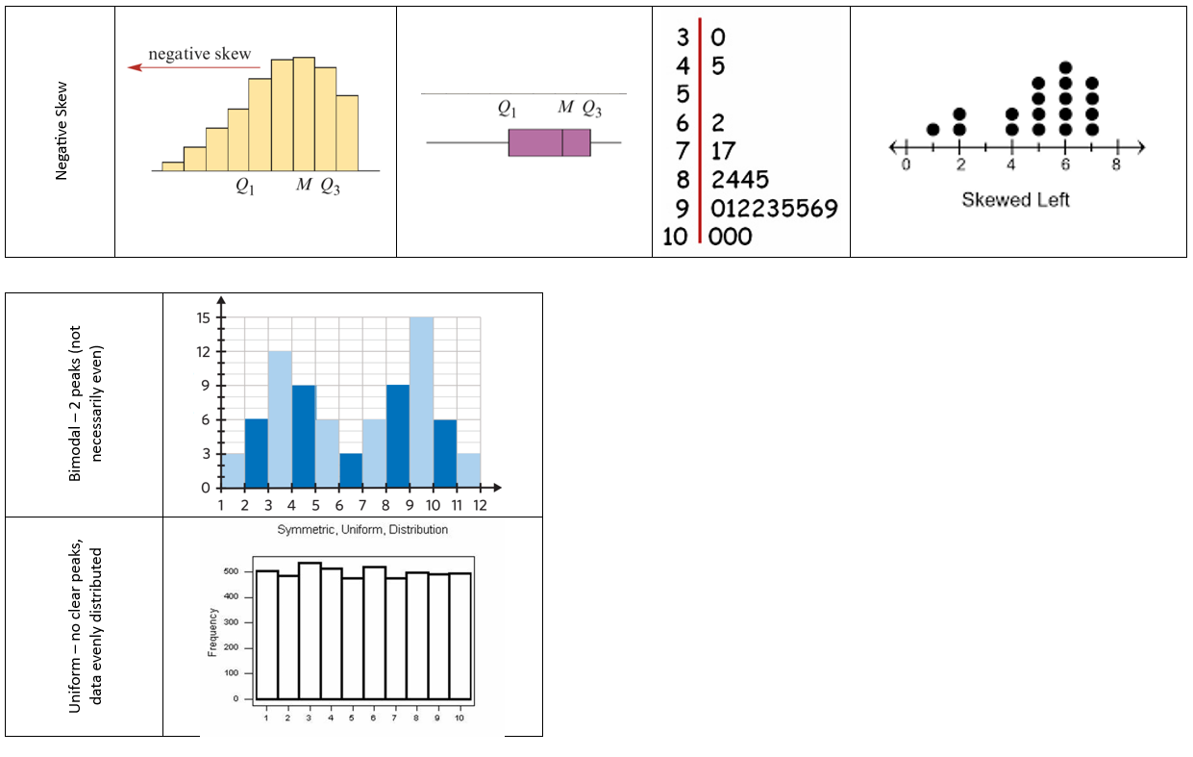
Constructing a histogram with a log scale

Slide 14
    exercises & Summary Book
1. Ex page 1D
2. Summary notes

