Slide 1

1G Introduction to standard deviation
Mean & Standard Deviation
1G

Slide 2
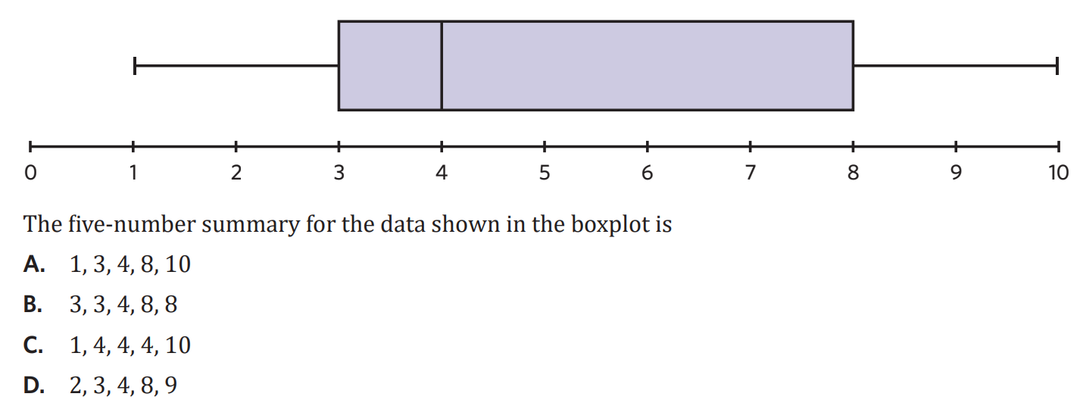

Slide 3



1G : Introduction to standard deviation
mean: “average”
• measure of centre
• $\overset{ˉ}{x}$→ “x bar”
• mean = $\frac{\text{sum} \text{of} \text{all} \text{data} \text{points}}{\text{number} \text{of} \text{data} \text{points}}$} $\overset{ˉ}{x}=\frac{Σx}{n}$
• population: entire groups data
• sample: smaller subset of population
standard deviation:
• another measure of spread
• how far away each data point is from the mean
• Sx
• calculate using CAS
example:
1. calculate the mean for the following weights of 10 rugby players:
80, 95, 85, 91, 102, 93, 87, 78, 84, 90
$$\overset{ˉ}{x}=\frac{80+95+85+91+102+93+87+78+84+90}{10} \\ \overset{ˉ}{x}=88.5$$
2. Homer was embarrassed about his weight loss results and would not tell anyone. 14 other men compiled their results, and the data is shown below. Given that the mean weight lost was 3.8 kg, how much weight did Homer lose over the month? (2 MARKS)
$$\frac{5+5.2+3.8+3.7+2.5+2.9+4.8+5.6+4.7+3.8+3.6+2.4+4.1+4.2+x}{15}=3.8$$
solve $\left(\frac{56.3+x}{15}=3.8,x\right)$
$$x=0.7$$
Weight lost (kg) | 5 | 5.2 | 3.8 | 3.7 | 2.5 | 2.9 | 4.8 | 5.6 | 4.7 | 3.8 | 3.6 | 2.4 | 4.1 | 4.2 | ??
Notes:
Board notes

Slide 4

Notes:
Einstein, Elon Musk CEO of SpaceX, Stephen W. Hawking

Slide 5
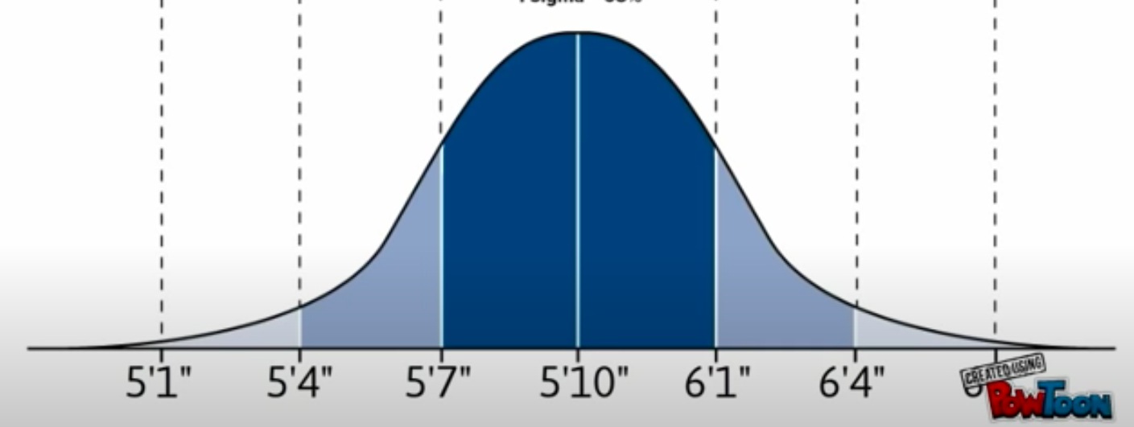
US Male Heights
1.55m 1.63m 1.70m 1.78m 1.85m 1.93m 2.01m

Slide 6
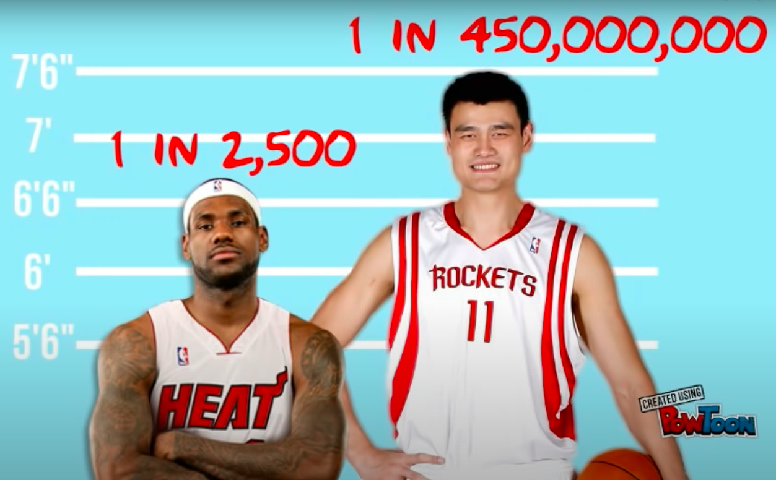
US Male Heights
2.03m 2.29m

Slide 7
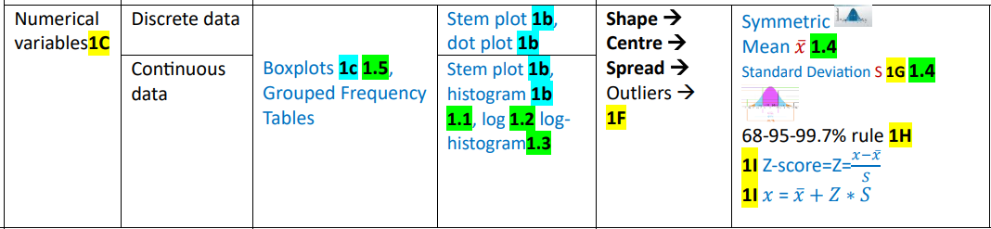
Data Distribution

Slide 8
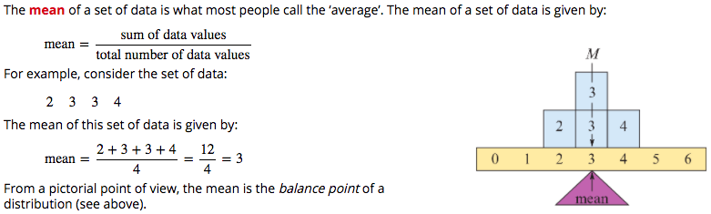
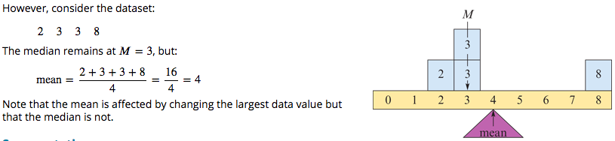
Mean

Slide 9
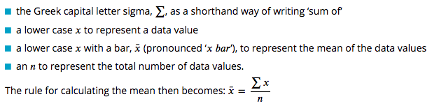
Mean Notation

Slide 10
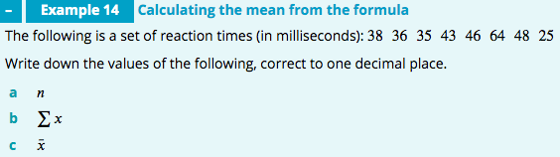
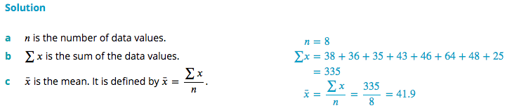

Slide 11
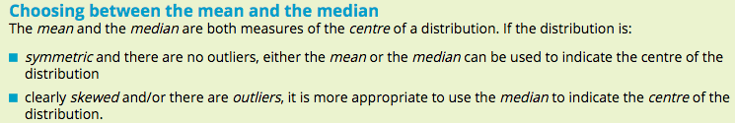
Using mean or median
mortality rates for 60 US cities
the population distribution of different cities
mean = 940 / 100 000
median =944 / 100 000 people
mean =1.4 million
median = 0.9 million

Slide 12
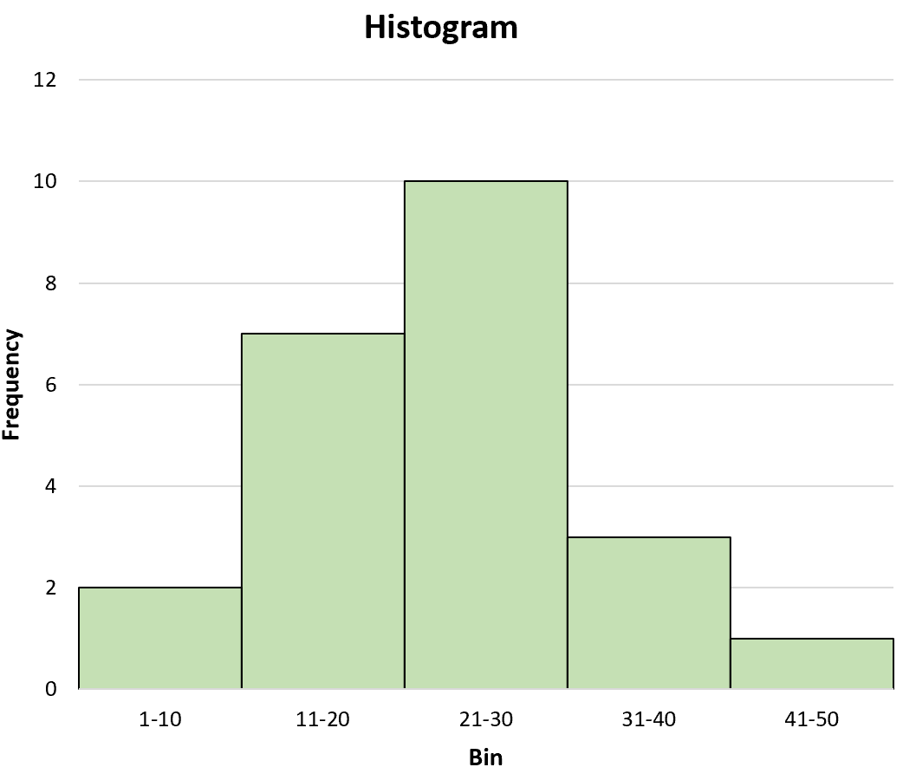
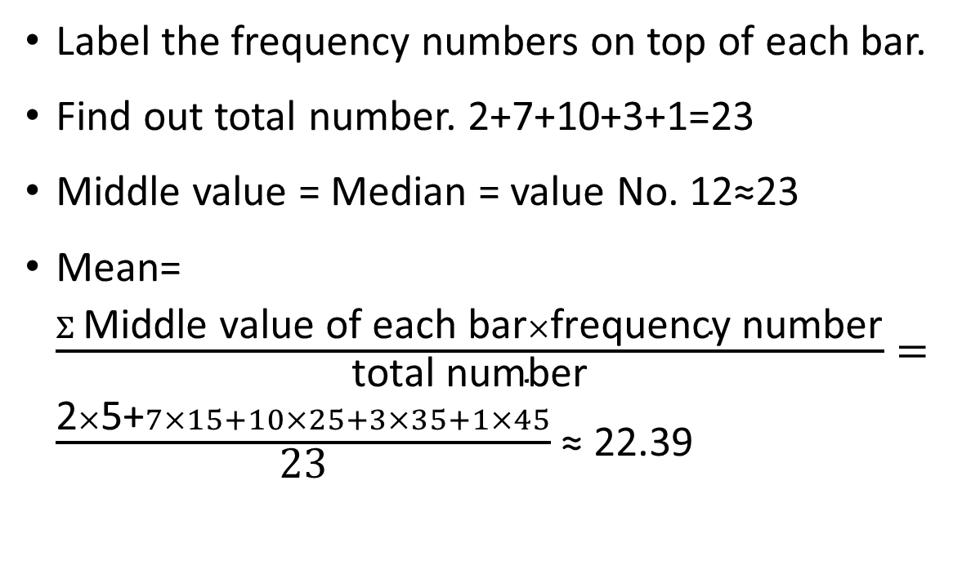
How to estimate mean and median from a histogram?
Label the frequency numbers on top of each bar.
Find out total number. 2+7+10+3+1=23
Middle value = Median = value No. 12≈23
Mean=$\frac{Σ \text{Middle} \text{value} \text{of} \text{each} \text{bar}×\text{frequency} \text{number}}{\text{total} \text{number}}=$ $\frac{\text{2}×\text{5+}7×15+10×25+3×35+1×45}{\text{23}}$ ≈ 22.39
10
7
3
2
1

Slide 13
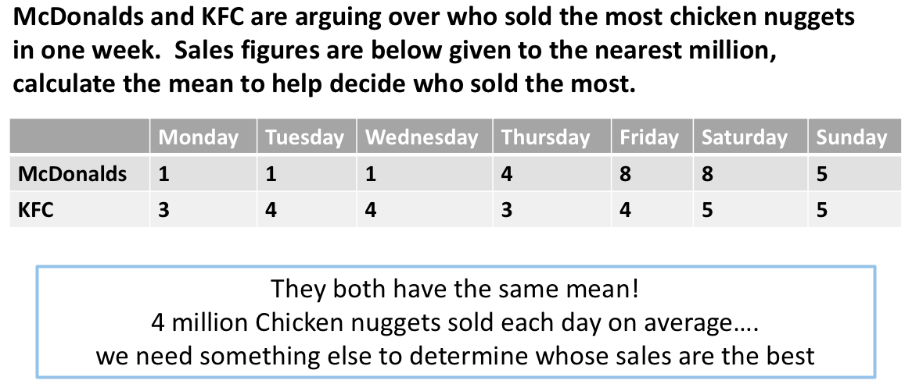



Slide 14
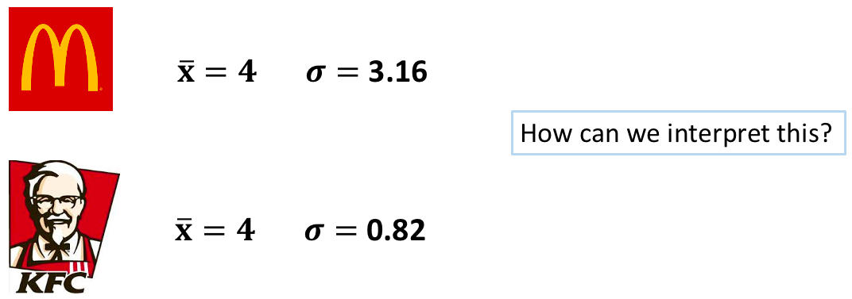

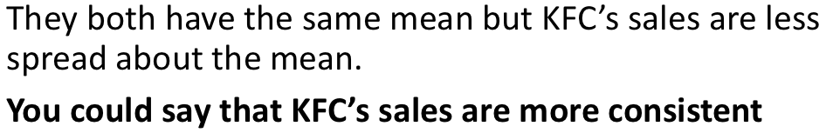
More Consistent
More Variable

Slide 15
The Standard Deviation
https://www.youtube.com/watch?v=MRqtXL2WX2M

Slide 16
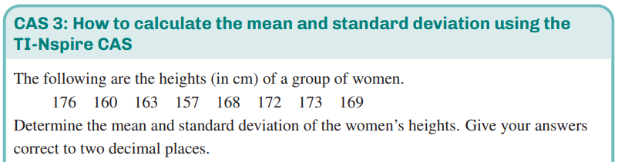
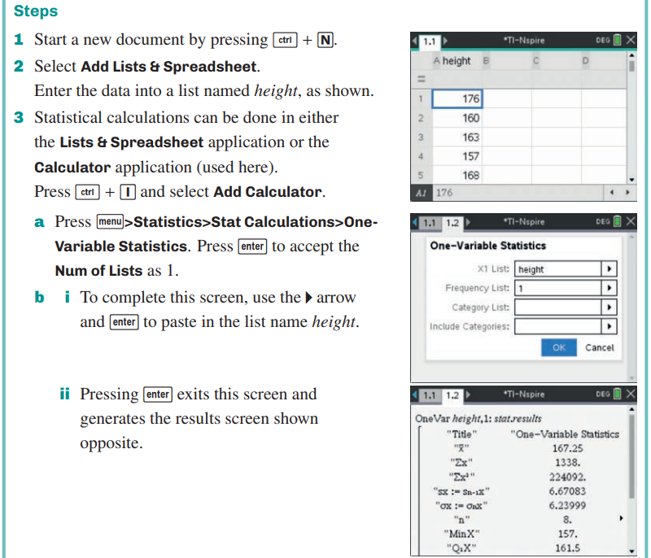
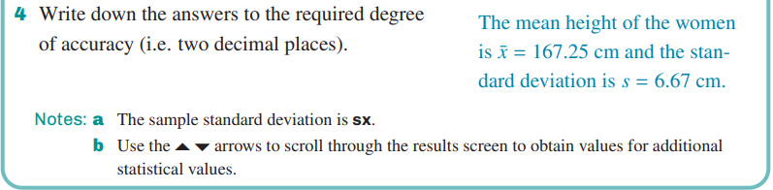
The Standard Deviation
CAS Notes 1.4

Slide 17

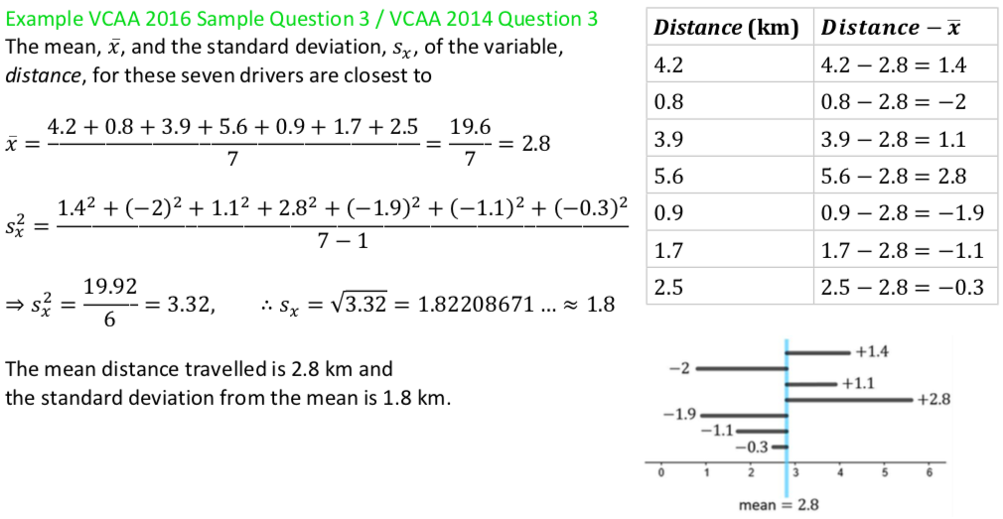
The standard deviation

Slide 18
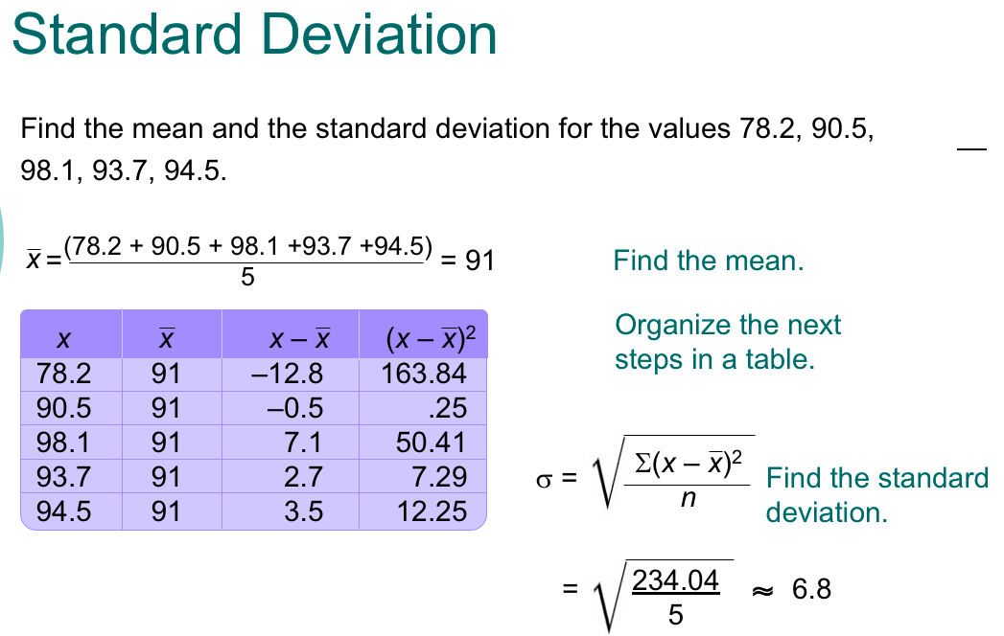
-1
-1

Slide 19
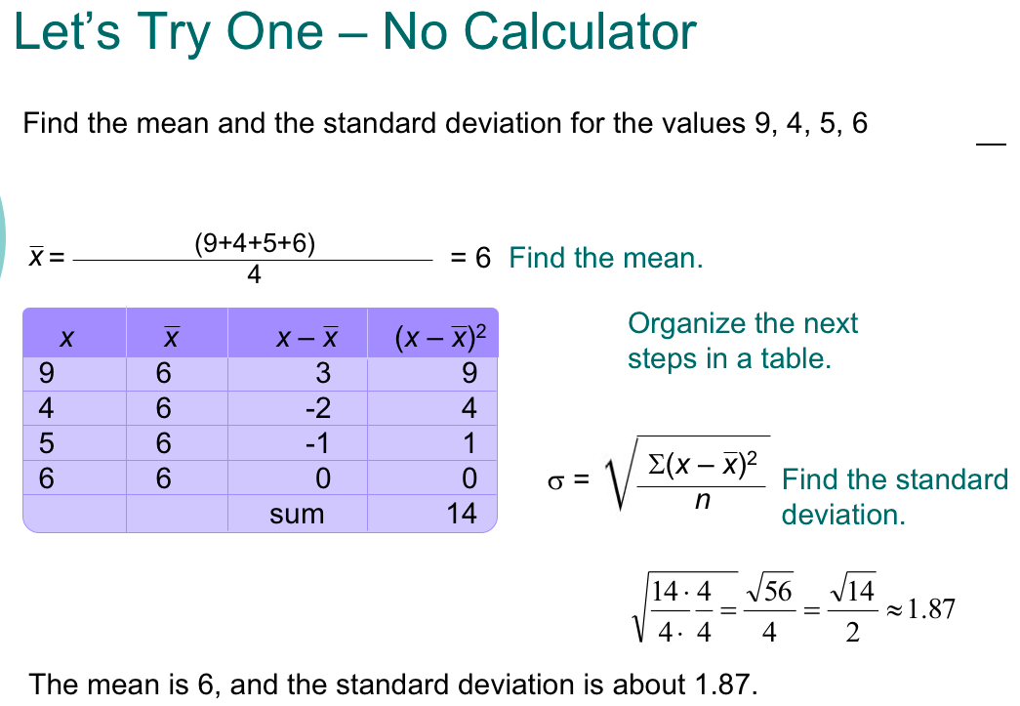
-1

Slide 20
    exercises & Summary Book
1. Ex page 1G
2. Summary notes

