Slide 1

The normal distribution
1H
Notes:
https://create.kahoot.it/details/4704860a-60da-4611-8b28-81ace5ba0c3b
https://create.kahoot.it/details/509f536c-f3f8-4966-b2d7-b6f7263dafd9
https://create.kahoot.it/details/616d8c8b-0f0b-40d1-8f9c-cd1d2d781a48

Slide 2
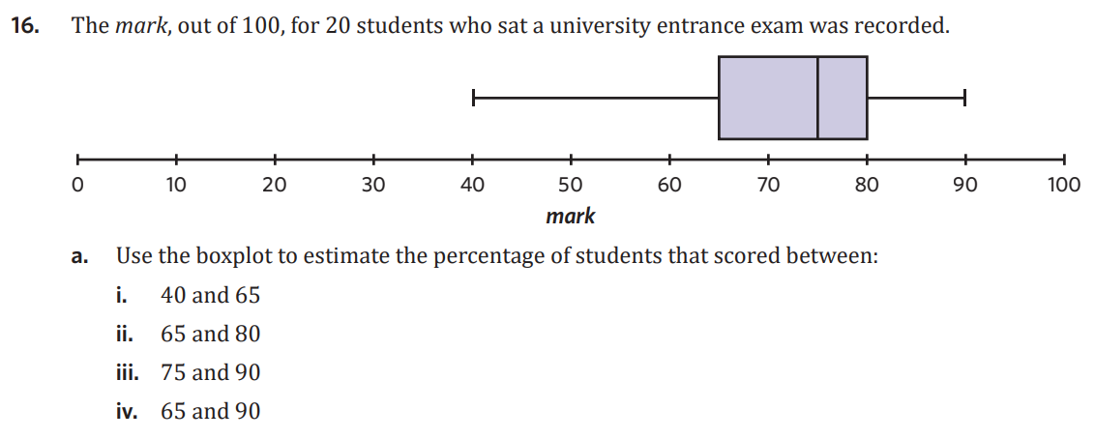
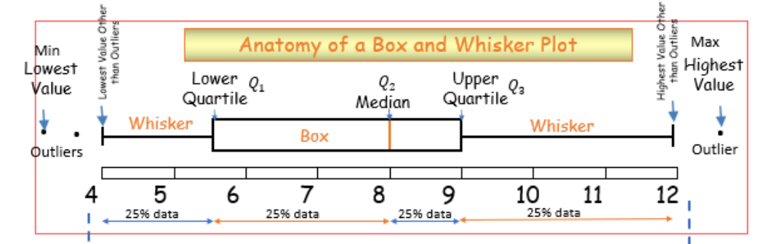

Slide 3

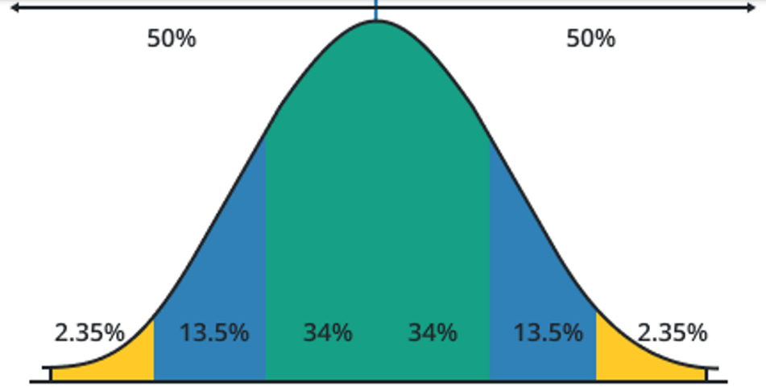
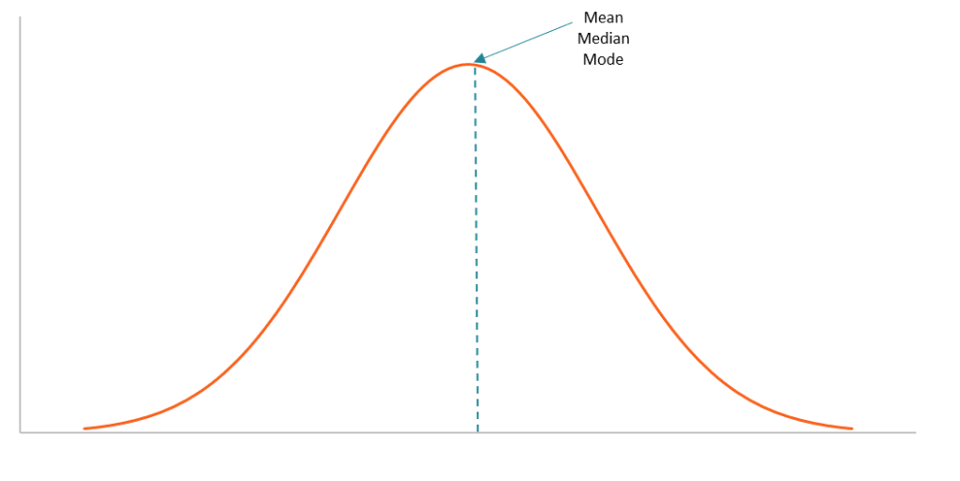
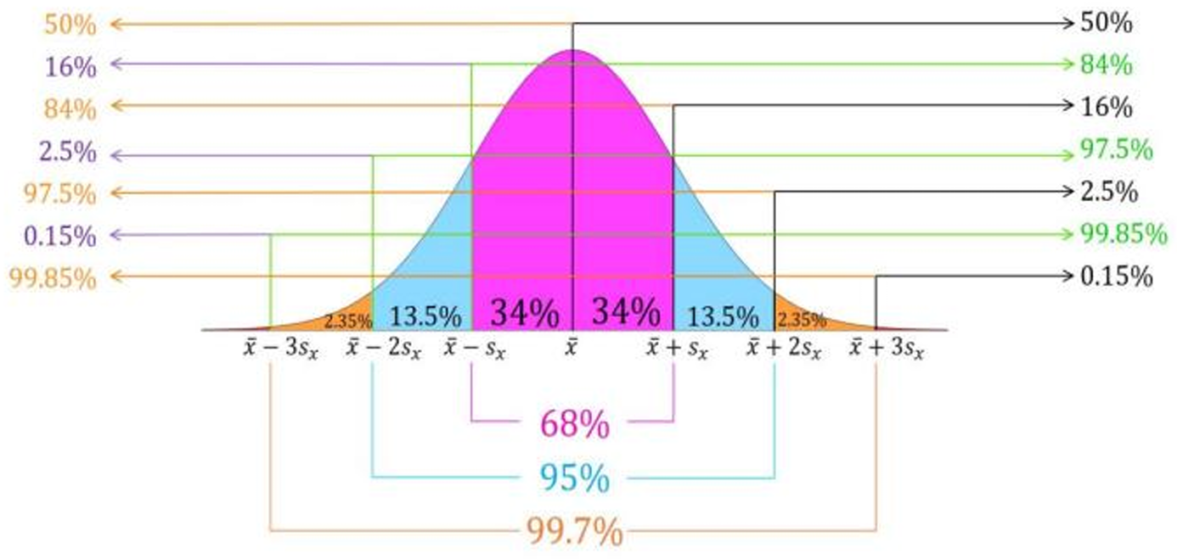
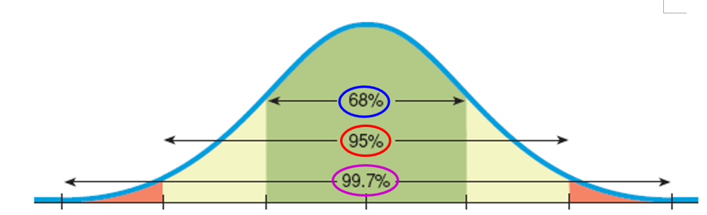
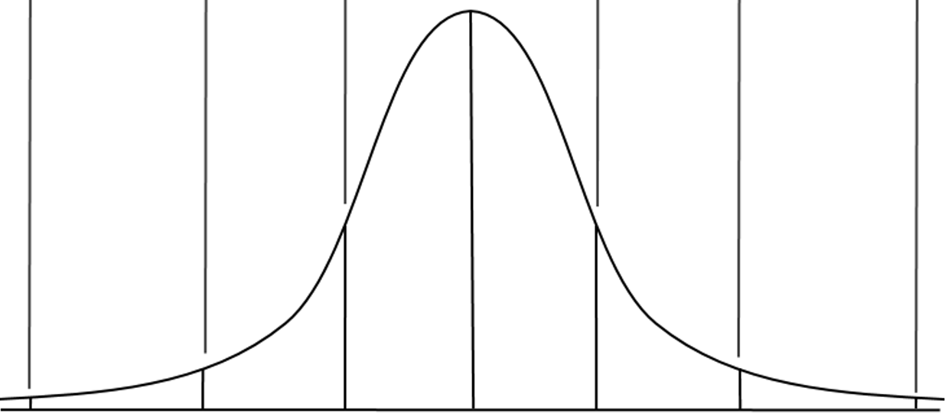


1H: Normal Distribution
normal distribution = symmetrical (approx.) distributions, “bell-shaped”
numerical data sets
mean and median are both appropriate
mean and standard deviation are used
68–95–99.7% rule
-3 -2 -1 0 1 2 3
x̄ − 3$s_{x}$ x̄ − 2$s_{x}$ x̄ −$s_{x}$ x̄ x̄ +$s_{x}$x̄ + 2$s_{x}$ x̄ + 3$s_{x}$
“mean”+ 3 standard deviations
Section breakdown
-3 -2 -1 0 1 2 3
example: New plants are planted in the TC gardens and are measured after a year. There are 50 plants, the mean is 62 cm & a standard deviation of 6 cm.
a. construct a bell curve:
62−6 62 62+6 62 + 2(6) 62 + 3(6)
44 50 56 62 68 74 80
-6 -6 -6 +6 +6 +6
b. what % of plants are smaller than 68cm?
34 + 34 + 13.5 + 2.35 + 0.15 = 84%
c. how many plants are between 50 and 74cm?
13.5 + 34 + 34 + 13.5 = 95%
$\frac{95}{100}$ × 50 = 47.5 ≈ 48 plants
0.15%
0.15%
mean/ median
Notes:
Board notes

Slide 4
The normal distribution

Slide 5
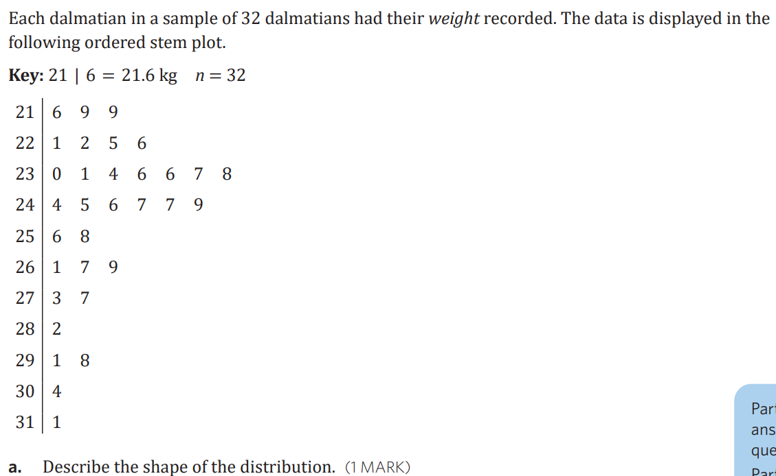

Slide 6
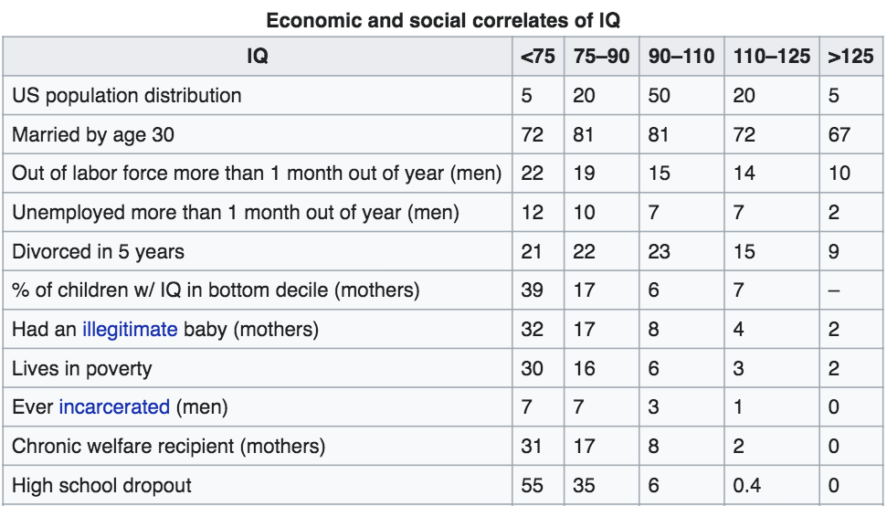

Slide 10
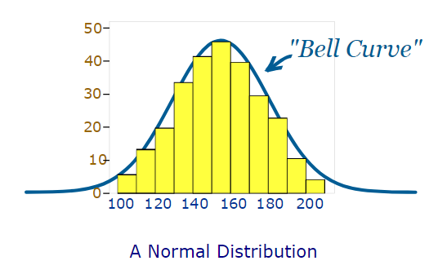
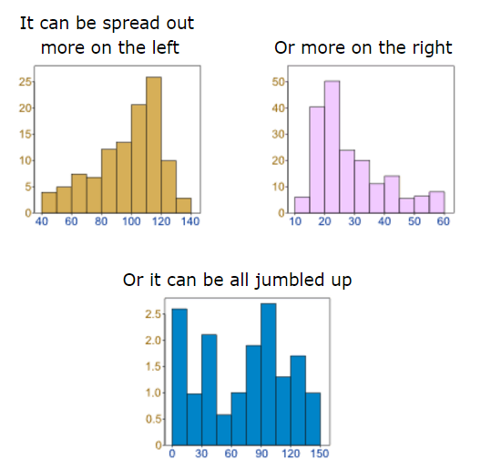
Data can be spread out in different ways.
Many things closely follow a Normal Distribution:
heights of people
size of things produced by machines
errors in measurements
blood pressure
marks on a test
In general, a normal distribution is representative of continuous data (such as measurements) that have some variation but no bias above or below the mean.

Slide 11
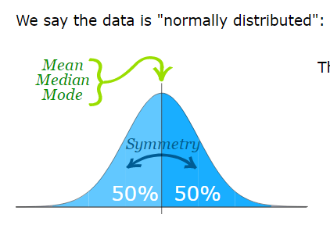
mean = median = mode
Symmetry about the centre (mean)
50% of the values are less than the mean and 50% are greater than the mean
All normal distributions have these features. The only differences between one normal distribution and another are:
Where the centre value is (mean)
How spread out the data is (the standard deviation)

Slide 12
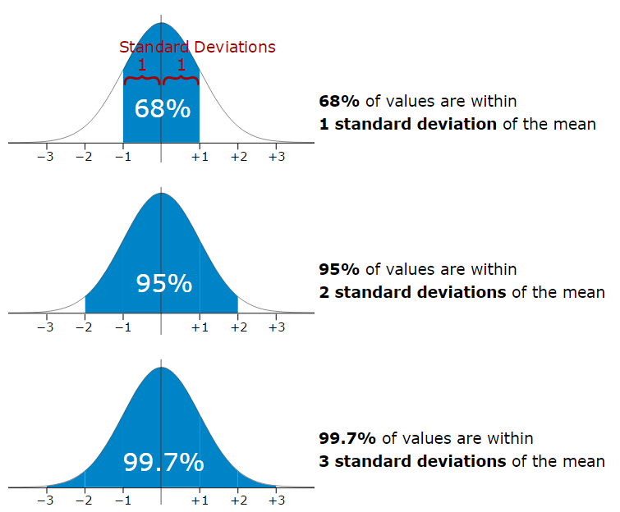
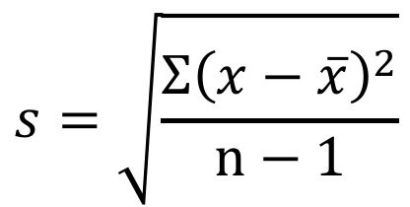
The mean is easy to spot, it is the middle point. But what about the standard deviation?
We have previously looked at how to calculate the standard deviation for a set of data.
The distance of each point from the mean – squared to eliminate and minus signs from points that are below the mean.
We then add up all these distances of all the values in the set of data.
$$s=\sqrt{\frac{Σ{\left(x−\overline{x}\right)}^{2}}{n−1}}$$
The whole thing is then square rooted to counteract the effect of squaring.
Divided by the number of points to find the average.
This gives us an idea of the average distance of each data point from the mean value.
It is good to know the standard deviation, because we can say that any value is:
likely to be within 1 standard deviation
very likely to be within 2 standard deviations
almost certainly within 3 standard deviations
But what does the standard deviation really mean in terms of a normal distribution?

Slide 13
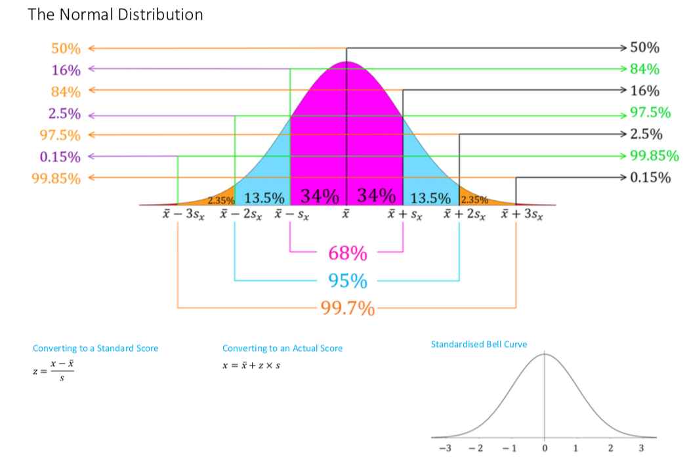

Slide 14
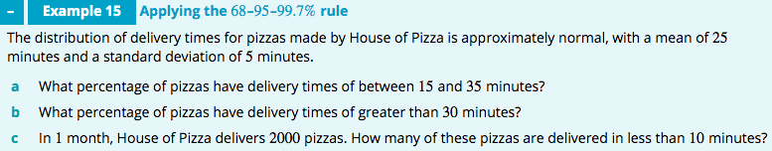
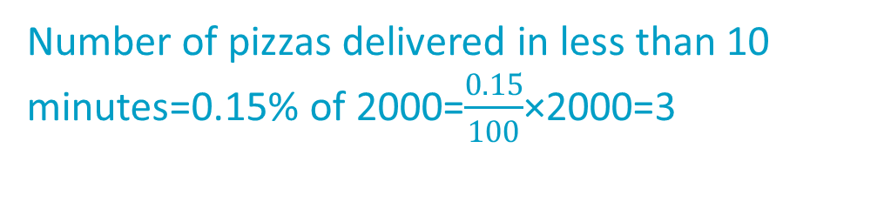
a 95% of pizzas will have delivery times of between 15 and 35 minutes.
b 16% of pizzas will have delivery times of greater than 30 minutes.
c Number =2000
Percentage delivered in less than 10 minutes =0.15%
Number of pizzas delivered in less than 10 minutes=0.15% of 2000=$\frac{0.15}{100}$×2000=3

Slide 15
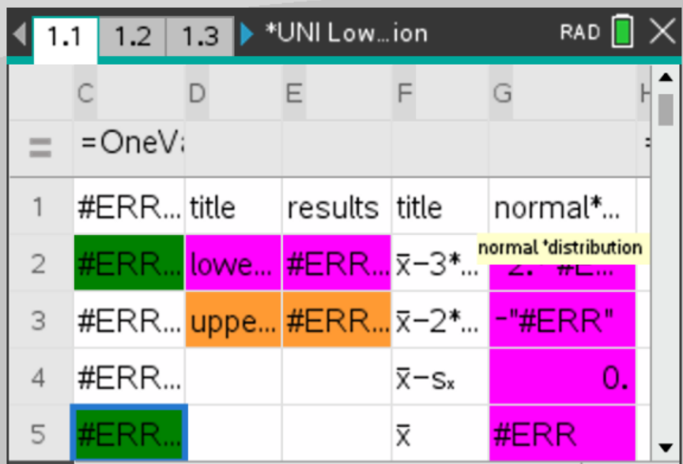
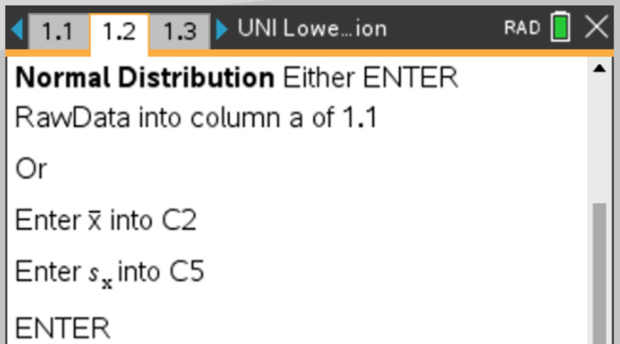
Normal Distribution
https://www.youtube.com/watch?v=e_h3RBgBx8M&feature=youtu.be
1.6 Using “UNI Lower Upper Fences Normal Distribution” template

Slide 17
exercises & Summary Book
1. Ex page 1H
2. Summary notes

