Slide 1

Associations between two categorical variables
2B

Slide 2
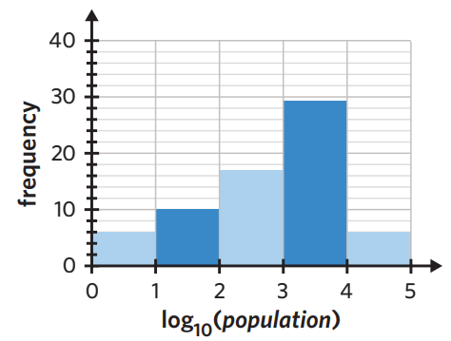
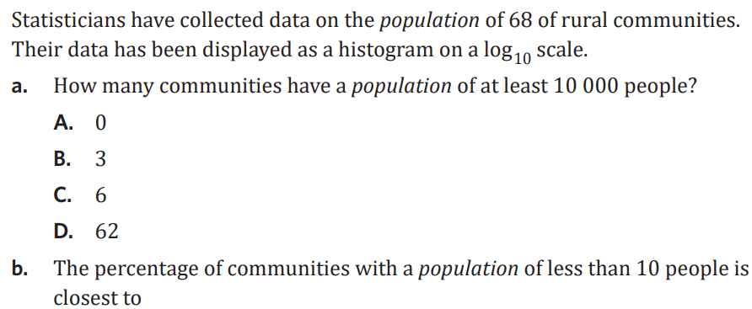

Slide 3

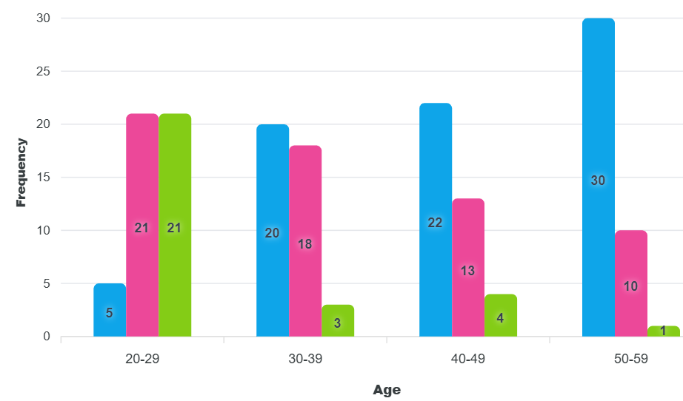

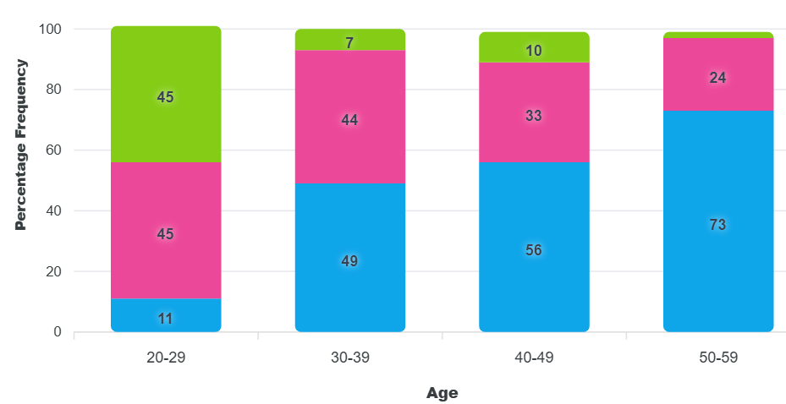
2A Associations between two categorical variables
bivariate data = two bits of data
two-way frequency tables:
- allow two sets of categorical data to be compared
- columns = EV
- rows = RV
- percentages are used when sample sizes of data are different
describing the association between two categorical variables:
- analyse for an association or pattern
- percentages to support findings
displaying:
grouped bar chart:
- displays 2 categorical variables
- frequency on vertical (y) axis
- EV on horizontal (x) axis
- RV represented by the columns (key)
percentage segmented bar charts:
- gap between columns
- each bars height is 100%
- frequency on vertical (x) axis
- EV on horizontal (y) axis
- RV represented by the columns (key)
example: A group of people were surveyed as to their chocolate preference (dark, milk, white), their age was also recorded
a. complete the two-way frequency tables:
number age
i. 47 − 21 − 5 = 21 ii. 20 + 18 + 3 = 41
percentage age
* when rounding to the nearest whole % it won't always add to 100%! *
i. 20 ÷ 41 × 100 = 49% ii. 18 ÷ 41 × 100 = 44% iii. 3 ÷ 41 × 100 = 7%
b. display as a grouped bar chart:
c. display as a % segmented bar chart:
d. determine if there is an association between chocolate preference and age:
Yes, there is an association. As age increases preference for dark chocolate increases (11%, 49%, 56%, 73%). Preference for milk (45%, 44%, 33%, 24%) and white (45%, 7%, 10%, 2%) decreases.
Choc preference | 20–29 | 30–39 | 40–49 | 50–59
dark | 5 | 20 | 22 | 30
milk | i. 21 | 18 | 13 | 10
white | 21 | 3 | 4 | 1
total | 47 | ii. 41 | 39 | 41
Choc preference | 20–29 | 30–39 | 40–49 | 50–59
dark | 11% | i. 49% | 56% | 73%
milk | 45% | ii. 44% | 33% | 24%
white | 45% | iii. 7% | 10% | 2%
total | 101% | 100% | 99% | 99%
Notes:
Board notes

Slide 4
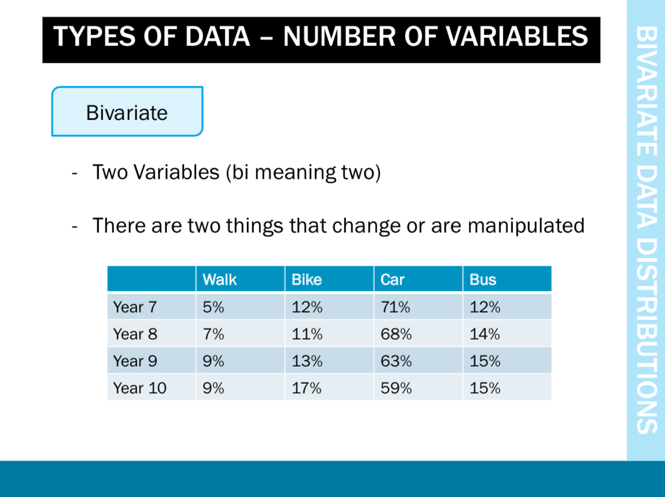

Slide 5
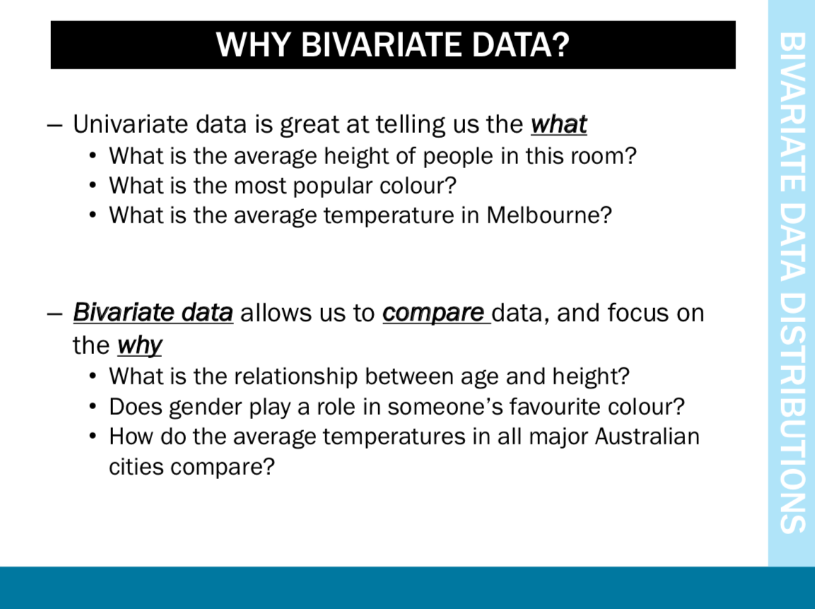

Slide 6
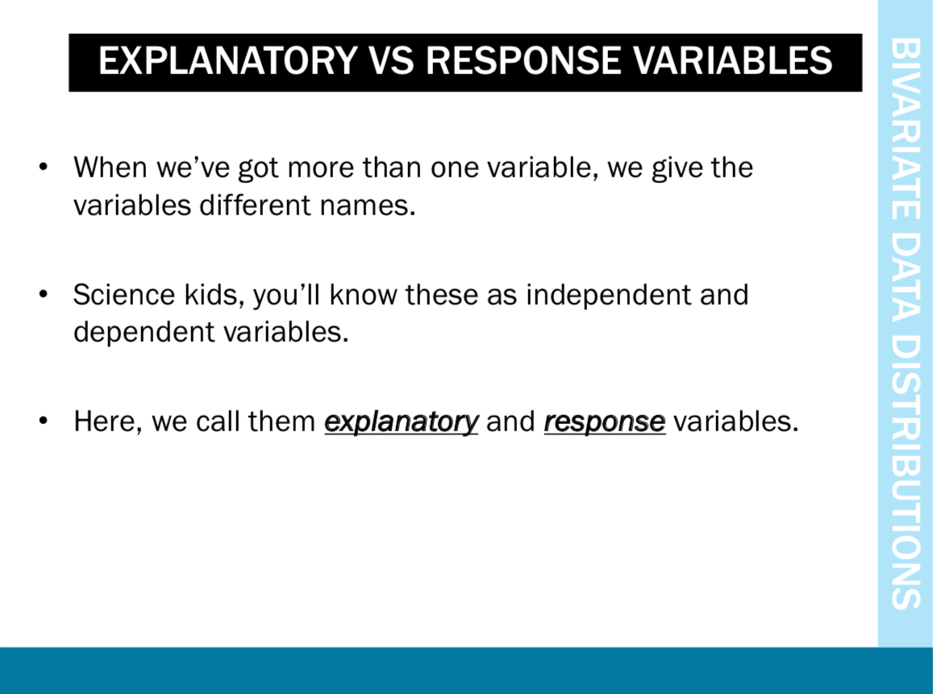
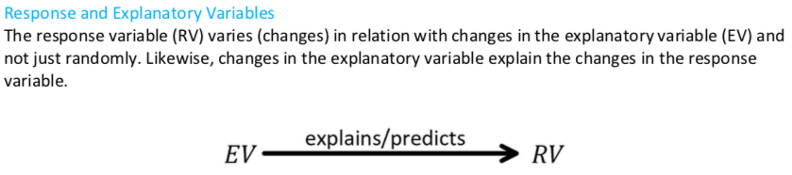

Slide 7
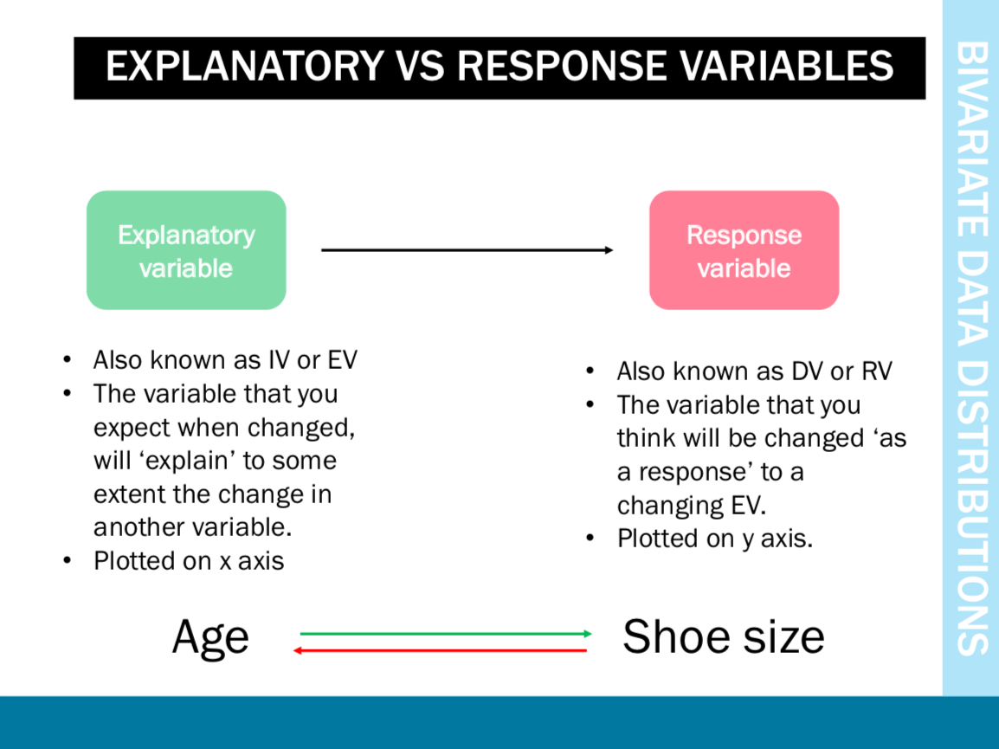

Slide 8
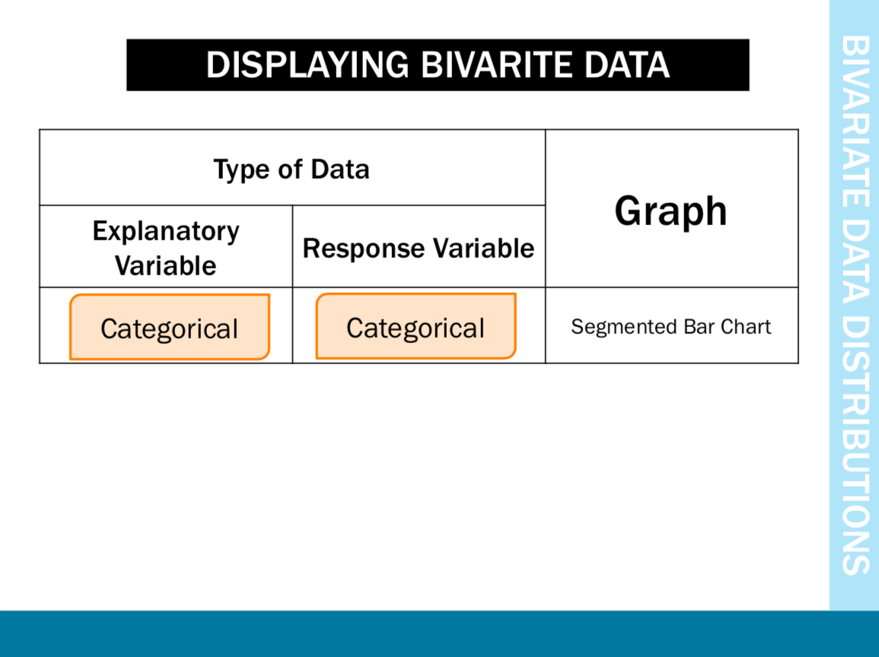

Slide 9
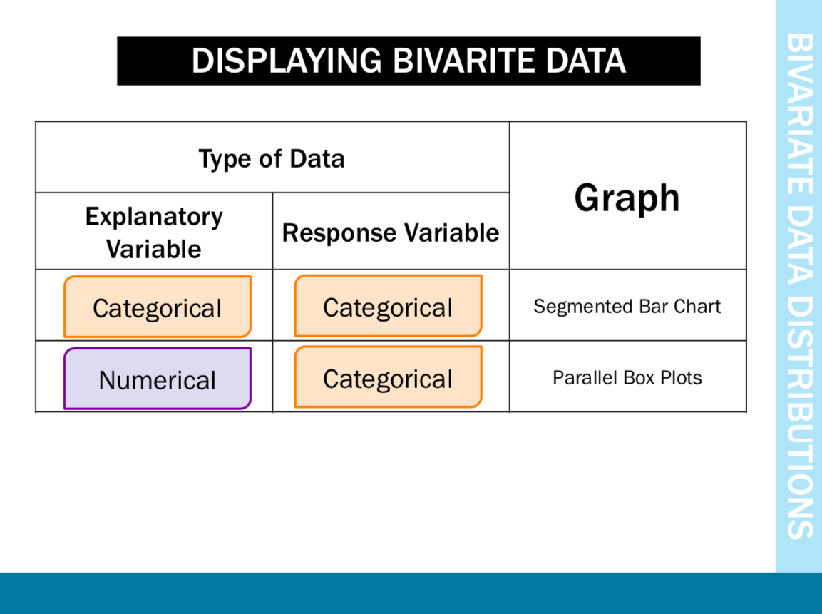

Slide 10
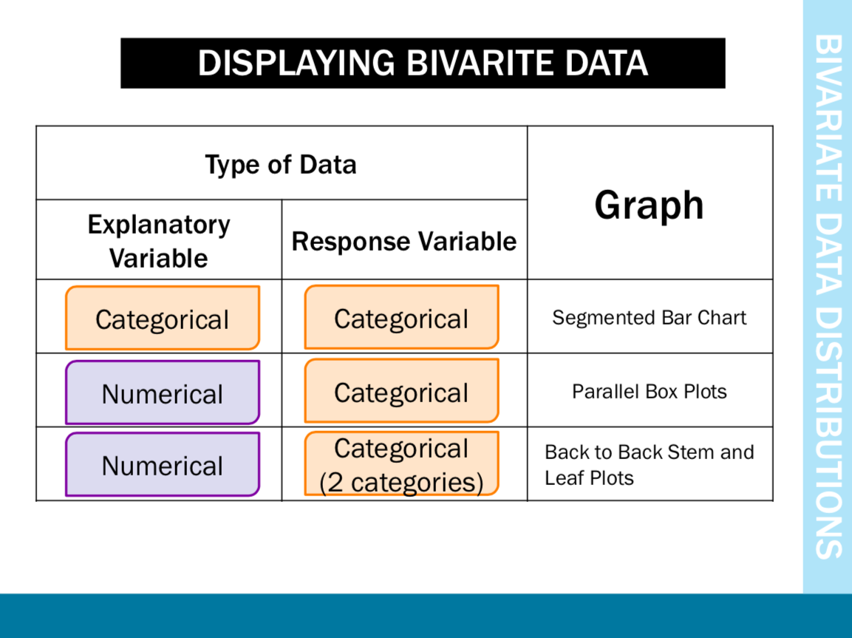

Slide 11
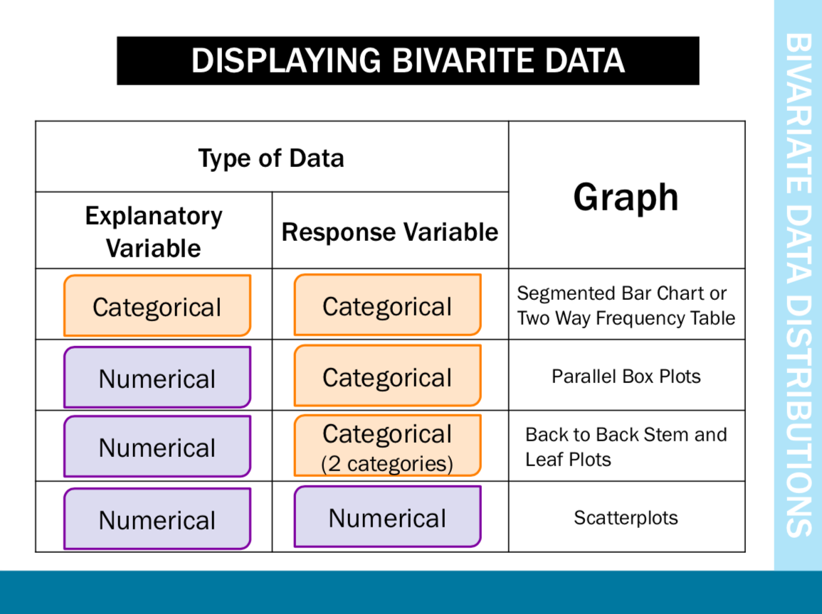

Slide 12
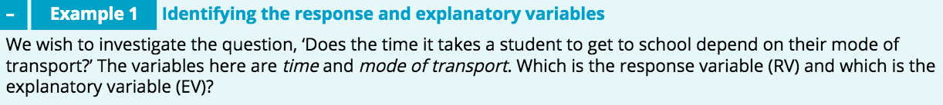


Slide 13
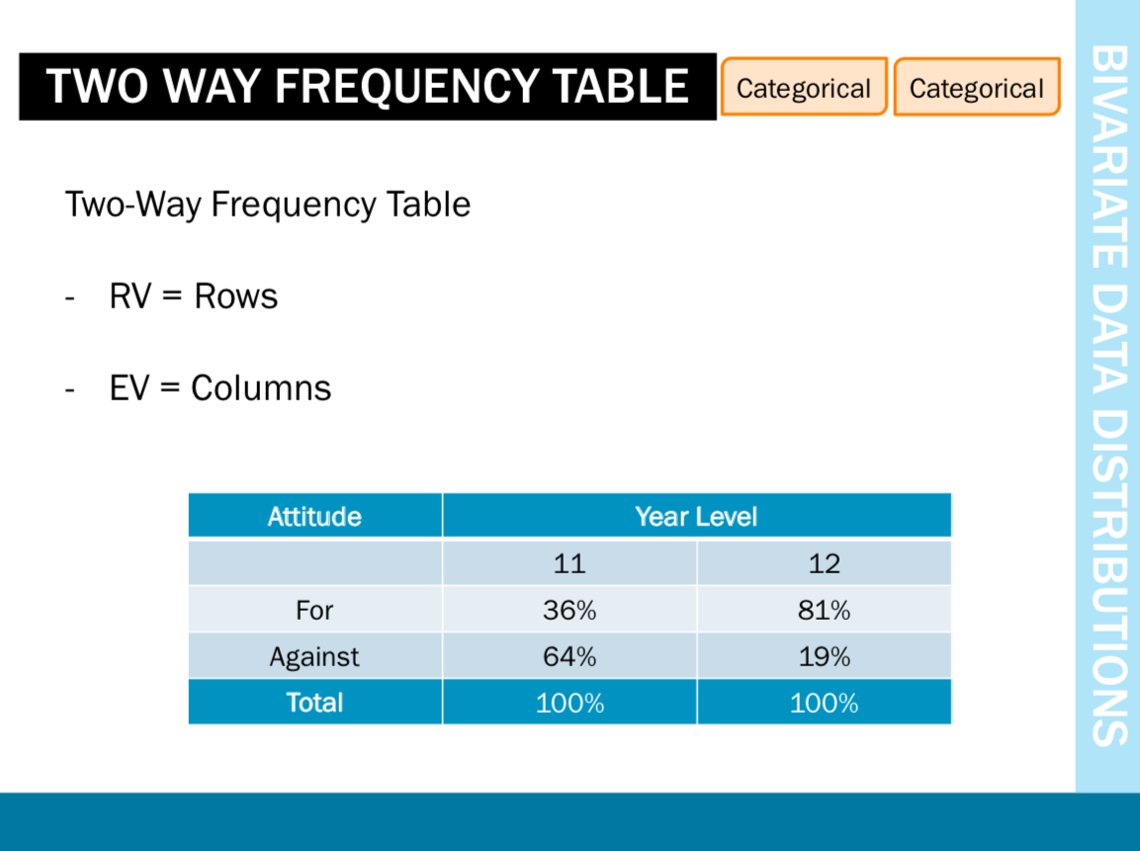

Explanatory Variable
Response Variable

Slide 14
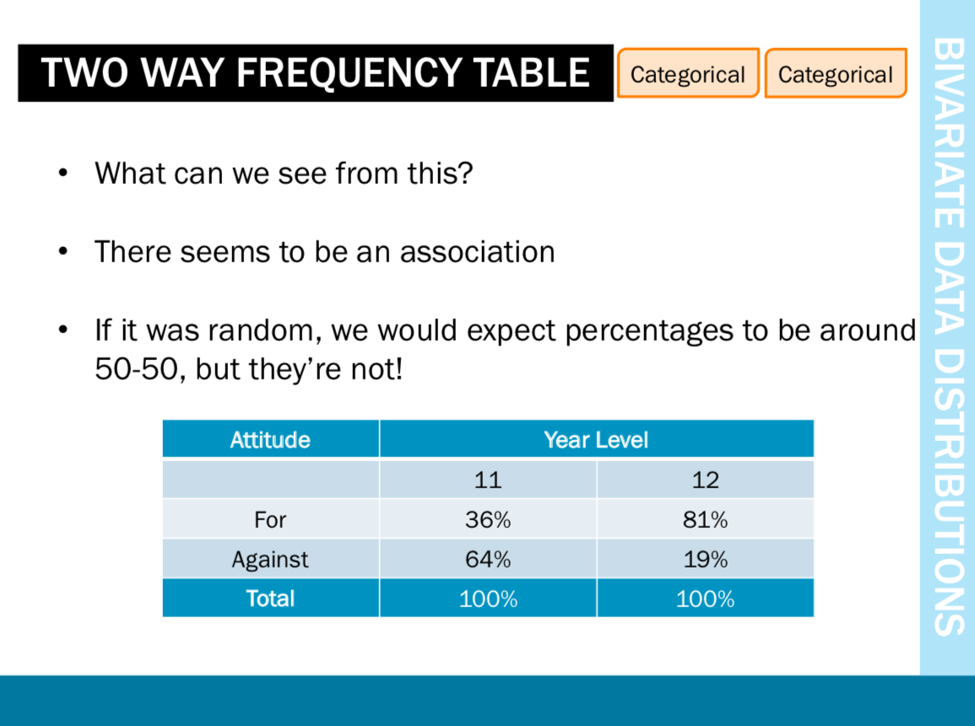

Slide 15
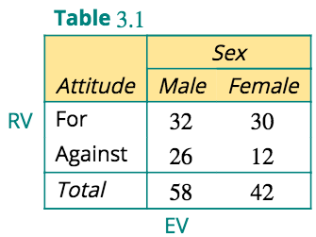
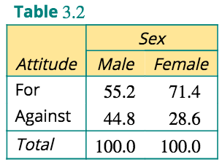
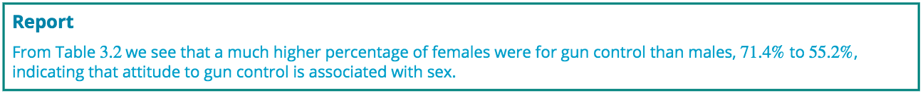

Slide 16
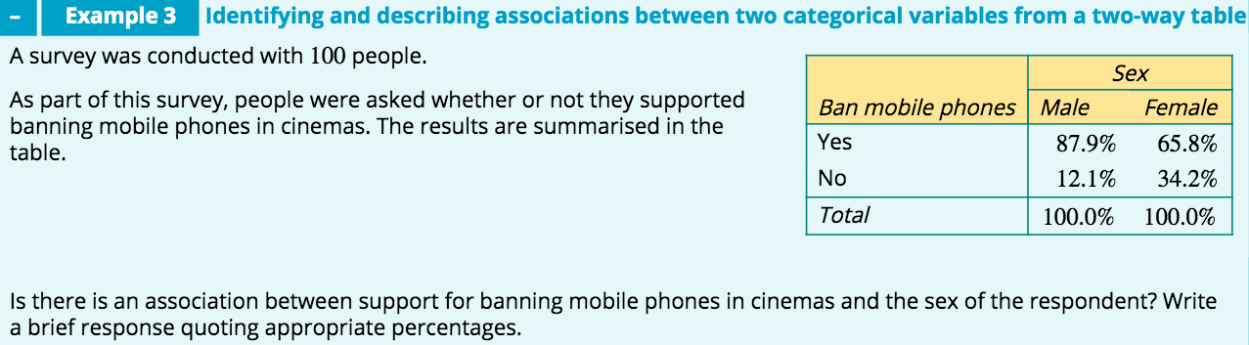
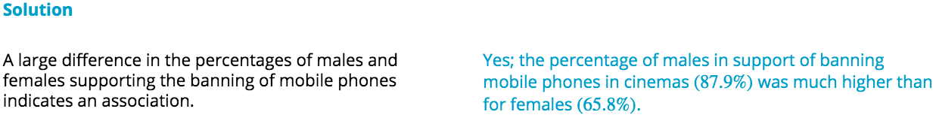

Slide 17
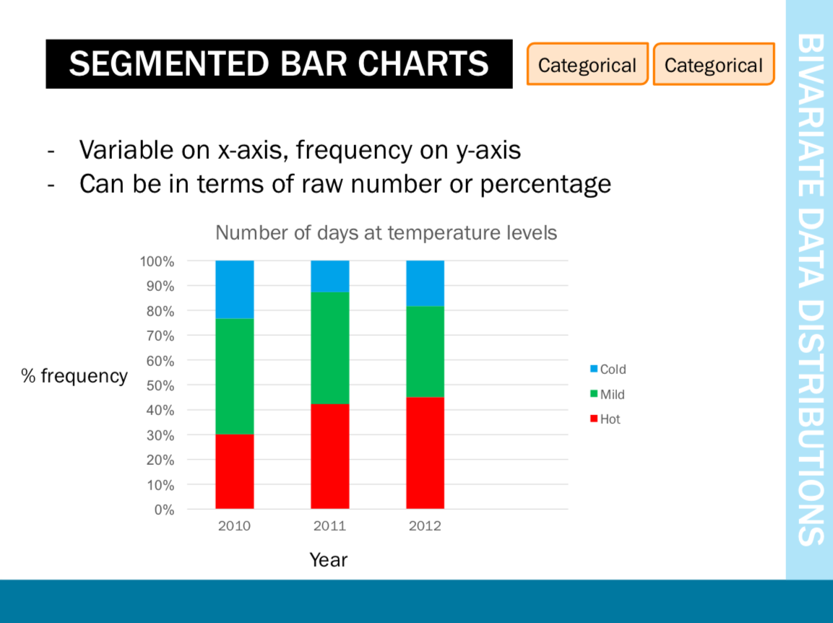
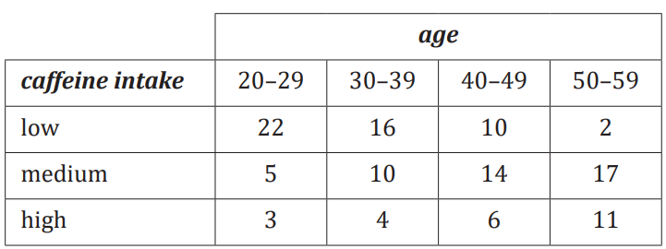
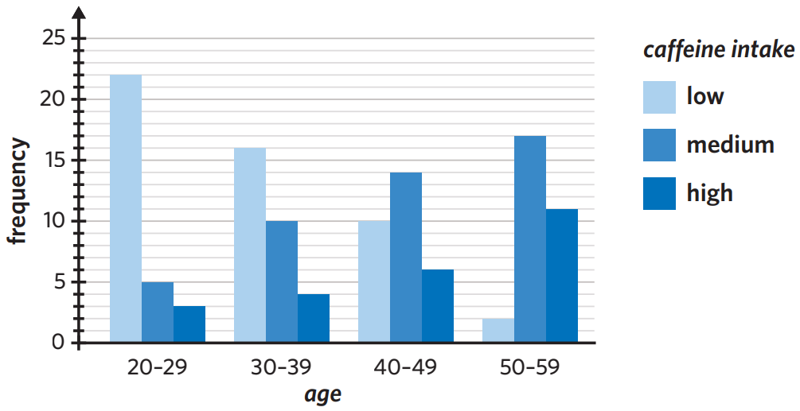
GROUPED BAR CHART

Slide 19
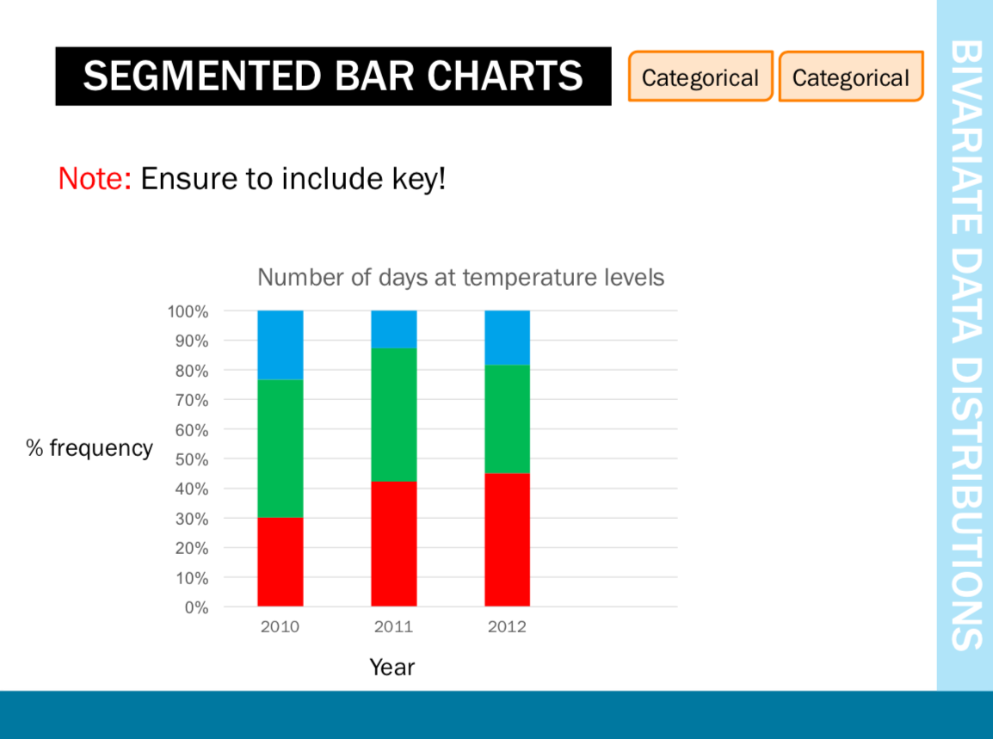


Slide 20
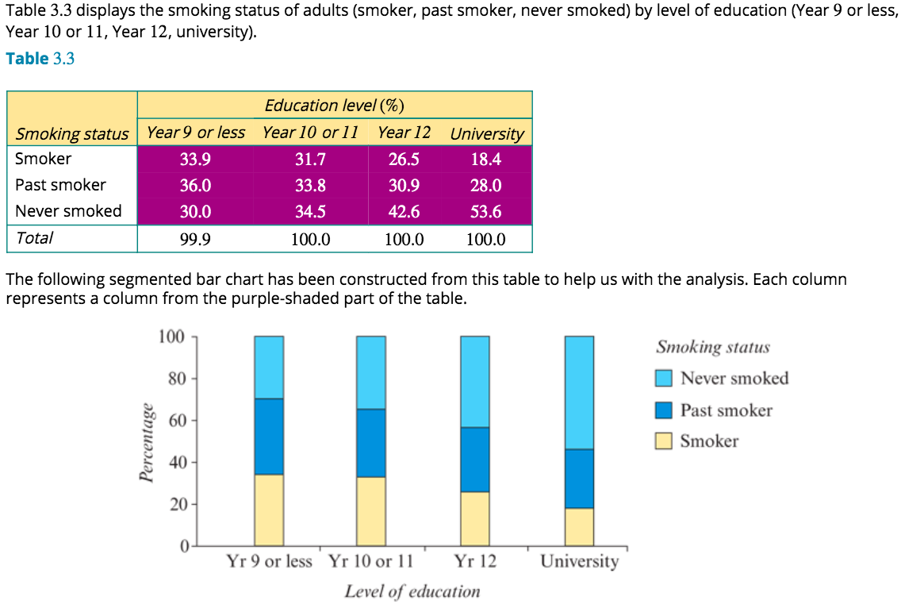
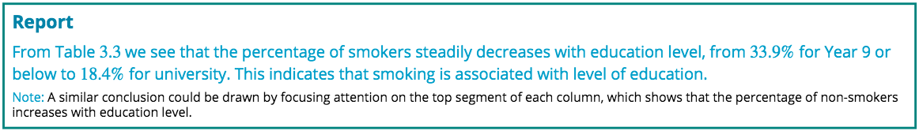
Analysing a situation where two categorical variables have multiple categories

Slide 21
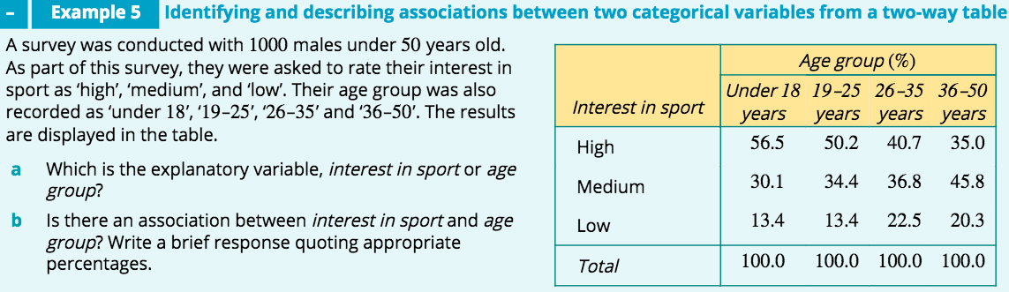
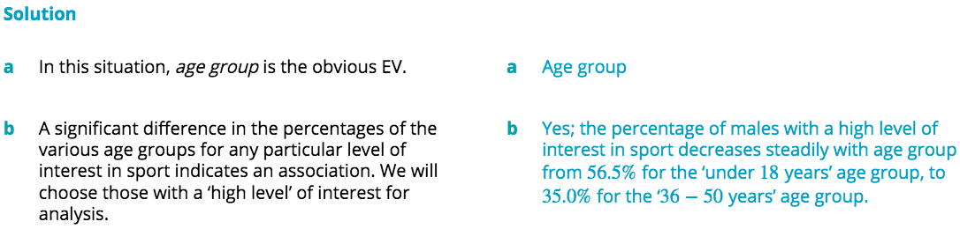

Slide 22
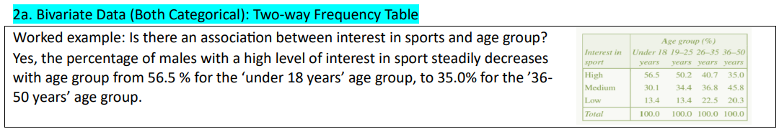
REPORT

Slide 23
exercises & Summary Book
1. Ex page 2A
2. Summary notes

