Slide 1

Associations between numerical and categorical variables
2B
Notes:
https://create.kahoot.it/details/af8643fd-2302-4342-836d-5dfe36f15cc9

Slide 2
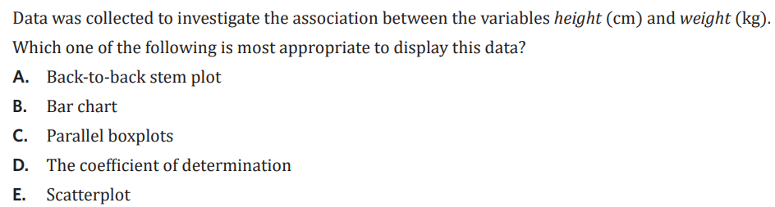

Slide 3
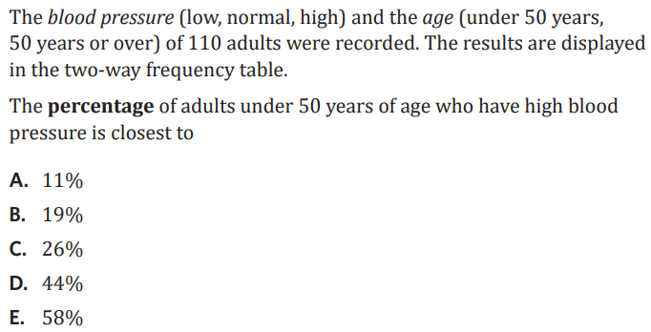
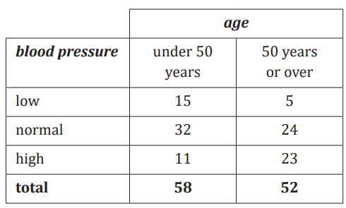

Slide 4

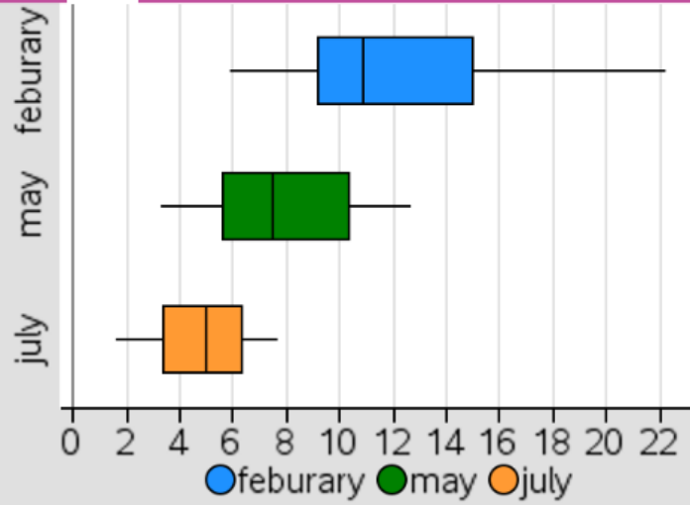


2B : Association between numerical and categorical variables
- compares distribution of 2 or more categorical variables
- if distributions differ an association between numerical and categorical may exist.
displaying:
- back-to-back stem plot
- parallel dot plots
- parallel boxplots
describing: use comparative language (eg: larger/smaller)
- shape: positive/negative skew, approx. symmetrical, outliers
- centre: median
- spread: range or IQR if outliers are present
examples:
1. back-to-back stem plot: number of points scored by two bball teams
Key: 3 | 7 = 37 points
a. compare the results:
Team Zebra was the more successful team, their results are negatively skewed and have a median of 69.5 points, this is larger than the crocodiles median score of 44 and their data is positively skewed. The crocodiles' results are more varied with a range of 60, compared to 47 for the zebras.
2. parallel boxplots
The five-number summary for the distribution of minimum daily temperature for the months of February, May and July in 2017 is shown in the table. The associated boxplots are shown following the table.
Explain why the information given supports the contention that minimum daily temperature is associated with the month. Refer to the values of an appropriate statistic in your response. (2 MARKS)
Minimum daily temperature is associated with month as the median temperature decreases from Feb to May to July from 10.9 to 7.5 to 5.0. The range/variability is larger in Feb, 12.7°C, compared to 6.7 and 4.0 (May and July). Feb is positively skewed with an outlier, May is slightly positively skewed (approximately symmetrical and July is approximately symmetrical.
Crocodiles |  |  |  |  | Zebras
 |  | 4 | 0 | 2
8 | 7 | 5 | 2 | 3 | 7
 | 7 | 4 | 4 | 4
 |  | 8 | 2 | 5 | 2 | 8
 |  | 3 | 1 | 6 | 0 | 1 | 5 | 9
 |  |  |  | 7 | 0 | 3 | 5 | 8
 |  |  | 0 | 8 | 1 | 3 | 4
median position =$\frac{14+1}{2}$ = 7.5
(between 7th and 8th point)
croc: 44
zebras: $\frac{69+70}{2}$ = 69.5
month | minimum | Q1 | median | Q3 | maximum
February | 5.9 | 9.5 | 10.9 | 13.9 | 22.2
May | 3.3 | 6.0 | 7.5 | 9.8 | 12.7
July | 1.6 | 3.7 | 5.0 | 5.9 | 7.7
Notes:
Board notes

Slide 5
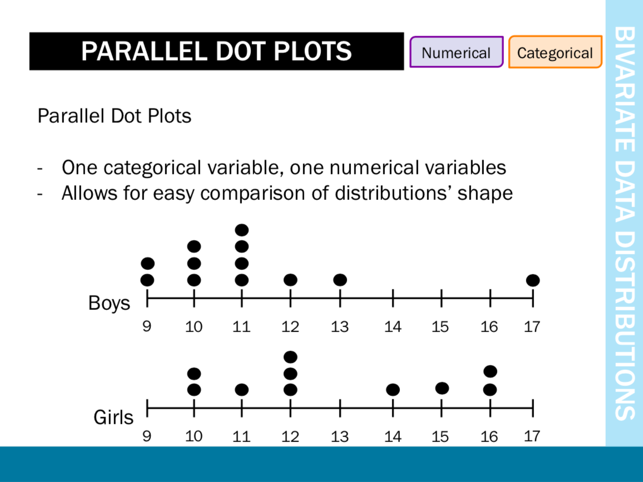

Slide 6
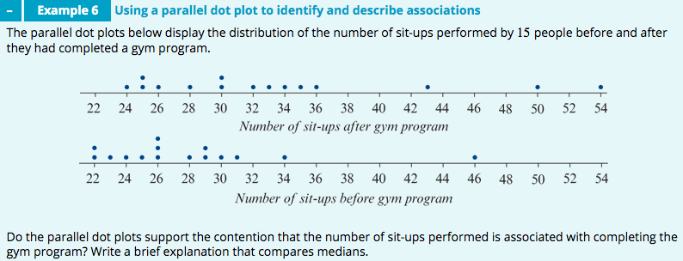
𝑀=32
𝑀=26
Yes; the median number of sit-ups performed after attending the gym program (𝑀=32) is considerably higher than the number of sit-ups performed before attending the gym program (𝑀=26). This indicates that the number of sit-ups performed is associated with completing the gym program.

Slide 7
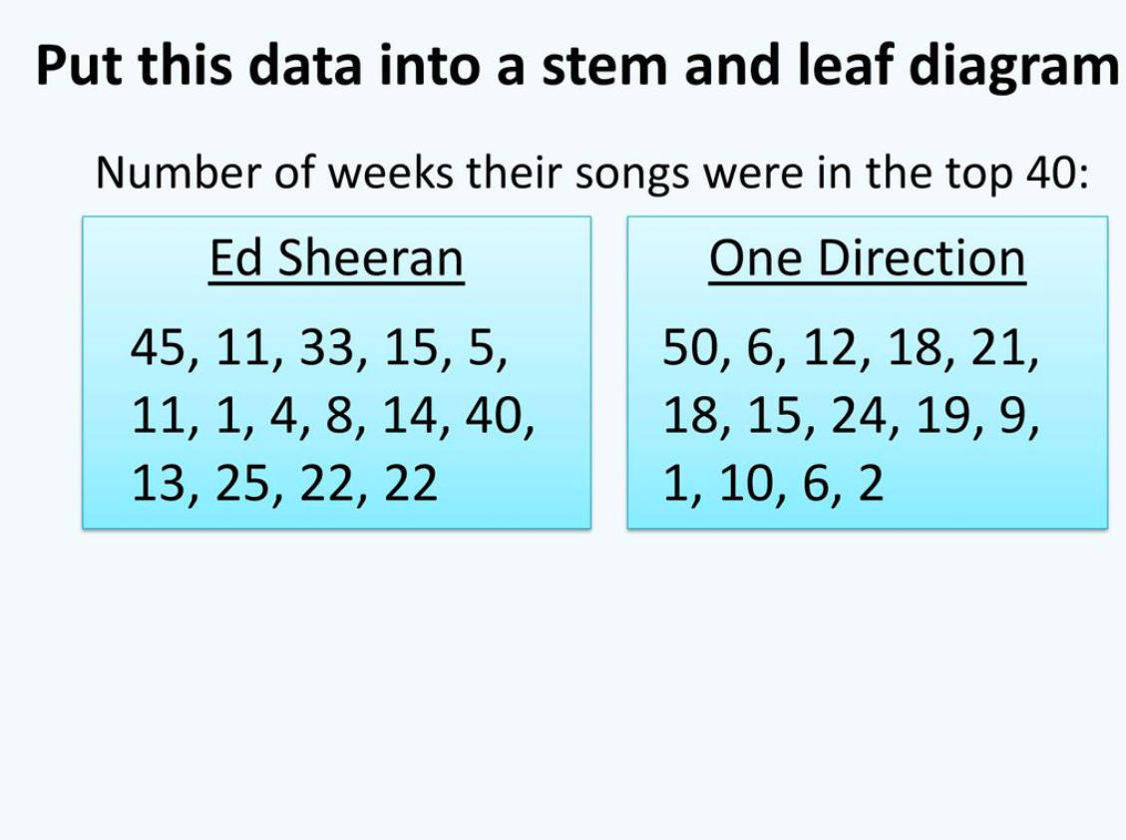

Slide 8
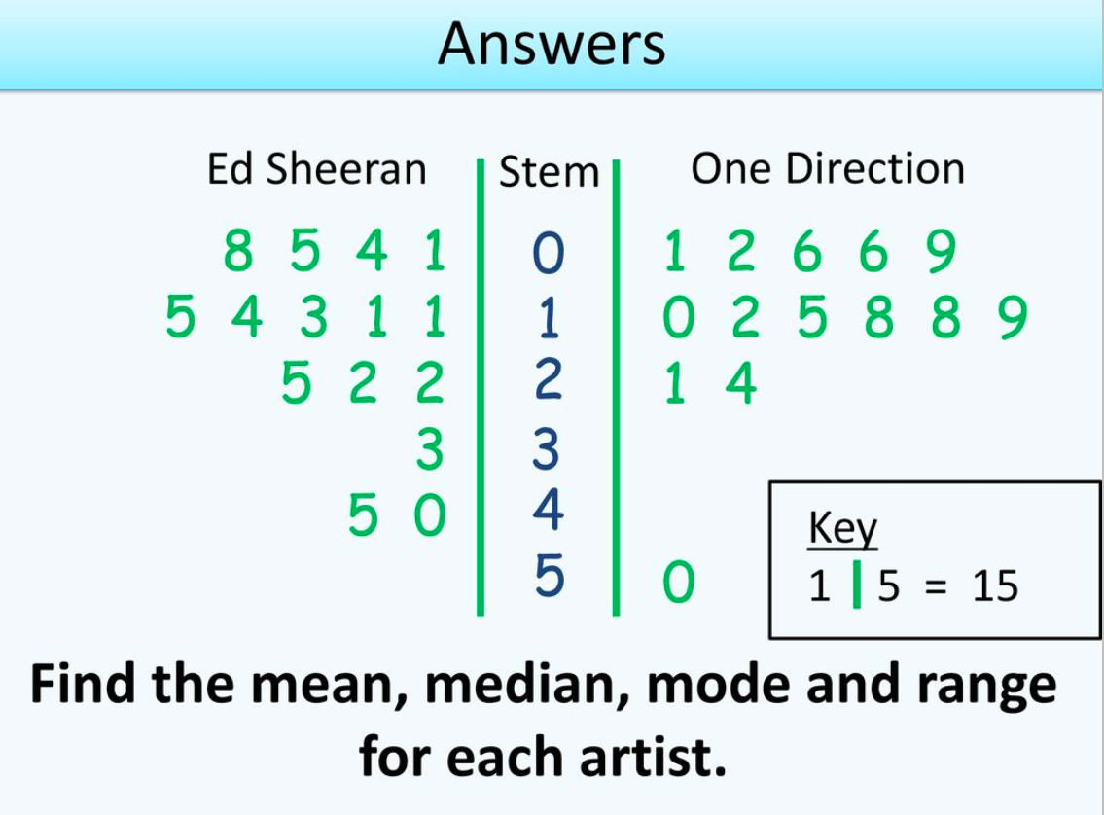

Slide 9
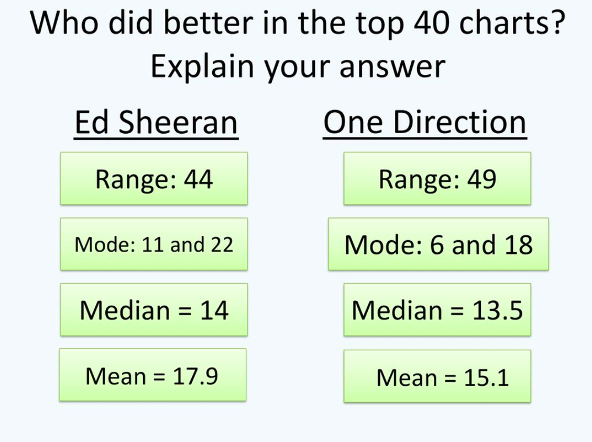

Slide 10
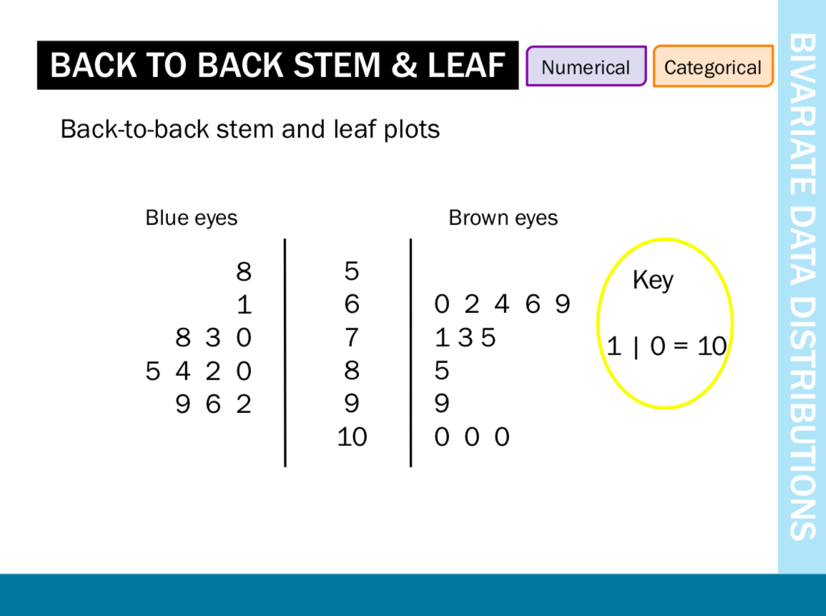

Slide 11
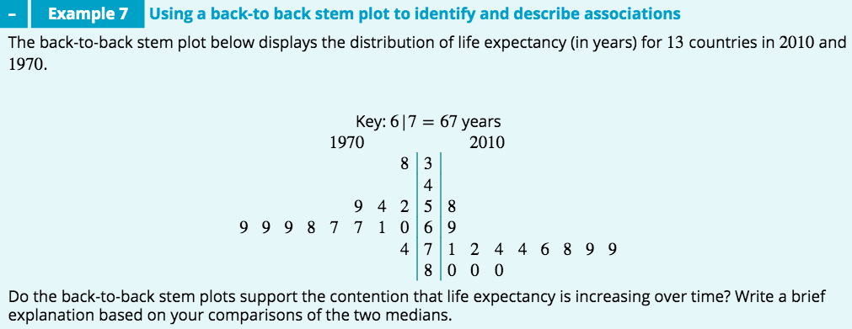
M=76
M=67
Yes: the median life expectancy in 2010 (𝑀=76 years) is considerably higher than the median life expectancy in 1970 (𝑀=67 years). This indicates that life expectancy is increasing over time.

Slide 12
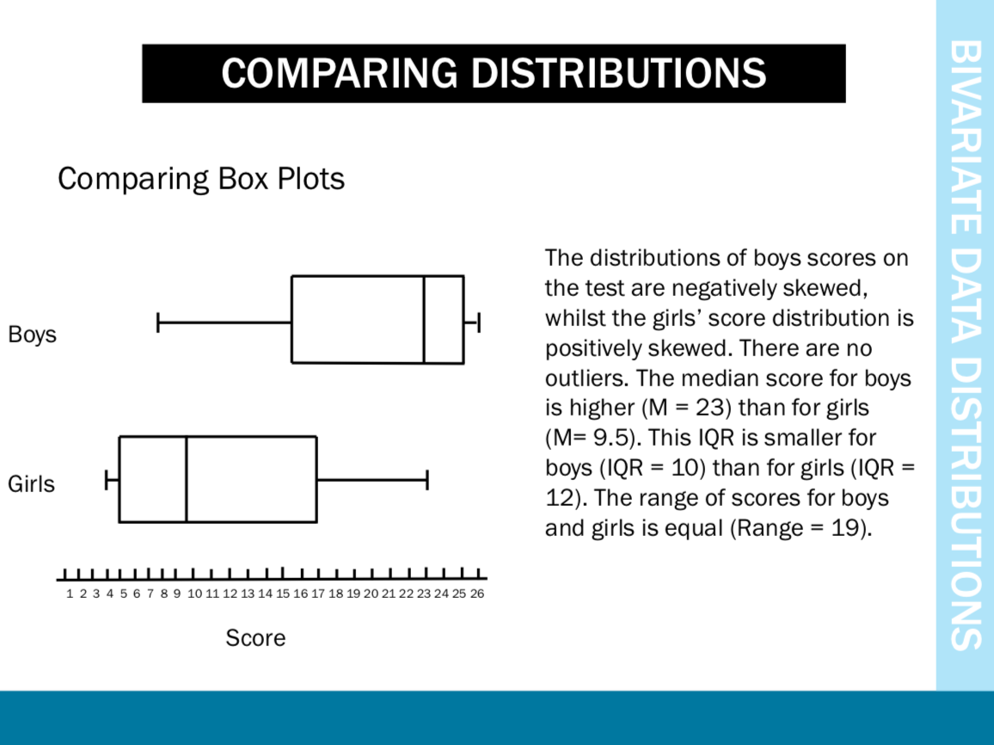


Slide 13
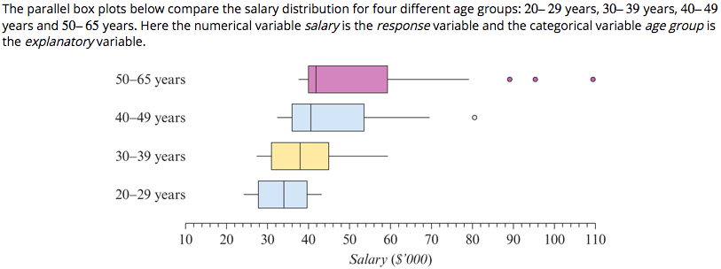
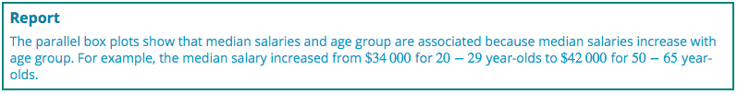


comparing medians
comparing 𝐼𝑄𝑅s and/or ranges
comparing shapes.

Slide 14
exercises & Summary Book
1. Ex page 2B
2. Summary notes

