Slide 1

Associations between two numerical variables
2C
Notes:
https://create.kahoot.it/details/5baa8445-f785-40f3-9491-a8d0cd07fe1b
https://create.kahoot.it/details/b19d1fc1-eba5-4443-8950-5c3535a17d7c
https://create.kahoot.it/details/3879379c-0410-4b45-96af-398d48e9f154
https://create.kahoot.it/details/66ed0e26-b382-4954-917b-1489f5238c2f

Slide 2
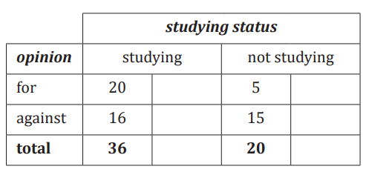
Which one is EV? Which one is RV?
How to calculate Percentage?
How to use CAS to do a Grouped Bar Chart?

Slide 3
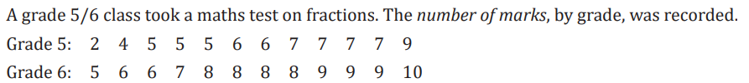
Which one is EV? Which one is RV?
What kind of graphs can we use?
How to use CAS do Parallel Box Plot?

Slide 4
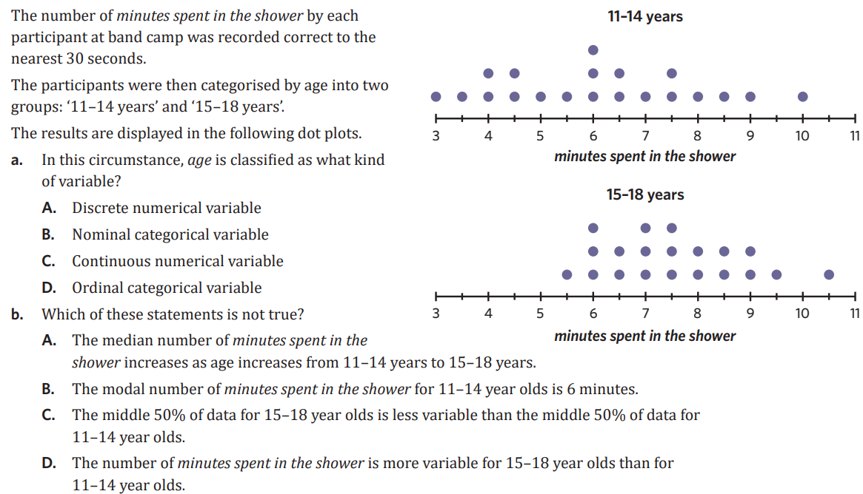

Slide 5
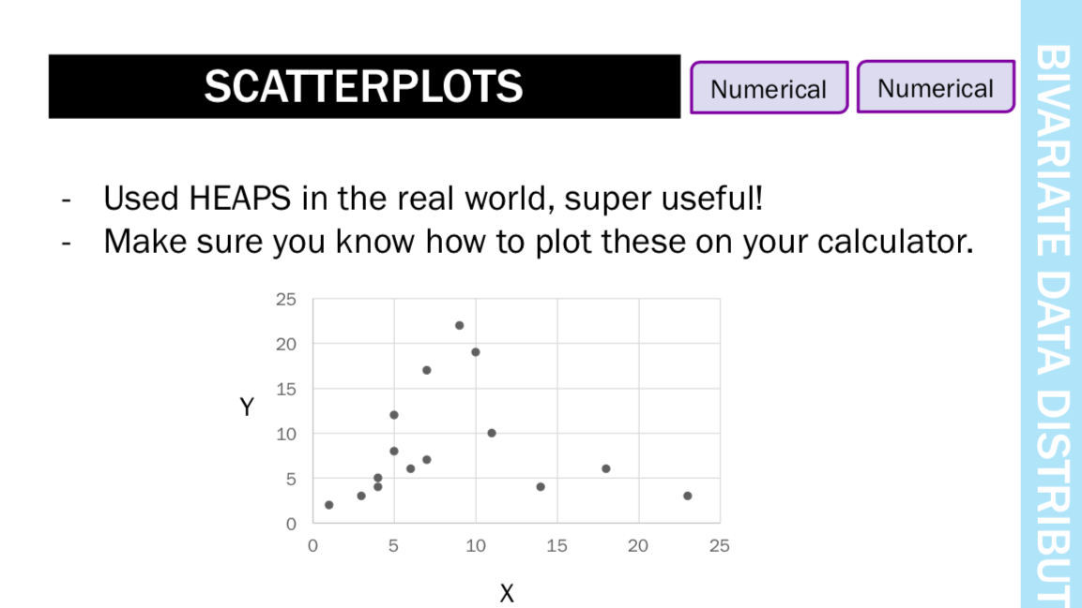

Slide 6

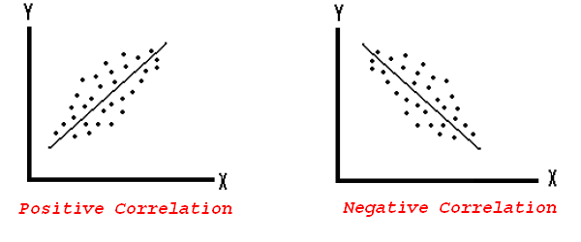


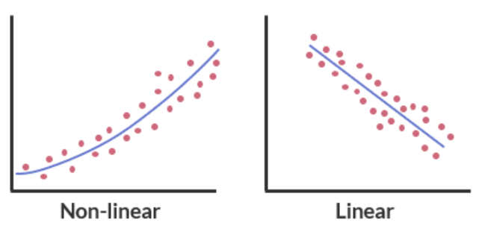
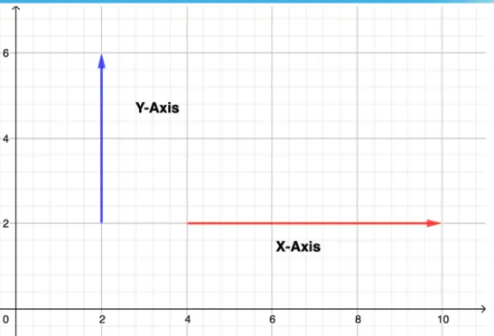
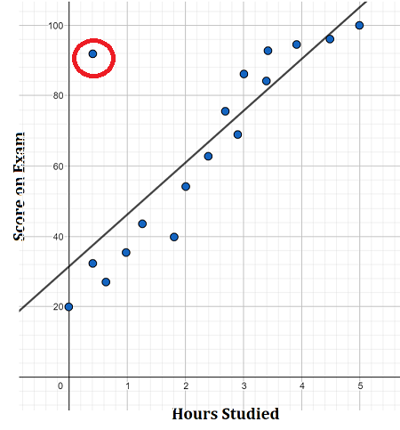
2C : association b/w 2 variables:
scatterplots.
bivariate data: two variables are analysed to determine an association
EXPLANATORY VARIABLE (EV):
can be used to predict or explain the changes observed in the RV.
RESPONSE VARIABLE (RV):
may be explained or predicted by changes in the EV
“ EV explains the RV ”
eg:
“ temp explains the time of day ” ✗
OR
“ time of day explains the temp ” ✓
constructing scatterplots:
see CAS notes sheet
describing relationships b/w 2 variables / scatterplots:
strength: weak, moderate or strong
weak = wide band of points
strong = narrow band of points
direction: positive or negative
- positive = RV ↑ as EV ↑
- negative = RV ↓ as EV ↑
form: linear or non-linear
- outliers: a point away from
rest of graph
See hand out
Non-linear
Linear
RV
EV
outlier
Notes:
Board notes

Slide 7
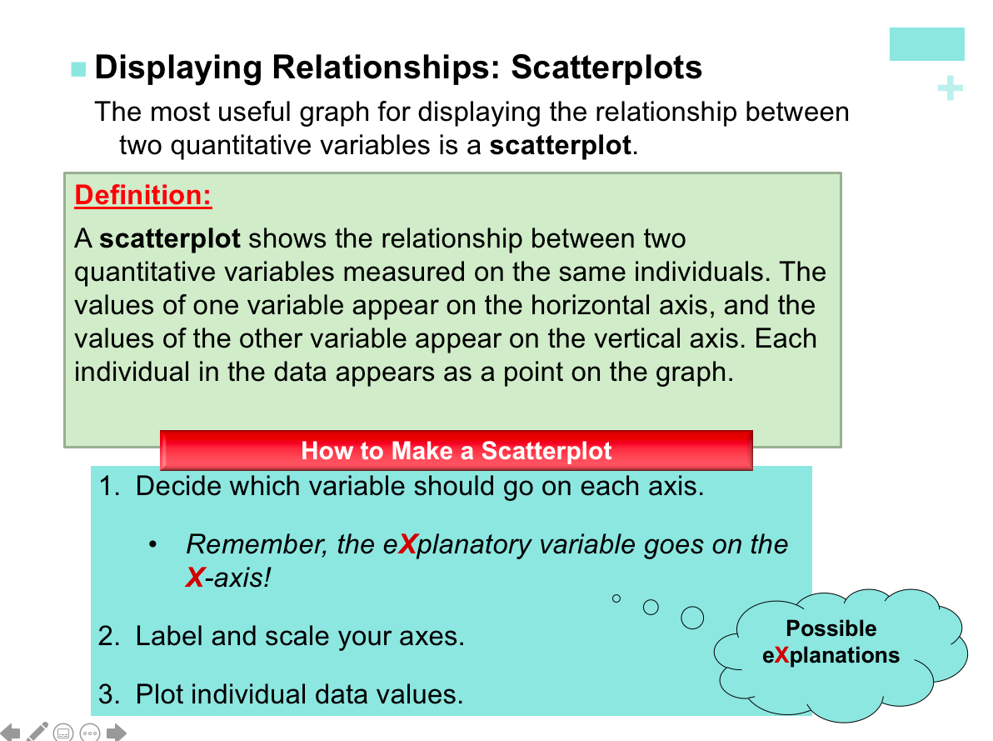

Slide 8
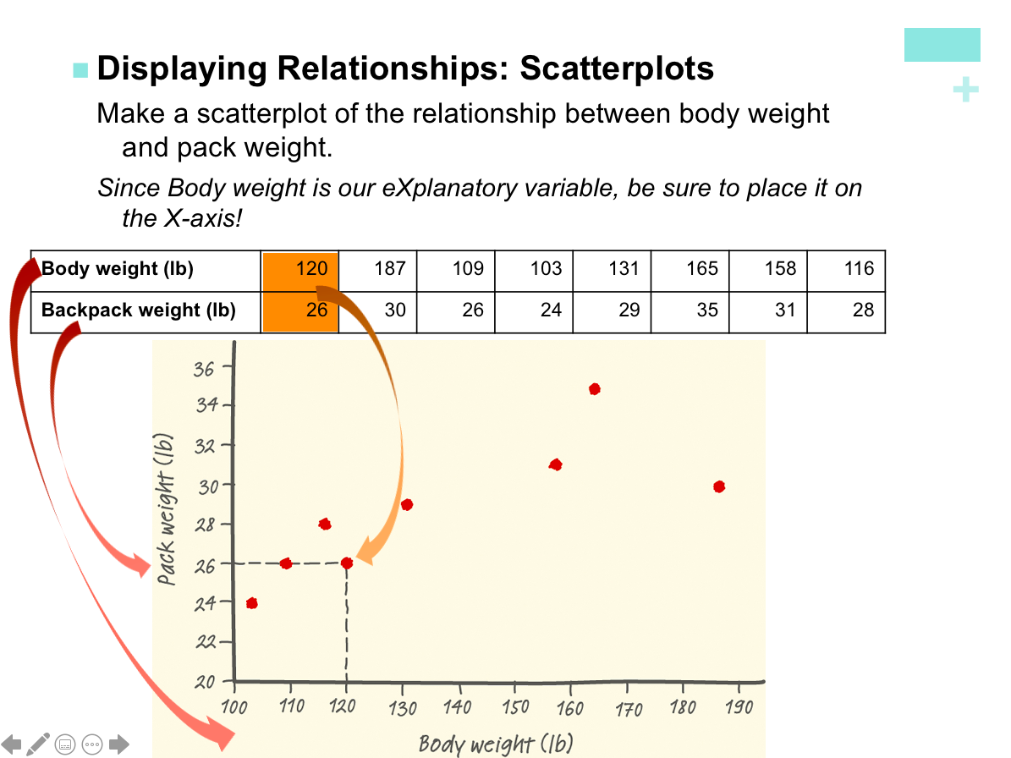

Slide 9
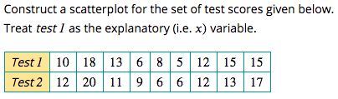
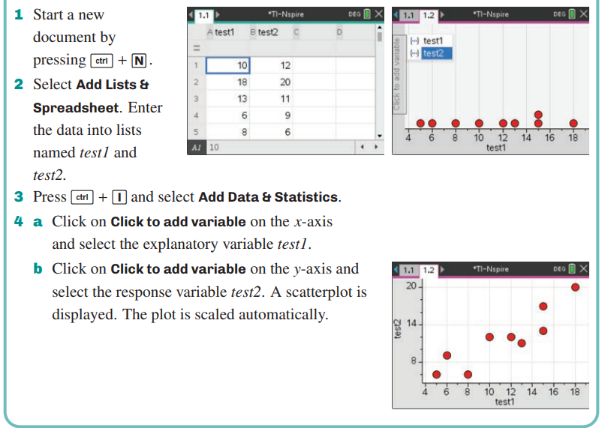
How to construct a scatterplot using CAS
CAS Notes 2.1

Slide 10
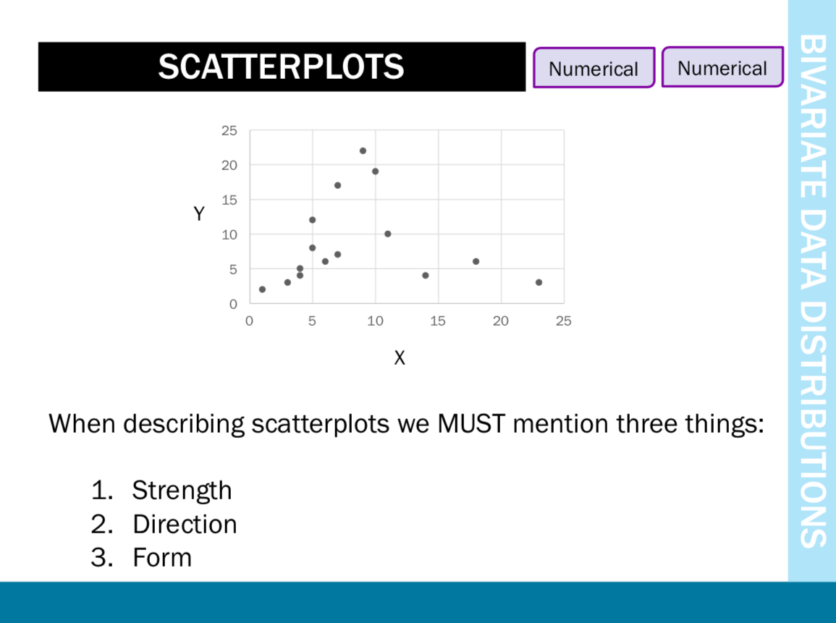

(RV)
(EV)

Slide 11
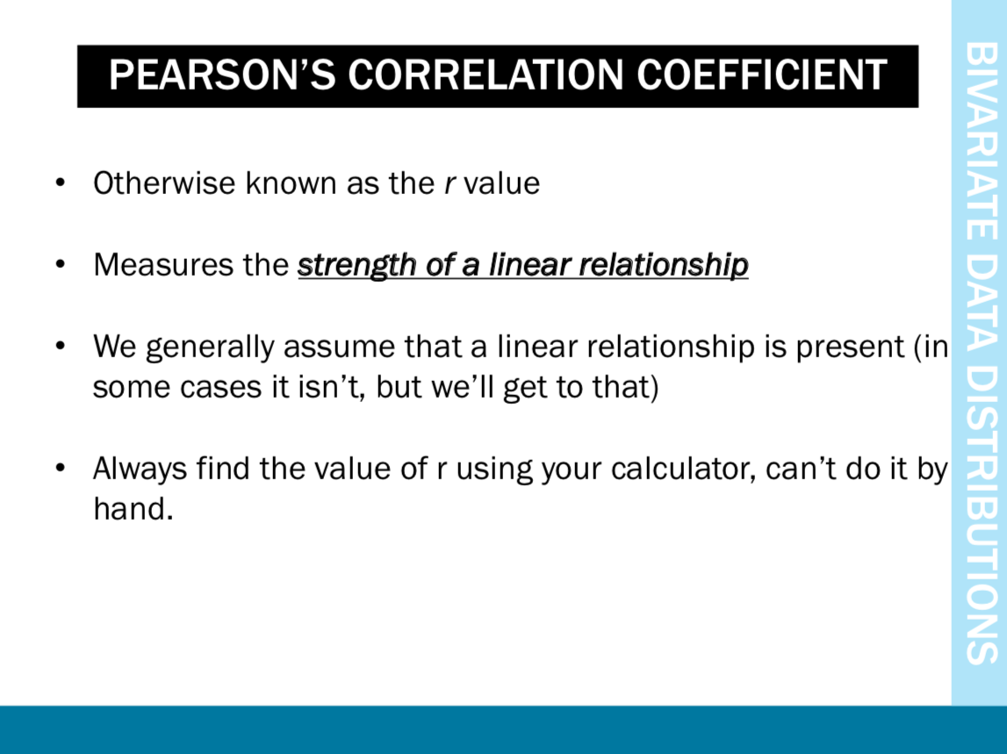
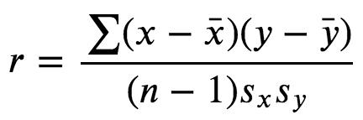

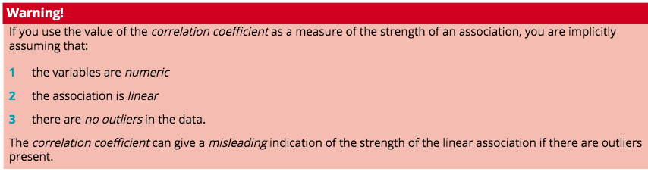
Strength

Slide 12
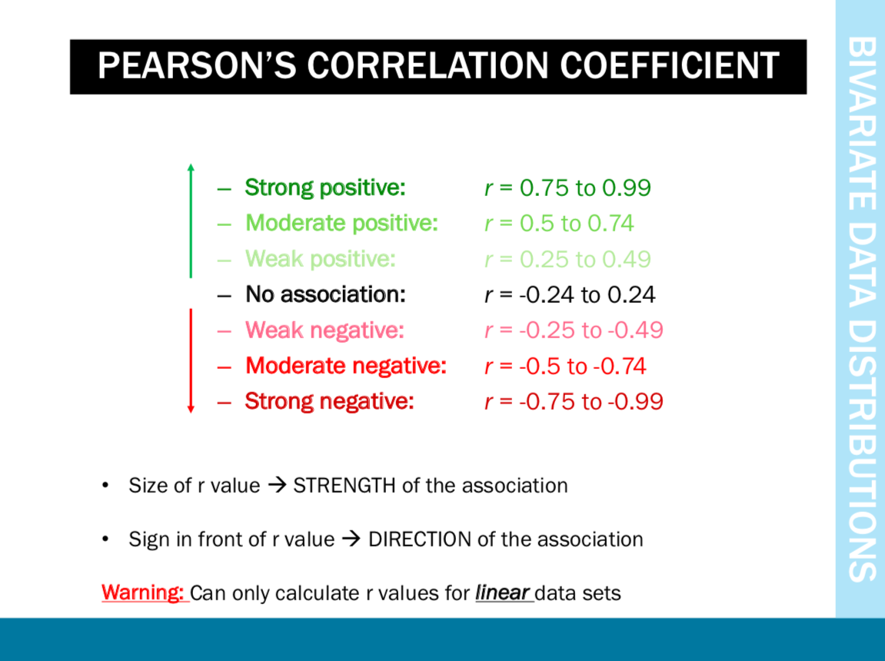
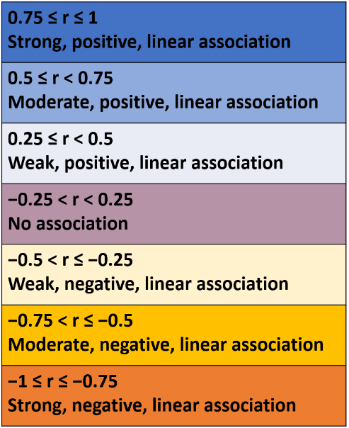

Strength
-1 ≤ r ≤ 1

Slide 13

Strength
𝑟=0
𝑟=+1
𝑟=−1
𝑟=−0.7
𝑟verbal,mathematical=+0.275
A weak positive linear association.
𝑟CO level,traffic volume=+0.985
A strong positive linear association between carbon monoxide level and traffic volume.
𝑟=+ 0.5
𝑟=−0.3
𝑟=+0.9

Slide 14
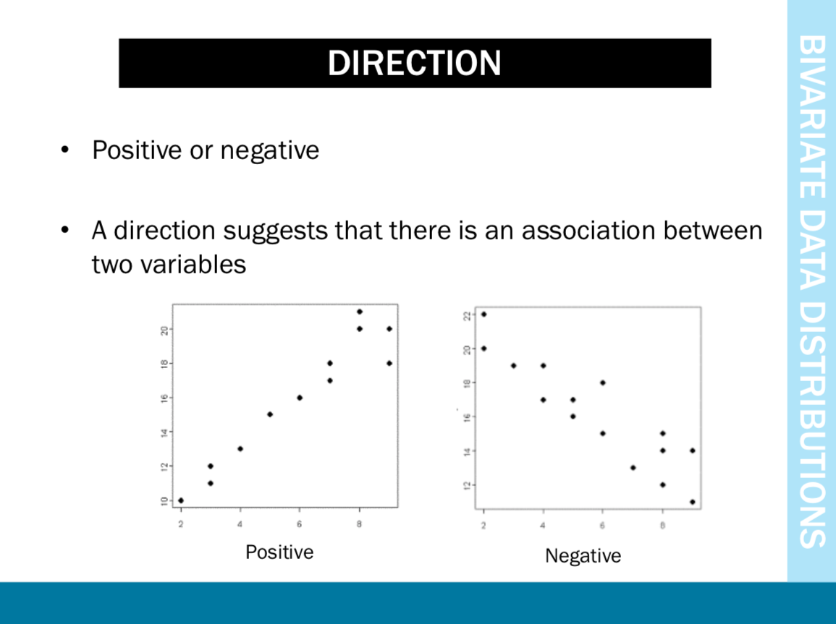

Slide 15
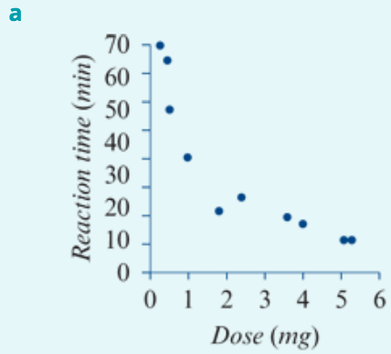
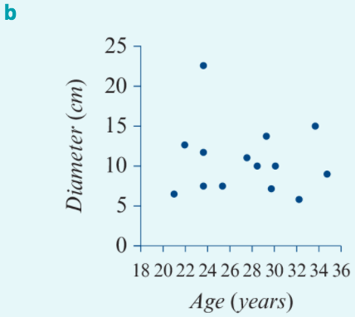
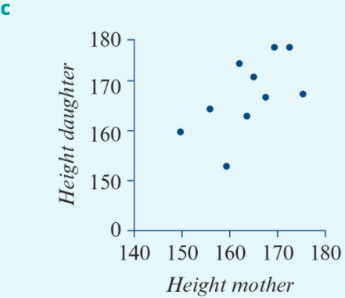
Direction
The direction of the association is negative. Reaction times tend to decrease as the drug dose increases.
There is no association between diameter and age.
The direction of the association is positive. Taller mothers have taller daughters.

Slide 16
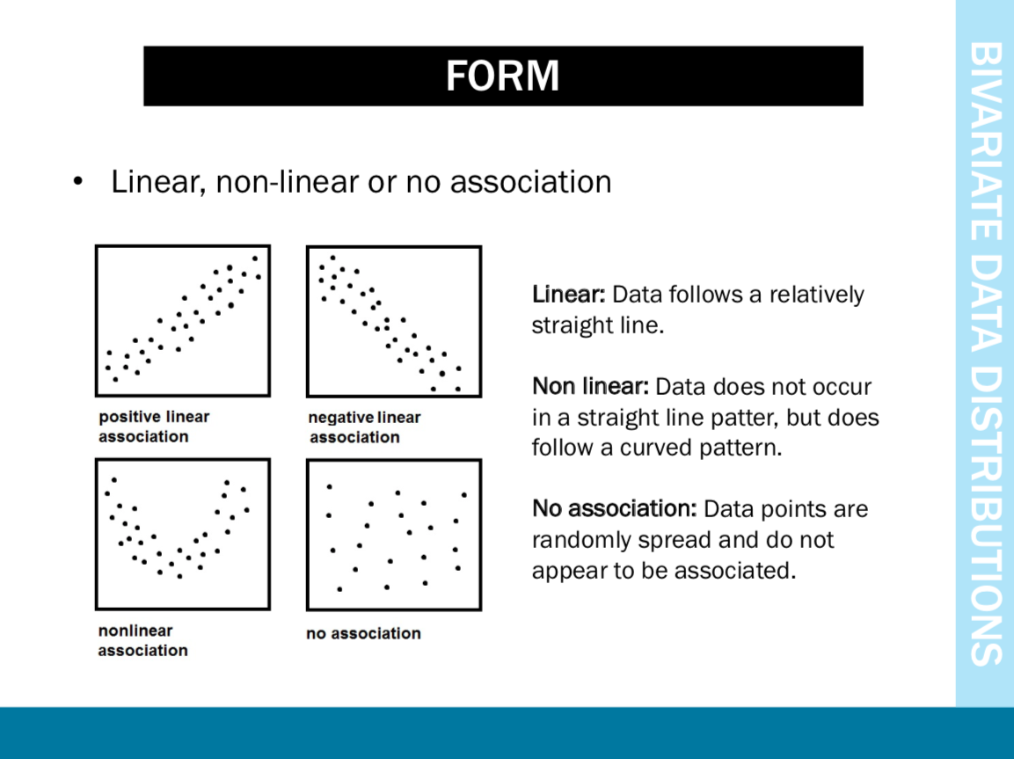

Slide 17
Form
The association is linear.
The association is linear.
The association is non-linear.

Slide 18
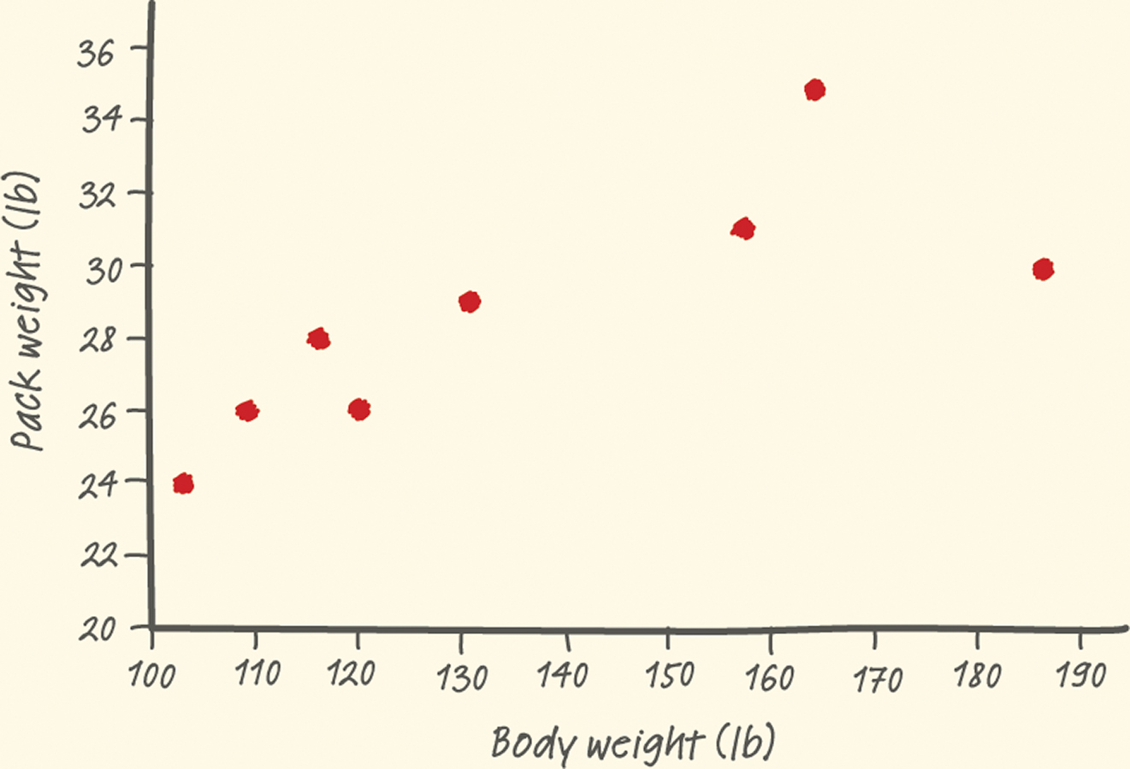
Scatterplots and Correlation
Interpreting Scatterplots
Outlier
There is one possible outlier, the hiker with the body weight of 187 pounds seems to be carrying relatively less weight than are the other group members.
Strength
Direction
Form
There is a moderately strong, positive, linear relationship between body weight and pack weight.
It appears that lighter students are carrying lighter backpacks.

Slide 19
    exercises & Summary Book
1. Ex page 2C
2. Summary notes

