Slide 1

Data Types
1A

Slide 2

Titanic
The ship Titanic sank in 1912 with the loss of most of its passengers
809 of the 1,309 passengers and crew died
  = 61.8%
Statistics: Did class (of travel) affect survival? Were ‘wealthy’ people more likely to survive on board the Titanic?
Notes:
Ask the audience what the null and hypothesis might be, what type of data we would have and what test we should consider using.

Slide 3
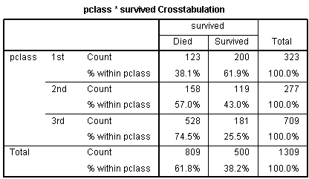
Did class (of travel) affect survival? Were ‘wealthy’ people more likely to survive on board the Titanic?
%’s within each class are preferable
Notes:
The question of interest is whether the class of an individual affected their chance of survival.
As there are different numbers in the classes, the percentages within those who died are misleading in option 1. There were 709 people in 3rd class but only 323 and 277 in 1st and 2nd class respectively so we would expect a higher % of 3rd class people in both the died and survived categories. It’s clear that people in the lower classes were much more likely to have died. 74.5% of those in 3rd class died but only 38.1% of those in 1st class.

Slide 4
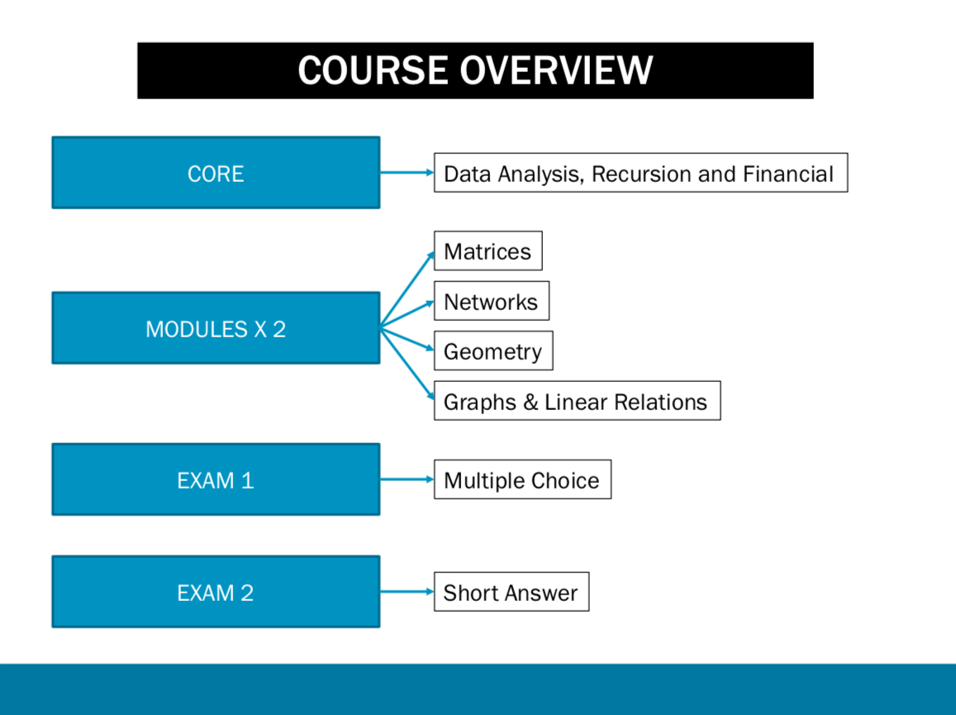
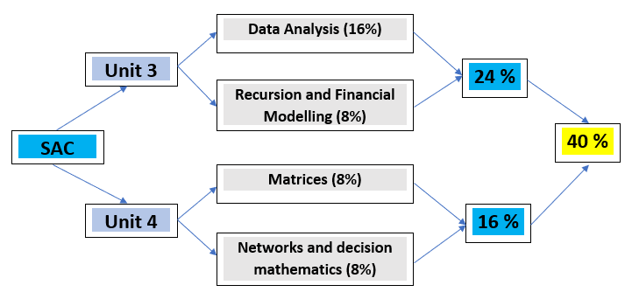
School Assessment Coursework SAC

Slide 5
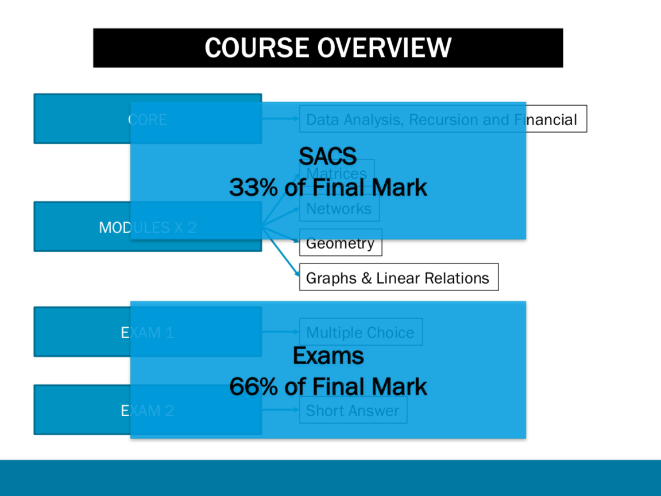
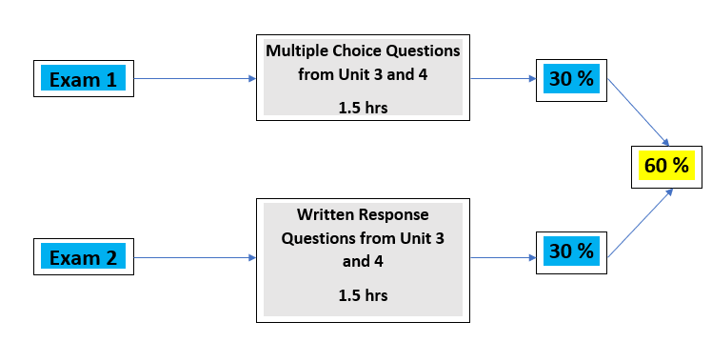
External Exams
34

Slide 6
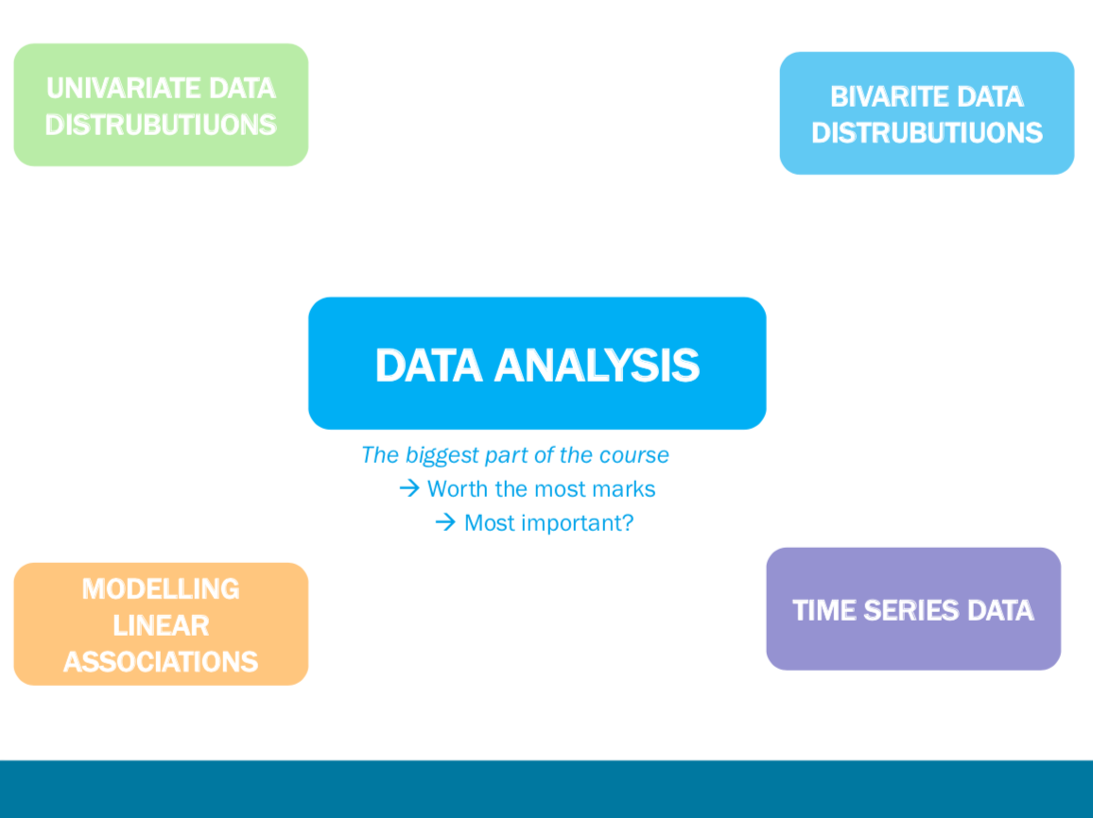

Slide 7
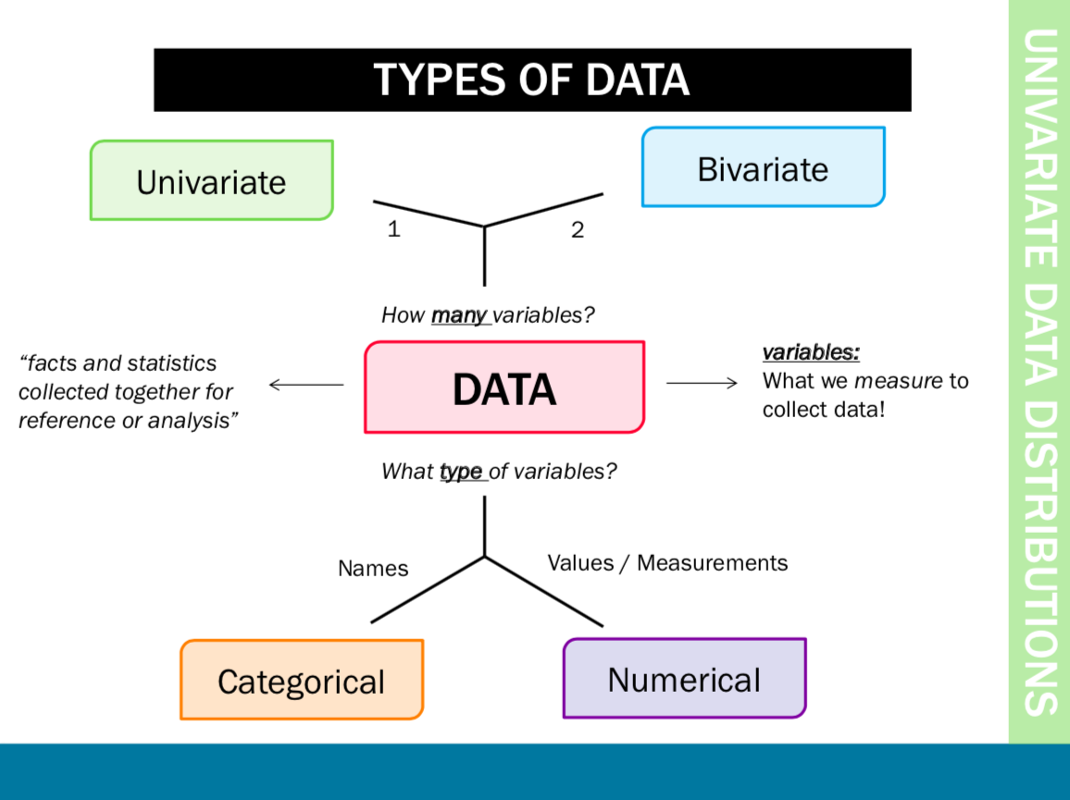

Slide 8
1A Data Types
numerical categorical
• quantities • characteristics
• numbers • qualities
discrete continuous nominal ordinal
• whole numbers • decimal numbers • group according • can be grouped
• can be counted • can be measured to characteristics and ordered
• # students in each class • height • hair/eye colour • maccas fries
• # cars in a car park • weight • favourite sport Size (S-m-L)
• # siblings • temperature • fare animal • months of the year
• amount of rain

Slide 9
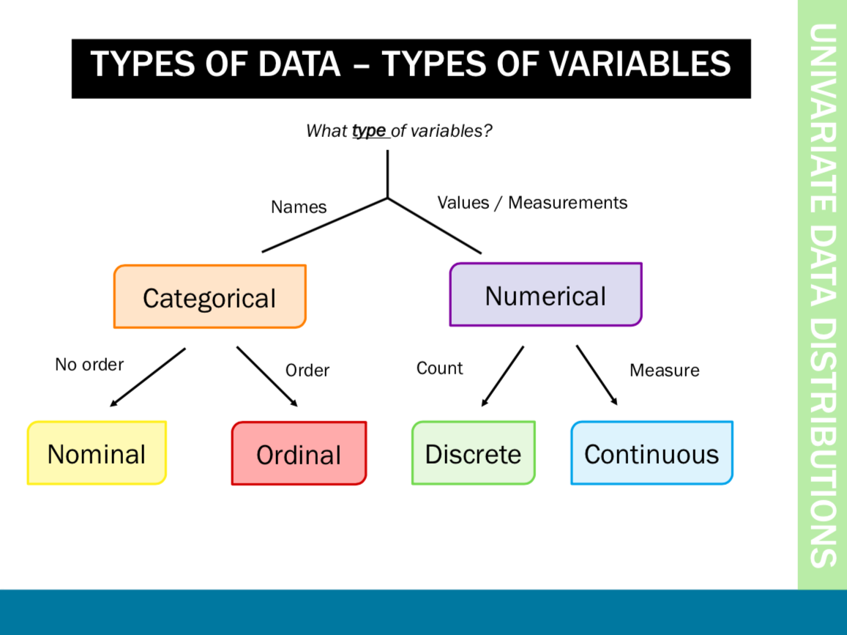

Slide 10
Data types
Data Variables
Numerical:
Measured/ counted data
Categorical:
appear as categories
Tick boxes on questionnaires
Notes:
What types of data are there? Within the data structure there are observations or individuals, and for each observation there are data variables. These variables can be classified into two main groups, Numerical and categorical.
Categorical variables indicate categories and questions with categorical answers usually appear as tick boxes on questionaires. Numerical variables are either measurements or counts.

Slide 11





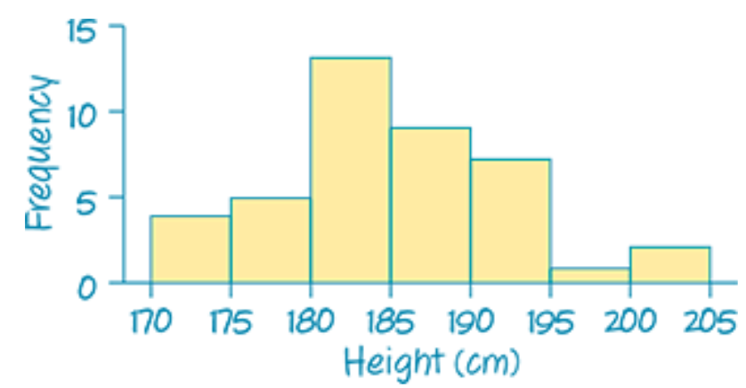
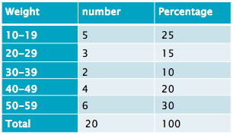
Data types
Variables
Numerical
Categorical
Continuous
Measurements
takes any value
Discrete:
Counts/ integers
Ordinal:
obvious order
Nominal:
no meaningful order
Notes:
Categorical variables can be divided into two: ordinal and nominal. If the categories are meaningfully ordered, the variable is ordinal; if it doesn’t matter in which way the categories are ordered, then the variable is nominal. For example, satisfaction levels (dissatisfied, satisfied and highly satisfied) and education level (secondary, sixth form, undergraduate and postgraduate) are ordinal variables; Student’s religion (Christian, Muslim, Hindu, etc) and favourite animal are nominal variables.
Numerical variables appear as meaningful comparable numbers, such as blood pressure, height, weight, income, age, and probability of illness etc. Numerical variables can be further divided into two subtypes: continuous and discrete. The continuous variables can take any value within a range and are the most common, e.g. body weight, height, income, etc. Discrete variables can only take whole numbers, such as number of students in class, number of new patients every day, etc but are treated as continuous for statistical analysis if there are a large range of numbers.
One point to make is that if ordinal data is scored as ranks such as 1, 2, 3 etc., and then this data is analysed as scale data, then a rather strong assumption is being made that the distances between the value of any pair of neighbouring ranks (e.g. 1 and 2 or 2 and 3 etc.) is the same, which is unlikely in practice to be true. Students often find the difference between ordinal and discrete difficult especially when ordinal is categorised as numbers
The point is that whilst this might not be the most interesting place to start – students need to be aware of the data they have since this affects what analyses are/not suitable.

Slide 12
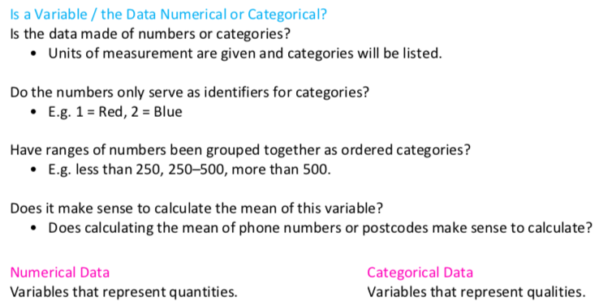

Slide 13
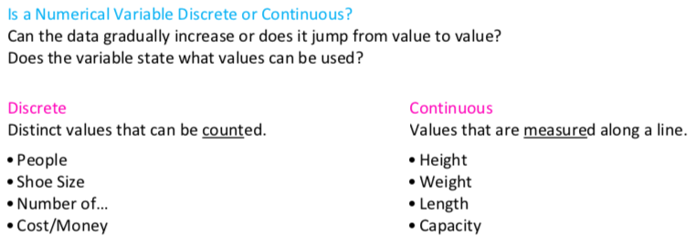

Slide 14
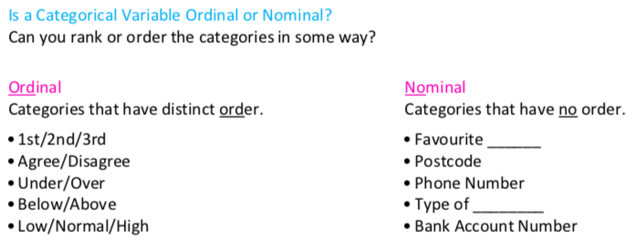

Slide 15
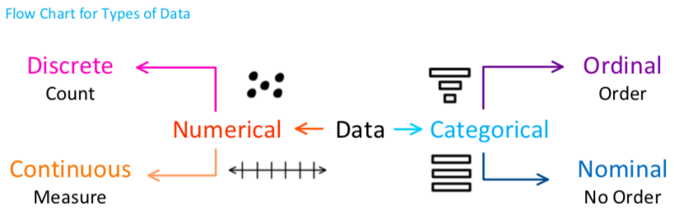

Slide 16
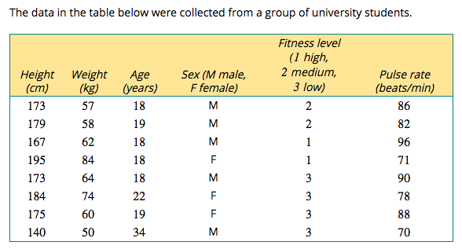

Slide 17
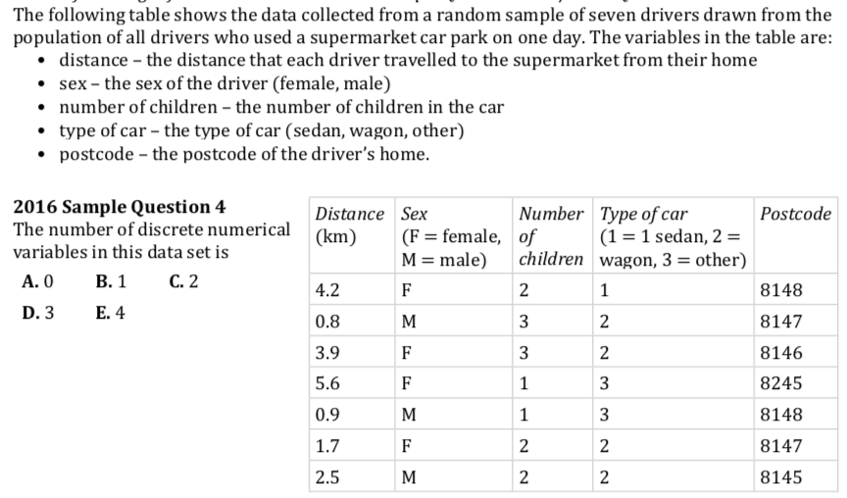

Slide 18
    exercises & Summary Book
1. Ex page 1-9, 11
2. Summary notes

