Slide 1

z-scores
1I
Notes:
https://create.kahoot.it/details/7d6f53b7-0165-40d8-9dcc-1a3cc2df942d

Slide 2
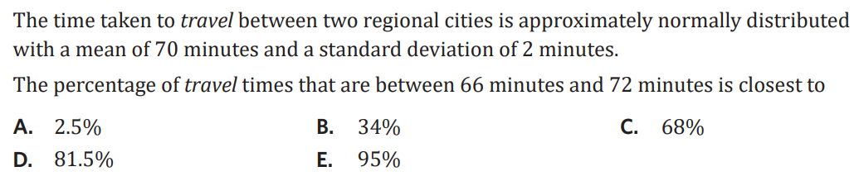
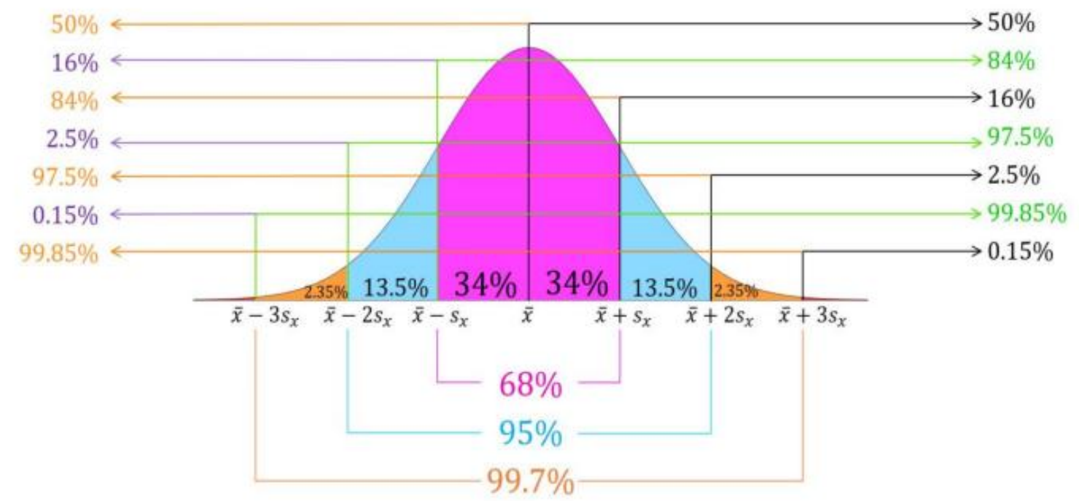
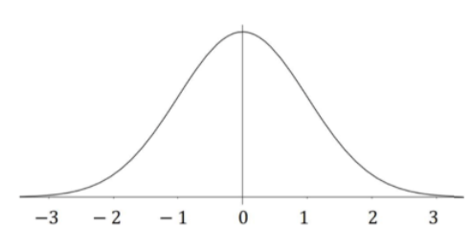

Slide 3

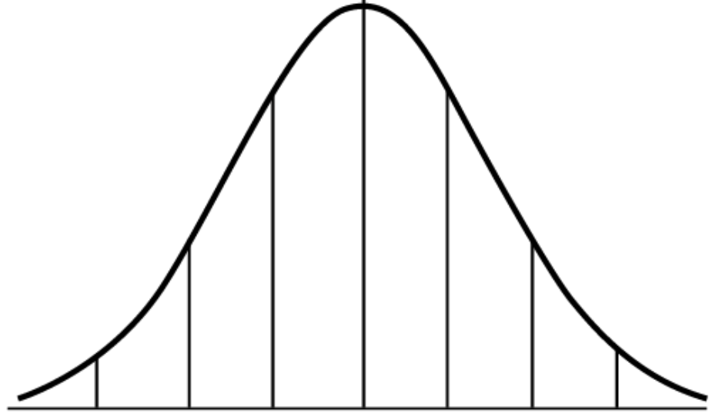
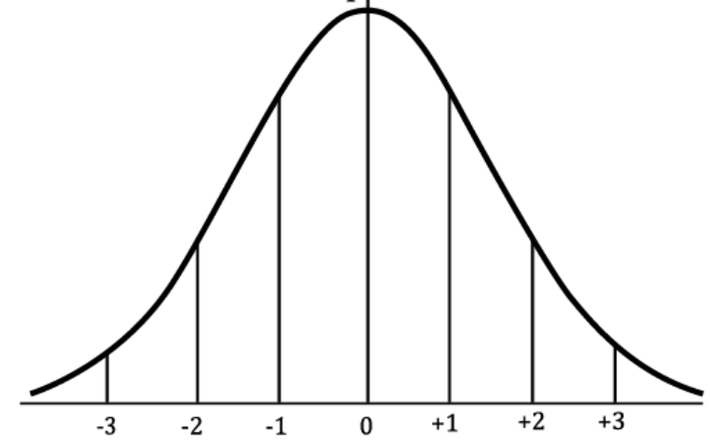
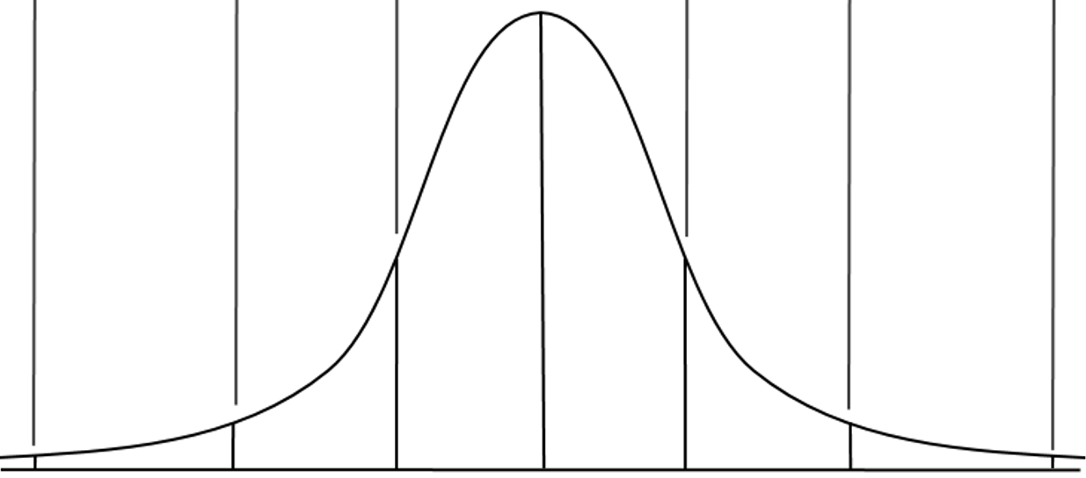
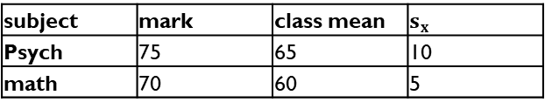


1I. z - scores
- "standardised score"
- provides a precise measure of the location of each data point in the normal distribution curve.
calculating z scores:
z = $\frac{x−\overline{x}}{s_{x}}$
z = standardised score
$x$ = actual data point
$\overline{x}$ = mean
$s_{x}$ = standard dev.
calculating actual scores:
$x$ = $\overline{x}$ + (z × $s_{x}$ )
these are the z-scores
examples:
1. The average height of this class is 170cm, the standard dev. is 8cm.
a. Joel is 190cm tall, what is his standardised score?
z = $\frac{x−\overline{x}}{s_{x}}$ = $\frac{190−170}{8}$ = 2.5
b. Tia’s z-score is −1.8, what is her actual height?
x = 170 + (−1.8 × 8)
= 155.6 cm
146 154 162 170 178 186 194
− 3 − 2 − 1 0 1 2 3
2. Which subject did Oliver do better in?
(determine the z-scores and interpret)
Oliver did better in maths (relative to the class) as the z-score is 2 compared to 1 in Psych.
Psych
35 45 55 65 75 85 95
Math 1
45 50 55 60 65 70 75
2
subject | mark | class mean | $s_{x}$
Psych | 75 | 65 | 10
math | 70 | 60 | 5
if z is:
+ above mean
− below mean
0 same as mean
13.5% 2.5% 0.15%
Tia’s
z=−1.8
Joel’s
z=2.5
2.5% 0.15%
Notes:
Board notes

Slide 4
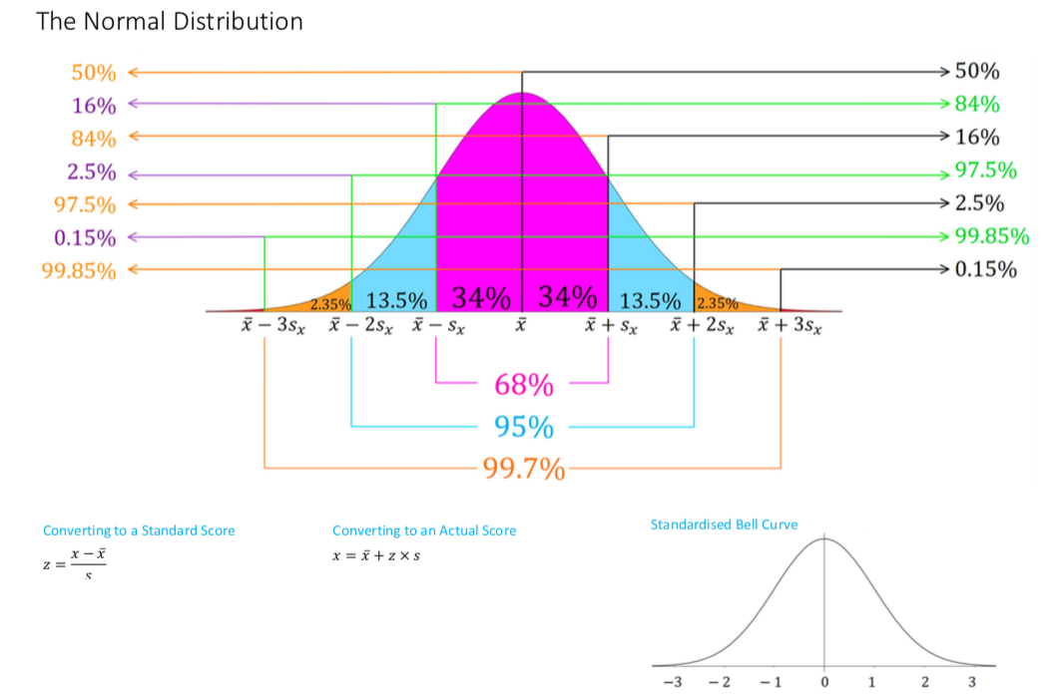

Slide 5
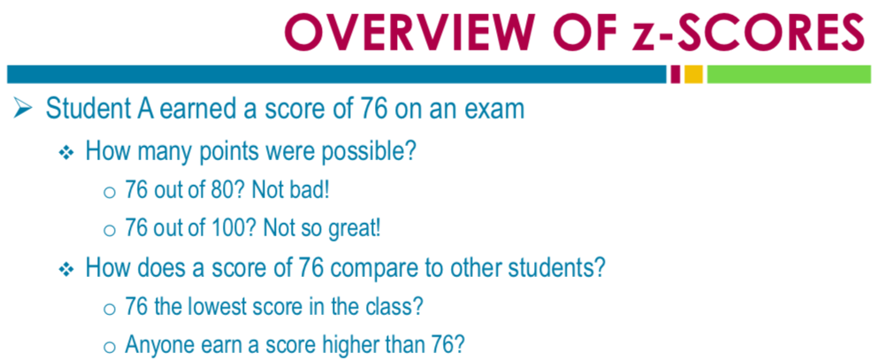
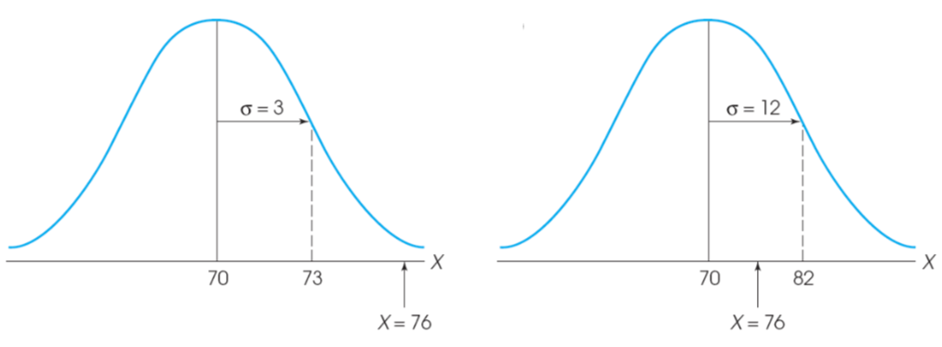
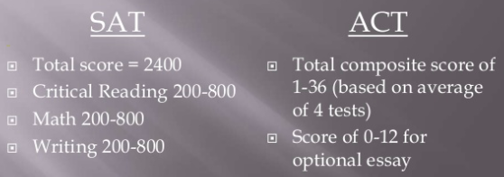

Slide 6
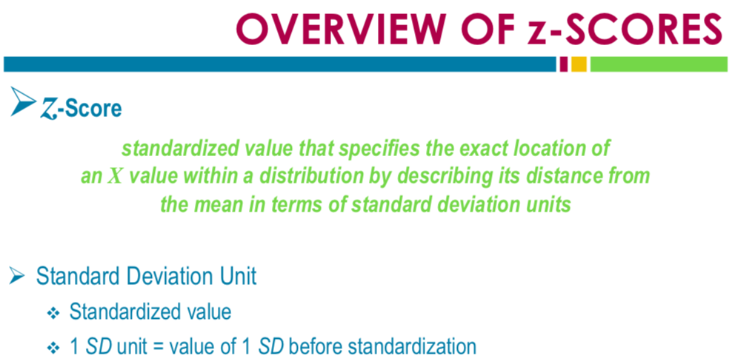
0 1
0 1

Slide 7
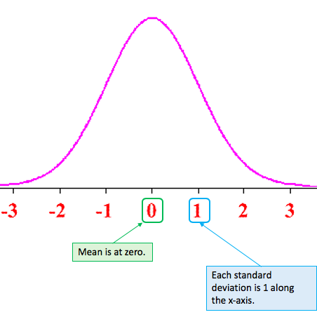

Standardised or z-scores
The value of the standard score gives the distance and direction of a data value from the mean in term of standard deviations.
The rule for calculating a standardized score is

Slide 8
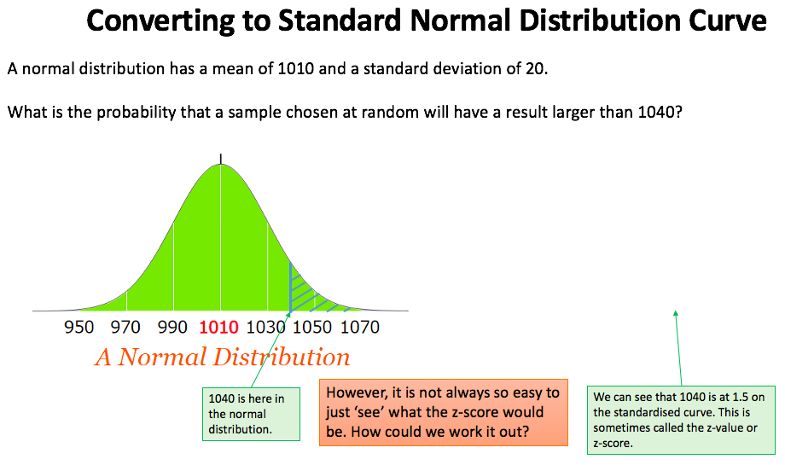

Slide 9
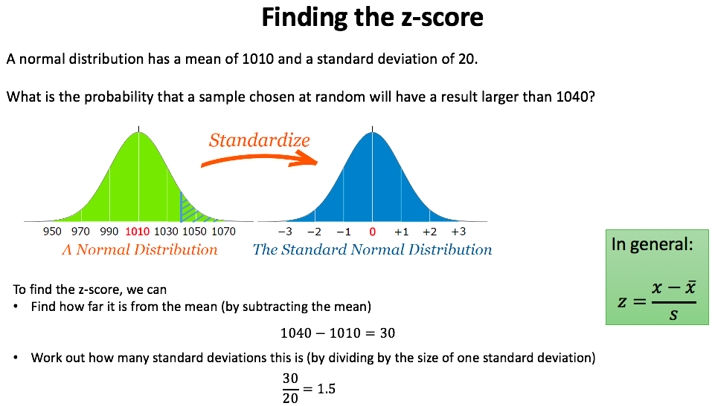

Slide 10
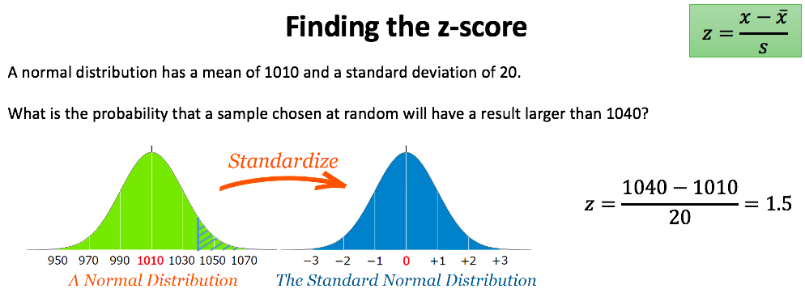
Above 93.32% of the sample group

Slide 11
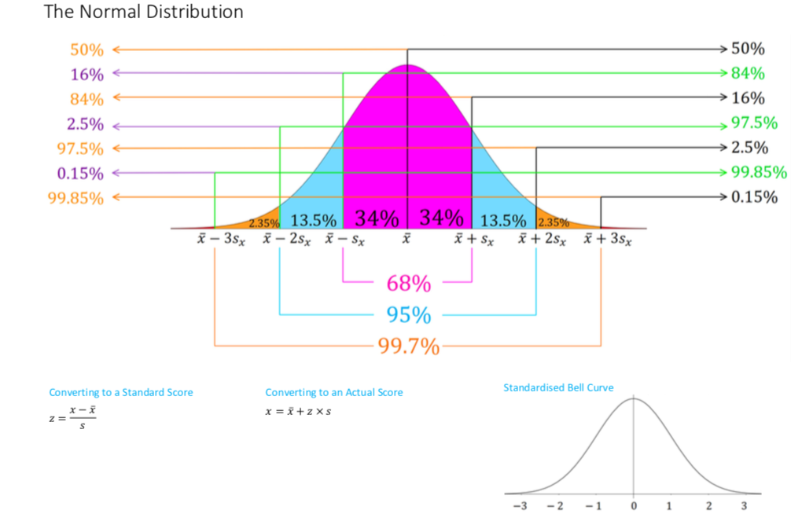

Slide 12
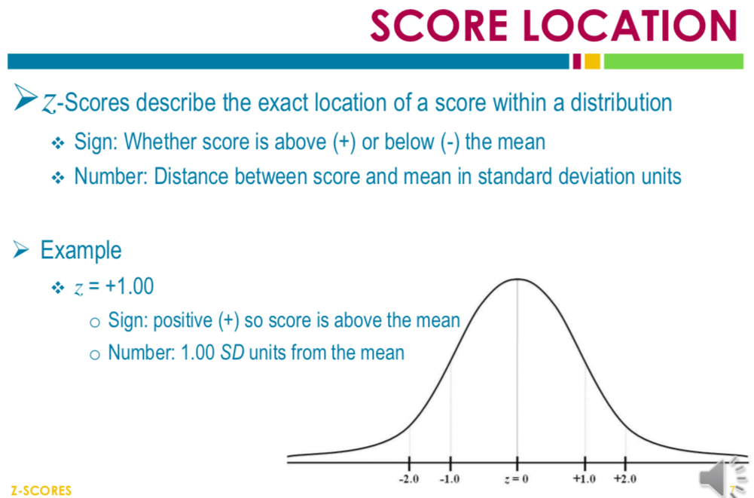
Above 84% of the sample group

Slide 13
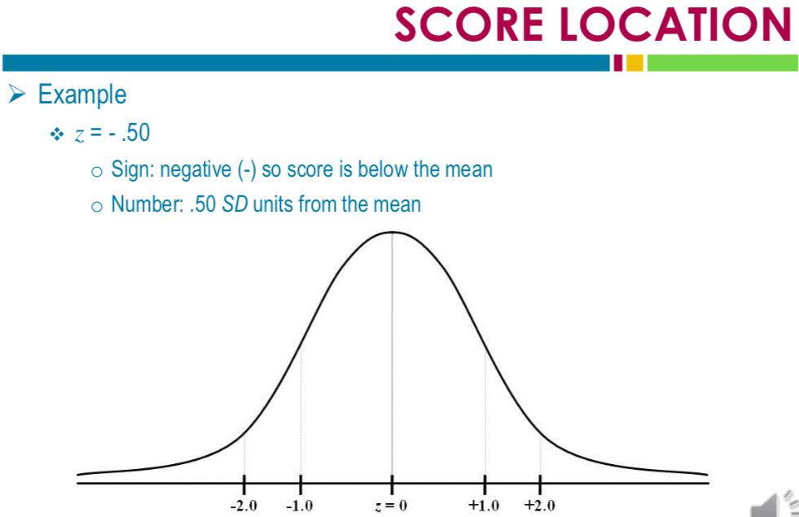
Above 30.85% of the sample group

Slide 14
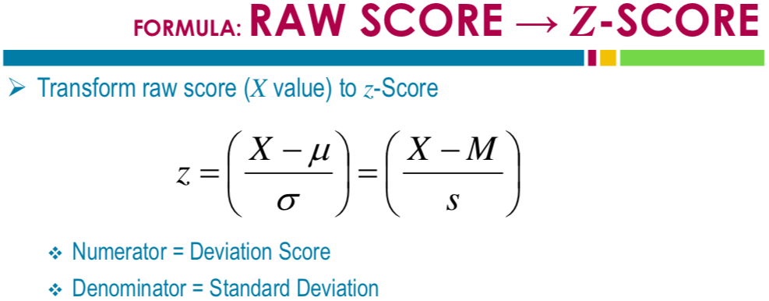

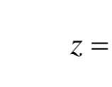

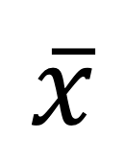
$$\overline{x}$$

Slide 15
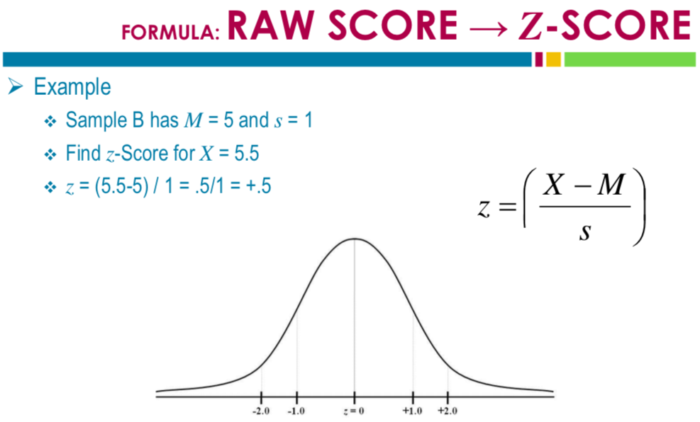

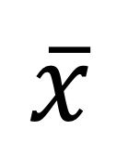
$$\overline{x}$$
$$\overline{x}$$
Above 69.15% of the sample group

Slide 16
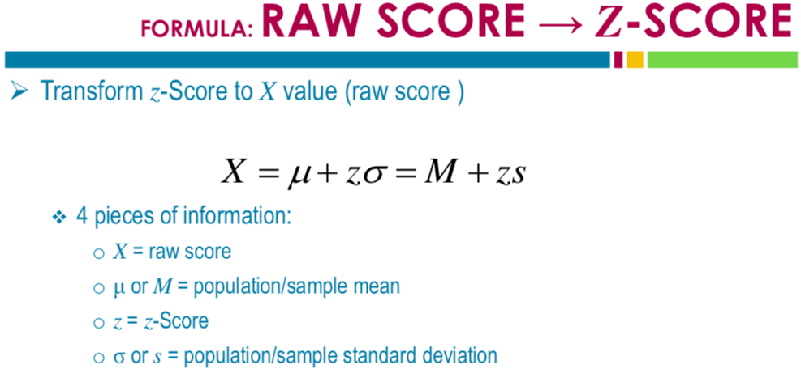




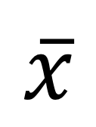
$$\overline{x}$$
$$\overline{x}$$

Slide 17
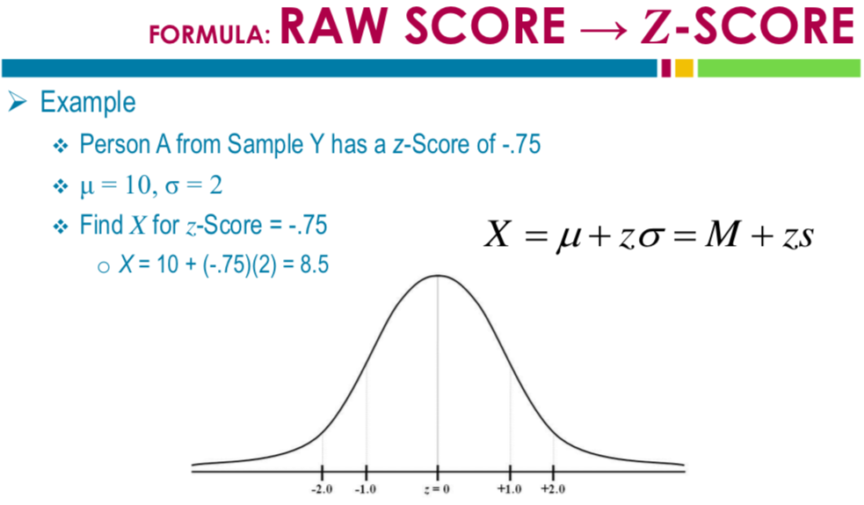




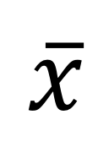
Above 22.66% of the sample group
$$\overline{x}$$
$$\overline{x}$$

Slide 18

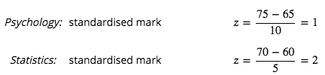
Which subject has the higher score?
Above 84.13% of the sample group
Above 97.73% of the sample group

Slide 19
Which class would you rather be in? Justify.
Class 1: mean=88.7%, SD= 1.2
Class 2: mean=65.6%, SD=3.4
Class 3: mean=71.2%, SD=0.75

Slide 20
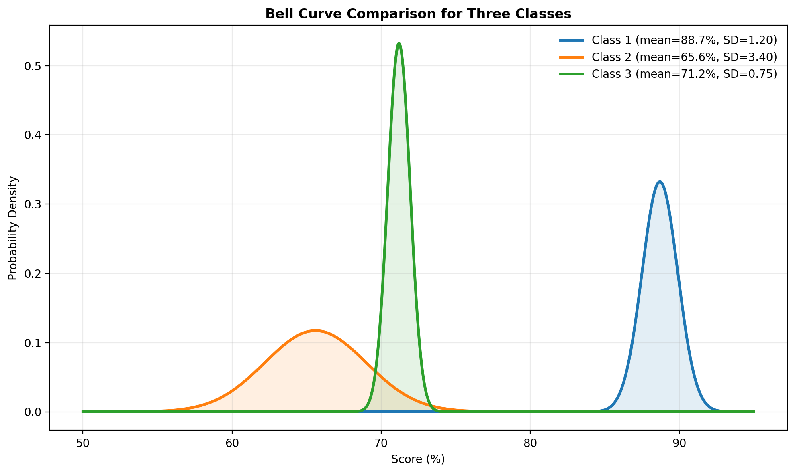
Which class would you rather be in? Justify.
Class 1: mean=88.7%, SD= 1.2
Class 2: mean=65.6%, SD=3.4
Class 3: mean=71.2%, SD=0.75

Slide 21
    exercises & Summary Book
1. Ex page 1I
2. Summary notes

