Slide 1

Interpreting a least squares regression line
3B
Key words: explain, interpret, show, residual, predict, scatter plot, equation, correlation coefficient, r value, coefficient of determination, r^2 value in %, y-intercept, slope, regression line, residual plot.
Slides 8-13, 17, 21
Notes:
https://create.kahoot.it/details/a5bdc5c0-bf42-4ad7-99bd-1eb8b93b93be
https://create.kahoot.it/details/a1ec0488-9619-480b-85a5-144a46f314f0
https://create.kahoot.it/details/b34fc759-7058-469b-aa87-c2a2e12422b6
https://create.kahoot.it/details/08a032d4-3683-4ed3-a37e-a4e0062415b6
https://create.kahoot.it/details/68bd89a6-b362-437a-b379-56209258272e
https://create.kahoot.it/details/91fa8455-d2f6-4909-99bc-b5e0e076bee0

Slide 2
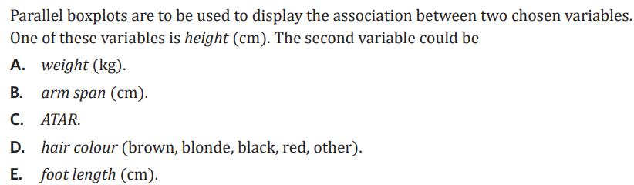

Slide 3
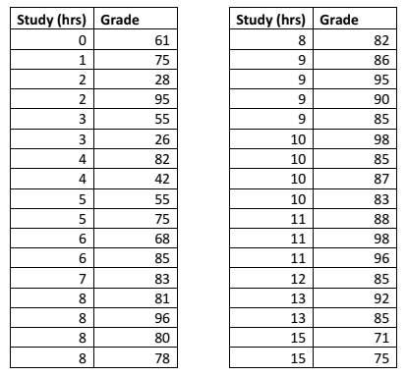
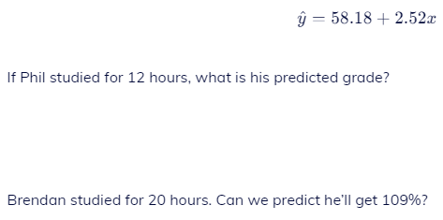
58.18+2.52*12=88.42
58.18+2.52*20=108.58
What is actual Grade value of 12 hours?
85
What is residual of 12 hours?
85-88.42= – 3.42
Notes:
Starter

Slide 4

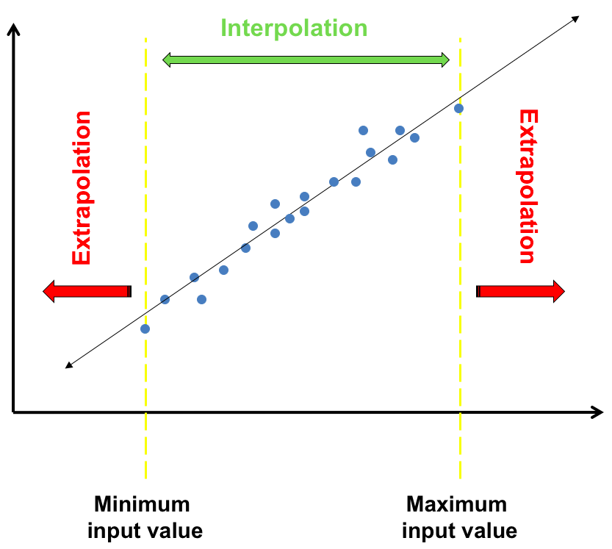


3B Interpreting + making predictions:
LSRL:
y = a + bx
RV y-int slope EV
interpret statements:
y-intercept (a): when the $\boxed{EV}$ EV is 0, the $\boxed{RV}$ is $\boxed{a}$
slope (b): for every one-unit increase in the $\boxed{EV}$ , the $\boxed{RV}$ increases/decreases by $\boxed{b}$
if b is $\boxed{+}$ choose increase
if b is $\boxed{\text{–}}$ choose decrease
fill variable names and a and b values!
making predictions:
* interpolation: predicting $\boxed{within}$the range of data
* extrapolation: predicting $\boxed{outside}$ the range of data
→ less reliable
* how to predict:
sub the EV value that you are predicting for into the LSRL equation to predict the RV
y = a + b x
predict for RV sub EV value here
Notes:
Board notes

Slide 5
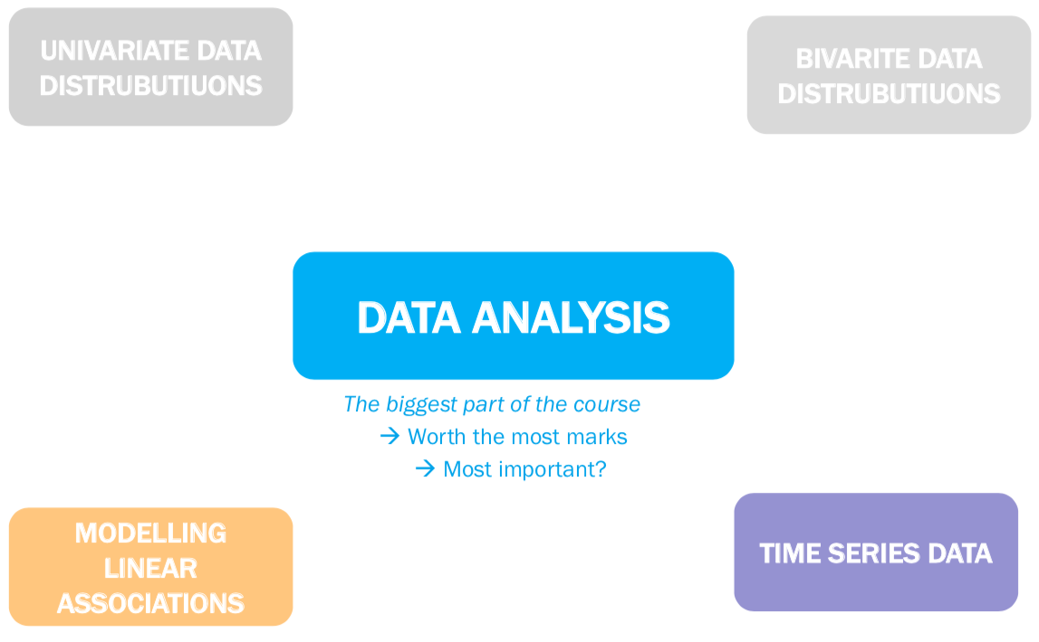

Slide 6
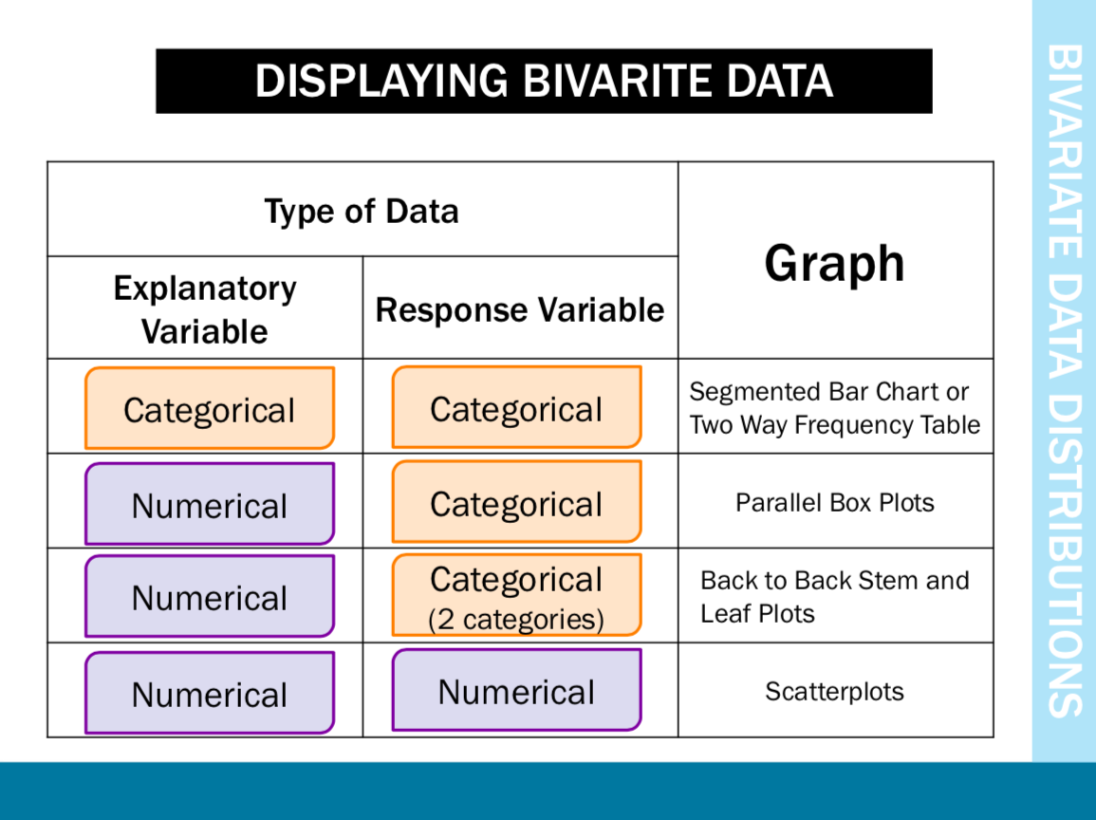

Slide 7
a scatterplot
correlation coefficient
the equation
𝑦-intercept (𝑎) and slope (𝑏)
investigate the nature of an association
indicate the strength of the relationship
Of the regression line
of the least squares line 𝑦=𝑎+𝑏𝑥
1
2
3
4
5
6
7
8
indicate the predictive power of the association
to make predictions
to test the assumption of linearity
on your findings
coefficient of determination
the regression line
residuals and a residual plot
writing a report

Slide 8
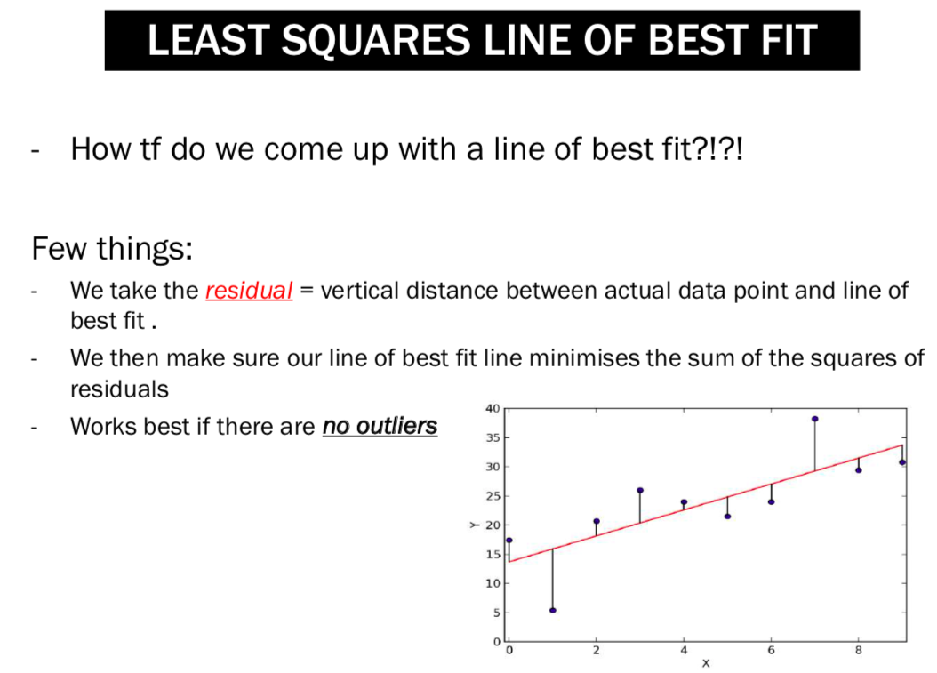

Slide 9
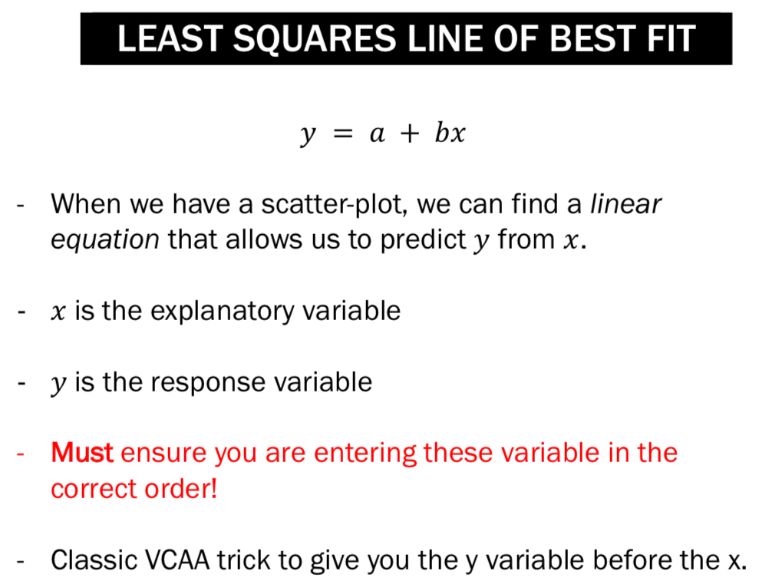

Slide 10

Is it Response, Explanatory Variable?
RV EV

Slide 11
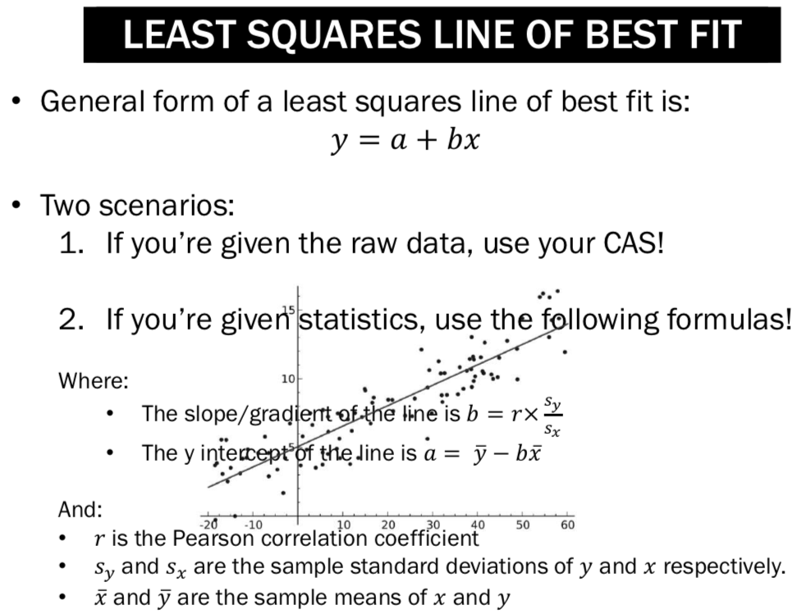


Two scenarios:
If you’re given the raw data, use Mathematica!
If you’re given statistics, use the following formulas!
Where:
The slope/gradient of the line is b=$\frac{rs_{y}}{s_{x}}$
The y intercept of the line is a= $\overline{y} −$ b$\overline{x}$
And:
r is the Pearson correlation coefficient
$s_{y}$ and $s_{x}$ are the standard deviations of y and x respectively.
$\overline{x}$ and $\overline{y}$are the means of x and y.

Slide 12
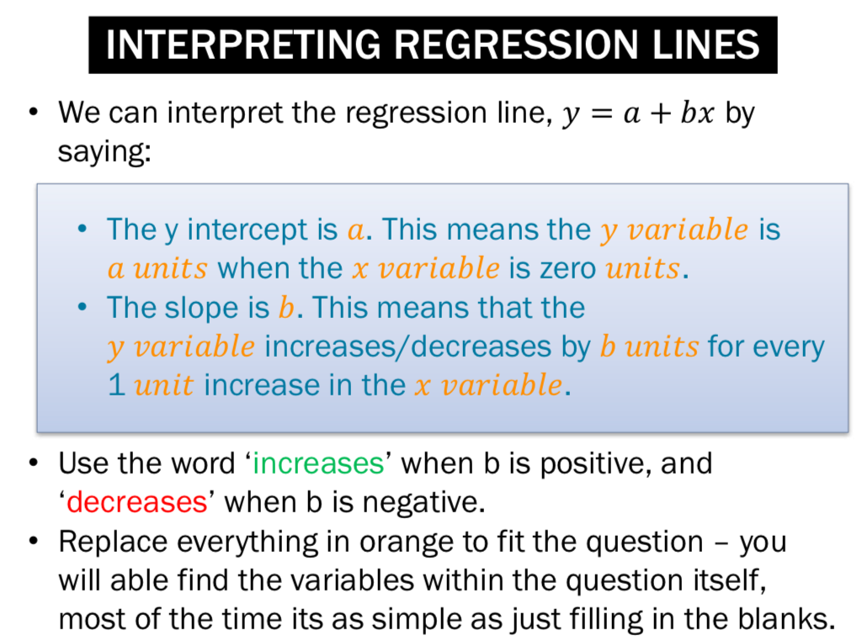
Notes:
Searching key words for questions: explain, interpret, show, residual, predict,

Slide 13
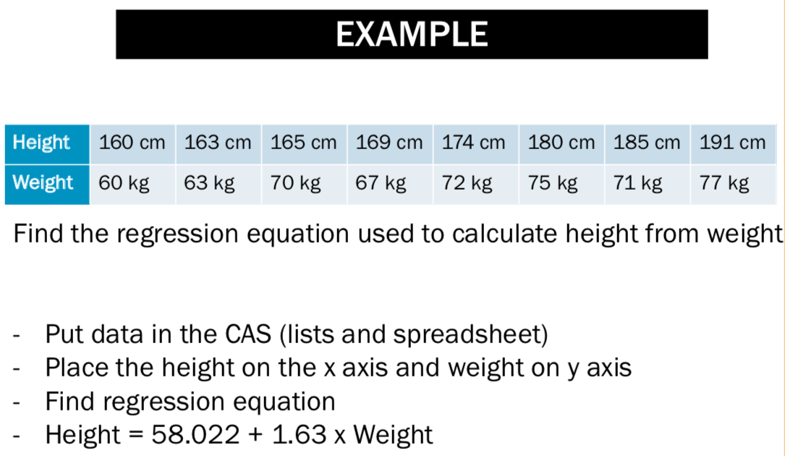
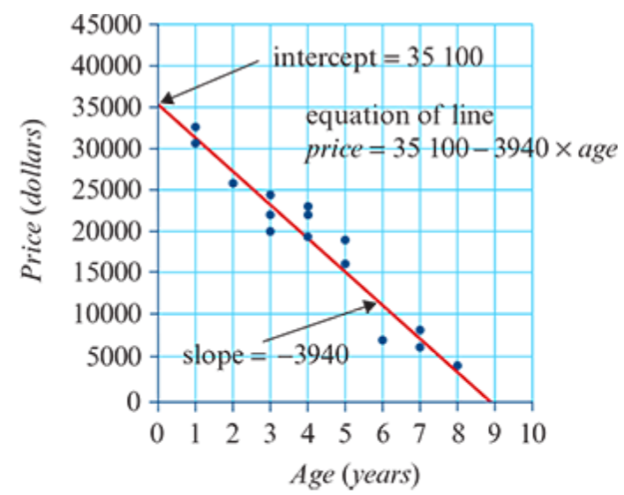



The price of one type of second-hand car changes with time:
price=35100−3940×𝑎𝑔𝑒
Slope=$−$3940
Y-intercept=35 100
Slope: On average, the price of these cars decreases by $3940 each year.
Y-intercept: The new car price is $35 100.

Slide 14

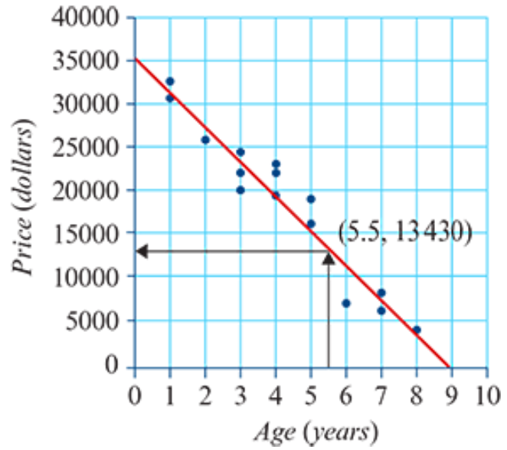

Prediction: Price=35100−3940×5.5=$13430

Slide 15
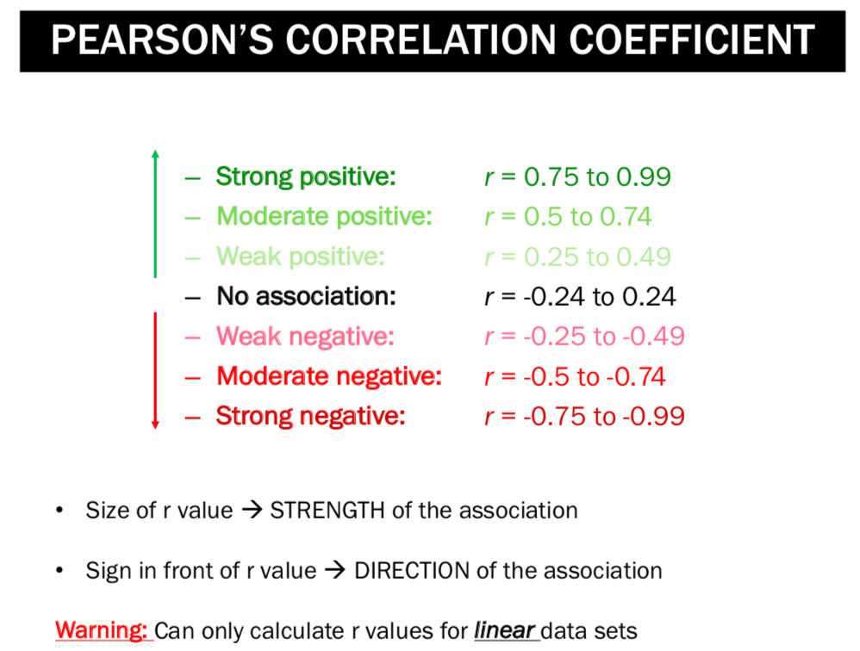
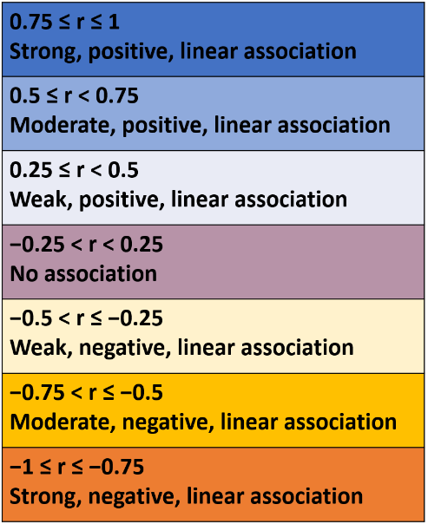


Slide 16
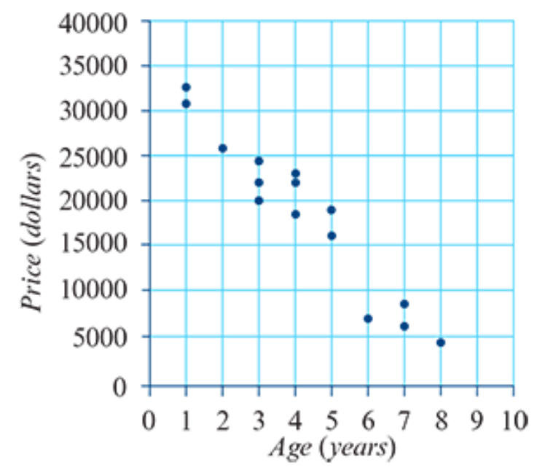


Slide 17
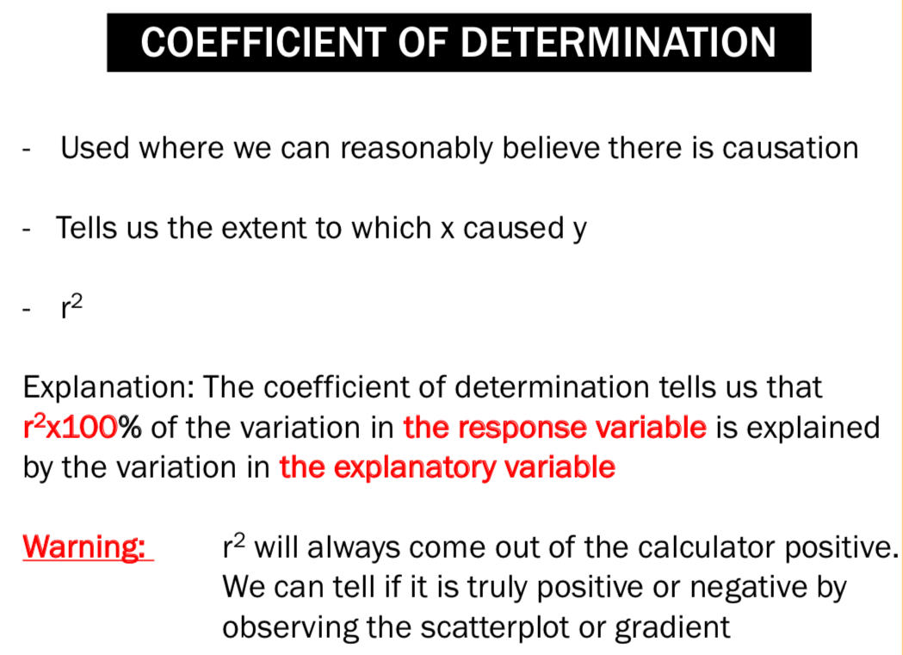
Example:
Example: 93% of the variation in price of the second-hand cars can be explained by the variation in the ages of the cars.

Slide 18
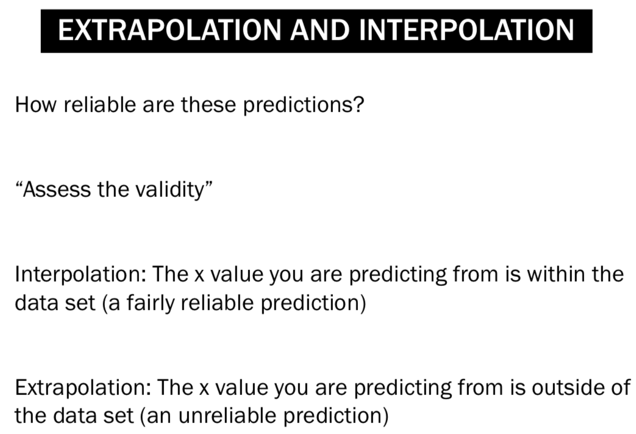

Slide 19
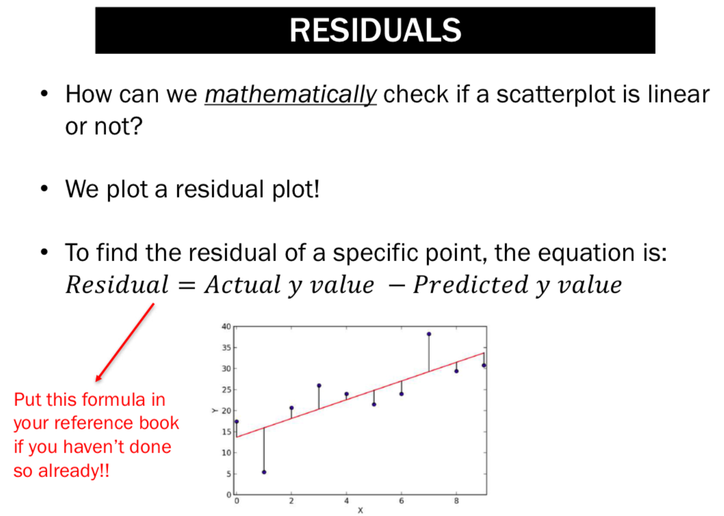
Data points above the regression line have a positive residual.
Data points below the regression line have a negative residual.
Data points on the line have a zero residual.

Slide 20

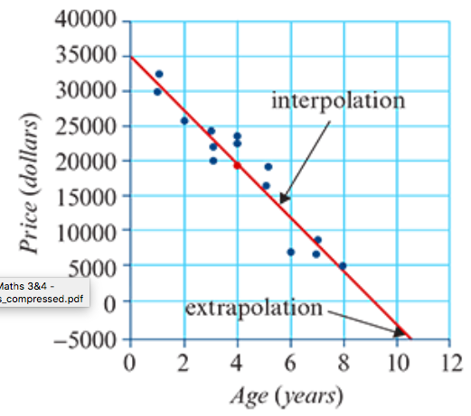
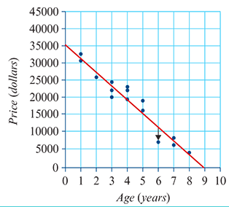
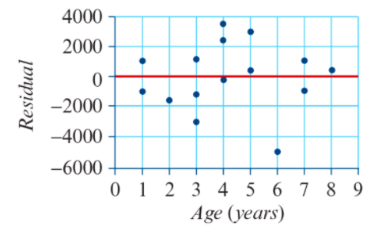

Data points above the regression line have a positive residual.
Data points below the regression line have a negative residual.
Data points on the line have a zero residual.
Actual price: $6500
Predicted price=35100−3940×6=$11460
Residual=actual−predicted=$6500−$11460=−$4960

Slide 21
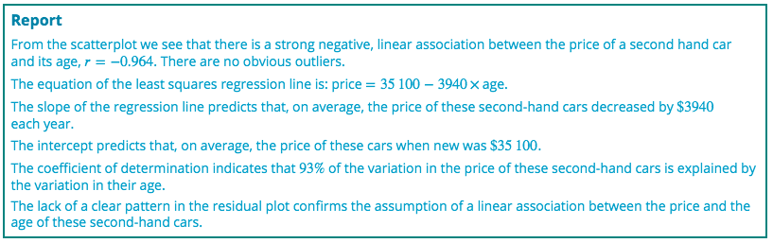
Reporting the results of a regression analysis

Slide 22
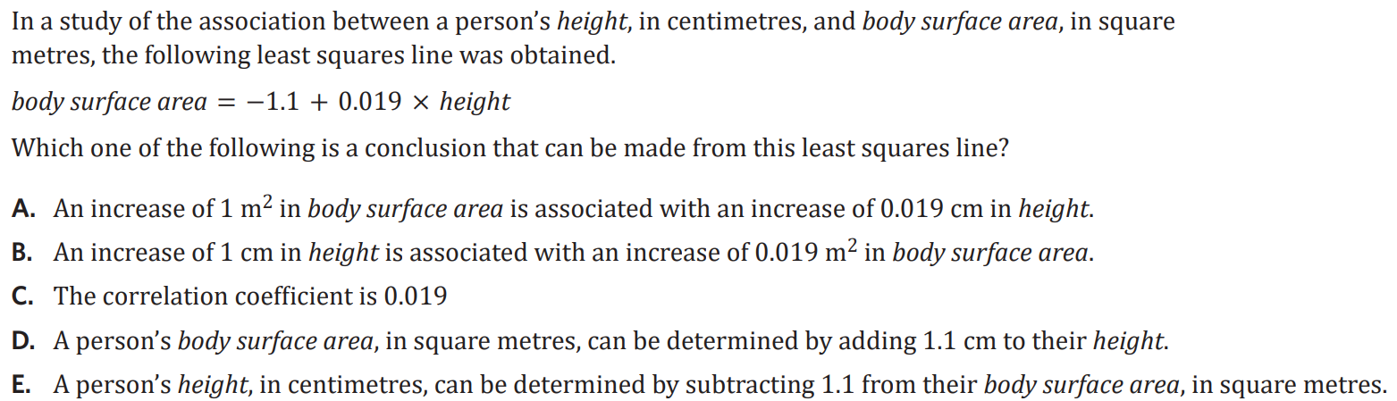
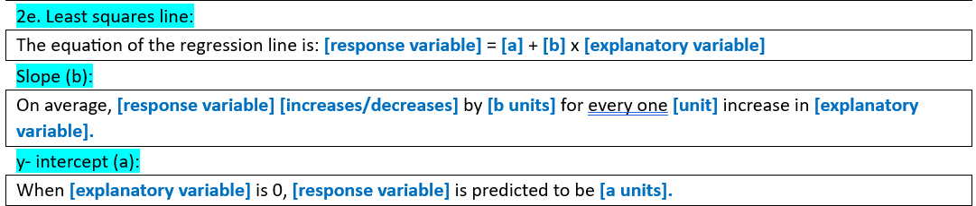
Exam Qs

