Slide 1

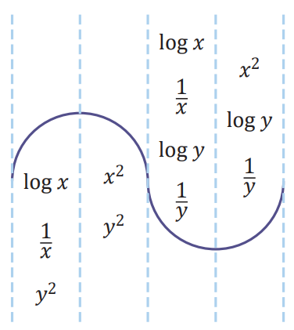
Data Transformation
3D
Notes:
https://quizizz.com/admin/quiz/5eb3ecd0272827001be13023?source=quiz_share
https://quizizz.com/admin/quiz/5f439516596f6b001b7eb347?source=quiz_share
https://create.kahoot.it/details/chapter-5-regression-and-data-transformation/9ad91423-8579-4a49-badf-1af2bd244702
https://create.kahoot.it/details/data-transformation-basic-skills/e1be7d0b-faf1-45c7-bb54-279b47ca0a6a

Slide 2
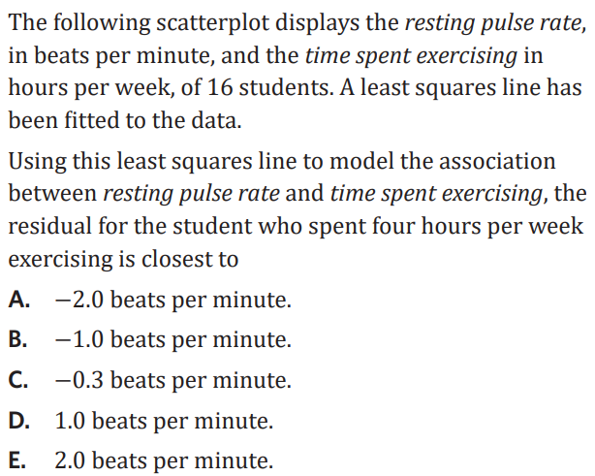
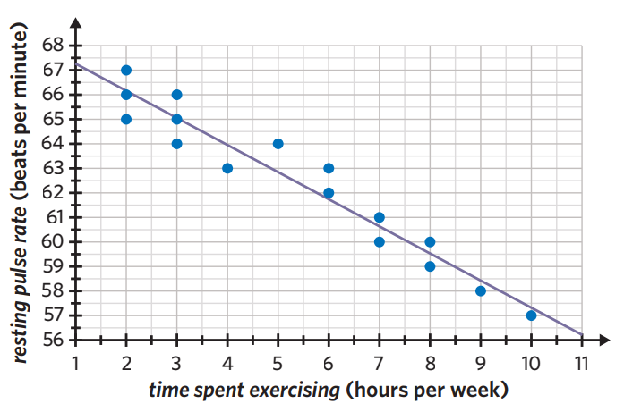

Slide 3

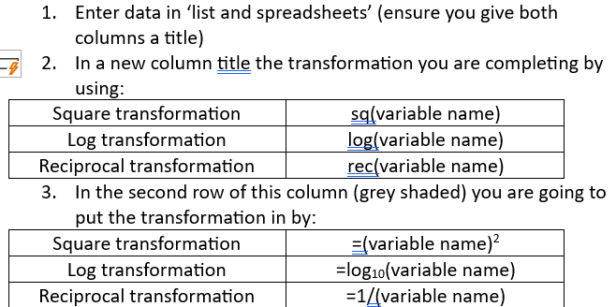
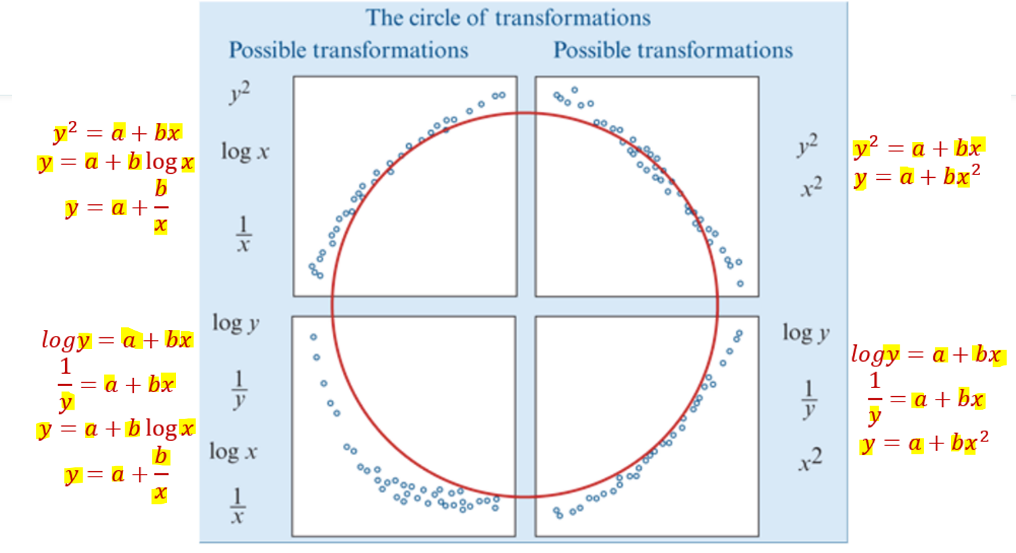
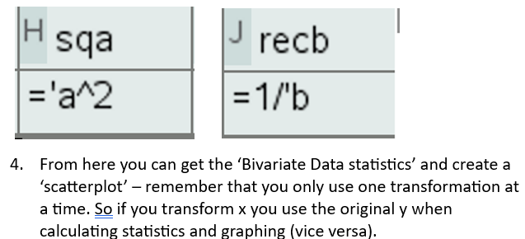

3D: Data Transformations
– you shouldn’t perform linear regression analysis for data that is non-linear
– ∴ nonlinear data is transformed
– transformations linearise data so that you can accurately perform regression analysis
– match the nonlinear scatterplot with one in the diagram to help you determine the best transformation
types of transformations:
log: compresses the data log₁₀(x) or log₁₀(y)
square: stretch the data x² or y²
reciprocal: compresses values greater than 1, stretches values less than 1 $\frac{1}{x}$ or $\frac{1}{y}$
CAS see CAS reference sheet.
strongest r value
(closest to +1 or –1)
closest r² % to 100%
Notes:
Board notes

Slide 4
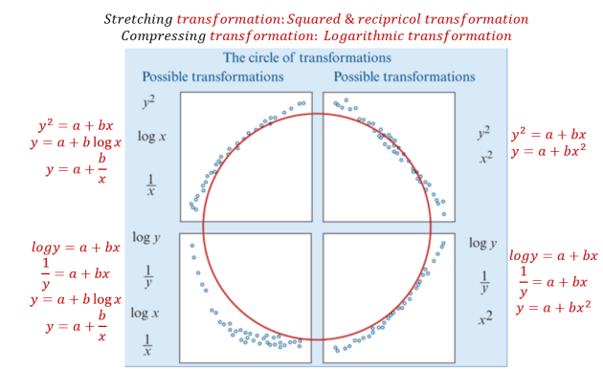
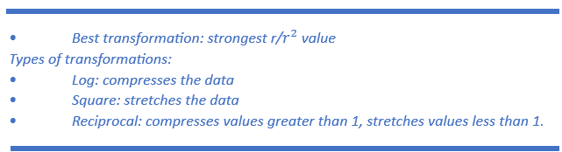
Data Transformation
The types of scatterplots that can be transformed by the squared, log or reciprocal transformations can be fitted together into what we call the circle of transformations.
Use a mathematical rule to change the scale on either x- or y-axis in order to linearise a non-linear scatterplot.

Slide 5
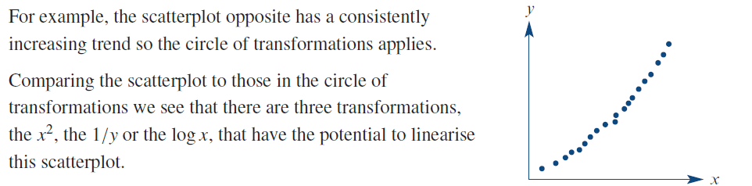
Data Transformation
The purpose of the circle of transformations is to guide us in our choice of transformation to linearise a given scatterplot.
There are two things to note when using the circle of transformations:
1. In each case, there is more than one type of transformation that might work.
2. These transformations only apply to scatterplots with a consistently increasing or decreasing trend.

Slide 6
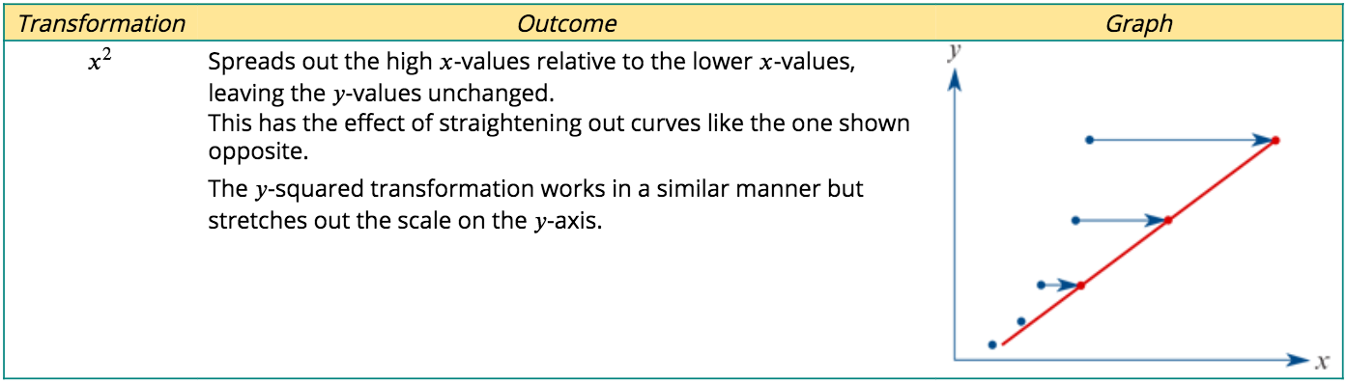
Using data transformation to linearise a scatterplot The squared transformation
The squared transformation is a stretching transformation. It works by stretching out the upper end of the scale on either the x- or y-axis. The effect of applying an $x^{2}$transformation to a scatterplot is illustrated graphically below.

Slide 7
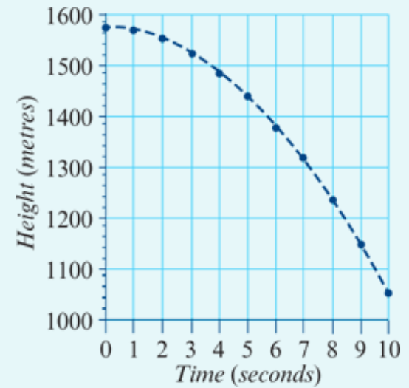
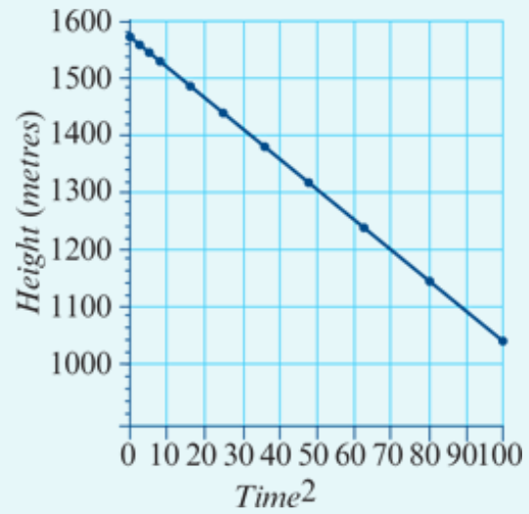

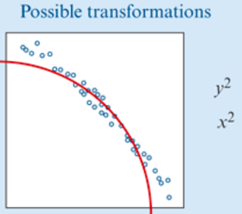
Applying the squared transformation
A base jumper leaps from the top of a cliff, 1560 metres above the valley floor. The scatterplot below shows the height (in metres) of the base jumper above the valley floor every second, for the first 10 seconds of the jump. After this time she opened her parachute to bring her safely to the ground.
A scatterplot shows that there is a strong negative association between the height of the base jumper above the ground and time.

Slide 8
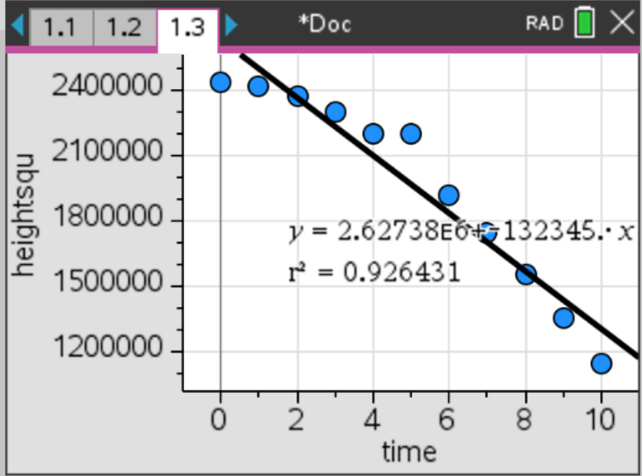
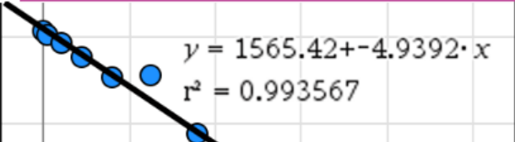
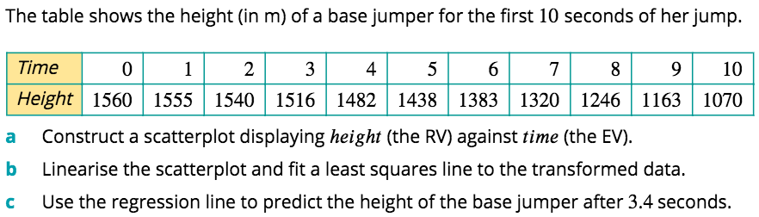






Using CAS to perform a squared transformation
$$EV^{2}$$
Ti$mⅇ^{2}$ | 0 | 1 | 4 | 9 | 16 | 25 | 36 | 49 | 64 | 81 | 100
$$x^{2}$$
E$V$
x
$$RV$$
$$y$$
$$RV=y−ⅈnt+Slope∗EV$$
$$y=1565−\text{4.939}∗x^{2}$$
$Height=1565−\text{4.939}∗{3.4}^{2}$ = 1502.2
$$RV=y−ⅈnt+Slope∗EV^{2}$$
$$Height=1565−\text{4.939}∗{Time}^{2}$$

Slide 9
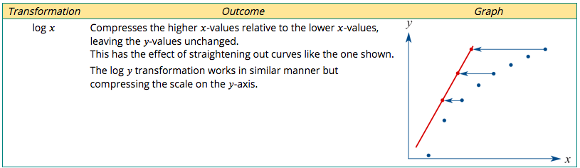
The logarithmic transformation
The logarithmic transformation is a compressing transformation and the upper end of the scale on either the x- or the y-axis. The effect of applying a log x transformation to a scatterplot is illustrated graphically below.

Slide 10
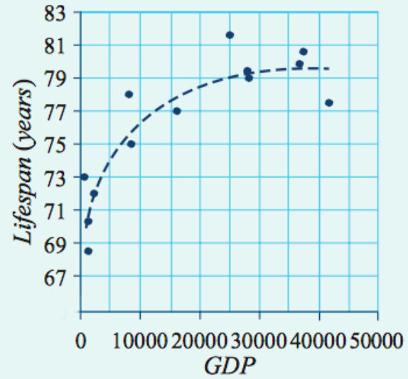
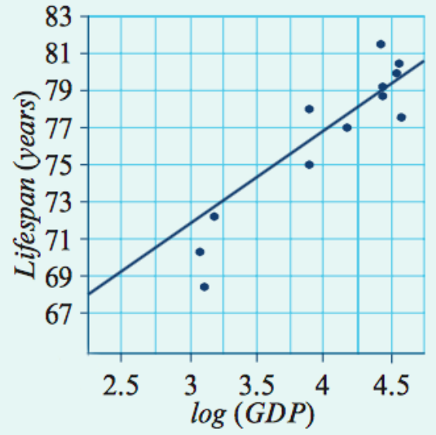
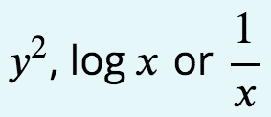
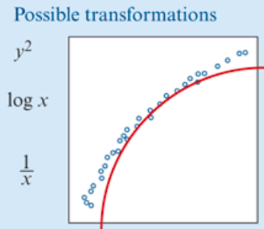
Applying the log transformation
The general wealth of a country, often measured by its Gross Domestic Product (GDP), is one of several variables associated with lifespan in different countries. However, the association it not linear, as can be seen in the scatterplot below which plots lifespan (in years) against GDP (in dollars) for 13 different countries.

Slide 11

Applying the log transformation
The general wealth of a country, often measured by its Gross Domestic Product (GDP), is one of several variables associated with lifespan in different countries. However, the association it not linear, as can be seen in the scatterplot below which plots lifespan (in years) against GDP (in dollars) for 13 different countries.

Slide 12
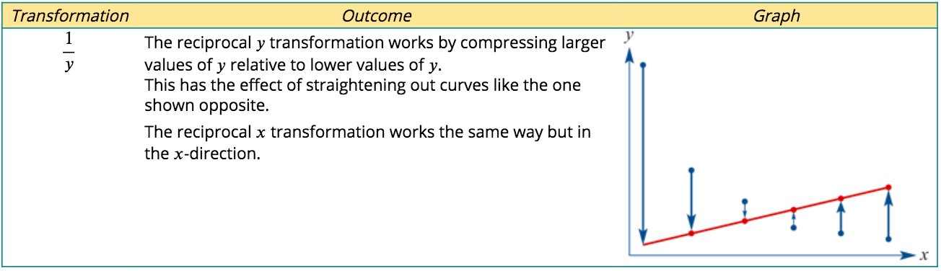
The reciprocal transformation
The reciprocal transformation is a stretching transformation that compresses the upper end of the scale on either the 𝑥- or 𝑦-axis. The effect of applying a reciprocal y transformation to a scatterplot is illustrated below.

Slide 13
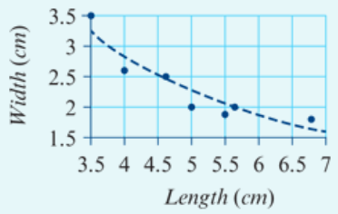
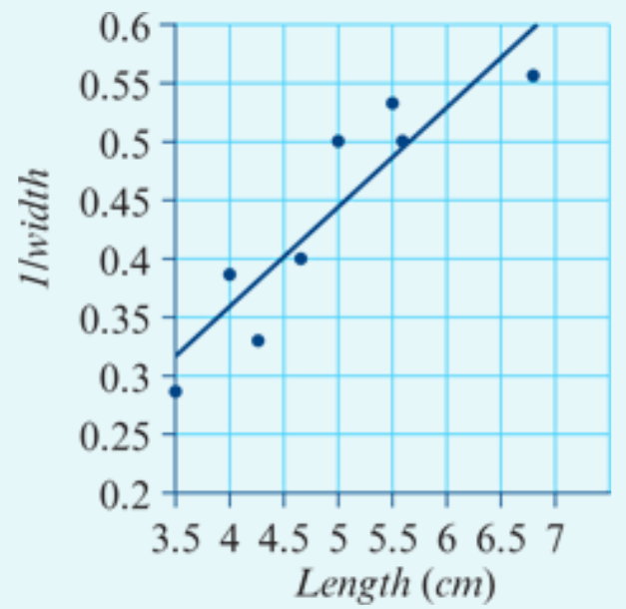

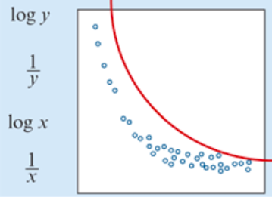
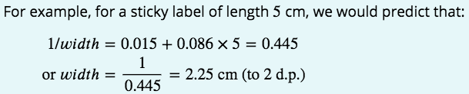
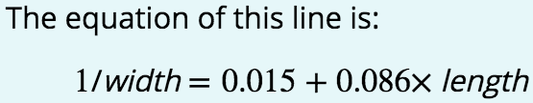
Applying the reciprocal transformation
A homeware company makes rectangular sticky labels with a variety of lengths and widths.
The scatterplot opposite displays the width (in cm) and length (in cm) of eight of their sticky labels.

Slide 14
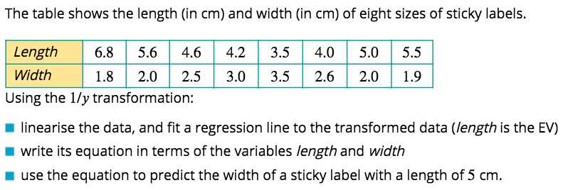
Using CAS to perform a reciprocal transformation
$$\frac{1}{y}$$
X
Y
$Transformed scatterplot with a straight line.$
$\frac{1}{Width}$= + ×length
$\frac{1}{Width}$= + ×5
Notes:
Know Maths calculation by heart. Then find key words.

Slide 15
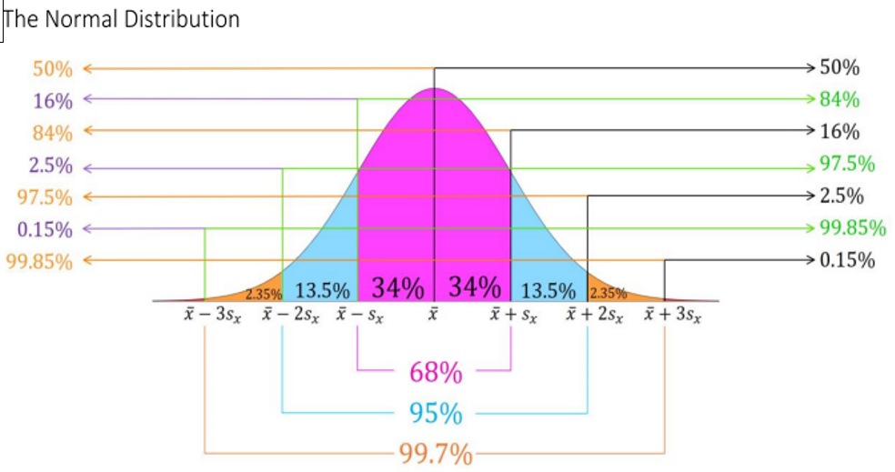
Which starter question are you choosing?
Would you prefer a question answered accurately by the top 41% of students or by the top 19%?
Would you prefer z score of 0.228 or 0.877 for your ATAR score?

Slide 16
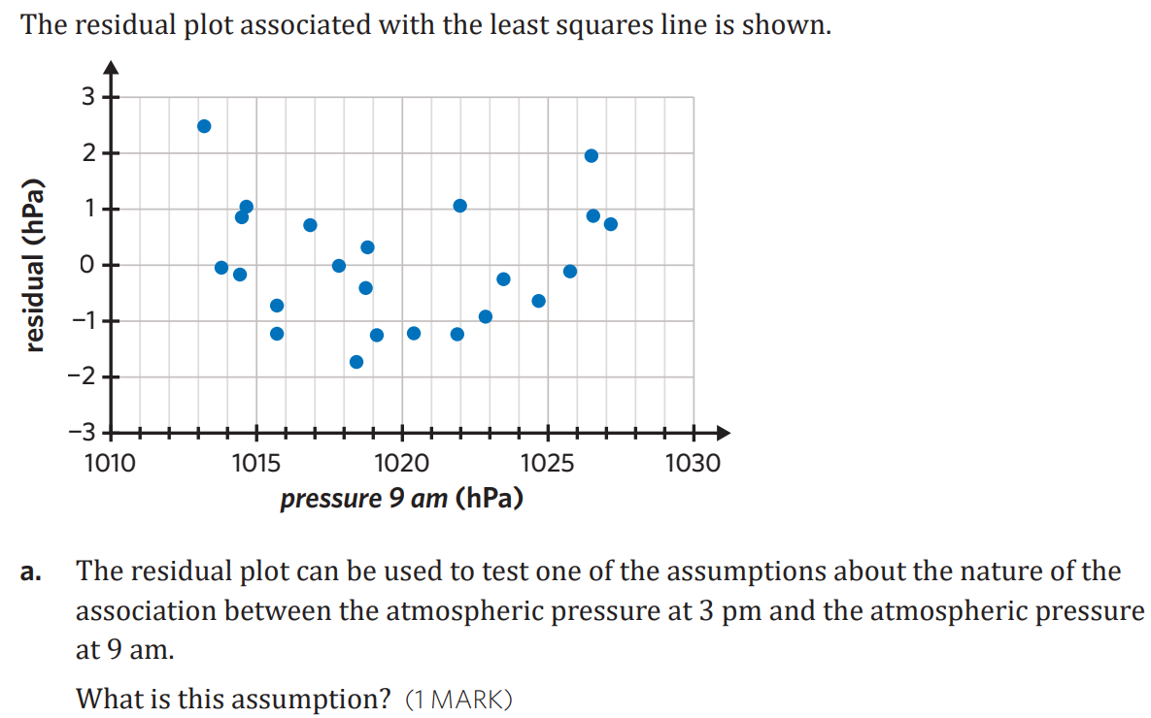

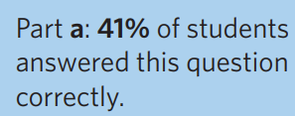
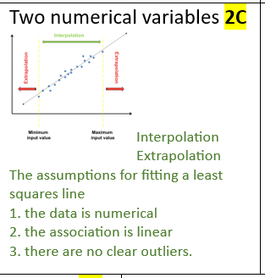


Slide 17
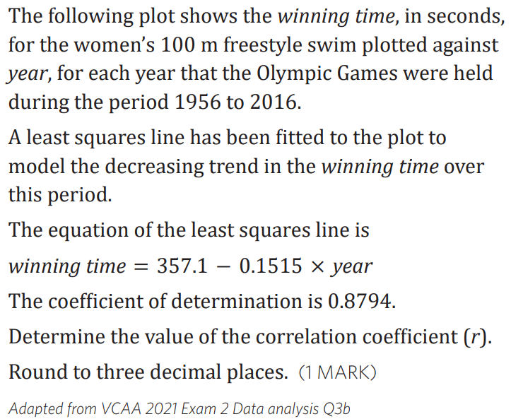
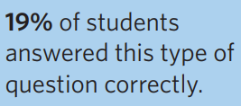
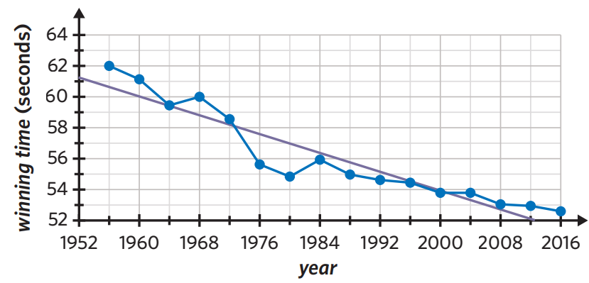
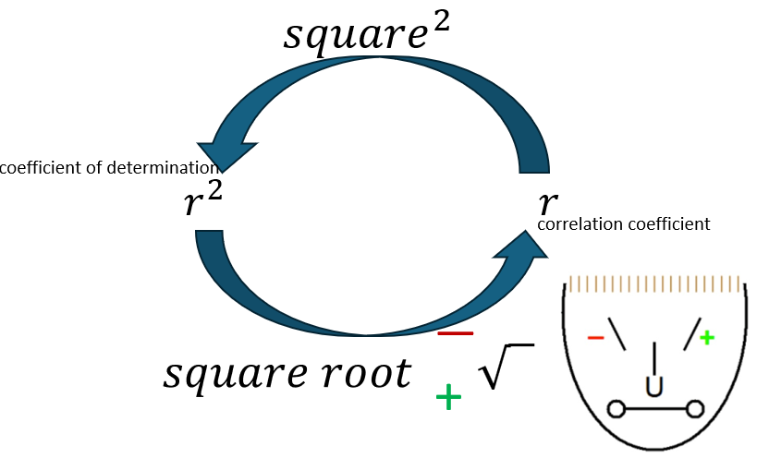

Slide 18
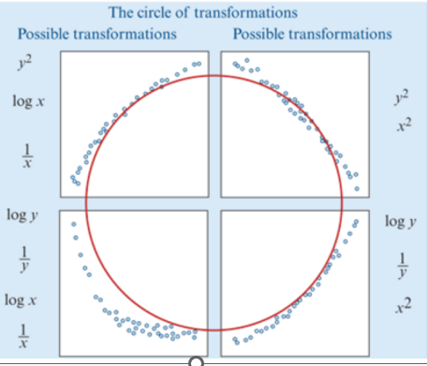
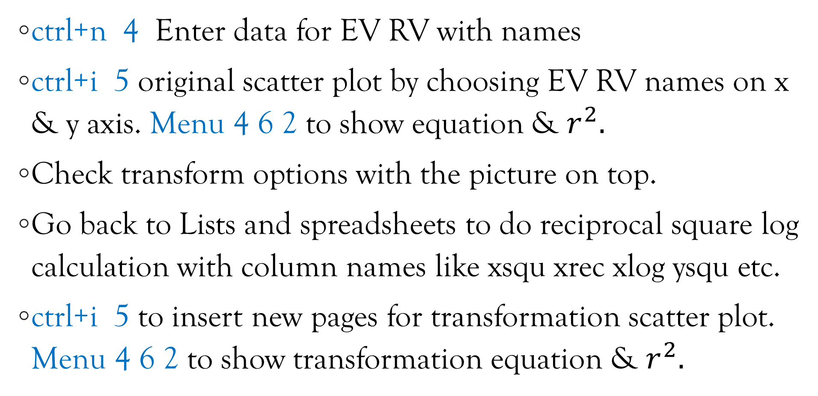
Transformation steps on CAS
ctrl+n 4 Enter data for EV RV with names
ctrl+i 5 original scatter plot by choosing EV RV names on x & y axis. Menu 4 6 2 to show equation & $r^{2}.$
Check transform options with the picture on top.
Go back to Lists and spreadsheets to do reciprocal square log calculation with column names like xsqu xrec xlog ysqu etc.
ctrl+i 5 to insert new pages for transformation scatter plot. Menu 4 6 2 to show transformation equation & $r^{2}.$

Slide 19
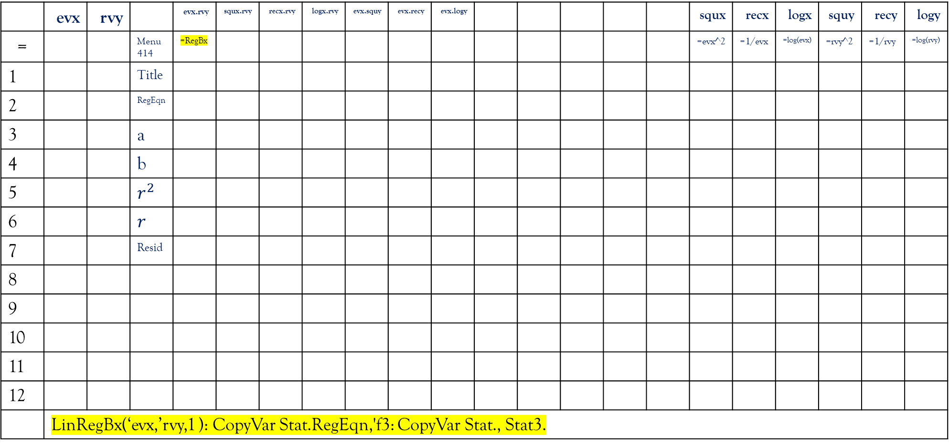
Pre-making all in one Bi variate data & Transformation CAS file
a | b | c | d | e | f | g | h | i | j | k | l | m | n | o | p | q | r | s | t | u
 | evx | rvy |  | evx.rvy | squx.rvy | recx.rvy | logx.rvy | evx.squy | evx.recy | evx.logy |  |  |  |  |  | squx | recx | logx | squy | recy | logy
= |  |  | Menu 414 | =RegBx |  |  |  |  |  |  |  |  |  |  |  | =evx^2 | =1/evx | =log(evx) | =rvy^2 | =1/rvy | =log(rvy)
1 |  |  | Title
2 |  |  | RegEqn
3 |  |  | a
4 |  |  | b
5 |  |  | $$r^{2}$$
6 |  |  | $$r$$
7 |  |  | Resid
8
9
10
11
12
 | LinRegBx(‘evx,’rvy,1 ): CopyVar Stat.RegEqn,'f3: CopyVar Stat., Stat3.

