Slide 1

Smoothing – moving means
4B
Notes:
https://create.kahoot.it/details/6cee124d-9336-4e06-a07a-05343112b695

Slide 2
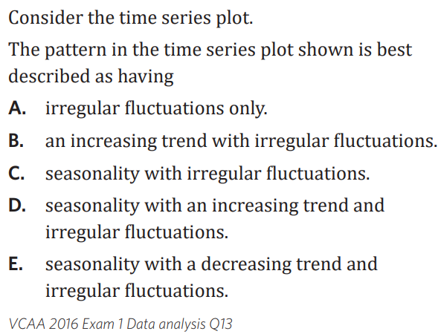
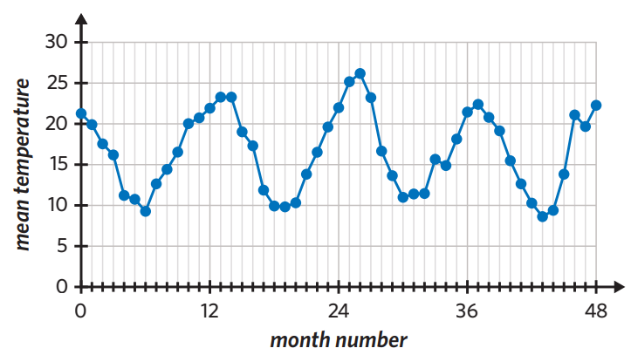
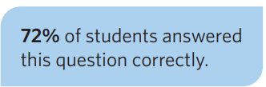

Slide 3
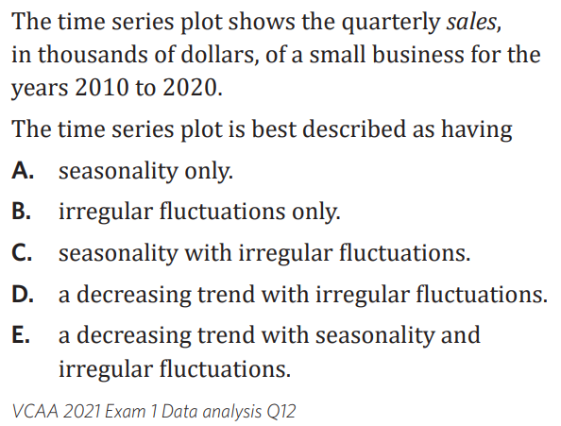
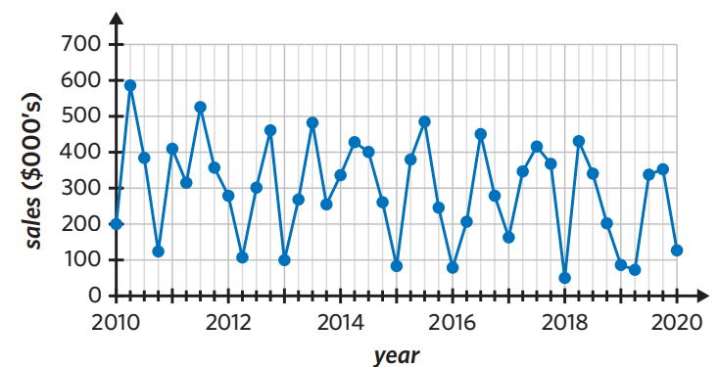
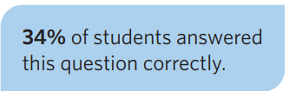

Slide 4





4B: mean smoothing.
why smooth? to even out fluctuations and identify any underlying trends.
only smooth the RV!
larger means are more effective in smoothing (5 better than 3).
smoothing
3 mean = use 3 values, find the mean
always centred around value trying to smooth.
centering is an addition step when smoothing with an even number of points
Centering rules
ODD 3 EVEN 2
y₂ =$\frac{\text{y}\text{₁ + }\text{y}\text{₂ + }\text{y}\text{₃}}{3}$ y₂ = =$\frac{\text{y}\text{₁ + }\text{y}\text{₂ + }\text{y}\text{₂ + }\text{y}\text{₃}}{4}$
ODD SMOOTHING (3,5,7…)
example
a. 3 mean smooth Tuesday:
$\frac{\text{M}\text{ + }\text{T}\text{ + }\text{W}}{3}$ = $\frac{\text{18.1 + 24.8 + 26.4}}{3}$ = 23.1
b. 5 mean smooth Thursday
$\frac{\text{T}\text{ + }\text{W}\text{ + }\text{Th}\text{ + }\text{F}\text{ + }\text{S}}{5}$
5
$\frac{\text{24.8 + 26.4 + 13.9 + 12.7 + 14.2}}{5}$=18.3
c. 7 mean smooth Thursday
$\frac{\text{M}\text{ + }\text{T}\text{ + }\text{W}\text{ + }\text{Th}\text{ + }\text{F}\text{ + }\text{S}\text{ + }\text{S} }{7}$
EVEN smoothing 2,4,6…
w/ CENTERING
2 mean smooth Tuesday
long way:
$\frac{\text{108.1 + 24.8}}{2}$= 21.45
$\frac{\text{24.8 + 26.4}}{2}$ = 25.6
short way:
$\frac{\text{M}\text{ + }\text{T}\text{ + }\text{T}\text{ + }\text{W} }{4}= \frac{\text{18.1 + 24.8 + 24.8 + 26.4}}{4}$ = 23.5
b. 4 mean smooth Thursday
$\frac{\text{T}\text{ + }\text{W}\text{ + }\text{W}\text{ + }\text{Th}\text{ + }\text{Th}\text{ + }\text{F}\text{ + }\text{F}\text{ + }\text{S}}{8}$=
$\frac{\text{24.8 + 26.4 + 26.4 + 13.9 + 13.9 + 12.7 + 12.7 + 14.2 }}{8}$= 18.1
2 mean: like 3 mean, middle value used twice, divided by 4
4 mean: like 5 mean, middle values used twice, divided by 8.
6 mean: like 7 mean middle values used twice, divided by 12.
day | M | T | W | T | F | S | S
temp | 18.1 | 24.8 | 26.4 | 13.9 | 12.7 | 14.2 | 24.9
day | M | T | W | T | F | S | S
temp | 18.1 | 24.8 | 26.4 | 13.9 | 12.7 | 14.2 | 24.9
Centering
$\frac{\text{21.45 + 25.6}}{2}$=23.5
Notes:
Board notes

Slide 5
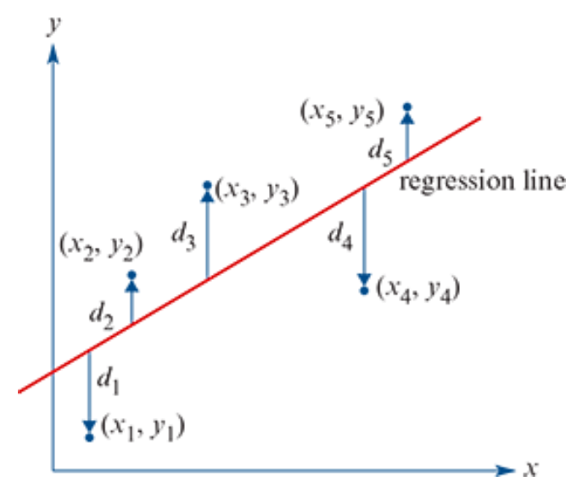
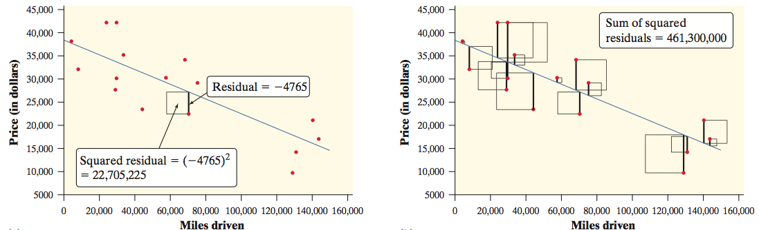
Least Squares Regression Line y=a+bx
The least-squares regression line of y on x is the line that makes the sum of the squared residuals as small as possible.

Slide 6
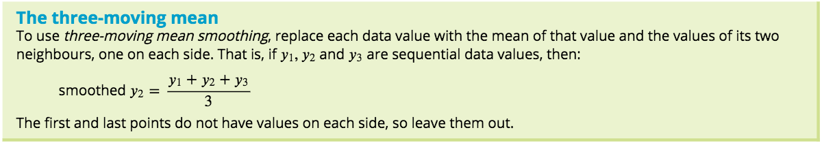
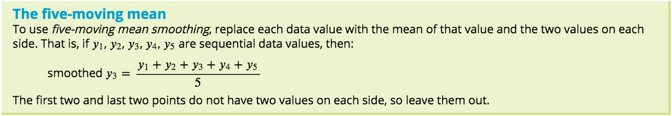
Smoothing a time series using moving means
This method of smoothing (moving mean smoothing) involves replacing individual data points in the time series with their moving means. The simplest method is to smooth over a small number of odd number points – for example, three or five.

Slide 7
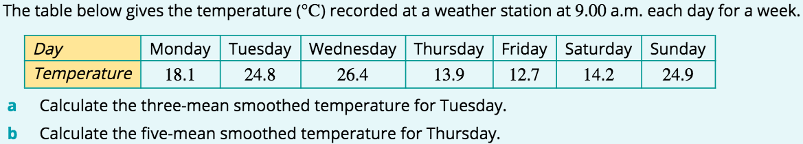


Three- and five-moving mean smoothing
Day | Temperature | 3-Mean Smoothing | 5-Mean Smoothing
Monday | 18.1
Tuesday | 24.8
Wednesday | 26.4
Thursday | 13.9
Friday | 12.7
Saturday | 14.2
Sunday | 24.9
24.8
$\frac{18.1+24.8+26.4}{3}$=23.1
The three-mean smoothed temperature for Tuesday is 23.1°C.
13.9
$\frac{24.8+26.4+13.9+12.7+14.2}{5}$=18.4
The five-mean smoothed temperature for Thursday is 18.4°C.

Slide 8
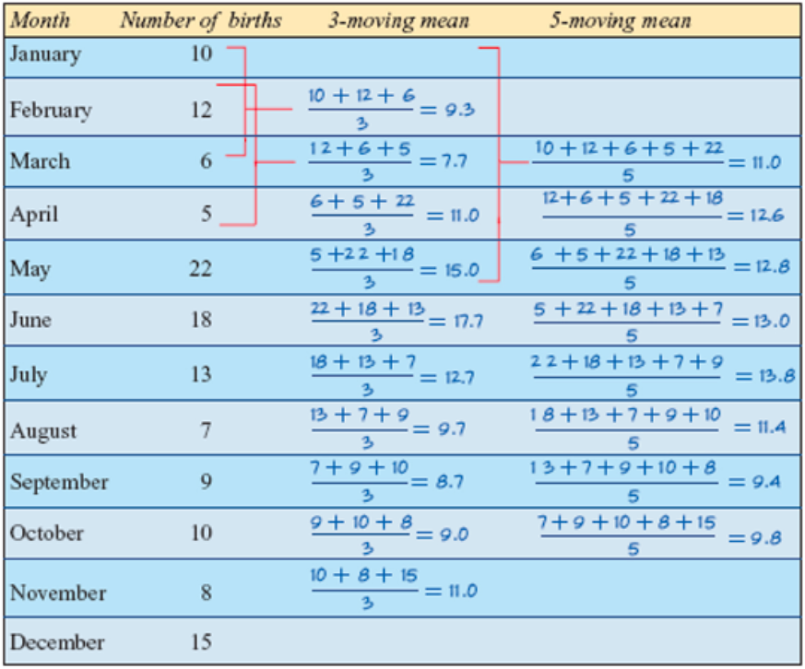
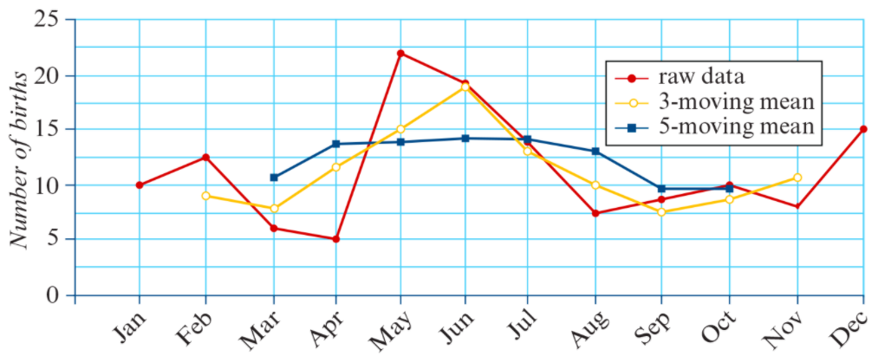
Three- and five-moving mean smoothing of a time series
The following table gives the number of births per month over a calendar year in a country hospital.
5-mean smoothing is more effective in reducing the irregular fluctuations than 3-mean smoothing
the 5-mean smoothed plot shows that there is no clear trend although the raw data suggest that there might be an increasing trend.

Slide 9
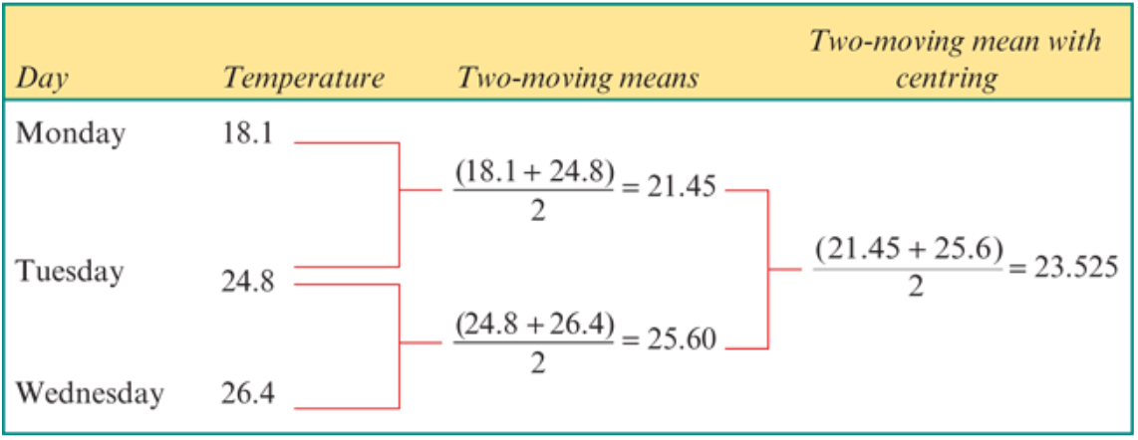
Two-mean smoothing with centring
Centring involves taking a two-moving mean of the already smoothed values so that they line up with the original time values.

Slide 10
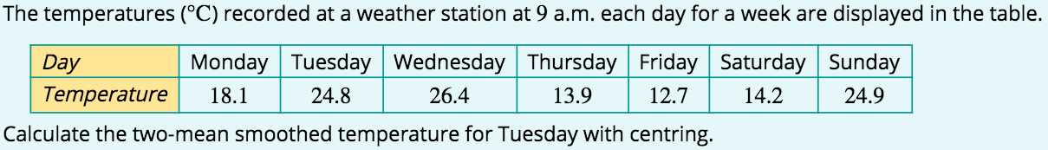



Two-moving mean smoothing with centring
Day | Temperature | Two-moving means | Two-moving mean with centring
Monday | 18.1
Tuesday | 24.8
Wednesday | 26.4
Thursday | 13.9
Friday | 12.7
Saturday | 14.2
Sunday | 24.9
$\frac{18.1+24.8}{2}$=21.45
24.8
$\frac{21.45+25.6}{2}$=23.525
$\frac{24.8+26.4}{2}$=25.6
The two-mean smoothed temperature, centred on Tuesday, is 23.5(°C) (to 1 d.p.).

Slide 11
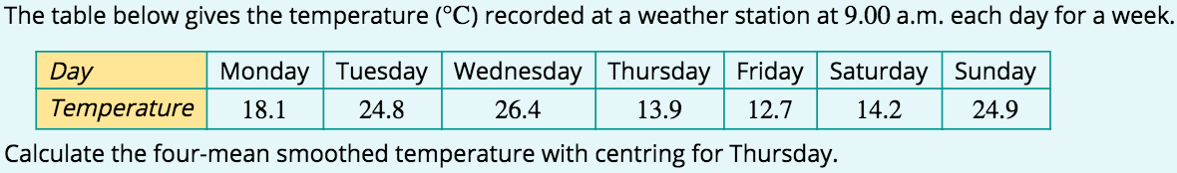



Four-moving mean smoothing with centring
Day | Temperature | Four-moving means | Four-moving mean with centring
Monday | 18.1
Tuesday | 24.8
Wednesday | 26.4
Thursday | 13.9
Friday | 12.7
Saturday | 14.2
Sunday | 24.9
$\frac{24.8+26.4+13.9+12.7}{4}$=19.45
13.9
$\frac{19.45+16.8}{2}$=18.125
$\frac{26.4+13.9+12.7+14.2}{4}$=16.8
The four-mean smoothed temperature centred on Thursday is 18.1°C (to 1 d.p.).

