Slide 1

Smoothing – moving medians
4C
Notes:
https://create.kahoot.it/details/6cee124d-9336-4e06-a07a-05343112b695
https://create.kahoot.it/details/87b07e62-37bb-4ed5-aa51-a839423ca593
Revision
https://create.kahoot.it/details/482c4b74-a6b0-46a3-b3e8-a1b08f378329

Slide 2
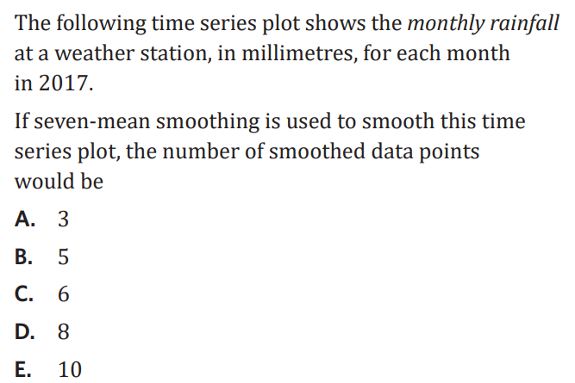
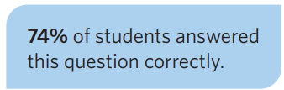
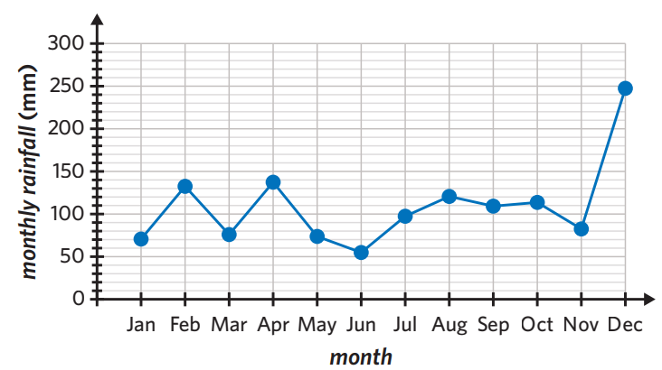
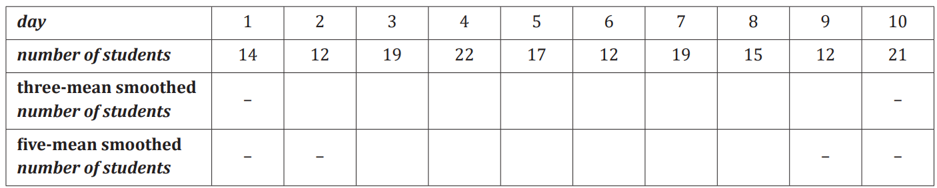

Slide 3
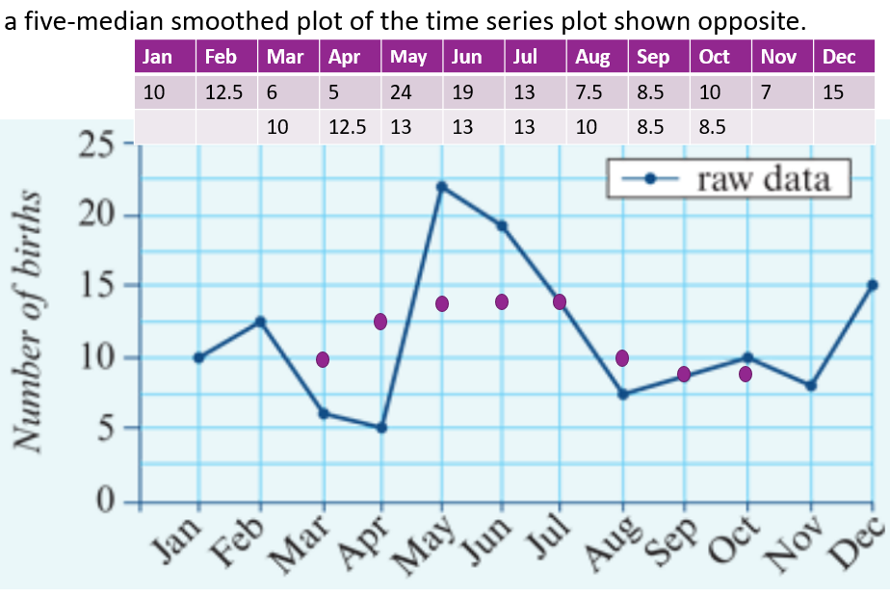

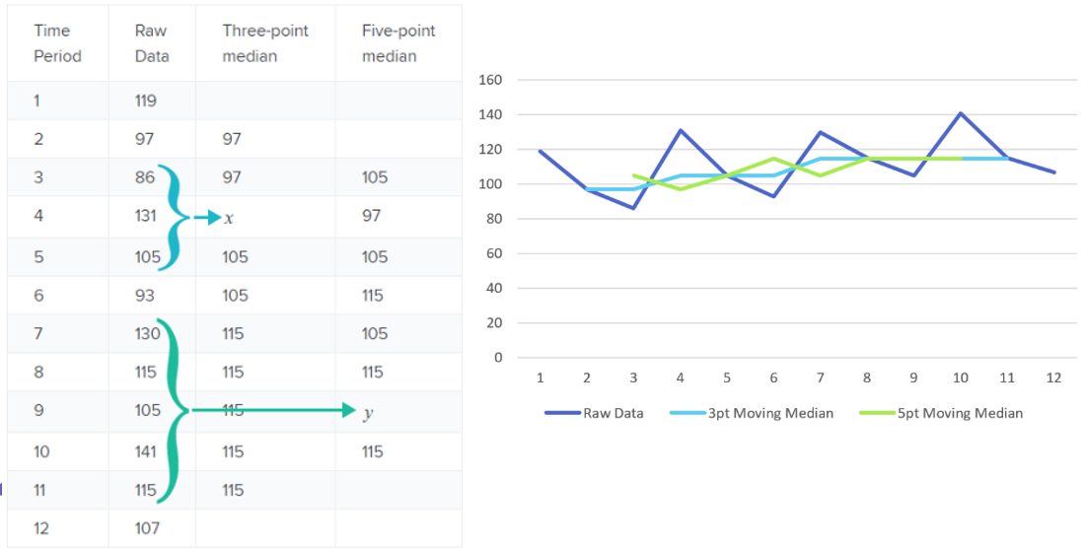
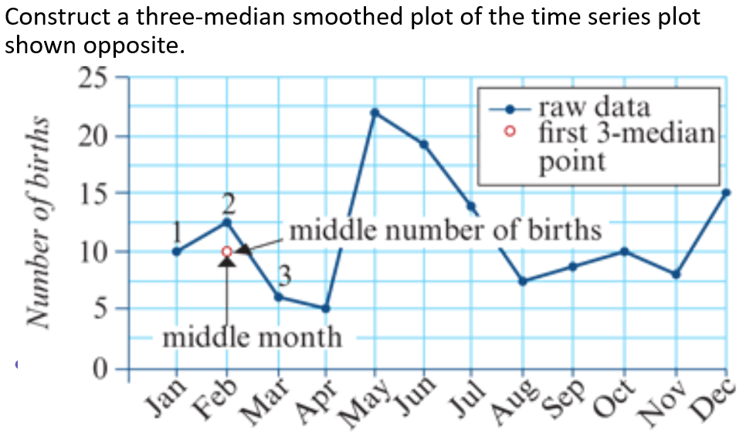
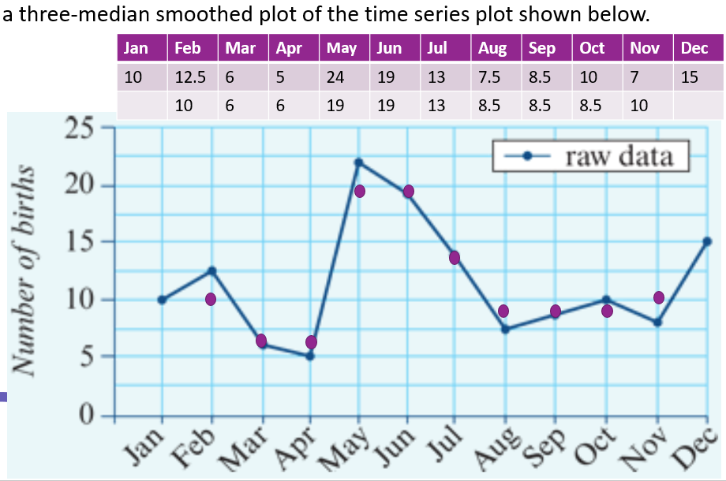
4C: Smoothing – moving medians
Notes:
Board notes

Slide 4
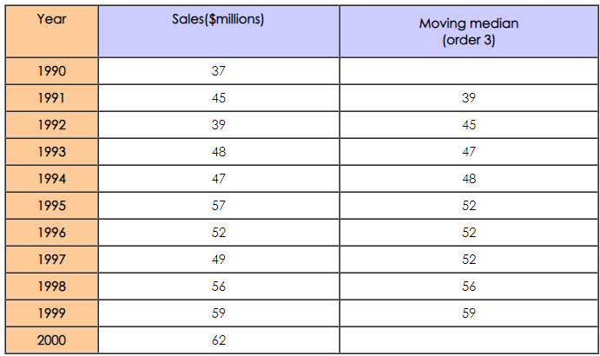
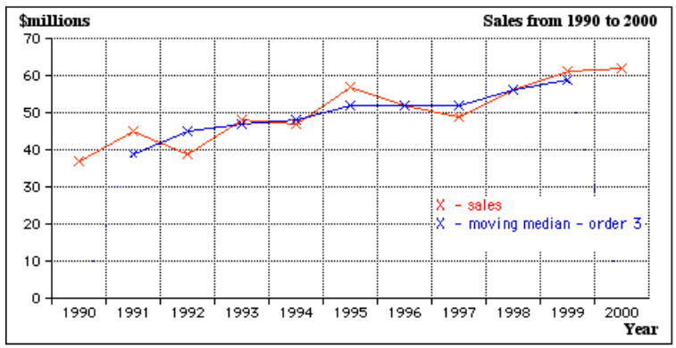
Smoothing a time series plot using moving medians

Slide 5
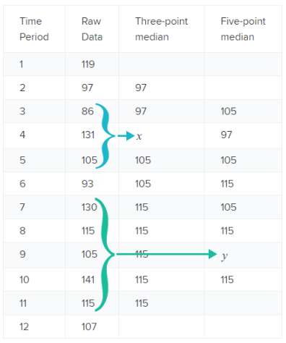
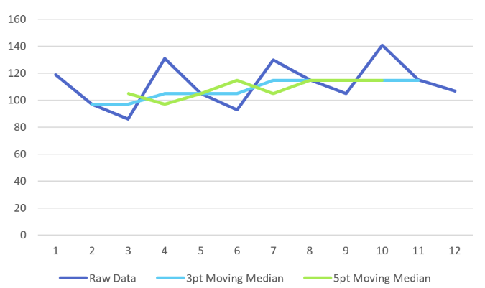
Smoothing a time series plot using moving medians

Slide 6
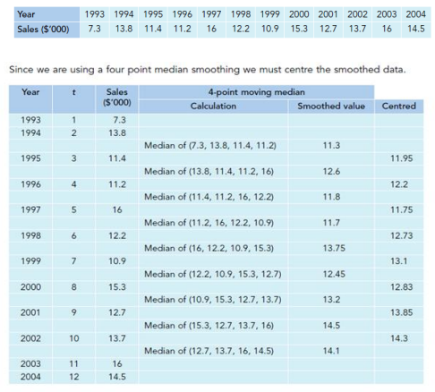
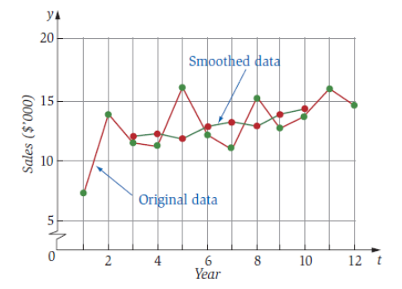
Smoothing a time series plot using moving medians

Slide 7
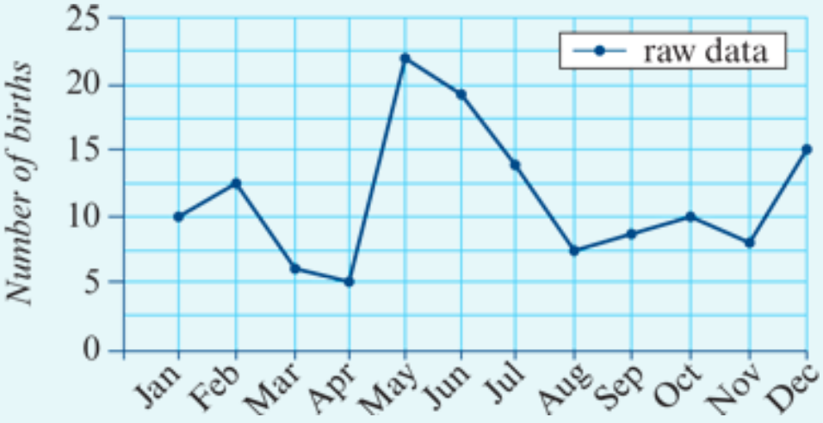
Three-median smoothing using a graphical approach
Construct a three-median smoothed plot of the time series plot shown below.
Jan | Feb | Mar | Apr | May | Jun | Jul | Aug | Sep | Oct | Nov | Dec
10 | 12.5 | 6 | 5 | 24 | 19 | 13 | 7.5 | 8.5 | 10 | 7 | 15
 | 10 | 6 | 6 | 19 | 19 | 13 | 8.5 | 8.5 | 8.5 | 10

Slide 8
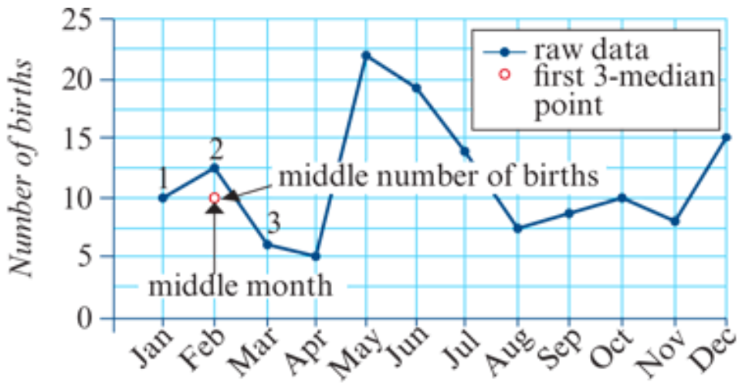
Three-median smoothing using a graphical approach
Construct a three-median smoothed plot of the time series plot shown opposite.

Slide 9
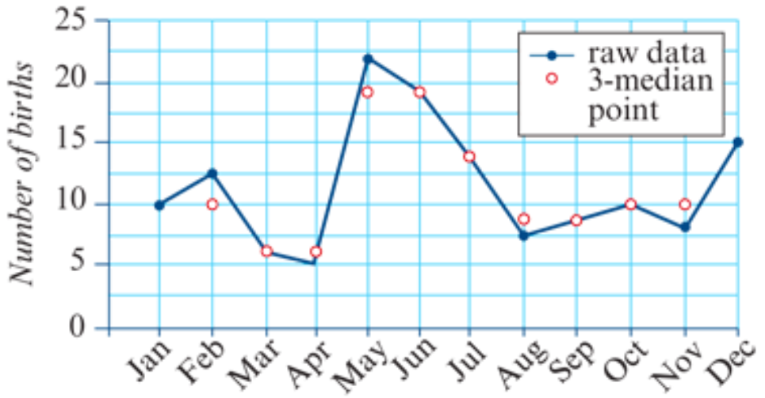
Three-median smoothing using a graphical approach
Construct a three-median smoothed plot of the time series plot shown opposite.

Slide 10
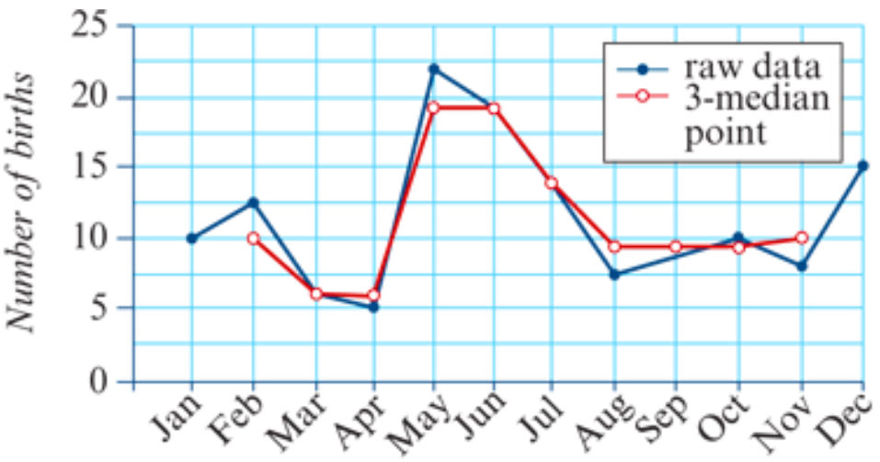
Three-median smoothing using a graphical approach
Construct a three-median smoothed plot of the time series plot shown opposite.

Slide 11
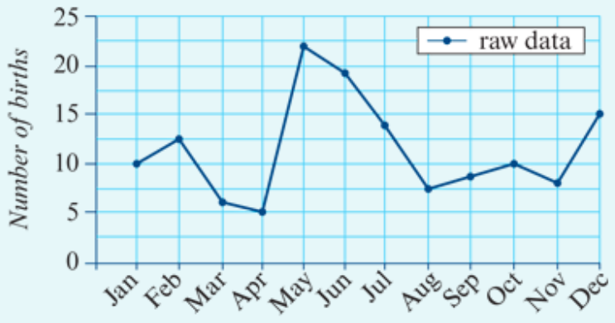
Five-median smoothing using a graphical approach
Construct a five-median smoothed plot of the time series plot shown opposite.
Jan | Feb | Mar | Apr | May | Jun | Jul | Aug | Sep | Oct | Nov | Dec
10 | 12.5 | 6 | 5 | 24 | 19 | 13 | 7.5 | 8.5 | 10 | 7 | 15
 |  | 10 | 12.5 | 13 | 13 | 13 | 10 | 8.5 | 8.5

Slide 12
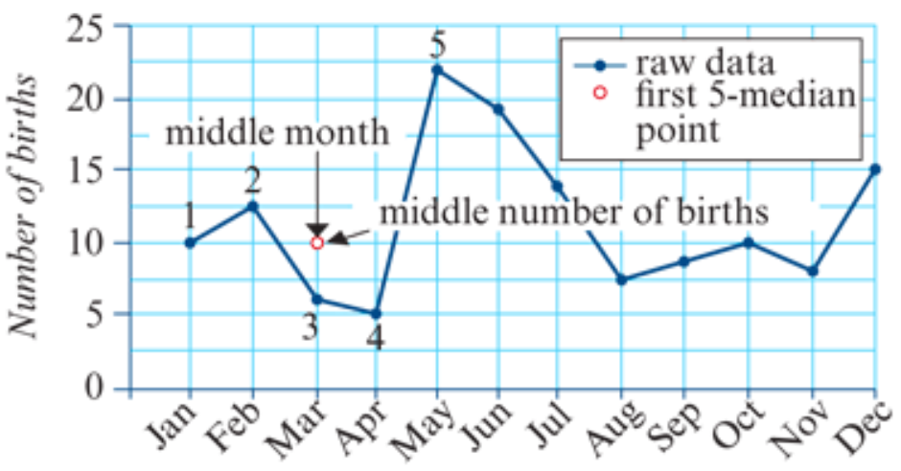
Five-median smoothing using a graphical approach
Construct a five-median smoothed plot of the time series plot shown opposite.

Slide 13
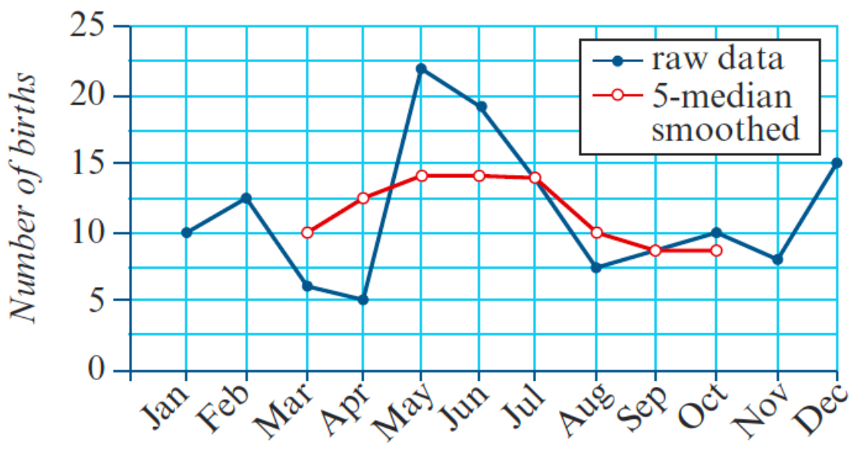
Five-median smoothing using a graphical approach
Construct a five-median smoothed plot of the time series plot shown opposite.

