Slide 1

Seasonal adjustments
4D
Notes:
https://create.kahoot.it/details/fff66786-3f62-4aaf-8b31-f87403a3f808
https://create.kahoot.it/details/fd1e0921-452a-46d3-8737-00333a529a4c
https://create.kahoot.it/details/a2d63691-b8bf-4992-b43e-48a2a9dc635e
https://create.kahoot.it/details/ab30306f-ecc4-436d-b97d-b4a2a3c4fdf8
https://create.kahoot.it/details/17a3fd56-c462-417e-9b69-8b4cd363ae3d
https://create.kahoot.it/details/9098a1cb-af2f-4f0d-bc72-3e109736abd4

Slide 2
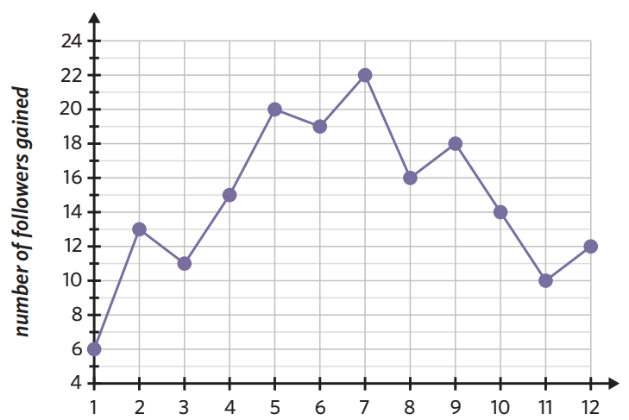
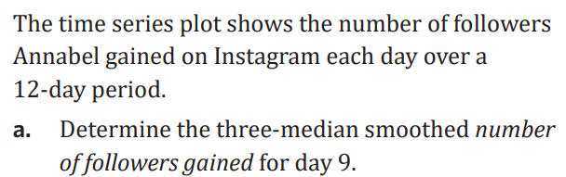

Slide 3

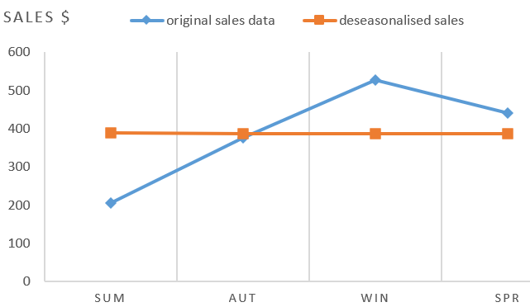
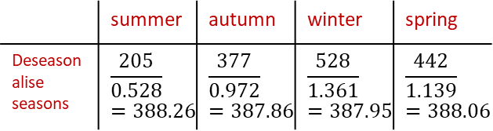
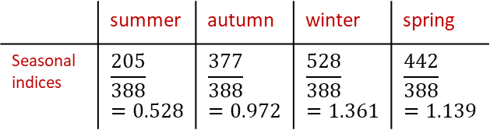


4D Seasonal Indices:
example: Charlie owns an umbrella shop the following table shows his 2022 sales:
1. find the seasonal average for 2022
SA= $\frac{\text{205 + 377 + 528 + 442}}{4}$ = 388
2. calculate the seasonal indices:
3. Interpret summer and winter SI’s:
summer: (0.528 − 1) × 100 = −47.2%
Summer is 47.2% below the seasonal av.
winter: (1.361 − 1) × 100 = 36.1%
winter is 36.1% above the seasonal av.
4. summer and winter should be corrected for seasonality:
summer:
($\frac{1}{0.528}$ − 1) × 100 = 89.4%
To correct summer for seasonality, sales need to increase by 89.4%
winter:
($\frac{1}{1.361}$ − 1) × 100 = −26.5%
To correct winter for seasonality, sales need to decrease by 26.5%
5. deseasonalise the seasons
6. reseasonalise autumn:
RS = 387.86 × 0.972 = 376.99 ≈ 377
7. graph the deseasonalised values
 | summer | autumn | winter | spring
Deseasonalise seasons | $$\frac{205}{0.528}=388.26$$ | $$\frac{377}{0.972}=387.86$$ | $$\frac{528}{1.361}=387.95$$ | $$\frac{442}{1.139}=388.06$$
 | summer | autumn | winter | spring
umbrella sales ($) | 205 | 377 | 528 | 442
 | summer | autumn | winter | spring
Seasonal indices | $$\frac{205}{388}=0.528$$ | $$\frac{377}{388}=0.972$$ | $$\frac{528}{388}=1.361$$ | $$\frac{442}{388}=1.139$$
Notes:
Board notes

Slide 4




















Seasonal indices(S.I.)
When the data is seasonal, it is often necessary to deseasonalise the data before further analysis. To do this we need to calculate seasonal indices.
The quarterly sales figures for Mikki’s shop over a 3-year period are given below.
Year | Summer |  | Autumn |  | Winter |  | Spring
1 | 920 |  | 1085 |  | 1241 |  | 446
2 | 1035 |  | 1180 |  | 1356 |  | 541
3 | 1299 |  | 1324 |  | 1450 |  | 659
Summer
S.I.
Autumn S.I.
Winter S.I.
Spring S.I.
Year Average
$\frac{920}{923}$=0.997
$\frac{1085}{923}$=1.176
$\frac{1241}{923}$=1.345
$\frac{446}{923}$=0.483
$\frac{920+1085+1241+446}{4}$=923
$\frac{1035}{1028}$=1.007
$\frac{1180}{1028}$=1.148
$\frac{1356}{1028}$=1.319
$\frac{541}{1028}$=0.526
$\frac{1035+1180+1356+541}{4}$=1028
$\frac{1299}{1183}$=1.098
$\frac{1324}{1183}$=1.119
$\frac{1450}{1183}$=1.226
$\frac{659}{1183}$=0.557
$\frac{1299+1324+1450+659}{4}$=1183
S.I.
$\frac{0.997+1.007+1.098}{3}$=1.034
$\frac{1.176+1.148+1.119}{3}$=1.148
$\frac{1.345+1.319+1.226}{3}$=1.297
$\frac{0.483+0.526+0.557}{3}$=0.522
+
+
+
=4

Slide 5
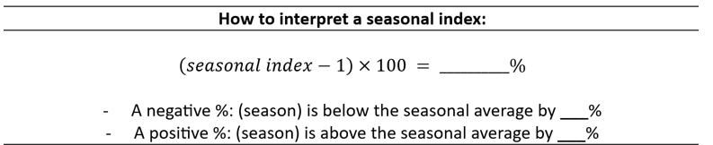
The concept of a seasonal index
Consider the (hypothetical) monthly seasonal indices for unemployment given in the table.
Key fact 1: Seasonal indices are calculated so that their average is 1. This means that the sum of the seasonal indices equals the number of seasons.
Key fact 2: Seasonal indices tell us how a particular season (generally a day, month or quarter) compares to the average season.
1.1 for Jan tells us that Jan Unemployment are typically 10% above average.
0.85 for Sep tells us that Sep Unemployment are typically 15% below average.
Notes:
Page 13 sum notes

Slide 6
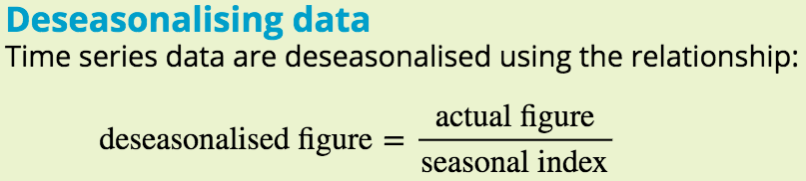
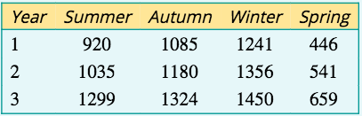
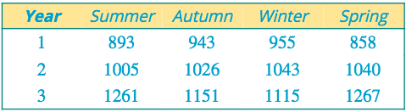

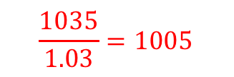

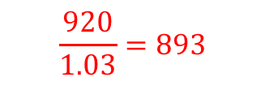

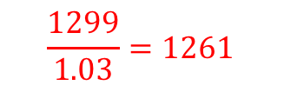

Using seasonal indices to deseasonalise a time series
We can use seasonal indices to remove the seasonal component (deseasonalise) from a time series. Smoothing Time Series when Seasonality spotted.
The quarterly sales figures for Mikki’s shop over a 3-year period are given below.
$$\frac{920}{1.03}=893$$
$$\frac{1035}{1.03}=1005$$
$$\frac{1299}{1.03}=1261$$
Deseasonalised sales figures
Use the seasonal indices shown to deseasonalise these sales figures. Write answers correct to the nearest whole number.
$$893$$
$$1005$$
$$1261$$

Slide 7
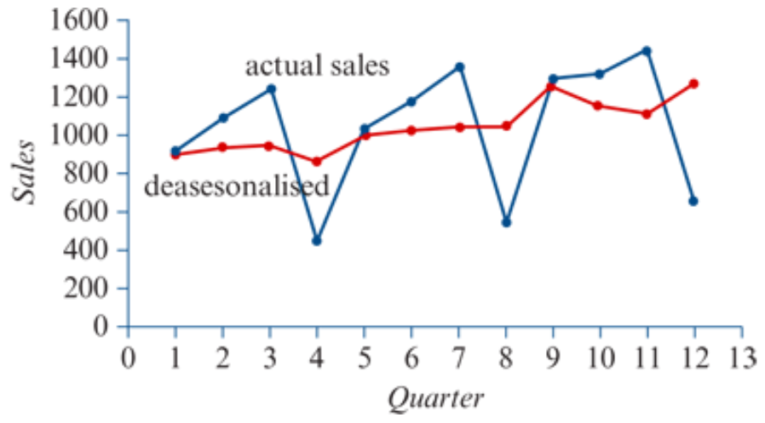
Comparing a plot of the raw data with the deseasonalised data
The plot below shows the time series deseasonalised sales.
Two things to be noticed are that deseasonalising has:
removed the seasonality from the time series plot
revealed a clear underlying trend in the data.
It is common to deseasonalise time series data before you fit a trend line.

Slide 8
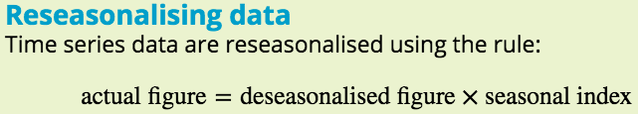
Using seasonal indices to reseasonalise a time series
We can use seasonal indices to remove the seasonal component (deseasonalise) from a time series, or to put it back in (reseasonalise).
The seasonal index for cold drink sales for spring is SI=0.85.
Last spring a beach kiosk’s deseasonalised cold drink sales totalled $10870.
What were the actual sales?
Solution
deseasonalised sales=$10870 and SI=0.85.
Actual sales=10870×0.85=9239.50
The actual sales for spring were $9239.50.

Slide 9
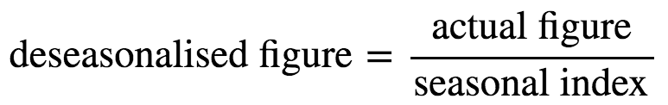
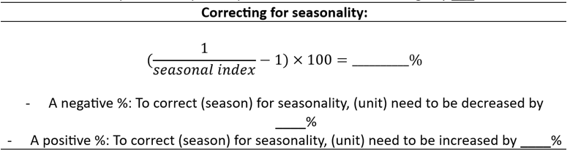
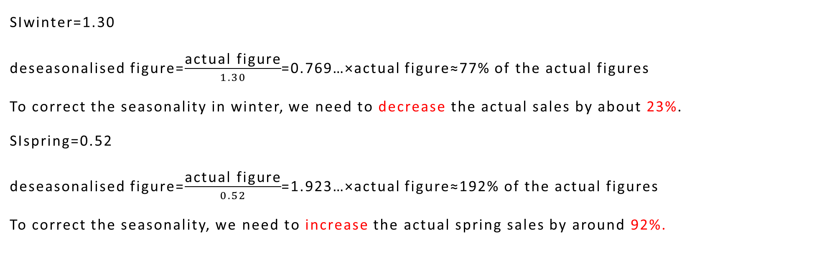
Correcting for seasonality
SIwinter=1.30
deseasonalised figure=$\frac{\text{actual} \text{figure}}{1.30}$=0.769…×actual figure≈77% of the actual figures
To correct the seasonality in winter, we need to decrease the actual sales by about 23%.
SIspring=0.52
deseasonalised figure=$\frac{\text{actual} \text{figure}}{0.52}$=1.923…×actual figure≈192% of the actual figures
To correct the seasonality, we need to increase the actual spring sales by around 92%.
Notes:
Page 13

Slide 10
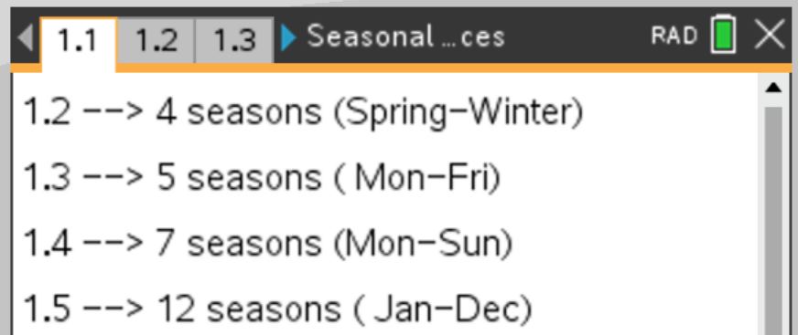
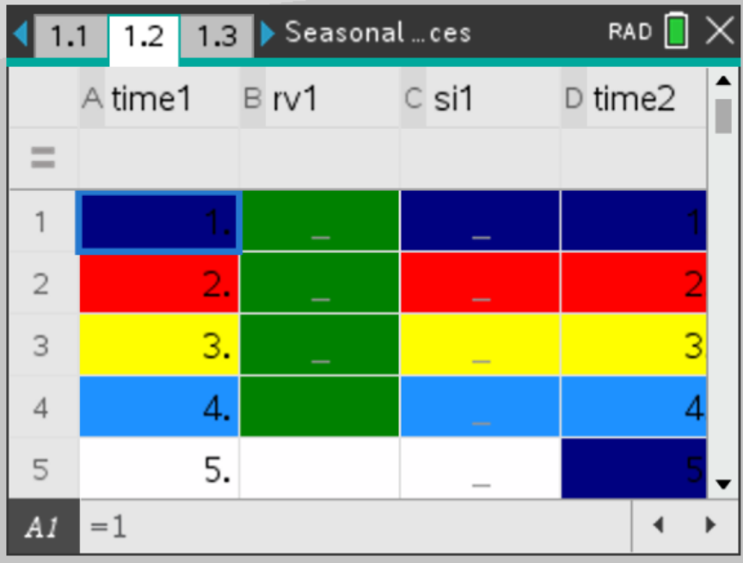
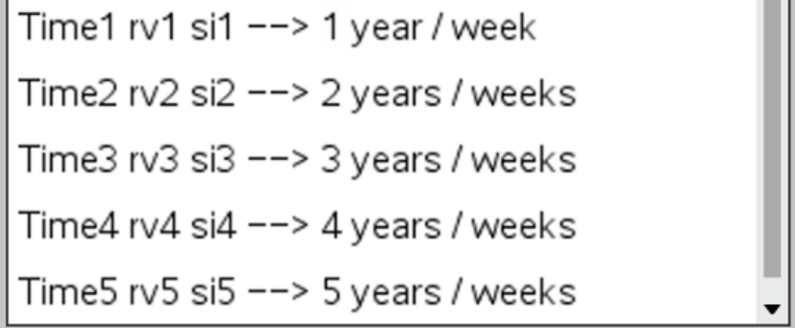
CAS using “ SEASONING” template
CAS Notes 4.6
4 seasons
5 seasons
…………
S.I. Results will show here for each season
Data Input Here

Slide 11
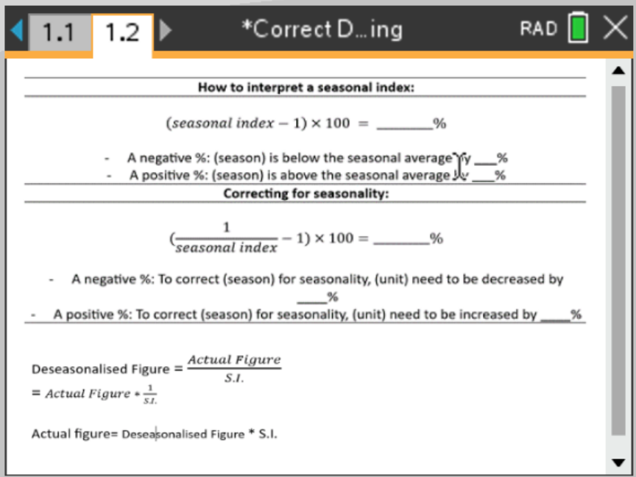
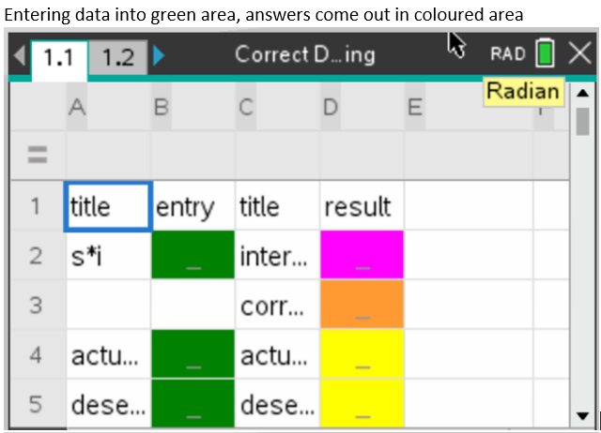
CAS using “ Correct De Seasoning” template
CAS Notes 4.7

