Slide 1

Time series data and least squares regression modelling
4E
Notes:
https://create.kahoot.it/details/6cee124d-9336-4e06-a07a-05343112b695
https://create.kahoot.it/details/3a316544-a450-4b97-ae47-642f4806a571
https://create.kahoot.it/details/3d83c821-1c93-4ae8-b773-dd590cea2002
https://create.kahoot.it/details/5658ab49-804f-4618-af68-51d8065abdff
https://create.kahoot.it/details/01305a2e-ceb2-426b-90ba-61e36af1f8a7

Slide 2
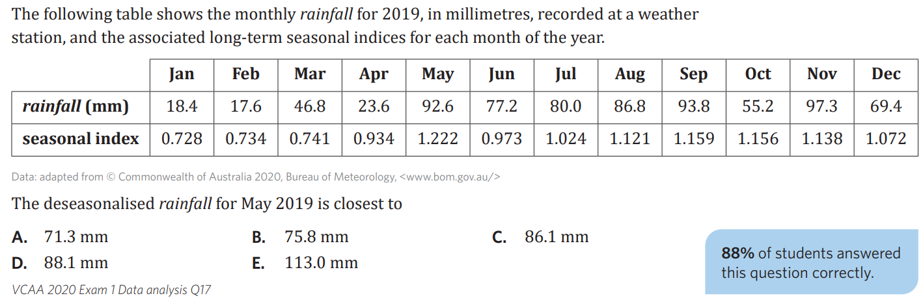


Slide 3

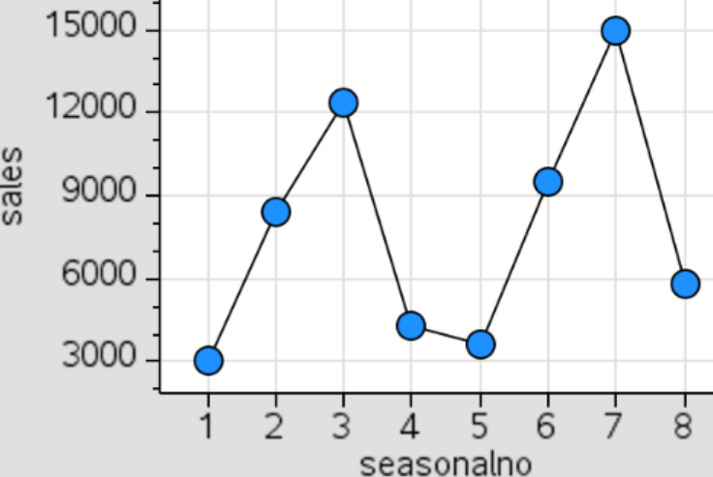
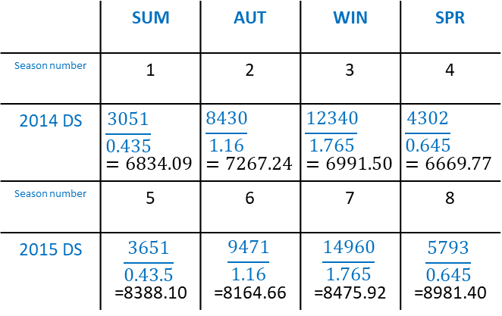
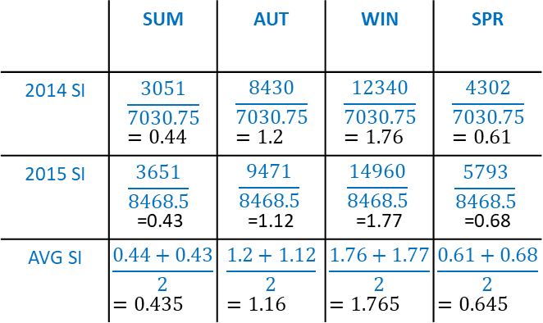
4E: Trendlines and forecasting
trend lines can be fitted to time series plots if there appears to be an increasing or decreasing trend.
→ the LSRL is used
if seasonality is present, data needs to be deseasonalised first before fitting the LSRL
forecasting: making a prediction for the future
→ you need to re-seasonalise the value if the prediction was made from a deseasonalised LSRL.
example: the following sales are from a ski hire shop
seasonality present → need to deseasonalise
1) determine the average SI for each season:
2) deseasonalise each value using the average seasonal index
3) use deseasonalised values to determine LSRL
CAS
ds sales = 6362.35 + 304.97 × season number
4) Forecasting: predict actual sales for winter 2016
season number: 11
DS sales: 6362.35 + 304.97 × 11
= 9717.02
reseasonalise: 9717.02 × 1.765
= 17150.56
 | SUM | AUT | WIN | SPR
Season number | 1 | 2 | 3 | 4
2014 DS | $$\frac{3051}{0.435}=6834.09$$ | $$\frac{8430}{1.16}=7267.24$$ | $$\frac{12340}{1.765}=6991.50$$ | $$\frac{4302}{0.645}=6669.77$$
Season number | 5 | 6 | 7 | 8
2015 DS | $$\frac{3651}{0.43.5}$$ =8388.10 | $$\frac{9471}{1.16}$$ =8164.66 | $$\frac{14960}{1.765}$$ =8475.92 | $$\frac{5793}{0.645}$$ =8981.40
 | SUM | AUT | WIN | SPR
2014 SI | $$\frac{3051}{7030.75}=0.44$$ | $$\frac{8430}{7030.75}=1.2$$ | $$\frac{12340}{7030.75}=1.76$$ | $$\frac{4302}{7030.75}=0.61$$
2015 SI | $$\frac{3651}{8468.5}$$ =0.43 | $$\frac{9471}{8468.5}$$ =1.12 | $$\frac{14960}{8468.5}$$ =1.77 | $$\frac{5793}{8468.5}$$ =0.68
AVG SI | $$\frac{0.44+0.43}{2}=0.435$$ | $$\frac{1.2+1.12}{2}=1.16$$ | $$\frac{1.76+1.77}{2}=1.765$$ | $$\frac{0.61+0.68}{2}=0.645$$
 | SUM | AUT | WIN | SPR | Season av.
2014 | 3051 | 8430 | 12340 | 4302 | 7030.75
2015 | 3651 | 9471 | 14960 | 5793 | 8468.50
Notes:
Board notes

Slide 4

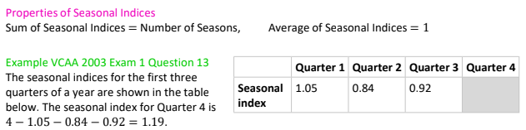

Seasonal Index

Slide 5
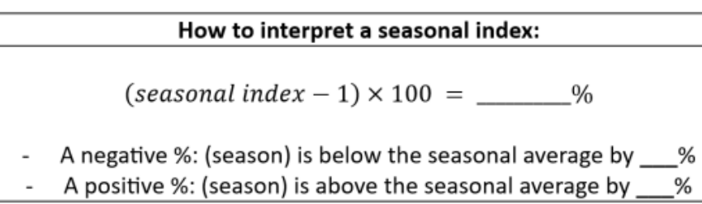
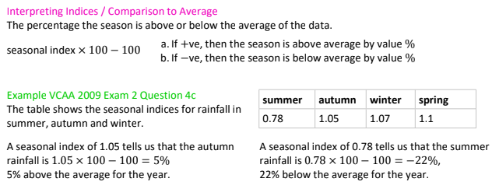
Seasonal Index

Slide 6


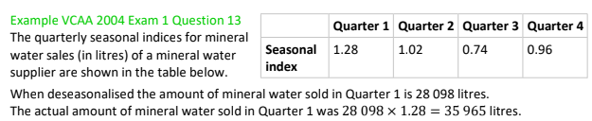
Seasonal Adjustment / De-Seasonalising / Correcting for Seasonality

Slide 7

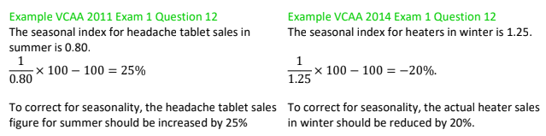
Seasonal Adjustment / De-Seasonalising / Correcting for Seasonality

Slide 8
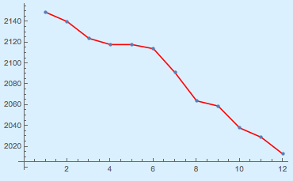
Fitting a trend line
Fit a trend line to the data in the following table, which shows the number of government schools in Victoria over the period 1981–92 and interpret the slope.
EV | 1 | 2 | 3 | 4 | 5 | 6 | 7 | 8 | 9 | 10 | 11 | 12
Number of Schools
Replace Y with RV
Replace X with EV
Number of schools
Year 1982. 1984. 1986 1988 1990. 1992
Year

Slide 9
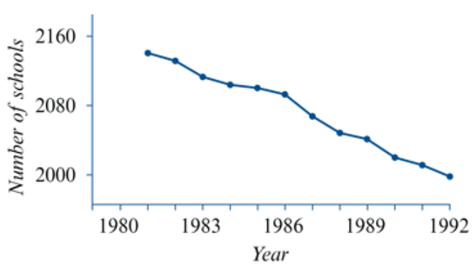
Fitting a trend line
Fit a trend line to the data in the following table, which shows the number of government schools in Victoria over the period 1981–92 and interpret the slope.
EV | 1 | 2 | 3 | 4 | 5 | 6 | 7 | 8 | 9 | 10 | 11 | 12
Number of schools =2169−12.5×=2169−12.5× year
Slope =−12.5
Over the period 1981–92 the number of schools in Victoria decreased at an average rate of 12.5 schools per year.

Slide 10
Forecasting
Using a trend line fitted to a time series plot to make predictions about future values is known as trend line forecasting.
Number of schools =2169−12.5×=2169−12.5× year
How many government schools do we predict for Victoria in 2015 if the same decreasing trend continues? Give your answer correct to the nearest whole number.
= year ‘1’, then 2015 = year ‘35’.
Number of schools=2169−12.5×year
=2169−12.5×35≈1732 schools

Slide 11
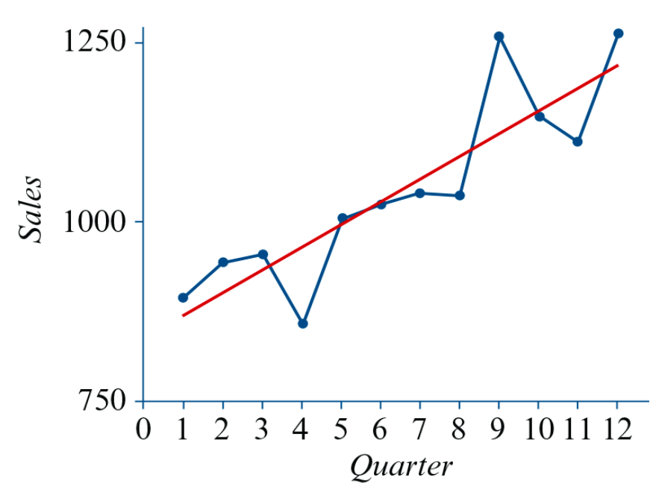
Fitting a trend line (seasonality)
The deseasonalised quarterly sales data from Mikki’s shop are shown below.
Fit a trend line and interpret the slope.
Sales =838.0+32.1× quarter
Over the 3-year period, sales at Mikki’s shop increased at an average rate of 32 sales per quarter.

Slide 12
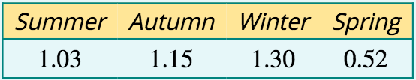
Forecasting taking seasonality into account
When time series data is seasonal, it is usual to deseasonalise the data before fitting the trend line.
Prediction = a deseasonalised value.
This result must be reseasonalised by $×$ S.I.
Sales =838.0+32.1× quarter
What sales do we predict for Mikki’s shop in the winter of year 4? (Because many items have to be ordered well in advance, retailers often need to make such decisions.)
Quarter | 1 | 2 | 3 | 4 | 5 | 6 | 7 | 8 | 9 | 10 | 11 | 12 | 13 | 14 | 15 | 16
 | Summer | Autumn | Winter | Spring | Summer | Autumn | Winter | Spring | Summer | Autumn | Winter | Spring | Summer | Autumn | Winter | Spring
 | Year 1 |  |  |  | Year 2 |  |  |  | Year 3 |  |  |  | Year 4
Sales=838.0+32.1×quarter=838.0+32.1×15=1319.5
Deseasonalised sales prediction for winter of year 4=1319.5
Seasonalised sales prediction for winter of year 4 =1319.5×1.30≈1715

