Slide 1

Operations with matrices
7B

Slide 2
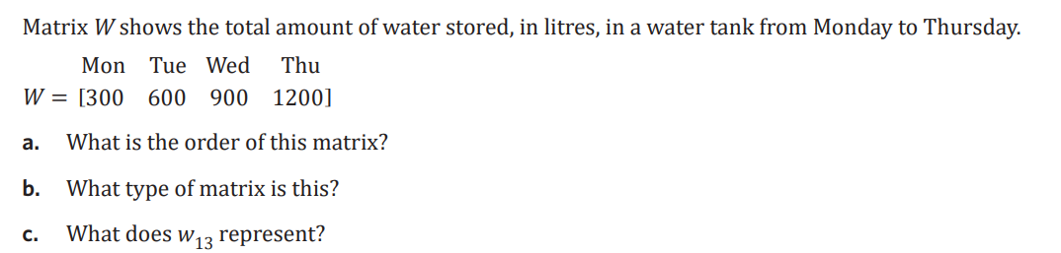

Slide 3
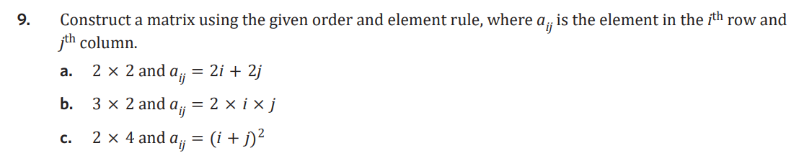
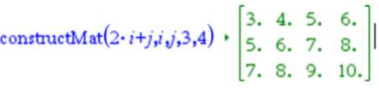
Menu 7 1 a

Slide 4

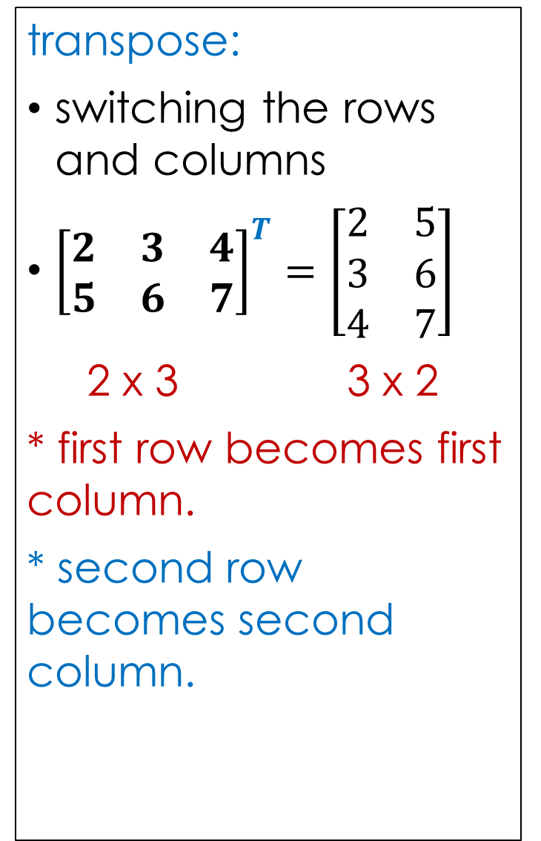


7B: matrix operations
Addition and subtraction:
must have the same order (rows x columns)
add/subtract elements in the same position
A = $\left[\begin{matrix}4 & 7 \\ 8 & 10\end{matrix}\right]$B = $\left[\begin{matrix}6 & 3 \\ 0 & 1\end{matrix}\right]$c = $\left[\begin{aligned}2 \\ 1\end{aligned}\right]$
A + B =$\left[\begin{matrix}4 & 7 \\ 8 & 10\end{matrix}\right]$+$\left[\begin{matrix}6 & 3 \\ 0 & 1\end{matrix}\right]=\left[\begin{matrix}10 & 10 \\ 8 & 11\end{matrix}\right]$
B - A =$\left[\begin{matrix}6 & 3 \\ 0 & 1\end{matrix}\right]─\left[\begin{matrix}4 & 7 \\ 8 & 10\end{matrix}\right]=\left[\begin{matrix}2 & −4 \\ −8 & −9\end{matrix}\right]$
c + B = undefined
scalar multiplication:
multiply each element in the matrix by the scalar.
3A=3$\left[\begin{matrix}4 & 7 \\ 8 & 10\end{matrix}\right]=\left[\begin{matrix}12 & 21 \\ 24 & 30\end{matrix}\right]$
transpose:
switching the rows and columns
${\left[\begin{matrix}2 & 3 & 4 \\ 5 & 6 & 7\end{matrix}\right]}^{T}=\left[\begin{matrix}2 & 5 \\ 3 & 6 \\ 4 & 7\end{matrix}\right]$
2 x 3 3 x 2
* first row becomes first column.
* second row becomes second column.
x
x
Notes:
Board notes

Slide 5
Matrices Operations
Definitions
Equal matrices
Null matrices
Adding and subtracting matrices
Scalar multiplication
Application

Slide 6
Addition and Subtraction of Matrices
We may add or subtract two matrices ONLY if they have the SAME ORDER.
Adding or subtracting matrices is carried out by adding or subtracting their corresponding elements.
If two matrices A and B are of UNEQUAL ORDER
then A + B does not exist.

Slide 7
Addition and Subtraction of Matrices
If two matrices A and B are of SAME ORDER then
A + B = B + A

Slide 8
Rules for Addition and Subtraction of matrices
Matrices are added by adding the elements that are in the same positions.
Matrices are subtracted by subtracting the elements that are in the same positions.
Matrix addition and subtraction can only be done if the two matrices have the same order.

Slide 9
Matrices - Operations
EQUALITY OF MATRICES
Two matrices are said to be equal only when all corresponding elements are equal
Therefore their size or dimensions are equal as well
A =
B =
A = B

Slide 10
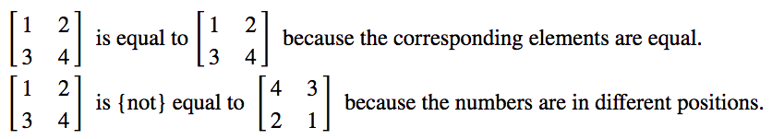
Equality of two matrices
Equal matrices have the same order and each corresponding element is identical in value. It is not sufficient for the two matrices to contain an identical set of numbers; they must also be in the same positions.
For example:

Slide 11
EQUAL MATRICES
Two matrices A and B are equal if EVERY element in A
is equal to EVERY element in B.
Two matrices may be the SAME ORDER but NOT EQUAL.
CAN YOU SEE WHY?

Slide 12
Null Matrix
A square matrix where all elements equal zero.

Slide 13



The zero matrix, 0
In a zero matrix every element is zero.
The following are examples of zero matrices.

Slide 14
Addition and Subtraction (cont.)
Where

Slide 15
Subtraction of matrices
Now, we will subtract the same two matrices
Subtract corresponding entries as follows:
=

Slide 16
An example:
1. Add the matrices
First, note that each matrix has dimensions of 3X3, so we are able to perform the addition. The result is shown at right:
Solution: Adding corresponding entries we have

Slide 17
Definitions - scalar
a scalar is a number
  (denoted with regular type: 1 or 22)

Slide 18
Multiplication by a Scalar
If k is a constant scalar, the matrix kA
is such that EACH OF ITS ENTRIES ARE MULTIPLIED by k

Slide 19
Matrix Multiplication
To multiply a scalar times a matrix, simply multiply each element of the matrix by the scalar quantity

Slide 20
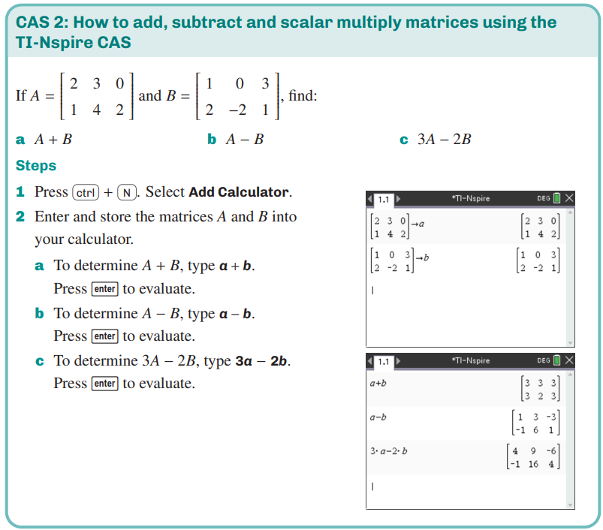

CAS
CAS Notes 7.2

Slide 21
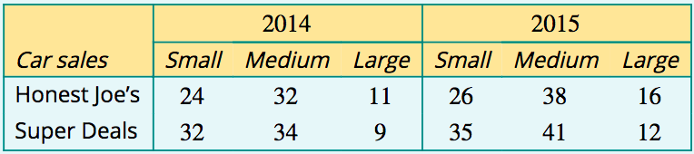

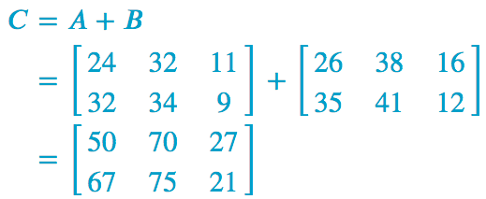
Processing data using addition, subtraction and scalar multiplication
The sales data for two used car dealers, Honest Joe’s and Super Deals, are displayed below.
Construct two matrices, 𝐴 and 𝐵, to represent the sales data for 2014 and 2015 separately.
2. Construct a new matrix 𝐶=𝐴+𝐵. What does this matrix represent?
Matrix 𝐶 represents the total sales for
2014 and 2015 for the two dealers.

Slide 22
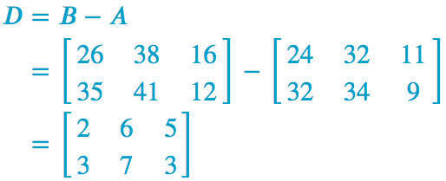
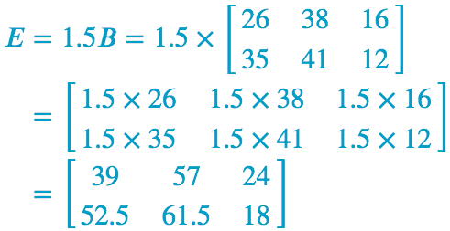
Processing data using addition, subtraction and scalar multiplication
The sales data for two used car dealers, Honest Joe’s and Super Deals, are displayed below.
3. Construct a new matrix, 𝐷=𝐵−𝐴.
What does this matrix represent?
Matrix 𝐷 represents the increase in sales from 2014 and 2015 for the two dealers.
4. Both dealers want to increase their 2015 sales by 50% by 2016. Construct a new matrix 𝐸=1.5𝐵. Explain why this matrix represents the planned sales figures for 2016.
Forming the scalar product 1.5𝐵 multiplies each
element by 1.5. This has the effect of increasing
Each value by 50% per year.

