Slide 1

The equilibrium state matrix
7H

Slide 2
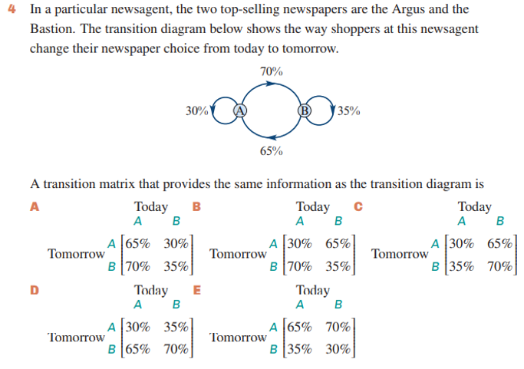

Slide 3

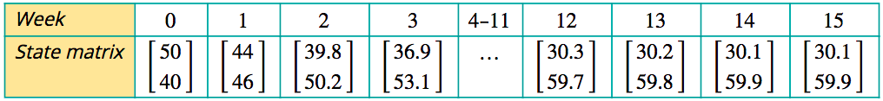
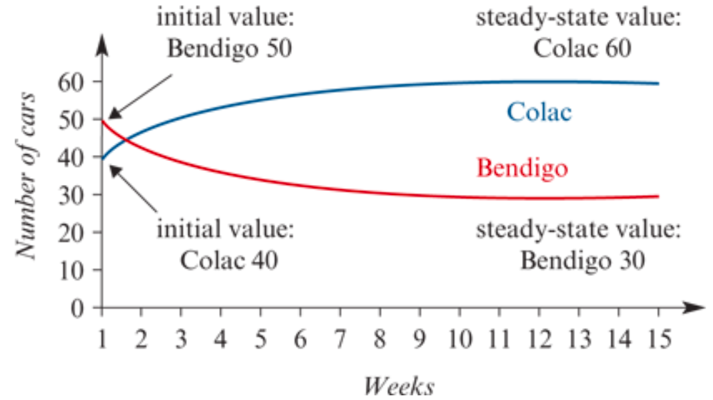
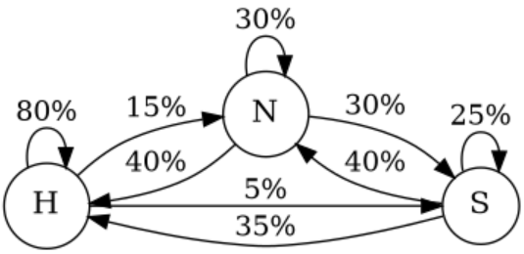

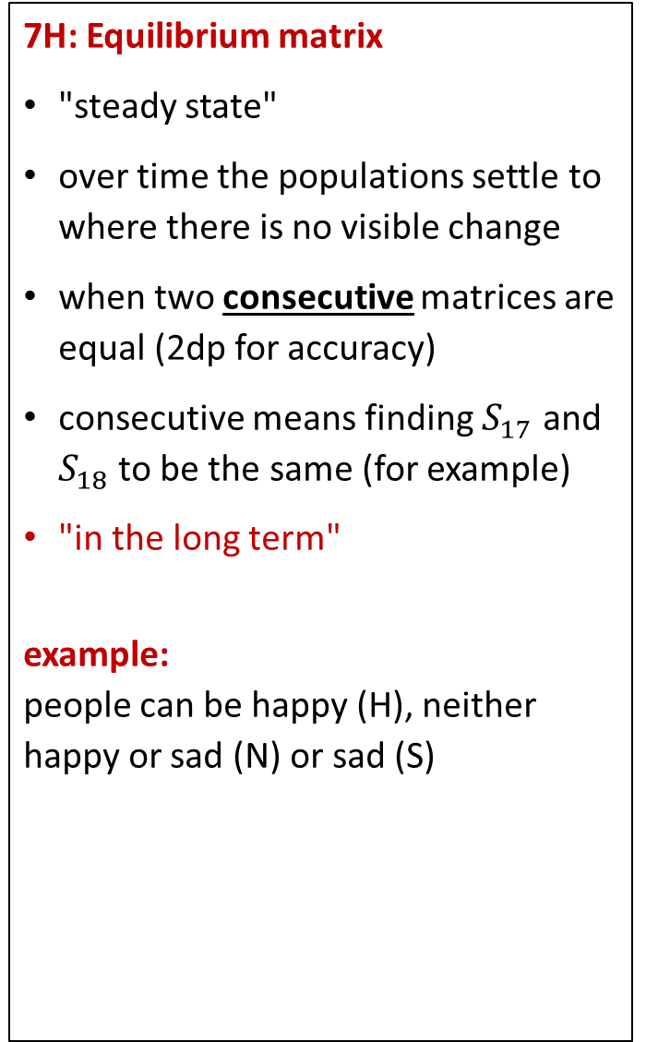
7H: Equilibrium matrix
"steady state"
over time the populations settle to where there is no visible change
when two consecutive matrices are equal (2dp for accuracy)
consecutive means finding $S_{17}$ and $S_{18}$ to be the same (for example)
"in the long term"
example:
people can be happy (H), neither happy or sad (N) or sad (S)
a. complete T today
H N S
$$T=\left[\begin{matrix}0.8 & 0.4 & 0.35 \\ 0.15 & 0.3 & 0.4 \\ 0.05 & 0.3 & 0.25\end{matrix}\right]$$
0.05 = 5%
b. on a given day 1200 ppl are happy, 600 are neither and 200 are sad, construct $S_{0}$
$$S_{0}=\left[\begin{aligned}1200 \\ 600 \\ 200\end{aligned}\right]$$
c. In the long term, how many people are expected to be happy??
$$S_{15}=S_{16}=\left[\begin{aligned}1312 \\ 429 \\ 259\end{aligned}\right]$$
1312 ppl expected to be happy.
To investigate a car rental question, we start by listing the state matrices from week 0 to week 15.
In summary, even though the number of cars returned to each location varied from day to day, the numbers at each location eventually settled down to an equilibrium or steady-state solution. In the steady state, the number of cars at each location remained the same.
H
N
S
tomorrow
H
N
S
H
N
S
Notes:
Board notes

Slide 4
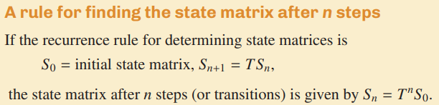
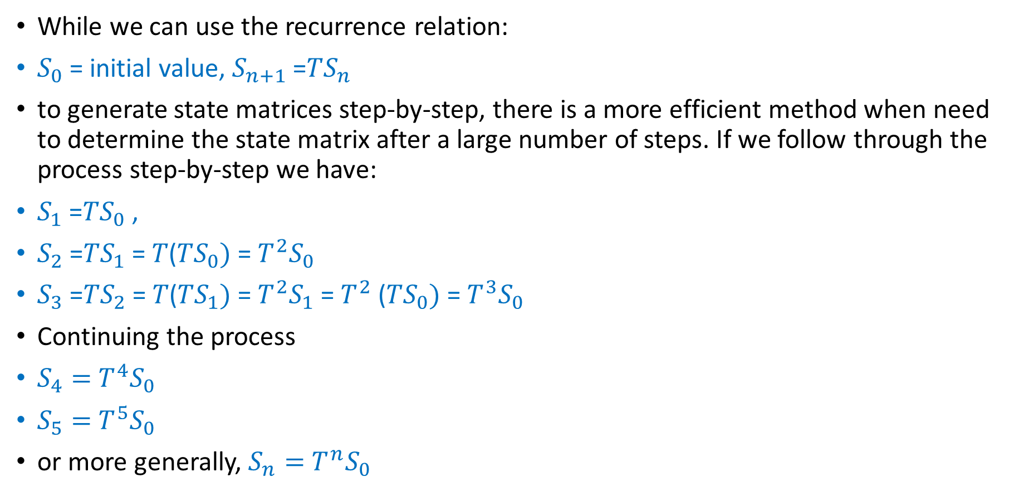
A rule for determining the state matrix of a system after 𝐧 steps
While we can use the recurrence relation:
$S_{0}$= initial value, $S_{n+1}$=𝑇$S_{n}$
to generate state matrices step-by-step, there is a more efficient method when need to determine the state matrix after a large number of steps. If we follow through the process step-by-step we have:
$S_{1}$=𝑇$S_{0}$,
$S_{2}$=𝑇$S_{1}$= 𝑇(𝑇$S_{0})$= $T^{2}S_{0}$
$S_{3}$=𝑇$S_{2}$= 𝑇(𝑇$S_{1})$= $T^{2}S_{1}$= $T^{2}$ (𝑇$S_{0})$= $T^{3}S_{0}$
Continuing the process
$S_{4}=$ $T^{4}S_{0}$
$S_{5}=$ $T^{5}S_{0}$
or more generally, $S_{n}=$ $T^{n}S_{0}$

Slide 5

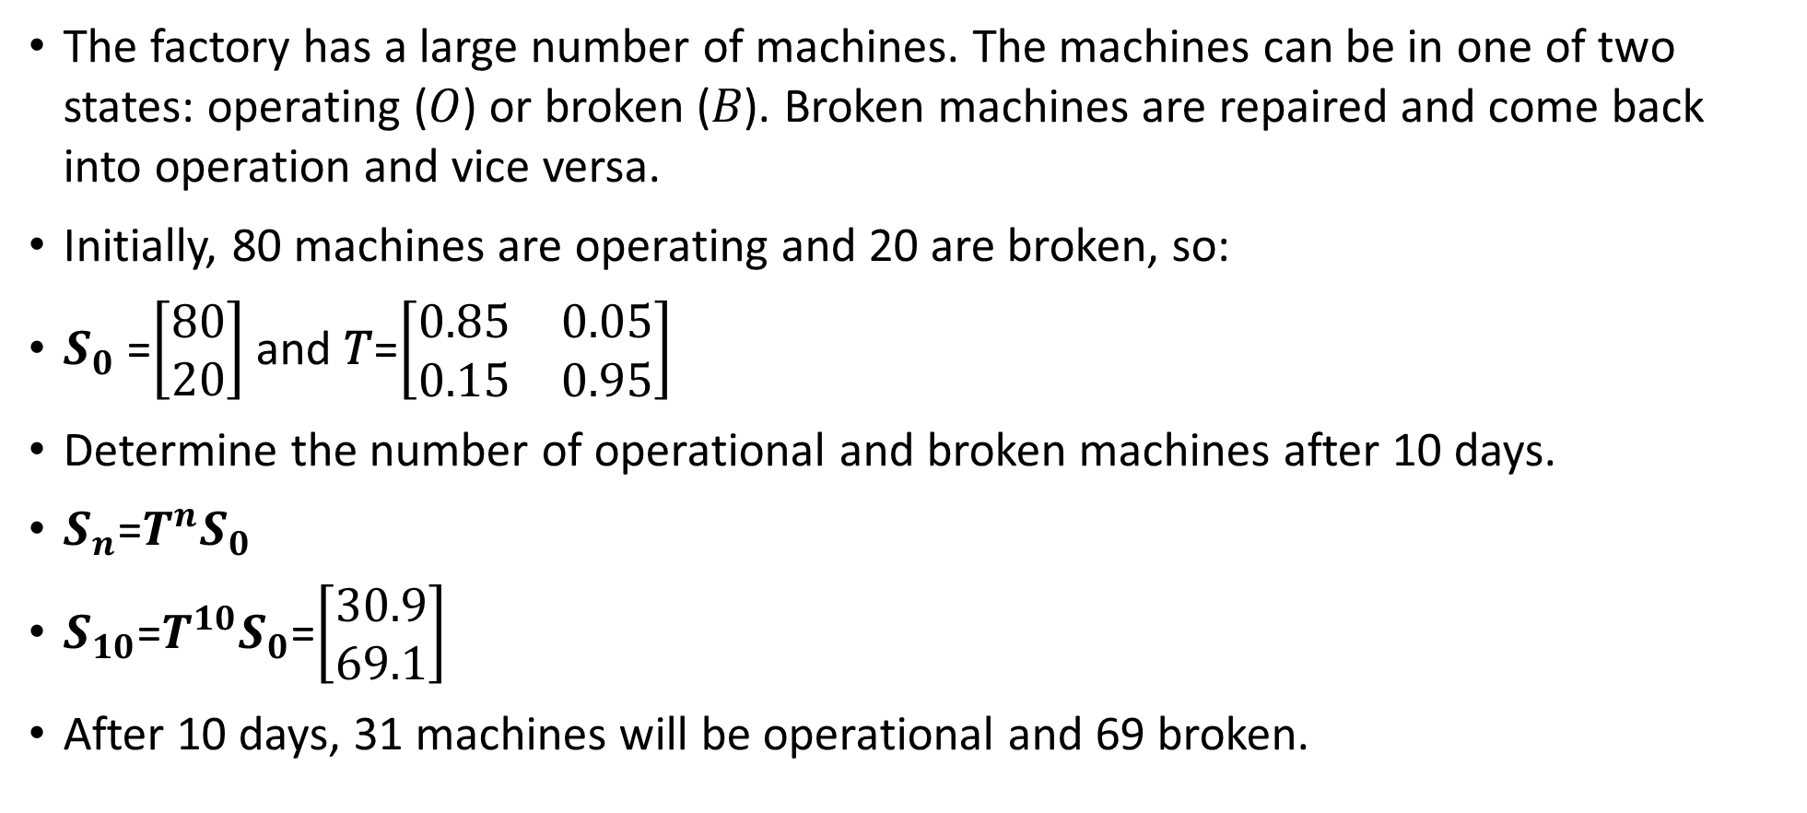
Determining the 𝑛th state of a system using the rule $S_{n}$=$T^{n}S_{0}$
The factory has a large number of machines. The machines can be in one of two states: operating (𝑂) or broken (𝐵). Broken machines are repaired and come back into operation and vice versa.
Initially, 80 machines are operating and 20 are broken, so:
$S_{0}$=$\left[\begin{aligned}80 \\ 20\end{aligned}\right]$ and 𝑇=$\left[\begin{matrix}0.85 & 0.05 \\ 0.15 & 0.95\end{matrix}\right]$
Determine the number of operational and broken machines after 10 days.
$S_{n}$=$T^{n}S_{0}$
$S_{10}$=$T^{10}S_{0}$=$\left[\begin{aligned}30.9 \\ 69.1\end{aligned}\right]$
After 10 days, 31 machines will be operational and 69 broken.
Need CAS

Slide 6
The steady-state solution
A second question a manager might like answered about the car rental is as follows.
‘Will the number of rental cars available from each location vary from week to week or will they settle down to some fixed value?’
To investigate this question, we start by listing the state matrices from week 0 to week 15.
In summary, even though the number of cars returned to each location varied from day to day, the numbers at each location eventually settled down to an equilibrium or steady-state solution. In the steady state, the number of cars at each location remained the same.

Slide 7
The steady-state solution
Important
In the steady state, cars are still moving between Bendigo and Colac, but the number of cars rented in Bendigo and returned to Colac is balanced by the number of cars rented in Colac and returned to Bendigo. Because of this balance, the steady state is also called the equilibrium state.
For a system to have a steady state, the transition matrix must be regular and the columns must add up to 1. A regular matrix is one whose powers never contain any zero elements. In practical terms, this means that every state represented in the transition matrix is accessible, either directly or indirectly from every other state.

Slide 8
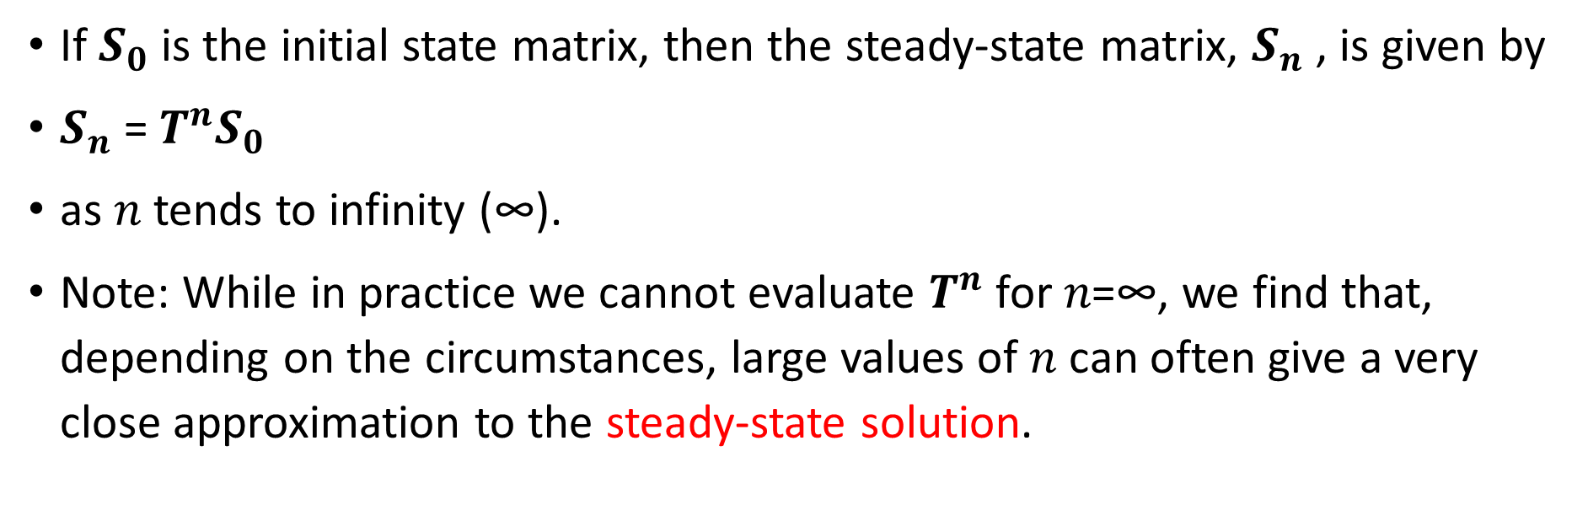
Estimating the steady state solution
If $S_{0}$ is the initial state matrix, then the steady-state matrix, $S_{n}$, is given by
$S_{n}$= $T^{n}S_{0}$
as 𝑛 tends to infinity (∞).
Note: While in practice we cannot evaluate $T^{n}$ for 𝑛=∞, we find that, depending on the circumstances, large values of 𝑛 can often give a very close approximation to the steady-state solution.

Slide 9
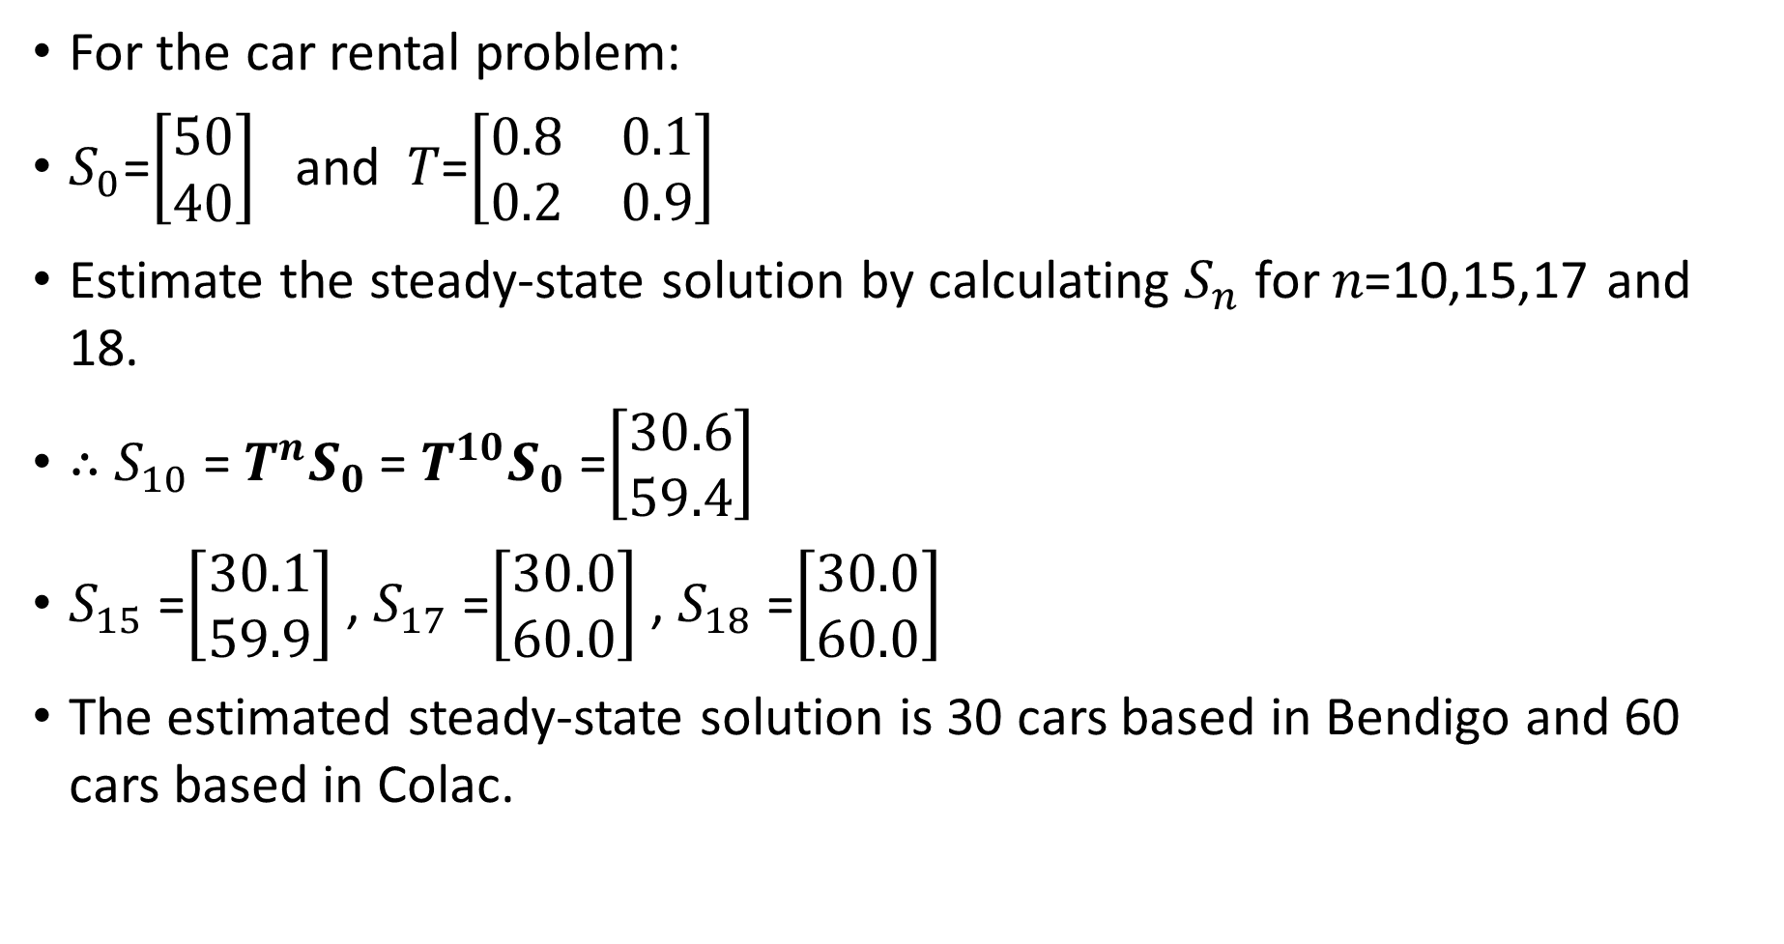
Estimating the steady-state solution
For the car rental problem:
$S_{0}$=$\left[\begin{aligned}50 \\ 40\end{aligned}\right]$ and 𝑇=$\left[\begin{matrix}0.8 & 0.1 \\ 0.2 & 0.9\end{matrix}\right]$
Estimate the steady-state solution by calculating $S_{n}$ for 𝑛=10,15,17 and 18.
∴ $S_{10}$= $T^{n}S_{0}$= $T^{10}S_{0}$=$\left[\begin{aligned}30.6 \\ 59.4\end{aligned}\right]$
$S_{15}$=$\left[\begin{aligned}30.1 \\ 59.9\end{aligned}\right]$, $S_{17}$=$\left[\begin{aligned}30.0 \\ 60.0\end{aligned}\right]$, $S_{18}$=$\left[\begin{aligned}30.0 \\ 60.0\end{aligned}\right]$
The estimated steady-state solution is 30 cars based in Bendigo and 60 cars based in Colac.
Need CAS

Slide 10
Transition matrix modelling using the rule $S_{n+1}$=$TS_{n}+B$
To date, we have only considered matrix recurrence models of the form
$S_{0}$= intial state matrix, $S_{n+1}$=𝑇$S_{n}$
This recurrence model → cars, machines, people or birds
But what happens if management wants to add an extra car at each location each week?
To allow for this situation we need to use the matrix recurrence relation:
$S_{0}$= intial state matrix, $S_{n+1}$=𝑇$S_{n}+B$
where 𝐵 is a column matrix.

Slide 11
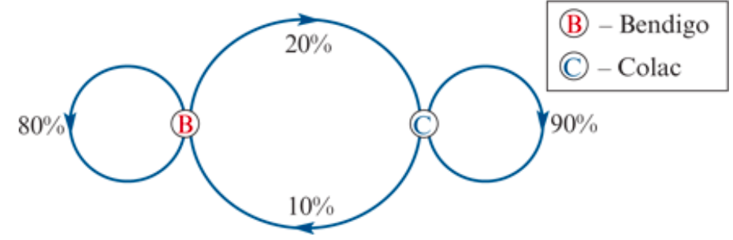
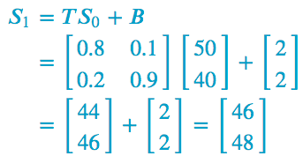
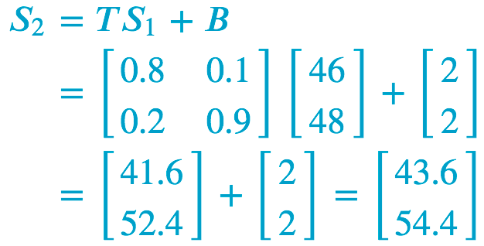
Determining the $n^{th}$ state of a system using the rule $S_{n+1}$=$TS_{n}+B$
A rental starts with 90 cars, 50 located at Bendigo and 40 located at Colac.
To increase the number of cars, 2 extra cars are added to the rental fleet at each location each week. The recurrence relation that can be used to model this situation is:
$S_{0}$=$\left[\begin{aligned}50 \\ 40\end{aligned}\right]$ $S_{n+1}$=$TS_{n}+B$where 𝑇=$\left[\begin{matrix}0.8 & 0.1 \\ 0.2 & 0.9\end{matrix}\right]$and 𝐵=$\left[\begin{aligned}2 \\ 2\end{aligned}\right]$
Determine the number of cars at Bendigo and Colac after:
1 week
2 weeks.
Thus, we predict that there will be 46 cars in Bendigo and 48 cars in Colac.
Thus, we predict that there will be 44 cars in Bendigo and 55 cars in Colac.
Notes:
Unfortunately, the recurrence rule 𝑆𝑛+1=𝑇𝑆𝑛+𝐵 does not lead to a simple rule for the state matrix after 𝑛n steps, so we need to work our way through this sort of problem step-by-step.

Slide 12
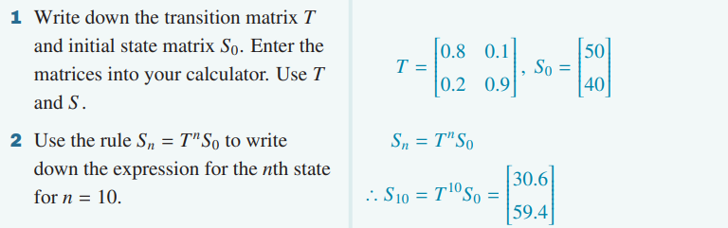
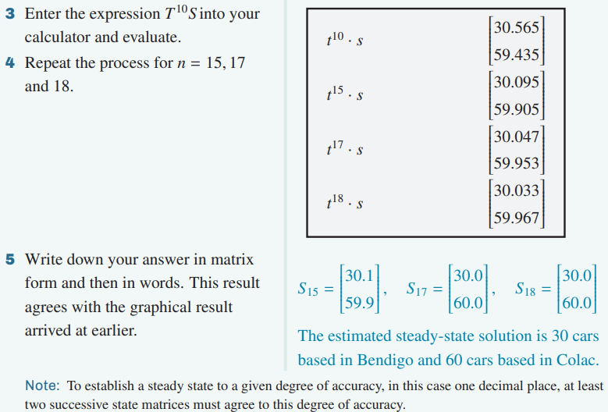
CAS Notes 7.7
CAS Notes 7.9

Slide 13
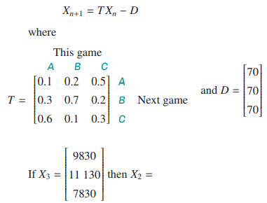
Using the inverse matrix of a transition matrix
$S_{n+1}$=$TS_{n}+B$
If we are looking for previous term, we use in Question 4:
$S_{n}$= $T^{−1}$ ($S_{n+1}$− B)
Need CAS

