Slide 1
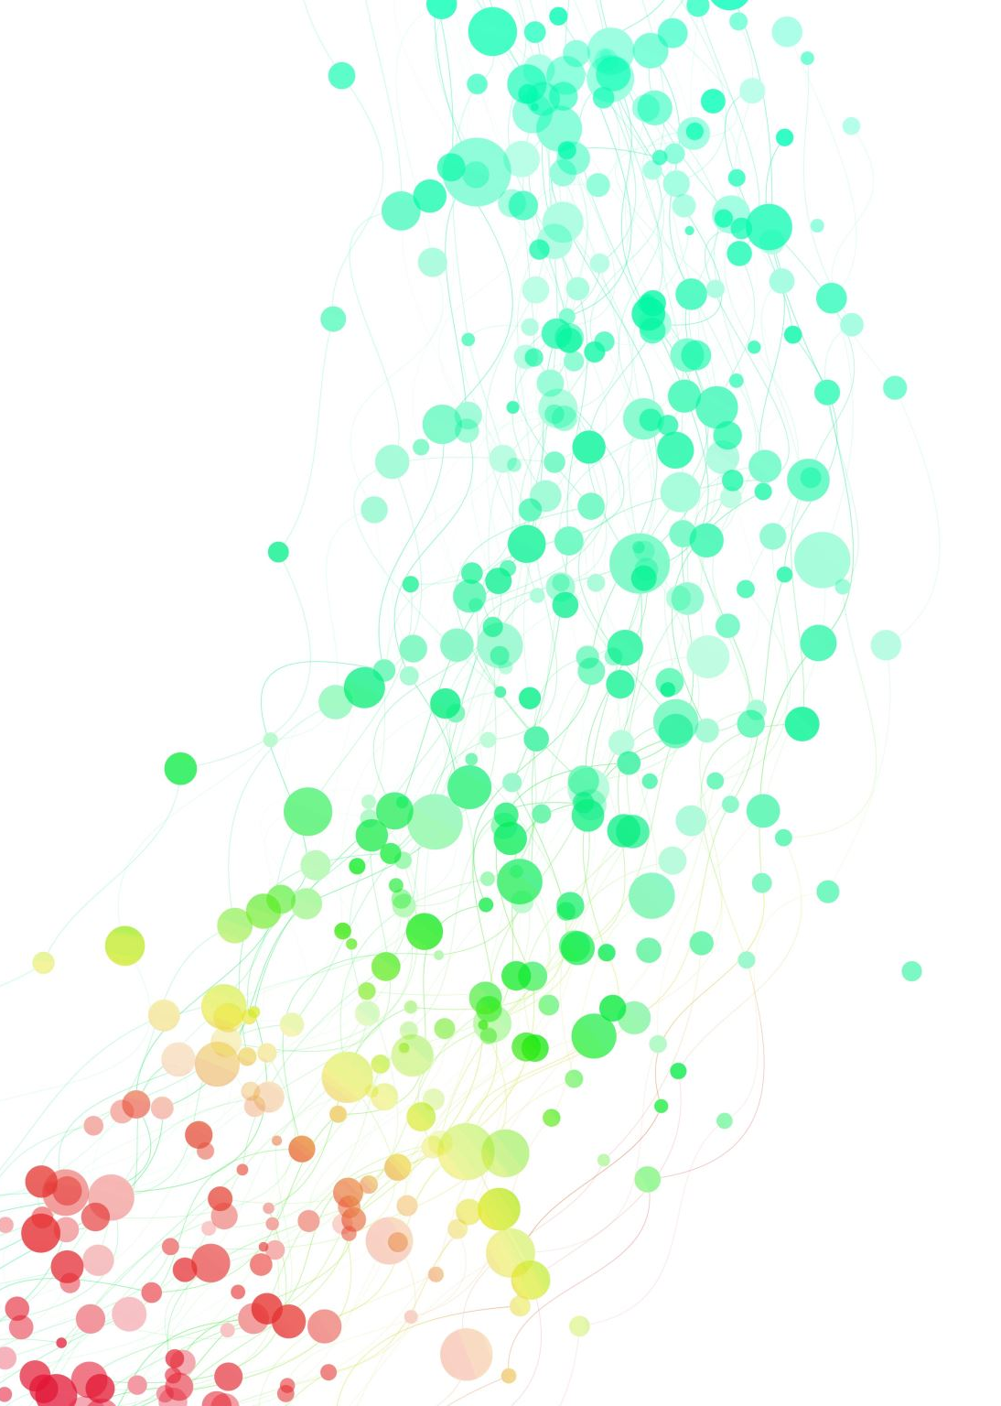
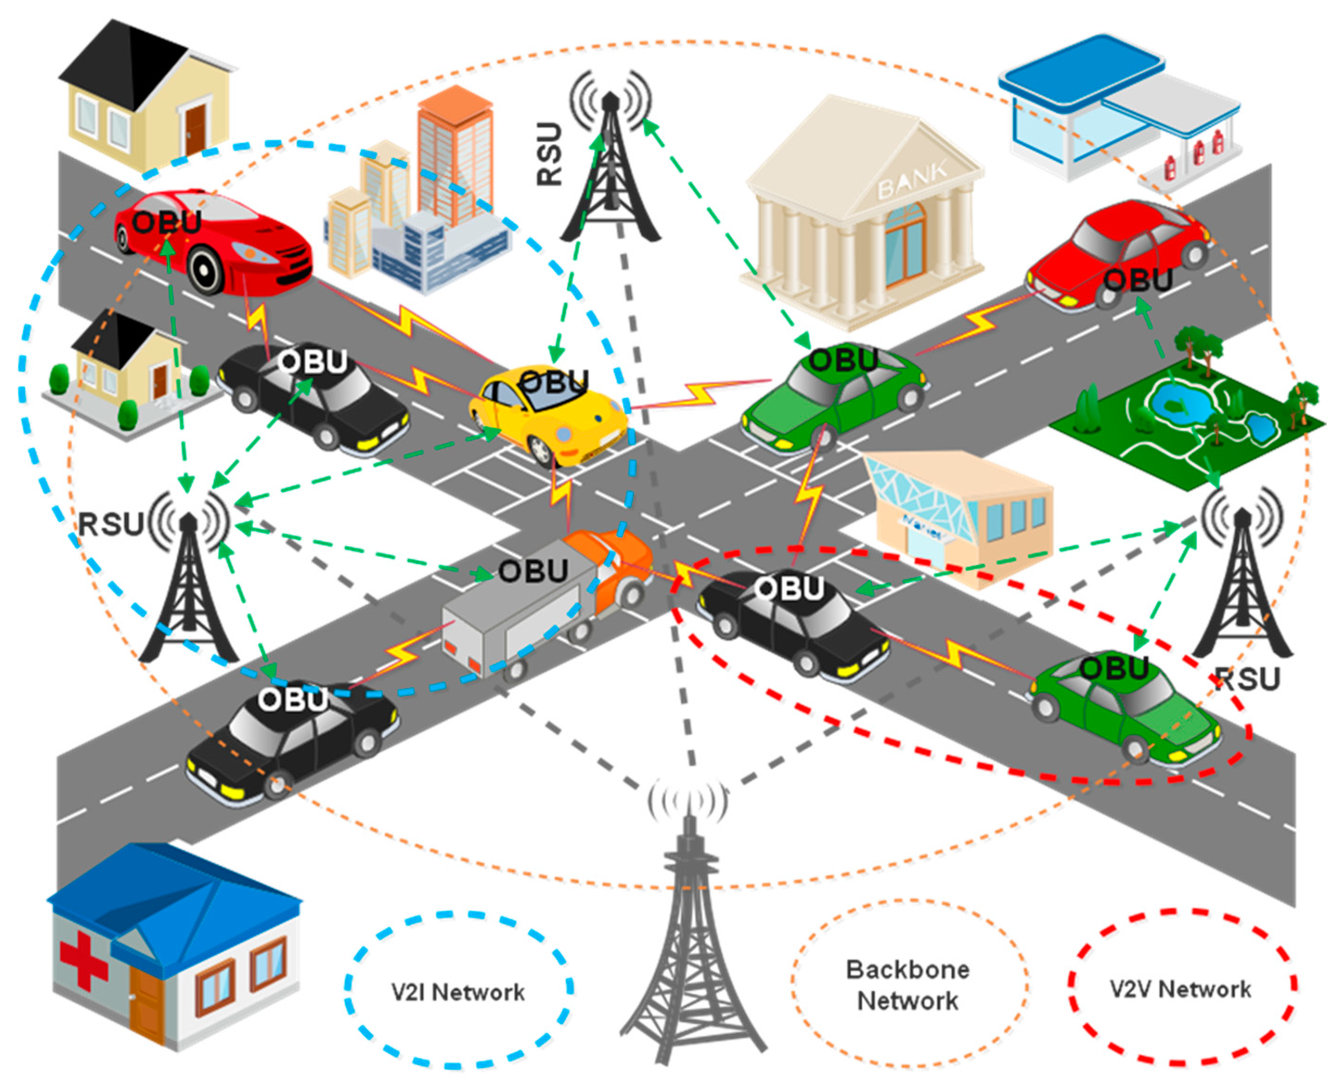
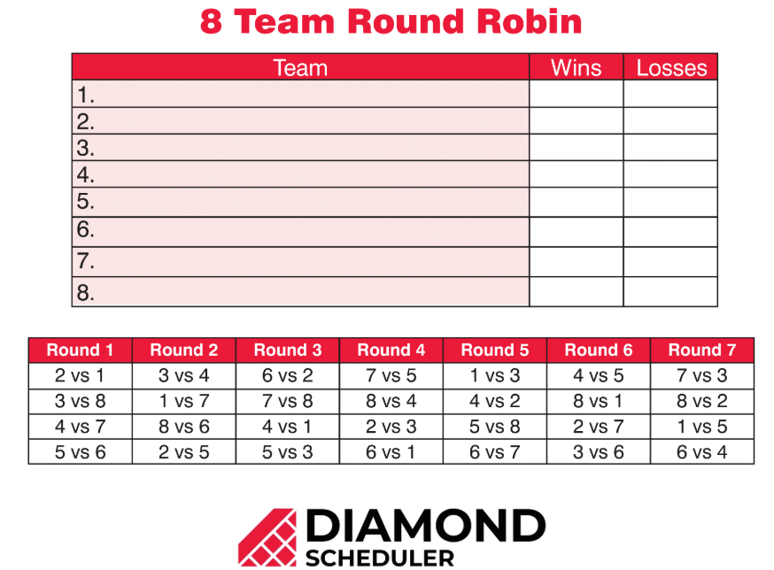
Communication and dominance matrices
7F
V2V Enabled Intelligent Transportation System

Slide 2
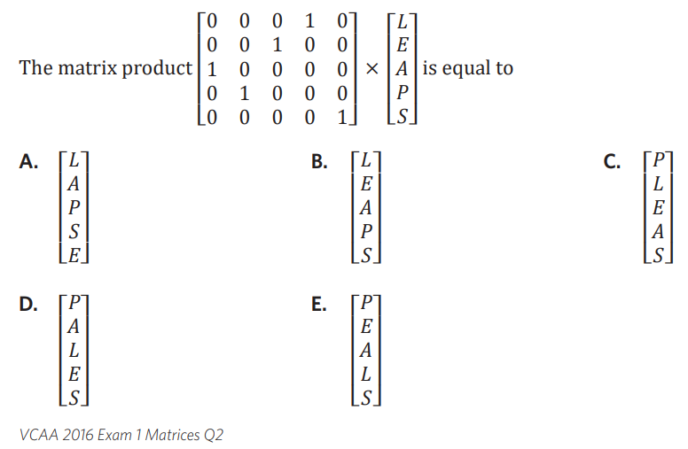
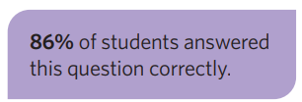

Slide 3

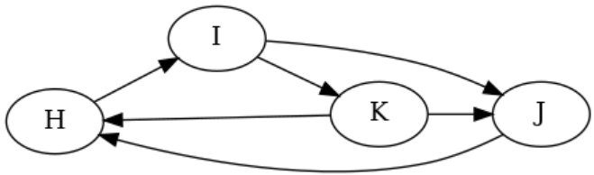



7F: communication + dominance.
communication:
one step: square binary matrix
- 1’s represent a direct line of communication
- links go both ways
- C = one step
- C² = two step (communication via someone else)
- C + C² = TC (total communication) showing all one and two step links
Example (undirected)
Jess
Hailey Charlie
C H J
$$C=\left[\begin{matrix}0 & 0 & 1 \\ 0 & 0 & 1 \\ 1 & 1 & 0\end{matrix}\right]$$
C H J
$$C^{2}=\left[\begin{matrix}1 & 1 & 0 \\ 1 & 1 & 0 \\ 0 & 0 & 2\end{matrix}\right]$$
C + C² = TC
C H J
$$TC=\left[\begin{matrix}1 & 1 & 1 \\ 1 & 1 & 1 \\ 1 & 1 & 2\end{matrix}\right]$$
dominance:
- used to display hierarchy
- one-way connections
- 1’s are used for “winners”
- D = one step
D² = two step
D + D² = TD
directed
arrows point to losers
example: chess tournament results
H beat I
I beat J and K
J beat H
K beat H and J
who is the most dominant?
Loser
H I J K
$$D= winner \left[\begin{matrix}0 & 1 & 0 & 0 \\ 0 & 0 & 1 & 1 \\ 1 & 0 & 0 & 0 \\ 1 & 0 & 1 & 0\end{matrix}\right]$$
$$D^{2}= \left[\begin{matrix}0 & 0 & 1 & 1 \\ 2 & 0 & 1 & 0 \\ 0 & 1 & 0 & 1 \\ 1 & 1 & 0 & 0\end{matrix}\right]$$
$$TD= \left[\begin{matrix}0 & 1 & 1 & 1 \\ 2 & 0 & 2 & 1 \\ 1 & 1 & 0 & 1 \\ 2 & 1 & 1 & 0\end{matrix}\right]$$
sum
rows
3
3
4
C
H
J
H
I
J
K
1
2 → best
1
2 → best
H
I
J
K
2
3 → 1st
1
2
C
H
J
H
I
J
K
3 → 3rd
5 → 1st
3 → 3rd
4 → 2nd
C
H
J
*1 way for H and C
to comm via J
*redundant links
“message bounces back”
Notes:
https://www.youtube.com/watch?v=XM8MWi8_A3o

Slide 4
Communication matrices
A communication matrix is a square binary matrix in which the 1s represent the links in a communication system.

Slide 5
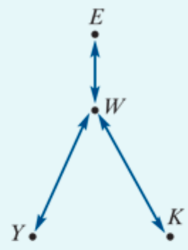
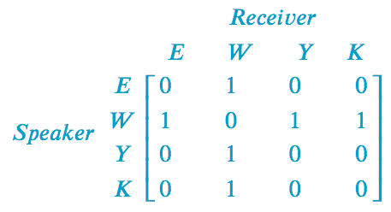
Constructing a communication matrix
Eva, Wong, Yumi and Kim are students who are staying in a backpacker’s hostel. Because they speak different languages, they can have problems communicating. The situation they must deal with is that:
Eva speaks English only
Yumi speaks Japanese only
Kim speaks Korean only
Wong speaks English, Japanese and Korean.
Conveniently, this information can be summarised in a network diagram, as shown above. In this diagram, the arrow linking Eva and Wong indicates that they can communicate directly because they both speak English.
The task is to construct a communication matrix.
Notes:
Designate each element as a ‘1’ or ‘0’ according to the following rules:the element =1 if two people can communicate directly because they speak the same language
the element =0 if two people cannot communicate directly because they do not have a common language.

Slide 6
one-step & two-step communication link
For example, we can see from the network diagram that Eva, who speaks only English, cannot communicate directly with Yumi, who speaks only Japanese. We call this a one-step communication link.
However, Eva can communicate with Yumi by sending a message via Wong, who speaks both English and Japanese. In the language of communication systems we call this a two-step communication link.

Slide 7
one-step & two-step communication link
A one-step communication link is when communication can occur directly between two people in the network.
We can see that W has a one-step communication link with each of the other 3 members of the network, and each of the other three have only a single one-step communication link (with W).
However, Y,K and E can still communicate with each other, by using W as an intermediary. For example:
K can communicate with Y using the links: 𝐾 → 𝑊 → 𝑌. This is called a two-step communication link, because there are two steps (and one intermediary).
Question:
Determine all the two-step communication links in this network?

Slide 8
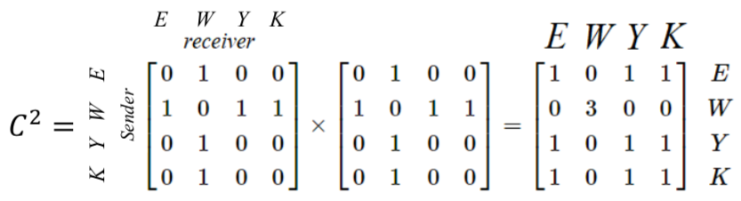
The power of the matrix → 2-step communication link
The power of the matrix representation is that squaring the communication matrix generates a matrix that identifies all possible two-step communication links in a communication network. For example, if we call the communication matrix 𝐶, we have:

Slide 9
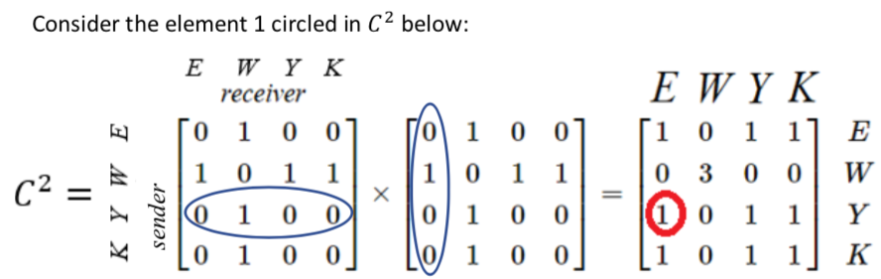
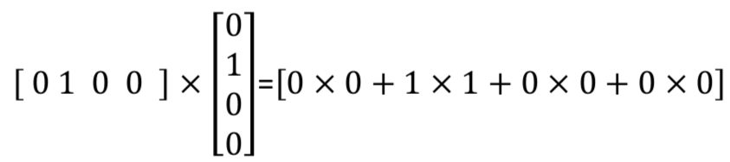

The power of the matrix → 2-step communication link
Multiplying the two 1’s together in the 3rd row and 1st column represents the two step link: Y→ 𝑊 → 𝐸

Slide 10

Redundant communication links
Two-step links that have the same sender and receiver are said to be redundant communication links because they do not contribute to the communication between different people.

Slide 11
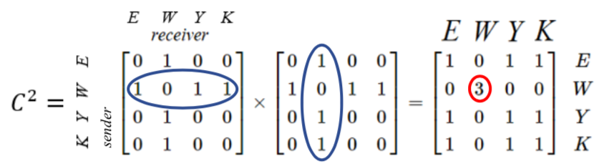


Redundant communication links
Consider the element 3 in $C^{2}$ circled:
Each time we multiply 1 by 1 we are representing a 2 step communication link with the communicator and the receiver being the same person:
The first product of 1⋅1 corresponds to: 𝑊 → 𝐸 → 𝑊, which is a redundant communication link.
The product of 0⋅0 corresponds to 𝑊 → 𝑊 → 𝑊, which is not a communication link at all.
The second product of 1⋅1 corresponds to: 𝑊 → 𝑌 → 𝑊, which is a redundant communication link .
The third product of 1⋅1 corresponds to: 𝑊 → K → 𝑊, which is a redundant communication link.

Slide 12
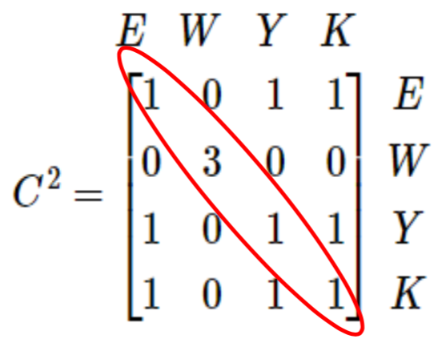
All of the non-zero elements in the leading diagonal of a communication matrix, or its powers, represent redundant links in the matrix.
However, all of the remaining non-zero elements represent meaningful two-step communication links.
For example, the 1 in row Y, column K represents the two-step communication link that enables Yumi to send a message to Kim.

Slide 13
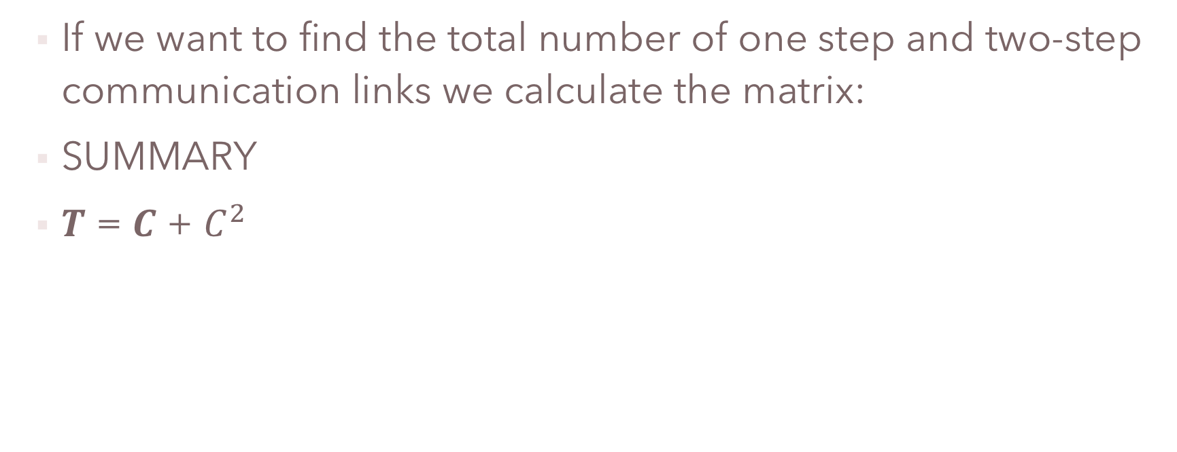
The total number of one step and two-step communication links
If we want to find the total number of one step and two-step communication links we calculate the matrix:
SUMMARY
𝑻 = 𝑪 + $C^{2}$

Slide 14
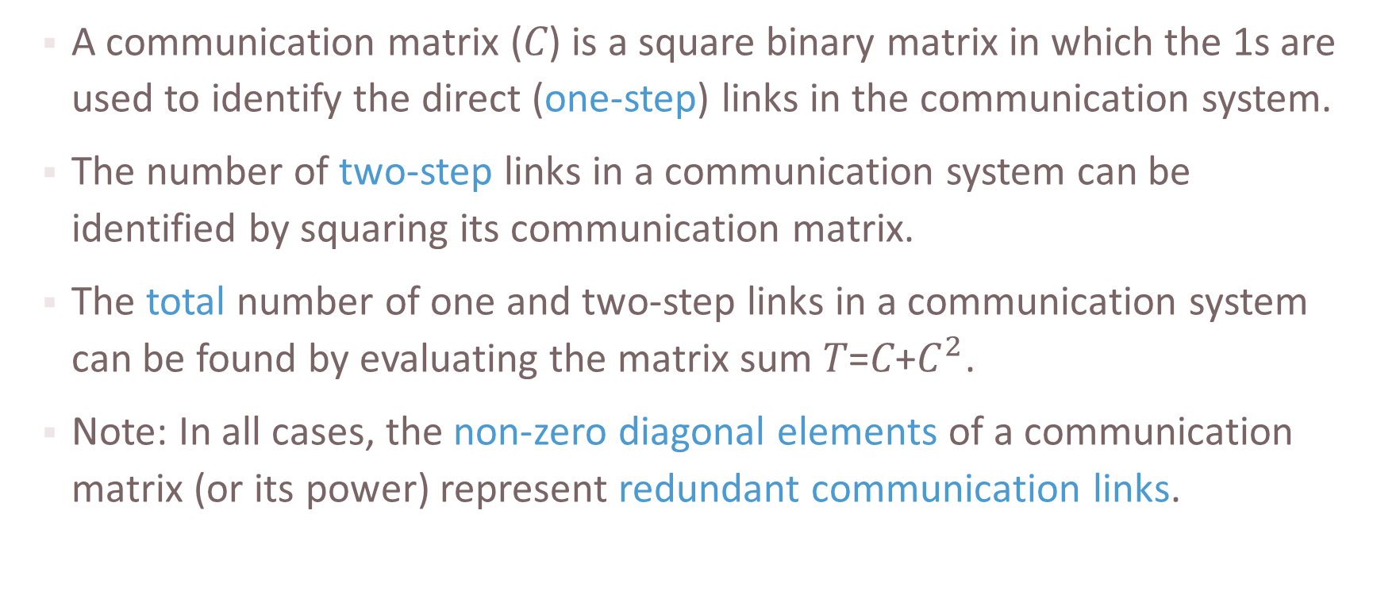
Analysing communication matrices
A communication matrix (𝐶) is a square binary matrix in which the 1s are used to identify the direct (one-step) links in the communication system.
The number of two-step links in a communication system can be identified by squaring its communication matrix.
The total number of one and two-step links in a communication system can be found by evaluating the matrix sum 𝑇=𝐶+$C^{2}$.
Note: In all cases, the non-zero diagonal elements of a communication matrix (or its power) represent redundant communication links.

Slide 15
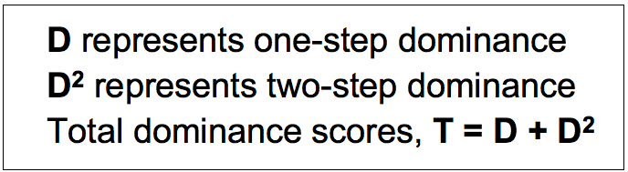
Dominance matrix
Is a square binary matrix in which 1s represent one-step dominance between members of a group. The same approach as communication networks can be used to analyse problems.

Slide 16
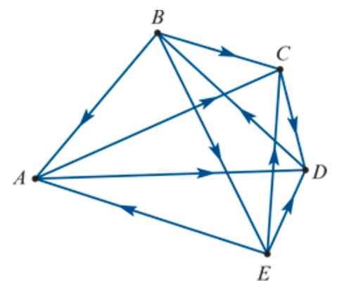
Dominance
For example, five players – Anna, Birgit, Cas, Di and Emma – played in a round-robin tournament of tennis to see who was the dominant (best) player.
The results were as follows:
Anna defeated Cas and Di. (A→C, A→D)
Birgit defeated Anna, Cas and Emma (B→A, B→C, B→E)
Cas defeated Di (C→D)
Di defeated Birgit (D→B)
Emma defeated Anna, Cas and Di (E→A, E→C, E→D).
We can use a network diagram to display the results graphically, as shown above. In this diagram, the arrow from 𝐵 to 𝐴 tells us that, when they played, Birgit defeated Anna.
Both Birgit and Emma had three wins each so there is a tie. How can we resolve this situation and see who is the best player? One way of doing this is to calculate a dominance score for each player. We do this by a constructing a series of dominance matrices.
Notes:
A round-robin tournament is one in which each of the participants play each other once.

Slide 17
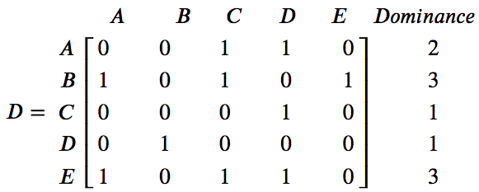
One-step dominances
The first dominance matrix, 𝐷, records the number of one-step dominances between the players.
For example, Anna has a one-step dominance over Cas because, when they played, Anna beat Cas.
This matrix can be used to calculate a one-step dominance score for each player, by summing each of the rows of the matrix. According to this analysis, 𝐵 and 𝐸 are equally dominant with a dominance score of 3.

Slide 18
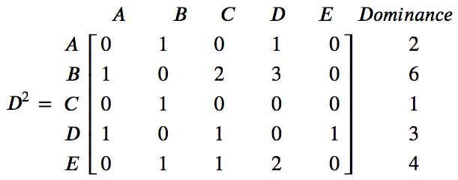
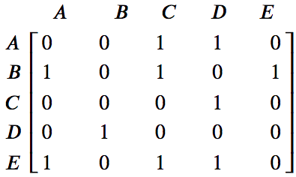






Two-step dominances
$$×$$
$$=$$
$$\begin{matrix}1 \\ 0 \\ \begin{aligned}1 \\ 0 \\ 1\end{aligned}\end{matrix}$$
$$\begin{matrix}[1 & 0 & 1 0 1]\end{matrix}$$
$$×$$
$=$ 1$×1 +0×0 +1×1 +0×0 +1×1 =3$
A two-step dominance occurs when a player beats another player who has beaten someone else. For example, Birgit has a two-step dominance over Di because Birgit defeated Cas who defeated Di.
The first product of 1×1 corresponds to: B → A → D.
The third product of 1×1 corresponds to: B → C → D.
The fifth product of 1×1 corresponds to: B → E → D.

Slide 19
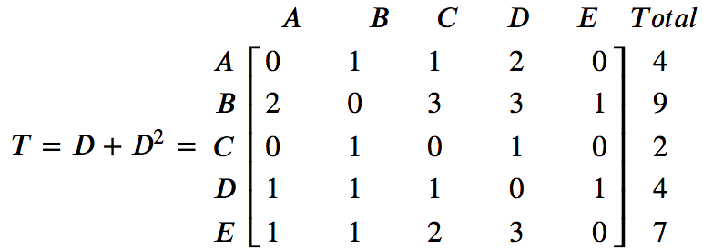
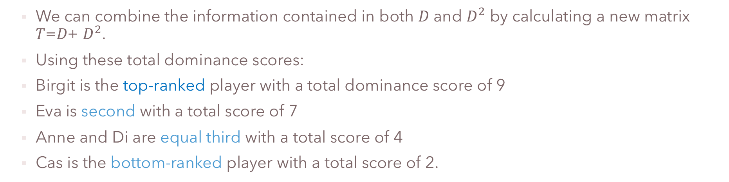
Total dominance scores
We can combine the information contained in both 𝐷 and $D^{2}$ by calculating a new matrix 𝑇=𝐷+ $D^{2}$.
Using these total dominance scores:
Birgit is the top-ranked player with a total dominance score of 9
Eva is second with a total score of 7
Anne and Di are equal third with a total score of 4
Cas is the bottom-ranked player with a total score of 2.

Slide 20

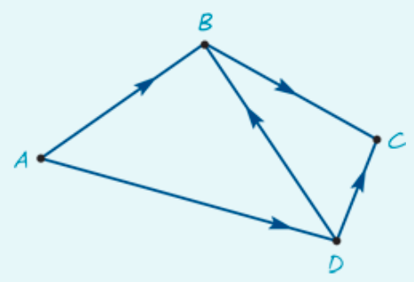
Determining dominance
Four people, 𝐴,𝐵,𝐶 and 𝐷, have been asked to form a committee to decide on the location of a new toxic waste dump.
From previous experience, it is known that:
𝐴 influences the decisions of 𝐵 and 𝐷
𝐵 influences the decisions of 𝐶
𝐶 influences the decisions of no one
𝐷 influences the decisions of 𝐶 and 𝐵.
1. Use the graph to construct a dominance matrix that takes into account both one-step and two-step dominances.
2. From this matrix, determine who is the most influential person on the committee.

Slide 21
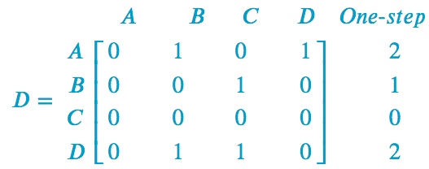
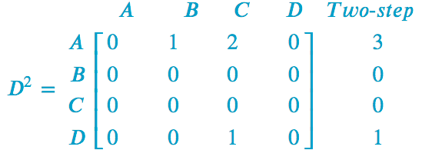
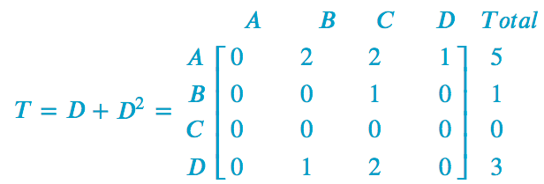
Determining dominance
1. Use the graph to construct a dominance matrix that takes into account both one-step and two-step dominances.
2. From this matrix, determine who is the most influential person on the committee.
Person 𝐴 is the most influential person with a total dominance score of 5.

Slide 22
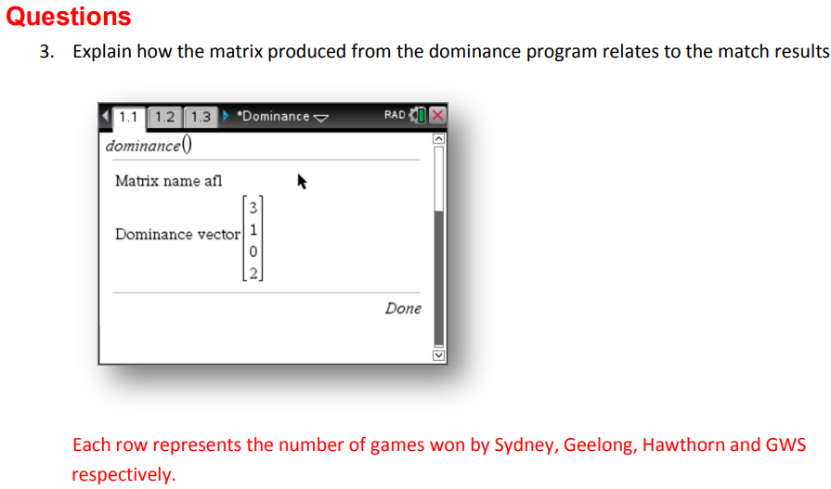
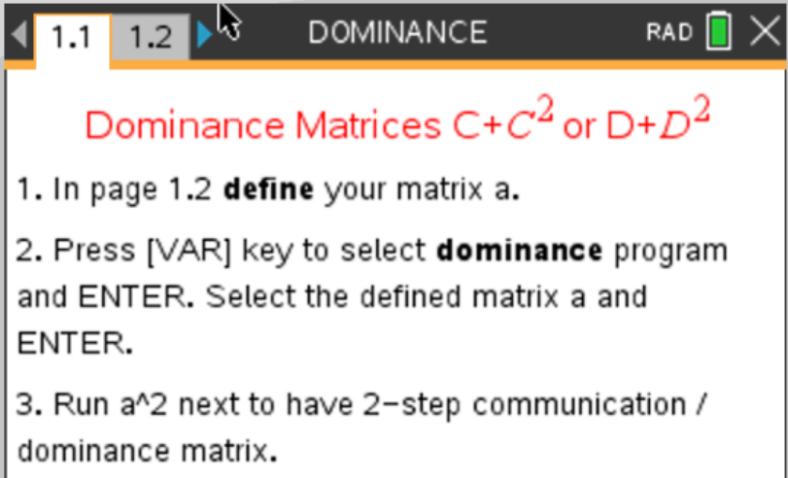
CAS Calculator
CAS Notes 7.8

