Slide 1

Applications of transition matrices Leslie matrices
7I

Slide 2
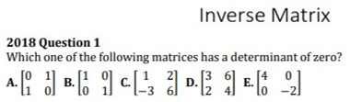

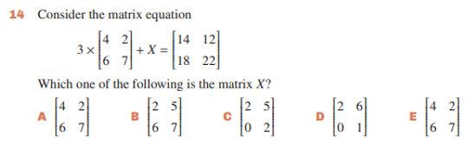

Slide 3
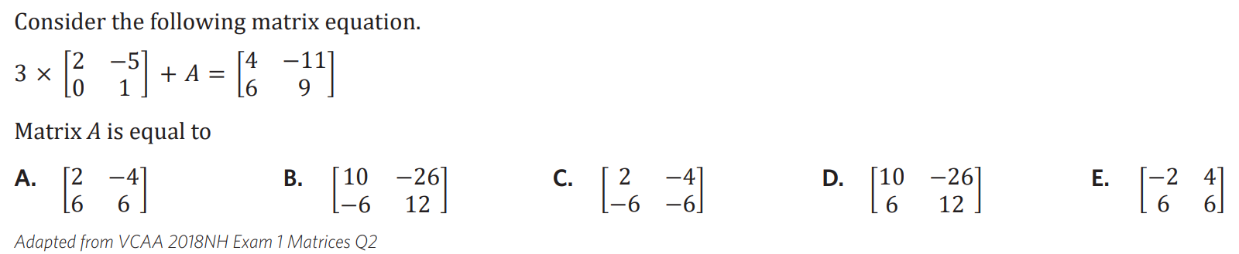

Slide 4

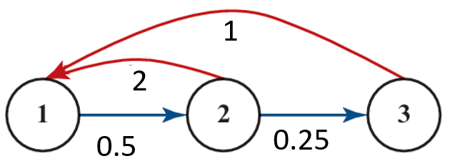
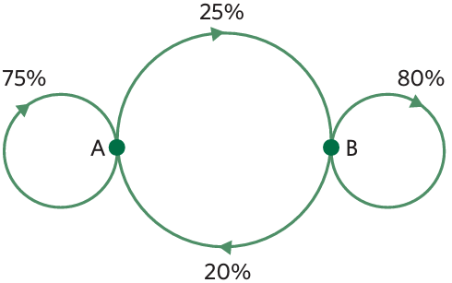



7I Applications of transition matrices
The total population is regularly increased or decreased by a set quantity, for a reason that is not already accounted for, a new model is required.
This model is particularly useful for modelling the population of animals, where humans may choose to add or remove a set number of animals at a regular interval.
Use recursion (step by step)
$S_{0}=$ initial state, $S_{n+1}=T×S_{n}$ + B
matrix
where B is a matrix of the same order as $S_{n}$ and $S_{n+1}$
Culling is the reduction of an animal population by slaughter. Represents a subtraction to the population from one state to the next.
Restocking typically refers to replacing stock with a new supply. Represents an addition to the population from one state to the next.
example 1: A wildlife park has two groups of kangaroos:
Each month:
75% of kangaroos in A stay in A.
25% move to B.
20% of kangaroos in
B move to A.
80% stay in B.
a. construct a transition matrix
this month
A B
$T=\left[\begin{matrix}0.75 & 0.20 \\ 0.25 & 0.80\end{matrix}\right]$ $\begin{aligned}A \\ B\end{aligned}$
b. Suppose this month's population is
$P_{0}=\left[\begin{matrix}200 \\ 300\end{matrix}\right]$ $\begin{aligned}A \\ B\end{aligned}$
Find the population tomorrow.
$P_{1}=TP_{0} P_{1}=\left[\begin{matrix}210 \\ 290\end{matrix}\right]$ $\begin{aligned}A \\ B\end{aligned}$
c. Unfortunately, a disease outbreak requires wildlife managers to cull 20 animals from A. write a culling matrix.
$C=\left[\begin{matrix}−20 \\ 0\end{matrix}\right]$ $\begin{aligned}A \\ B\end{aligned}$
d. The following month, healthy kangaroos are introduced.
40 kangaroos to enclosure A
25 kangaroos to enclosure B
The restocking matrix is
$R=\left[\begin{matrix}40 \\ 25\end{matrix}\right]$ $\begin{aligned}A \\ B\end{aligned}$
Find the new population after restocking.
$P_{\text{final}}=TP_{1}+R$ $P_{\text{final}}$= $\left[\begin{matrix}256 \\ 310\end{matrix}\right]$ $\begin{aligned}A \\ B\end{aligned}$
example 2: The following life-cycle describes the growth of a rabbit population. Stage 1 = Baby rabbits; Stage 2 = Young rabbits; Stage 3 = Adult rabbits.
Young rabbits produce 2 baby rabbits each breeding season. Adults produce 1 Baby rabbit.
50% of baby rabbits survive to become young rabbits.
25 of young rabbits survive to become adults.
Write the Leslie matrix and graph for this system.
now
1 2 3
$L=\left[\begin{matrix}0 & 2 & 1 \\ 0.5 & 0 & 0 \\ 0 & 0.25 & 0\end{matrix}\right]$ $\begin{aligned}1 \\ 2 \\ 3\end{aligned}$
b. The initial population is $S_{0}=\left[\begin{aligned}204 \\ 96 \\ 23\end{aligned}\right]$ $\begin{aligned}1 \\ 2 \\ 3\end{aligned}$, find $S_{3}$
$S_{3}=\left[\begin{aligned}241 \\ 114 \\ 27\end{aligned}\right]$ $\begin{aligned}1 \\ 2 \\ 3\end{aligned}$
c. Find $S_{20} S_{21}.$Verify that the stage distributions of the two population matrices are nearly in the same ratio and hence determine the long-term population growth rate per breeding season.
$S_{20}=\left[\begin{aligned}622 \\ 294 \\ 70\end{aligned}\right]$ $\begin{aligned}1 \\ 2 \\ 3\end{aligned}$ ${ S}_{21}=\left[\begin{aligned}658 \\ 311 \\ 74\end{aligned}\right]$ $\begin{aligned}1 \\ 2 \\ 3\end{aligned}$
$S_{21}$≈1.057 * $S_{20}$
At this stage, the rate of increase is approximately 5.7% for each breeding season.
Next month
next
Culling
Or
restocking
find next
state
transition
matrix
previous
state
Notes:
Board notes

Slide 5
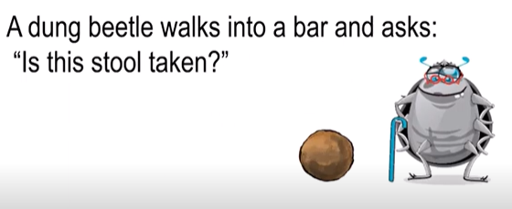
Leslie matrices
A type of transition matrix, designed specifically to model the change in age distribution over time for an animal population.

Slide 6




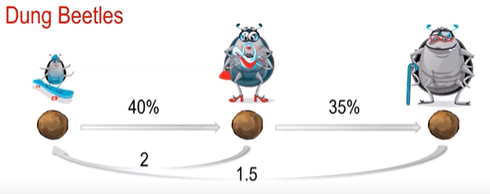
Dung beetles
The typical life span of a dung beetle is 3 years.
Juveniles have a 40% survival rate.
Adults have a 35% survival rate & reproduction factor of 2.
Seniors have a 0% survival rate & reproduction factor of 1.5.

Slide 7
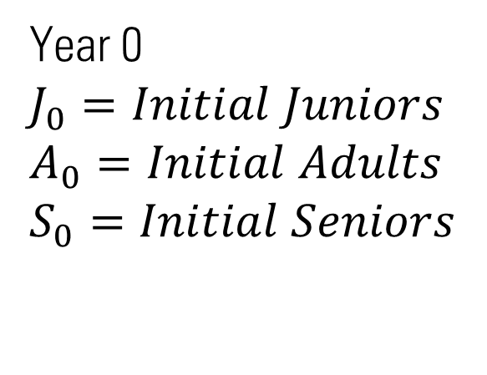
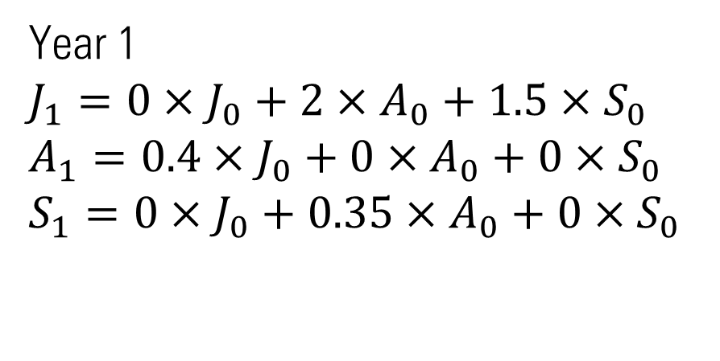
Year 0
$$J_{0}=Initial Juniors$$
$$A_{0}=Initial Adults$$
$$S_{0}=Initial Seniors$$
Year 1
$$J_{1}=0×J_{0}+2{×A_{0}+1.5×S}_{0}$$
$$A_{1}=0.4×J_{0}+0{×A_{0}+0×S}_{0}$$
$$S_{1}=0×J_{0}+0.35{×A_{0}+0×S}_{0}$$

Slide 8
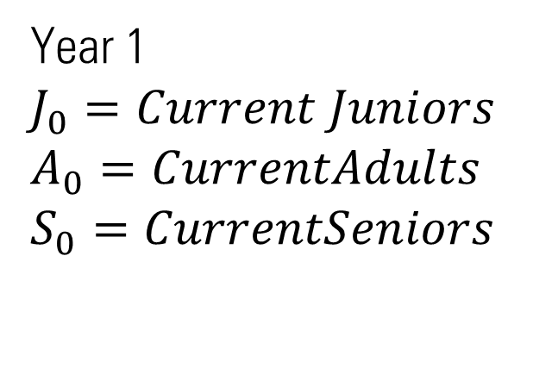
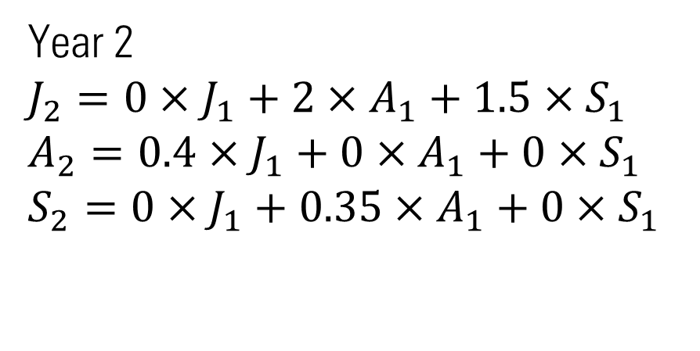
Year 1
$$J_{0}=Current Juniors$$
$$A_{0}=CurrentAdults$$
$$S_{0}=CurrentSeniors$$
Year 2
$$J_{2}=0×J_{1}+2{×A_{1}+1.5×S}_{1}$$
$$A_{2}=0.4×J_{1}+0{×A_{1}+0×S}_{1}$$
$$S_{2}=0×J_{1}+0.35{×A_{1}+0×S}_{1}$$

Slide 9
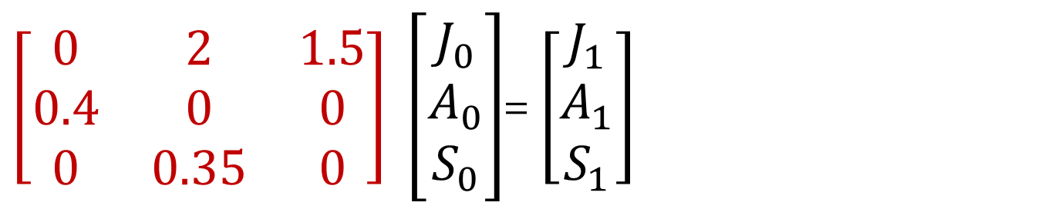
Leslie matrices→ L
$\left[\begin{matrix}0 & 2 & 1.5 \\ 0.4 & 0 & 0 \\ 0 & 0.35 & 0\end{matrix}\right] \left[\begin{matrix}\begin{aligned}J_{0} \\ A_{0}\end{aligned} \\ S_{0}\end{matrix}\right]$= $\left[\begin{matrix}\begin{aligned}J_{1} \\ A_{1}\end{aligned} \\ S_{1}\end{matrix}\right]$

Slide 10

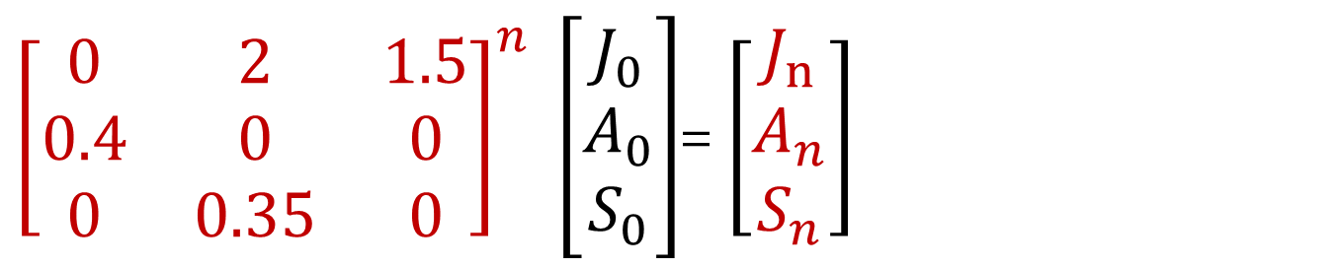
Leslie matrices→ L
${\left[\begin{matrix}0 & 2 & 1.5 \\ 0.4 & 0 & 0 \\ 0 & 0.35 & 0\end{matrix}\right]}^{n} \left[\begin{matrix}\begin{aligned}J_{0} \\ A_{0}\end{aligned} \\ S_{0}\end{matrix}\right]$= $\left[\begin{matrix}\begin{aligned}J_{n} \\ A_{n}\end{aligned} \\ S_{n}\end{matrix}\right]$

Slide 11
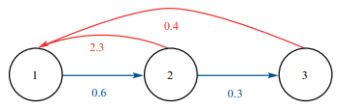
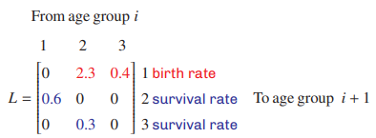
Life cycle transition diagram

Slide 12
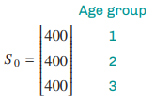


The population state matrix→ column matrix
The initial population state matrix → $S_{0}$

Slide 13
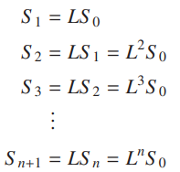
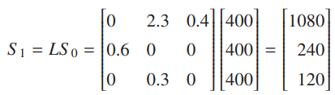
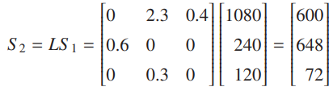
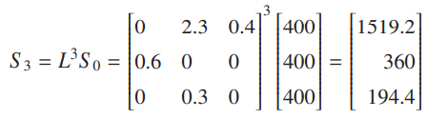

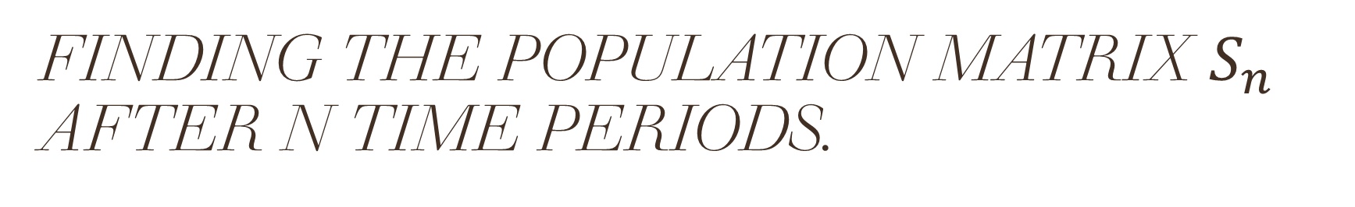
Finding the population matrix $S_{n}$ after n time periods.

Slide 14
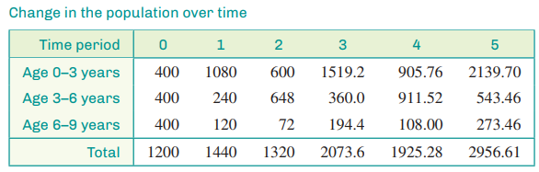
Population Change

Slide 15
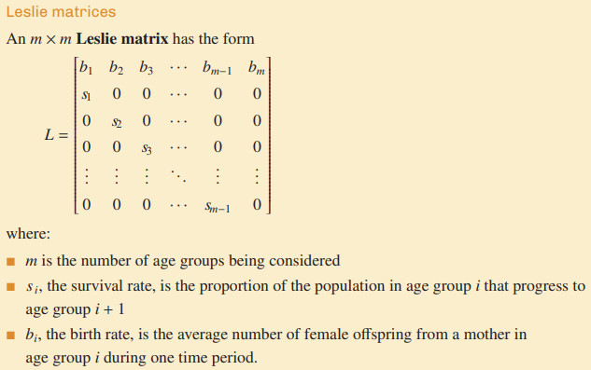
Leslie matrices

Slide 16
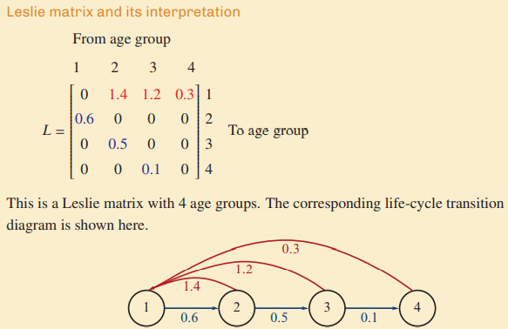

Slide 17
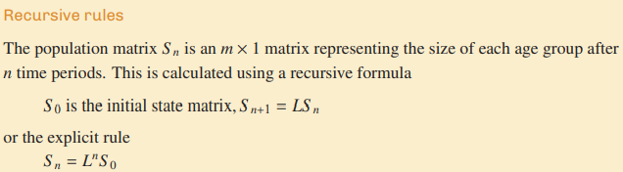

Slide 18
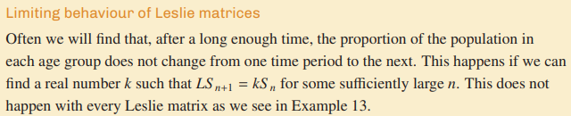
CAS Notes 7.9

Slide 19
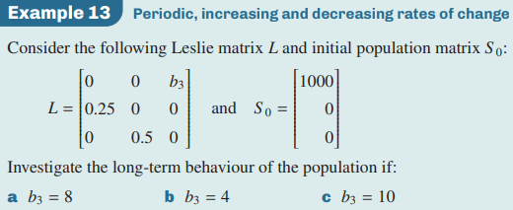
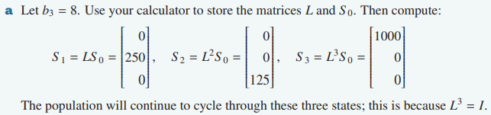

Slide 20
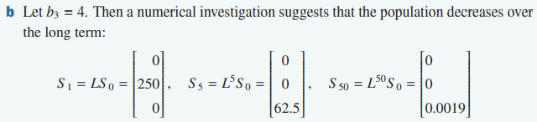

Slide 21
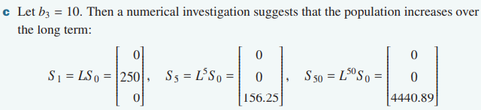
Notes:
https://www.youtube.com/watch?v=iR5E4iKCRe8
https://www.youtube.com/watch?v=Q1zbgd6xpGQ

