Slide 1

8B Graphs, networks and matrices
Lesson 8B
Notes:
https://www.transum.org/software/SW/Starter_of_the_day/students/Anagrams.asp?Level=2
https://play.blooket.com/host?id=6531b0cb2e34ab282032bbd5

Slide 2

Learning Intentions
Graphs, networks and matrices

Slide 3
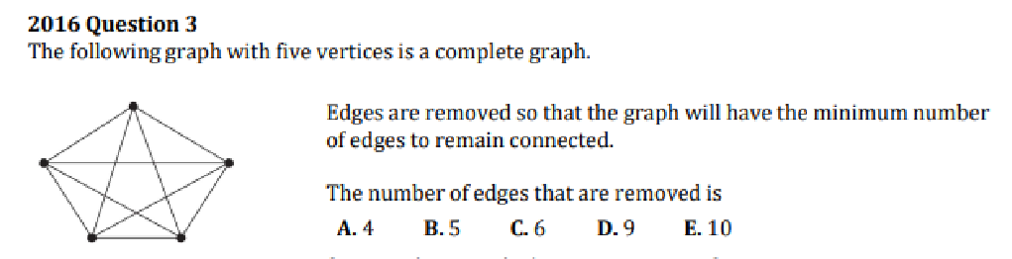
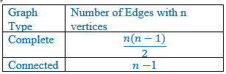

Slide 4

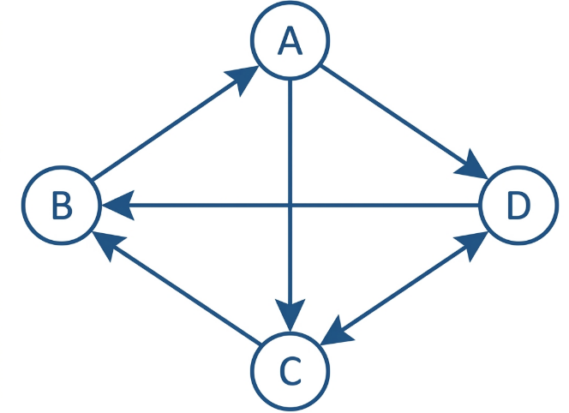
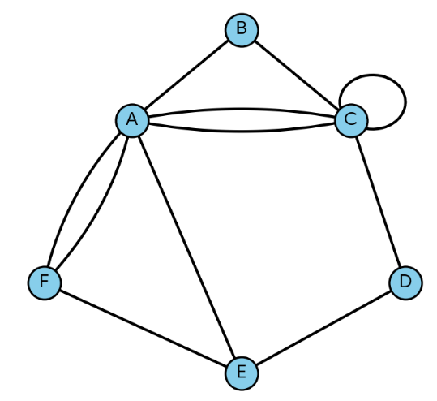
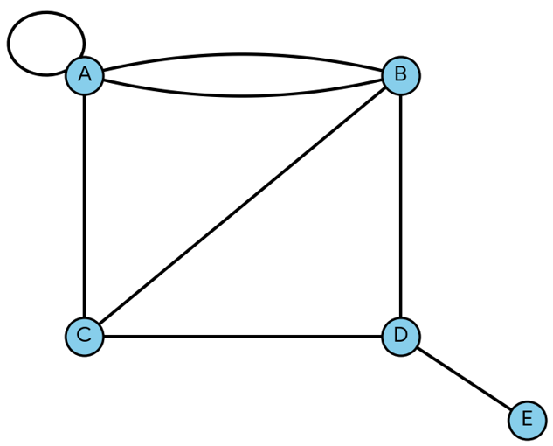

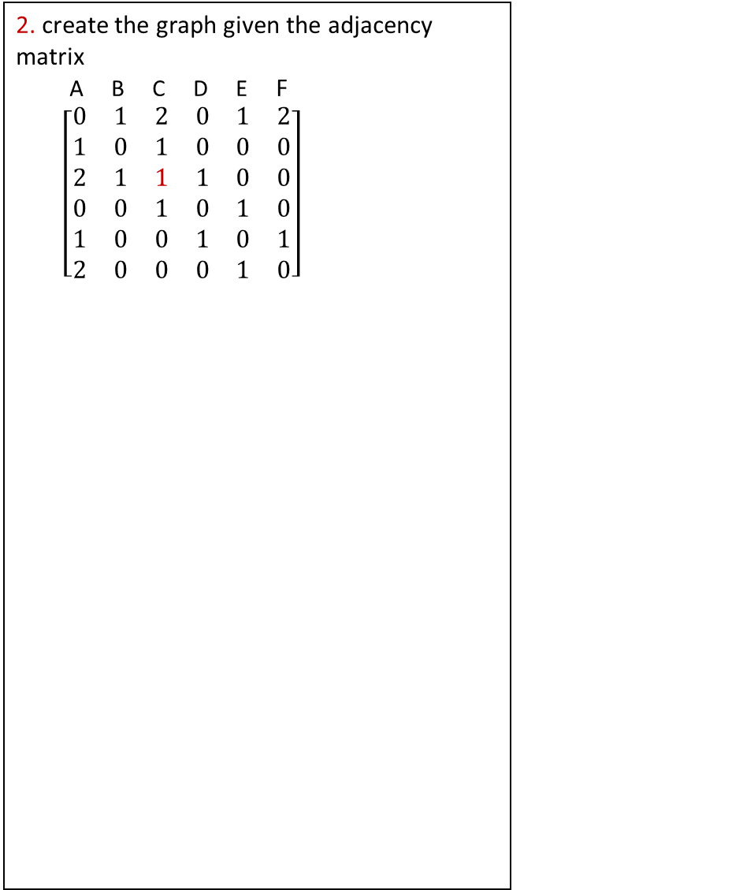
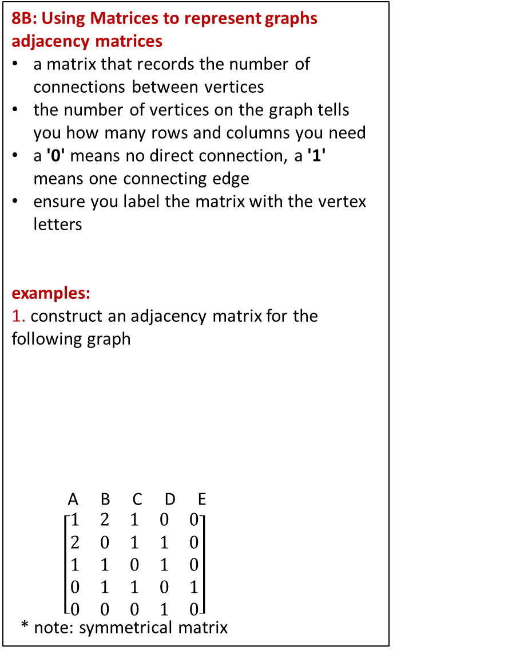
8B: Using Matrices to represent graphs
adjacency matrices
a matrix that records the number of connections between vertices
the number of vertices on the graph tells you how many rows and columns you need
a '0' means no direct connection, a '1' means one connecting edge
ensure you label the matrix with the vertex letters
examples:
1. construct an adjacency matrix for the following graph
A B C D E
$\left[\begin{matrix}1 & 2 & 1 & 0 & 0 \\ 2 & 0 & 1 & 1 & 0 \\ 1 & 1 & 0 & 1 & 0 \\ 0 & 1 & 1 & 0 & 1 \\ 0 & 0 & 0 & 1 & 0\end{matrix}\right]$
* note: symmetrical matrix
2. create the graph given the adjacency matrix
A B C D E F
$\left[\begin{matrix}0 & 1 & 2 & 0 & 1 & 2 \\ 1 & 0 & 1 & 0 & 0 & 0 \\ 2 & 1 & 1 & 1 & 0 & 0 \\ 0 & 0 & 1 & 0 & 1 & 0 \\ 1 & 0 & 0 & 1 & 0 & 1 \\ 2 & 0 & 0 & 0 & 1 & 0\end{matrix}\right]$
representing directed graphs:
network containing arrows on each edge
one way direction
example: construct an adjacency matrix
from
A B C D
$\left[\begin{matrix}0 & 1 & 0 & 0 \\ 0 & 0 & 1 & 1 \\ 1 & 0 & 0 & 1 \\ 1 & 0 & 1 & 0\end{matrix}\right]$
* note: no symmetrical matrix
also note: some questions may be labelled with 'from' and 'to' differently
to
A B
$\left[\begin{matrix}0 & 0 \\ 0 & 1\end{matrix}\right]$
A
B
C
D
E
F
A
B
C
D
to
5 vertices ∴ 5 × 5 matrix
A
B
C
D
E
A
B
from
Notes:
Board notes

Slide 5
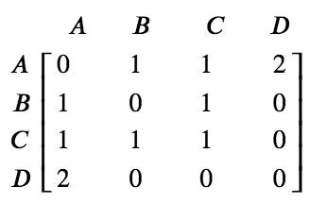
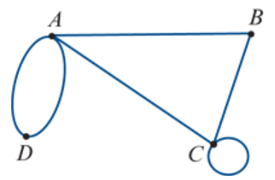




Adjacency matrices
An adjacency matrix is a square matrix that uses a zero or an integer to record the number of edges connecting each pair of vertices in the graph.
0
1
2
$$e_{1}$$
$$e_{2}$$
1

Slide 6
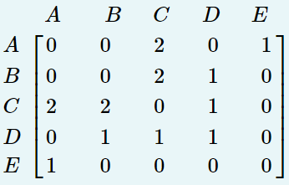
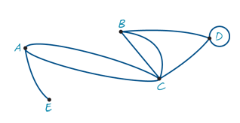
Drawing a graph from an adjacency matrix
A
C
E
D
B

Slide 7
Adjacency matrices
The adjacency matrix A of a graph is an n×n matrix in which, for example, the entry in row C and column F is the number of edges joining vertices C and F.
A loop is a single edge connecting a vertex to itself.
Loops are counted as one edge.

Slide 8
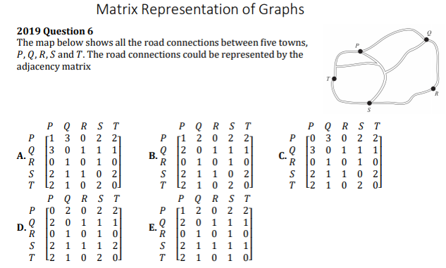

Slide 9
    exercises & Summary Book
1. Ex8B Q3,4,6,9,10,15
2. Summary notes for Homework.

