Slide 1
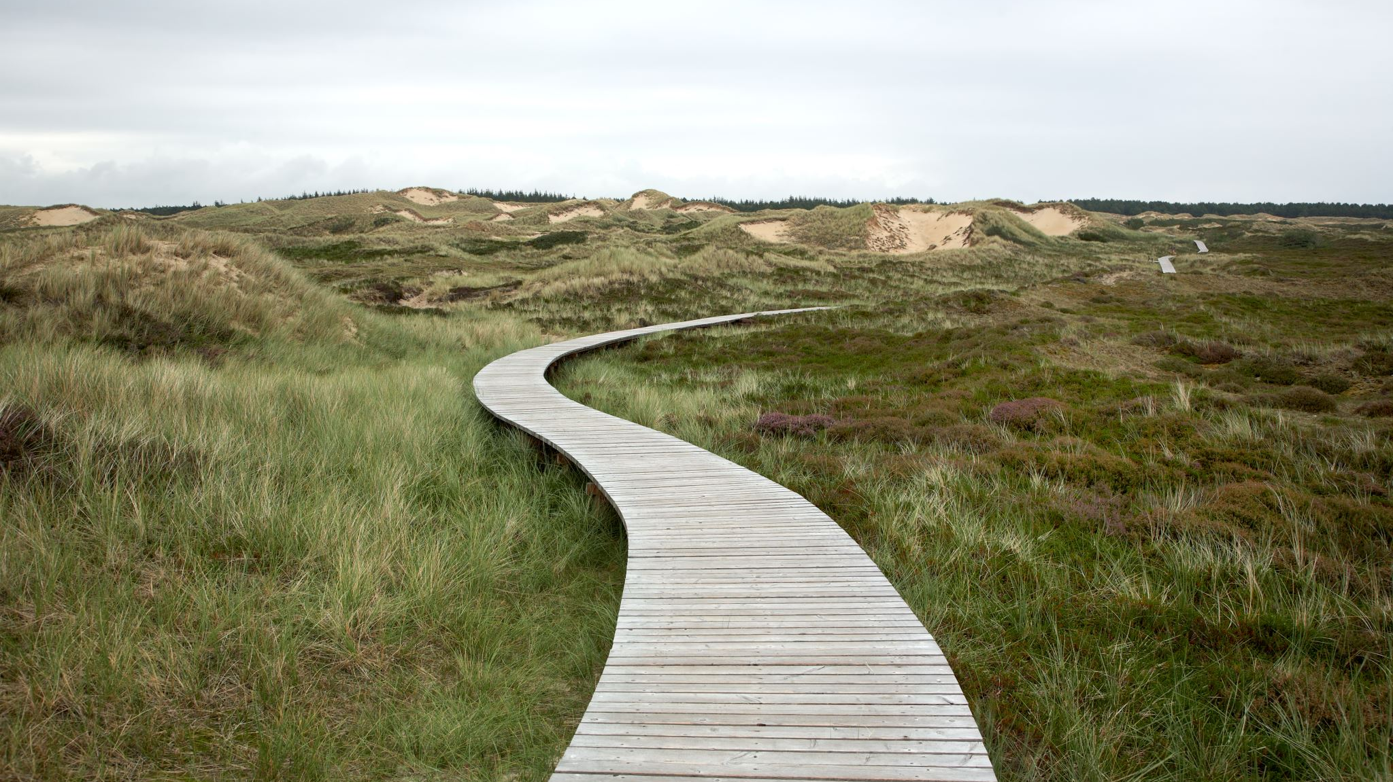
Exploring and travelling problems
8C
Notes:
2, 5-8, 11-12

Slide 2
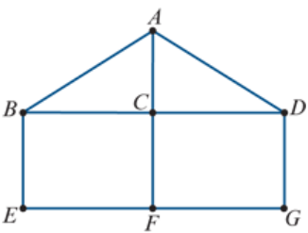
Learning Intentions
Walk
Trail
Path
Circuit
Cycle

Slide 3
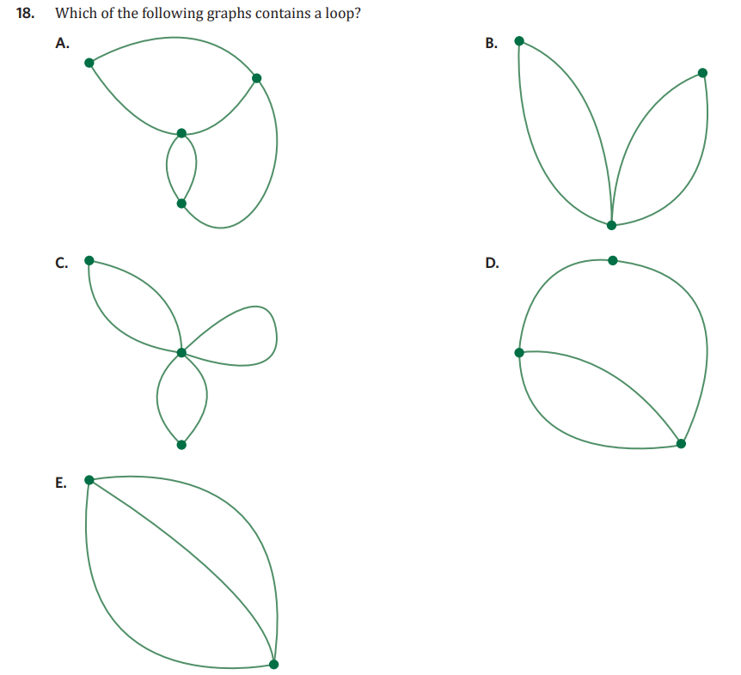

Slide 4

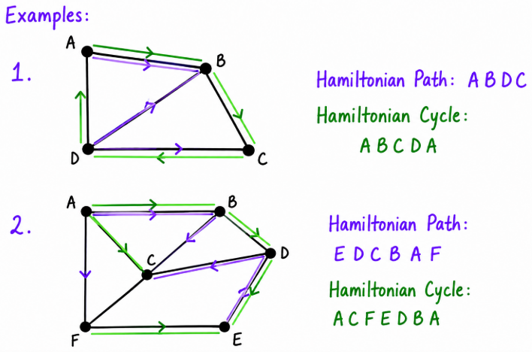
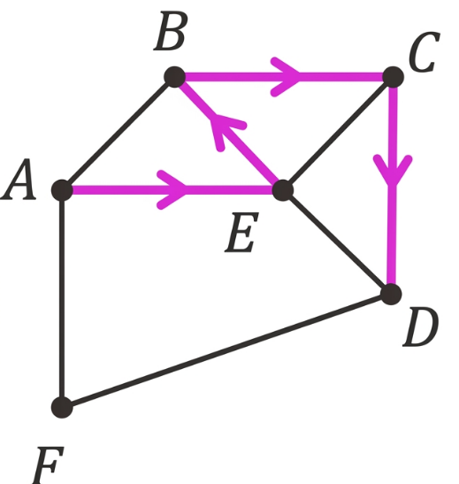
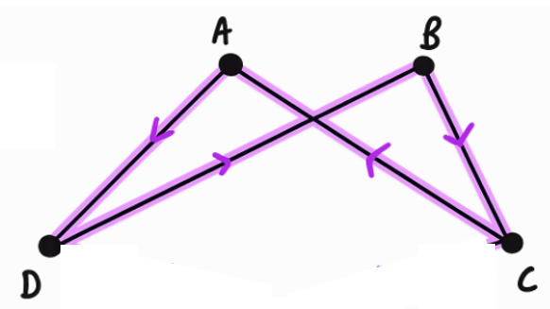
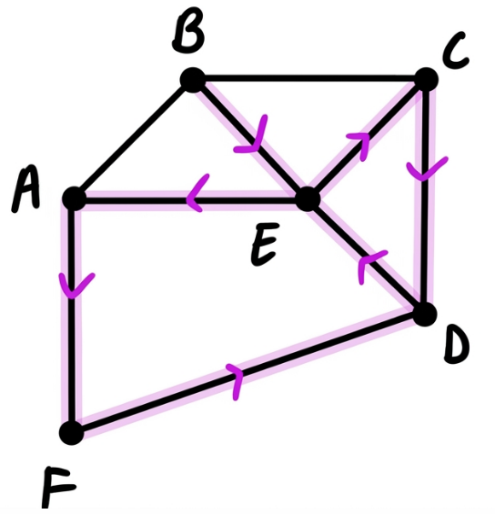
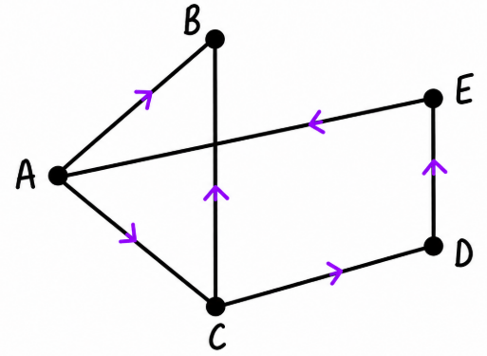
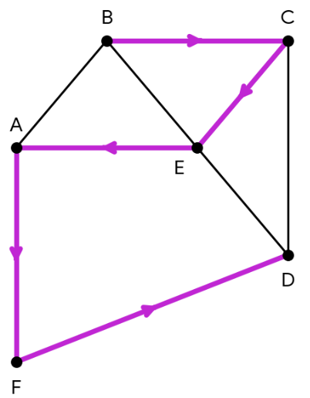
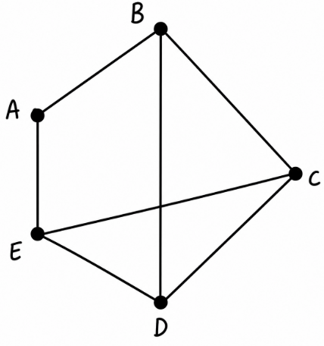
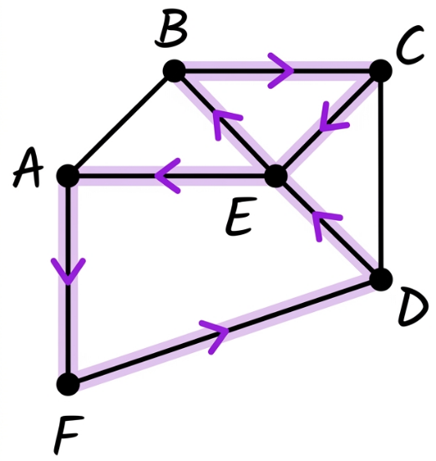
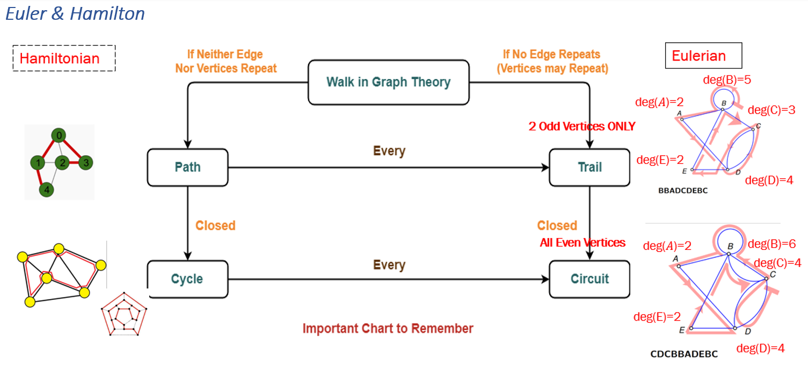
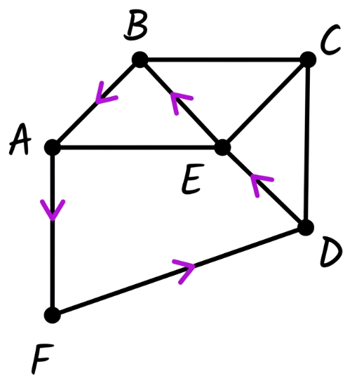
8C: Walks, Trails, Paths, Circuits and Cycles
route: a list of vertices travelled through, in order
walk: a walk is a sequence of edges linking successive vertices
Example:
A, E, B, C, D
trail: a trail is a walk with no repeated edges
Example:
B, E, C, D, E, A, F, D
path: a path is a walk with no repeated vertices
Example:
B, C, E, A, F, D
circuit: a circuit is a walk that has no repeated edges and starts and ends at the same vertex
Example:
B, C, E, A, F, D, E, B
cycle: a cycle is a walk that has no repeated vertices and starts and ends at the same vertex
Example:
B, A, F, D, E, B
Eulerian Trails and Circuits
Eulerian Trail:
  follows EVERY edge
  no repeat edges
  has exactly 2 vertices of odd degree, the rest are even
  will begin at one of the odd vertices and end at the other
Eulerian Circuit:
follows every edge, starts and ends at the same vertex
no repeat edges
vertices are ALL an even degree
it can begin at any vertex
examples:
1. ADBCA
All vertices have an even degree of 2
∴ an Eulerian Circuit exists.
2. CDEACBA
A and C have an odd degree of 3, the rest are even
∴ an Eulerian Trail exists.
3. BCDE are all odd degrees, A is even
∴ neither an Eulerian Trail or Circuit exists.
Hamiltonian Paths and Cycles
Hamiltonian Path:
visits EVERY vertex
no repeat vertices
does not need to go through every edge
Hamiltonian Cycle:
visits EVERY vertex, starts and ends at same vertex
no repeat vertices
does not need to go through every edge

Slide 5

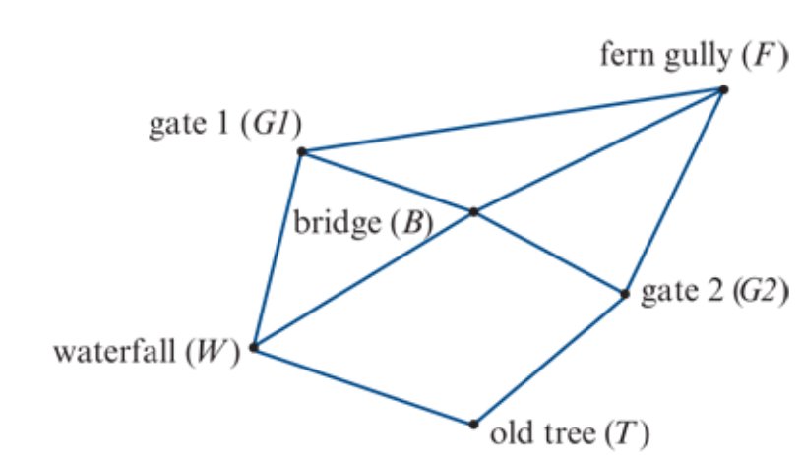
Practical problems
Practical problems: designing a postal delivery route or solving the Königsberg bridge problem.
To solve such problems you will need to know about a number of concepts

Slide 6
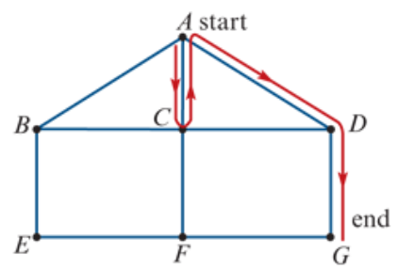
Walk
Start
A walk is a sequence of edges, linking successive vertices, that connects two different vertices in a graph.
The red line in the graph opposite traces out a walk. This walk can be written down by listing the vertices in the order they are visited: A−C−A−D−G.
Finish

Slide 7
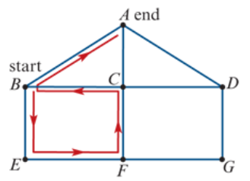
Trail
Finish
A trail is a walk with no repeated edges.
The red line in the graph opposite traces out a trail. This trail can be written down by listing the vertices in the order they are visited: B−E−F−C−B−A.
Note: There are no repeated edges in this trail, but one vertex (B) is repeated.
Start

Slide 8
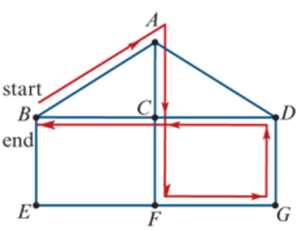
Circuit
A circuit is a trail (no repeated edges) that starts and ends at the same vertex. Circuits are also called closed trails.
The red line in the graph opposite traces out a circuit. This circuit can be written down by listing the vertices in the order they are visited: A−C−F−G−D−C−B−A.
Note: There are no repeated edges in this circuit, but one vertex, C, is repeated. The start and end vertices are also repeated because of the definition of a circuit.
Start
Finish

Slide 9
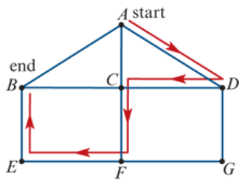
Path
Start
A path is a walk with no repeated edges and no repeated vertices.
The red line in the graph opposite traces out a path. This path can be written down by listing the vertices in the order they are visited: A−D−C−F−E−B.
Finish

Slide 10
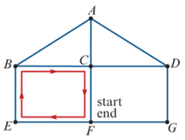
Cycle
A cycle is a path (no repeated edges, no repeated vertices) that starts and ends at the same vertex. The start and end vertex is an exception to repeated vertices. Cycles are also called closed paths.
The red line in the graph opposite traces out a cycle. This cycle can be written down by listing the vertices in the order they are visited: F−E−B−C−F.
Note: There are no repeated edges and no repeated vertices in this cycle, except for the start and end vertices.
Start
Finish

Slide 11
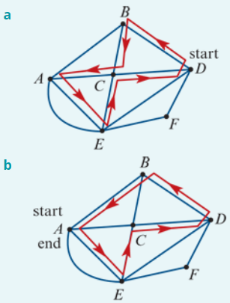
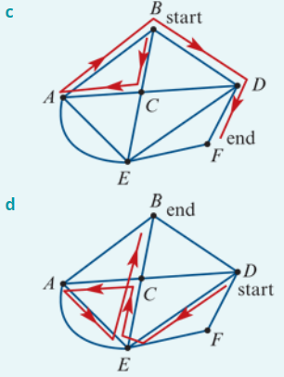
Identifying types of walks
Circuit
Cycle
Trail
Walk

Slide 12
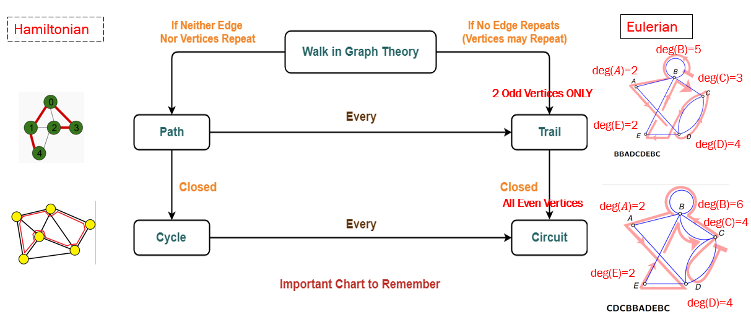

Slide 13
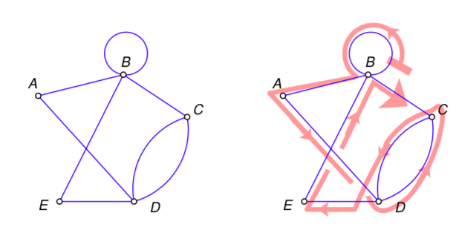
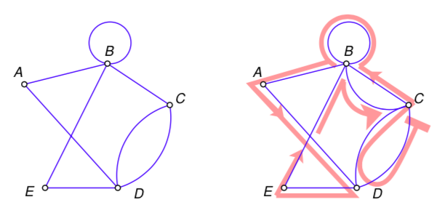
Eulerian trails and circuits
An Eulerian trail is a trail that includes every edge in a graph.
An Eulerian circuit is a circuit that includes every edge in a graph.
An Eulerian trail starts and ends at different vertices.
An Eulerian circuit starts and ends at the same vertex.
An Eulerian trail: BBADCDEBC
An Eulerian circuit: CDCBBADEBC

Slide 14
The Criterion for Eulerian trails
Only traversable graphs
If a graph has an Eulerian trail, then it must have exactly two odd vertices.
Or, to put it another way,
If the number of odd vertices in a graph is anything other than 2, then the graph cannot have an Eulerian trail.

Slide 15
The Criterion for Eulerian Circuits
Only traversable graphs
If a graph has an Eulerian circuit, then all of its vertices must be even vertices.
Or, to put it another way,
If the number of odd vertices in a graph is anything other than 0, then the graph cannot have an Eulerian circuit.

Slide 16
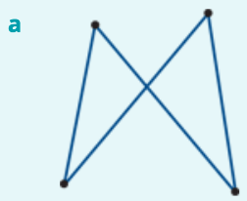
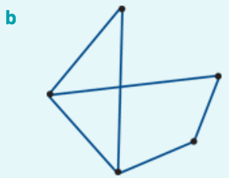
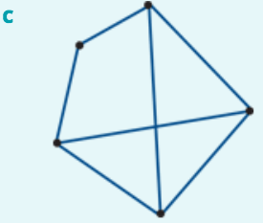

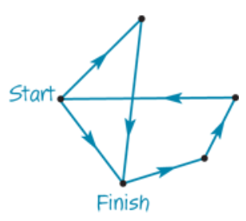
Identifying Eulerian trails and circuits
deg(𝐴)=2
deg(B)=2
deg(𝐴)=2
deg(𝐴)=3
deg(E)=2
deg(B)=2
deg(E)=3
deg(B)=3
deg(D)=3
deg(C)=2
deg(D)=2
deg(C)=2
deg(D)=3
deg(C)=3
Neither: more than two odd vertices
Eulerian circuit: all even vertices
Eulerian trail: two odd vertices, the rest even.

Slide 17
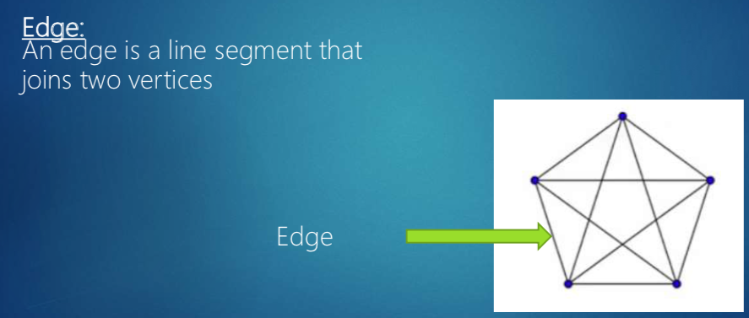
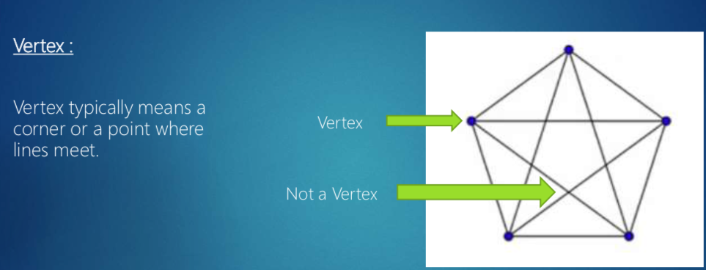
Difference between Euler & Hamilton
Eulerian trails and circuits focus on edges.
Hamiltonian paths and cycles focus on vertices.

Slide 18
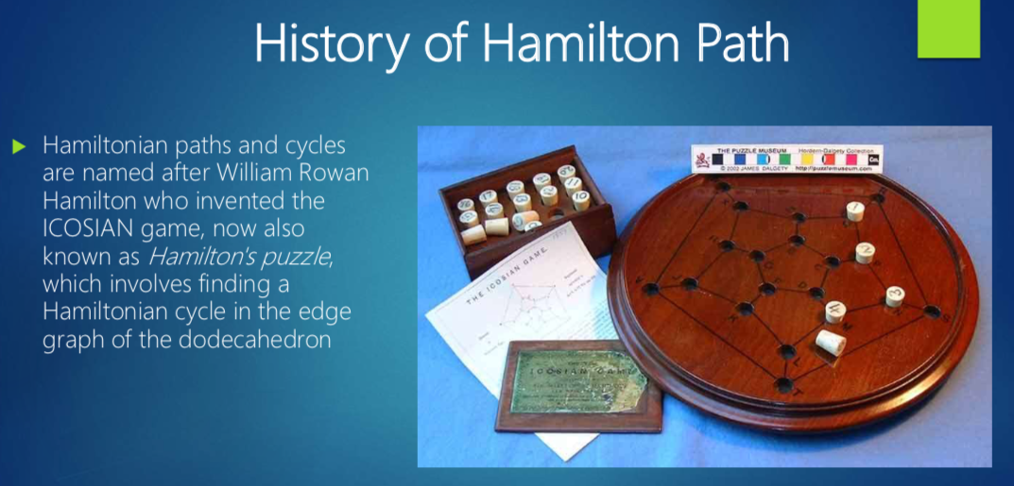

Slide 19
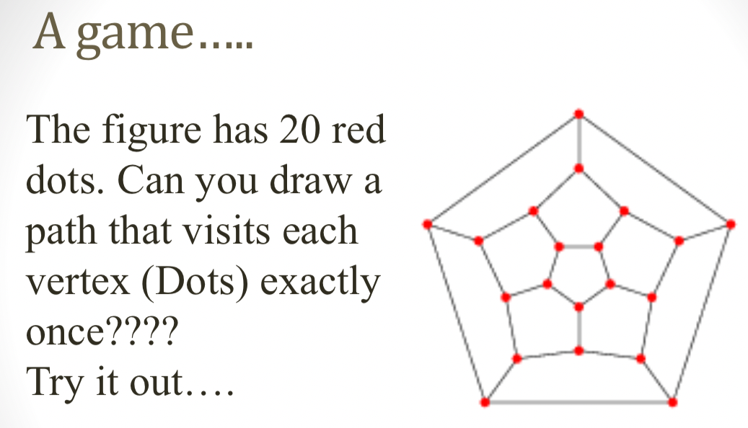

Slide 20
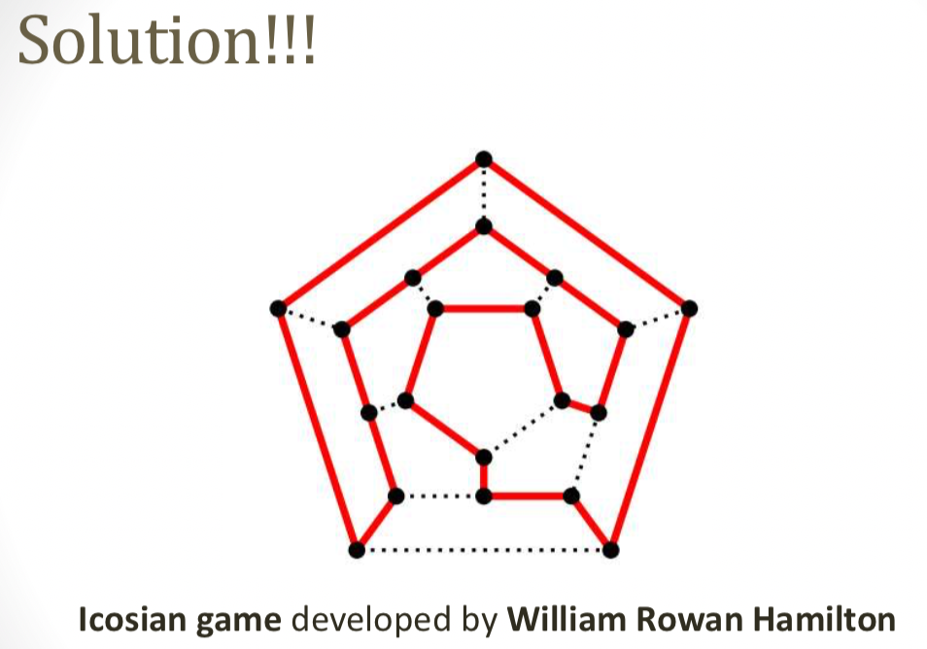

Slide 21
Hamiltonian paths and cycles
A Hamiltonian path passes through every vertex in a connected graph. It may or may or may not involve all of the edges in the graph.
A Hamiltonian cycle is a Hamiltonian path that starts and finishes at the same vertex.

Slide 22
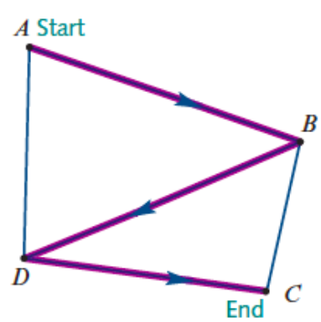
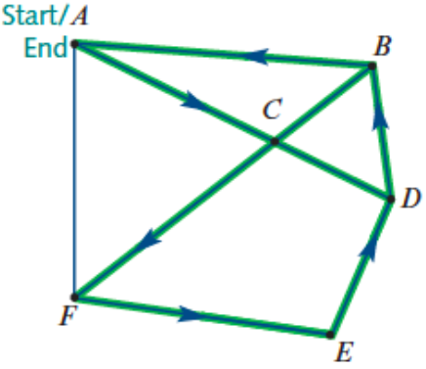
Hamiltonian path: 𝐴-𝐵-𝐷-𝐶
Hamiltonian cycle: 𝐴-𝐶-𝐹-𝐸-𝐷-𝐵-𝐴

Slide 23
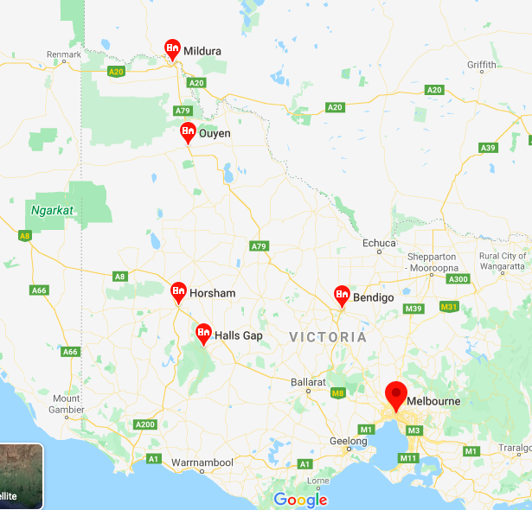
Applications of Hamiltonian paths
Hamiltonian paths You plan a trip from Melbourne to Mildura, with visits to Bendigo, Halls Gap, Horsham, Stawell and Ouyen on the way, but do not want to visit any town more than once.

Slide 24
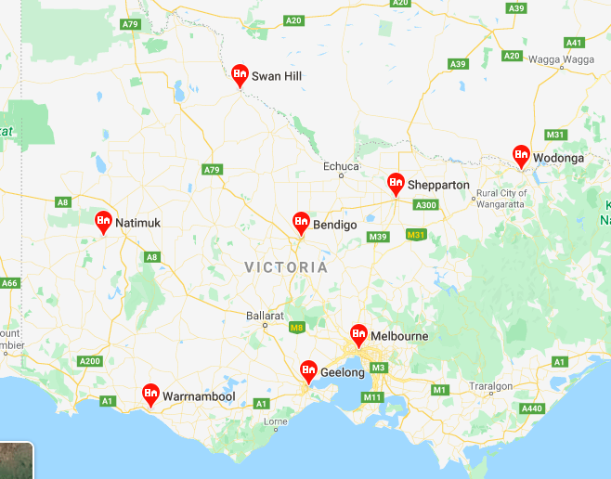
Applications of Hamiltonian cycles
A courier leaves her depot to make a succession of deliveries to a variety of locations before returning to her depot. She does not like to go past each location more than once.
A tourist plans to visit all of the historic sites in a city without visiting each more than once.
You are planning a trip from Melbourne to visit Shepparton, Wodonga, Bendigo, Swan Hill, Natimuk, Warrnambool and Geelong before returning to Melbourne. You don’t want to visit any town more than once.

Slide 25
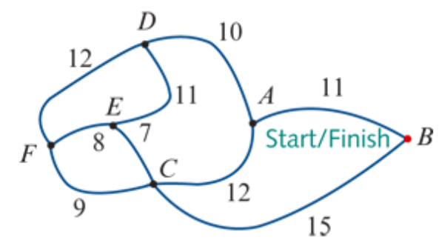
Finding Hamilton Cycle
A
C
B
D
C
A
E
F
E
F
F
B
E
A
D
F
F
D
F
E
C
D
E
A
F
D
C
A
B
D
C
A-D-E-F-C-B-A
A-B-C-F-E-D-A
A-D-F-E-C-B-A
A-B-C-E-F-D-A
B
A
A
A
E
D
D
E
C
A
B
A
F
A
A
E
D
A
B
A
A
A
A

