Slide 1
Flow problems
8E
Notes:
1,2,4,6,8,9,12

Slide 2
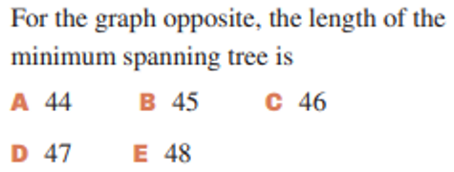
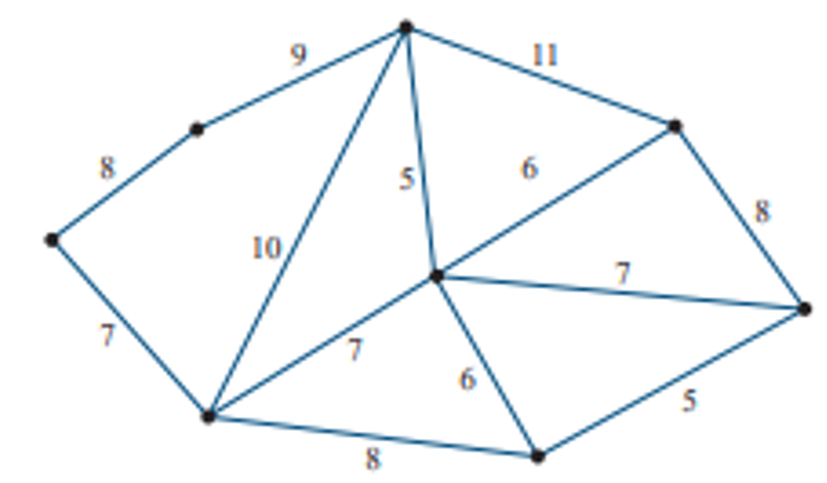

Slide 3

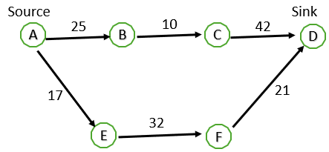
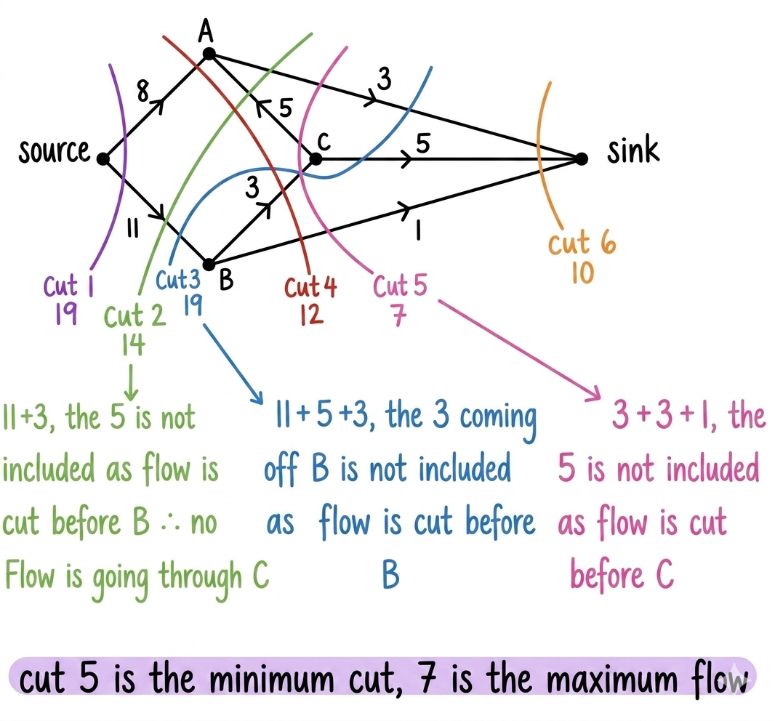
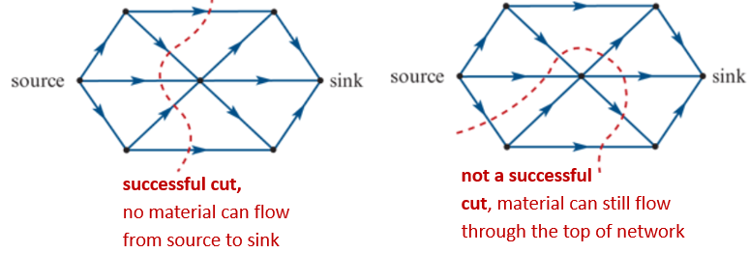
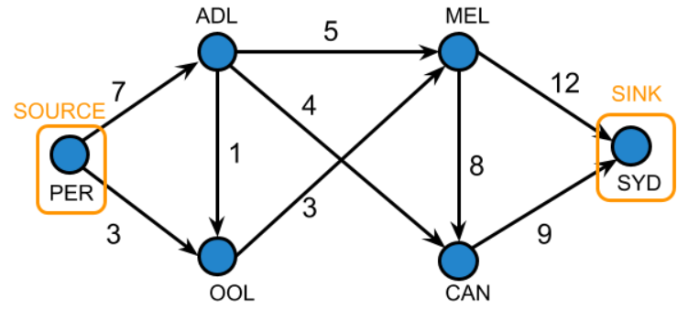
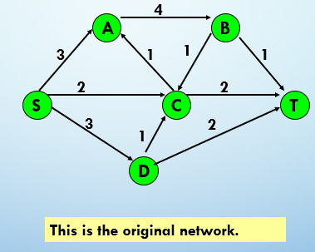
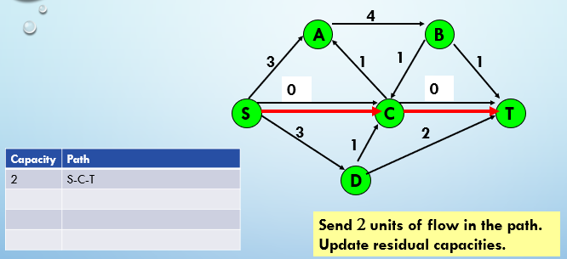
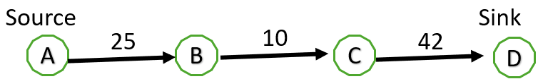
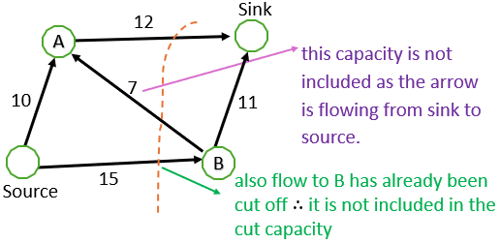
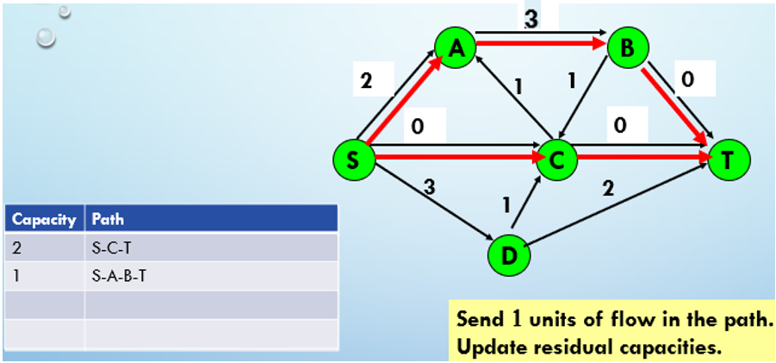
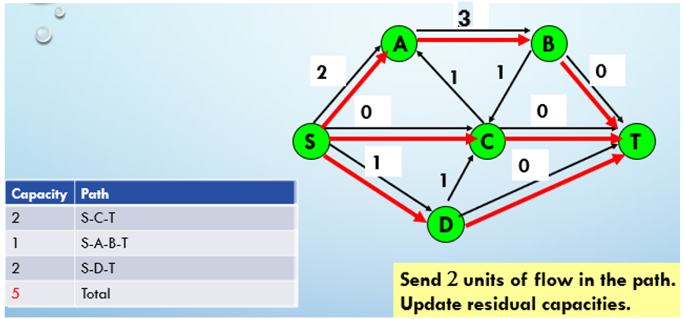
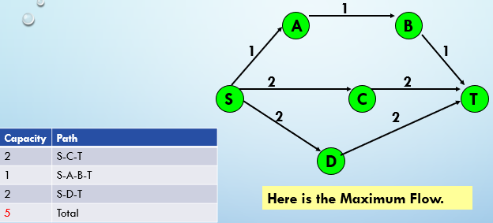
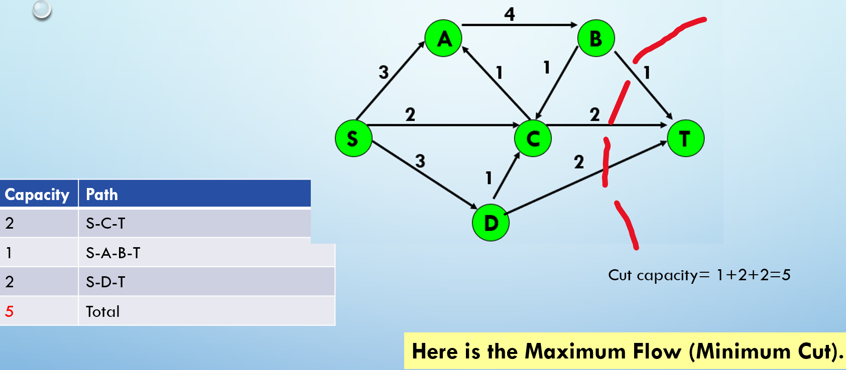
8E: Using networks to model flow
directed graph:
network containing arrows on each edge
networks show directional information between vertices
weights can represent distance, time or cost
flow:
flow problems involve the transfer or flow of material from one point (source) to another point (sink)
eg: water flowing through pipes or traffic flow on roads
maximum flow:
if edges of different capacities are connected one after the other, the maximum flow through the edges is equal to the minimum capacity of the individual edges
maximum flow = minimum capacity
Example 1: what is the maximum flow?
The above network displays 3 connected roads and the capacities for each road.
* 25 cars can travel along A →B, however only 10 along B →C, this would slow traffic reducing flow.
* although C → D can hold 42 cars, there are only 10 travelling through B → C at a time
∴ max flow = min capacity = 10 cars
Example 2.
max flow through ABCD = 10
max flow through AEFD = 17
∴ max flow = 10 + 17 = 27 cars
cuts:
a cut divides the network into two parts, completely separating the source from the sink
completely stop flow
cut capacity:
the sum of all capacities of the edges that the cut passes through, taking into account the direction of flow
the capacity is only counted if it flows from source to sink
example:
cut capacity = 12 + 15 = 27
minimum cut capacity:
a cut that has the lowest cut capacity. for a network minimum cut capacity = maximum flow
Example: determine the max flow through the network
Ford Fulkerson Algorithm
no matter the situation, things flow in one direction only
weights on graphs are called capacities
Notes:
Board notes

Slide 4
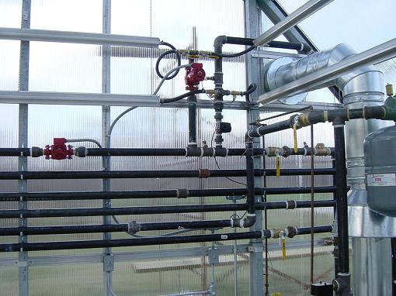
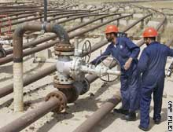
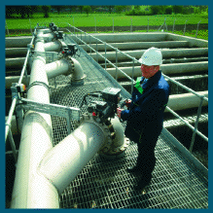
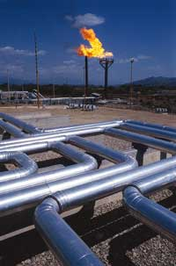
Network Flow

Slide 5
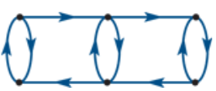
Directed graphs
A directed graph, or digraph, records directional information on networks using arrows on the edges. The network on the right shows roads around a city. The vertices are the intersections of the roads and the edges are the possible road connections between the intersections. The arrows show that some of the roads only allow traffic in one direction, while others allow traffic in both directions.

Slide 6
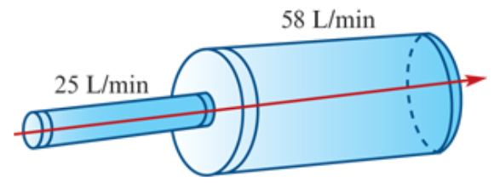
Understanding minimum flow
Flow problems involve the transfer or flow of material from one point, called the source, to another point called the sink. Examples of this include water flowing through pipes, or traffic flowing along roads.
source → flow through network → sink
The weights of flow problem directed graphs are called capacities.

Slide 7
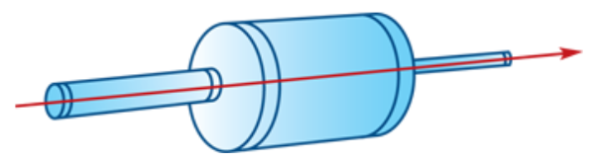
Maximum flow
If pipes of different capacities are connected one after the other, the maximum flow through the pipes is equal to the minimum capacity of the individual pipes.

Slide 8
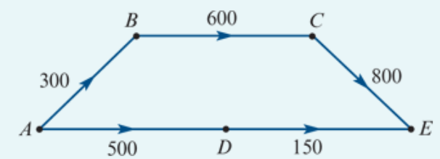
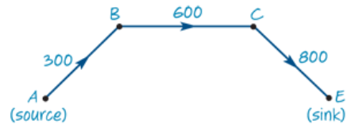
Calculating the maximum flow
In the digraph shown on the right, the vertices A, B, C, D and E: towns. The edges: roads and the weights: the maximum number of cars that can travel on the road each hour. The roads allow only one-way travel.
1. Find the maximum traffic flow from A to E through town C.
The maximum flow from A to E through town C is equal to the smallest capacity road along that route. The maximum flow is 300 cars per hour.

Slide 9
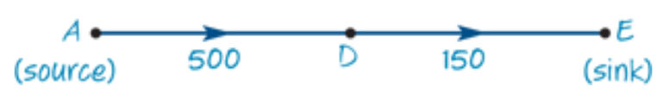
Calculating the maximum flow
In the digraph shown on the right, the vertices A, B, C, D and E: towns. The edges: roads and the weights: the maximum number of cars that can travel on the road each hour. The roads allow only one-way travel.
2. Find the maximum traffic flow from A to E overall.
The maximum flow from A to E overall is:
300+150=450 cars per hour

Slide 10
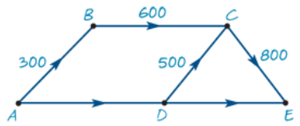
Calculating the maximum flow
In the digraph shown on the right, the vertices A, B, C, D and E: towns. The edges: roads and the weights: the maximum number of cars that can travel on the road each hour. The roads allow only one-way travel.
3. A new road is being built to allow traffic from town D to town C. This road can carry 500 cars per hour.
1). Add this road to the digraph.

Slide 11

Calculating the maximum flow
In the digraph shown on the right, the vertices A, B, C, D and E: towns. The edges: roads and the weights: the maximum number of cars that can travel on the road each hour. The roads allow only one-way travel.
3. A new road is being built to allow traffic from town D to town C. This road can carry 500 cars per hour.
2). Find the maximum traffic flow from A to E overall after this road is built.
The maximum flow through A−B−C−E is 300. But C−E has capacity 800. If another 500 cars per hour come through D−C, they will be able to travel from C−E.
The new maximum flow is now 800 cars per hour.

Slide 12
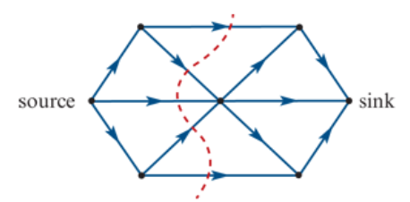
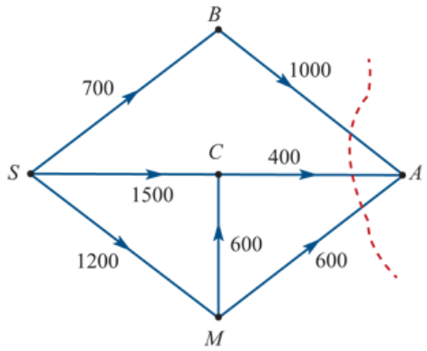
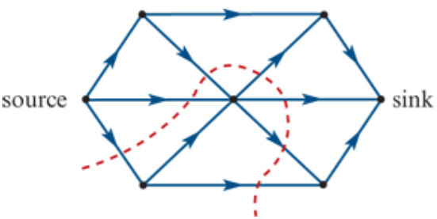
Cuts
We can simplify the search for maximum flow by searching for cuts within the digraph.
A cut divides the network into two parts, completely separating the source from the sink.

Slide 13
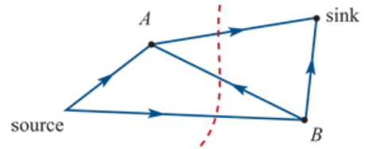
Capacity of a cut
The cut capacity is the sum of all the capacities of the edges that the cut passes through, taking into account the direction of flow. The capacity of an edge is only counted if it flows from the source side to the sink side of the cut.

Slide 14
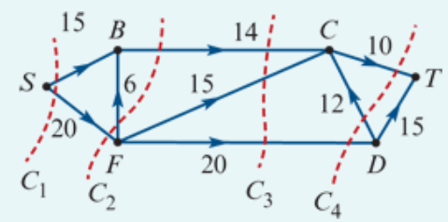
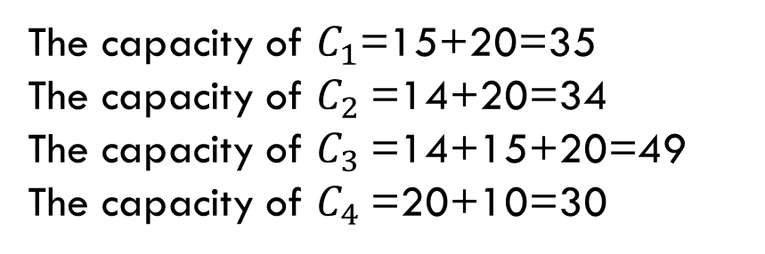
Calculating cut capacity
Calculate the capacity of the four cuts shown in the network on the right. The source is vertex S and the sink is vertex T.
The capacity of $C_{1}$=15+20=35
The capacity of $C_{2}$=14+20=34
The capacity of $C_{3}$=14+15+20=49
The capacity of $C_{4}$=20+10=30

Slide 15
Cut, cut capacity and minimum cut capacity
The minimum cut capacity = the maximum flow

Slide 16
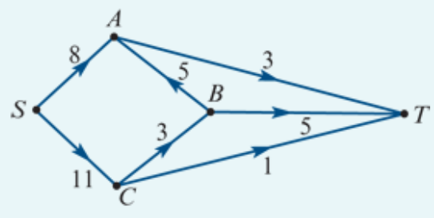
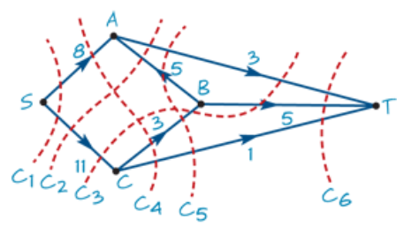
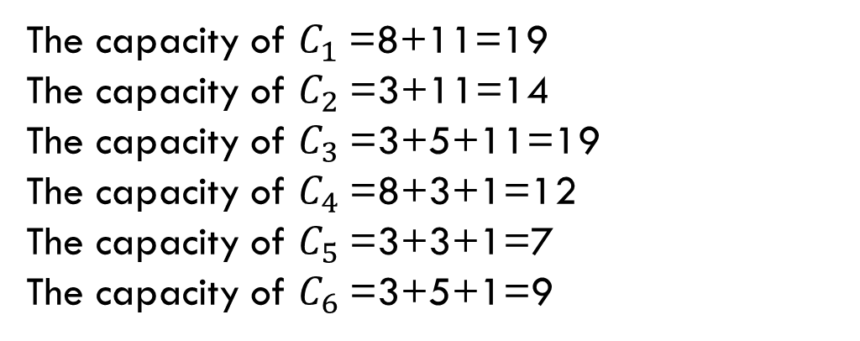
Calculating maximum flow
Determine the maximum flow from S to T for the digraph shown on the right.
The capacity of $C_{1}$=8+11=19
The capacity of $C_{2}$=3+11=14
The capacity of $C_{3}$=3+5+11=19
The capacity of $C_{4}$=8+3+1=12
The capacity of $C_{5}$=3+3+1=7
The capacity of $C_{6}$=3+5+1=9
The minimum cut capacity is 7 so the maximum flow from S to T is 7.

Slide 17
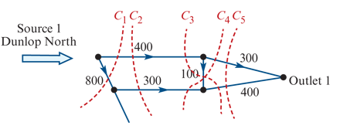
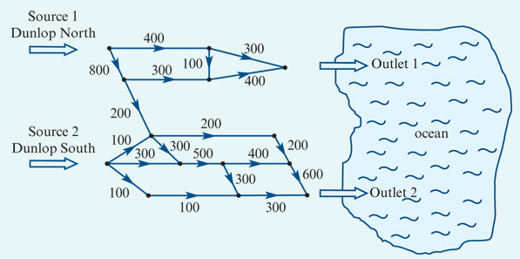
Calculating maximum flow
Storm water enters a network of pipes at either Dunlop North (Source 1) or Dunlop South (Source 2) and flows into the ocean at either Outlet 1 or Outlet 2.
Determine the maximum rate, in kilolitres per minute, at which water can flow from these pipes into the ocean at Outlet 1 and Outlet 2.
The capacity of C1 is: 400+800=1200
The capacity of C2 is: 400+300=700
The capacity of C3 is: 400+400=800
The capacity of C4 is: 300+100+300=700
The capacity of C5 is: 300+400=700
The minimum cut/maximum flow is 700 kilolitres per minute.

Slide 18
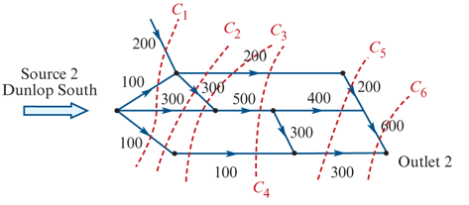
Calculating maximum flow
Storm water enters a network of pipes at either Dunlop North (Source 1) or Dunlop South (Source 2) and flows into the ocean at either Outlet 1 or Outlet 2.
Determine the maximum rate, in kilolitres per minute, at which water can flow from these pipes into the ocean at Outlet 1 and Outlet 2.
The capacity of C1 is: 200+100+300+100=700
The capacity of C2 is: 200+300+300+100=900
The capacity of C3 is: 200+300+300+100=900
The capacity of C4 is: 200+500+100=800
The capacity of C5 is: 200+400+300=900
The capacity of C6 is: 600+300=900
The minimum cut/maximum flow is 700 kilolitres per minute.

Slide 19
The Ford-Fulkerson Algorithm for the Maximum Flow Problem

Slide 20
Ford-Fulkerson Max Flow
4
A
B
3
1
1
1
2
2
S
C
T
3
2
1
D
This is the original network.

Slide 21
Ford-Fulkerson Max Flow
4
A
B
3
1
1
1
2
0
0
2
S
C
T
3
2
1
Capacity | Path
2 | S-C-T
D
Send 2 units of flow in the path.
Update residual capacities.

Slide 22
Ford-Fulkerson Max Flow
4
3
2
A
B
3
1
1
1
0
0
0
2
2
S
C
T
3
2
1
Capacity | Path
2 | S-C-T
1 | S-A-B-T
Capacity | Path
2 | S-C-T
D
Send 1 units of flow in the path.
Update residual capacities.

Slide 23
Ford-Fulkerson Max Flow
4
3
2
A
B
3
1
1
1
0
2
0
2
0
S
C
T
3
2
1
1
0
Capacity | Path
2 | S-C-T
1 | S-A-B-T
2 | S-D-T
Capacity | Path
2 | S-C-T
1 | S-A-B-T
Capacity | Path
2 | S-C-T
1 | S-A-B-T
2 | S-D-T
5 | Total
Capacity | Path
2 | S-C-T
D
Send 2 units of flow in the path.
Update residual capacities.

Slide 24
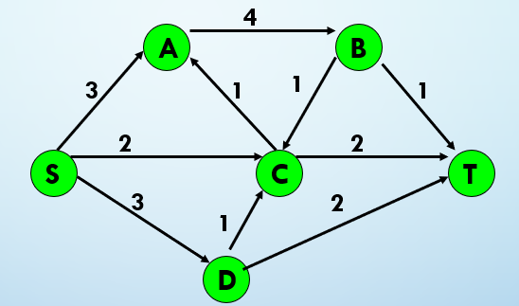


Ford-Fulkerson Max Flow
Cut capacity= 3+2+3=8
Capacity | Path
2 | S-C-T
1 | S-A-B-T
2 | S-D-T
5 | Total
Cut capacity= 4+0+2+2=8
Cut capacity= 1+2+2=5
Here is the Maximum Flow (Minimum Cut).

