Slide 1

Shortest path problems
8F Dijkstra’s Algorithm
Notes:
1,2,4,5,7-9 Need easy way

Slide 2
Real-world Applications:
Urban Navigation: Optimising routes for tourists and residents in cities.
Emergency Evacuation: Planning efficient evacuation routes during emergencies.
Robotics: Pathfinding for robots and drones.
Circuit Design: Optimizing the layout of components on circuit boards.

Slide 3
Learning Intentions
Weighted Graphs
The shortest paths
Dijkstra’s Algorithm
Finding Hamilton Cycles

Slide 4
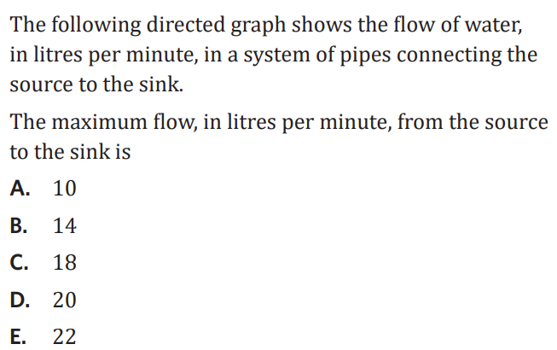
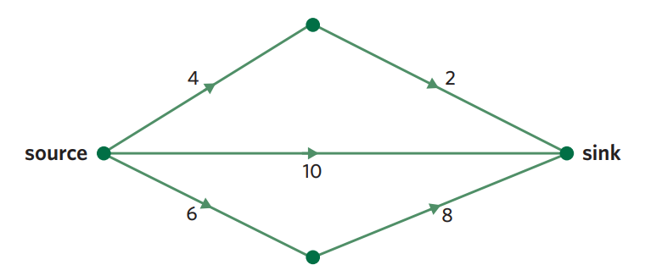

Slide 5
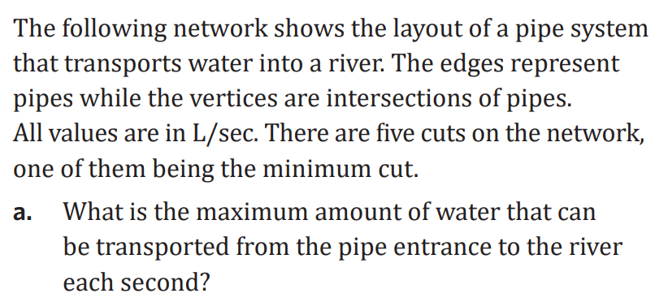
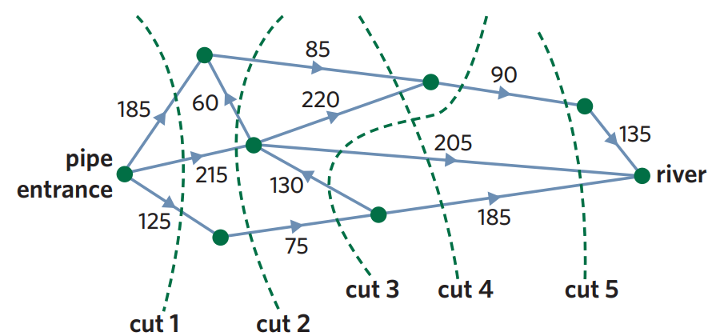

Slide 6

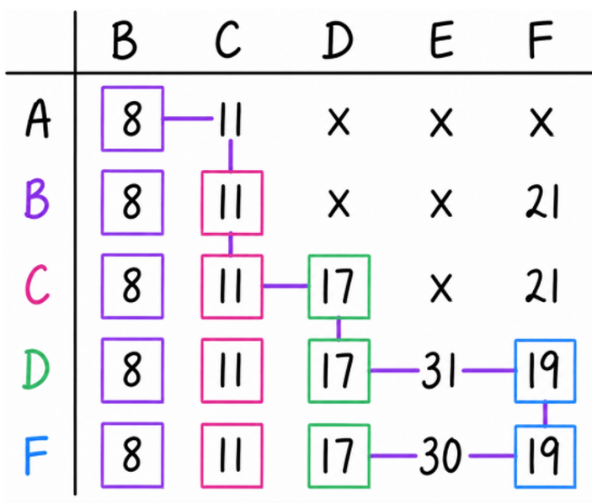
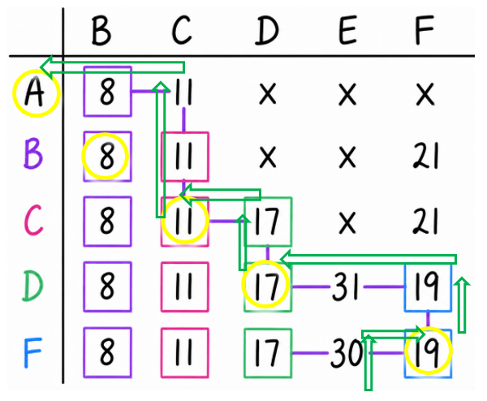
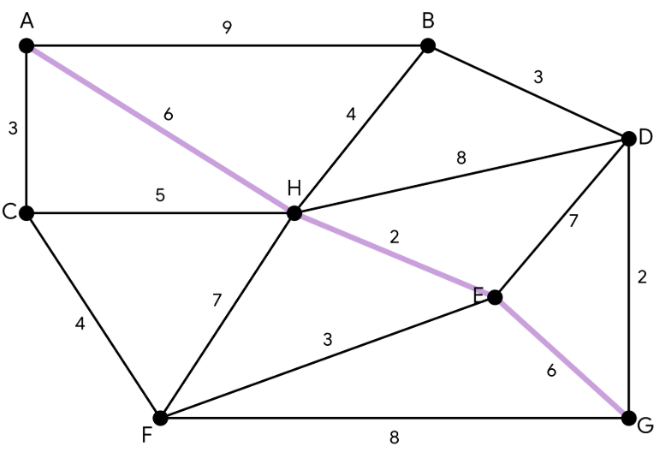
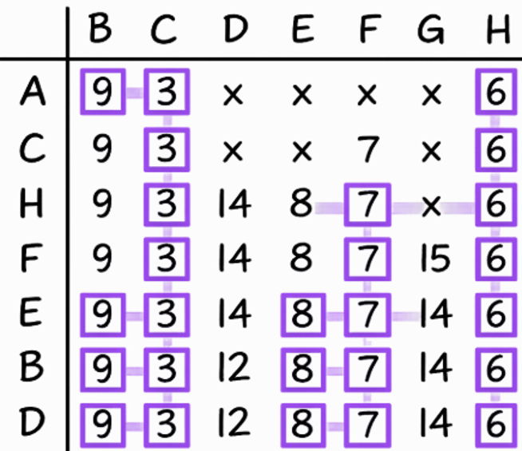
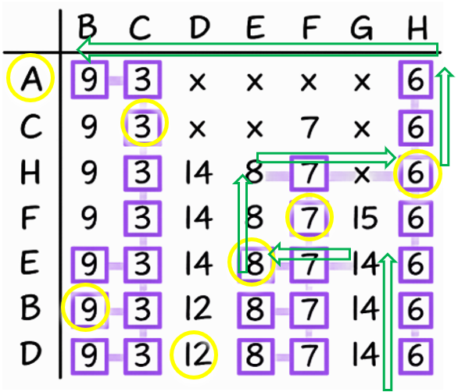
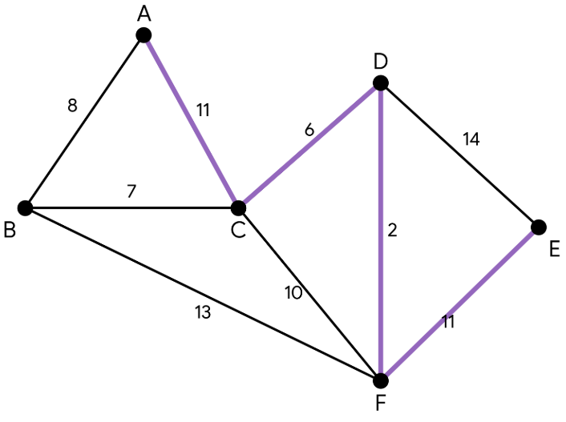
8F: Dijkstra's Algorithm and Shortest Path Problems
shortest path problems:
exists so that you can minimise cost, time or distance
involves finding the shortest path from one vertex to another
you can do this by eye or using Dijkstra's Algorithm
Dijkstra's Algorithm:
steps:
1. create a table, the starting vertex is in the first row, the rest of the vertices form the column labels
2. complete the first row
write the distance from the starting vertex to each other vertex in the corresponding column
if there is no direct connection, mark a cross 'x'
find the smallest number in the first row and put a box/square around it (if there are two or more the same, any can be chosen)
the column vertex that has the box around it becomes the next row
3. complete further rows
copy all boxed numbers into the next row
add the boxed number from the row vertex to the column vertex
  if the value is greater than the value above it, ignore the new one and copy down the smaller number
  if the value is less than or equal to the value above it, write down the new value
  if there is no direct connection, mark a cross ‘x’
look for the smallest unboxed number in the row and draw a box around it
the column vertex for this new boxed number becomes the next row vertex
repeat until the destination vertex value has a box around it
4. backtrack to identify the shortest path and its length
start at the destination box - this is the length of the shortest path
draw a line up the column to the last number that is the same
look at the row vertex for this number and draw a horizontal line to the column
repeat until you reach the start
the horizontal lines indicate the shortest path
helpful hints:
if there is no direct connection and there is a number above, bring it down
always bring down the smallest number
don't forget to add the previous total to your new moves
if two numbers are the same it doesn't matter which one you bring down
example:
1. find the shortest path from A → E
2. find the shortest path from A to G
30 = shortest distance
shortest path =
A C D F E
shortest path = 14 A H E G
Notes:
Board notes

Slide 7
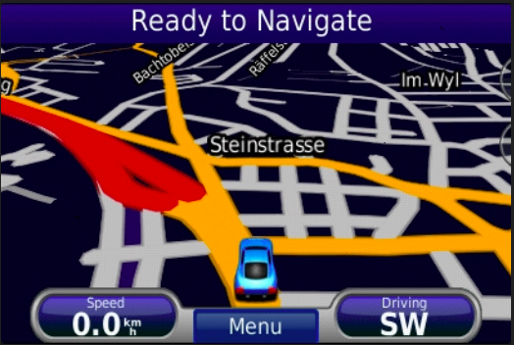
Real life Application
Geographical Maps.
IP routing to find Open shortest Path First.
Telephone network.

Slide 8
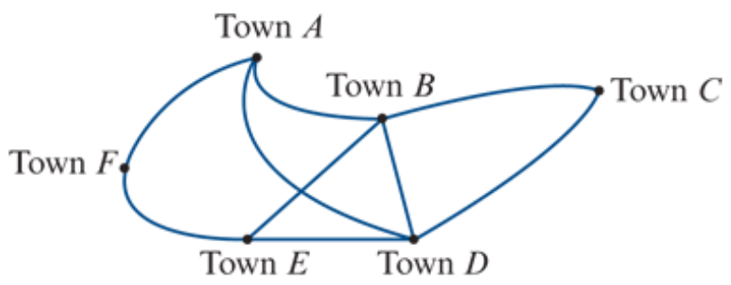
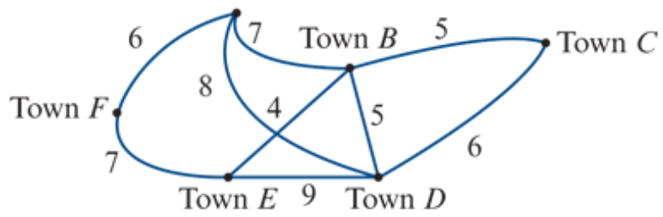
Weighted graphs and networks
A weighted graph is a graph where a number is associated with each edge. These numbers are called weights.
A network is a weighted graph in which the weights are physical quantities, for example, distance, time, cost.

Slide 9
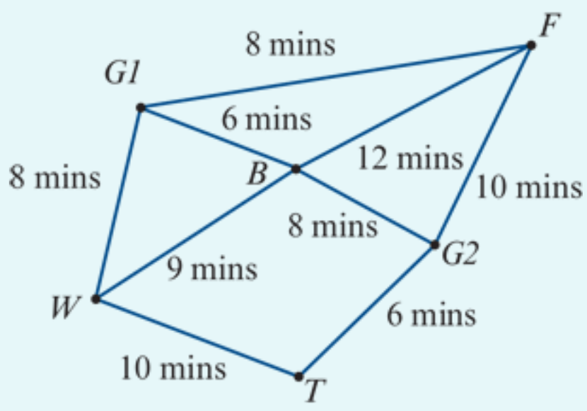
Interpreting a network
The network opposite is used to model the tracks in a forest connecting a suspension bridge (𝐵), a waterfall (𝑊), a very old tree (𝑇) and a fern gully (𝐹).
Walkers can enter or leave the forest through either Gate 1 (𝐺1) or Gate 2 (𝐺2).
The numbers on the edges represent the times (in minutes) taken to walk directly between these places.
a. How long does it take to walk from the bridge directly to the fern gully?
b. How long does it take to walk from the old tree to the fern gully via the waterfall and the bridge?
a. The edge is 𝐵-𝐹. The time taken is 12 minutes.
b. The path is 𝑇-𝑊-𝐵-𝐹. The time taken is 10+9+12=31 minutes.

Slide 10
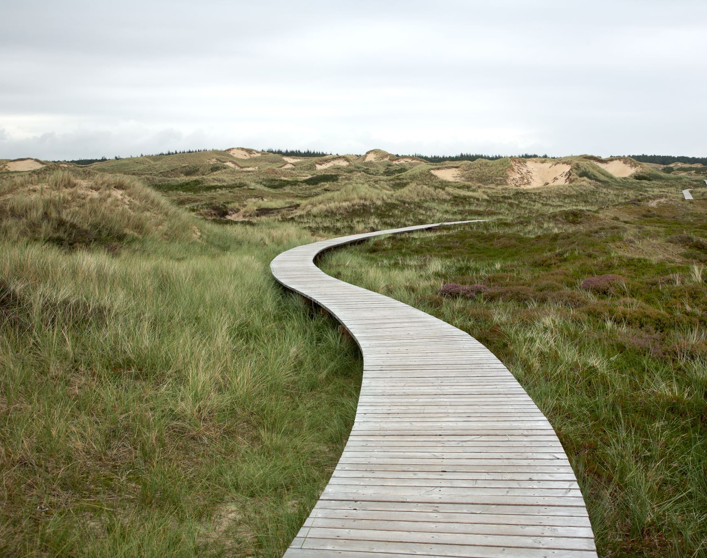
The shortest path problem
Determining the shortest distance or time or the least cost to move around a network is called the shortest path problem.

Slide 11
Finding the shortest path by inspection
Find the shortest route between Town 𝐶 and Town 𝐹 in the previous network opposite.
𝐶-𝐷-𝐸-𝐹: The distance is 6+9+7=22 km.
𝐶-𝐵-𝐸-𝐹: The distance is 5+4+7=16 km.
𝐶-𝐵-𝐴-𝐹: The distance is 5+7+6=18 km.
The shortest path is 𝐶-𝐵-𝐸-𝐹.
Notes:
https://www.youtube.com/watch?v=wtdtkJgcYUM
https://www.youtube.com/watch?v=pVfj6mxhdMw

Slide 12
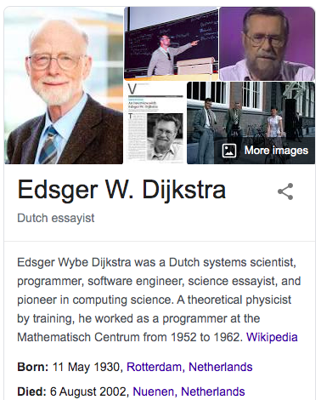
Finding the shortest path by Dijkstra’s Algorithm

Slide 13
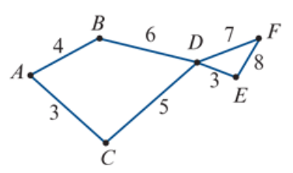



Finding the shortest path by Dijkstra’s Algorithm
Find the shortest path from vertex 𝐴 to vertex 𝐸 in this network. The numbers represent time in hours.
 | B | C | D | E | F
A | 4 | 3 | X | X | X
4
19
C | 4 | 3 | 8 | X | X
10
15
B | 4 | 3 | 8 | X | X
D | 4 | 3 | 8 | 11 | 15
8
E | 4 | 3 | 8 | 11 | 15
11
F | 4 | 3 | 8 | 11 | 15
A C D E
3
3 + 5 + 3 = 11 Hours

Slide 14





Finding the shortest path by Dijkstra’s Algorithm
Find the shortest path from vertex 𝐴 to vertex 𝐸 in this network. The numbers represent time in hours.
$$10$$
4
15
19
From Starting vertex.
The shortest edge first.
Write distance from the starting vertex.
Cover all edges from this vertex.
Find the next shortest distance vertex to start over again.
Until all vertices and edges covered.
8
0
11
3+5+3=11 Hours
3

Slide 15




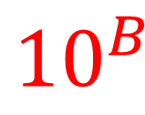
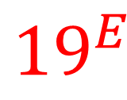


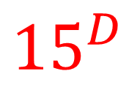

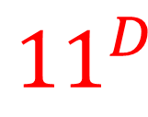

Finding the shortest path by Dijkstra’s Algorithm
Find the shortest path from vertex 𝐴 to vertex 𝐸 in this network. The numbers represent time in hours.
$${10}^{B}$$
$$4^{A}$$
$${15}^{D}$$
$${19}^{E}$$
From Starting vertex.
The shortest edge first.
Write distance from the starting vertex.
Label the last vertex passing by.
Cover all edges from this vertex.
Find the next shortest distance vertex to start over again.
Until all vertices and edges covered.
$$8^{C}$$
0
$${11}^{D}$$
3+5+3=11 Hours
$$3^{A}$$
$${Weights from starting vertex}^{the last passing by vertex}$$

Slide 16
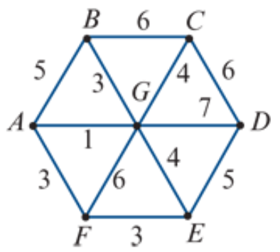


Finding the shortest path by Dijkstra’s Algorithm
Find the shortest path from vertex 𝐵 to vertex 𝐹 in this network. The numbers represent time in minutes.
7
 | A | C | D | E | F | G
6
B | 5 | 6 | X | X | X | 3
3
12
G | 4 | 6 | 10 | 7 | 9 | 3
5
10
A | 4 | 6 | 10 | 7 | 7 | 3
4
12
C | 4 | 6 | 10 | 7 | 7 | 3
7
F | 4 | 6 | 10 | 7 | 7 | 3
9
10
E | 4 | 6 | 10 | 7 | 7 | 3
7
B G A D
D | 4 | 6 | 10 | 7 | 7 | 3
3 + 1 + 3 = 7 minutes

Slide 17
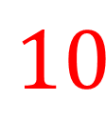



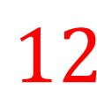
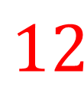










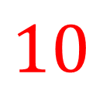



Finding the shortest path by Dijkstra’s Algorithm
Find the shortest path from vertex 𝐵 to vertex 𝐹 in this network. The numbers represent time in minutes.
0
$$6$$
$$7$$
From Starting vertex.
The shortest edge first.
Write distance from the starting vertex.
Cover all edges from this vertex.
Find the next shortest distance vertex to start over again.
Until all vertices and edges covered.
$$12$$
$$4$$
$$5$$
$$3$$
$$10$$
$$12$$
3+1+3=7 minutes
$$7$$
9
$$10$$
$$7$$

Slide 18
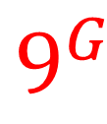
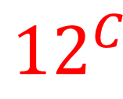
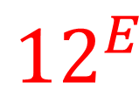
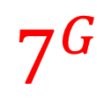

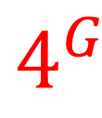

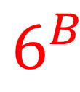
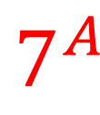
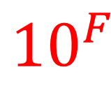


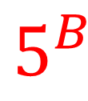

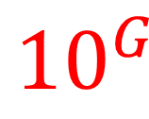
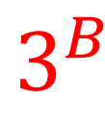
Finding the shortest path by Dijkstra’s Algorithm
Find the shortest path from vertex 𝐵 to vertex 𝐹 in this network. The numbers represent time in minutes.
0
$$6^{B}$$
$$7^{G}$$
From Starting vertex.
The shortest edge first.
Write distance from the starting vertex.
Label the last vertex passing by.
Cover all edges from this vertex.
Find the next shortest distance vertex to start over again.
Until all vertices and edges covered.
$${12}^{E}$$
$$4^{G}$$
$$5^{B}$$
$$3^{B}$$
$${10}^{G}$$
$${12}^{C}$$
3+1+3=7 minutes
$$7^{A}$$
$$9^{G}$$
$${10}^{F}$$
$$7^{G}$$
$${Weights from starting vertex}^{the last passing by vertex}$$

Slide 19
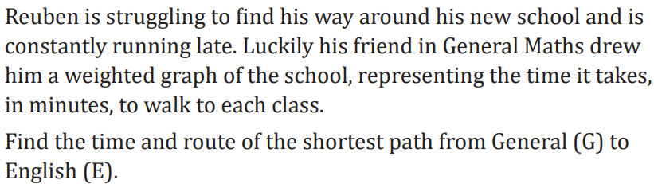
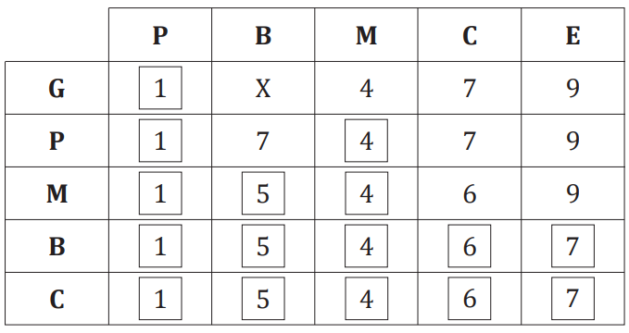
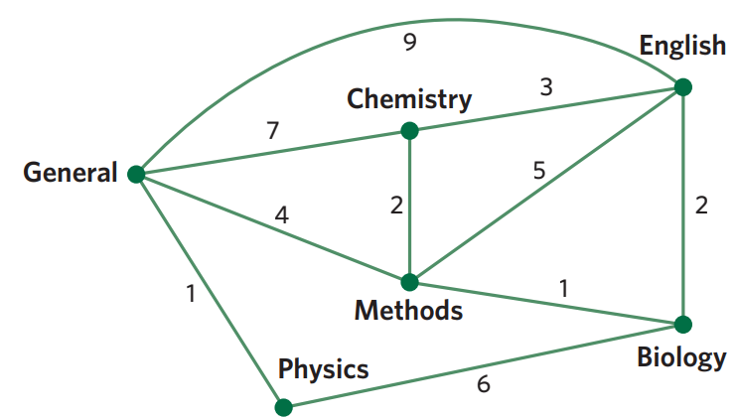

Slide 21
Dijkstra’s Algorithm steps
Draw a nxn table, n is vertices number.
Write all vertices names on the top row 1.
Write starting vertex name at the beginning of row 2.
Write all distances from starting point on the row 2, the rest no connection will be X’s.
Put a square around the smallest number on row 2. The smallest number vertex from row 2 will go to the beginning of row 3.
Write accumulating distance on row 3 from this new vertex, the rest numbers can be from above row.
Repeating step 5, 6 until all table filled.
Circle all intersection vertex on the table (e.g A-A, B-B)
Find the end vertex.
Use arrows to retreat on the column before the number changes.
Find the vertex from this new row.
Repeat step 10, 11 until trace back to starting vertex.

