Slide 1
Matching problems
8G
Notes:
1,2,6,7

Slide 2
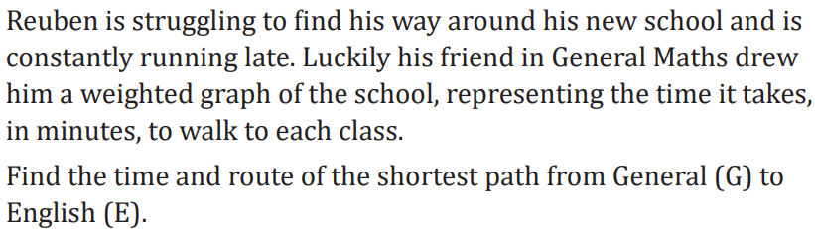
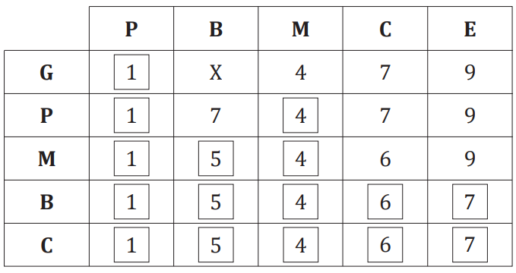
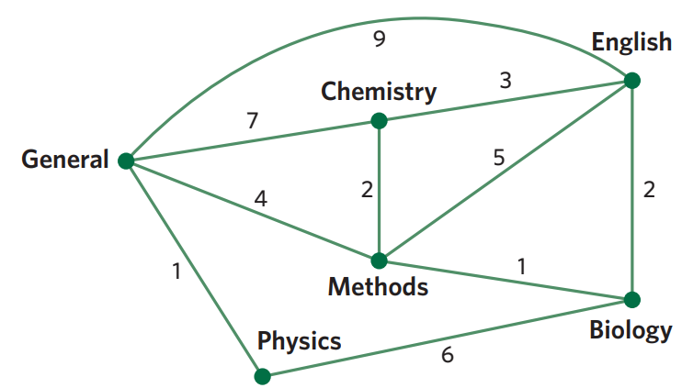


Slide 3

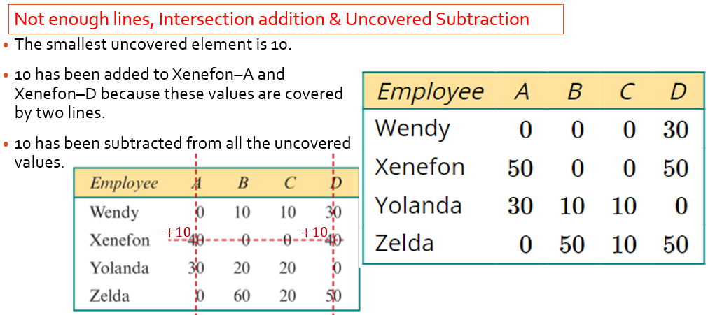
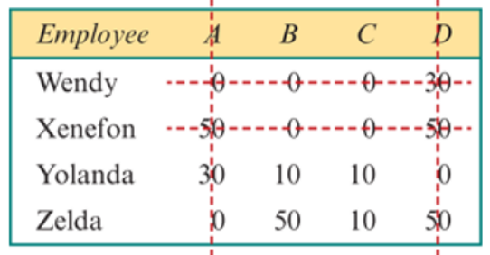
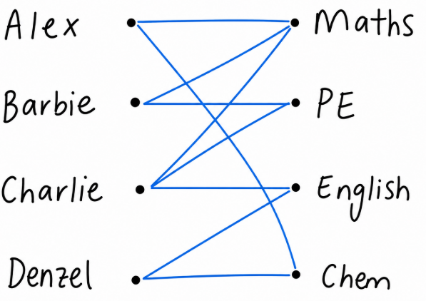
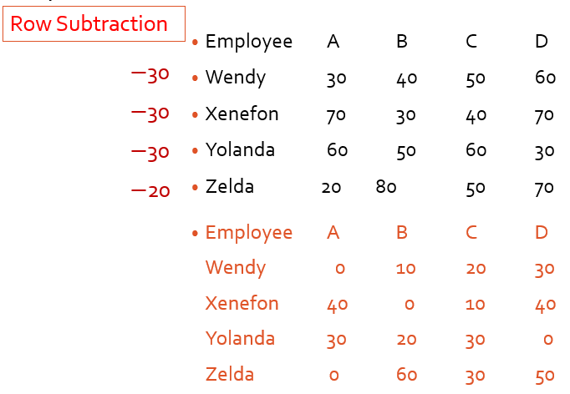
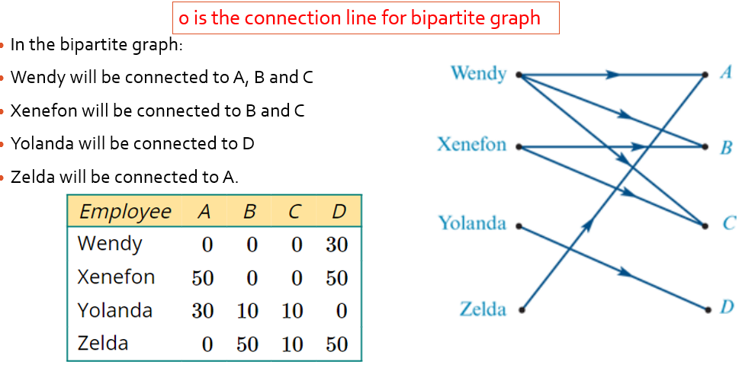
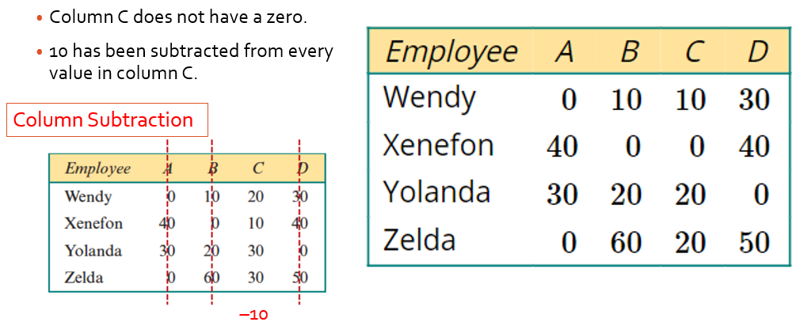
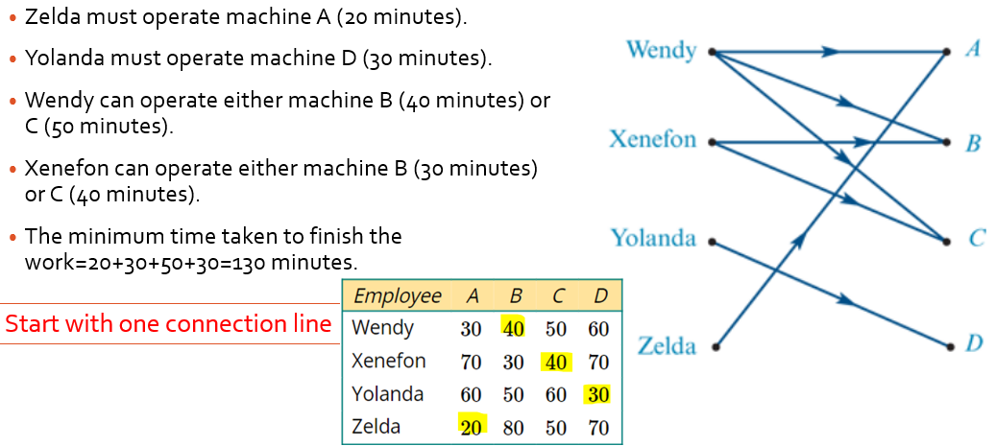
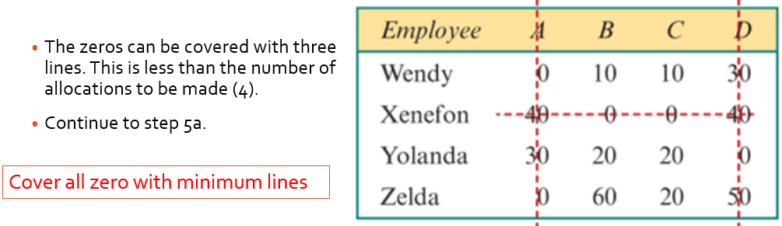
8G Matching Problems
bipartite graph: Shows connections
between two groups
there is no connection b/w vertices
of the same group.
Student Subject
The Hungarian algorithm
Steps:
1. Locate the lowest value in each row and subtract that from each element in the row
2. Find the minimum number of lines required to cover all of the zeros (if it is the same as the number of subjects then skip to step 7) (it is usually 4 so if you have four lines then skip)
3. Locate the lowest value in each column (it may be zero) and subtract that from each element in the column
4. Find the minimum number of lines requires to cover all of the zeros (skip to step 7 if you have the same number of lines as there are subjects)
5. Locate the smallest value which is not covers by a line. Subtract that from all uncovered elements and add the value to all elements covered by 2 lines (line intersection)
6. Find the minimum number of lines required to cover all the zeros in the table (if it is not the same as the number of subjects repeat 5)
7. Make the allocation based on the location of the zeros in the matrix (Bipartite)
8. Find the minimum time by referring to the initial table costs
Notes:
Board notes

Slide 4
Applications-You're getting married.
200 guests, champaign, bow tie, dresses, it's all going to be beautiful.
But a few days before the wedding, you remember that you forgot to plan the tables!
Where are your guests going to seat? And most of all, with who?
Your father is okay to sit with his in-law, but not with his brother! Your in-law is okay to sit with your parents, but not with their friends... And your two best friends who broke up last month? Should they sit together?

Slide 5
Applications-designing the Uber Algorithm to match drivers and clients.
Your job is to match drivers and clients based on their distances to each other. Every time a client orders a ride; the nearest driver is assigned the task and drives to the client.
Now, what if there are 20 drivers near the client's location? What if some of them refuse rides below 20$? And what if there are 20 other clients waiting? What if some of them have a bad ranking? Or what if multiple of them have 5 stars?
How do you match the right clients to the right drivers so that everybody waits as little as possible?

Slide 6
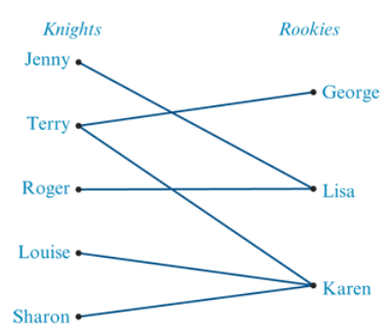
Bipartite graphs
Two chess teams
Each edge in a bipartite graph joins one vertex from one group to a vertex in the other group.
the vertices of a graph belong in two separate sets.

Slide 7
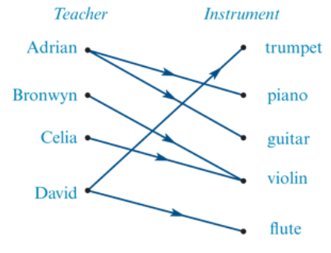
Directed bipartite graphs
In matching problems, one vertex from one group is matched or allocated to one, or more, vertices of the second group and we use a directed bipartite graph to represent this matching.
Imagine a music school that has four teachers: Adrian, Bronwyn, Celia and David. These teachers, between them can teach five different instruments: trumpet, piano, guitar, violin and flute.

Slide 8
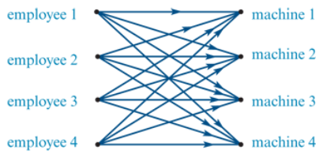
Complete weighted bipartite graphs
Every employee can use every machine and so the bipartite graph is complete. Employees and machines can be matched in many different ways.
Rather than writing all of the weights on a complete bipartite graph, we can summarise the time information in a table and then use an algorithm, called the Hungarian algorithm, to allocate employees to machines in order to minimise the time taken to finish the tasks.

Slide 9
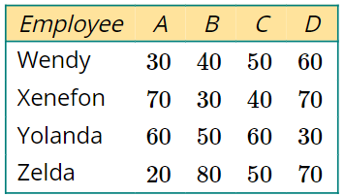
The Hungarian algorithm
The table on the right shows the four employees: Wendy, Xenefon, Yolanda and Zelda. The machines in a factory are represented by the letters A, B, C and D.
The numbers in the table are the times, in minutes, it takes each employee to finish the task on each machine.
The table is called a cost matrix. The cost matrix can be used to determine the best way to allocate an employee to a machine so that the overall cost, in terms of the time taken to finish the work, is minimised. The Hungarian algorithm is used to do this.

Slide 10

Performing the Hungarian algorithm
Step 1: Subtract the lowest value in each row, from every value in that row.
Row Subtraction
Employee A B C D
Wendy 30 40 50 60
Xenefon 70 30 40 70
Yolanda 60 50 60 30
Zelda 20 80 50 70
Employee A B C D
Wendy 0 10 20 30
Xenefon 40 0 10 40
Yolanda 30 20 30 0
Zelda 0 60 30 50
$−$30
$−$30
$−$30
$−$20

Slide 11
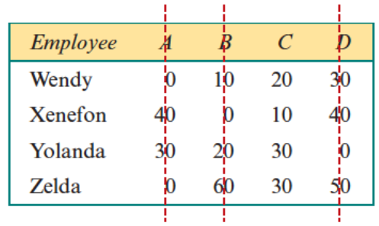
Step 2: If the minimum number of lines required to cover all the zeros in the table is equal to the number of allocations to be made, jump to step 6. Otherwise, continue to step 3.
The zeros can be covered with three lines. This is less than the number of allocations to be made (4).
Continue to step 3.

Slide 12
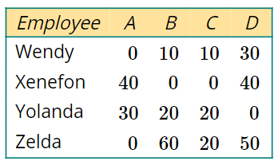
Step 3: If a column does not contain a zero, subtract the lowest value in that column from every value in that column.
Column C does not have a zero.
10 has been subtracted from every value in column C.
–10
Column Subtraction

Slide 13
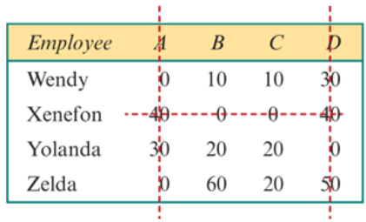
Step 4: If the minimum number of lines required to cover all the zeros in the table is equal to the number of allocations to be made, jump to step 6. Otherwise, continue to step 5a.
The zeros can be covered with three lines. This is less than the number of allocations to be made (4).
Continue to step 5a.
Cover all zero with minimum lines

Slide 14
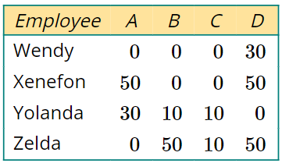


Step 5a: Add the smallest uncovered value to any value that is covered by two lines. Subtract the smallest uncovered value from all the uncovered values.
Not enough lines, Intersection addition & Uncovered Subtraction
The smallest uncovered element is 10.
10 has been added to Xenefon–A and Xenefon–D because these values are covered by two lines.
10 has been subtracted from all the uncovered values.
$$+10$$
$$+10$$

Slide 15
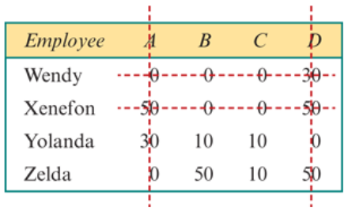
Step 5b: Repeat from step 4.
The zeros can be covered with a minimum of four lines. This is the same as the number or allocations to make.
Continue to step 6.

Slide 16
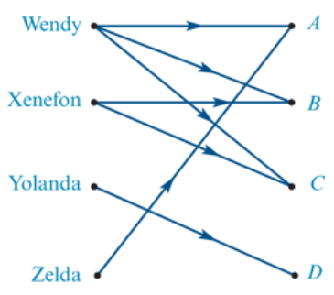
Step 6: Draw a directed bipartite graph with an edge for every zero value in the table.
0 is the connection line for bipartite graph
In the bipartite graph:
Wendy will be connected to A, B and C
Xenefon will be connected to B and C
Yolanda will be connected to D
Zelda will be connected to A.

Slide 17
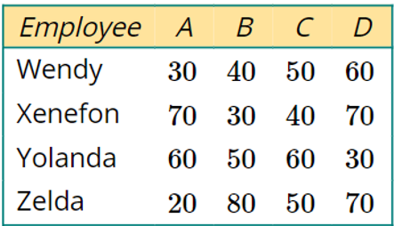





Step 7: Make the allocation and calculate minimum cost
Zelda must operate machine A (20 minutes).
Yolanda must operate machine D (30 minutes).
Wendy can operate either machine B (40 minutes) or C (50 minutes).
Xenefon can operate either machine B (30 minutes) or C (40 minutes).
The minimum time taken to finish the work=20+30+50+30=130 minutes.
Start with one connection line

Slide 18
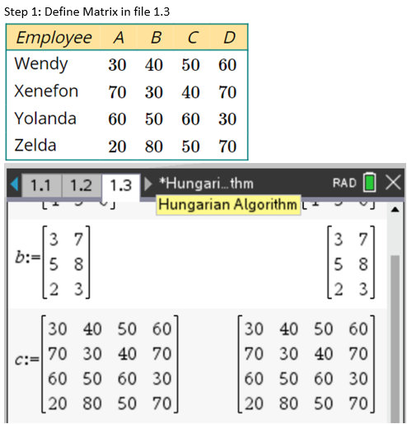
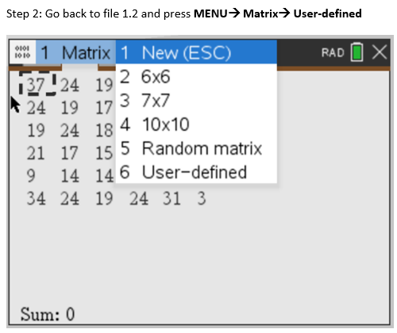
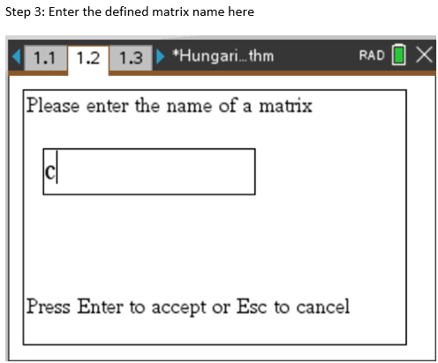
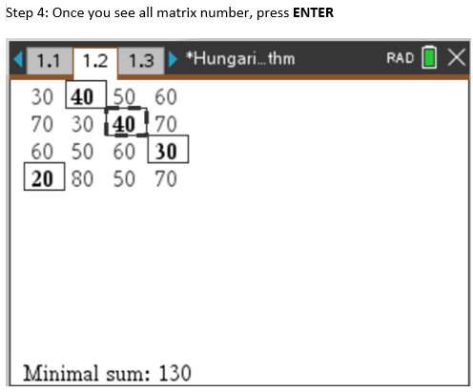
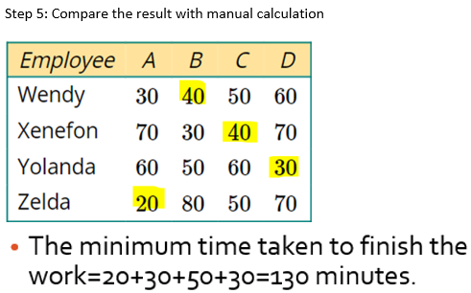
CAS
CAS Notes 8.1

