Slide 1

7E Binary and permutation matrices
7E
Notes:
https://dashboard.blooket.com/set/618966a617762f1c1c272b7d
https://create.kahoot.it/details/76de5c72-45ef-4579-ba10-82e06a4bf912
https://create.kahoot.it/details/86712fd5-d057-47a6-83dc-58f7a6ab5407

Slide 2
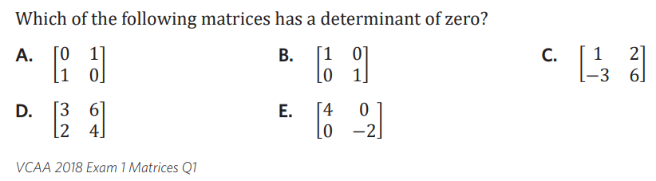
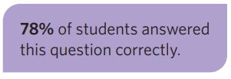

Slide 3
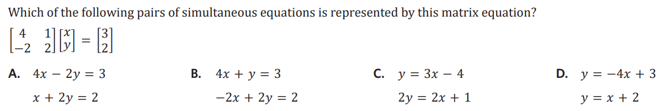

Slide 4

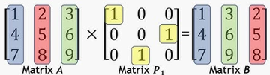
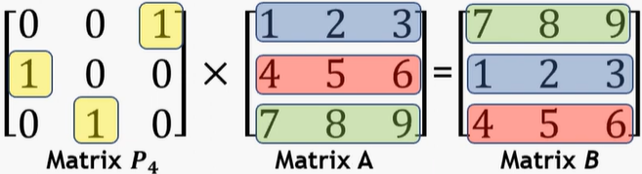


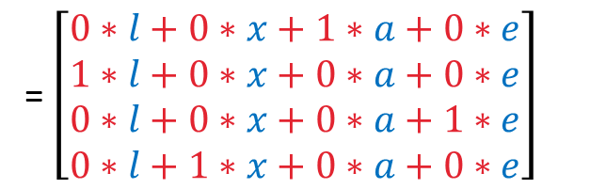
7E: Binary and Permutation matrices.
binary matrix: only has 1’s and 0’s as
its elements (any size)
permutation matrix: (square only)
- type of binary matrix
*only has one 1 in each row and column
- used to re-arrange elements
column permutation rearranges columns Post multiply (Q × P)
row permutation rearranges rows.
Pre multiply (P × Q)
examples
binary or permutation?
$\left[\begin{aligned}0 \\ 1\end{aligned}\right]$ $\left[\begin{matrix}0 & 0 \\ 0 & 1\end{matrix}\right]$ $\left[\begin{matrix}1 0 & 0 \\ 0 1 & 0 \\ 0 0 & 1\end{matrix}\right] \left[\begin{matrix}0 & 1 & 0 & 0 \\ 1 & 0 & 0 & 0 \\ 0 & 0 & 1 & 0 \\ 0 & 0 & 0 & 1\end{matrix}\right]$
binary binary identity permutation
binary
create a permutation matrix to rearrange.
1. $\left[\begin{aligned}l \\ x \\ a \\ e\end{aligned}\right]→\left[\begin{aligned}a \\ l \\ e \\ x\end{aligned}\right]$
$\left[\begin{matrix}0 & 0 & 1 & 0 \\ 1 & 0 & 0 & 0 \\ 0 & 0 & 0 & 1 \\ 0 & 1 & 0 & 0\end{matrix}\right]$ $\left[\begin{aligned}l \\ x \\ a \\ e\end{aligned}\right]=\left[\begin{aligned}r_{1}c_{1} \\ r_{2}c_{1} \\ r_{3}c_{1} \\ r_{4}c_{1}\end{aligned}\right]=\left[\begin{aligned}a \\ l \\ e \\ x\end{aligned}\right]$
4×4 4×1 4×1
P × Q = 4×1
2.$\left[u l m p\right]$ to $\left[p l u m\right]$
$\left[u l m p\right]\left[\begin{matrix}0 & 0 & 1 & 0 \\ 0 & 1 & 0 & 0 \\ 0 & 0 & 0 & 1 \\ 1 & 0 & 0 & 0\end{matrix}\right]$=$\left[p l u m\right]$
1×4 4×4 1×4
=$\left[r_{1}c_{1 }r_{1}c_{2 }r_{1}c_{3}{ r}_{1}c_{4}\right]$
$r_{1}c_{1}=$ $u∗0+l∗0+m∗0+p∗1$
$r_{1}c_{2}=$ $u∗0+l∗1+m∗0+p∗0$
$r_{1}c_{3}=$ $u∗1+l∗0+m∗0+p∗0$
$r_{1}c_{4}=$ $u∗0+l∗0+m∗1+p∗0$
Rearranging the rows
pre-multiply P × Q
Rearranging the columns
post multiply (Q × P)
= $\left[\begin{aligned}0∗l+0∗x+1∗a+0∗e \\ 1∗l+0∗x+0∗a+0∗e \\ 0∗l+0∗x+0∗a+1∗e \\ 0∗l+1∗x+0∗a+0∗e\end{aligned}\right]$
Notes:
Permutation matrices | General Maths | RouTube

Slide 5
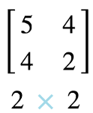
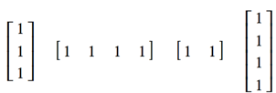
TYPES OF MATRICES
NAME | DESCRIPTION | EXAMPLE
Row matrix | A matrix with only 1 row
Column matrix | A matrix with only I column
Square matrix | the number of rows equals the number of columns
Zero (Null) matrix | A matrix with all zero entries
Summing matrix | A row or column matrix in which all the elements are 1. To sum the rows of an m × n matrix, post-multiply the matrix by an n × 1 summing matrix. To sum the columns of an m × n matrix, pre-multiply the matrix by a 1 × m summing matrix.

Slide 6

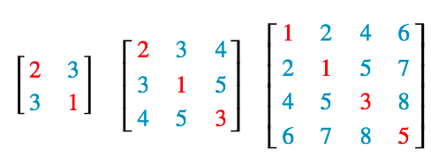
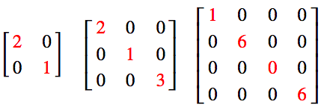
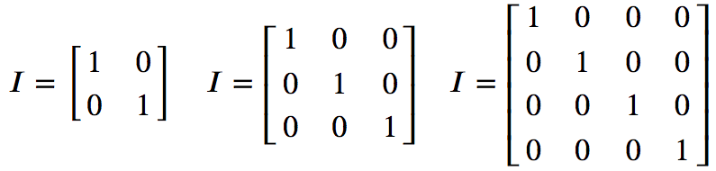
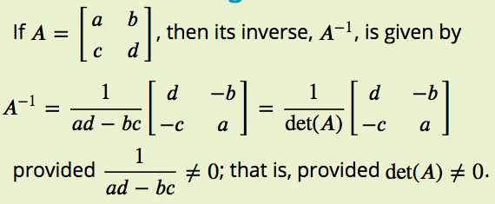
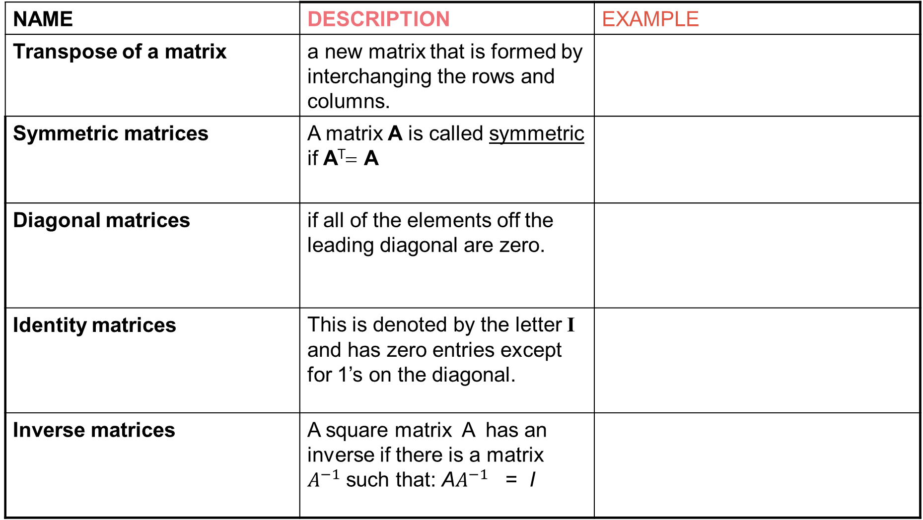
TYPES OF MATRICES
NAME | DESCRIPTION | EXAMPLE
Transpose of a matrix | a new matrix that is formed by interchanging the rows and columns.
Symmetric matrices | A matrix A is called symmetric if A^{T}= A
Diagonal matrices | if all of the elements off the leading diagonal are zero.
Identity matrices | This is denoted by the letter I and has zero entries except for 1’s on the diagonal.
Inverse matrices | A square matrix A has an inverse if there is a matrix $A^{−1}$ such that: A$A^{−1}$ = I

Slide 7
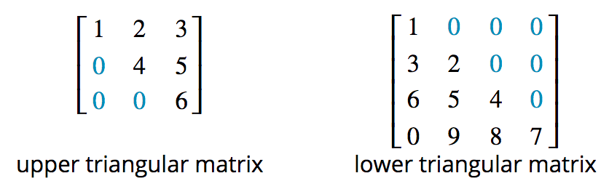


TYPES OF MATRICES
NAME | DESCRIPTION | EXAMPLE
Triangular matrices | 1. An upper triangular matrix: all elements below the leading diagonal are zeros. 2. A lower triangular matrix: all elements above the leading diagonal are zeros.
Binary matrices | A special kind of matrix that has only 1s and zeros as its elements.
Permutation matrices | A square binary matrix in which there is only one ‘1’ in each row and column.

Slide 8
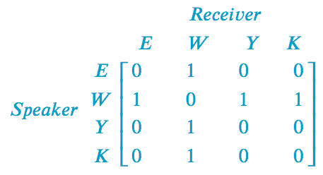
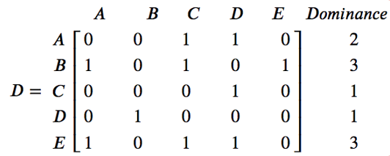
TYPES OF MATRICES
NAME | DESCRIPTION | EXAMPLE
Communication matrices | A square binary matrix in which the 1s represent the links in a communication system. All of the non-zero elements in the leading diagonal of a communication matrix, or its powers, represent redundant links in the matrix.
Dominance matrices | Is a square binary matrix in which 1s represent one-step dominance between members of a group.

Slide 9

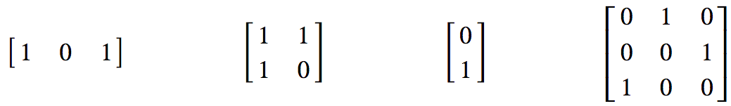
Binary matrices
A binary matrix is a special kind of matrix that has only 1s and zeros as its elements. It is used to investigate communication systems and the ranking of players in sporting competition.
The following matrices are examples of binary matrices.

Slide 10
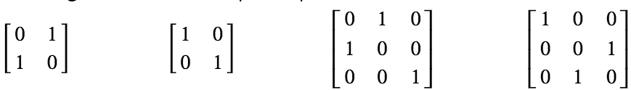
Permutation matrices
A square binary matrix in which there is only one ‘1’ in each row and column.
The following matrices are examples of permutation matrices.
An identity matrix is a special permutation matrix. A permutation matrix can be used to rearrange the elements in another matrix.
The word ‘permutation’ means a rearrangement a group of objects, in this case the elements of a matrix, into a different order.

Slide 11

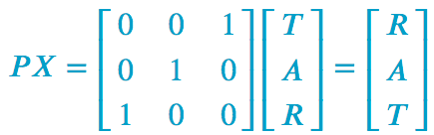
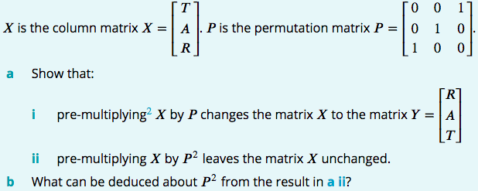
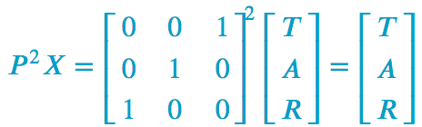
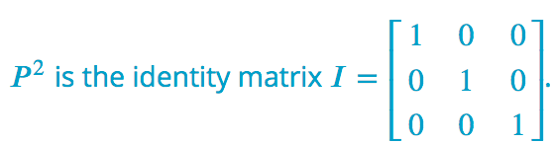
Applying a permutation matrix
To leave the matrix 𝑋 unchanged, $P^{2}$must be an identity matrix.

Slide 12
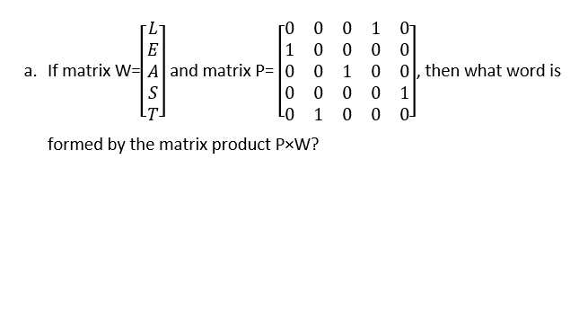
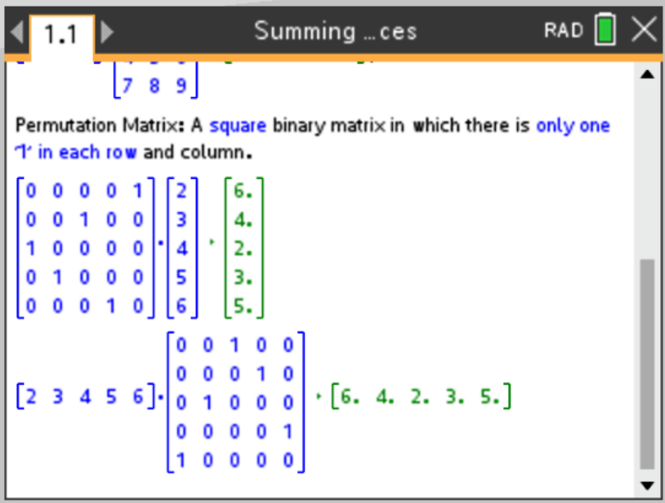
CAS Notes 7.13

Slide 13
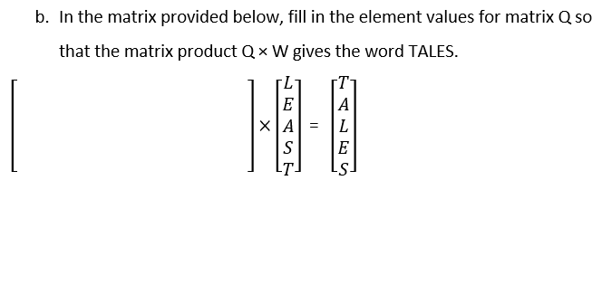
CAS Notes 7.13

Slide 14
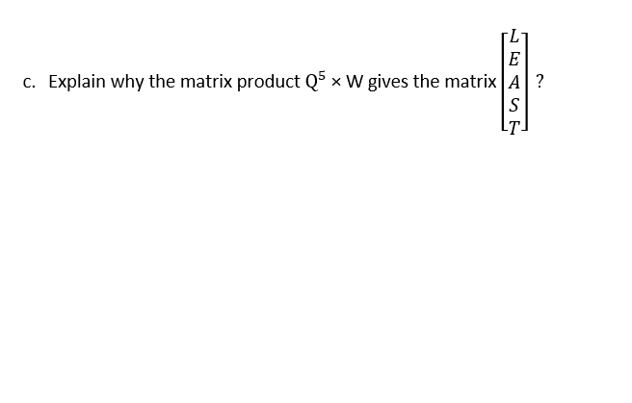
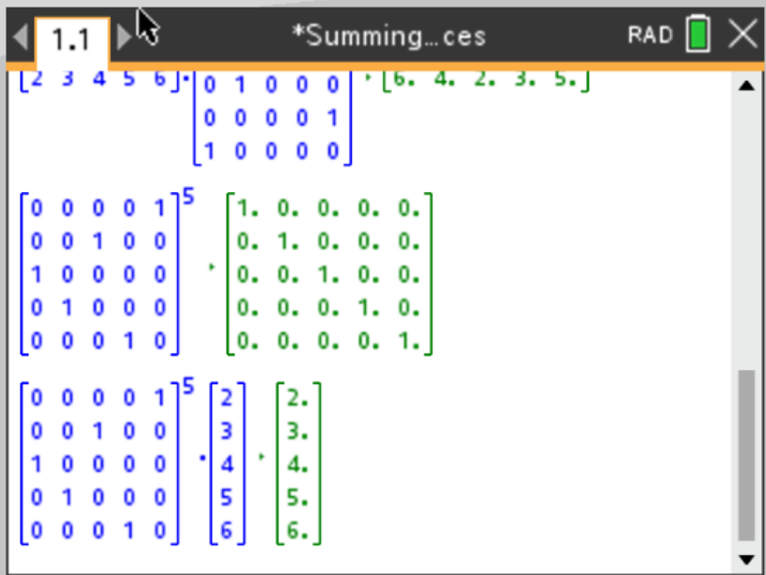
CAS Notes 7.13

