Slide 1

Introduction to transition matrices
7G

Slide 2
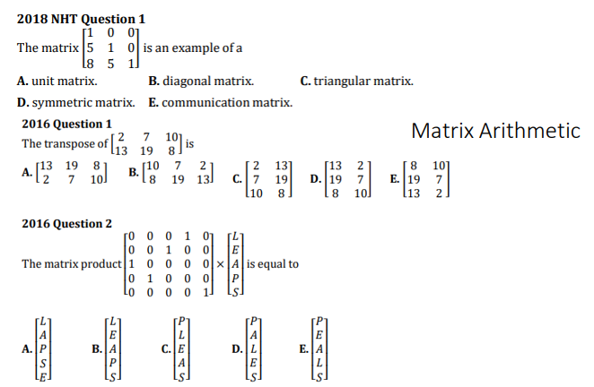

Slide 3
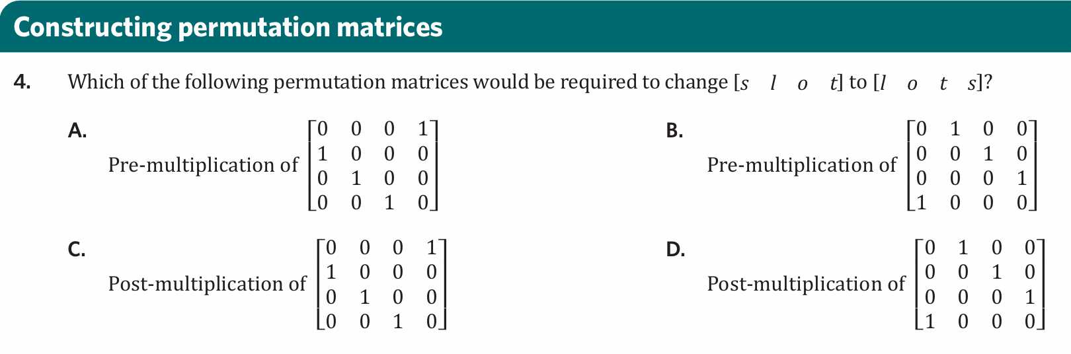

Slide 4
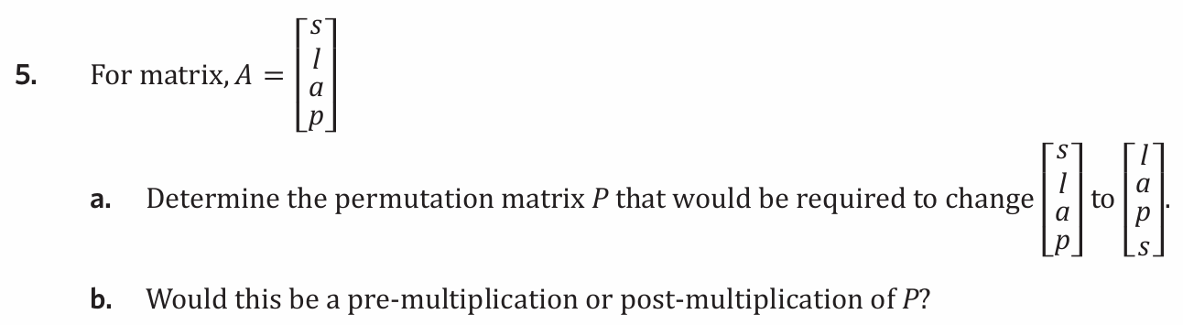

Slide 5

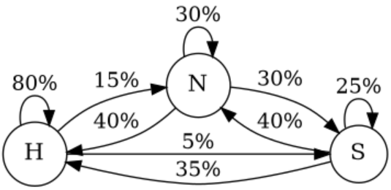
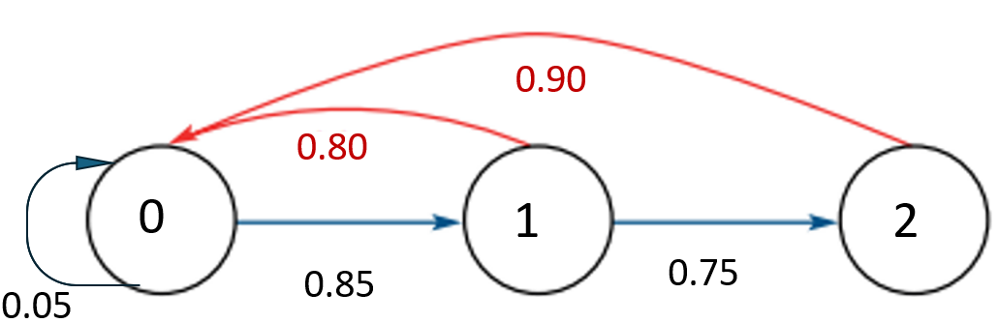



7G: transition matrices
State matrix:
column matrix
population at a given time
initial state matrix:
initial / starting population
transition matrix:
states change over time
always SQUARE
columns MUST add up to 1
labelling: now
A B
$T=\left[\begin{aligned} \\ \end{aligned}\begin{aligned} \\ \end{aligned}\right]$ $\begin{aligned}A \\ B\end{aligned}$
only decimals inside a transition matrix (0-1)
calculating state matrices:
to find the next state
use recursion (step by step)
$S_{0}=$ initial state, $S_{n+1}=T×S_{n}$
matrix
rule: (find future values faster)
$$S_{n}=T^{n}×S_{0}$$
n = time frame interested in.
example: people can be happy (H), neither happy or sad (N) or sad (S)
a. complete T today
H N S
$$T=\left[\begin{matrix}0.8 & 0.4 & 0.35 \\ 0.15 & 0.3 & 0.4 \\ 0.05 & 0.3 & 0.25\end{matrix}\right]$$
0.05 = 5%
b. on a given day 1200 ppl are happy,
600 are neither and 200 are sad, construct $S_{0}$
$$S_{0}=\left[\begin{aligned}1200 \\ 600 \\ 200\end{aligned}\right]$$
c. how many people are happy, neither or sad tomorrow?
$$S_{1}=T×S_{0}=\left[\begin{aligned}1270 \\ 440 \\ 290\end{aligned}\right]$$
d. how many people are happy, neither or
sad in 5 days time?
$$S_{5}=T^{5}×S_{0}=\left[\begin{aligned}1310 \\ 430 \\ 260\end{aligned}\right]$$
Leslie matrix
RR $S_{n+1}=L×S_{n}$
Rule $S_{n}=L^{n}×S_{0}$
Leslie matrix example.
fighting fish population
age
0 1 2
$L=\left[\begin{matrix}0.05 & 0.80 & 0.90 \\ 0.85 & 0 & 0 \\ 0 & 0.75 & 0\end{matrix}\right]$ $S_{0}=\left[\begin{aligned}50 \\ 40 \\ 30\end{aligned}\right]$
a. interpret $L_{21}$ 0.85 survival rate of less than 1 year old.
b. Interpret $L_{13}$ 0.90 fertility rate of 2-year-old fish
c. fish population in 2 years?
$S_{2}=L^{2}×S_{0}=\left[\begin{aligned}64 \\ 52 \\ 32\end{aligned}\right]$ 64 + 52 + 32 = 148
d. Calculate $S_{8}$
$$S_{8}=L^{8}×S_{0}=\left[\begin{aligned}128 \\ 97 \\ 66\end{aligned}\right]$$
H
N
S
tomorrow
0
1
2
0
1
2
other language:
“today” / “tomorrow”
“from” / “to”
H
N
S
next
H
N
S
find next
state
transition
matrix
previous
state
0
1
2
H
N
S
0
1
2
Notes:
Board notes

Slide 6
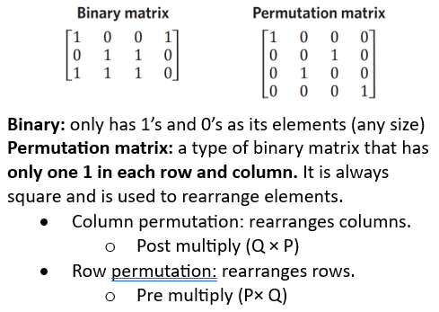
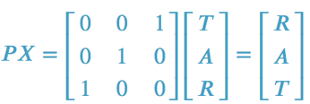
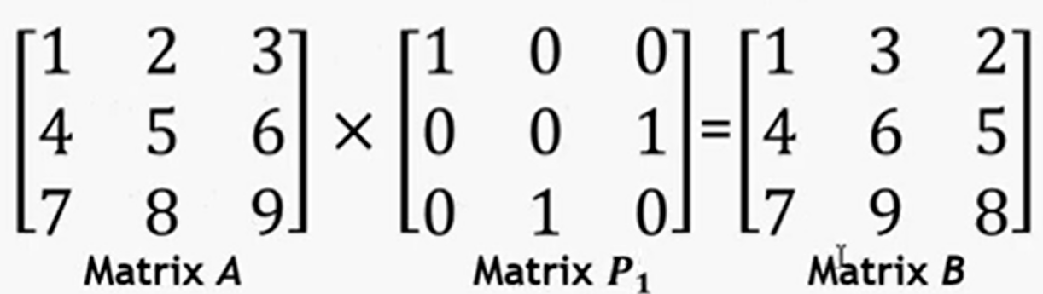

Slide 7
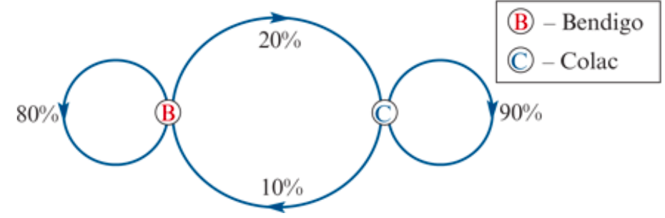
Setting up a transition matrix
A car rental firm has two branches: one in Bendigo and one in Colac. Cars are usually rented and returned in the same town. However, a small percentage of cars rented in Bendigo each week are returned in Colac, and vice versa. The diagram below describes what happens on a weekly basis.

Slide 8
Setting up a transition matrix
What does this diagram tell us?
From week to week:
0.8 (or 80%) of cars rented each week in Bendigo are returned to Bendigo
0.2 (or 20%) of cars rented each week in Bendigo are returned to Colac
0.1 (or 10%) of cars rented each week in Colac are returned to Bendigo
0.9 (or 90%) of cars rented each week in Colac are returned to Colac.

Slide 9
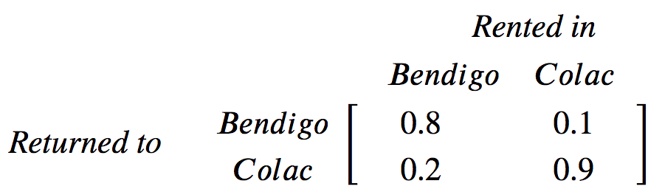



A transition matrix
The percentages (written as proportions) are summarised in the form of the matrix below.
This matrix is an example of a transition matrix (T). It describes the way in which transitions are made between two states:
state 1: the rental car is based in Bendigo.
state 2: the rental car is based in Colac.
Note: In this situation, where the total number of cars remains constant, the columns in a transitional matrix will always add to one (100%). For example, if 80% of cars are returned to Bendigo, then 20% must be returned to Colac.

Slide 10

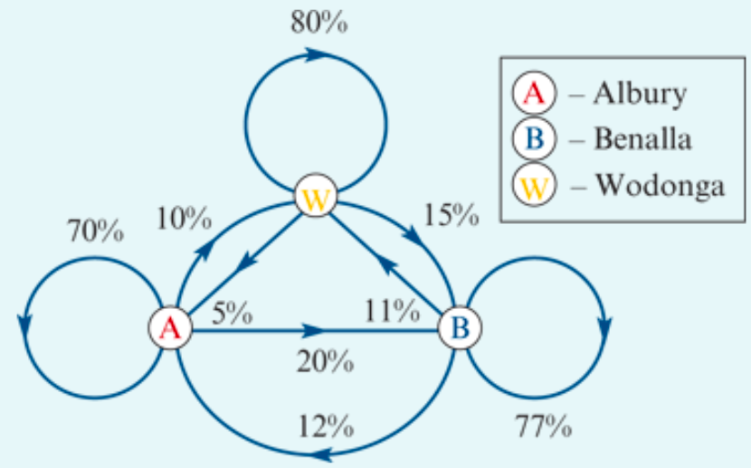
Setting up a transition matrix
The diagram gives the weekly return rates of rental cars at three locations: Albury, Wodonga and Benalla. Construct a transition matrix that describes the week-by-week return rates at each of the three locations. Convert the percentages to proportions.

Slide 11
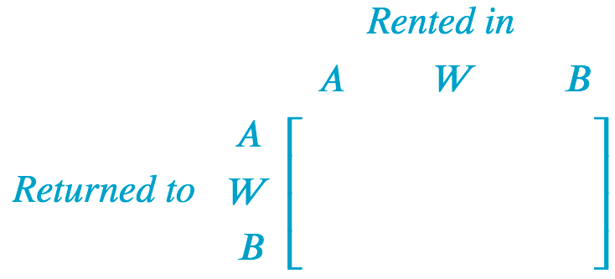


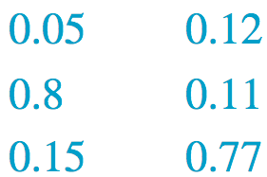


Setting up a transition matrix
Mentally check your answer by summing columns; they should sum to 1.

Slide 12
Setting up a transition matrix
A factory has a large number of machines. Machines can be in one of two states: operating or broken. Broken machines are repaired and come back into operation, and vice versa. On a given day:
85% of machines that are operational stay operating
15% of machines that are operating break down
5% of machines that are broken are repaired and start operating again
95% of machines that are broken stay broken.
Construct a transition matrix to describe this situation. Use the columns to define the situation at the ‘Start’ of the day and the rows to describe the situation at the ‘End’ of the day.

Slide 13
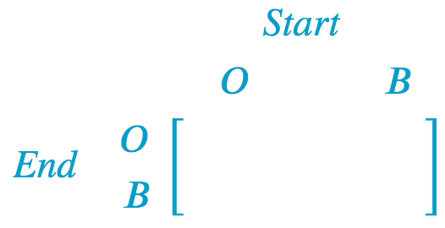





Setting up a transition matrix
85% of machines that are operational stay operating
15% of machines that are operating break down
5% of machines that are broken are repaired and start operating again
95% of machines that are broken stay broken.

Slide 14
Using recursion to generate state matrices step-by-step
‘If we start with 50 cars in Bendigo, and 40 cars in Colac, how many cars will be available for rent at both towns after 1 week, 2 weeks, etc?’
We solved this type of problem by using a recurrence relation to model the growth in our investment year-by-year. We do the same with the car rental problem, the only difference being that we are now working with matrices.

Slide 15
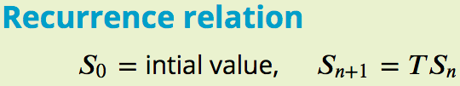
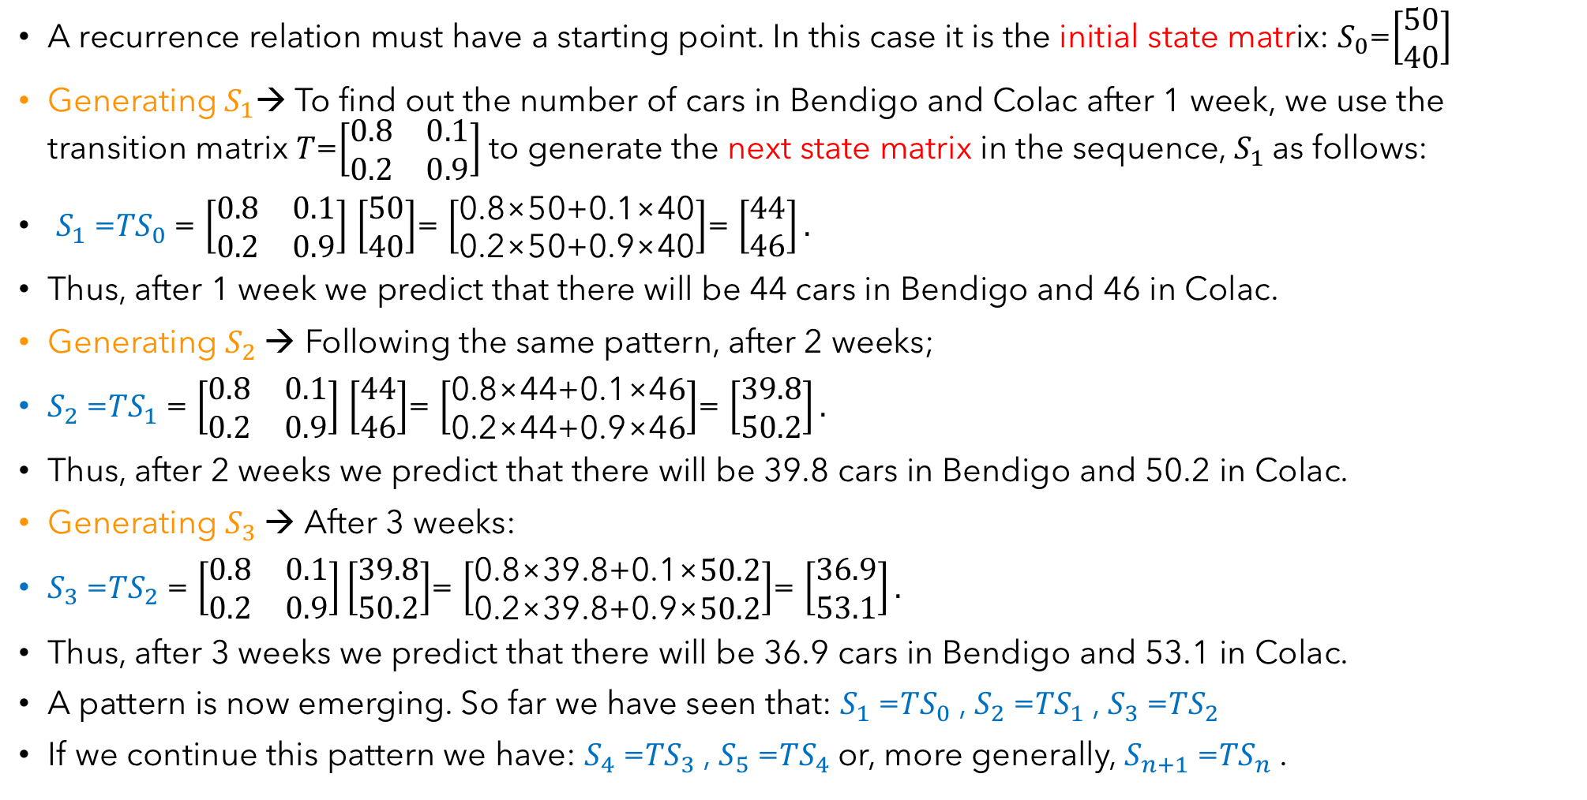
Constructing a matrix recurrence relation
A recurrence relation must have a starting point. In this case it is the initial state matrix: $S_{0}$=$\left[\begin{aligned}50 \\ 40\end{aligned}\right]$
Generating${ S}_{1}$→ To find out the number of cars in Bendigo and Colac after 1 week, we use the transition matrix 𝑇=$\left[\begin{matrix}0.8 & 0.1 \\ 0.2 & 0.9\end{matrix}\right]$to generate the next state matrix in the sequence, $S_{1}$as follows:
$S_{1}$=𝑇$S_{0}$= $\left[\begin{matrix}0.8 & 0.1 \\ 0.2 & 0.9\end{matrix}\right]$ $\left[\begin{aligned}50 \\ 40\end{aligned}\right]$= $\left[\begin{aligned}\text{0.8×50+0.1×40} \\ \text{0.2×50+0.9×40}\end{aligned}\right]$= $\left[\begin{aligned}44 \\ 46\end{aligned}\right].$
Thus, after 1 week we predict that there will be 44 cars in Bendigo and 46 in Colac.
Generating $S_{2}$→ Following the same pattern, after 2 weeks;
$S_{2}$=𝑇$S_{1}$= $\left[\begin{matrix}0.8 & 0.1 \\ 0.2 & 0.9\end{matrix}\right]$ $\left[\begin{aligned}44 \\ 46\end{aligned}\right]$= $\left[\begin{aligned}\text{0.8×}\text{44}\text{+0.1×4}6 \\ \text{0.2×}\text{44}\text{+0.9×4}6\end{aligned}\right]$= $\left[\begin{aligned}39.8 \\ 50.2\end{aligned}\right].$
Thus, after 2 weeks we predict that there will be 39.8 cars in Bendigo and 50.2 in Colac.
Generating $S_{3}$→ After 3 weeks:
$S_{3}$=𝑇$S_{2}$= $\left[\begin{matrix}0.8 & 0.1 \\ 0.2 & 0.9\end{matrix}\right]\left[\begin{aligned}39.8 \\ 50.2\end{aligned}\right]$= $\left[\begin{aligned}\text{0.8×}\text{39.8}\text{+0.1×}50.2 \\ \text{0.2×}\text{39.8}\text{+0.9×}50.2\end{aligned}\right]$= $\left[\begin{aligned}36.9 \\ 53.1\end{aligned}\right].$
Thus, after 3 weeks we predict that there will be 36.9 cars in Bendigo and 53.1 in Colac.
A pattern is now emerging. So far we have seen that: $S_{1}$=𝑇$S_{0}$, $S_{2}$=𝑇$S_{1}$, $S_{3}$=𝑇$S_{2}$
If we continue this pattern we have: $S_{4}$=𝑇$S_{3}$, $S_{5}$=𝑇$S_{4}$or, more generally, $S_{n+1}$=𝑇$S_{n}$.
CAS Notes 7.5
CAS Notes 7.9

Slide 16

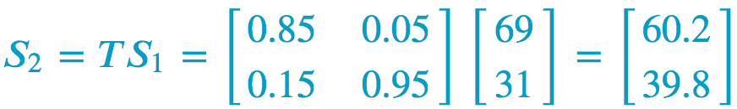
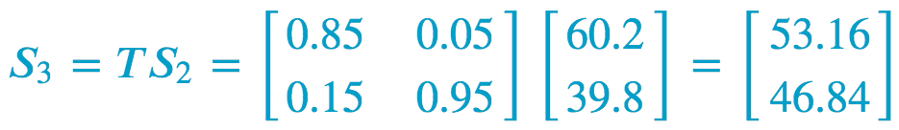
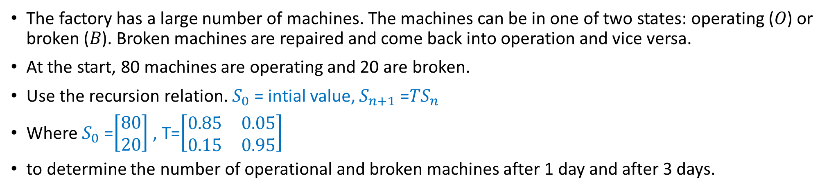
Using a recursion relation to calculate state matrices step-by-step
The factory has a large number of machines. The machines can be in one of two states: operating (𝑂) or broken (𝐵). Broken machines are repaired and come back into operation and vice versa.
At the start, 80 machines are operating and 20 are broken.
Use the recursion relation. $S_{0}$= intial value, $S_{n+1}$=𝑇$S_{n}$
Where $S_{0}$=$\left[\begin{aligned}80 \\ 20\end{aligned}\right]$ , T=$\left[\begin{matrix}0.85 & 0.05 \\ 0.15 & 0.95\end{matrix}\right]$
to determine the number of operational and broken machines after 1 day and after 3 days.
After 1 day, 69 machines are operational and 31 are broken.
After 3 days, 53 machines are operating and 47 are broken.

Slide 17
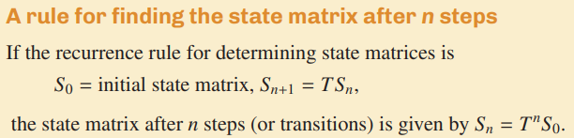
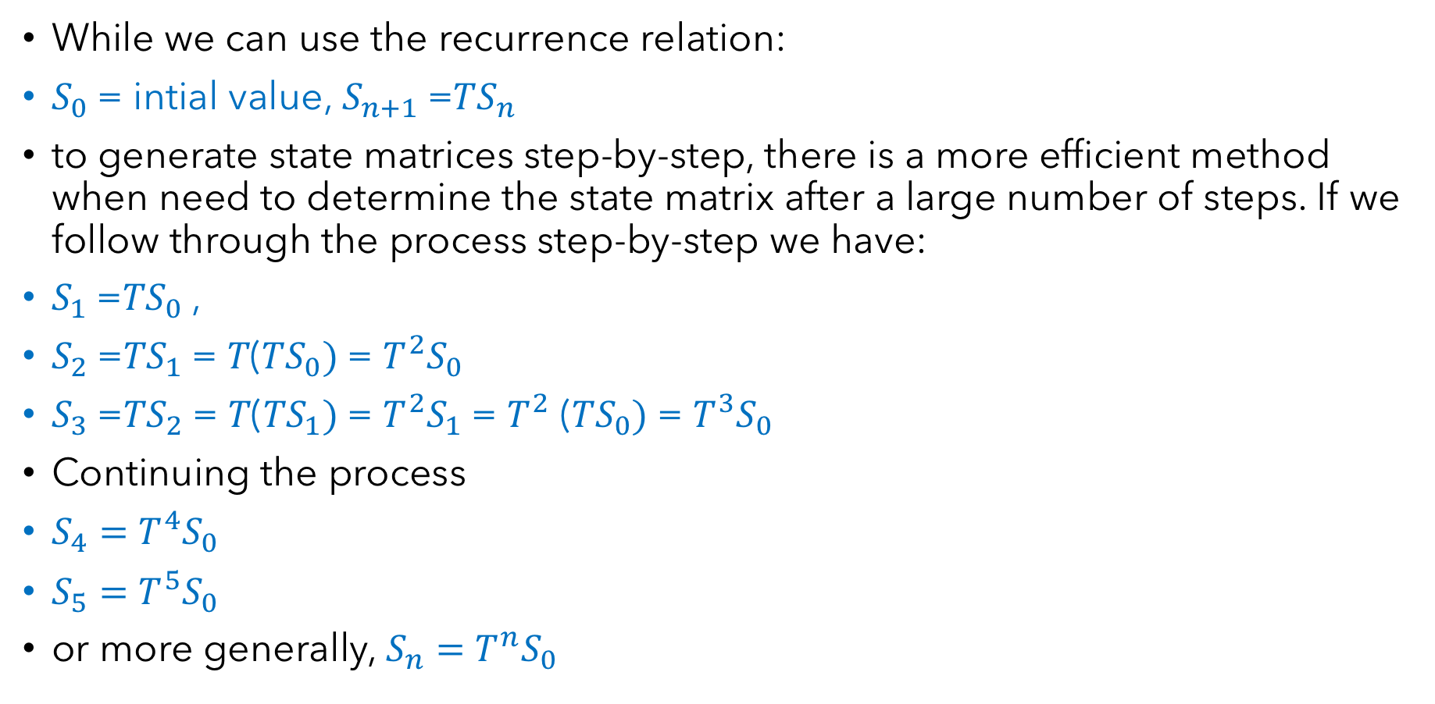
A rule for determining the state matrix of a system after 𝐧 steps
While we can use the recurrence relation:
$S_{0}$= intial value, $S_{n+1}$=𝑇$S_{n}$
to generate state matrices step-by-step, there is a more efficient method when need to determine the state matrix after a large number of steps. If we follow through the process step-by-step we have:
$S_{1}$=𝑇$S_{0}$,
$S_{2}$=𝑇$S_{1}$= 𝑇(𝑇$S_{0})$= $T^{2}S_{0}$
$S_{3}$=𝑇$S_{2}$= 𝑇(𝑇$S_{1})$= $T^{2}S_{1}$= $T^{2}$ (𝑇$S_{0})$= $T^{3}S_{0}$
Continuing the process
$S_{4}=$ $T^{4}S_{0}$
$S_{5}=$ $T^{5}S_{0}$
or more generally, $S_{n}=$ $T^{n}S_{0}$

Slide 18
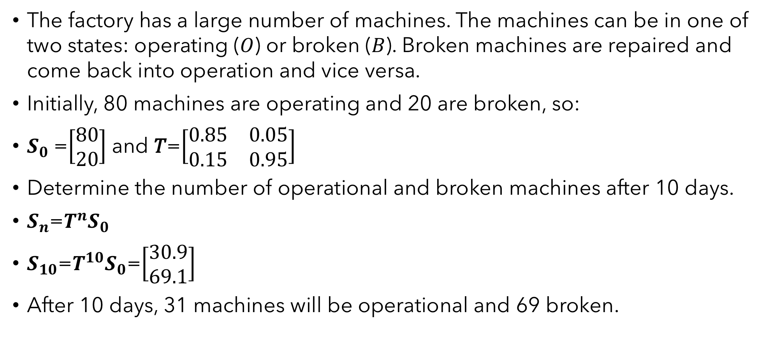
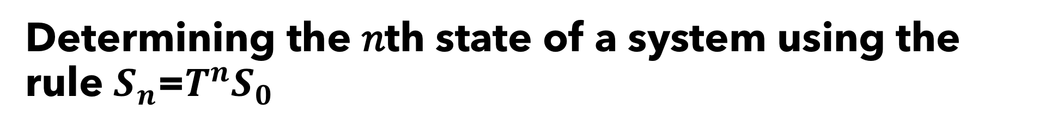
Determining the 𝑛th state of a system using the rule $S_{n}$=$T^{n}S_{0}$
CAS Notes 7.6
The factory has a large number of machines. The machines can be in one of two states: operating (𝑂) or broken (𝐵). Broken machines are repaired and come back into operation and vice versa.
Initially, 80 machines are operating and 20 are broken, so:
$S_{0}$=$\left[\begin{aligned}80 \\ 20\end{aligned}\right]$ and 𝑇=$\left[\begin{matrix}0.85 & 0.05 \\ 0.15 & 0.95\end{matrix}\right]$
Determine the number of operational and broken machines after 10 days.
$S_{n}$=$T^{n}S_{0}$
$S_{10}$=$T^{10}S_{0}$=$\left[\begin{aligned}30.9 \\ 69.1\end{aligned}\right]$
After 10 days, 31 machines will be operational and 69 broken.
CAS Notes 7.9

Slide 19
