Slide 1
ENERGY MANAGEMENT SYSTEM (EnMS) OVERVIEW
This proprietary overview depicts a brief introduction to Energy Management and Interrelated Systems.
Prepared by OP-EX SERVICES for Energy Management minded clients.
DATED SEPTEMBER 1ST 2021
For the purpose of this document ‘Energy Management System’ is defined as: interacting elements that form a system model, applied as designed to efficiently manage energy performance and interrelated disciplines across Organizational Assets.

Slide 2
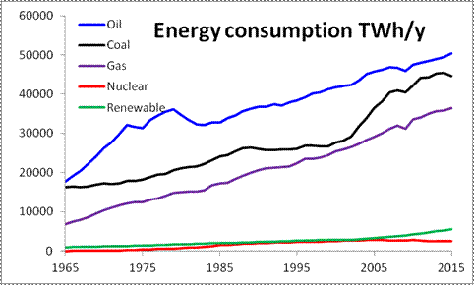
Energy Management Points of Note
Energy Management expectations now commonly form part of an organizations strategic view and policy in terms of; an Energy Management Strategy being in place together with setting organizational expectations to manage and control energy consumption and utilization.
World energy consumption continues to rise; (having doubled in the last 40 years and projected to increase 30% by 2040). Energy is the major contributor to climate change, making up nearly 60 % of the world’s greenhouse gas emissions.
Advances in energy-related technologies combined with global climate control, carbon emission policies and Industry IV (Factory of the Future) expectations will lead to significant change in how Energy Management is considered as a leading practice.
Acting to better manage energy consumption not only helps the planet, but it also saves money for organizations and society.

Slide 3
ENERGY MANAGEMENT SYSTEM (EnMS) ELEMENTS
Policy Development
Defining Energy Strategies at Business and/or Asset Level - Defined Energy Policies – Fix Objectives - Planning & Communication
Cross Functional Management Process
Aligned to International Standards – Functionally Integrated - Phases Include; Policy Development – Perform Energy Audit – Analyze Findings – Create Improvement plans – Monitor & Sustain
Supportive Organization Model
Defined Org. Structure – Leadership Expectations - Pre-defined Roles and Responsibilities - Creating EnMS Commitment Culture & Behavioral Expectations
Utilization & Performance Measures
Identification of Losses at Facility, Asset Area, Energy System and Equipment Levels - Asset Performance Tracking – Feasibility & Bench Marking – Financial Requirements – EnMS Payback Indicators
EnMS Process Implementation & Training
Pre-defined Implementation Process – Assessment of Facility / Organization – Prepare & Train the Organization – Deploying the Implementation Plan

Slide 4
ENERGY MANAGEMENT SYSTEM (EnMS) OVERVIEW DE-BRIEF
Further information with a deeper insight of the various Energy Management System and related disciplines i.e.,
Energy Policy Development
Energy Auditing / Loss Data Capture
Energy Management Process
Roles and Responsibilities
Overall Implementation Methods
is available on request from Op-Ex Services either by face to face – teleconference and/or virtual delivery.

