Slide 1
ANNUAL GENERAL MEETING
  LANSING POINT
  MARCH 2, 2026

Slide 2

UNIT | OWNER | PRESENT | PROXY
101 | Zdenek | ☐ | ☐
102 | Ann | ☐ | ☐
103 | Ted & Sue Staffen | ☐ | YES
104 | Lois | ☐ | ☐
105 | Gil & Cathy | ☐ | ☐
106 | Terry | ☐ | ☐
107 | Scott & Laura | ☐ | ☐
108 | Susan & Greg | YES | ☐
109 | Amy | ☐ | ☐
110 | Brent | ☐ | ☐
201 | Michelle | ☐ | ☐
202 | Bill & Lorrie | ☐ | ☐
203 | Jean | ☐ | YES
204 | Sigrid | ☐ | ☐
205 | Saskia | ☐ | ☐
206 | Jeanette | YES | ☐
207 | Barb & Jamie | ☐ | YES
208 | Michael & Donna | YES | ☐
209 | Lorrie & Bill | YES | ☐
210 | Wally & Laura | ☐ | YES
TOTAL
Quorum achieved |  | ☐ YES | ☐ NO
SIGNED: Michael McCann Secretary/Treasurer
LANSING POINT AGM: Quorum
Date: February 5, 2025
Article VII Section 38:
“A quorum for a general meeting is eligible voters holding 2/3rd of the units’ votes, present in person, telephonic, electronic or other methods or by proxy.”
Required for Quorum: 14Article VII Section 39:
“If within 30 minutes after the time appointed for the general meeting, a quorum is not present the meeting stands adjourned to the same day in the next week at the same place and time; and if on the day to which the meeting is adjourned a quorum described in Article VII section (38) of the bylaws is not present within 30 minutes after the time appointed for the meeting, the eligible voters present in person, telephonic, electronic or other methods or by proxy constitute a quorum.”
Article VIII Section 8:
“No person may vote more than two proxies at a meeting.”

Slide 3
Agenda
01. Determining Quorum
02. Welcome
Housekeeping
Introduction of current Board
How the meeting will be conducted
Additions to the Agenda
03. Reports
04. Regular Business
05. Final
Minutes of 2025 AGM
President Report
Property Management Report
Common Property Insurance
Reserve Fund
2025 Financial Statements
Budget Surplus/Deficit 2025
Reserve Expenditures in 2025
2026 Budget
Proposed Reserve Fund Expenditure in 2026
Budget Deficit / Surplus Projected 2026
Resolutions: Bylaw Amendment, Reserve Fund Expenditures, Budget Surplus
Election of New Board
Adjournment
Other Business

Slide 4
LANSING POINT 2025 AGM Meeting Minutes
DETERMINATION OF QUORUM
Quorum met with 15 units present (105, 103, 104 (proxy), 107, 108, 109, 201, 202, 203, 206, 208, 209, 210, 102, 106).
WELCOME
Mike explained Robert's Rules of Order, and the meeting began.
REPORTS
Minutes of 2024 AGM
Previous AGM meeting minutes were reviewed and approved by all members.
President’s Report
Ted gave an overview of his report, detailing all projects undertaken over the fiscal year.
Property Management Report
Denali and Irene from GMS explained the challenges of projects throughout the year, noting that all issues were addressed and handled.
Common Property Insurance
Discussion around coverage, limits, and providers.
Reserve Fund
Review of the reserve fund and expectations for maintaining an ageing building. Note: During project discussions, it was requested that the halls be painted a lighter color to add more light to the hallways. This request was echoed by most owners.
REGULATION BUSINESS
2024 Financial Statements
Motion to approve by ordinary resolution.
  Motioned by Mike (Unit 208), seconded by Scott (Unit 107).
  All in favor.
2025 Budget
Motion to approve by ordinary resolution.
  Motioned by Mike (Unit 208), seconded by Gill (Unit 105).
  All in favor. Potential Reserve Fund Expenditure in 2025
  Option 1 motioned by Mike (Unit 208), seconded by Scott (Unit 107).
2025 Budget Surplus
Motion to approve by ordinary resolution. … Motioned by Mike (Unit 208), seconded by Scott (Unit 107).
FINAL
Election of Board
Denali from GMS facilitated the board nominations.
  Ted (Unit 103), Mike (Unit 208), and Bill (Unit 202) were nominated.
  Motioned by Laura (Unit 107), seconded by Amy (Unit 106).
Adjournment
Meeting adjourned at 7:10 PM.
Other business
Update on sub-surface water issue and Yukon Government
Electrical Bills and Gate
MINUTES OF 2025 AGM
Annual General Meeting: March 2, 2026

Slide 5
President’s Report
Another busy year at Lansing Point. It was a year of mixed sadness and joy. We celebrated the lives of both Rosemary Burns and Ewald Lemke, and we extend our heartfelt sympathies to Terry and family, as well as to Lois and family.
This was also the year that saw Bob Ehman and Heidi Wan move up the street to Normandy House. We also welcomed new owners: Greg Bull and Susan Tinevez in 108, and Dennis and Shelia Singer in 202.
We also had a new member join our board of directors. Bill Greer is a welcome addition, as his skill set and background include construction inspection and management, practical knowledge of HVAC systems, building schematics, and a good sense of humour.
A reminder to all residents about the Lansing Point web page created by Michael McCann (http:/www.lansingpoint124.org) at no charge to the condo corporation. This is a valuable site for budget information, project updates, the latest Reserve Fund Study, and other pertinent information. Our major projects for 2025 included:
  5-year update of the Reserve Fund Study as mandated by the new Yukon Condominium Act
  Elevator maintenance and repair in Building B
  Replace a support column and repair the column’s millwork on Building A,
  Inspect and repair the column millwork on the northside of both buildings, with more to be done on both buildings in the summer of 2026.
  Fire alarm maintenance on both buildings.
Again, this year, residents volunteered their time to make our home more livable. Terry Burns ensured our compost bin was at the curb side each Thursday morning for pickup. When Terry went on vacation, Susan Tinevez and Greg Bull took over and are still, like the post office, “through rain or shine and -40 temperatures,” have that container curb-side each Thursday morning.
Gil and Cathy Boudin clear and pack the snow in the driveway in front of Building A as needed, and Bob Thornton regularly does yard work.
This past winter, we had a lot of snow in December, and I understand that all the residents here did a lot of shovelling to help their neighbours!
Donna Jones does a wonderful job of keeping both lobbies of A and B decorated with appropriate seasonal decorations that add a welcoming touch to both buildings.
We also welcome suggestions from owners at the AGM or at any time for future projects you would like to see carried out.
The financial statement reflects the hard work of Michael McCann and GMS’s Denali Gaetz.
In a world that is getting more complicated by the day, Lansing Point is in pretty good shape in both the physical plant and financial matters, considering the increase in goods and services we are all encountering.
We continue to have an excellent working relationship with GMS, and although we pay them for their services, they often go beyond their contractual obligations to assist the Board, and we are grateful for their support.
Ted Staffen
President

Slide 6
PROPERTY MANAGEMENT
THE COST?
WHAT DOES GMS DO TODAY?
ADMINISTRATION
THE CORPORATION REGISTER
CORPORATION ADDRESS OF BOOKS & RECORDS
CORPORATION DOCUMENTS:
COMMUNICATION
NEW MEMBERS
STATUS CERTIFICATES
FINANCIAL MANAGEMENT
BUDGET PREPARATION BY MANAGING AGENT
CONDO FEE & LEVY ASSESSMENT & COLLECTION
DELINQUENT ACCOUNTS, LATE CHARGES & LIEN
RIGHT TO LIEN
FINANCIAL REPORTING
FINANCIAL RECORDS
RESERVE FUND MANAGEMENT
RESERVE FUND STUDY
ANNUAL CONTRIBUTION
RESERVE FUND ACCOUNT
RESERVE FUND DRAWS
RESERVE FUND DEFICIENCY
COMMON PROPERTY INSPECTION
COMMON PROPERTY OVERSIGHT
COMMON ELEMENT INSPECTION
SITE VISIT & CHECKUP ROUNDS
SERVICE AGREEMENTS AND CAM CHARGES
WASTE MANAGEMENT & COMPOST
WATER & UTILITIES
SNOW REMOVAL
LANDSCAPING & SITE CLEANUP.
MAINTENANCE & REPAIR
EMERGENCY REPAIR AND UNIT ACCESS
OTHER BUILDING SERVICES
INSURANCE & WCB
CORPORATION INSURANCE
MANAGING AGENT INSURANCE
INSURANCE CLAIMS
WORKERS COMPENSATION BOARD (WCB)
THE NUMBERS
11.8% - Property Management increase from 2025
22.1% - Accounting increase from 2025
14% - increase in the cost of property management and accounting from 2023
THE COST
Cost have remained stable for the past three years
CONTEXT
22% of a Corporation’s operating budget is considered the standard for property management (not considering accounting).
Source: CPO - large full-service condominium management company
12.2% - In the 2026 budget for Accounting & Property Management
WHERE ARE COSTS GOING?
Future increases will be tied to inflation rate.
WHY CONTRACT WITH A PROPERTY MANAGEMENT COMPANY?
There are a multitude of reasons to have our property managed by a contracted service. Not the least of which is ensuring compliance with legislative requirements and ensuring long-term fiscal stability.
The details of maintaining records, paying bills, collecting fees, producing financial statements, conducting inspections, establishing and overseeing contracted services, and more require significant time and expertise. These are all things that can overwhelm a volunteer board.

Slide 7
A snapshot of what GMS did in 2025
Lansing Point – Property Management Overview Report: Year in Review: 2025
Prepared by: Grey Management Services (GMS)- Denali Gaetz
Overview
The 2025 fiscal year was an exceptionally active and maintenance-heavy year for Lansing Point. Grey Management Services (GMS) attended to a high volume of operational, preventative, and reactive maintenance items across the property, with a strong focus on resident safety, building integrity, and regulatory compliance. In total, over 150 individual maintenance and project-related tasks were managed throughout the year, reflecting both the building’s ageing components and the Board’s commitment to addressing issues promptly and responsibly.
Key Areas of Work
  1. Plumbing & Water-Related Issues. A significant portion of 2025 work involved plumbing and water mitigation, including:
    Unit-specific hot water and leak issues
    Garage and ceiling leaks
    Emergency water shut-offs
    Coordination of dry-out, restoration, and follow-up repairs
    These items required collaboration with licensed plumbing contractors and restoration professionals to prevent further damage and manage insurance-related risks.
  2. Building Envelope & Interior Repairs. GMS coordinated numerous repairs related to interior finishes and building protection, including:
    Ceiling and drywall repairs following leaks
    Spackling, patching, and finishing work
    Dry-out and material replacement after water exposure
    These repairs were often multi-step projects requiring careful sequencing between trades.
  3. Fire Safety & Compliance. Annual fire safety requirements were completed in accordance with regulations, including:
    Annual fire system testing
    Coordination with qualified contractors
    Documentation and follow-up where required Fire safety remains a core compliance priority for the Corporation.
  4. Vendor Coordination & Project Oversight. Throughout the year, GMS coordinated work with multiple vendors and trades, including:
    Licensed plumbers
    Restoration and renovation contractors
    General maintenance providers
    GMS managed scheduling, access, communication with residents, and follow-up to ensure work was completed appropriately and documented.
  Operational Management. In addition to physical maintenance, GMS provided ongoing operational oversight by:
    Responding to resident service requests
    Managing urgent and after-hours issues through emergency protocols
    Tracking work orders and outcomes
    Communicating with owners and occupants regarding access, timelines, and expectations
Conclusion
2025 was a demanding year at Lansing Point, marked by a high volume of maintenance activity and several complex, multi-stage repairs. Gray Management Services remained actively involved throughout the year to ensure issues were addressed efficiently, vendors were properly managed, and the property continued to be maintained in the best interests of the Corporation. GMS looks forward to continuing to work collaboratively with the Board to plan proactively for future maintenance needs and to support the long-term health of the building.

Slide 8
Common Property Insurance
Legislation requires that we carry property and liability insurance. Property insurance must be 100% of replacement cost.
  Part 8 Section 170 Subsection 3 of the Yukon Condominium Act states:
  The property insurance must be on a full replacement cost basis …
Our insurance in 2025 was brokered through HUB International Insurance Brokers, and we were quite fortunate that our entire policy is underwritten by one insurer – Wawanesa Cansure Underwriting Ltd.
In 2025, our premium was $37,233
The Board sought quotes for 2026; and we received two. One from HUB and the other from AVID.
The best quote and coverage came from HUB at $32,500
We have budgeted for a reassessment of Lansing Point in 2026. HUB has provided coverage based on our commitment to a reassessment and, under this policy, provides coverage up to 139% of the current assessed value.

Slide 9
Reserve Fund
Legislation requires:
A reserve fund study must be redone every five years
The study must be done by a “qualified” person
The study must establish a yearly contribution schedule
The Corporation must give the schedule due consideration when setting the annual contribution to the Reserve Fund
Funds can only be withdrawn by Special Resolution & only used for the intended purpose (as stated in the Special Resolution)
The Reserve Fund must be kept in a separate account and reported on annually
Annual General Meeting: March 2, 2026

Slide 10
Reserve Fund - Overview
Projected before any expenditures
The status of the reserve fund at the end of 2025

Slide 11

2025 Special Projects Update
At the last AGM, the membership voted, by way of a Special Resolution, to fund up to $10,000 for the painting of the 2nd floor of Buildings A & B.
That project was completed on time and under budget.
A second project was undertaken, the emergency replacement of a support column at the north end of Building A.
The Yukon Condominium Act 2015 and our Bylaws allow access to the Reserve Fund without a Special Resolution in an emergency.
Project | Cost
Painting of the 2nd Floor Building A & B | $4,554.25
Column Repair | $4,935.00
TOTAL | $ 9,498.25

Slide 12

Concerns Regarding the 2025 Reserve Fund Study
The reserve fund studies conducted in 2020 and 2025 were not condition-based studies of Lansing Point. The reports state that no engineering investigations or exhaustive physical examinations were performed, which is the hallmark of a financial reserve study rather than a condition‑based assessment.
The report emphasizes that the condition evaluations are subjective, based on observation and professional judgment, not on technical testing.
As stated, the studies were financial planning documents, not diagnostic reports. Component conditions are based solely on visual inspection, not on destructive testing, code compliance review, or engineering analysis.
Consequently, it should be understood that the report does not certify the actual condition of structural, mechanical, electrical, or building‑envelope systems.
This matters because once a property passes roughly 15–20 years of age, the reliability of a purely financial‑model‑based reserve fund study declines sharply. This is because the assumptions it relies on (generic life‑cycle tables + visual observation) no longer match the real behaviour of ageing building systems.
Ageing buildings stop behaving like the “average” buildings that life‑cycle tables are based on. By year 20, the actual condition of components diverges significantly from the assumed condition.

Slide 13
This summary highlights several issues identified in the 2025 revised Reserve Fund Study. These concerns we feel may affect the accuracy of the long‑term financial plan and the recommended monthly reserve contributions. Our goal is to ensure you have clear, reliable information about Lansing Point’s future repair needs and savings strategy.
Replacement Timelines Don’t Match the Funding Plan … The study describes when major components (balconies, roofs, windows, parking lot, etc.) are expected to reach the end of their life. However, the cash‑flow schedule—the part that determines how much we need to save—often uses different years. When the narrative and the schedule don’t line up, the funding plan may be unreliable.
  Examples include:
  Balconies: described as due in 2033, but scheduled for 2034
  Exterior wall staining: described as due in 2033, but scheduled for 2036 and 2047
  Parking lot: described as due in 2038, but scheduled for 2050
  Windows: described as due in 2043, but scheduled in 2034, 2042, and 2049
Interest Rate Assumptions Are Lower Than Our Actual Earnings … The study assumes the reserve fund will earn 2.64% interest each year. But in 2025, the corporation earned $4,500 of interest on $104,000, which equals 4.33%. This means the study underestimates our investment income, making the reserve fund appear weaker than it actually is. Underestimating interest leads to higher recommended monthly contributions.
Some Building Components Are Treated Inconsistently … Several items are described as one‑time replacements in the narrative but treated as recurring small costs in the cash‑flow table. This inconsistency makes it difficult to understand the true long‑term plan and whether the funding levels are appropriate. Examples include:
  Windows
  Sidewalks
  Irrigation system
  Front gate
  Suite doors
  Lobby renovation
The Recommended $230/Month Contribution May Be Higher Than Necessary … Because the study uses a low interest rate and inconsistent timelines, the recommended contribution is likely inflated. This suggests the consultant’s recommendation is $15–$25 per unit higher than what our actual investment performance supports. When the numbers are recalculated using realistic interest rates:
  At 2.64% (study assumption): about $238/month per unit
  At 3.25–3.50% (typical GIC rates): about $223–$227/month per unit
  At 4.3% (our actual 2025 performance): about $205–$215/month per unit
Why This Matters to Owners
  Owners deserve a clear, consistent, and accurate long‑term plan.
  Contribution levels should be fair and defensible, not inflated by incorrect assumptions.
  A reliable reserve fund plan helps avoid both under‑funding and unnecessary over‑funding.
  Correcting these issues strengthens transparency and confidence in the corporation’s financial planning.
Next Steps … The new Board will review the report and the inconsistencies, and with the approval of owners seek to have the study amended. Owners will be kept informed before any change to the contribution to the reserve fund is considered.

Slide 14
Recommendations
The 2026 budget should be adjusted to fund a condition-based assessment of the major common-property elements. This could be accomplished by deferring the rewrite of the Declaration by one year and returning our contribution to the reserve fund to 2025 levels.
An amendment to the budget will be introduced at the AGM on Monday.
If approved by Owners a letter should be sent to Condo Max Reserve Planners, by the new Board setting out our issues and concerns and seeking a response.
If the amendment to the 2026 Budget is approved the new Board will commission a condition-based assessment in 2026 of the major common-property elements and having its findings merged into the financial assessment for a more accurate assessment determination of what the contribution level should be.

Slide 15
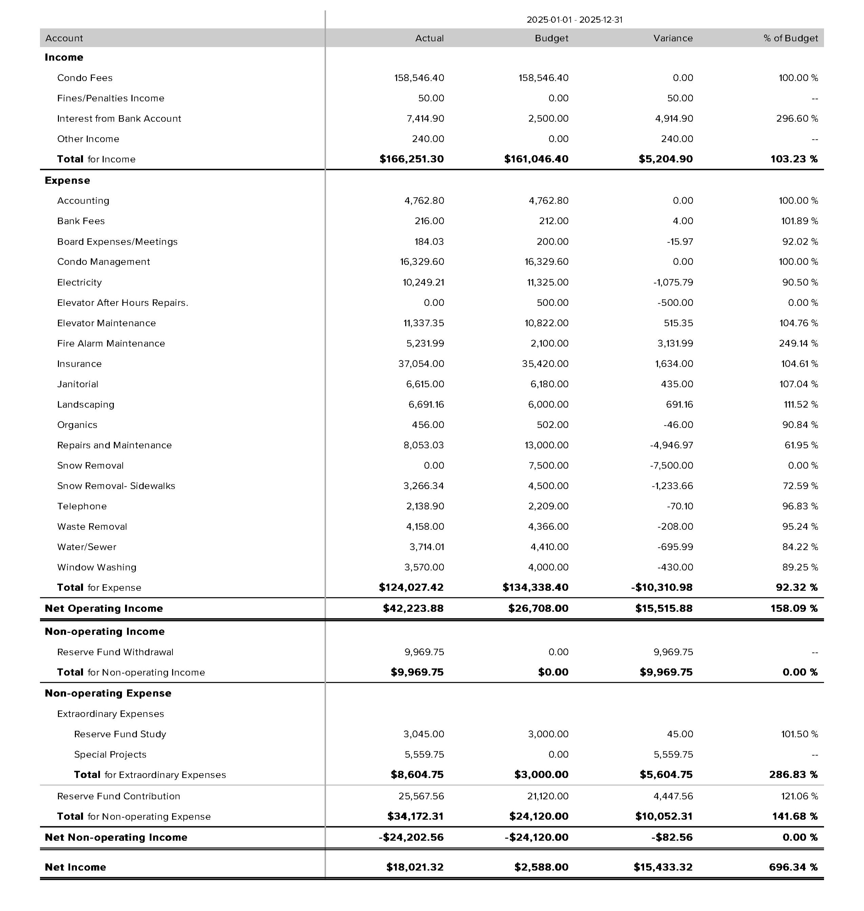
Our Financial Position as of December 31, 2025
Bottom line
Lansing Point ended 2025 in a strong financial position.
Revenues over expenditures resulted in a surplus of $18,021.32
Most of the surplus was generated by

Slide 16
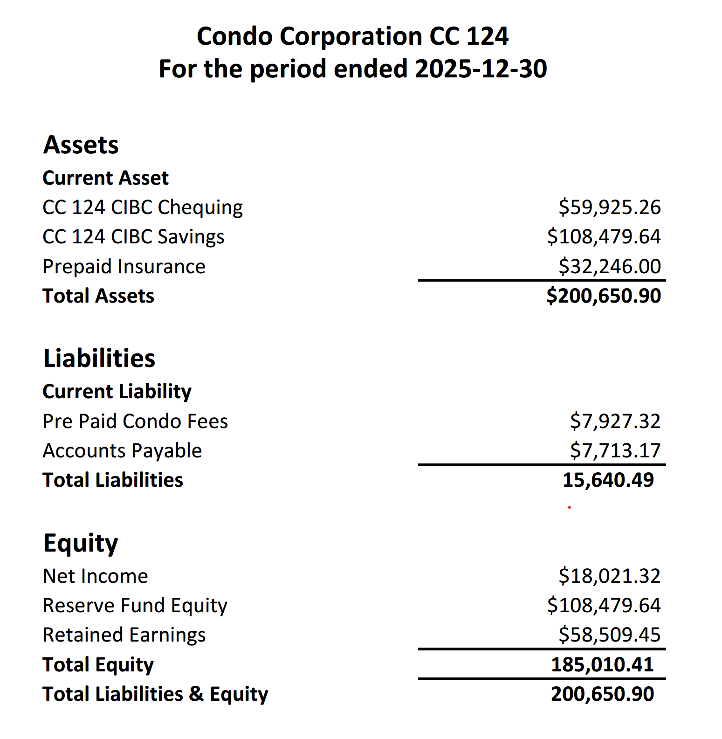
2025 Year-End Balance Sheet
“A balance sheet should always balance. Assets must always equal liabilities plus owners' equity. Owners' equity must always equal assets minus liabilities. Liabilities must always equal assets minus owners' equity.”
We ended the year with a surplus (net income) of, a healthy reserve fund, operating fund and contingency fund that you can draw from in the future.
Assets
Accounts Receivable is in a negative balance due to an owner who pre-pays their condo fees.
Chequing Account is the Operating Fund
Savings+ GIC is the Reserve Fund
Prepaid expenses is for elevator maintenance
Liabilities
Amounts owing to vendors
Equity
Reserve Fund & surplus income over the lifetime of the condo

Slide 17
Where Did Your
Condo Fee Go in 2025?
24% Insurance
14% Property management & accounting
7% Electricity
9% Special Projects
8% Elevator Maintenance
14% Reserve Fund

Slide 18

2025 Financial Statement - Vote
MOTION: TO APPROVE 2025 FINANCIAL STATEMENT
“I move that the 2025 financial statements as presented at the annual general meeting of Whitehorse Condominium Corporation #124 on the 2nd of March, 2026, in the City of Whitehorse, be hereby approved.”
Moved by: Michael McCann
Seconded by:
Vote: In favour: Opposed:
Date: March 2, 2026
Signed Board Representative
Name:
Signature:

Slide 19
2026 BUDGET - Context
42(1) Subject to subsection (2), a condominium corporation is responsible for properly maintaining, repairing, and, when necessary, replacing the common property and common assets.
128(1) The owners of units in a condominium are responsible for the payment of monthly condo fees to the condominium corporation so that the corporation will have sufficient money available to pay the common expenses.
147(1) For presentation at the second and each subsequent annual general meeting, the board of a condominium corporation must prepare a proposed annual budget for the corporation showing, for the next fiscal year
(a) The estimated common expenses to be paid out of the operating fund;
(b) the estimated common expenses, if any, to be paid out of the reserve fund;
(c) the estimated common expenses, if any, to be paid out of any other funds established by the corporation;
(d) The proposed annual contribution to the reserve fund, determined under section 158 of the Act, which states: 158 Subject to the regulations, a condominium corporation is responsible for determining the amount of the annual contribution to its reserve fund, having due regard to its most recent reserve fund study.
(e) the proposed annual contribution, if any, to any other funds established by the corporation; and
(f) each unit’s condo fee is calculated on the basis of the total estimated common expenses and contributions for the 12-month period, under section 128 of the Act.
At the 2025 AGM, a vote by way of Ordinary Resolution was held on what the disposition would be of any surplus funds from 2025.
Owners voted to use any surplus in 2026 to:
“Offset possible deficits and any funds left over put towards the 2026 recommended Reserve Fund Contribution”
You will see in the 2026 budget that the 2025 surplus has been factored into the reserve fund contribution.

Slide 20
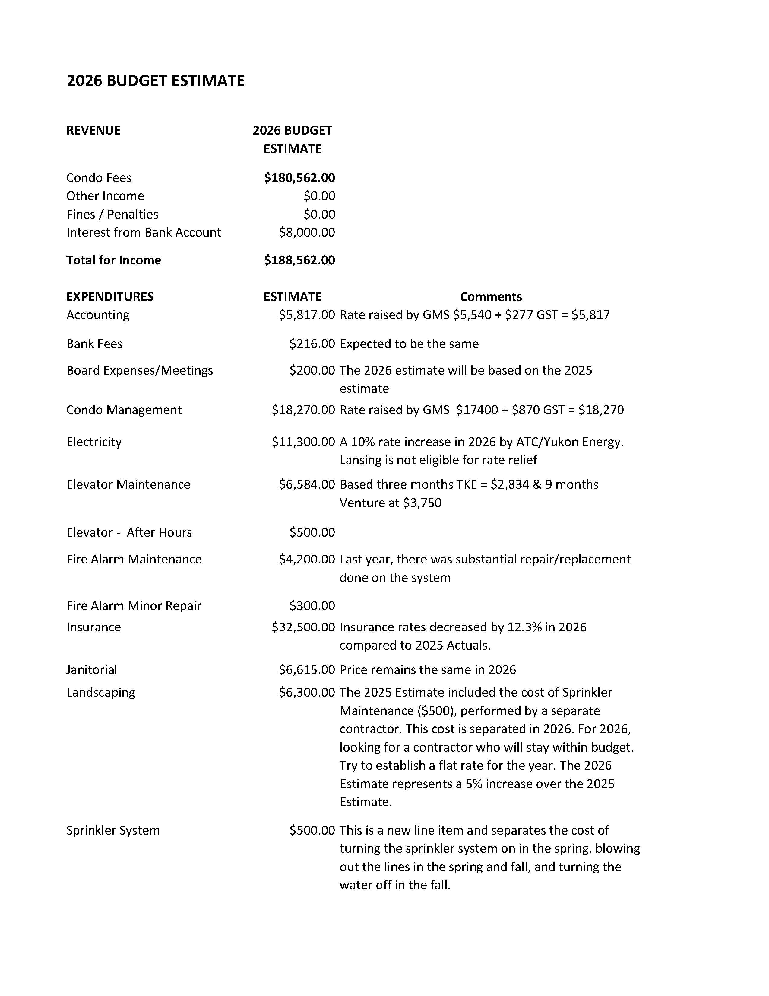
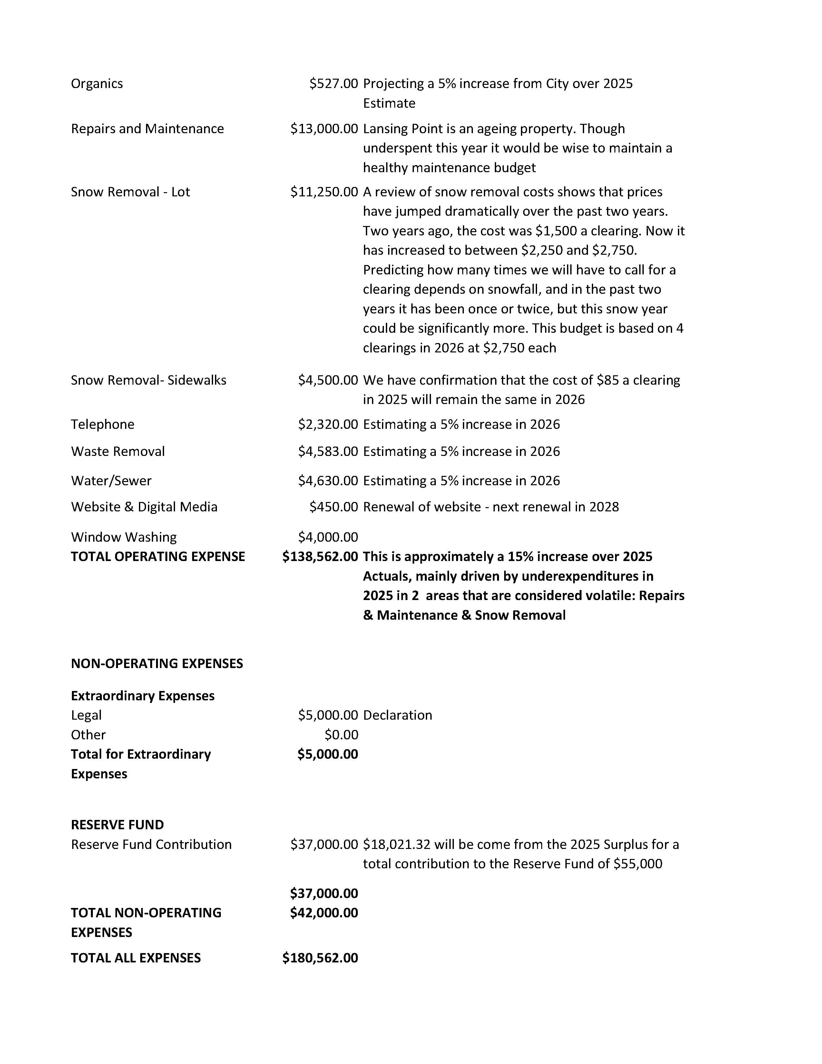
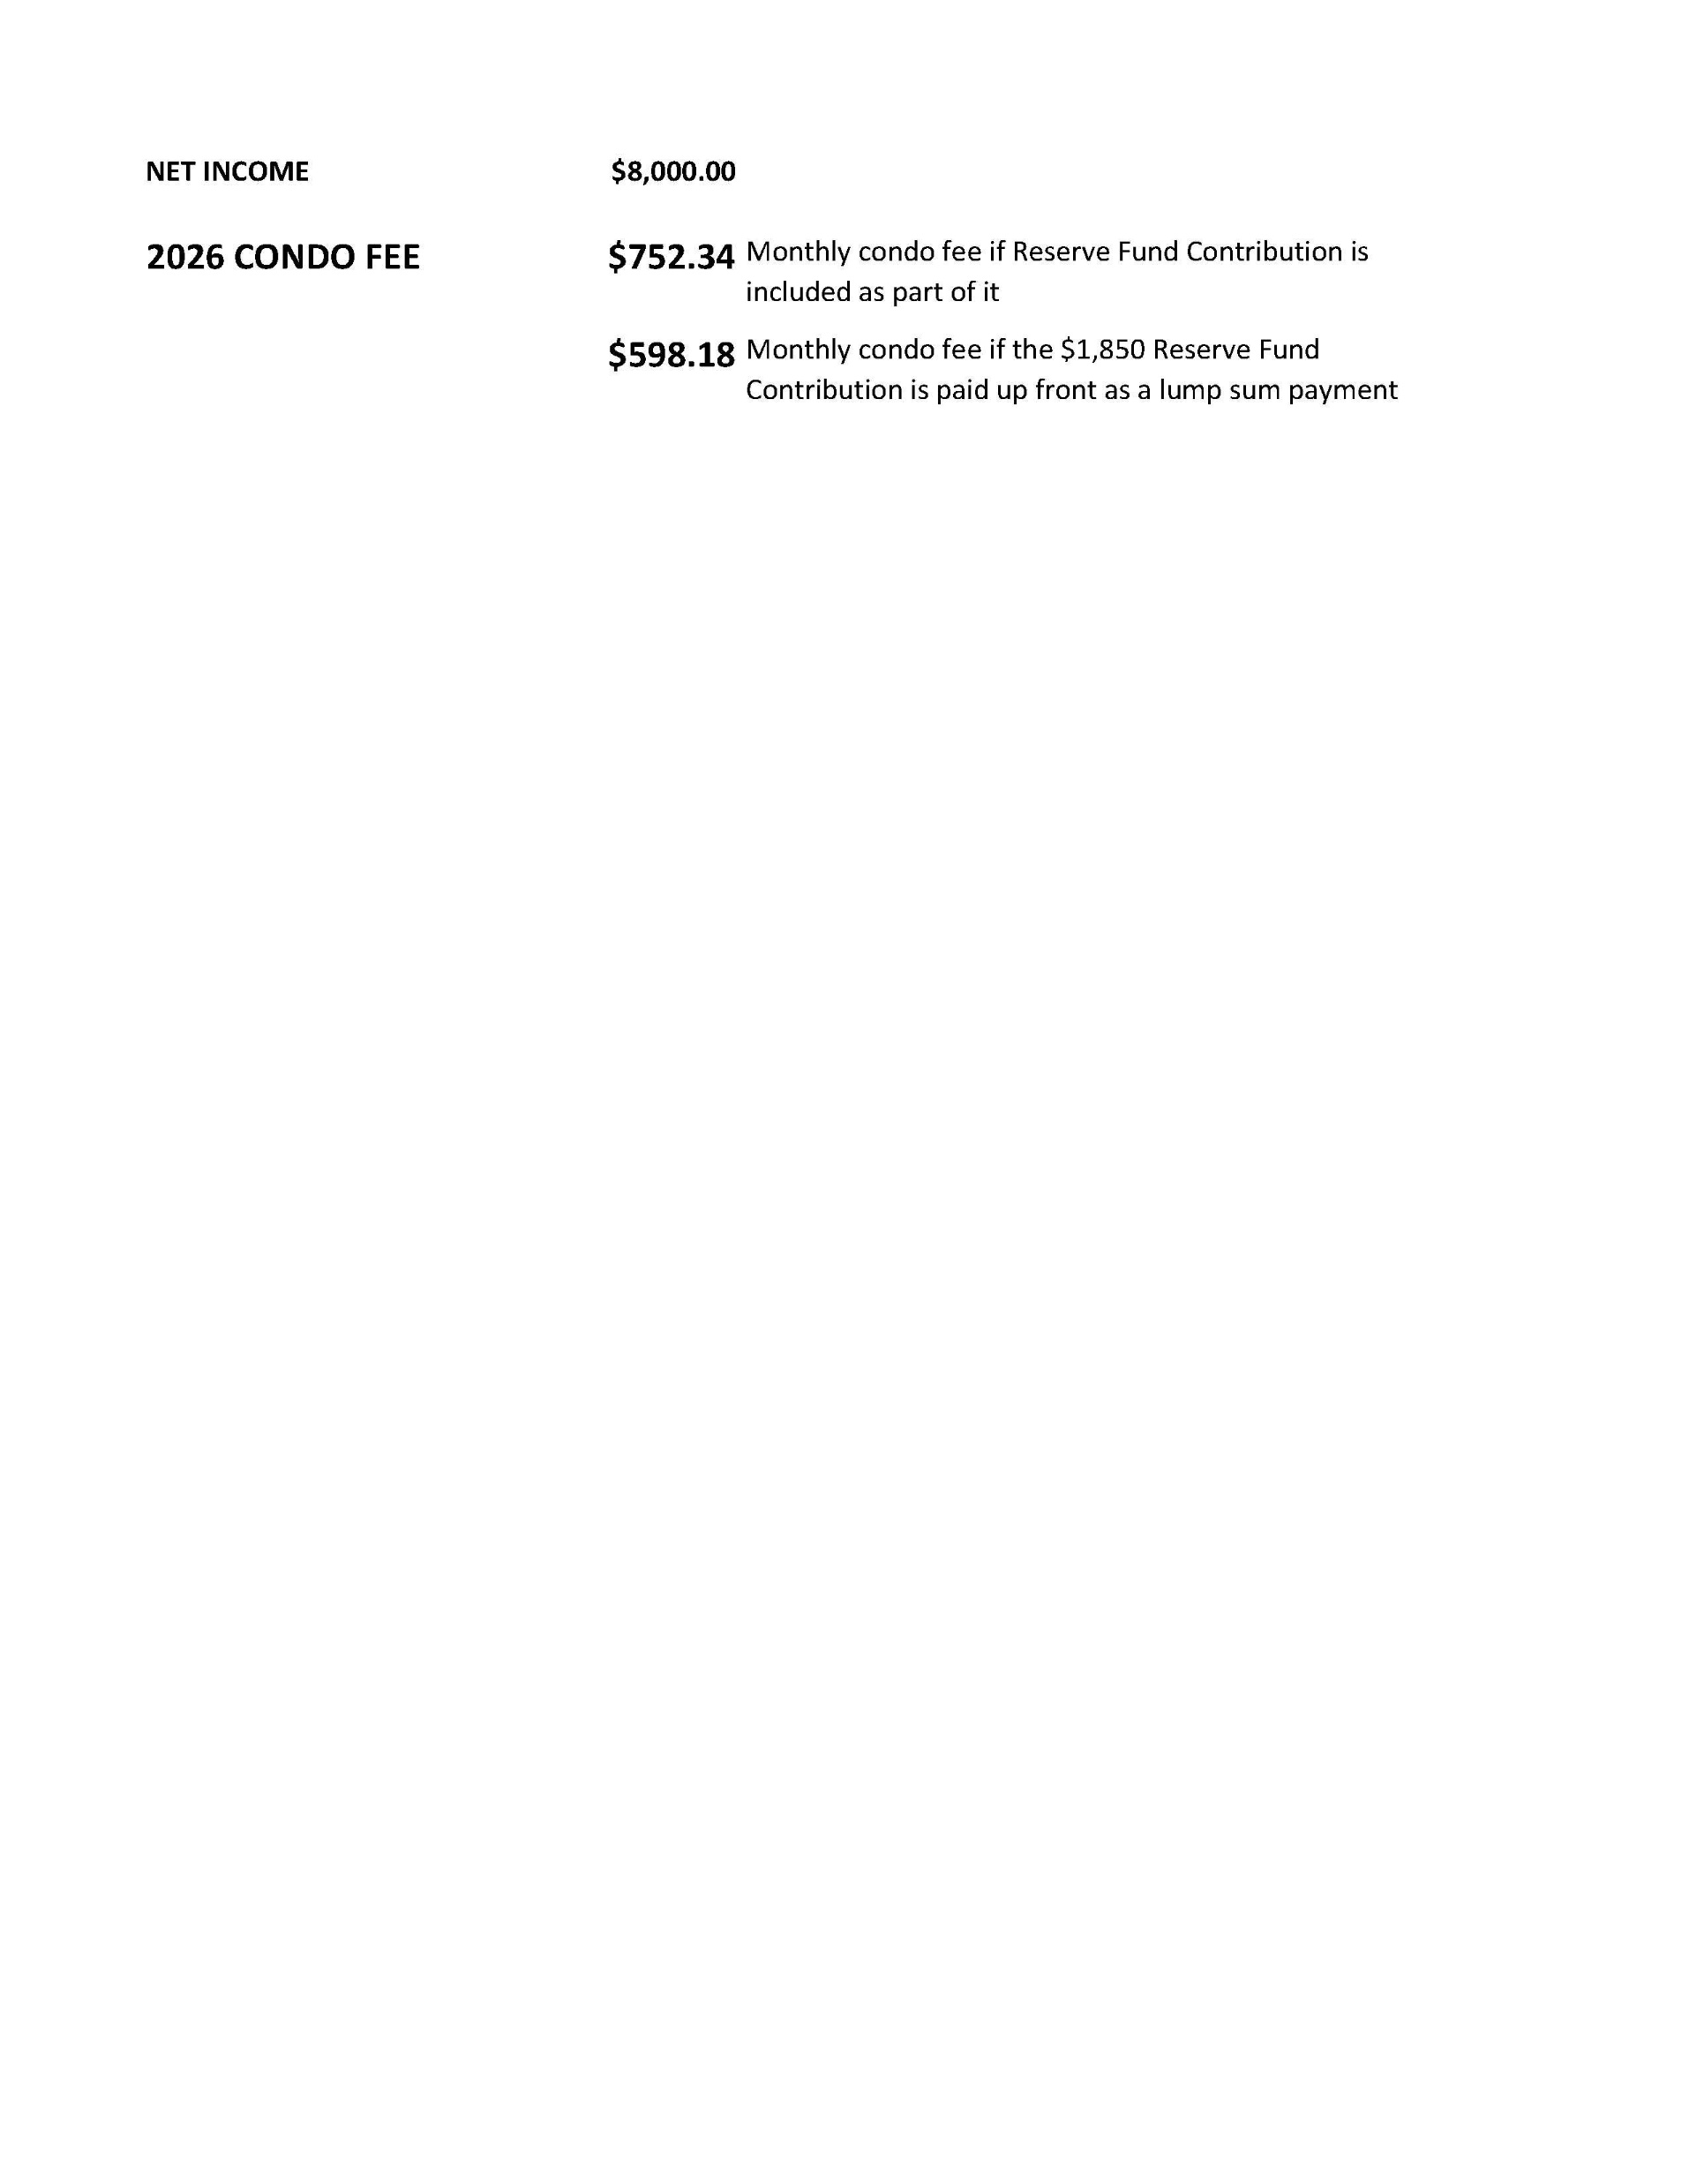

Slide 21
2026 Budget – Vote
MOTION: TO APPROVE THE 2026 BUDGET
“I move that the 2026 budget, as presented at the annual general meeting of Whitehorse Condominium Corporation #124 on the 2nd of March, 2026 in the City of Whitehorse be hereby approved.”
Moved by: Michael McCann
Seconded by:
Vote: In favour: Opposed:
Date: March 2, 2026
Signed Board Representative
Name:
Signature:
21

Slide 22
Amendment –to the proposed 2026 Budget
“ I move that the 2026 Budget be amended in the following manner.
The reserve contribution be changed from $55,000 to $36,000.
The line item titled “Legal” under Non-Operating Expenses be called Reserve Fund – Condition-Based Assessment.
That the expense to this line change from $5,000 to $10,000”
Moved by: Michael McCann
Seconded by:
Vote: In Favour: Opposed:
Date: March 2, 2026
Signed Board Representative
Name:
Signature:

Slide 23
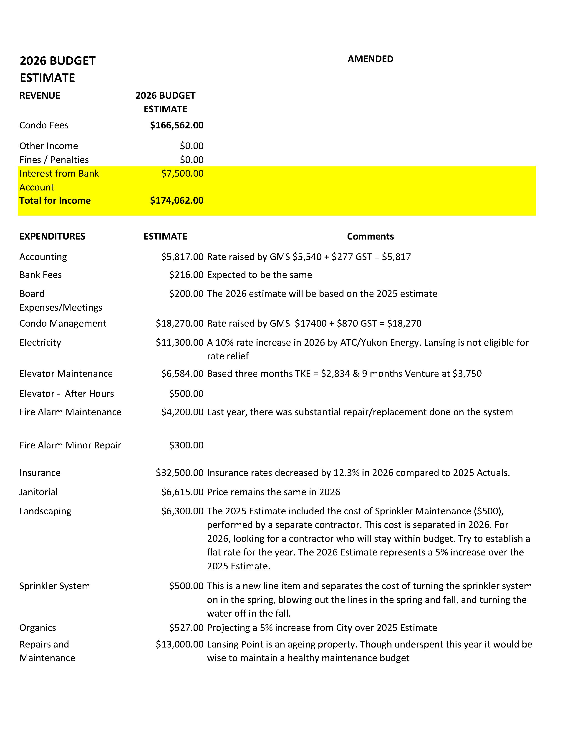
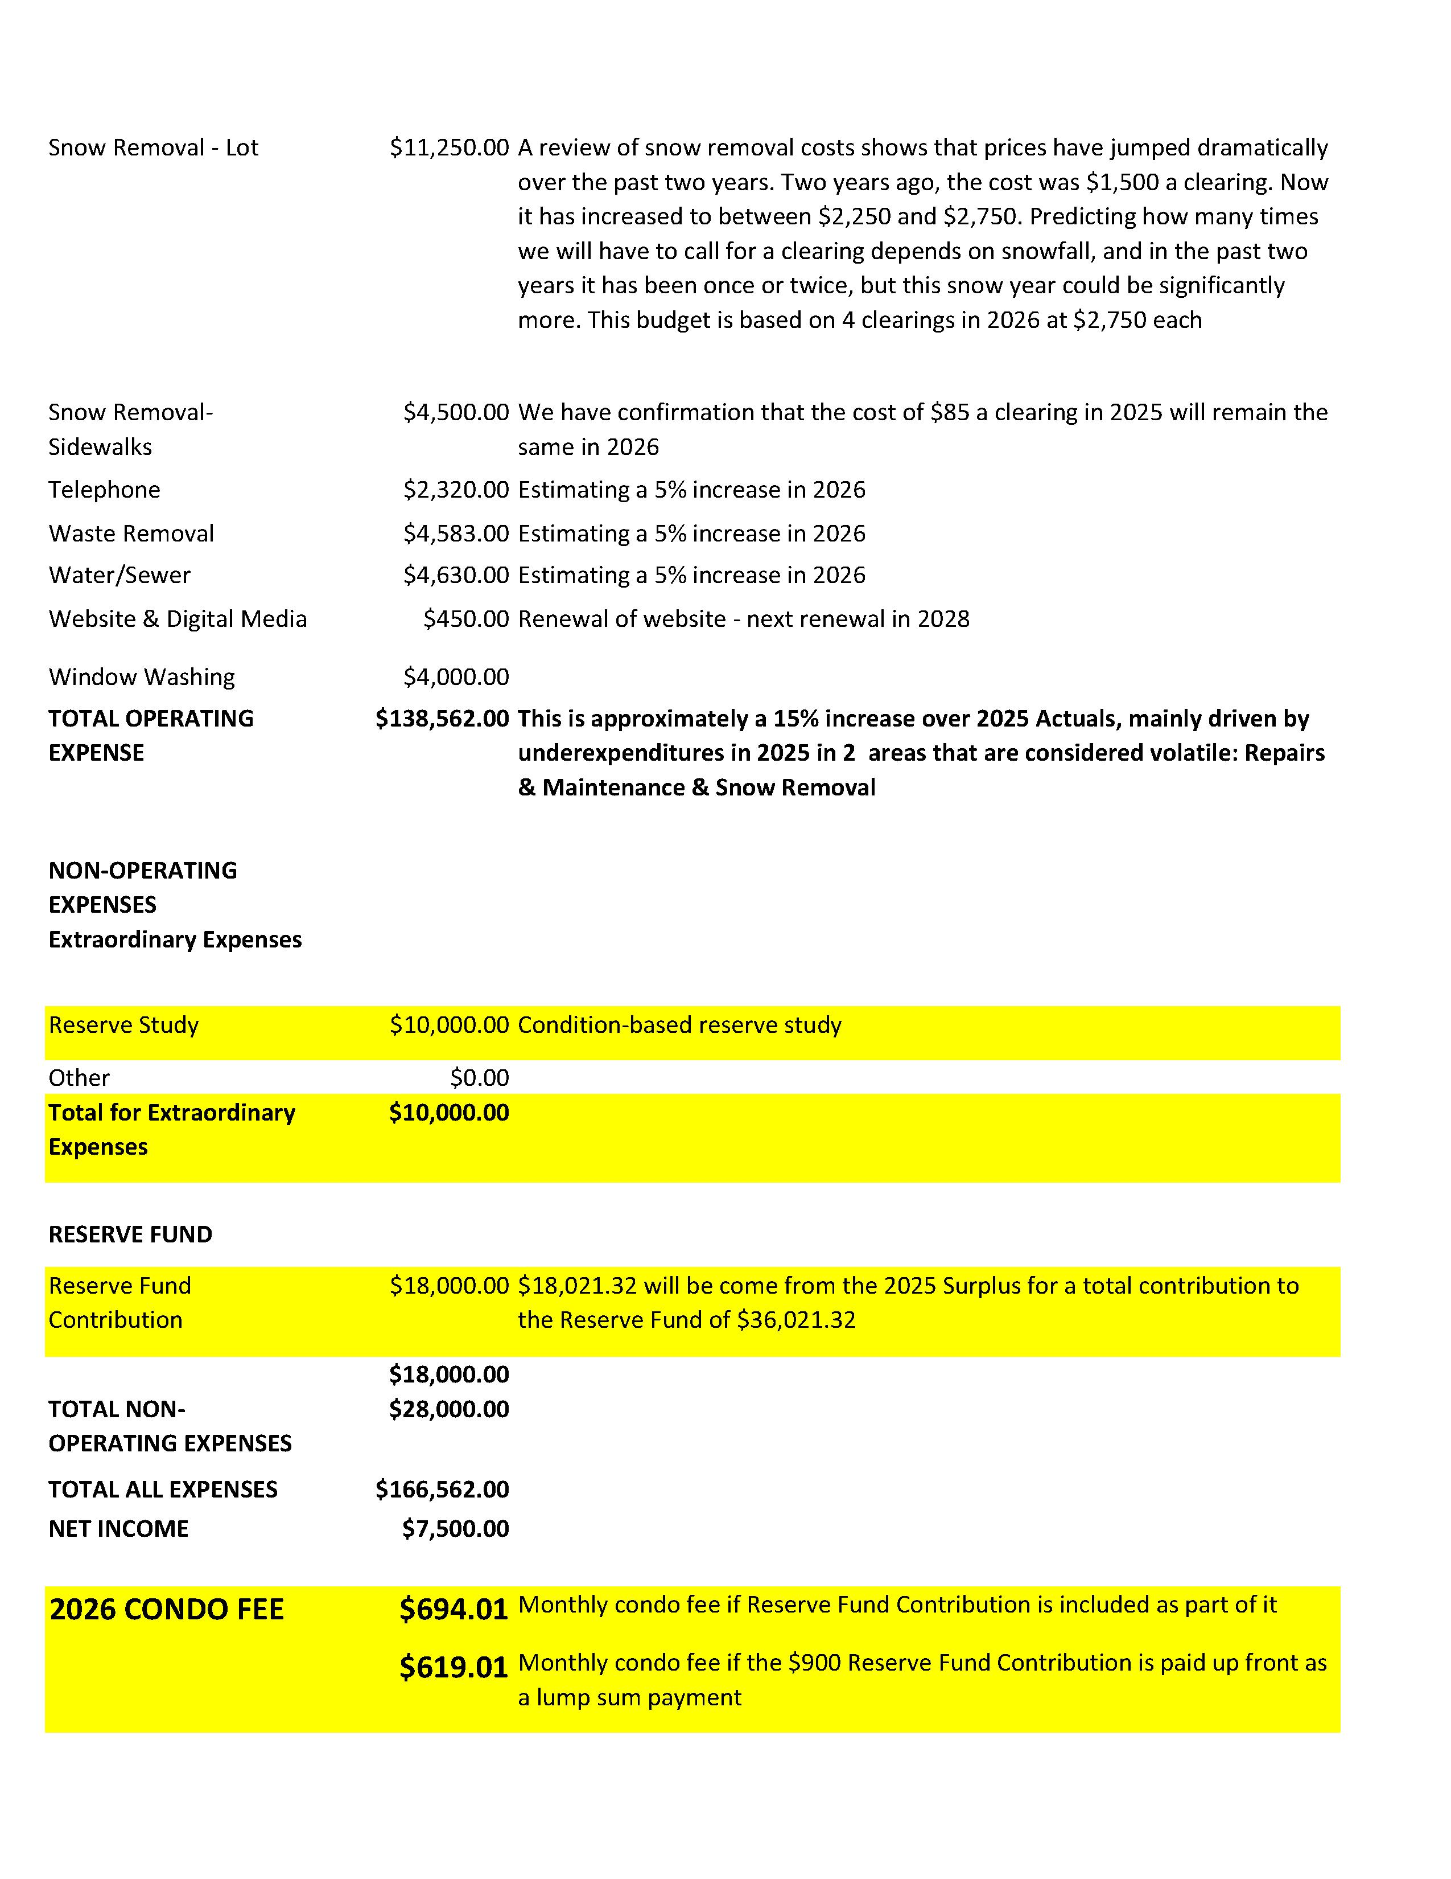
AMENDED

Slide 24
Where do your condo fees go in 2026?

Slide 25
2026 Budget – Vote
MOTION: TO APPROVE THE 2026 BUDGET
“I move that the 2026 budget, as amended at the annual general meeting of Whitehorse Condominium Corporation #124 on the 2nd of March, 2026, in the City of Whitehorse, be hereby approved.”
Moved by: Michael McCann
Seconded by:
Vote: In favour: Opposed:
Date: March 2, 2026
Signed Board Representative
Name:
Signature:

Slide 26
Potential Reserve Fund Expenditures
There are a number of possible projects we can undertake this year.
 | ESTIMATED COST
FENCE: The fence running along Seine Square is made of wood, and a large number of the posts have rotted at the base. The Board recommends replacing the fence with a “chain-link” fence. | $14,000
PARKING LOT: There are a number of areas where vegetation has broken through the asphalt, and some cracks have developed. It is recommended that these areas be remediated as water can permeate down and freeze, causing heaving. | $1,000
ATTIC INSPECTION: It is believed that the attics in Buildings A & B have never been inspected. The Board feels it is essential to do a visual inspection to determine: a) are there any signs of mould; b) are all vent pipes going through the roof connected properly; c) are there any issues with the insulation. | $1,800
BALCONY INSPECTION: The structural integrity of the balconies is the corporation’s responsibility. The Board is proposing that an inspection of all balconies be conducted to assess whether railings and glass panels are safe or require repair. | $2,500
PRESSURE WASHING BUILDINGS A&B: The buildings were last washed in 2022 | $1,500
PAINTING: Continue with our plan to paint one floor a year. In 2026, the plan was to patch and paint the 3rd floor of both buildings. In 2027, it would be time to do the stairwells. | $5,775
REKEYING: The Board believes there is a safety issue with the buildings' security. Over the years, many keys have been cut for the building’s entrance doors, and no one knows how many keys have been made or who has them. Rekeying the entrance door and utilities rooms is the responsibility of the Corporation and should be owned and controlled by the Corporation. It is proposed that the entrance door and utility rooms be rekeyed. All Owners will be issued two keys to the entrance door. These keys are the property of the corporation and will be numbered and logged by the corporation. If a unit sells, the keys are to be returned to the corporation. The keys cannot be copied. If additional keys are required, the corporation will have them cut, logged and issued, and a deposit collected (returnable upon a return of the key). Lost keys will be replaced at the owner’s expense. | $1,800
COLUMN MILLWORK & INSPECTION: Last year, we embarked on a plan to redo the millwork at the base of four columns. The plan was to redo four each year. The replacement of the millwork around a north-facing column on Building A revealed rot at the base (and the subsequent replacement of the column). The Board is proposing that we continue with the initiative and, in 2026, assess which columns to inspect and which millwork to replace. | $2,500
ELECTRICAL: A project to determine what is drawing power in both buildings in order to get a handle on why Building A’s cost is almost ½ of Building B | $1,600
SIDING: This involves using sheets of siding to create “patches” in areas where the siding no longer overlaps, exposing the building's envelope. | $2,000
Garage Drains: There have been two occasions in 2025 where water has seemingly entered a garage through the floor drain. It is suspected that they have become clogged with silt over the years and may require cleaning. | $500
Cleaning Out Dryer Vents: | $2,000
 | $37,975.00

Slide 27

Special Resolution: 2025 Reserve Fund Expenditures
MOTION:
“I move that #s ___ be undertaken in 2026 and that no more than $___ be allocated from the Reserve Fund for such purpose, so moved at the annual general meeting of Whitehorse Condominium Corporation #124 on the 2nd of March 2026 in the City of Whitehorse be hereby approved.”
Moved by: Michael McCann
Seconded by:
Vote: In favour: Opposed:
Date: March 2, 2026
Signed Board Representative
Name:
Signature:

Slide 28
Surplus Funds
The Board is seeking direction from the owners as to where surplus funds identified at the end of 2026 should be directed.
The options:
Placed in the 2027 Reserve Fund as an offset to the recommended amount
Placed in the 2027 Reserve Fund as an addition to the recommended amount
Placed in the 2027 Budget as a “contingency” and used to offset any over-expenditures or for any unexpected expenditures.

Slide 29
Surplus Funds - Vote
MOTION: USE OF SURPLUS FUNDS
“I move that funds determined surplus at the end of the 2026 fiscal year, after a final accounting has taken place, and a minimum of three months operating expenses and annual insurance premium is on hand, be used in the following manner, that it be Option # , so moved at the annual general meeting of Whitehorse Condominium Corporation #124 on the 2nd of March, 2026 in the City of Whitehorse be hereby approved.”
Moved by: Michael McCann
Seconded by:
Vote: In favour: Opposed:
Date: March 2, 2026
Signed Board Representative
Name:
Signature:

Slide 30
Special Resolution:
Bylaw Amendment
Why the bylaws needed updating … The review found several problems in the old bylaws:
The term “single-family residence” was used but never defined.
The definition of “family” was outdated and not compliant with the Yukon Human Rights Act.
There were no clear occupancy rules, making enforcement inconsistent and legally risky.
The bylaws did not address exceptions, such as caregivers, house sitters, or extended family stays.
The amendments fix these gaps and bring the bylaws into compliance with modern law and real-life living patterns.
New definitions that modernize and clarify … The amendments add clear, inclusive definitions for:
Single‑Family Household — a modern, flexible definition that includes blended families, multigenerational households, and diverse living arrangements.
Occupant, Guest, Visitor, Tenant — clarifies who is actually living in the unit vs. visiting.
House Sitter and Live-In Caregiver — formally recognised and regulated.
Home Office — allowed, but with limits to preserve residential character.
These definitions ensure fairness, consistency, and legal compliance.
Clear occupancy rules … The new Article X establishes:
Maximum occupancy: 2 persons per bedroom (as permitted under the Condominium Act).
Lansing Point is formally recognised as a single-family residential community.
Occupancy must reflect one housekeeping group, not multiple separate groups or rooming‑house use.
This protects the community from overcrowding, excessive wear, and commercial or high‑turnover uses.
Registration of occupants … Owners must:
Register all legal occupants (not short-term guests).
Keep the corporation updated on who lives in the unit.
Provide contact information for safety, emergency access, and compliance.
This ensures transparency and supports emergency response and bylaw enforcement.
Key Points of the Proposed Bylaw Amendments
(Article I &
Article X)

Slide 31
Reasonable, real-life exceptions … The amendments include flexible exceptions so the rules don’t become punitive:
Guests may stay up to 14 days without registration, or up to 30 days with registration.
Longer stays require Board approval.
Caregivers may be approved when needed.
House sitters are allowed with limits.
Family rentals are treated differently from commercial rentals.
These exceptions prevent hardship while still protecting the community.
Prohibited uses … To preserve Lansing Point’s residential character, the bylaws prohibit:
Short-term rentals (Airbnb, VRBO)
Rooming houses, boarding houses, or renting individual rooms
Multiple separate housekeeping groups
Commercial accommodation
Installing partitions to increase sleeping capacity
Excessive noise, traffic, or misuse of common property
This ensures Lansing Point remains quiet, stable, and residential.
Enforcement and compliance … The amendments:
Require enforcement to be consistent with the Yukon Human Rights Act.
Allow the Board to request information only when there are reasonable grounds.
Provide clear authority to enforce occupancy limits and prohibited uses.
Reduce conflict by making expectations clear and objective.
Overall purpose … The amendments:
Modernize outdated language
Ensure legal compliance
Protect Lansing Point’s residential character
Provide clarity for owners and the Board
Reduce conflict and improve enforcement
Future‑proof the community as Whitehorse grows
They balance fairness, flexibility, and community protection.

Slide 32
Bylaw Amendment - Vote
MOTION
I move that, this Special Resolution under the Yukon Condominium Act, 2015, the Owners of Whitehorse Condominium Corporation No. 124 (Lansing Point) approve the amendments to the Bylaws as circulated with the Notice of Meeting, including:
Amending Article I to add modern, inclusive definitions for:
  Occupant
  Single‑Family Household
  House Sitter
  Live‑In Caregiver
  Guest
  Visitor
  Tenant
  Home Office
Deleting Article X in its entirety and replacing it with a new Article X – Unit Occupancy, which:
  Confirms units may be used only as residential dwellings.
  Establishes occupancy consistent with Single‑Family Household living.
  Sets a maximum occupancy of two persons per bedroom, as permitted under section 106(2)(b) of the Condominium Act, 2015.
  Establishes rules for occupant registration, guest stays, house sitters, caregivers, rentals, and prohibited uses.
  Prohibits short‑term rentals, rooming‑house use, commercial accommodation, and multiple separate housekeeping groups.
  Provides reasonable exemptions for guests, caregivers, and house sitters.
  Sets out enforcement provisions consistent with the Yukon Human Rights Act and the Condominium Act, 2015.
Directs that these amendments take effect upon registration of this Special Resolution with the Land Titles Office.
BE IT FURTHER RESOLVED THAT the Board is authorized to complete all filings and administrative steps required to register and implement these amendments.
Moved by: Michael McCann
Seconded by:
Vote: In favour: Opposed:
Date: March 2, 2026
Signed Board Representative
Name:
Signature:

Slide 33
Election of the Board of Directors
WHITEHORSE CONDOMINIUM COPRORATION #124 BYLAW: ELECTION OF BOARD OF DIRECTORS
The number of directors shall be no greater than ten (10) and no less than two (2).
At each annual general meeting of the corporation, the eligible voters present in person or by proxy must elect the board of directors.
The corporation may appoint a nominating committee three months prior to the annual general meeting, chosen amongst eligible voters, who will recruit candidates that meet the eligibility criteria to stand for election to the board of directors.
The nominating committee, if constituted, will oversee the election of the board of directors.
Nominations to the board of directors shall also be open from the floor at the annual general meeting
If the number of candidates exceeds the number of positions available, voting will be by secret ballot, with the results verified and approved by the chair.
If the number of candidates is fewer than the number of seats available, the nominated candidates will be acclaimed by the chair.
The results of the election will be posted
LEGISLATION: Election of board of directors
Section 86
(1) At each annual general meeting of a condominium corporation, the eligible voters who are present at the meeting in person or by proxy must elect a board of directors.
(2) Subject to this Act and the regulations, the processes for nominations and elections, and the term of office, compensation and removal from the office must be as provided in the bylaws.

Slide 34
Responsibility of Directors
honesty and good faith:
I will act honestly and in good faith. I will do nothing to violate the trust of the unit owners I serve.
care, diligence and skill:
I will exercise the degree of care, diligence and skill of a reasonably prudent person in comparable circumstances. I commit to attending all Board and owners’ meetings, barring unforeseen circumstances or an absence approved by the Board Chair. I will act responsibly and with due diligence to become familiar with the affairs of the Corporation and to uphold its Declaration, Description, Plans, By-Laws, Rules, Resolutions, Policies, Agreements, and the requirements of the Condominium Act and other legislation.
conflict of interest:
I am not currently aware of any actual or potential conflict of interest with respect to any contract, transaction, building deficiency claim, warranty claim, legal action, proceedings or any matter detrimental to the Corporation. If I become aware of any conflict, I will immediately disclose it to the Board. I will not promote my own interests or those of any owner, resident, family member, friend or contractor to the detriment of the Corporation. I will not seek any special benefits or privileges as a Director or Officer or accept any compensation either personally or on behalf of any other person except as permitted by a bylaw. I will act only in the best interests of the Condominium Corporation as a whole and I will not favour the interests of any individual or group of owners or residents.
confidentiality:
I will not disclose to any person information decided by the Board to be confidential or privileged or which reasonably ought to be deemed confidential. When in doubt, I will request a determination by a resolution of the Board.
Good conduct:
At all times, I will conduct myself in a professional and businesslike manner at meetings of Directors or Owners. I will approach all Board issues with an open mind, preparing to make the best decisions on behalf of the Corporation. I will act ethically with integrity and in accordance with legal criteria. I will comply with the rules of good conduct and treat others respectfully. I will comply with the principles of good governance and procedural rules of order.
Support:
I will abide by the decisions of the majority of the Directors, even though I may disagree, but I reserve the Right to express my own views to the owners on non-confidential issues.
Defamation:
I will not make erroneous or defamatory statements about the Corporation or any owner, resident, director, officer, manager, staff or contractor of the Corporation.
minimize conflict:
I will attempt to prevent or minimize conflict and disruption and will promote good relations amongst persons involved in our Condominium Community. I will promote a first-class image for our Corporation, its units, owners and residents.
education:
I recognise that governance of a Condominium Corporation involves complex and changing requirements. I will continue to educate myself on pertinent legislation, bylaws, regulations, and current issues relevant to the better management of Lansing Point.
PART VI: GOVERNANCE:
director’s standard of care
In exercising the powers and performing the duties of the corporation, each director must act honestly and in good faith with a view to the best interests of the corporation; exercise the care, diligence and skill that a reasonably prudent person would exercise in comparable circumstances; and disclose conflicts of interest in accordance with Article VI section (27) of the bylaws.

Slide 35
The Process
The election will be conducted using Robert’s Rules of Order
There are up to 10 Director positions available
Names nominated prior to AGM
  Ted Staffen – Unit 103
  Michael McCann – Unit 208
  Bill Greer – Unit 209
Owners may nominate a candidate from the floor
Candidates from the floor may nominate themselves.
A Seconder is not required though if someone wants to “Second” by way of endorsing the Nominee, they can
A nominee may decline a nomination from the floor.
Nominees may remain in the meeting during floor nominations, voting, and counting (if required)
Floor nominees must meet the requirements stated in the bylaws
If the number of candidates is the same as or fewer than the number of board positions available the Chair can acclaim them as elected
If the number of candidates exceeds the number of board positions available a secret ballot will be held using the plurality method

Slide 36
Election
Chair:
“There are three names presently before you, they are:
  Bill Geer,
  Ted Staffen and
  Mike McCann”
“Are there any nominations from the floor?”

Slide 37
Motion to Close the AGM
Chair: “Are there any announcements before we close the meeting?”
Chair: “Can I have a motion from the floor to adjourn the meeting?”
Chair: “The motion to ‘adjourn the Annual Meeting of Whitehorse Condominium Corporation #124 has been made, and the 2026 Annual General Meeting of Whitehorse Condominium Corporation #124 is hereby adjourned. Thank you.”
We will now move on to Other Business

Slide 38
Other Business
Website www.lansingpoint124.org

Slide 39

The outgoing Board of Directors would like to thank the residents of Lansing Point for their support over this past year and for making Lansing Point the caring community that it is.

