Slide 1
Hybrid Workshop on the management of observational user requirements for the evolved Rolling Review of Requirements in the context of WMO's Earth System approach
(RRR-2022, Geneva, Switzerland, 27-29 September 2022)
Doc 4(c) – Pilot User GCW: Status and Plans
Jeff Key¹, Rodica Nitu², Jenny Baeseman³
¹NOAA, ²WMO, ³Baeseman Consulting & Services LLC

Slide 2
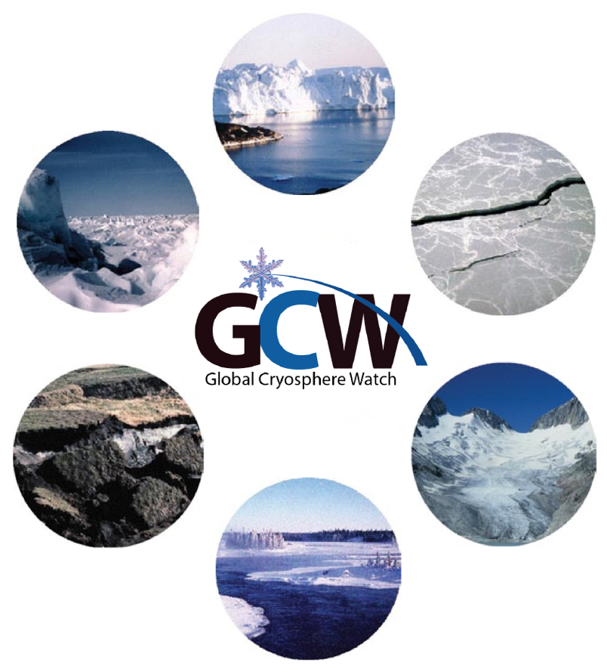
Components of the Cryosphere
Glaciers
Ice sheets, ice caps, ice shelves
✓
Sea ice
Permafrost and seasonally-frozen ground
✓
Snow
River and lake ice
✓
in pilot study

Slide 3
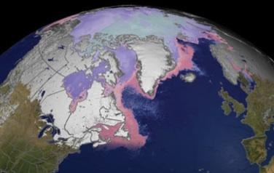
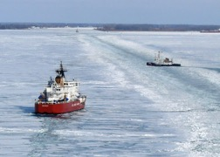
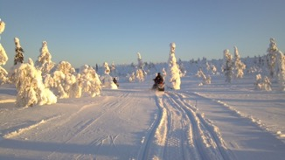
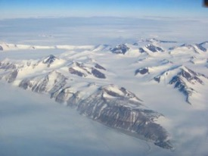
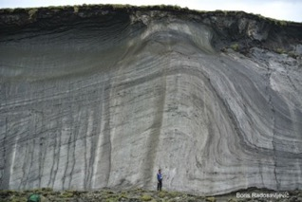
Objectives of the Pilot Study
The objectives of the GCW pilot study are to follow the RRR process for terrestrial snow and sea ice*. The process includes the following elements:
a review of technology-free Members' requirements for observations, within an area of application covered by WMO programmes and co-sponsored programmes;
a review of the observing capabilities of existing and planned observing systems, both surface- and space-based;
a Critical Review of the extent to which the capabilities (b) meet the requirements (a); and
a Statement of Guidance based on (c) for all Application Areas considered within the category.
*While the original plan was to address only terrestrial snow cover, we had already started work on sea ice and will therefore include it.

Slide 4
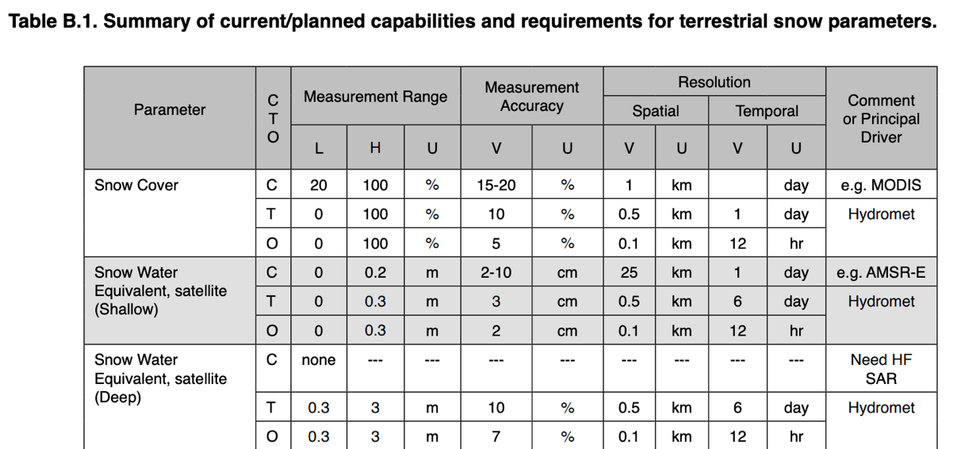
Historical Note
A compilation and consolidation of observational requirements and capabilities for the cryosphere was done and published in a report of the Integrated Global Observing Strategy (IGOS) in 2007.
Available at https://stratus.ssec.wisc.edu/igos/docs/cryos_theme_report.pdf

Slide 5
GCW has a Task Team Specifically for this Activity: CRYORA
CRYORA mandate: develop cryosphere observing requirements and related guidance in the framework of the new RRR.
GCW Substructures
Alignments with other structures
Expert Teams:
Cryosphere and Polar Observations (ET-CPO)
Cryosphere and Polar Data Interoperability (ET-CPDI)
Sea Ice Watch (ET-SIW)
Snow Watch (ET-SW)
Task Teams:
Cryosphere Observing Requirements (CRYORA)
Glaciers and Ice Caps (GIC-TT)
Permafrost (P-TT)
Coordinators:
GCW Best Practices Coordinator (GCW-BPC)
Polar Regional Climate Centres Focal Point (GCW-PRCC-FP)
Cryosphere Bulletin Coordinator (CBC)
GCW National Focal Points
ET-CPO → SC-ON (ET-WT) and SC-IMT (WIGOS MD TT)
CRYORA→ Joint Expert Team on Earth Observing System Design and Evolution (JET-EOSDE)
ET-CPDI →SC-IMT
ET-SIW and ET-SW – crosscutting with links to SC-ESMP, SERCOM, HCP, RB
GIC-TT and P-TT – SC-MINT and evolving, e.g. permafrost contributions to the WMO GHG monitoring strategy
GCW-BPC: SC-MINT, Editorial Board, WIGOS MD TT – liaison
GCW-PRCC-FP: liaison with Arctic RCC, TPRCC, Antarctic RCC Networks
Composition of teams was approved by President INFCOM in Feb 2022.

Slide 6
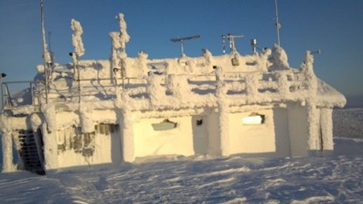
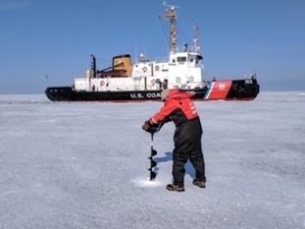
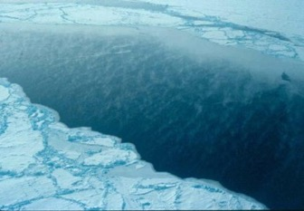
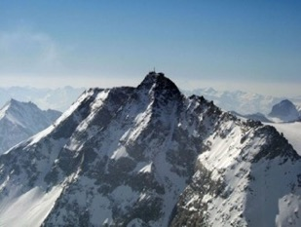
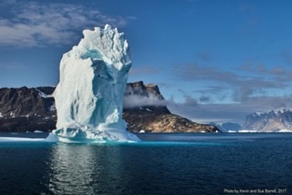
CRYORA Process
Literature review to assess user needs (geophysical variables, requirements) and applications;
Compile tables of variables, applications, requirements, and sources;
Determine the most useful (essential?) variables for each cryosphere component (e.g., snow, sea ice, permafrost, etc.);
Map applications from the literature to RRR Application Areas and reconcile findings with the JET-EOSDE recommended RRR structure;
Consolidate and refine numerical observational requirements for OSCAR;
Prepare a Statement of Guidance (SoG).

Slide 7
Status: Literature Review
Reviewed at least 30 documents for user needs (variables and requirements).
Appendix 1: CRYORA References
Allen, S., H. Frey, and C. Huggel. (2017). Assessment of Glacier and Permafrost Hazards in Mountain Regions. Technical Guidance Document. 10.13140/RG.2.2.26332.90245.
Bippus G., T. Nagler, S. Schiller, K. Luojus, and D. Gustafsson. 2016. Snow, Freshwater Ice, and Glacier information. CryoLand. 49pp.
Bring, A., I. Fedorova, Y. Dibike, L.Hinzman, J. Mård, S. H. Mernild, T. Prowse,O. Semenova, S. L. Stuefer, and M.-K. Woo(2016), Arctic terrestrial hydrology: A synthesis of processes, regional effects, and research challenges, J. Geophys. Res.Biogeosci.,121,621–649, doi:10.1002/2015JG003131.
…

Slide 8
Status: User Applications
Applications as they appear in the literature have been tabulated.
Weather Prediction
NWP (Numerical Weather Prediction)/Nowcasting
Global NWP
High Res NWP
Nowcasting / VSRF
Weather Research
Weather Forecasting Operations
AOPC
Synopic Met
Atmospheric Research
Ocean Applications
Ocean Apps
Marine Met Services
Species/Organisms and Food Web Change Research
Ocean State and Coastal Zone Change Research
Sea Ice Change Research
Ice Sheet/Glacier Change Research
CLIVAR
GOOS
Oil
Ecosystem Change Research
Risk Management/Disasters/Hazards/Engineering
Engineering Design / Risk Management / Emergency Response
Oil
Climate Change Adaptation Operations
Avalanches
Environmental Impact Assessment
Engineering Design
Operations Planning
Route Planning
Safe Navigation and Operations
Risk Management
Emergency Response
Search and Rescue Operations
Operations Planning
Environmental Impact Assessment
Snow Change Research
Ecosystem Change Research
Ocean State and Coastal Zone Change Research
Land Surface and Use Change Research
Sea Ice Change Research
River/Lake Ice Change Research
Ice Sheet/Glacier Change Research
Permafrost Change Research
TOPC
Weather Research
Weather Forecasting Operations
Climate
….
Transportation/Navigation
….
Agriculture
….
Coastal Applications / Sea Level Rise
Coastal Apps
Species/Organisms and Food Web Change Research
Ecosystem Change Research
Ocean State and Coastal Zone Change Research
Land Surface and Use Change Research
Sea Ice Change Research
Ice Sheet/Glacier Change Research
River/Lake Ice Change Research
Permafrost Change Research
CLIVAR
TOPC
Hydrology/ Water Resources
Hydrological Monitoring
Hydrological forecasting/prediction
Snow Change Research
Land Surface and Use Change Research
River/Lake Ice Change Research
Ice Sheet/Glacier Change Research
Permafrost Change Research
CliC/GEWEX
GCOS/TOPC

Slide 9
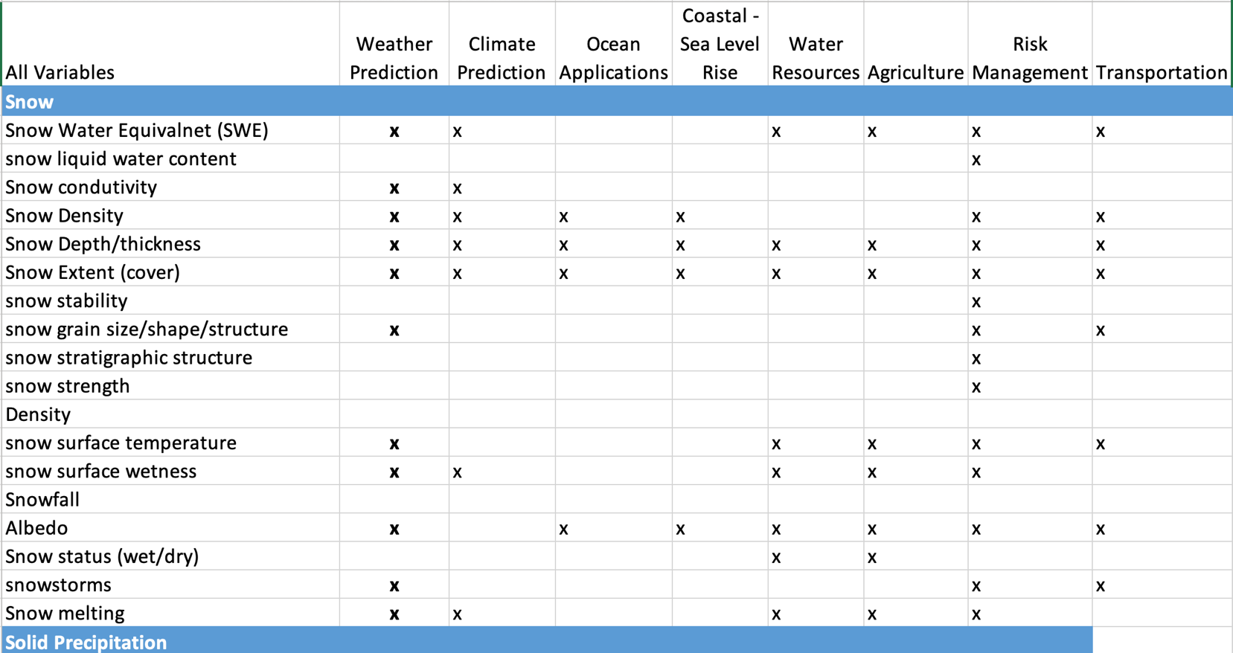
Status: Snow Variables and User Applications
Geophysical variables have been enumerated. Differences in terminology are sometimes problematic.
Equivalent
Note: This not a complete list

Slide 10
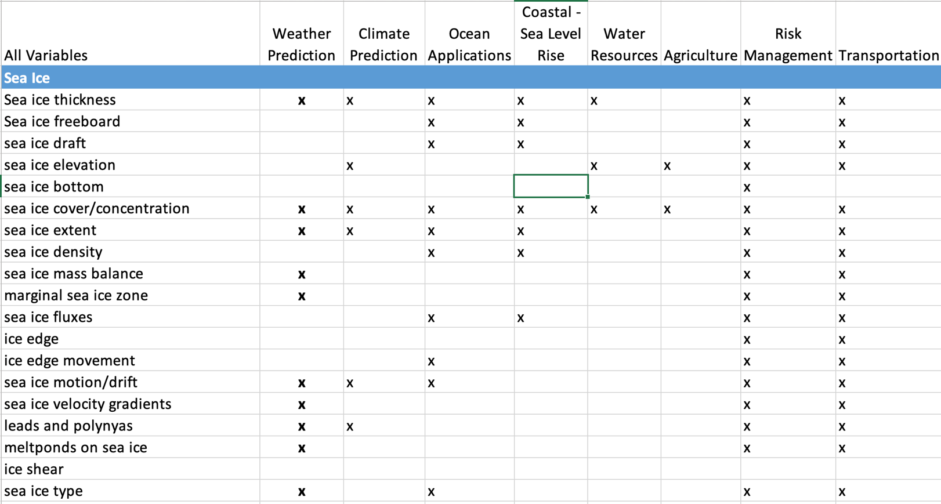
Status: Sea Ice Variables and User Applications
Geophysical variables have been enumerated. Differences in terminology are sometimes problematic.
x
Note: This not a complete list

Slide 11
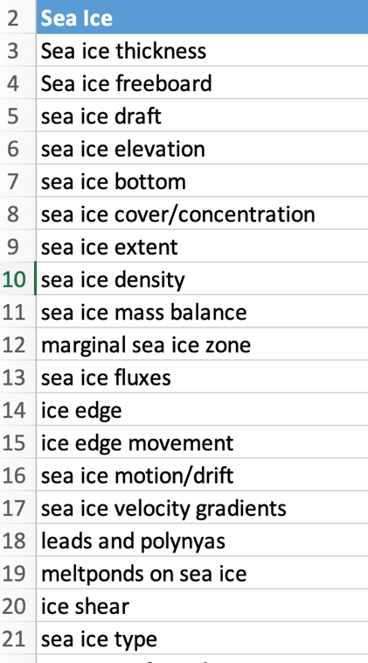
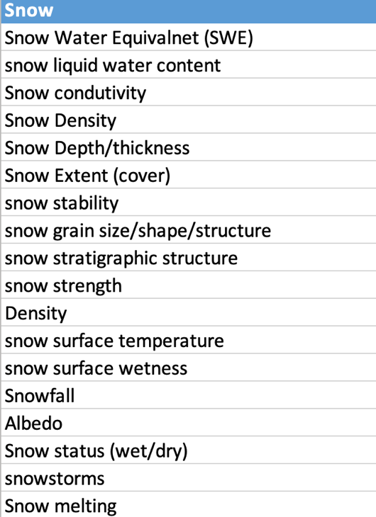
Status: Determining Essential Variables
Subject matter experts (SMEs) have been enlisted for the task of consolidating and ranking variables. What are the redundancies? Which variables are the most important to observe; i.e., which will have the greatest impact in applications?
Equivalent
Note: These are not complete lists
…
…

Slide 12
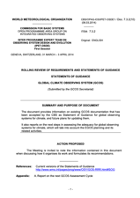
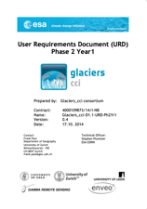
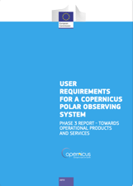
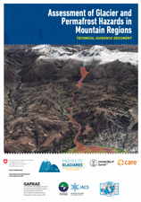
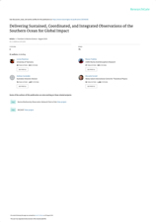
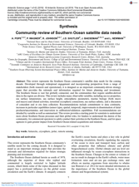
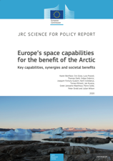
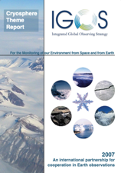
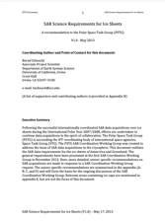
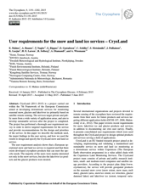
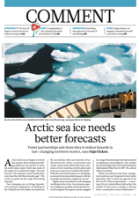
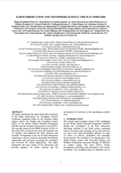
Status: Mapping CRYORA Application Areas to
WMO Earth System Application Categories/Areas
Started, but not a trivial task!
Some variables within GCW Areas will map to multiple WMO Application Categories/Areas and have different requirements
GCW Draft
Application Areas
Earth System Application Category
Weather
Ocean
Space Weather
Coastal / Sea Level Rise
Atmospheric
Ocean
Climate
Hydrological / Terrestrial
Hydrology / Water Resources
Cryospheric*
Agriculture
Integrated Earth System Apps
Risks/Disasters/
Hazards/Eng
Literature Review
for Requirements
and Variables
Transportation/ Navigation
* All GCW Application Areas map to Cryospheric App Category
Arrows not drawn to simplify illustration

Slide 13
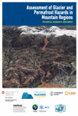
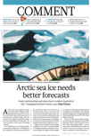
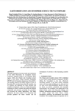
Status: Mapping Variables to WMO Earth System Application Categories/Areas – An Example for Sea Ice Thickness
GCW Draft
Application Areas
1.1 Space Weather
1.2 Energetic Particle Forecasting & Monitoring
2.1 Global NWP & Real-time Monitoring
2.2 High Resolution NWP
2.3 Nowcasting / Very Short Range Forecasting (VSRF)
2.4 Sub-Seasonal to Longer Predictions (SSLP)
2.5 Atmospheric Climate Monitoring and Forecasting
2.6 Atmospheric Composition Forecasting & Monitoring³
2.7 Atmospheric Composition information services in urban and populated areas³
2.8 Aviation Meteorology
2.9 Agricultural Meteorology³
2.10 Atmospheric Disaster Risk Reduction
3.1 Ocean Mesoscale Forecasting & Real-Time Monitoring
3.2 Wave Forecasting
3.3 Oceanic Climate Monitoring
3.4 Tsunami Monitoring & Detection
3.5 Oceanic Disaster Risk Reduction
4.1 Hydrology Forecasting & Real-Time Monitoring
4.2 Hydrological and Terrestrial Climate Monitoring
4.3 Hydrological and Terrestrial Disaster Risk Reduction
5.1 Terrestrial Cryosphere Forecasting and Monitoring⁴
5.2 Sea Ice Forecasting and Monitoring
5.3 Cryospheric Climate Monitoring
5.4 Cryospheric Disaster Risk Reduction
6.1 Earth System Forecasting & Monitoring⁵
6.2 Understanding Earth System processes¹
Earth System Application Category
Weather
Ocean
Space Weather
Coastal / Sea Level Rise
Atmospheric
Ocean
Climate
Hydrological / Terrestrial
Hydrology / Water Resources
Agriculture
Cryospheric
Risks/Disasters/
Hazards/Eng
Integrated Earth System Apps
Transportation/ Navigation
Notes:
Sea Ice Thickness was identified as an important required variable in 6 of the GCW Cryora Application Areas. The specific requirements might be different for each application area which might also be the case for the WMO Application Categories and Areas. Sea Ice Thickness would be an important variable for all WMO Categories except perhaps Space Weather. What the requirement level would be for each of the relevant WMO Areas would need to be determined.

Slide 14
Summary and Remaining Questions
GCW is prepared to engage in a pilot study.
Relevant work has already begun:
Formed a GCW Task Team for this activity, CRYORA, building on the work of the IGOS Cryosphere Theme.
Performed a literature review to assess user needs (variables, requirements) and applications;
Compiled tables of variables, applications, requirements, and sources;
Determine the most useful (essential?) variables for each cryosphere component (e.g., snow, sea ice, permafrost, etc.);
Map applications from the literature to RRR Earth System Application Categories and Application Areas, and reconcile findings with the JET-EOSDE RRR structure;
Consolidate and refine numerical requirements;
Prepare a Statement of Guidance (SoG).
Some questions need to be addressed in this workshop and/or by JET-EOSDE:
The crosscutting nature of the cryosphere, which is relevant to other domain-specific applications (e.g. weather, ocean, hydrology). How do we address the overlap between Application Areas?
What does Application Area ownership imply?
Mostly
done
Just
started
Not yet
started

Slide 15
Thank You

