Slide 1
University of California, Davis Department of Land, Air and Water Resources
Gestión Compartida del Agua
para Usos Humanos y Ambientales
Dr. Samuel Sandoval Solis In collaboration with: Janet Escorcia, Jesus Loredo, Pablo Ortiz, Laura Garza, Shona Paterson, Luzma Nava, John (Jack) Schmidt and Todd Blythe
Notes:
Add USGS, UACH

Slide 2
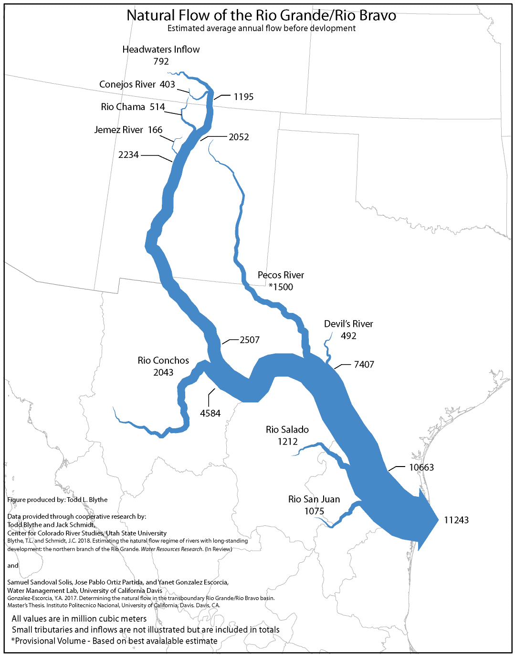
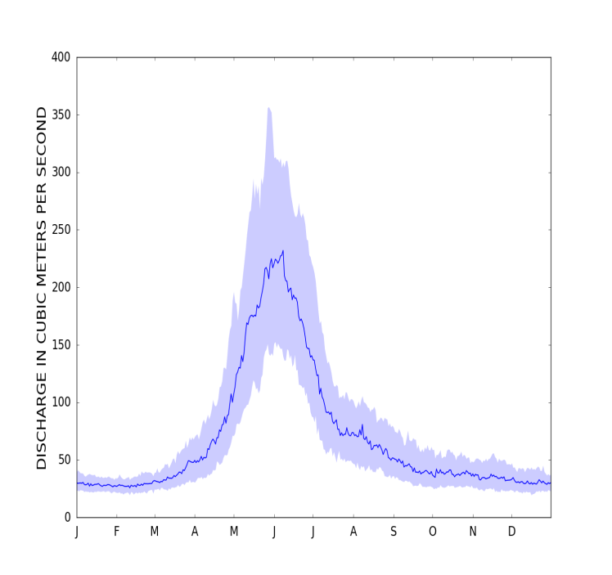
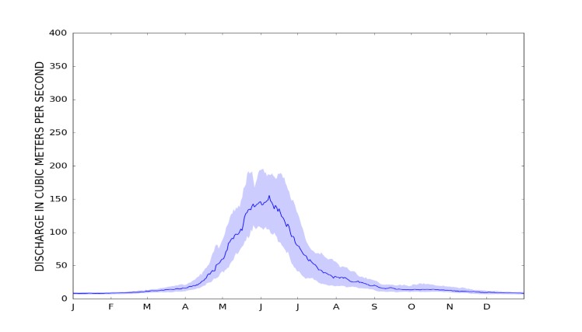
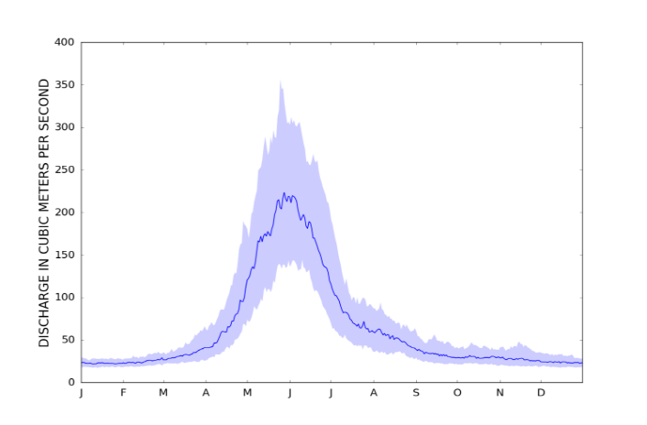
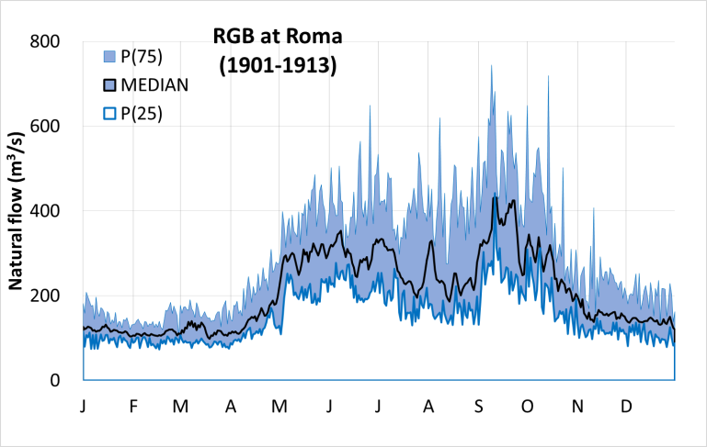
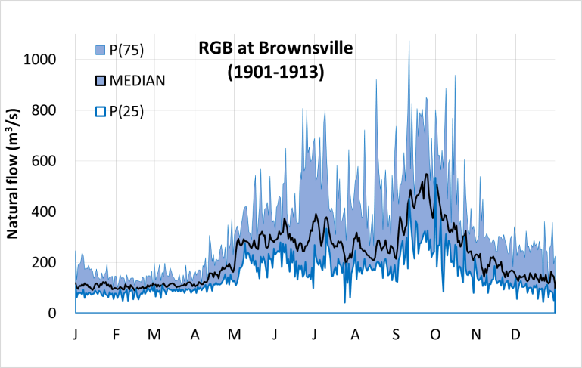
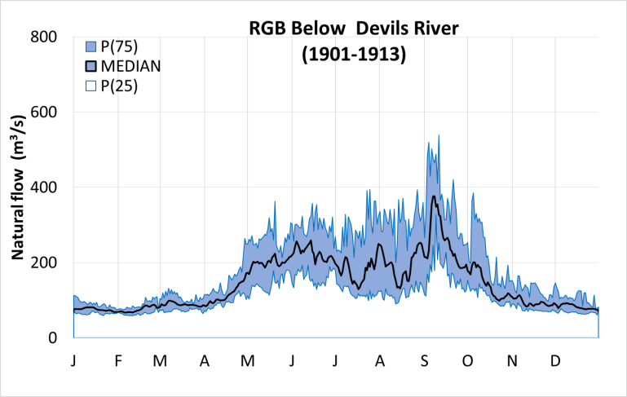
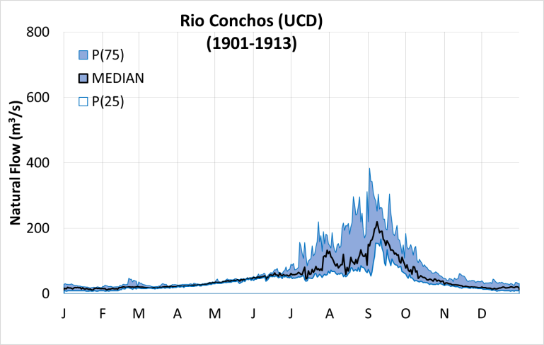
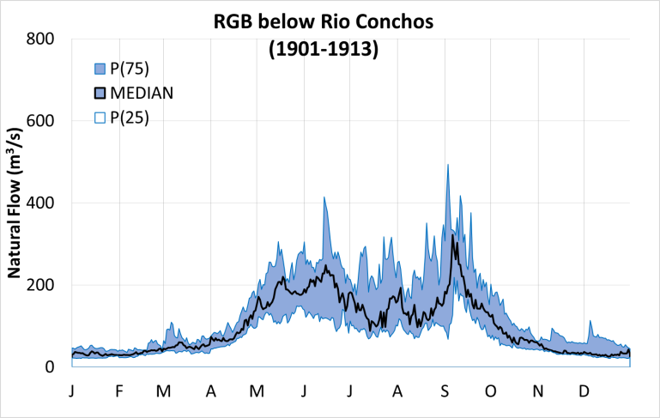
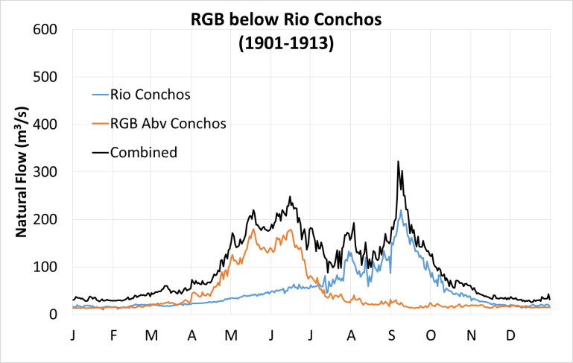
Natural Hydrology
400
Presidio, TX
San Marcial, NM
Lobatos, CO
Flow Regime
300
Discharge (m³/s)
Natural
200
100
0
J F M A M J J A S O N D
RGB below Rio Conchos
RGB below Rio Conchos
RGB below Devils
Rio Conchos
800
RGB below Rio Salado
RGB at Gulf of Mexico
600
Discharge (m³/s)
400
200
0
J F M A M J J A S O N D
Notes:
Need to send an email to Jack and Todd
Citation Jack’s Paper

Slide 3
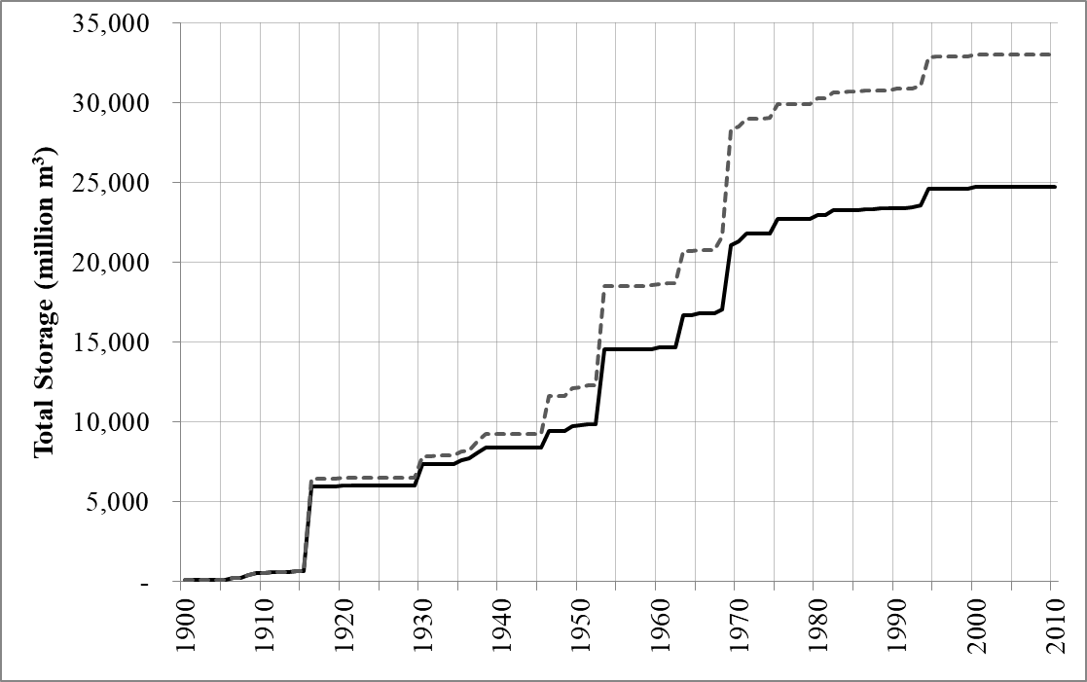
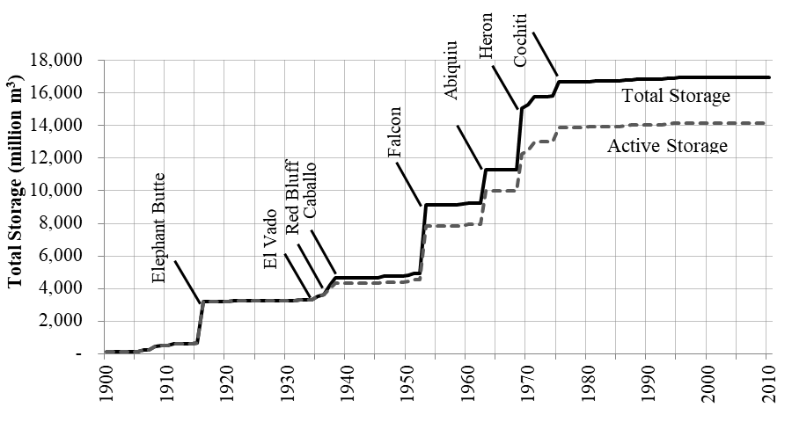
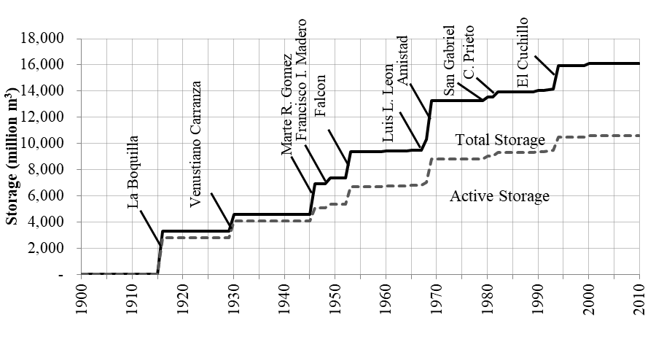
Water Infrastructure
Amistad
Marte R. Gomez
Venustiano Carranza
Elephant Butte & La Boquilla
Falcon
Cochiti
El Cuchillo
Abiquiu
Rio Grande/Bravo Basin
United States
Mexico
Sandoval-Solis S.(2011). Integrated Water Resources Management for transboundary basins. Case of Study Rio Grande/Bravo Basin. Dissertation. University of Texas at Austin. Austin, TX.
Notes:
Pablo – Map of Dams
Hectareas and Water Use

Slide 4
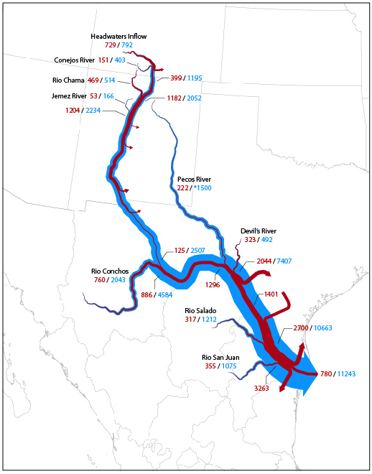
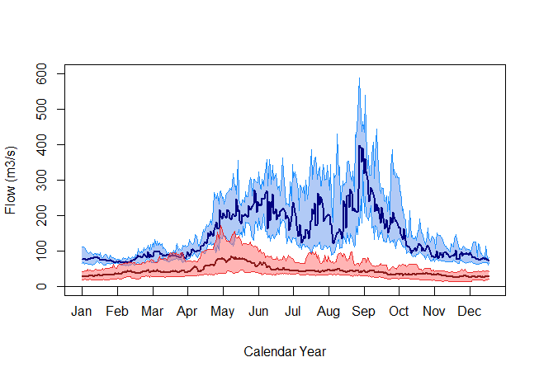
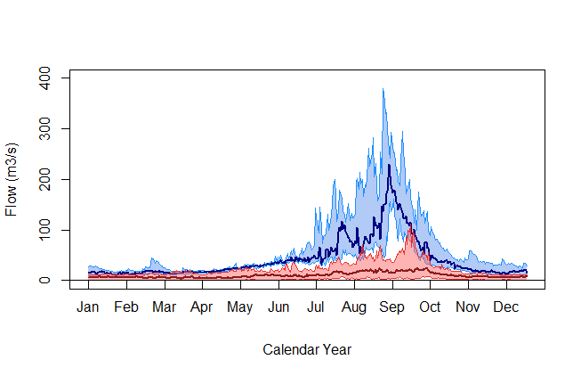
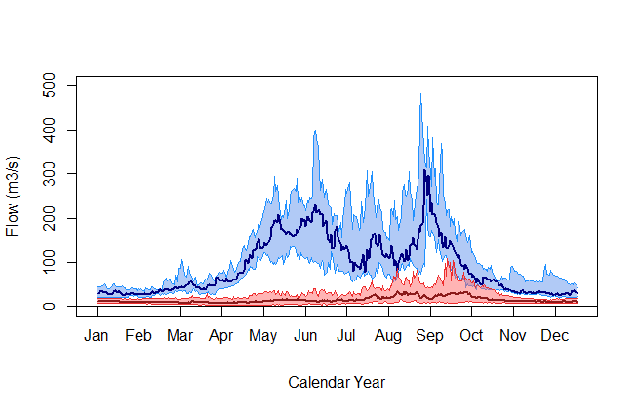
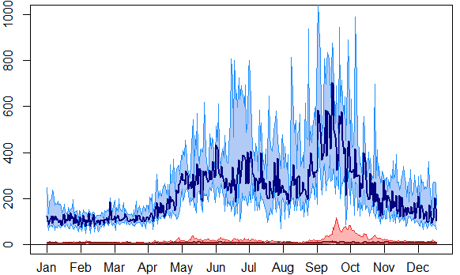
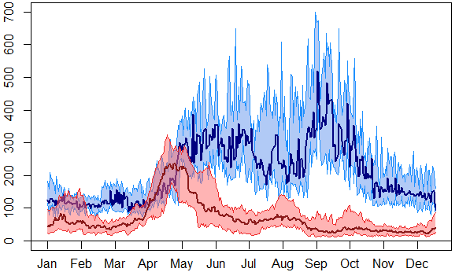
Modern Hydrology
400
San Marcial, NM
Lobatos, CO
Presidio, TX
300
Discharge (m³/s)
200
Flow Regime
Natural
100
Regulated
0
J F M A M J J A S O N D
Rio Conchos
RGB at the Gulf of Mexico
RGB below Falcon
RGB below Amistad
800
RGB below Rio Conchos
600
400
600
450
300
Discharge (m³/s)
Discharge (m³/s)
Discharge (m³/s)
200
400
300
100
200
150
0
0
0
J F M A M J J A S O N D
Notes:
Need to send an email to Jack and Todd
Citation Jack’s Paper

Slide 5
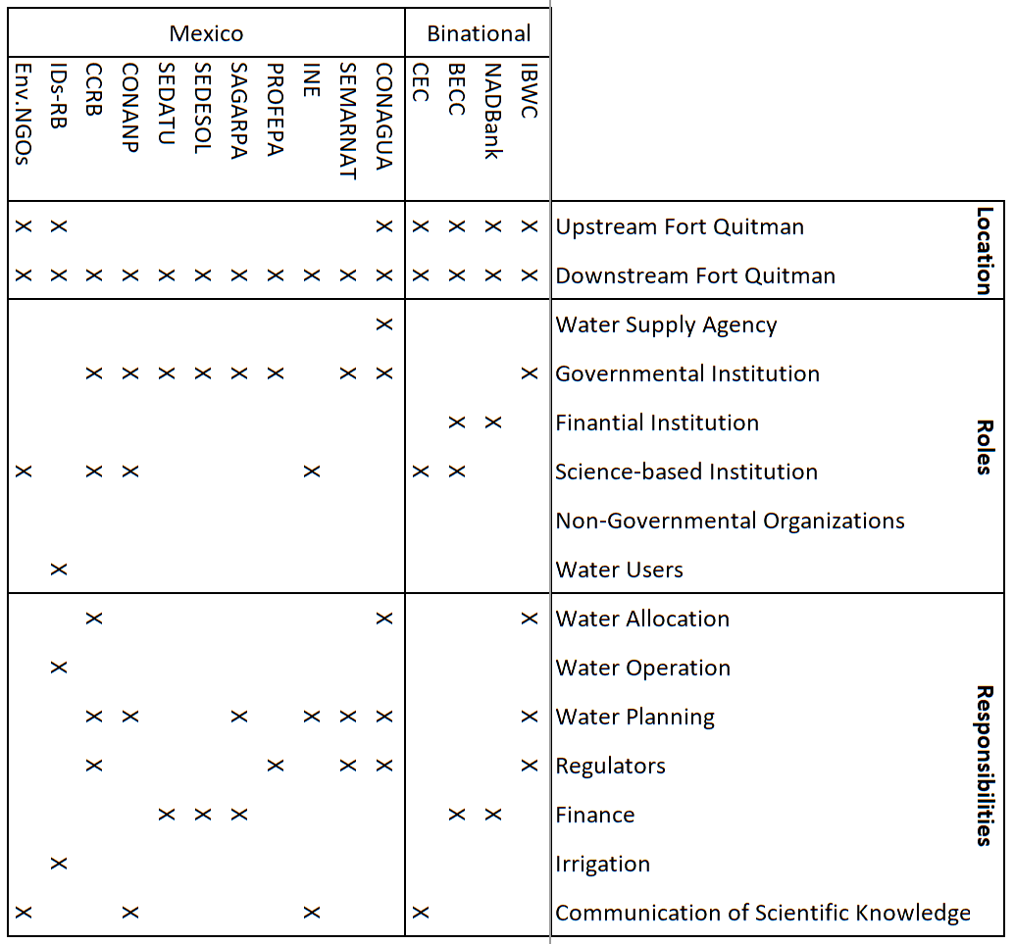
Water Governance
Notes:
Need to send an email to Jack and Todd
Citation Jack’s Paper

Slide 6
Oportunidades
Quién quiere dar un paso adelante?
Flow Regime
Puntos en Común
Responsabilidades
Interés
Capacidades técnicas
Servicios Ecosistémicos
Recarga de Acuíferos
Mitigación de Inundaciones
Mejorar Calidad de Agua
Sitios con Caudal Ecologico
Rio Conchos – 7 sitios
RGB Cauce Principal – 3 sitios
Tributarios – 4 sitios
Natural

Slide 7
Thank you
Gracias
Obrigado
Grazie
Merci
Shukran
Xie Xie
samsandoval@ucdavis.edu
http://watermanagement.ucdavis.edu

