Slide 1
Domestic Abuse
Partnership Challenges
Police Perspective
Darren Downs

Slide 2
What do I know ?
My thoughts & observations
30 years of experience across policing and partners
Chair of 4 Community Safety Partnerships, numerous safeguarding boards & multi-agency groups
A number of Challenges faced and managed

Slide 3
Three Strategic Challenges
Governance & Accountability
Inspectorate Remit
Funding

Slide 4
C.S.P
L.S.A.B
Domestic Abuse
L.S.C.B
Tri-Partite Structure
C.S.P – Community Safety Partnership
L.S.A.B – Local Safeguarding Adult’s Board
L.S.C.B – Local Safeguarding Children’s Board
Crime & Disorder Act 1998

Slide 5
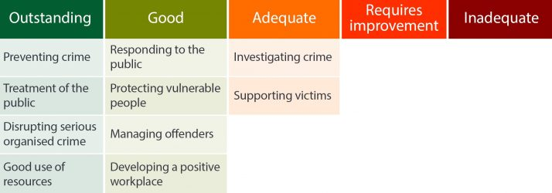
HMICFRS – How well the Police do their job
OFSTED – Raise standards in education and children’s social care
QCC – Regulates health and social care in England
CQC – Health and adults social care standards are met
HMIP – Treatment of prisoners

Slide 6
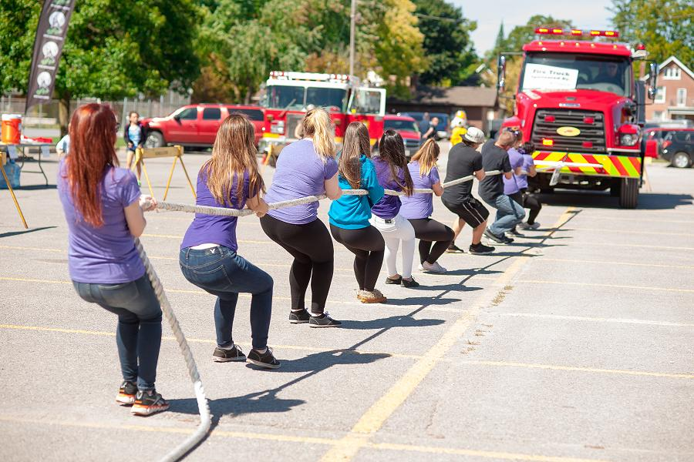

Slide 7
The future ?

Slide 8
Darren Downs
07885 210860
leadconsultancy2022@outlook.com

