Slide 1
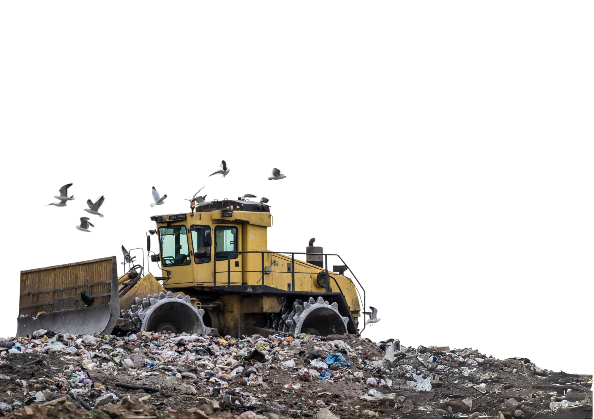

PITCH
DECK
Environmental, Clean-Tech energy, Waste Recycling, Land Reclamation
Landfill is a Triple Threat: Health, Environment, Economy
THE TRADING NAME OF PYROLYSISE LTD

Slide 2

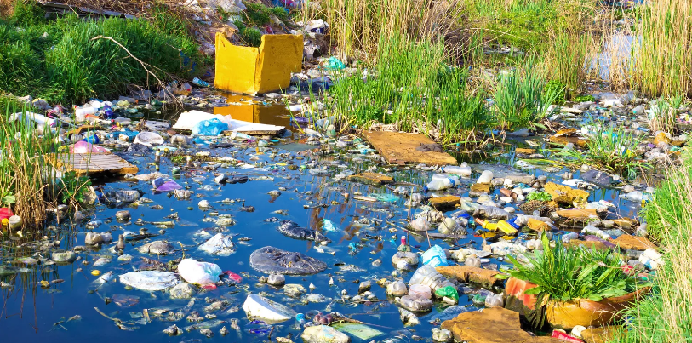
John Bell, Managing Director
PYROLYSISE LTD
I have witnessed the impact of unmanaged waste across four continents — from choking rivers and plastic-covered beaches in Africa to the direct harm I have seen to livestock and farmland.
On my farm in Northern Victoria, I saw livestock die after ingesting plastic silage wrapping and baler twine, waste that had accumulated over years before my ownership. I spent months clearing 1,250 acres to restore safe grazing.
That experience reinforced a simple truth: unmanaged waste poisons ecosystems, damages biodiversity, and undermines both animal and human health.
After decades in the fossil fuel sector, I also know the cost of inaction — both environmental and economic.
Waste is both the problem and the opportunity. GreenMine’s Waste Carbonisation Plants are designed to clean it up and convert it into value: reducing greenhouse gases, producing clean energy and biochar, generating carbon credits, recovering critical minerals, and unlocking land for housing and community use.
Our waste Carbonisation plant is not a theoretical innovation. The technology is EU-certified, validated by independent engineering review, operating successfully in South America.
With exclusive UK deployment rights, GreenMine is positioned to capture both the environmental and commercial upside at the right time

Slide 3
Landfill is a Triple Threat: Health, Environment, Economy
Public Health
Microplastics in food & water
Rising illness, lost productivity
Health problems, lost work production / school days
Food and water contamination
Gas emissions and pest infestations
Environmental Damage
6% of UK GHG emissions from landfill
Methane, CO₂, VOCs & bioaerosols pollute air, soil & rivers
Global flora and fauna environmental damage
Recycled microplastics, cloud and rainfall contamination
Coastal erosion & biodiversity loss
Beaches contaminated with landfill waste
Contaminated rivers, polluted air & soils
Economic & Social Strain
Housing shortage growing population, worsened by redundant capped sites
Redundant land near communities, costly to maintain
Valuable agricultural land for landfill threatens future food security
Liabilities stretching decades into the future
Liability and maintenance costs, capped landfill sites

Slide 4
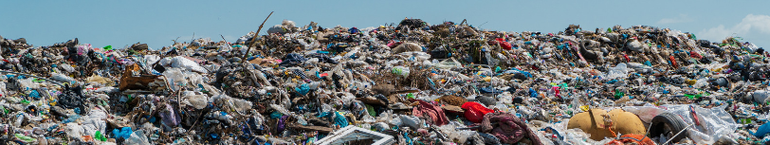
Waste: Problem & Opportunity
PYROLYSISE LTD
The Problem :
UK produces c. 27m tonnes residual waste annually.
Landfill space is running out; Landfill Tax increasing
zero avoidable waste to landfill by 2050.
incineration faces opposition
Complex waste streams (plastics, composites, medical).
Housing demand collides with sterilised land.
Medical Waste increasing
The Opportunity :
Landfill reclamation unlocks new land.
Carbonisation = valuable outputs (energy, biochar, bio fuel, carbon credits,
Current REE market value exceeds $9–10 billion annually, a regulatory and financial backing opportunity.
Incinerators are a transitional technology
Medical waste is one of the fastest-growing waste streams globally.
Investors access a scalable UK-exclusive platform.

Slide 5
Market Drivers
PYROLYSISE LTD
Population Growth: UK adds c.3m by 2035.
Housing Shortage: 1.3 million homes plus current backlog 4.3 million required by 2035
Policy Pressure: landfill/incineration limits.
Energy Security: decentralized steady, predictable renewable power that can operate 24/7,
REE Global Shortages: brownfield remediation is not just a land play — it is also a critical minerals play.
Agricultural land under threat, national food security
Net Zero and ESG mandates. medical waste mismanagement

Slide 6
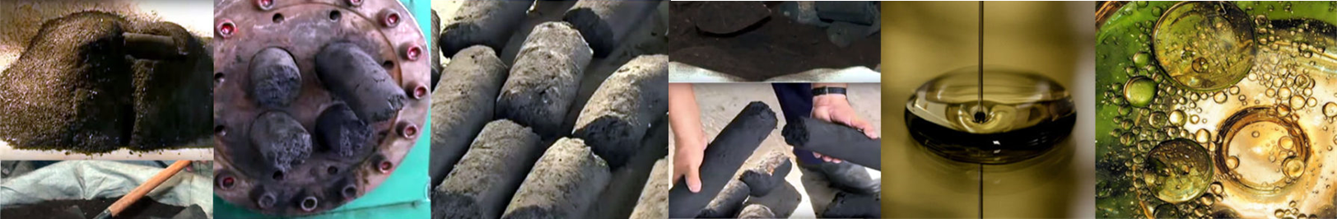
Our Solution: GreenMine Technology
GreenMine’s WCPs apply advanced pyrolysis to waste, transforming liabilities into valuable outputs.
Outputs:
Cut greenhouse gases.
Produce syngas, electricity, bio-oil.
Generate biochar with certified sequestration.
Unlock carbon credits.
Reclaim valuable land and repurpose
Recover REEs and minerals.
Energy security
Why Now?
Proven at scale in South America.
Exclusive UK rights via manufacturing partners.
Independent validation by Stopford’s Engineering.
Housing shortage rising population
green belt reform on Government’s immediate growth agenda
Resilient Market Position: Broad offtake markets: energy, fertiliser, fuels, carbon credits, REEs, land reclamation
Medical waste emerging market
•

Slide 7
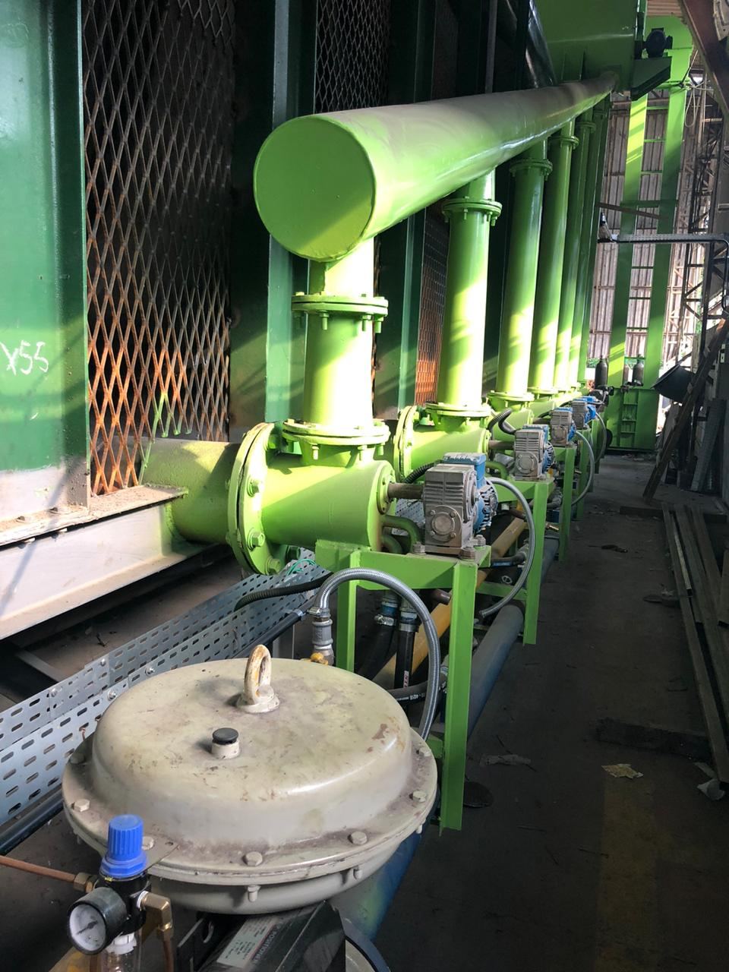
Technology
Validation
PYROLYSISE LTD
Proven & Certified
• Two EU-certified technologies
• 8+ years operational track record
• TRL 9 validation, 8,400 hours testing
Independently Verified
• UK compliance confirmed by Stopford Consultancy
Independent Eurofins testing confirms NOx and dioxin/furan emissions from our 1200 °C reactors are over 100× cleaner than EU/UK limits, validating true zero-toxic operation.
Industrial waste site throughput:
3 t/h SWIPs — a lighter regulatory route with faster, local authority permitting and lower planning resistance.”
Superior Performance:
Processes unsegregated municipal waste.
Meets Medical waste criteria, 1200c
Deployable & Scalable
• 5t/h units, <1,000 sqm footprint
• Commissioned in under 6 months
• Modular: 500kg/h → 20t/h capacity

Slide 8
Our Waste Carbonisation Plant (WCP): Proven, Certified, Ready
GreenMine brings forward two complementary pyrolysis technologies, both EU certified and validated for commercial deployment.
• Thermal degradation pyrolysis
• Successfully operating for over 8 years.
• Originally designed for 900°C, upgradeable to 1200°C.
• Fully modular, with capacity ranging from 500 kg per hour to 20 tonnes per hour per unit.
• Proven continuous operation with a track record of environmental compliance.
• Gasification Pyrolysis
• Completed 8,400 hours of independent testing.
• Validated at Technology Readiness Level 9 — deployment-ready.
• Designed to operate at 1200°C, suitable for medical waste and other high-contaminant streams.
• Capacity of 3 tonnes per hour, ideal for UK industrial applications.
Both systems are effectively emissions-free.
Independent Eurofins testing confirms over 100× cleaner than EU/UK limits, validating true zero-toxic operation.
They process unsegregated municipal waste Each plant is self-sustaining, using just 10% of its own bio-coal to power continuous operation, while generating multiple outputs
With a compact footprint (<1,000 sqm) and commissioning time of under six months, the WCP is highly deployable across industrial and landfill reclamation sites.

Slide 9
Asset Acquisition Three-Step Strategic Roadmap
Our pivot will transform Pyrolysise from a standalone project developer into a platform company anchored by the acquisition of a profitable c. £40m Waste Management Business (WMB), giving us asset-backed EBITDA, permits, and feedstock security. This strengthens our ability to leverage £15m in convertible debt and accelerates rollout across both industrial and medical waste markets
Phase 1 – Waste Management Business (WMB): Acquisition of a profitable £40 m turnover waste management company delivering 10–15% EBITDA (£4–6m). This provides feedstock security, SWIP permits, and baseline EBITDA for debt leverage.
Phase 2 – Industrial Waste Sites: Rollout of waste Carbonisation plants across six industrial waste sites within 19 months. Each plant generates ~£5.8 m gross EBITDA, of £ 4.5 adding ~£27m+ to earnings. Medical waste capability at 1,200°C provides compliance and premium pricing resilience.
Phase 3 – Landfill Reclamation, REE Recovery, and Housing Development: Capped landfill sites represent unique opportunities for redevelopment into housing and land banks while enabling recovery of rare earth elements (REEs). This unlocks future carbon credits, ESG gains, and significant land value appreciation.

Slide 10
Phase 1 Anchor Acquisition –
Platform with Pyrolysise Value Add
• Target: Established recycling & aggregates operator
– Assets: land, wash plant, fleet, permitted sites
– Baseline EBITDA: ~£6m p.a. (EV ~£40m @ 6–7×)
• Rationale: Provides secure platform + land for reactor rollout
• Pyrolysise Value Add:
– Revenue per reactor: ~£5.8m
– EBITDA (25% opex): ~£4.35m
– Phase 1 (6 units, 12 months): +£26m EBITDA
• Combined EBITDA: £6m → £32m+ within 12 months

Slide 11
Funding Stack & Valuation Bridge
Funding Structure:
• Equity: £12–14m (30–35% EV) – infra/ESG investors
• Senior Debt: £15–18m – secured on land, plant, cashflows
• Growth/Convertible Debt: £15m – reactor rollout, ESG/mezzanine
Valuation Bridge:
• Entry: £40m EV @ 6–7× £6m EBITDA
• Post-Phase 1 (6 reactors): £32m EBITDA × 6× = ~£190m EV
• Equity re-rating: >5× uplift in 2–3 years

Slide 12
Capital Stack – Acquisition & Growth Funding
Equity £12–14m
(30–35%) – Infra/ESG Investors
Senior Debt £15–18m
Secured on Land, Plant, Cashflows
Convertible Debt £15m
Reactor Rollout – ESG/Growth Funds
Servicing:
• Anchor business (~£6m EBITDA) supports senior debt.
• Convertible debt serviced by incremental EBITDA (~£26m from 6 reactors).
• Equity provides risk buffer and upside participation.

Slide 13
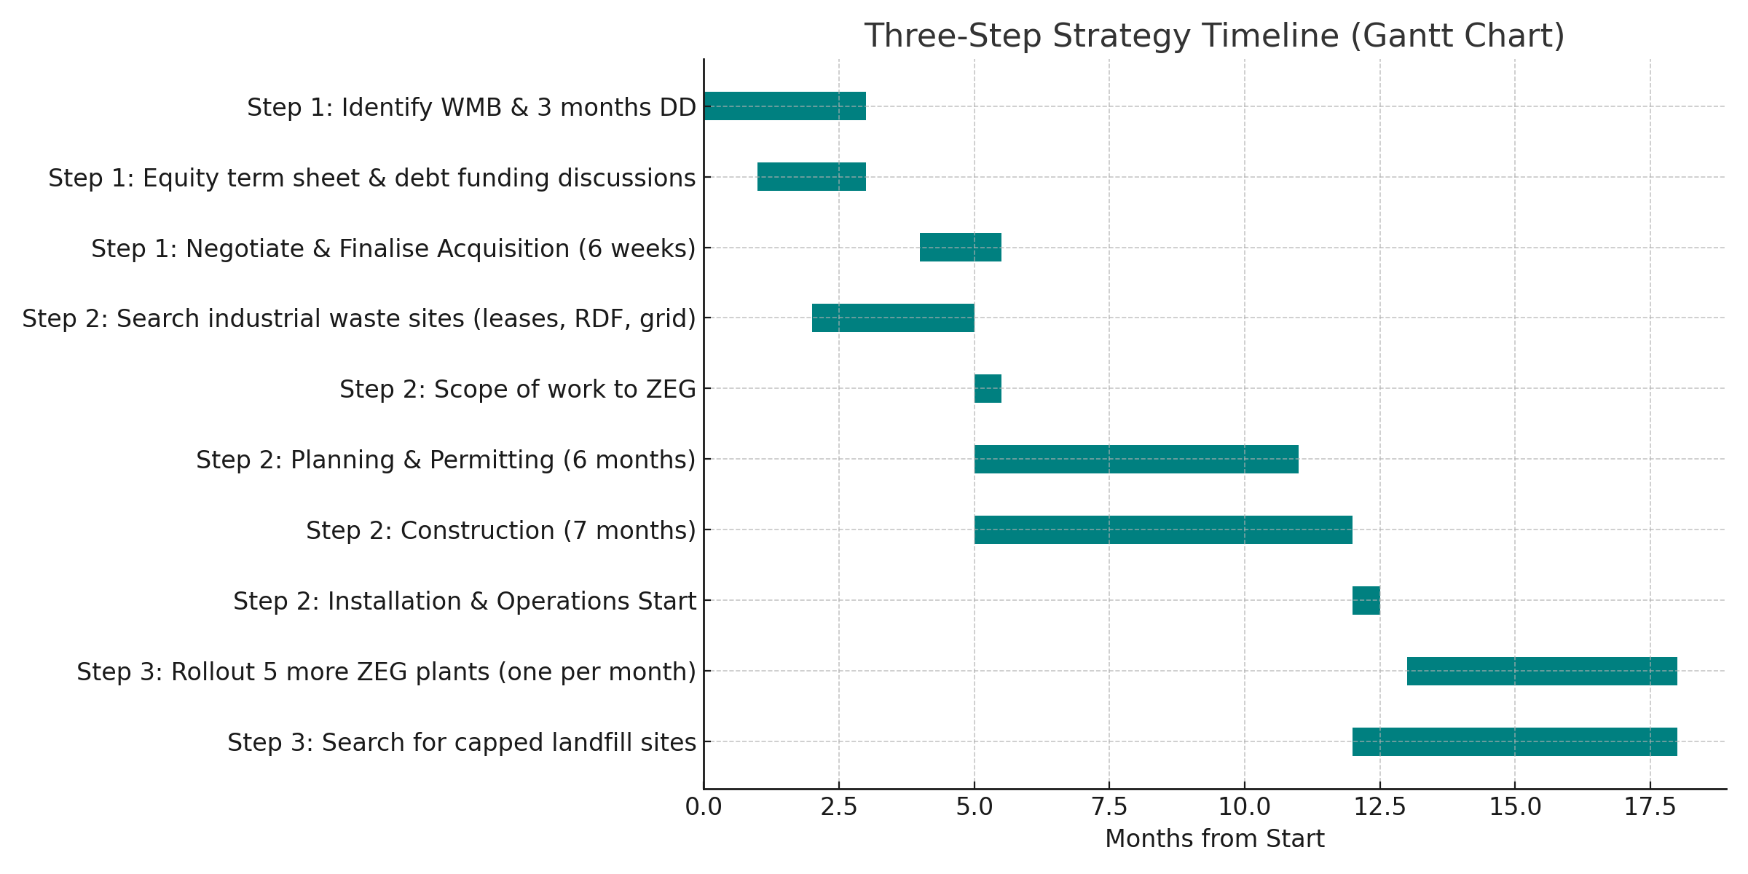
Three-Step Strategy Timeline
Phase 1

Slide 14
Industrial and Landfill Waste Plan:
PYROLYSISE LTD
Industrial Waste sites
Landfill Reclamation Model
Phase 2: Industrial Deployment
Lease industrial waste sites (20-year terms) with grid connection
Local Authority permitting under SWIP (~6 months)
Install & commission 3t/h WCP unit; monitor performance over 6 months
Secure rollover feed stock and offtake contracts:
Add 5 further units consecutively (1 per month)
6 sites → £35m annual revenue (20% biochar yield)
Expansion to 12 and 24 sites → proportional
revenue growth
Industrial sites first (cashflows).
Landfill sites later (developer-funded)
Phase 3: Landfill Reclamation
GIS dashboard to shortlist capped landfill sites
Non-invasive site evaluation for emissions, organics & solids
Local Authority planning & permitting under controlled pathways
Prioritise brownfield sites near residential areas
3-year cycle: excavation → backfill → land ready for redevelopment
Recover metals, REEs, fuels, biochar & energy

Slide 15
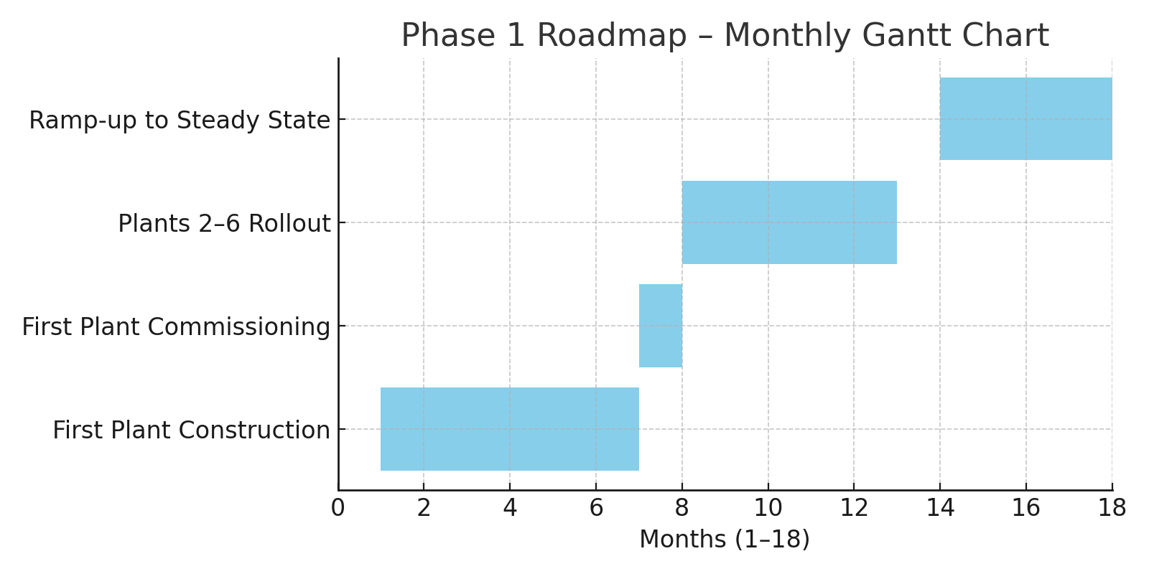
Phase 2 Industrial Waste Site Roadmap
PYROLYSISE LTD
Q4 2025:
Secure lease, feedstock, offtakes.
Submit planning & permitting.
Kickoff with manufacturing partners.
.
Q3 2026:
Commercial operations.
Performance monitoring & DNV accreditation.
Q1 2026:
Site prep & groundworks.
Procure under EPC.
Source ancillary equipment (EPCM).
Q2 2026:
Install & commission 3t/h plant.
Commission infrastructure.

Slide 16
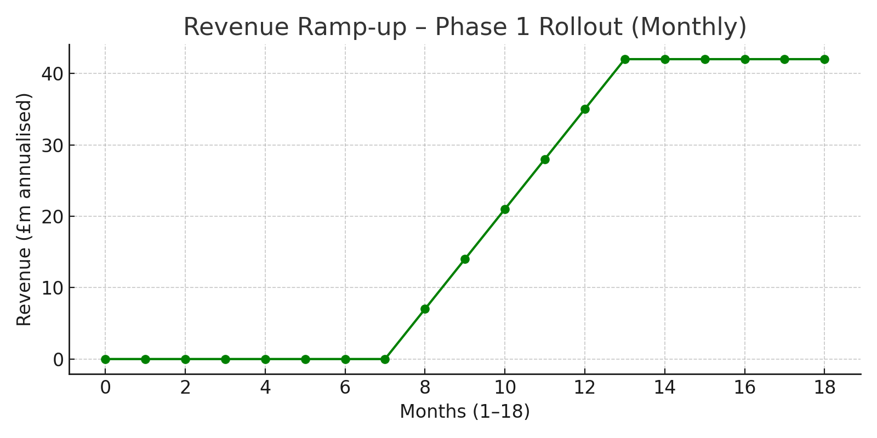
Revenue
PYROLYSISE LTD
Phase 1 revenue comes from the development of our WCP technology in industrial locations, processing third party supplied RDF feedstock and then selling power and by-products recovered from the process.
Phase 2 revenue derived from the deployment of our WCP technology to historic capped landfill locations where it will be used to remediate and regenerate land, releasing it for valuable development.
Many UK landfill sites are closed but remain active and a liability for decades post closure, requiring extensive management. Apart from energy recovery from landfill gas and resource extraction from in-situ mining, other benefits of landfill mining include land reclamation, thereby mitigating long-term management obligations.
Landfills contain valuable minerals, ferrous metals, copper, aluminium, palladium, tin, zinc, nickel, steel, glass, waste electrical and electronic equipment.
The recovery of rare earth elements (REE’s) and critical metals as well as recycled plastics, bioenergy offtakes are capable of revenues to meet excavation costs in part in the absence of gate fees. However, reclaiming redundant land for further development adds commercial value, compounding the case for undertaking landfill mining on a large scale.

Slide 17
Phase 2 financials: Industrial waste site
PYROLYSISE LTD
Plant revenues based on one 3 tonne per hour WCP plant on six sites to demonstrate sustainability
Waste feedstock sourced from local waste management companies under Supply Contracts
Gate Fees: £80 per tonne
Offtake contracts with agri-fertiliser companies for bio-char and Power Purchase Agreements
Electricity: £95 per MWh Biochar: £400 per tonne
Planned initial 6 sites and plant £32.8 million per annum 134,028 tonnes of RDF per annum
12 sites and plants per annum £65.6 million per annum 268.056 tonnes of RDF per annum
24 sites and plants per annum £131.2 million per annum 536,112 tonnes of RDF per annum
REVENUE | Jul-26 | Aug-26 | Sep-26 | Oct-26 | Nov-26 | Dec-26 | Jan-27 | Feb-27 | Mar-27 | Apr-27 | May-27 | Jun-27 | Jul-27
6 PLANT | 1 | 2 | 3 | 4 | 5 | 6
INCOMING WASTE | £148,900 | £298,000 | £447,000 | £596,000 | £745,000 | £894,000 | £894,000 | £894,000 | £894,000 | £894,000 | £894,000 | £894,000 | £894,000
EXPORTED POWER SALES | £106,000 | £212,000 | £318,000 | £424,000 | £530,000 | £636,000 | £636,000 | £636,000 | £636,000 | £636,000 | £636,000 | £636,000 | £636,000
BIO-CHAR SALES | £201,000 | £402,000 | £603,000 | £804,000 | £1,005,000 | £1,206,000 | £1,206,000 | £1,206,000 | £1,206,000 | £1,206,000 | £1,206,000 | £1,206,000 | £1,206,000
BIO_FUEL SALES* | £0 | £0 | £0 | £0 | £0 | £0 | £0 | £0 | £0 | £0 | £0 | £0
CARBON* CREDITS | £0 | £0 | £0 | £0 | £0 | £0 | £0 | £0 | £0 | £0 | £0 | £0
TOTAL REVENUE | £456,000 | £912,000 | £1,368,000 | £1,824,000 | £2,280,000 | £2,736,000 | £2,736,000 | £2,736,000 | £2,736,000 | £2,736,000 | £2,736,000 | £2,736,000 | £2,736,000
Cumulative Revenue | £456,000 | 1,368,000 | 2,276,000 | 4,560,000 | 6,840,000 | 6,840,000 | £9,576,000 | 12,312,000 | 15,048,000 | 7,784,000 | 20,520,000 | 23,560,000 | 25,992,000
* evolving market, assumed zero sales for the financial model

Slide 18
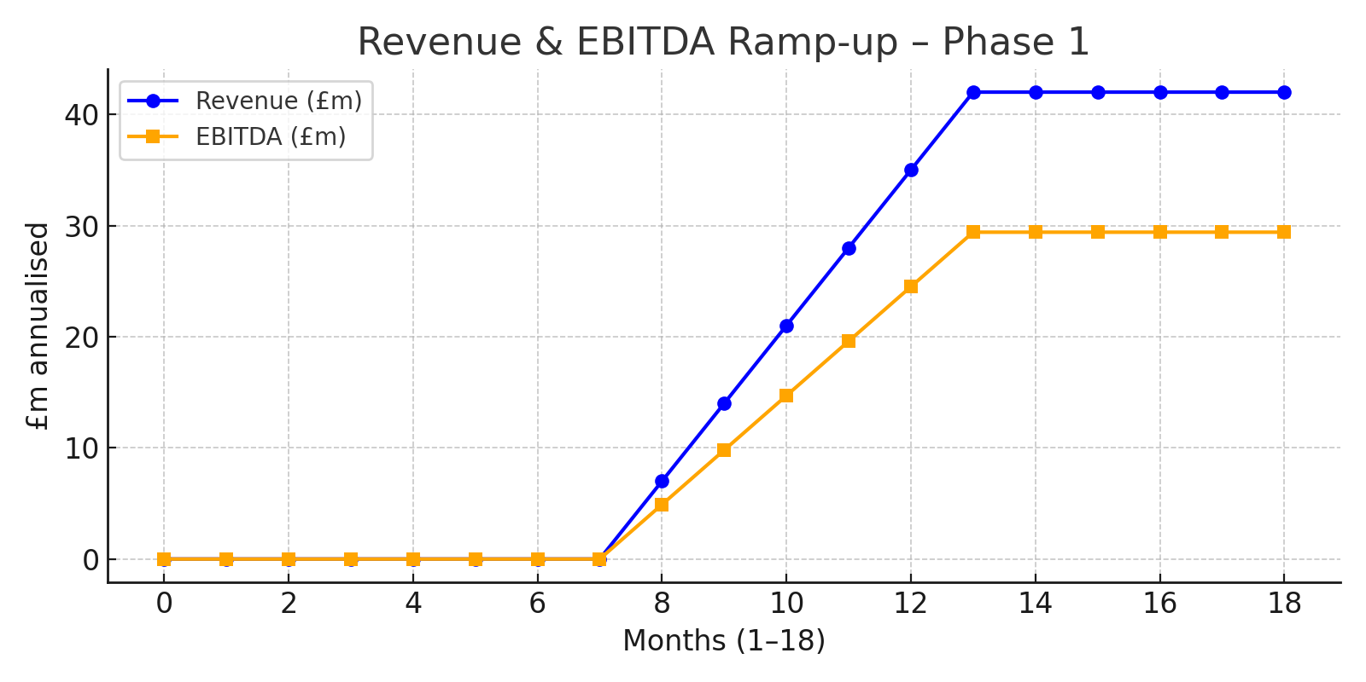
Phase 2 Investor Returns
PYROLYSISE LTD
IRR: 29–38%
Equity multiple: 2.8–3.5x
Payback: ~1.5 years
Why secure?
Contracted revenues
Proven technology (TRL 9 + 6 yrs)
Exclusive UK rights

Slide 19
Sensitivity Analysis (IRR & Returns)
Investor Returns (Summary)
6 plants online in 15 months → ~£37m–42m annualised revenue
EBITDA margin >70% across all scenarios
Payback period ≈ 1.3 years
IRR range 24%–42%
Strong downside protection with significant upside potential

Slide 20
Expansion Path (Scale Beyond 6 Sites)
Validated Case (27% yield)
6 sites → ~£42m/year revenue
12 sites → ~£84m/year revenue
24 sites → ~£168m/year revenue
Conservative Case (20% yield)
6 sites → ~£35m/year revenue
12 sites → ~£70m/year revenue
24 sites → ~£140m/year revenue
Key Point
Modular, repeatable rollout enables rapid
national and international scaling
Revenue Resilience
20% yield case: ~£5.8m/plant/year → ~£35m for 6 sites
27% yield case: ~£7.0m/plant/year → ~£42m for 6 sites
IRR Scenarios
Downside: ~24%
Base case: >35%
Upside: ~42%
Key Point
Portfolio economics remain robust under conservative assumptions

Slide 21
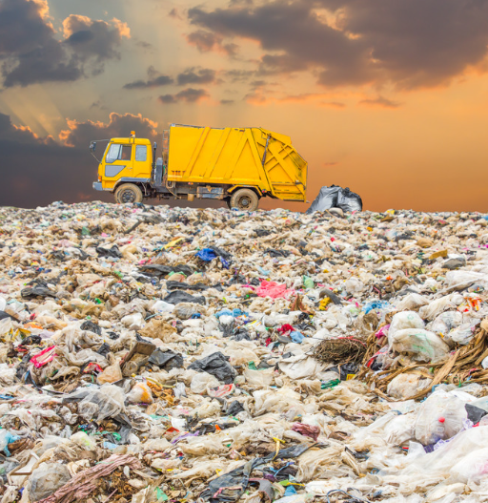
Phase 3: capped landfill site
PYROLYSISE LTD
The application of the WCP Technology presents a huge opportunity to mine legacy/problematic landfills.
Bringing on early-stage development partners to realise the value of recycled land, with prospective uses being renewable energy parks, housing, commercial or mixed use regeneration.
The Greenmine model will allow land to be acquired cheaply, with significant land value appreciation.
In addition to land value appreciation offtake revenues include, Biochar, Biofuel, Electricity from Bio coal, carbon credits.
Recovery of recyclable materials and long-term participation in revenue generation from recycled sites.
Recycled metals examples, ferrous metals, steels, glass, Aluminium, Palladium, Nickel , Copper , Aluminium, Zinc, Tin, electrical and electronic equipment.

Slide 22
Partnerships & Support Network
PYROLYSISE LTD
Pyrolysise Experienced multi-skilled team supported by
Stopford’s Engineering: independent validation, planning & permitting.
Manufacturing partners: EPC providers, proven technology.
Legal & Advisory: institutional funding, compliance, gov’t relations.
Developers: landfill reclamation & land banking.
Business Structure & Value Creation
Two layers of value:
Project cashflows (feedstock & offtakes).
Enterprise value (multi-site expansion, landfill reclamation).
Exclusive rights secure platform scalability.

Slide 23
Funding Strategy
PYROLYSISE LTD
Stage 1: Bridge round £500k (waste management business, LOI, dd and industrial waste sites, permitting, manufacturing scope of work).
Stage 2: LOI for asset acquisition c. £40 million
Stage 3: Structured debt facility for build-out of industrial waste sites
Investor protections:
Staged funding limits early risk.
Assets & feedstock and offtake contracts collateralize later funding

Slide 24
Pyrolysise – Investment Positioning
Core Proposition
• Validated high-margin model: ~£7.0m revenue / >70% EBITDA per plant
• Proven technology:
TRL 9, EU-certified, 8,400+ hours,
Plant operational c 6 years Stopford validated
Strengths & Opportunities
• Market-leading margins & diversified revenues (RDF, electricity, biochar, fuels, medical waste)
• ESG-aligned: landfill reclamation, carbon-negative biochar, GHG reduction
• Upside drivers: carbon credits, medical waste premiums, UK landfill-to-housing redevelopment
Risks & Mitigations
• Funding reliance: £500k bridge + £15m convertible debt – active discussions underway
• Execution capacity: rollout of 6 plants in 19 months – modular, repeatable model
• External threats: permitting delays, commodity volatility,
Investor Takeaway
• High-margin, ESG-driven disruptor at validated scale point
• Robust IRR (24–42%) with ~1.3 year payback
• Clear asymmetric investment: innovation upside + asset-backed stability

Slide 25
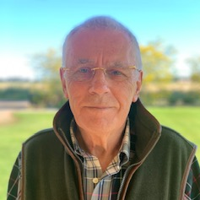
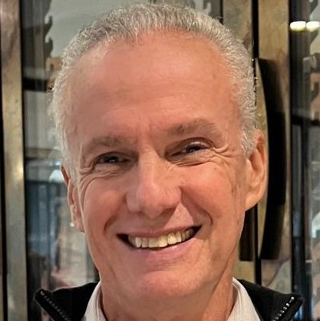
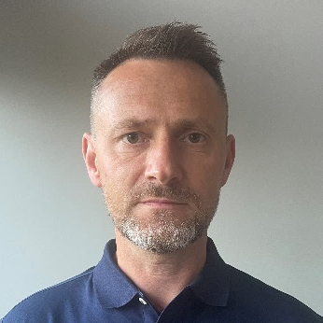
Management Team
PYROLYSISE LTD
JOHN BELL
Managing Director
A seasoned entrepreneur who previously built a unique world first global project management and well engineering company to the oil and gas industry, with contract values to £2bn plus. Chairman and major shareholder of a listed oil and gas company. Proven skills in leadership, project management and contractual negotiations, procurement and logistics, John is very committed to this environmental project and has invested £1.5m in the business so far.
OSANAN BARROS
Director
A highly accomplished professional with extensive experience in international markets and a comprehensive understanding of dealing with diverse economic and cultural environments. Osanan's background is Management, Risk Management and Finance and his expertise extends to consulting services in the energy, commodities, and mining sectors.
CHRIS FARMER
Project Manager
A qualified Chartered Surveyor, specialising in minerals, waste and environmental management. Chris has worked in the mineral extraction and waste management sectors for 25 years, involved in a wide range of disciplines including quarry and landfill site development. Since 2011, Chris has run his own waste brokerage and consultancy business, achieving sales over £40M.

Slide 26

Independent validation
PYROLYSISE LTD
GreenMine engaged Stopford Engineering under a EPCM contract
Validate equipment certification HSE and structural compliance
Industrial waste site due diligence, planning application and environmental permitting
Plant technical due diligence and validation of Brazilian, EU certification
Issue CE Marking standards in scope of work for UK compliance
Witness plant manufacturing construction, UK commissioning
Sourcing and procurement of UK equipment
Monitoring emissions and equipment performance after commissioning
Develop HS&E management systems
Validate Operations and Maintenance systems

Slide 27
Disclaimer
PYROLYSISE LTD
Confidentiality
The Pitch has been prepared exclusively by the Company. It is being provided to a limited number of persons, each of whom is considered to be a legitimate recipient, solely as a guide for the purpose of giving background information to enable recipients to assess whether they wish to place an order to subscribe for shares in the Company.
The information and opinions contained within the Pitch are strictly confidential and are being made available only to parties who agree to keep them confidential. Neither the Pitch nor any part of it may be copied, published, disclosed, reproduced or distributed to any person at any time without the prior written consent of the Company, and shall not be used for any purpose other than in connection with the proposed investment in the Company.
By accepting the Pitch, you are deemed to undertake and warrant to the Company that you will keep it confidential. You agree to indemnify the Company against any losses incurred by the Company as a result of any unauthorised disclosure, and to return on demand, the Pitch and any related documents or information to the Company.
Enterprise Investment Scheme (EIS)
No representation or warranty is given as to the availability of EIS relief/reliefs. Since the requirements to fall within the EIS must be monitored all the time it is possible that if the requirements are met today, they might not be tomorrow. The management believe the company qualifies today (earlier investors have received EIS certificates) and will use all reasonable endeavours to ensure the company qualifies in the future for the three years necessary for EIS investors to attain and sustain their EIS reliefs, but this cannot be guaranteed. Investors should be aware that tax treatment may vary.
Section 21 Disclaimer and Waiver
The content of this Information Memorandum by Pyrolysise Ltd (the Company) and the documents, comments and information contained within it (together the Pitch) are the responsibility of the Company. Investment in the Company may expose the individual concerned to a significant risk of losing all the money or other assets invested.
Exemption
The Pitch is exempt from the general restriction (in section 21 of the Act) on the communication of invitations or inducements to engage in investment activity on the grounds that it is made to persons who are exempt from the general restriction, by virtue of Articles 43, 48 or 50A of the Financial Services and Markets Act 2000 (Financial Promotion) Order 2005, or who are otherwise exempt. Any recipient of the Pitch who does not qualify under the terms of the above exemptions must not view the Pitch, must return the Pitch documents to the Company immediately and should not read or act upon any of the information contained within it.
The Pitch does not constitute an offer of or an invitation to subscribe for securities to the public that would otherwise be required to comply with the Prospectus Regulations 2005. No public offer in any jurisdiction is being made by the Pitch. The Pitch is primarily intended for release in the United Kingdom and does not constitute an offer, or the solicitation of an offer, in relation to shares in any jurisdiction in which such offer or solicitation is unlawful.

Slide 28

SHARE ISSUE DETAILS
COMPANY
Pyrolysise Ltd
COMPANY STRUCTURE
Limited Company
SECTOR
Environmental/Clean Tech/Waste
Recycling/Land Reclamation
INVESTMENT DOMICILE
United Kingdom
SECURITY
Equity
CLASS OF SHARES
Ordinary Full Voting Shares
VALUE OF PREVIOUS FUNDRAISE
2022/23
Pre-seed round: £500k
EXIT
The company anticipates listing in Year 4
For more information, please register your interest and visit www.greenmine.world or email investment@pyrolysise.com
GreenMine is the trading name of Pyrolysise Ltd, a company registered in the United Kingdom under Company Number 14161810

