Slide 1
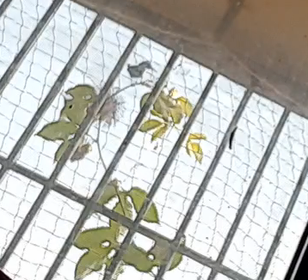
Humming-Like Bird Feeding on Leaf-Nectarics & not the Passiflora species Flower

Slide 2
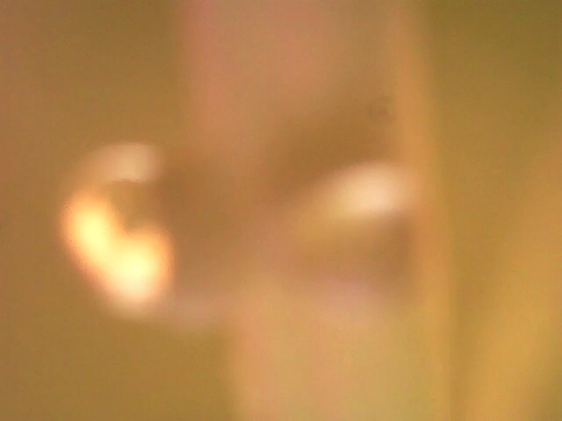
Leaf stalk Nectarics with the Viscous Nectar-Like Secretion

