Slide 1
Personal Expansion
Benefits of joining a professional organization
Nadine K. Thola * Liberty University EDU630
Image Origin
Notes:
Personal Expansion: The benefits of joining a professional organization. Presentation is made by Nadine K. Thola. I am a student at the Liberty University EDU630 class, and this is my Professional Development Presentation Assignment.
I will discuss why teachers should join professional organizations, review the ISTE group, examine four resources, and summarize the ISTE EdTech Conference.

Slide 2
Reviewing
International Society for Technology in Education (ISTE)
Benefits of joining ISTE
Membership
Certification
ISTE U- online courses
EdSurge
Publications
Educator advantages:
Relevant, reliable,
and accessible resources
Growth in learning, sharing, and networking ideas
Image Origin
(International Society for Technology in Education (ISTE), 2023)
Notes:
Through this presentation, the main focus is to present the benefits of the International Society for Technology in Education (ISTE). This organizational network transforms learning and teaching for all educators including teachers, administrators, librarians, coaches, students, and computer science personnel (the International Society for Technology in Education (ISTE), 2023). Benefits from their online services provide professional learning, a global network, innovation and transformation of digital knowledge for problem-solving at all interest levels.
For any interested professional, they need to have relevant, reliable, and accessible resources, and be able to grow in educational technological (EdTech) teaching. The ISTE organization provides many learning, sharing, and networking formats in current EdTech for educators.
The variety of EdTech topics would help me be a better teacher. I believe in STEAM and the interdisciplinary ways to use art in all subjects. ISTE supports me as an art, technology, and STEAM educator.
ISTE’s website breaks their advantageous services into 5 educational categories. Detailed examples of some areas will be shown in the coming slides.
Members have basic and premium levels for access to a wealth of resources and opportunities. They can reach global communities, build skills and reach their technological teaching objectives. Members get publication discounts and exclusive event opportunities.
The certification program is an internationally recognized pedagogical study for an educator or specialist. This 14 week program strengthens their technology and leadership skills.
ISTE U is a professional development course available in individual or instructor paced to develop digital educational skills.
EdSurge is the materials service that provides the information on news, research, podcasts, events, a Jobs Board, Product Index, Guides, and Advertising.
Publications are specifically written and sold for the ISTE EdTech.

Slide 3
ISTE Blog- Familiar Tools Offer New Tricks
for K-12 Educators
Image Origin
Teacher learning expectation
Possibly unused features
Resource: teachers serve students
Productive uses of common formats
Who benefits most
Students without devices or have
low-bandwidth
Struggling readers
Collaboration and participation for all
Image Origin
Supporting teachers using Educational Technology (EdTech) for learning
Tips and Tricks on common formats
Image Origin
(Snelling, 2022, January 10)
Notes:
EdSurge provides relevant podcasts, articles and blogs. These next four slides I will be presenting information that would help me as an instructor.
I am always interested in the new formats and their uses. By talking with other teachers, I gain insights to the EdTech used and how ISTE apply it to art and STEAM. This article gives tips and tricks for the most popular programs used.
A teacher can learn new support features to familiar formats they use with the students. The blog gives educators and students tools that make for effective learning and usage.
Familiar Tools Offer New Tricks for K-12 Educators, (Snelling, 2022) increases productive ways on commonly used resource sites. These include Flipgrid, Kahoot, Microsoft’s Immersive Reader, and a few more. The more the teacher and students can effectively use software, the more efficient learning becomes.
All teachers and students benefit from effective operation of common programs. Some programs help students without devices or low-bandwidth at home. Other sites help struggling readers. While a combination of other programs help with discussion, collaboration, and demonstrations for all.

Slide 4
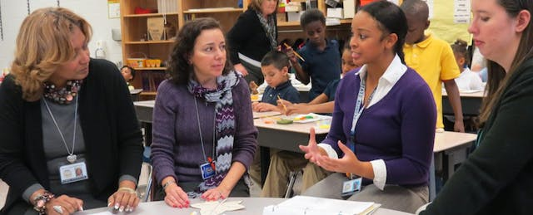
ISTE News- For Teachers, a STEAM Workshop Where Arts are Key
Image Origin
Image Origin
Teacher learning expectations
CreatED series for educators’ workshops
Art integration, creative leadership
Use core study concepts visually
Extend for the whole school
Resource: teachers serve students
Learners think about technology with a hands-on approach
Who benefits most
All students and teachers think visually
Tactile ideas and visual communications
STEAM interdisciplinary interactions
Hands-on lesson where arts important
Image Origin
(Noonoo, 2018, September 13)
Notes:
In this EdSurge News article, For Teachers, a STEAM Workshop Where the Arts are Key (Noonoo, 2018), STEAM workshops provide interdisciplinary interactions with hands-on lessons where arts are important.
I look for ways to include art in everything and hope to help colleagues look for more ways to use art in interdisciplinary ways.
Teachers’ expectation is to be comfortable and want to be trained with STEAM. CreatED series is a program workshop directed at educators. During their sessions, art integration, creative leadership, and visual teaching of core concepts such as Math or Science. In the workshop, Crayola presents a way for core concepts and activities to include STEAM for the whole school.
With this workshop, teachers benefit from STEAM ideas and learn how to teach and think visually. By using tactile ideas and visual communication, the teacher provides a relevant way for learners to gain understanding. In addition, all students can benefit from hands-on activities through participating engagement.

Slide 5
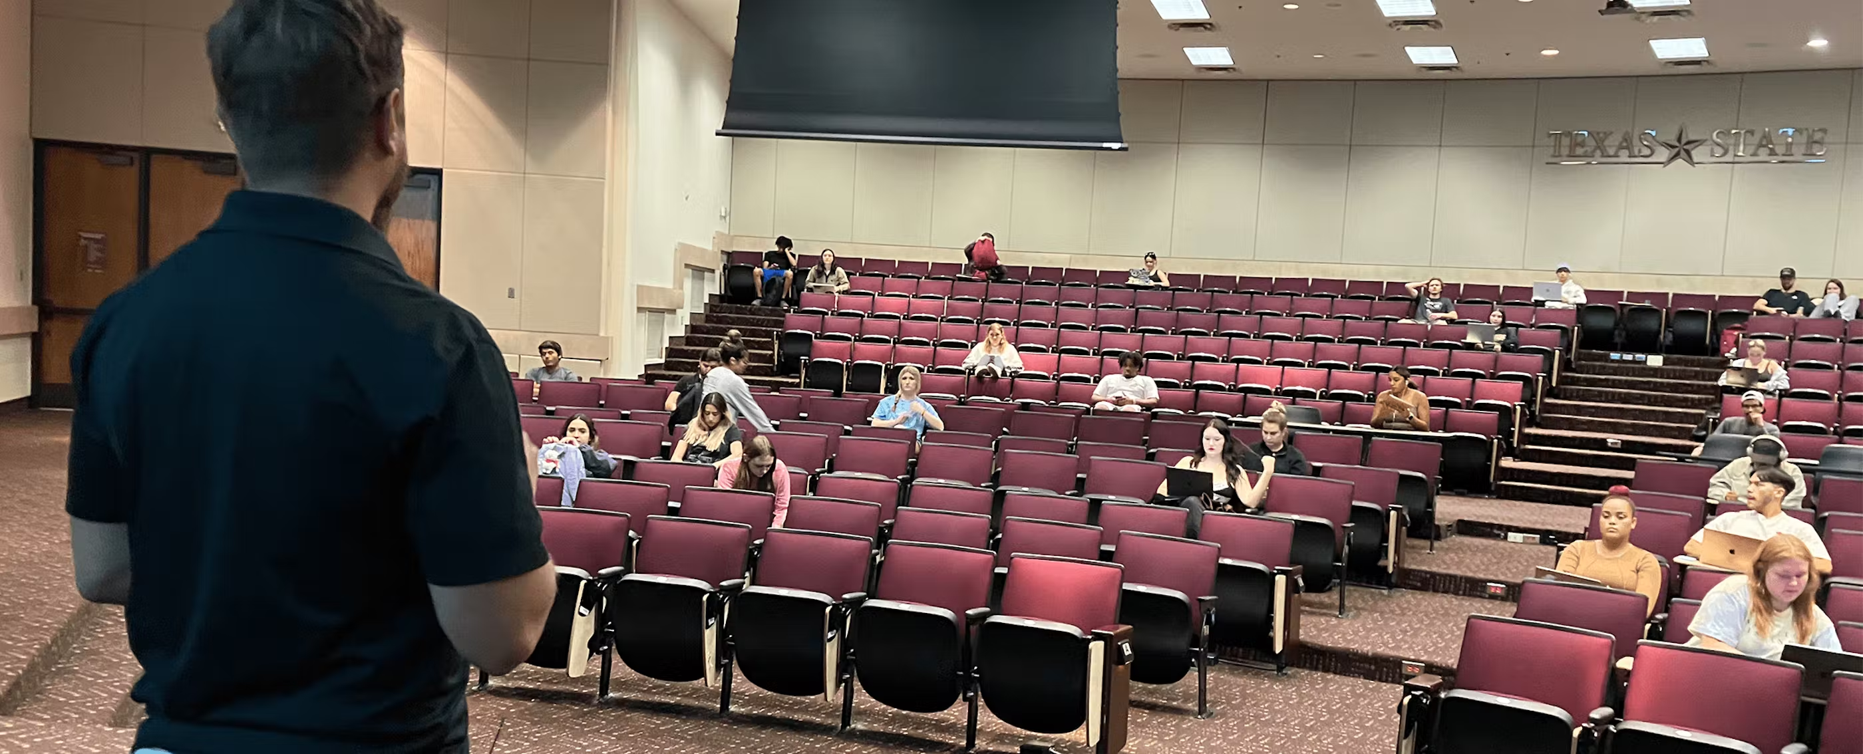
ISTE podcast and news- Hoping to Regain Attention of Students, Professors Pay More Attention to Them
Image Origin
Image Origin
Teacher learning expectations
More relevant and relating information
Methods to hold students attention and engagement
Resource: teachers serve students
Personal interactions (names)/Relationship
Social contract
Who benefits most
Attention two-way
Rewards: online & in-person
Length of demonstrations and lectures too long to sit
Regain focus
Distracted with notifications
Image Origin
(Young, 2023, January 31)
Notes:
This EdSerge podcast, Hoping to Regain Attention of Students, Professors Pay More Attention to Them (Young, 2023, January 31), with written highlights of the attention problem I need help with continuously. Students are constantly distracted, whether not connecting with demonstrations or lectures, have ADHD, or are flustered by their phones or others.
Some point given during the lecture was to keep informational presentations short. Physical movement can regain focus. The phone are to be turned off as it could be distracting with notifications and pings.
A teacher can gain methods for providing the most relevant and related information. The article gives educators suggestions for holding, attaining, and engaging student attention.
Students want to be recognized by their instructors, This resource encourages teachers to have a professional relationship with them. An example is for the instructor to learn all the students' names. Another benefit that motivates learners is being co-responsible for learning. A contract or lecture order suggestions can empower the pupils and make the educator’s interaction flexible.
All benefit from personal contact and a two-way relationship. Both the teacher and the student must interact and be respectful. Just as a video game gives rewards, a teacher can give prizes too.

Slide 6
ISTE: ADHD Blog- Want Students to Learn? Help Them get More Sleep and Exercise
Image Origin
Image Origin
Teacher learning expectations
Helping students’ short attention spans
Resource: teachers serve students
Memory consolidation, attention, brain growth, and sleep
Who benefits most
Children need breaks for healthy minds and bodies
ADHD and short attention students
Digital citizenship and wellness
Image Origin
(Team ISTE, 2017, January 12)
Notes:
My classes taught me that kids like to move at any age. I let them have hands-on outdoor activities and stations to keep them engaged and give them different perspectives. Digital citizenship is not only being responsible for computer time but also the time off mobile devices.
Teachers need ways to develop the whole child. This article, Want Students to Learn? Help them get More Sleep and Exercise (Team ISTE, 2017), suggests ways to help short attention spans. Examples may be exercising or stretching, a break from looking at a screen, or being aware of blue-lighted devices.
Sleep and exercise heighten the learning process and promote brain growth. Teachers who give learners various ways to experience information give their learners a great gift. In addition, all students must have multiple active senses to keep alertness and concentration best.
Instructors can have elementary school-aged pupils have an exercise or wiggle break followed by a short rest session. Motion allows ADHD kids not to look different or keeps active learners engaged and ready for the next activity or instruction. At any age, blue light from mobile devices can cause insomnia, affecting the student's ability to learn. A short spurt of energy can give everyone an increased heartbeat and a better outlet for a healthier lifestyle.

Slide 7
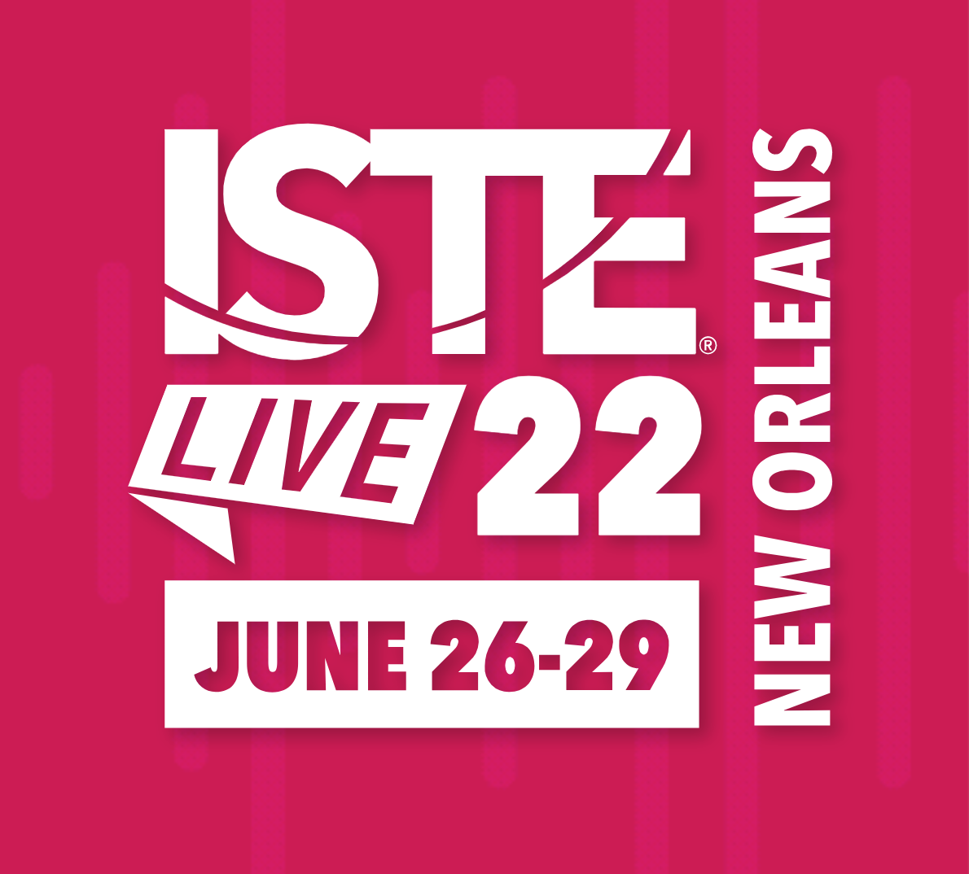
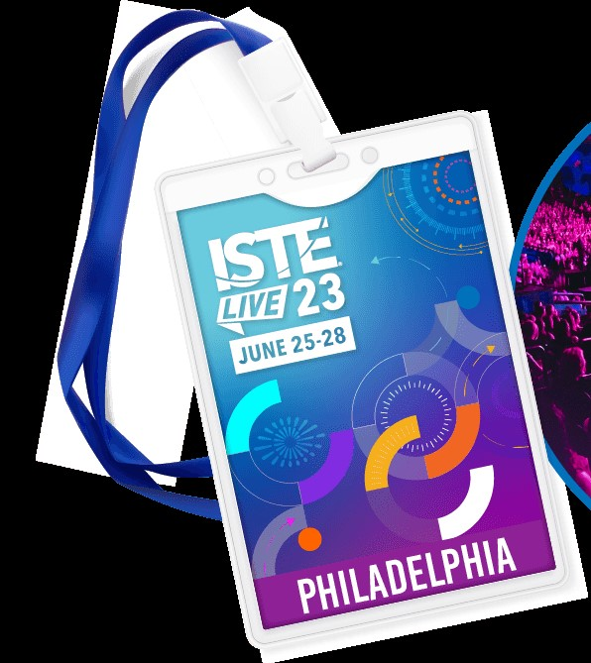
ISTE EdTech Conference
Exploration of technology , teaching and learning innovations
Four day hybrid event
Conference , events, and expo
Teachers, tech providers, researchers, and educational leaders globally
Virtual, live streaming interviews, and a gamified experience
EdTech Industry Network Summit
& Leader Exchange
Image Origin
Image Origin
(ISTE EdTech Conference, 2022; ISTE, 2022; 2022, June, 25-29; Poth, 2022, June 30)
Notes:
ISTELive22 (ISTE EdTech Conference, 2022) provided educators experiences during its four-day event (ISTE, 2022). At this experience, 868 in-person events and 143 virtually-presented forums created understandings and unique technology (2022, June 30) with 16,000 participants. Various formats offered 37 themes presented on Mainstage and panel discussions, EdTalks interviews, creation labs, interactive, playground, and posters periods, and research article reviews (Poth, 2022, July 14). Popular subjects were STEM, Equity, Virtual Reality, and Emerging Technologies. The event hosted the Leader Exchange and EdTech Industry Network Summit.

Slide 8
ISTE EdTech Conference 2022
Image Origin
Learn and Discover Copyright-Friendly Media
for Student Projects
Virtual
Creation lab – Online tools, apps & resources
Speakers: Melissa Henning; Darshell Silva
Copyright and digital citizenship
Media production tools
https://conference.iste.org/2022/program/search/
(2022, June, 25-29)
Notes:
This virtual presentation, Learn and Discover Copyright-Friendly Media for Student Projects (2022, June, 25-29), discussed using copyright-friendly images and audio and responsible online citizenship. The speakers demonstrated which tools to use, and the participants had time to create a project.
Copyright is important to me because I am an artist and work in the field. I want to promote responsible usage of images and audio in my demonstrations and for my students to learn correctly. Since I am not a member, I would have liked to see what tools they used to create the project and share their perceptions.

Slide 9
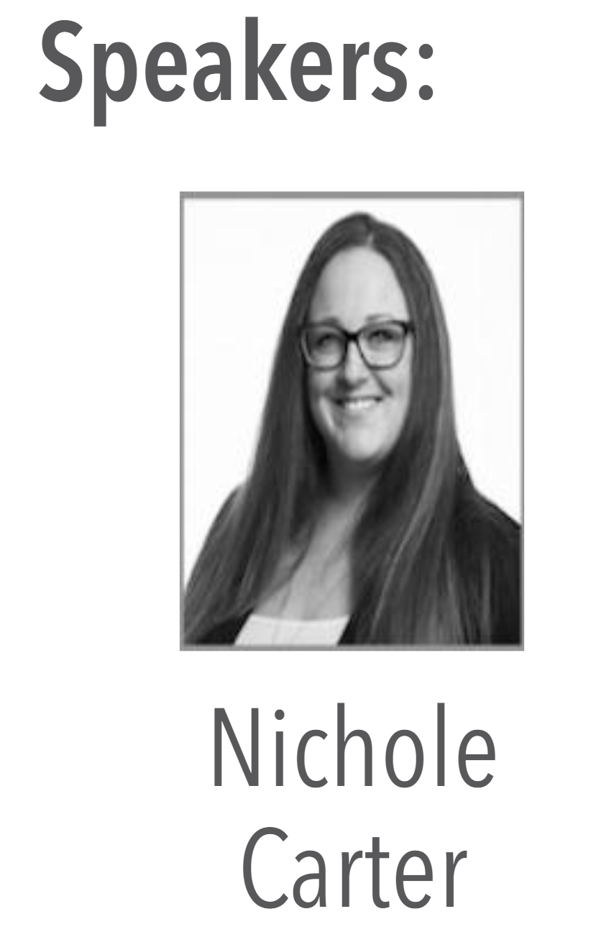
There Are No Mistakes, Just Happy Sketchnotes: Let's Bob Ross Our Learning
Virtual
Creation lab – Creativity & curation tools
Speakers: Nichole Carter
Sketchnotes
Multimodal
Hands-on
Pedagogy and brain science
https://conference.iste.org/2022/program/search/
(2022, June, 25-29)
Notes:
I love the concept that Bob Ross gave us. Art has No Mistakes! I teach adults and children alike that art is not perfect, just a way to create. I use this program, Sketchnotes, to help me design and think digitally. Sketchnotes is a way to implement STEAM. This app also gives me a place to store my ideas or notes so they do not get lost or misplaced.
In the article, There are No Mistakes, Just Happy Sketchnotes: Let’s Bob Ross Our Learning (2022, June, 25-29), this media is a way to learn visibly and another way of thinking. Nichole Carter explains brain science, pedagogy, and implementations with this resource.

Slide 10
Other Professional Art Organizations
(Benefits for art teachers )
The Miniature Painters,
Sculptors &Gravers
Society of Washington, D.C.
(MPSGS)
Image Origin
(The Washington Calligraphers Guild, 2023)
(MPSGS, n.d.)
Image Origin
Image Origin
(Creative Crafts Council, n.d.)
Image Origin
(Washington Woodworkers Guild, 2023)
Image Origin
Image Origin
(Torpedo Factory Art Center, 2023)
(Workhouse Arts Center, 2022)
Notes:
Throughout the presentation, the focus has been on ISTE, but as an art teacher, other professional art organizations also have importance to their art field, job, and gift. This slide presents why creative guilds add to teaching and each technology usage.
Collegiate and K-12 art teachers are encouraged to have memberships in local visual art chapters of their choice and promote their artwork in galleries and exhibitions to keep current in their fields. By being a working artist-teacher, more artistic technique and technology exposure translates into better student experiences.
An artist is encouraged to represent her mastered skills and understandings to their students. Art societies provide art teachers with honing their craft, new perspectives, cooperation, and sharing learned concepts and technology.
Here are some guilds and art centers in the area. This list is a tiny sampling of what is available in Washington, D.C., Maryland, and the northern Virginia area.
The Miniature Painters, Sculptors & Gravers Society of Washington, D.C. (MPSGS) (MPSGS, n.d.) promotes miniature art to the public and between artists. MPSGS sponsors an annual international exhibit (which is presented online and at the Strathmore Mansion) with awards, prizes, and scholarships presented. In addition, members’ websites and miniature painting supplies are also available on their site.
The Washington Calligraphers Guild (Washington Calligraphers Guild, 2023) is a nonprofit organization for U.S. and international lettering artists to non-calligrapher enthusiasts who appreciate lettering and the book arts. From beginners to professional scribes, the guild nourishes the history of lettering, calligraphy, and typeface design. Members can partake in online workshops, the Annual Postmark Envelope Contest, their Exhibit, Scripsit Publication, and Resources, and be on the list of Freelance Calligraphers for hire. The organization has a Zapf Scholarship Fund and a Facebook group.
The Washington Woodworkers Guild (Washington Woodworkers Guild, 2023) also serves Washington, D.C., Maryland, and Virginia. This club promotes online meetings with guest presentations, archived video demonstrations, a private Facebook group, hands-on workshops, and a woodworking tool evaluation. In addition, they exhibit in partnership with the Creative Council.
The Creative Craft Council (Creative Craft Council, n.d.) is a fine arts guild that hosts the Washington, D.C. area. This umbrella club organization is located in Arlington, VA, with CoOp gallery members run. The organization hosts an annual regional craft exhibit and promotes its sisters' guilds.
The Torpedo Factory (Torpedo Factory Art Center, 2023) and Workhouse Arts Centers (Workhouse Art Center, 2022) are historical buildings transformed into working cultural centers. Both hosts studios, galleries, exhibits, workshops, camps, and various art opportunities for their studio artists, associate members, and the public.

Slide 11
References
Creative Craft Council. (2023). https://www.creativecraftscouncil.org/
International Society for Technology in Education (ISTE). (2023). https://www.iste.org/
ISTE. (2022, June 30). More that 16,000 attend ISTELive22 virtually and in-person. [Press release]. https://www.iste.org/explore/press-releases/more-16000-attend-istelive22-virtually-and-person
ISTE EdTech Conference 2022. (2022). https://conference.iste.org/2022/program/search/detail_session.php?id=115651404
Noonoo, S. (2018, September 18). For teachers, STEAM workshop where arts ae key. ISTE. https://www.edsurge.com/news/2018-09-13-for-teachers-a-steam-workshop-where-arts-are-key

Slide 12
References
Poth, R. D. (2022, June 30). Seven takeaways from ISTE 2022. Getting Smart. https://www.gettingsmart.com/2022/07/14/seven-takeaways-from-iste-2022/
Snelling, J. (2022, January 10). Familiar tools offer new tricks for K-12 educators. ISTE. https://www.iste.org/explore/classroom/familiar-tools-offer-new-tricks-k-12-educators
Team ISTE. (2017, January 12). Want students to learn? Help them get more sleep and exercise. ISTE. https://www.iste.org/explore/Featured-videos/Want-students-to-learn%3F-Help-them-get-more-sleep-and-exercise
The Miniature Painters, Sculptors, & Gravers Society of Washington, D. C. (MPSGS). (n.d.). https://www.mpsgs.org/

Slide 13
References
The Washington Calligraphers Guild. (2023). https://www.calligraphersguild.org/
Torpedo Factory Art Center. (2023). https://torpedofactory.org/
(2022, June, 25-29). Program. (Conference). ISTELive202, New Orleans, LA. https://conference.iste.org/2022/program/search/
Washington Woodworkers Guild. (2023). https://washingtonwoodworkersguild.org/
Workhouse Arts Center. (2022). https://www.workhousearts.org/
Young, J.R. (2023, January 31). Hoping to regain attention of students, professors pay more attention to them. ISTE. https://www.edsurge.com/news/2023-01-31-hoping-to-regain-attention-of-students-professors-pay-more-attention-to-them

