Slide 1
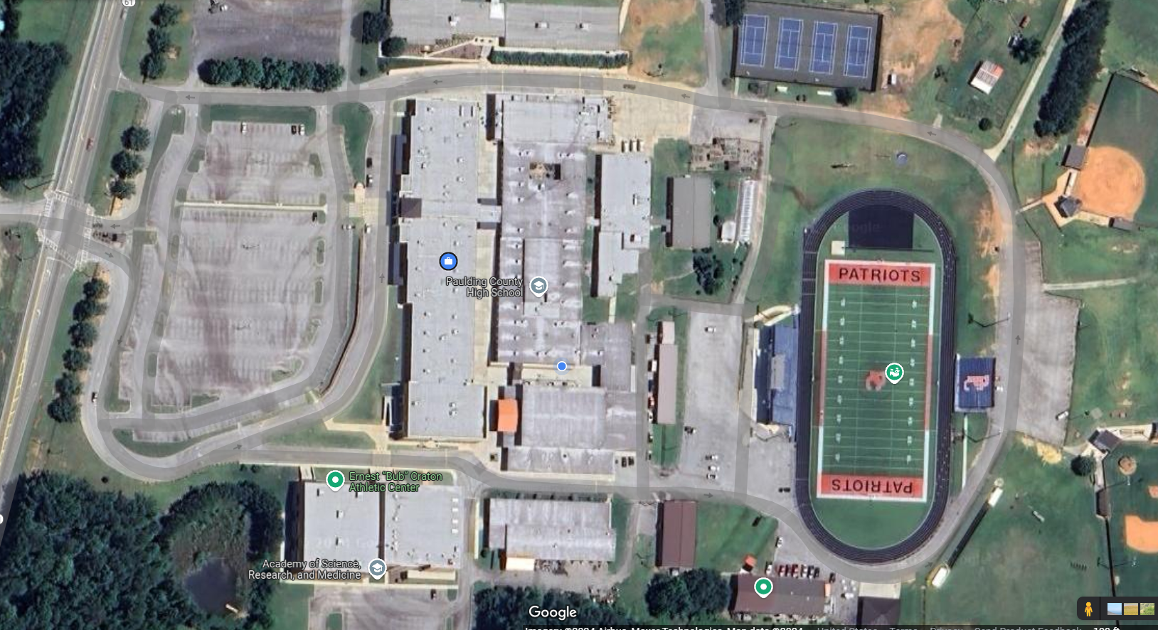
Overflow Parking
Buses
Color Guard
Buses
Trash
Tailgate
Buses
Ind & Dual Ex
Buses
Buses
Buses
Vehicle Parking
Tailgate
Armed Drill
Unarmed Drill
Tailgate
Bus Parking
JROTC
Buses
Trash
Tailgate
Buses
Concessions &
Restrooms

