Slide 1
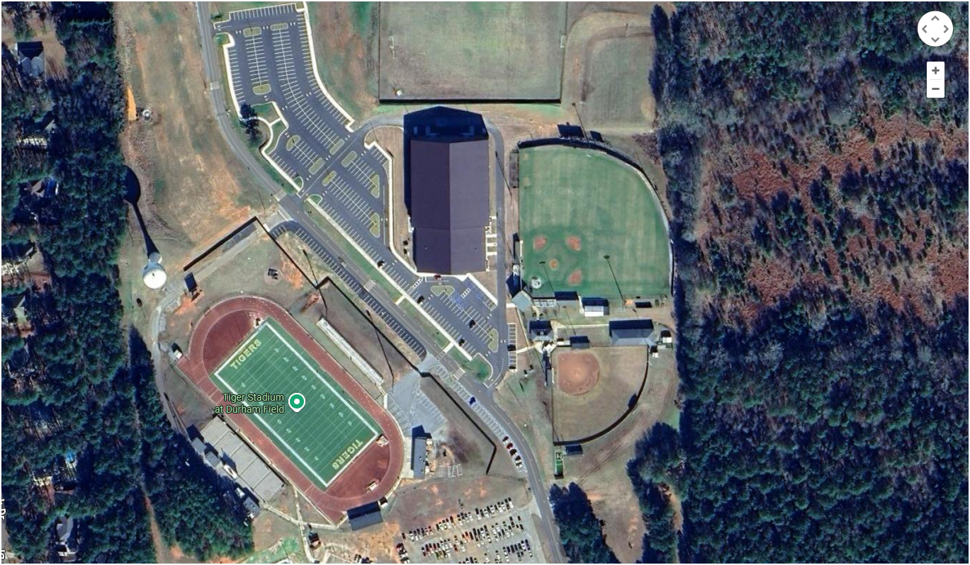
BUS / VEHICLE PARKING ENTIRE PARKING LOT
INDOOR FACILITY WHERE EVENT WILL BE HELD

