Slide 2
Introduction to Special Education

Slide 3
Special Education
“Specially designed instruction, at no cost to parents, to meet the unique needs of a child with a disability”
All children and youth with disabilities have the right to free appropriate public education
95% of students with disabilities are in regular schools
– 60% of these students are in general education classrooms
All educators need to be informed and involved in special education technologies

Slide 4
Issues and Challenges in Special Education

Slide 5
Policy Drivers of Technology Use
The Individuals with Disabilities Act (IDEA) – Federal law requiring IEP teams consider appropriate assistive technology devices and services for students with special needs
Universal Design for Learning (UDL) – Principles underlying technology that gives all individuals equal opportunities to learn through multiple means of representation, expression, and engagement
Web accessibility – Providing greater access to online information for all users

Slide 6
Challenges in Special Education Technology
Teacher knowledge of technologies for students with disabilities
Low emphasis on assistive technologies in teacher preparation
Student abandonment of assistive technologies
Inadequate technology training and support for students, families, and professionals

Slide 7
Foundations of Integration Strategies (1 of 2)
Assistive technology education referral – Made by IEP team ( individualized education program)
Assistive technology team
Assesses student for assistive technology
Facilitates implementation of AT
Classifications of AT Solutions
No-tech – Using one’s body in a different manner
Low-tech – Personal word lists, organizing systems
High-tech – Powered wheelchair, computers

Slide 8
Foundations of Integration Strategies (2 of 2)
Multiple means of representation (MMR) – Provides alternatives to textbook for acquiring information
Multiple means of expression (MMR) – Allows students various methods of demonstrating what they know
Mobile devices for students – Offers beneficial features such as touch screens, portability, apps, built-in AT
Selecting apps
Determine if app has effective instructional variables to meet students’ needs
Consider if app aligns with skills and standards to be taught

Slide 9
Technology Strategies for Students with Cognitive Disabilities (1 of 2)
Mild cognitive disabilities
Use productivity software, other resources
Software, apps, text-to-speech products develop reading skills
Voice recognition software and talking word processors assist with writing
Specialized calculators, graphing, and app support and develop math skills

Slide 10
Technology Strategies for Students with Cognitive Disabilities (2 of 2)
Moderate to severe disabilities
Software to teach important functional living skills (e.g., money and time management)
Video self-monitoring to increase functional activities
Alternative keyboards to simplify computer use

Slide 11
Technology Strategies for Students with Physical Disabilities
Assistive technologies
Power wheelchair operated by a joystick
Joysticks to control mouse
Switches to control and get input to computers

Slide 12
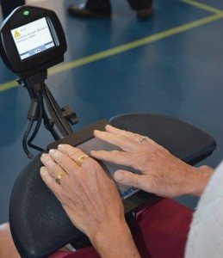
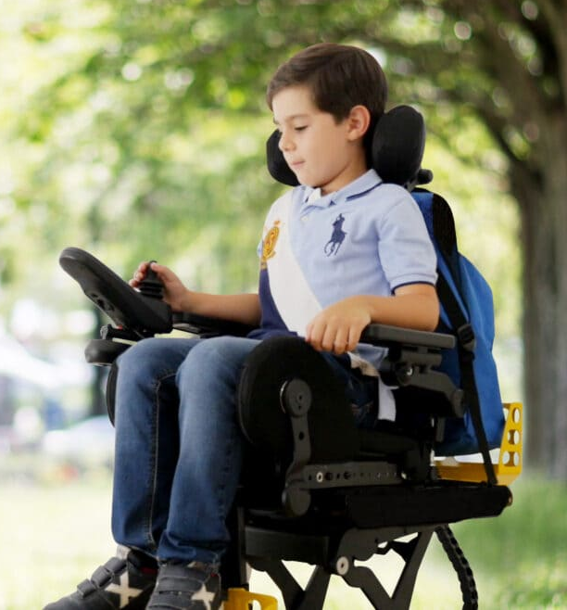
Power wheelchair

Slide 13
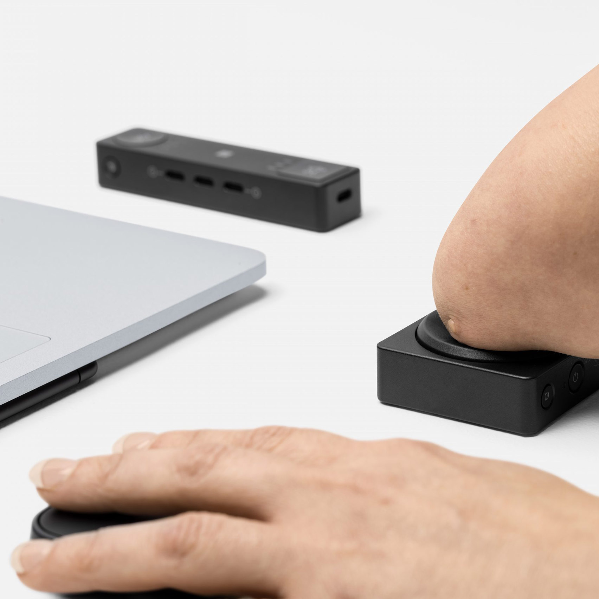
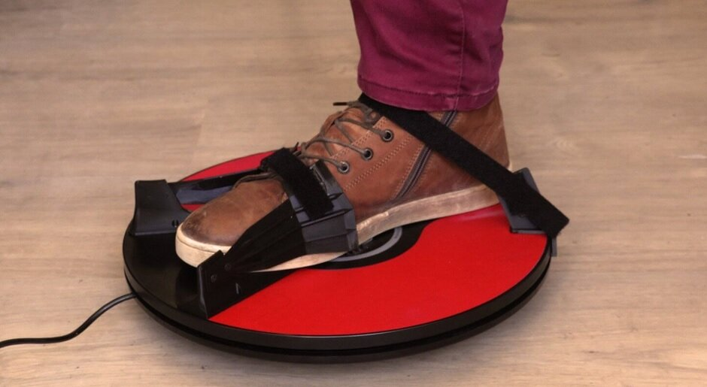
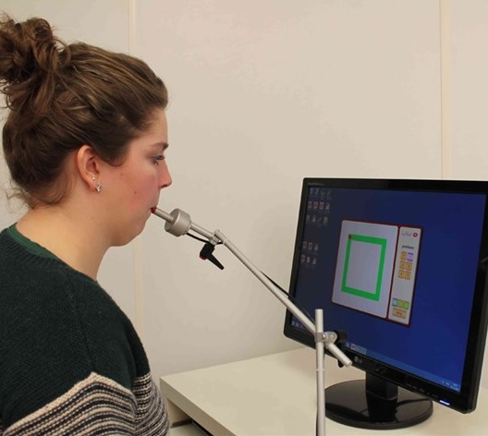
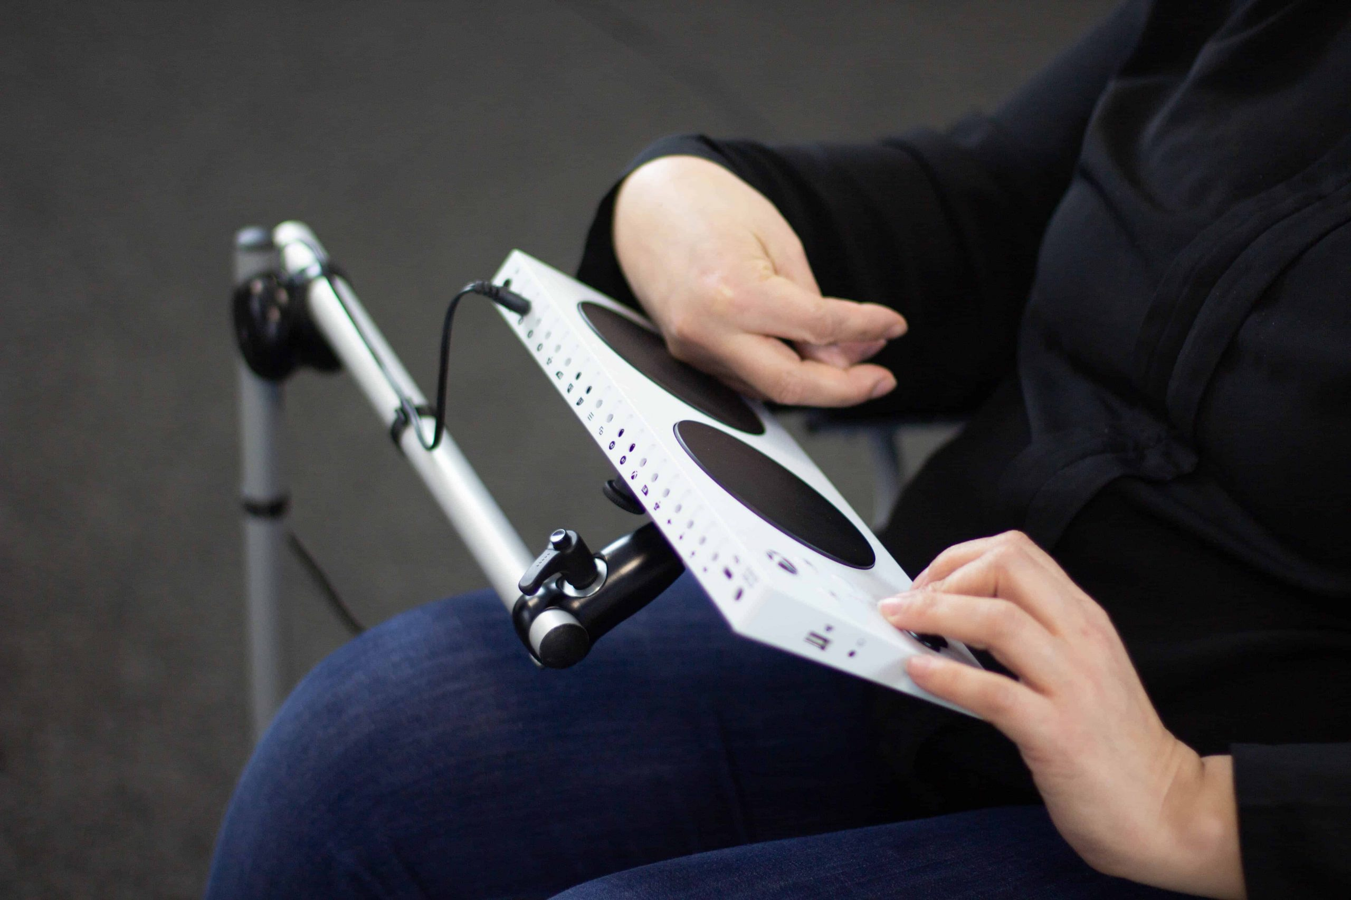
Joysticks to control mouse for disabilities

Slide 14
Technology Strategies for Students with Sensory Disabilities
Blind – Canes and sensory technology,, screen readers, Braille software and devices
Partially-sighted –screen magnification control panels
Deaf – Closed captioning, FM amplification, chatting technologies

Slide 15
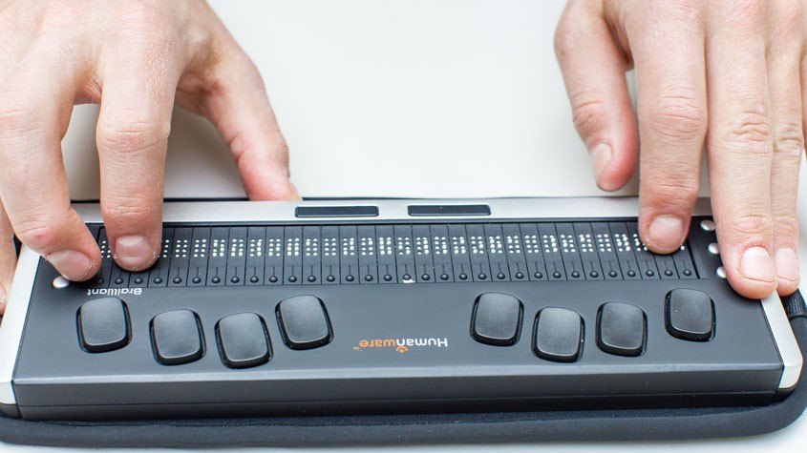
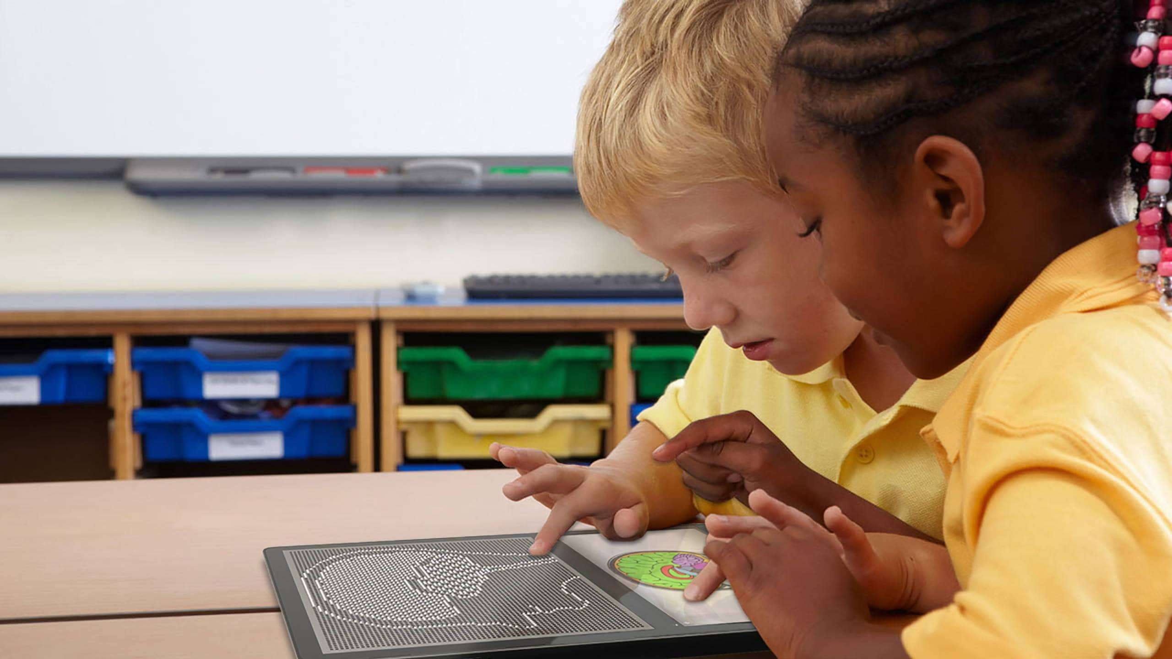
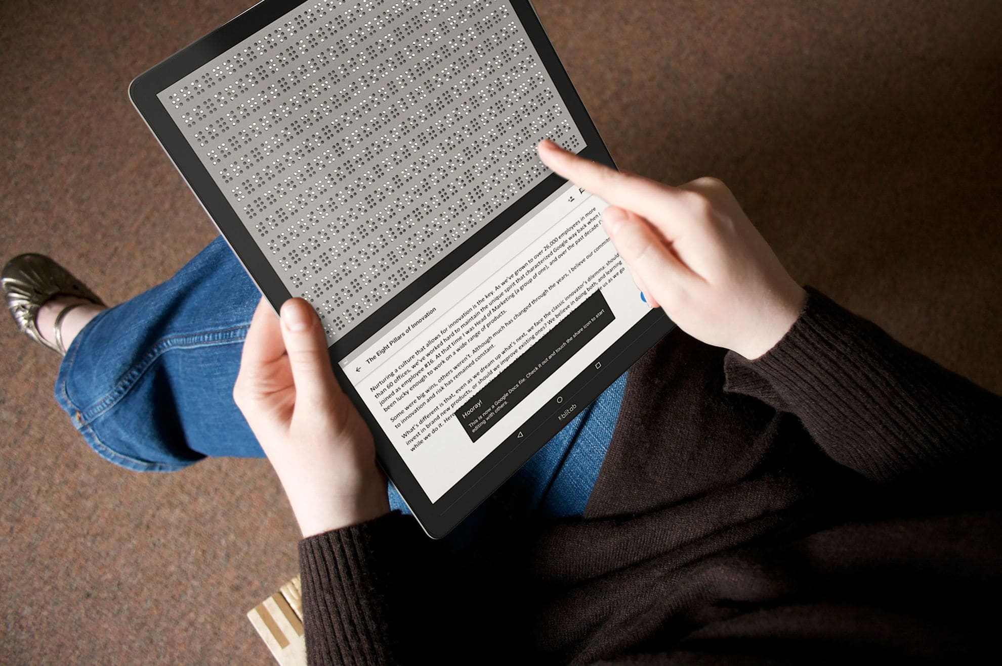

Slide 16
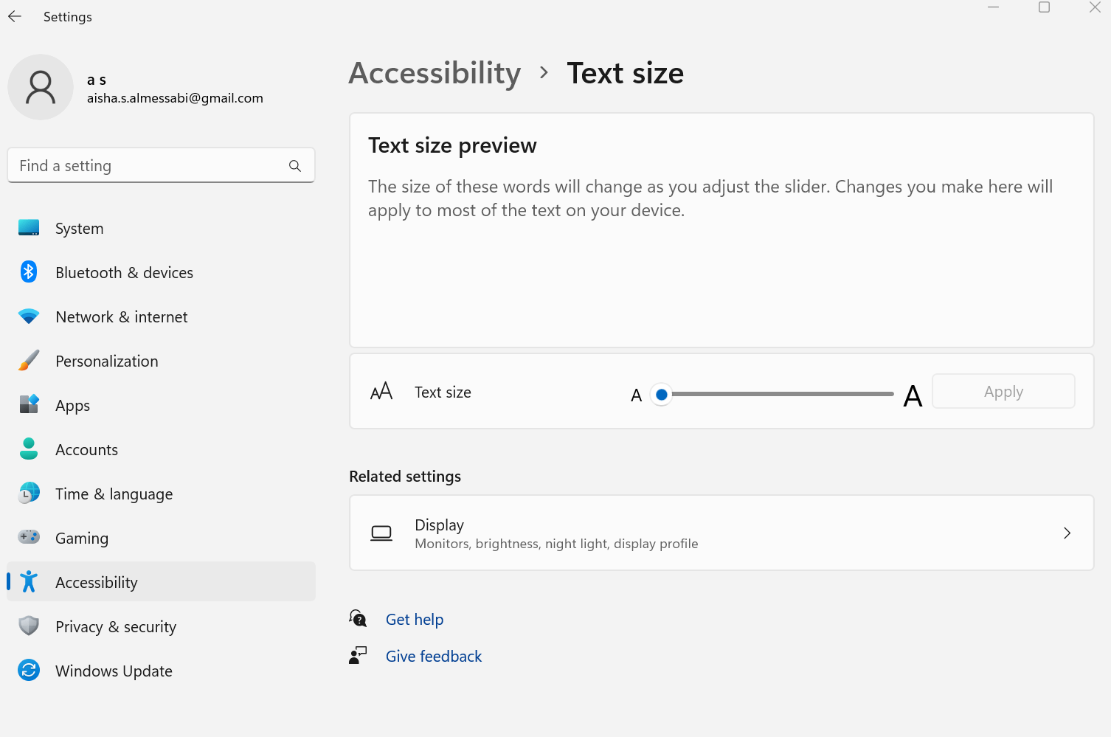
Text enlargement

Slide 17
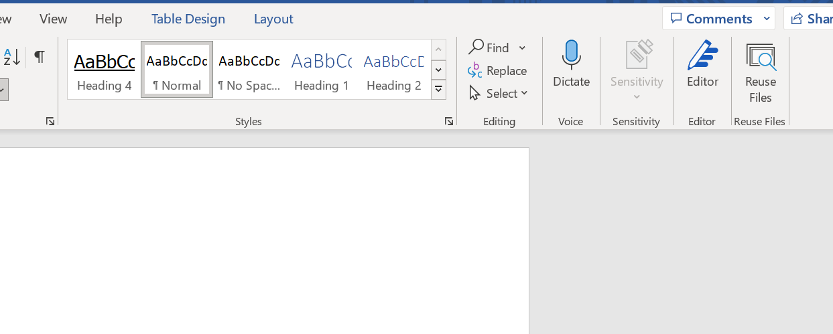
Text-to-speech

Slide 18
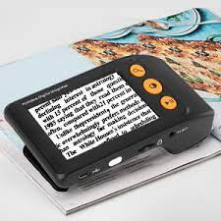
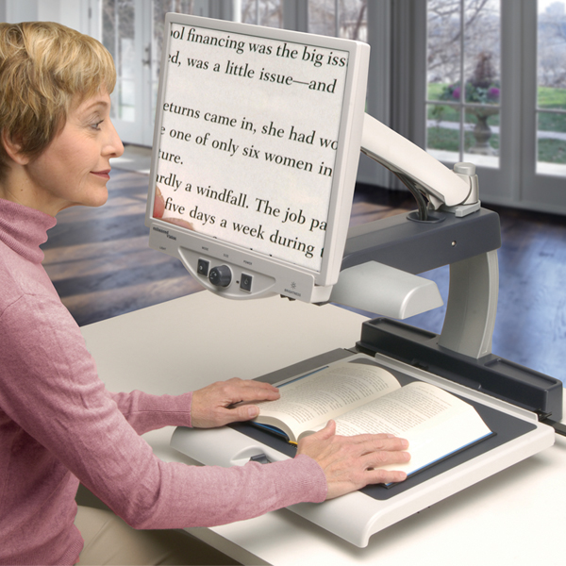
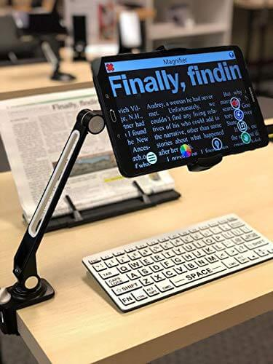
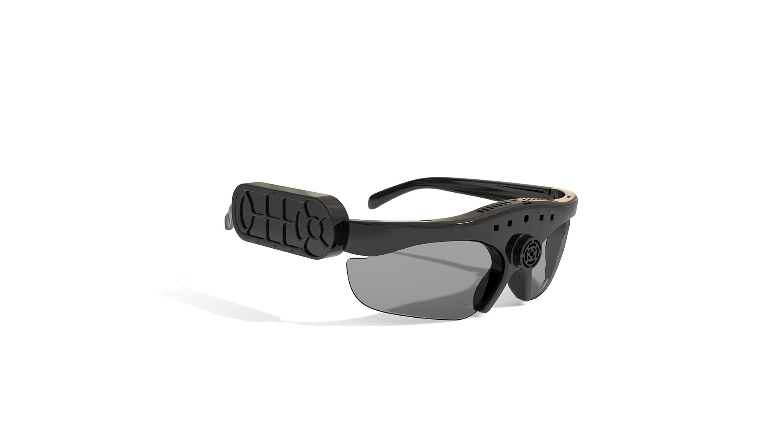
https://www.albayan.ae/health/life/2018-09-03-1.3348330

Slide 19
Technology Strategies for Students with Speech and Language Impairments
Augmentative and alternative communication (AAC devices)
Low-tech: eye gaze board, picture exchange communication book
Mid-tech: BIGmack or Go Talk NOW
High-tech: speech-generating devices activated with touch or switch

Slide 20
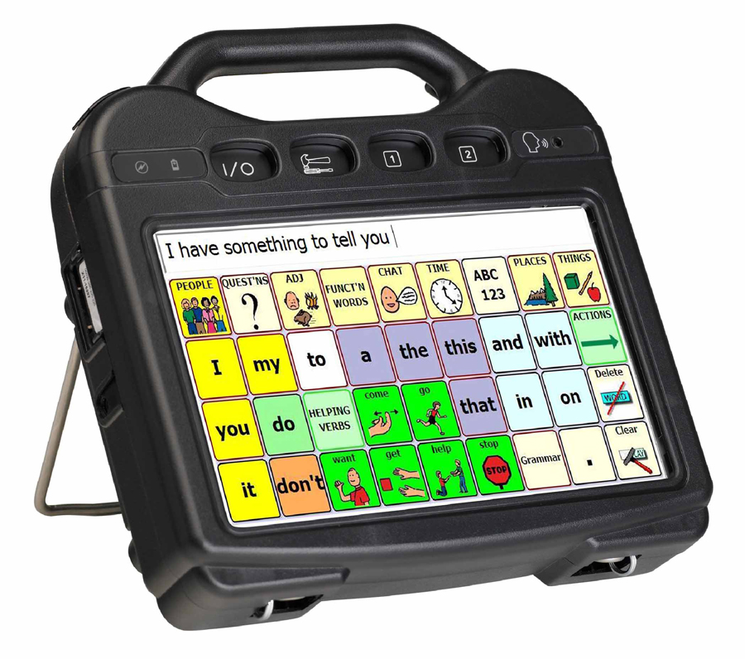
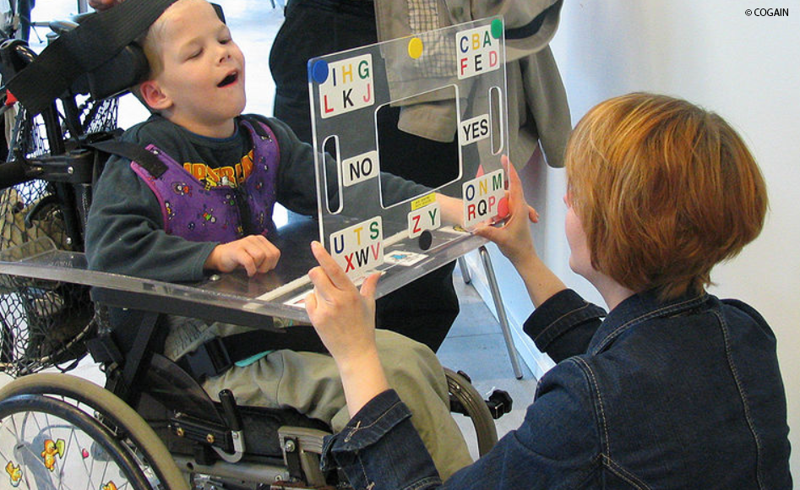
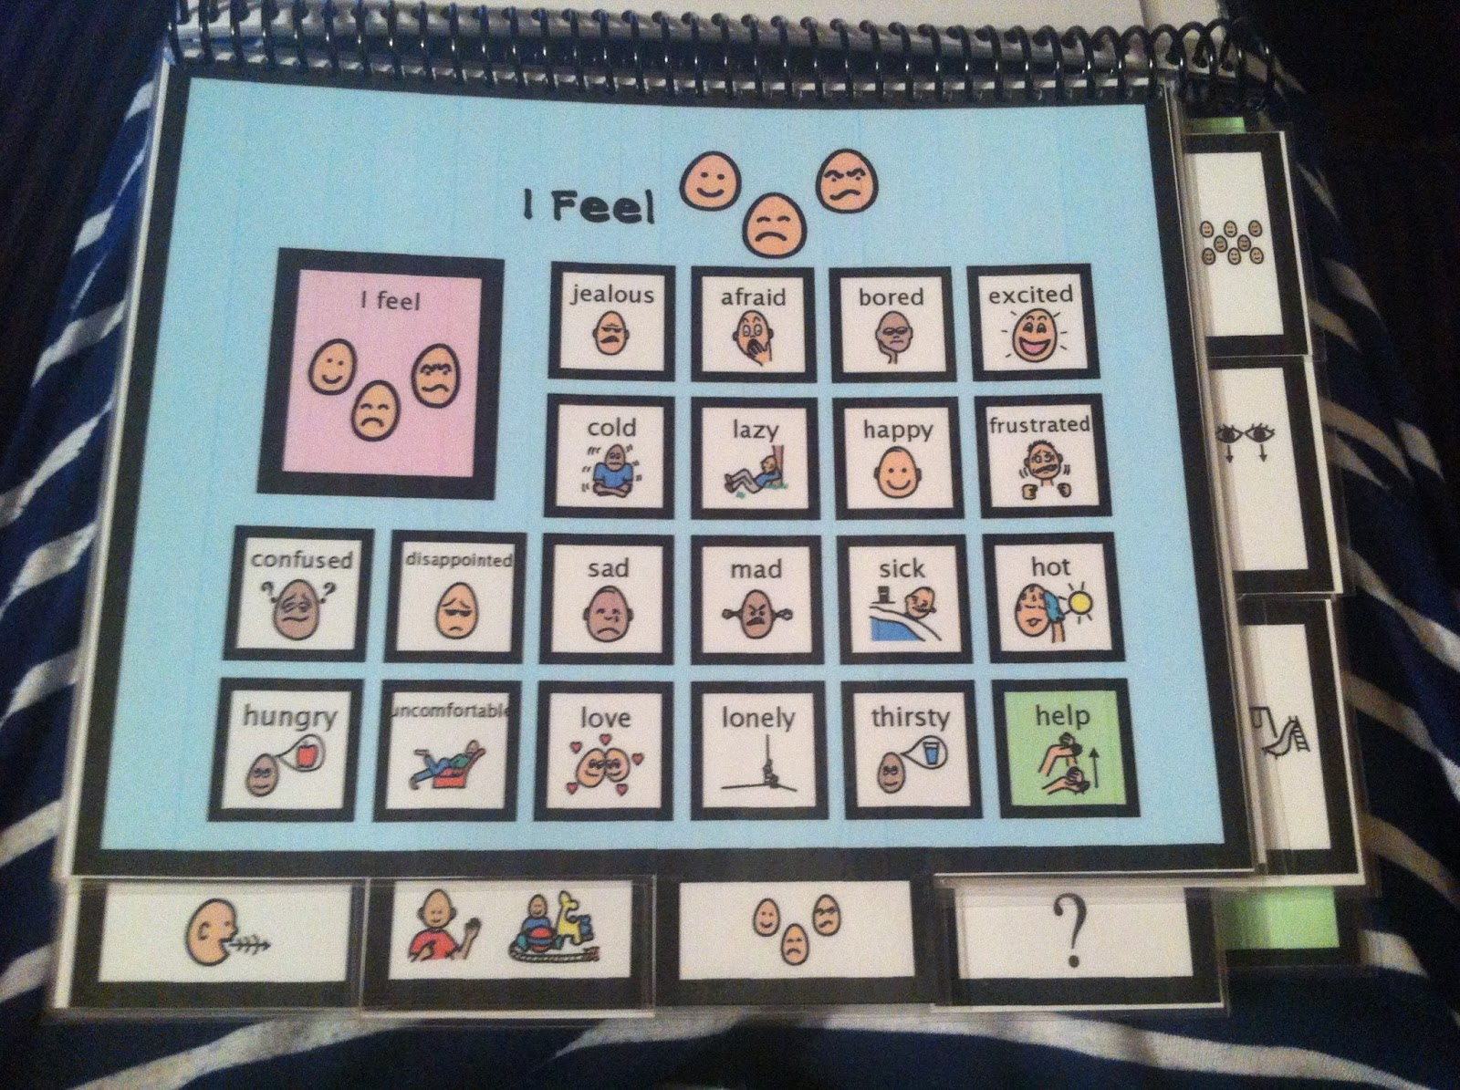
AAC device
eye gaze board, picture exchange communication book

Slide 21
Go Talk NOW

Slide 23
Technology Strategies for Students with Gifts and Talents (1 of 2)
Younger students like technology uses more than older ones
Boys write more, have better-quality writing with word processing
Computer-based games are effective at assessing the higher-level skills
Online courses offer access to advanced, elective courses

Slide 24
Technology Strategies for Students with Gifts and Talents (2 of 2)
Technology integration based on three kinds of strategies:
Enabling – Online learning opportunities enable access
Enhancing – Curriculum enrichment (e.g., online problem solving)
Transforming – Simulations, intelligent tutoring

Slide 25
Teacher Growth in Technology Integration for Students with Special Needs
Continue learning the issues, strategies, and resources for students with special needs
Become familiar with the array of resources available
Identify how to gain access to these resources
Keep updated on state and federal laws and policies
Join professional organizations
Monitor teacher growth using Rubric to Measure Teacher Growth in Technology Integration for Teachers of Students with Special Needs (Table 9.2)
Engage in ongoing professional learning

