Slide 1
DO NOT FOLLOW THE
MULTITUDE TO DO EVIL
(Exodus 23:2)

Slide 2
A child is taught from infancy to distinguish between good and evil. He is expected by the parents to walk according to their instructions.

Slide 3
A child born into any society is expected to imbibe the norms and values of his society. A child who does not follow the cultural norms of his society is seen as a deviance.

Slide 4
NOTE: No matter how decent a society is, there are certain kinds of people that will deliberately go against the cherished values of the people.

Slide 5
This being so, no society is devoid of crimes.
Some criminal behaviours are learnt from either the environment or peer groups. Other criminal tendencies are innate.

Slide 6
YOUR ENVIRONMENT

Slide 7
The environment one is born and brought up goes a long way to determine the behavioural pattern of the individual.

Slide 8
For example, a child that grows up in a home where the father constantly beat up the mother, will see such as a way of life and may replicate same in future in his home.

Slide 9
Also, growing up in an environment where drugs are used without restrictions will naturally lure one into drug abuse.

Slide 10
HOW ONE ACQUIRES CRIMINAL TENDENCIES
Peer group
Criminal by nature
Life challenges
Environmental factors

Slide 11
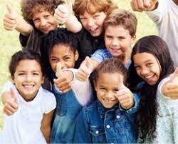
PEER GROUP

Slide 12
It is important to make your choice of friends wisely. Your parents can only control your choices of friends when you are young and under their roofs. When you have grown, you will totally be responsible for your choice of friends. Whatever your friends are, DEPENDING on the individual, that is exactly what you will become except by divine intervention.

Slide 13
CRIMINAL BY NATURE

Slide 14
Cesare Lombroso believes that criminality was inherited and that criminals could be identified by physical objects that conformed them as being savage. A thief for example could be identified by his expressive face, manner and small wandering eyes.

Slide 15
LIFE CHALLENGE
We are faced with decisions every day, most of which are decisions to either do right or wrong.

Slide 16
The bible says ‘Be ye not unequally yoked together with unbelievers; for what fellowship hath righteousness with unrighteousness and what communion hath light with darkness?’
II Corinthians 6:14

Slide 17
CHARACTERS THAT WILL HELP YOU TO RESIST BAD INFLUENCES

Slide 18
Knowing the consequences of good and evil.
Having the knowledge of God.
Being assertive: Being assertive shows that you respect yourself and you are willing to stand up for your interests and express your thought and feelings.

Slide 19
LIKELY BAD BEHAVIOURS IN THE SOCIETY
Joining secret cult.
Joining criminal gangs.
Dressing indecently.
Taking drugs.
Disobedience to parents.

Slide 20
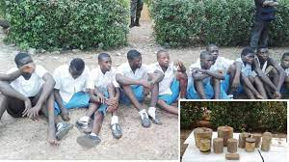
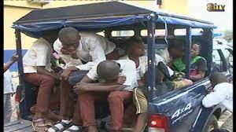
C0NSEQUENCES OF JOINING SECRET CULT
Arrest and prosecution
Clashes that may result in injury or death etc.

Slide 21
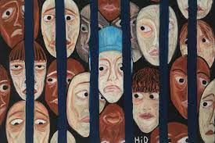
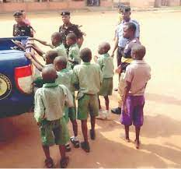
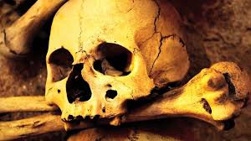

Slide 22
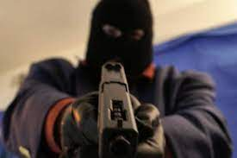
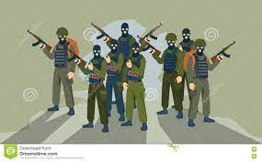
JOINING CRIMINAL GANGS
ARMED ROBBERS
TERRORISTS

Slide 23
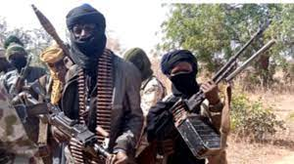
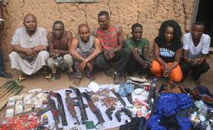
KIDNAPPERS
BANDITS

Slide 24
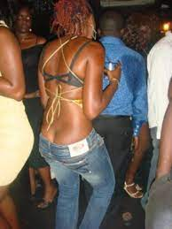
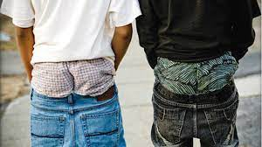
DRESSING INDECENTLY

Slide 25
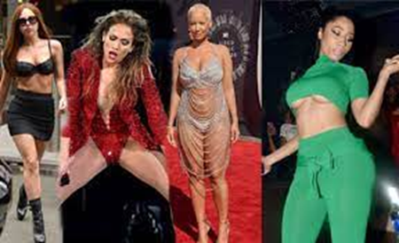

Slide 26
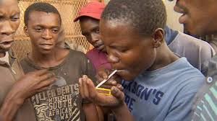
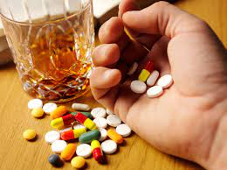
TAKING OF DRUGS

Slide 27
COMMONLY USED DRUGS
1. Cannabis
2. Cocaine
3. Amphetamine
4. Heroin
5. Diazepam
6. Codeine,
7. Cough syrup and
8. Tramadol.

Slide 28
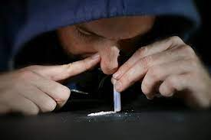
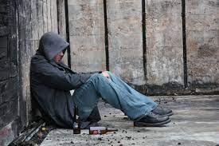
EFFECTS OF DRUG ABUSE
ADDICTION
MENTAL IMBALANCE

Slide 29
DISOBEDIENCE TO PARENTS
WAYS ONE CAN DISOBEY HIS OR HER PARENTS:
1. Talking back at your parents
2. Fighting of parents
3. Insulting your parents
4. Refusing to take instruction

Slide 30
CONCLUSION
No matter the ‘ SECCESSES’ of the bad people in the society, you are not expected to copy their ways of life.

Slide 31
Like flowers they blossom in the morning and fade in the evening. Also, we should bear in mind that every evil deed has consequences.

Slide 32
And that we shall all reap whatever we sow first in this world and in the world to come.

Slide 33
THE END
FOR FURTHER ENQUIRIES CONTACT:
Mr. Aniebiet Udo,
God’s Favour Bookshop,
110, Jakpa Road,
Opposite Eco Bank,
Effurun,
Delta State.
Call/Whatsapp – 08091734729
You Tube - penonpapercreation
Facebook - Penonpapercreation

