Slide 1
LEAVE FACEBOOK AND FACE YOUR BOOK

Slide 2
FACEBOOK AND OTHER SOCIAL MEDIA
Facebook is one the social media frequently used by the youth today. Others are TikTok, You tube, Twitter, Snapchat etc. Just like conventional media, the social media helps to educate, entertain and inform.

Slide 3
However, due to the nature of information posted on the social media, it is better to steer clear of it especially now that you are still in secondary school.
Before we proceed, I want to reiterate that Facebook as used here represents all the social media.

Slide 5
It is important to note that there are many good things to be learnt from Facebook and other social media
but I personally do not subscribe to buying internet enabled phone to learners in either primary or secondary schools. By personal experience, I see it as a distraction.

Slide 6
How many children today draw up their reading timetable and strictly adhere to it? How many learners read their books as a matter of routine? How many learners voluntarily pick up past questions and other exercises to study?

Slide 7
How many learners sit down together to discuss their academics and areas of challenges? How many learners form reading or study groups to help one another?
The questions continue?

Slide 8
These questions become necessary in order to properly determine the priorities of the learners today.
These things are not done not because the learners do not know the importance but because they don’t have the discipline to do them.

Slide 9
Today, children can spend hours watching television and pressing their phones but their future which is their education, they cannot spend such time on.

Slide 10
THE DANGERS OF THE
SOCIAL MEDIA TO A LEARNER
DISTRACTION: To succeed in your education, you are expected to be focused on your academics. This involves diligent study/ reading, doing of assignments and homework.

Slide 11
A child who spends time on Facebook cannot concentrate on his or her studies. This leads to distractions.

Slide 12
2. ACCESS TO ADULT CONTENTS: The social media is not restricted to any age. Therefore, contents are available to both adult and children. This being so, there are chances of consciously or unconsciously having access to contents you are not supposed to have access to.

Slide 13
3. UNVERIFFIED INFORMATION: Most information dished by the social media are not verified. This leads to believing and spreading false information. Those who rely solely on the social media for their news usually have half-baked information.

Slide 14
4. ACCESS TO STRANGERS: The social media gives one access to people known as “friends” which in the real sense most of them are total strangers. Many people have been killed, robbed, raped and abused for visiting the “friends” they met on Facebook.

Slide 15
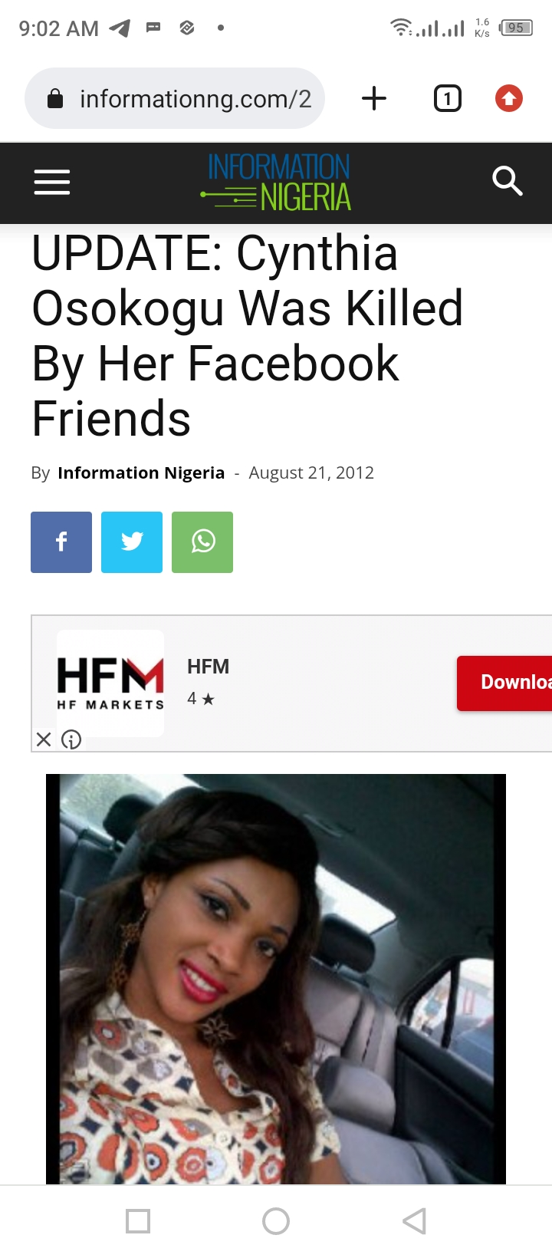
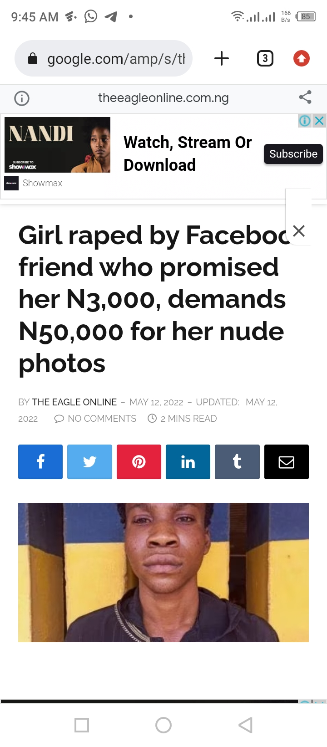

Slide 16
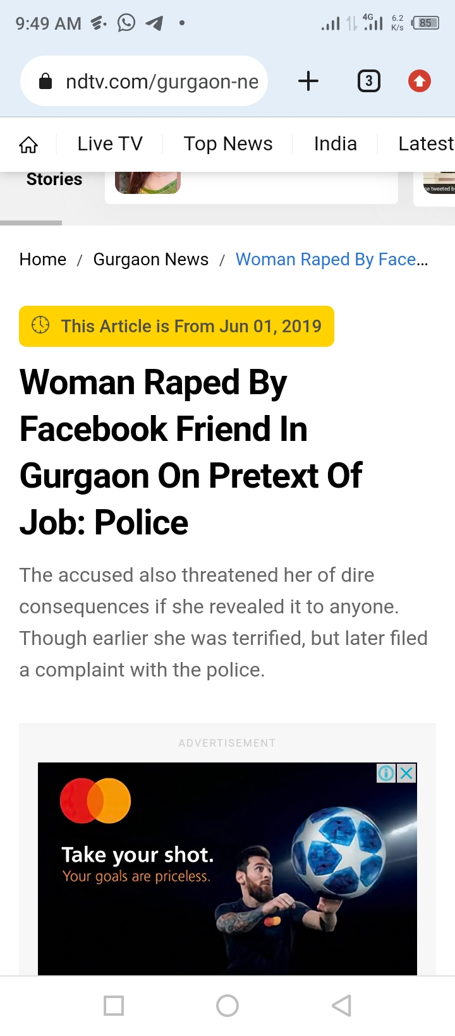
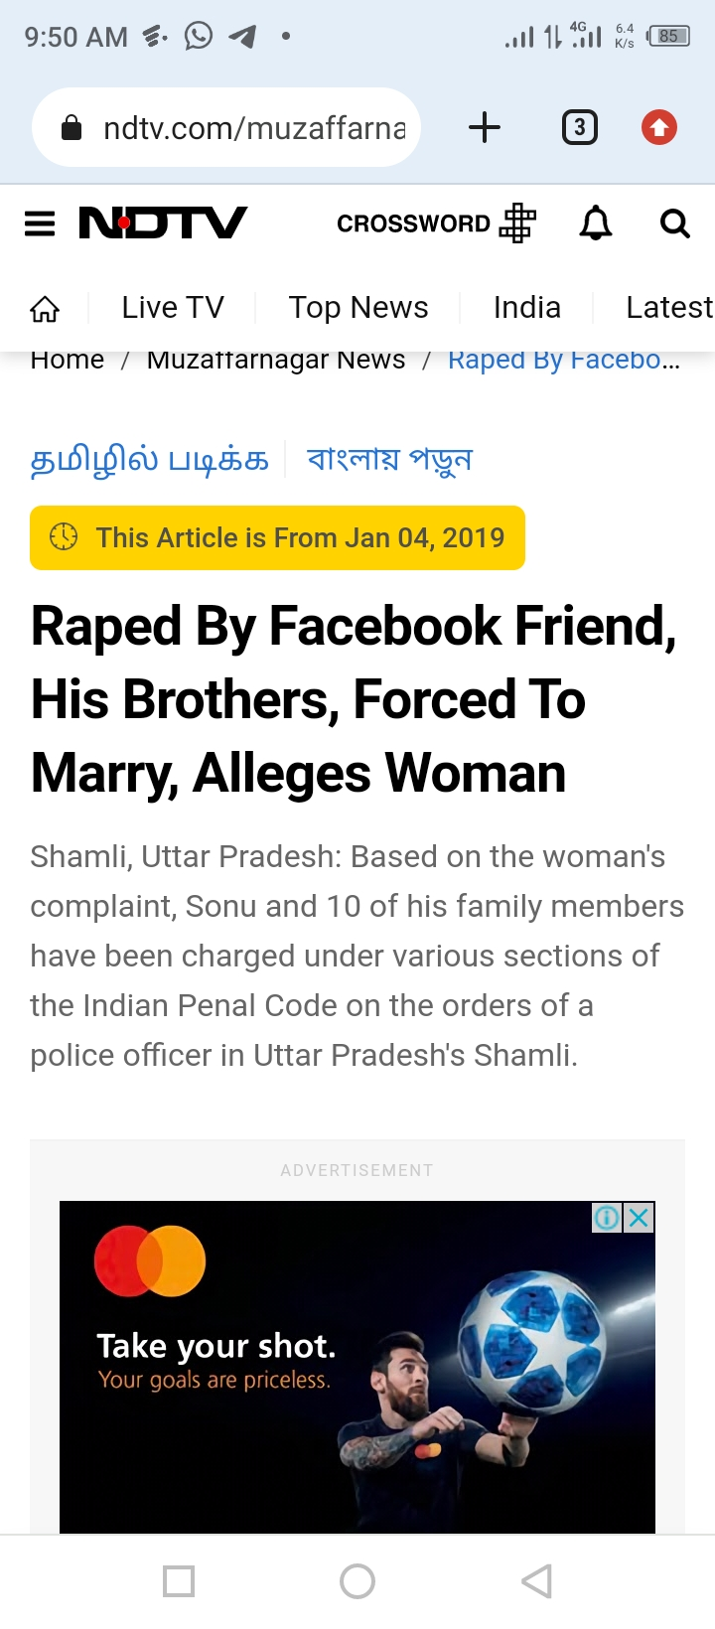
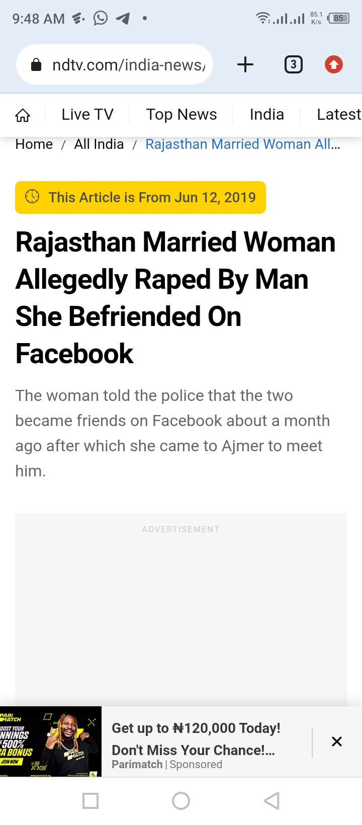

Slide 17
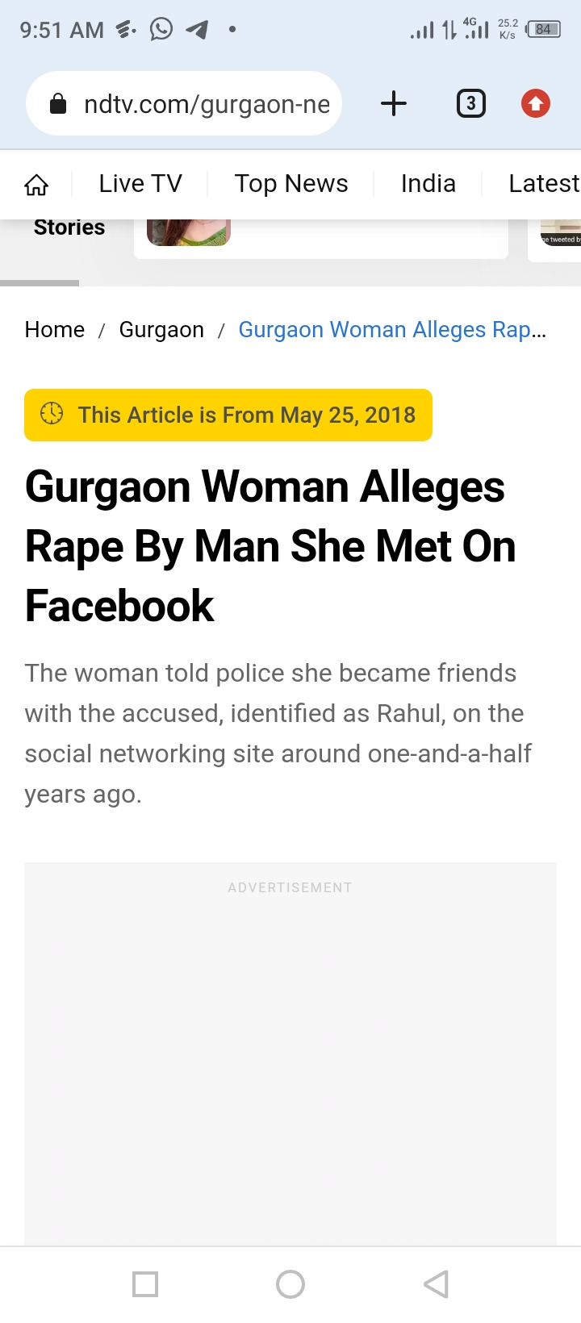
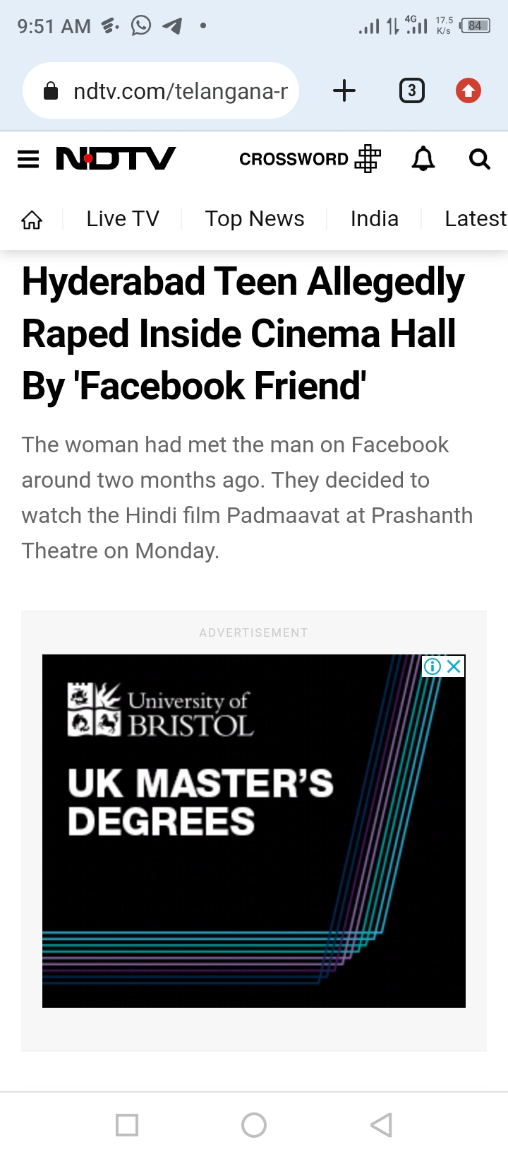
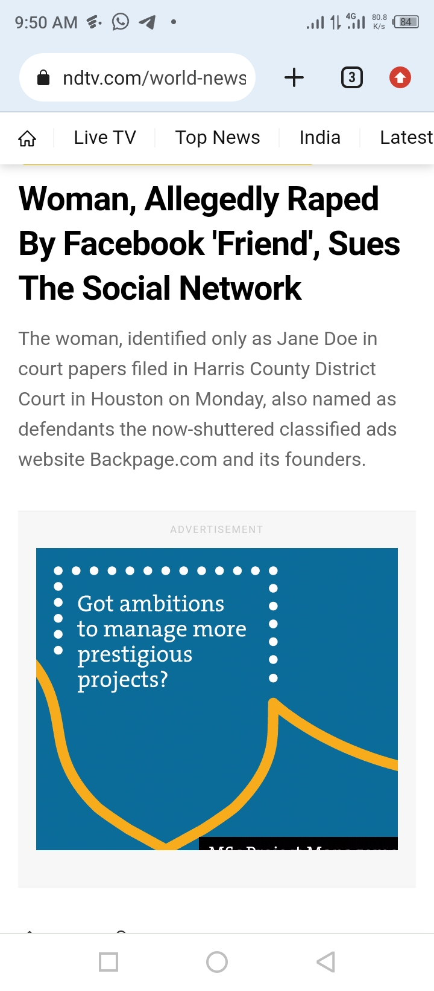

Slide 18
Despite the dangers highlighted above, the positive effects of the social media surpass the negative effects. However, it is important to wait for the right time to join the social media.

Slide 19
WHEN IS THE RIGHT TIME?
The right time, I think is when you are eighteen years and above or when you have gained admission into tertiary institutions when the used of phones becomes a necessity.

Slide 20
However, in order not to totally lose out of what is happening in the world, a student can be allowed to access the social media sparingly under strict supervision of the parents or guardians.

Slide 21
As a student, instead of relying on the social media, we recommend constant listening to news on radio and television. This helps to broaden your mind and knowledge and put you on the know of what is happening in your environment.

Slide 22
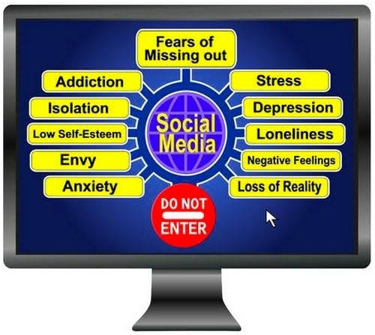

Slide 23
Don’t be deceived, Facebook is not as glamorous as it’s being presented. For now, my candid advice is that you concentrate on your studies, knowing fully well that a time is coming when your life will no longer be restricted by your parents or guardians but by your conscience and God.

Slide 24
THE END
FOR FURTHER ENQUIRIES CONTACT:
Mr. Aniebiet Udo,
God’s Favour Bookshop,
110, Jakpa Road,
Opposite Eco Bank,
Effurun,
Delta State.
Call/Whatsapp – 08091734729
You Tube-penonpapercreation
Facebook - Penonpapercreation

