Slide 1
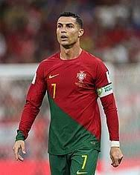
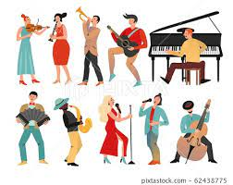
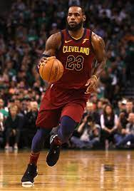
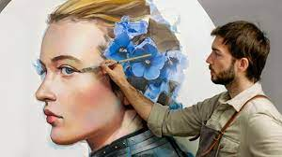
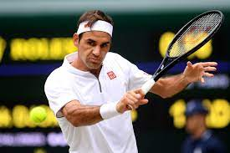
EXPLORE YOUR NATURAL TALENTS

Slide 2
Everyone is endowed with natural talents. These are exceptional gifts that are innate to the individuals. These gifts include; singing, dancing, writing, drawing, playing of football and other sporting activities etc.

Slide 3
Discovering your special talents on time helps you to develop them, thereby enhancing your advancement in life.
It is unfortunate that many people do not know their natural gifts.

Slide 4
HOW TO DISCOVER YOUR TALENT
It is important to note that:
nobody has ever been poor living on his God-given gifts.
(ii) with the level of unemployment, your natural talents will automatically give you something to do and even make you an employer of labour.

Slide 5
This being so, it is important for you to discover your talents and explore them for your future use.

Slide 6
WAYS YOU CAN DISCOVER YOUR TALENTS
There are different ways we can discover our talents.
The following are some of the ways:
Self
Parents
Schools
Church

Slide 7
SELF
Many people consciously discover their talents while others through their environment and life challenges discover theirs. This is really a very difficult way to discover one’s talents.

Slide 8
This is achieved by consistently doing what you love. As time goes on, you become a professional sought after for these talents. Many musicians, comedians, footballers etc. achieved their successes through this method.

Slide 9
PARENTS
Parents especially the enlightened ones help their children in discovering their talents. After watching their children for sometimes, they are able to identify their innate abilities. The talents can thereafter be harness through training either at home or by engaging tutors.

Slide 10
SCHOOLS
These are the major places, talents of learners are discovered. Schools engage in different activities such as singing, dancing, playing of football, basket ball and other sporting activities. Through these activities, talents are discovered and exploited.

Slide 11
In developed countries, academies are set up to train learners in their chosen disciplines. These afford them the opportunities to acquire both academic and professional trainings. The popular academies are; football academies, basket ball academies, film academies etc

Slide 12
CHURCH
Religious institutions also help in the discovery of the natural talents of their members especially music artists. Many music super stars/instrumentalists today, discovered their talents in the church.

Slide 13
BENEFITS OF DISCOVERING YOUR TALENTS
Everyone is blessed with one form of gift or the other. Therefore, discovering yours on time brings about the following benefits;

Slide 14
Source of income
Source of employment
Self fulfillment
Lasting legacies
Societal impact

Slide 15
SOURCE OF INCOME
A well developed talent brings money to the individual. Musicians, footballers, comedians, artist, e.t.c. make money by showcasing their talents to the people. Their services are paid for while many are in high demand. This constantly put money into their pockets.

Slide 16
SOURCE OF EMPLOYMENT
Many people with well developed talents are self employed. They do not need anybody to employ them. Rather, they are employers of labour. This helps to reduce the rate of unemployment in the society.

Slide 17
SELF FULFILMENT
Doing what you love, brings about self fulfilment. You are always excited while doing what you love. Since you see it as fun and part of you , you are not easily exhausted, thus leading to goal attainment.

Slide 18
LASTING LEGACIES
Gifts can serve as inspirations to your generation and future generations. These can be bequeathed as legacies to different generations. Music icons such as Bob Marley, Michael Jackson, 2Pac, Fela, are still impacting on people even though they have long gone.

Slide 19
SOCIETAL IMPACT
Talent developments have great impacts on the society. It makes people to be busy and active, thus reducing negative activities in the society. Many use their talents to impact on the society positively.

Slide 20
I DON’T KNOW MY GIFT, WHAT SHOULD I DO?
Though everyone is blessed by one gift or the other, many due to their environment and backgrounds find it difficult to discover their talents. Some eventually discovered their talent but late in life.

Slide 21
However, due to the present world economy, where white-collar jobs are scarcely found, due to the deployment of computers and robots by organizations and factories, it is advisable that you learn a skill. It is a must!

Slide 22
SKILLS ON HIGH DEMAND IN OUR SOCIETY TODAY
Web development (python, Php, java script, c++)
App development
Software development
Music production
Graphic design
Forex / stocks trading
Synthetic indices trading

Slide 23
OTHER AVAILABLE SKILLS
Catering services
Hair dressing
Dress making/fashion designing
Phones / computer repairs
Shoe making/ repairs
Carpentry etc.

Slide 24
CONCLUSION
Ask yourself ‘What can I do?’
If you are able to discover your talents, look for ways to develop them. You will definitely meet with challenges along the way, but if you persevere and refuse to quit, you will in the long run succeed.

Slide 25
However, if you are unable to discover your talents you can learn a skill. Afterall, all what we’re looking for in life is money. However or whatever you do to make the money does not really matter as long as it is legitimate. Don’t allow situations to force you into doing menial jobs or living on handouts. You can do better!

Slide 26
THE END
FOR FURTHER ENQUIRIES CONTACT:
Mr. Aniebiet Udo,
God’s Favour Bookshop,
110, Jakpa Road,
Opposite Eco Bank,
Effurun,
Delta State.
Call/Whatsapp – 08091734729
You Tube - penonpapercreation
Facebook - Penonpapercreation

