Slide 1
HARD WORK COMES BEFORE SUCCESS

Slide 2
The essence of living is for growth and development. One can only grow and develop when he or she achieves successes in his or her chosen endeavours.

Slide 3
As a student, your success is measured by your performance in your academics. Your parents will be happy to continue to invest in your education when they see consistent improvement in your academic performance. Therefore, you need to work hard to achieve this.

Slide 4
To be seen as a hard working student, one is expected to undertake the following as a matter of routine:
Reading
Doing of assignment
Participating in class activities
Being punctual to school
Obedience to school/class rules and regulations.

Slide 5
READING :
This is an integral part of study. A learner is expected to read daily. To achieve this, a reading timetable containing all the subjects offered. The daily allocation of subjects and time must be realistic and achievable.

Slide 6
To achieve the desired results, the timetable must be religiously followed. No excuse is tenable enough to explain why one did not read.

Slide 7
DOING OF ASSIGNMENT AND HOMEWORK:
Teachers give assignment and homework to students in order to test their understanding of the topic taught. Therefore a hard working student is expected to always do his or her homework independently.

Slide 8
This will enable the learner to go through the topic once again. This increases the learners’ understanding of the topic taught.

Slide 9
Areas of difficulties are also brought to the fore and further explanations are sought from the teacher. Copying assignment from classmates is as bad as not doing it in the first place.

Slide 10
PARTICIPATING IN CLASS ACTIVITIES:
A hardworking student is expected to participate actively in class activities. These include being attentive in class, asking and answering of questions,

Slide 11
doing of classwork and any other physical exercises initiated by the teacher in order to get the attention of the learners.

Slide 12
PUNCTUAL TO SCHOOL/ CLASS:
Punctuality is generally believed to be the soul of any business. This also includes school activities.

Slide 13
A hardworking learner is expected to get to school early and get his or herself ready for the day’s activities.
A late comer will always hurry over his or her work and sometimes misses some part of his or her lesson.

Slide 14
OBEDIENCE TO RULES AND REGULATIONS:
Rules and regulations exist to check and correct the behavioural patterns of people. This being so, obedience to rules and regulations will always make you to be on the part of favour.

Slide 15
You will always be excused from punishments which sometimes will take you out of the class, thereby missing your classes

Slide 16
THE BENEFITS OF HARDWORK
Everyone wishes to be successful in whatever he or she is doing. A successful student is one who works hard and does what he or she is expected to do in relation to his or her school’s activities.

Slide 17
SOME OF THE BENEFITS OF HARD WORK ARE:
1. HARD WORK BUILDS CHARACTER:
Hard work helps to build up character. You learn discipline and how to be focus. You equally learn how to manage time and resources.

Slide 18
2. HARD WORK GETS RESULTS:
When you work hard on whatever you have chosen to do, you will definitely get results. As a student, your results will be measured by good grades in your CAT and examinations.

Slide 19
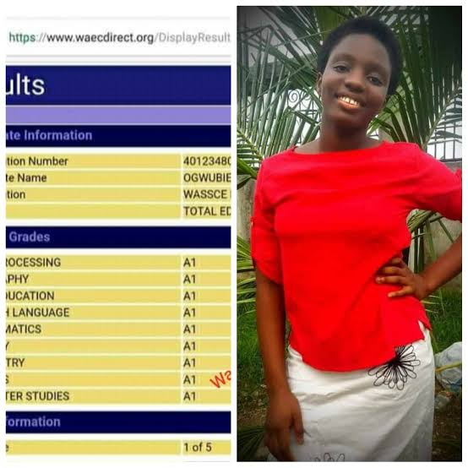
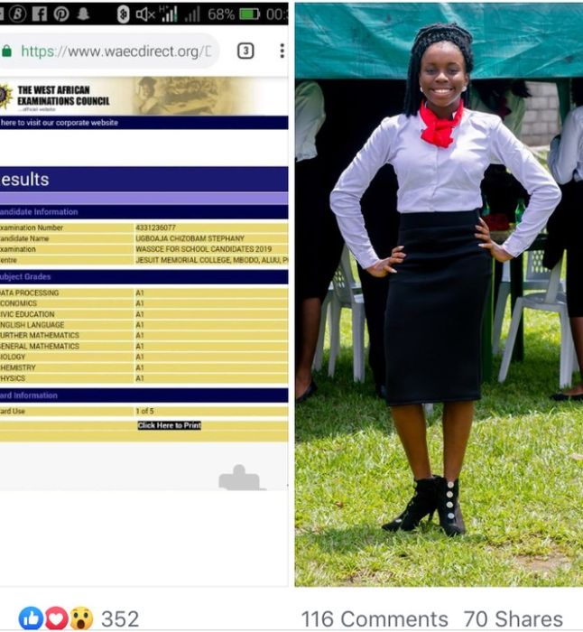
RESULT OF HARDWORK

Slide 20
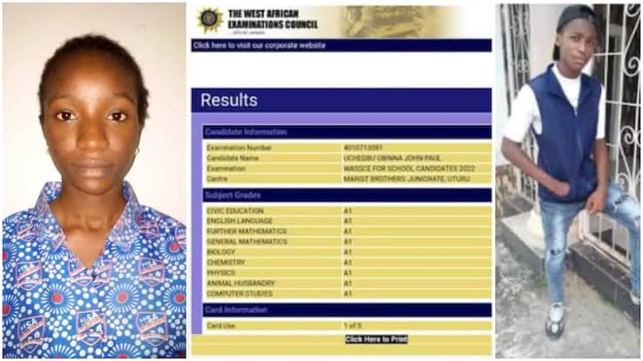
RESULT OF HARDWORK

Slide 21
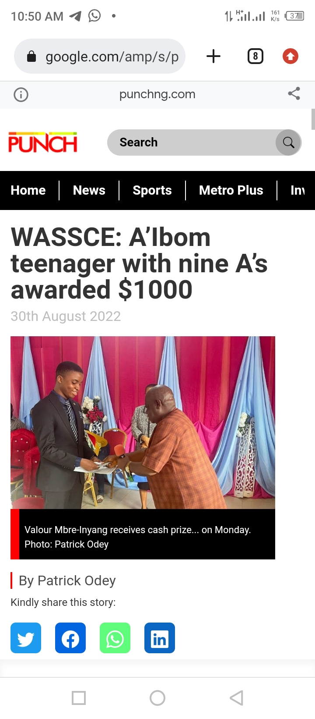
HE GOT $1000 FROM HIS SCHOOL FOR HIS OUTSTANDING PERFORMANCE
SHE MET FORMER GOVERNOR OF PLATEAU STATE BECAUSE OF OUTSTANDING PERFORMANCE

Slide 22
Awarded scholarship into tertiary institution because of outstanding performance by Davido

Slide 23
3. HARD WORK DRAWS ATTENTION:
Hard work brings success. Success definitely draws attention. You want to be noticed? Work hard. The diligent stands out.

Slide 24
4. HARD WORK BRINGS NEW OPPORTUNITIES:
Hard work open doors for more opportunities. Organizations, companies and the society appreciate hard working people. Therefore when you succeed in one assignment you will definitely be given more.

Slide 25
5. HARD WORK BLESSES OTHERS:
Hard work enriches you with materials and financial resources. With these you can bless others. As a student, you become so sound in your academics. With this knowledge, you can help your classmates and friends.

Slide 26
6. HARD WORK BRINGS FULFILMENT:
After you have achieved your goals through hard work you experience fulfilment and self satisfaction.

Slide 27
TO BE THE MAN OR WOMAN YOU ALWAYS DREAM OF, YOU NEED TO WORK HARD

Slide 28
THE END
FOR FURTHER ENQUIRIES CONTACT:
Mr. Aniebiet Udo
God’s Favour Bookshop
110, Jakpa Road,
Opposite Eco Bank,
Effurun,
Delta State,
Call/Whatsapp – 08091734729
You Tube-penonpapercreation
Facebook - Penonpapercreation

