Slide 1
LET YOUR BOOKS BE YOUR COMPANION

Slide 2
The future you desire for yourself is determined by your actions and inactions today. As a student , you are expected to get through different stages of training in order for you to be prepared for the future challenges.

Slide 3
It is expected that you go through your training with all sense of seriousness. Therefore, you must choose your companions rightly. The most important companions you are expected to have at this stage of your life are your books.

Slide 4
THE BOOKS INCLUDE;
Lesson notes,
Textbooks,
Magazines ,
Newspaper,
Jotters Etc.

Slide 5
LESSON NOTES
Lesson notes contain different topics taught by the teachers on different topics and subjects. The topics are selected from the curriculum of a particular subject. The curriculums are designed by educational administrators aimed at building the knowledge of the students gradually.

Slide 6
Each topic is laced with exercises such as classwork, homework, essay, practical etc.
A teacher’s lesson note is expected to pass the desired knowledge to the students irrespective of the class or status of the school and location. For example, a topic on water must be defined water, state the qualities of good and bad water etc.

Slide 7
A student is expected to copy his or her note diligently from the first topic of the term to the last one. He or she is expected to read these notes daily as a routine. A student without a reading timetable is not ready for his or her future.

Slide 8
From experience, a student who does not read daily cannot pass his or her examination and continuous assessment tests. Therefore note reading is an integral part of a student’s life.

Slide 9
TEXTBOOK
These are books that are written by seasoned authors to cover different subjects and topics. A good textbook is expected to treat every topic in detail with picture, examples, exercises etc. Most times, the information contained in textbooks are more than what is given to the students as lesson notes

Slide 10
Therefore, students read textbooks to get these extra information. This extra knowledge makes the students to do well in external examinations. No matter how rich a teacher’s note is, it is not richer than a good textbook. Besides the teacher extracts their notes from textbooks.

Slide 11
MAGAZINES
Magazines are periodical publications containing articles and illustration often on a particular subject or aimed at a particular readership. As a student, you are expected to read some of these magazines. Knowledge got from magazines are not regularly available in the classrooms. A student who reads magazines regularly is expected to vast in contemporary issues.

Slide 12
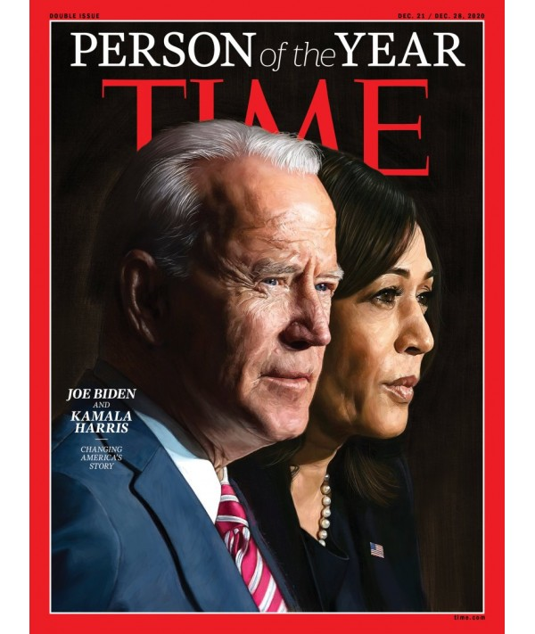

Slide 13
NEWSPAPERS
These contains regular news items both local and International. Reading newspapers makes it possible for one to be abreast with what is happening in the environment. It is important to note that, students don’t take this part of their studies seriously.

Slide 14
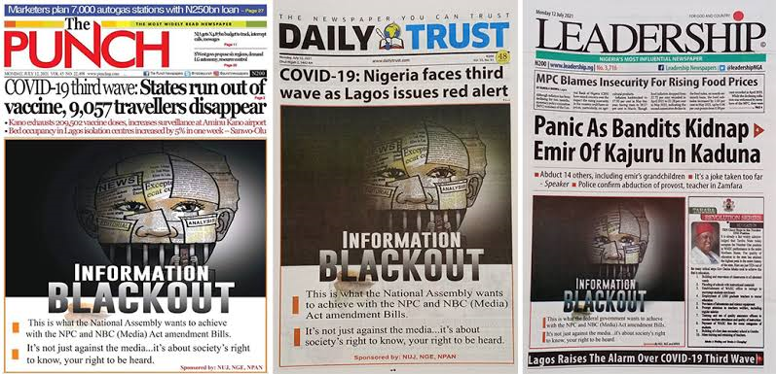
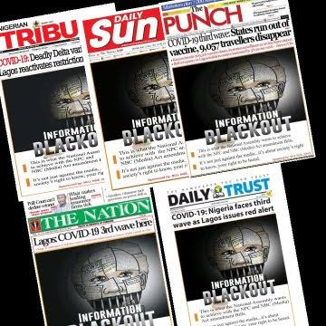

Slide 15
This makes it difficult for them to know their leaders both at the local and the national level. Newspapers can be accessed online or alternatively, students should constantly listen to news on radios and televisions.

Slide 16
CONCLUSION
A student is expected to be wholistic in learning. A good student must be sound mentally and academically and able to stand with his or her contemporaries anywhere in the world.

Slide 17
THE END
FOR FURTHER ENQUIRIES CONTACT:
Mr. Aniebiet Udo,
God’s Favour Bookshop,
110, Jakpa Road,
Opposite Eco Bank,
Effurun,
Delta State.
Call/Whatsapp – 08091734729
You Tube - penonpapercreation
Facebook - Penonpapercreation

