Slide 1
Formation . . .
St. Junipero Serra Region – 2025 Chapter

Slide 2
Formation . . .
“To form” means to give form to, to mold something or some person according to a model or vision, using the necessary and suitable means to attain that purpose. In our case, “to form” concerns a person as a being, perfectible up to the end of his life, by means of education, teaching and example. Formation includes “transformation” which is allowing the Holy Spirit, the actual formator, to transform our lives to become an “altus christos” or another face of Christ to others.

Slide 3
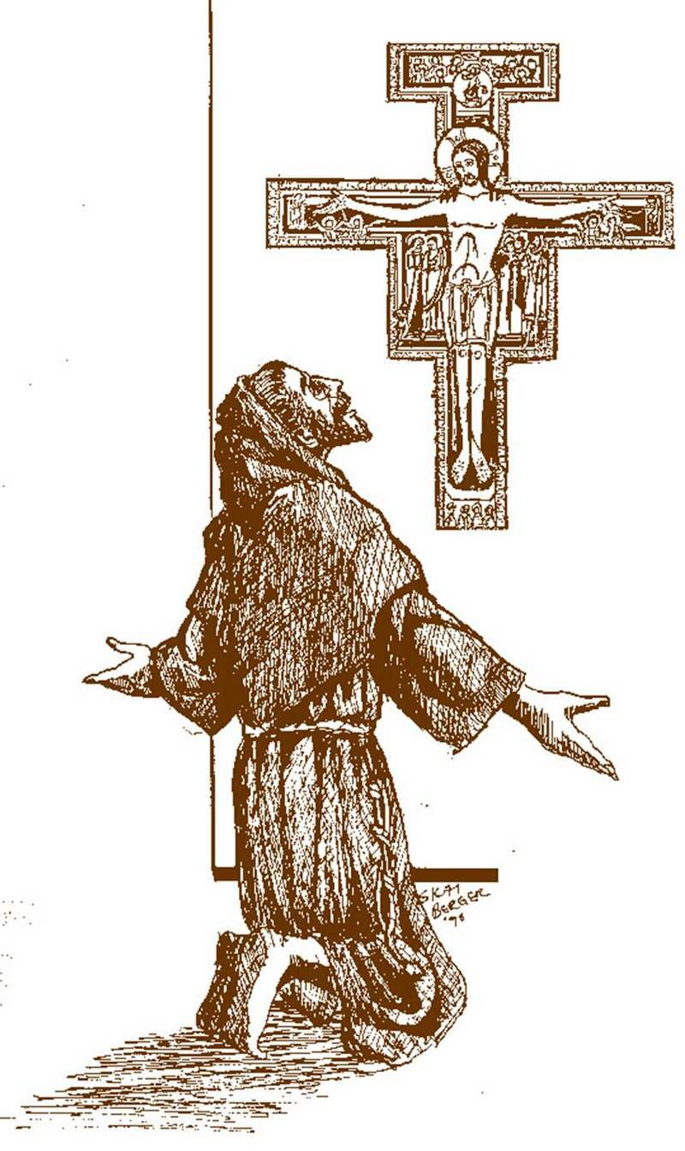
Formation . . .
Formation is the vehicle whereby we learn to internalize and integrate Franciscan Spirituality into every aspect of our lives – into our Franciscan Way of Life. This includes our fraternity life and our good works and our apostolic life.

Slide 4
Formation . . .
Formation directs us to identify and utilize our time, talents, and resources. As a wise Secular Franciscan once said, “Formation doesn’t end until ten minutes after we get into heaven!”
It is a lifelong process.

Slide 5
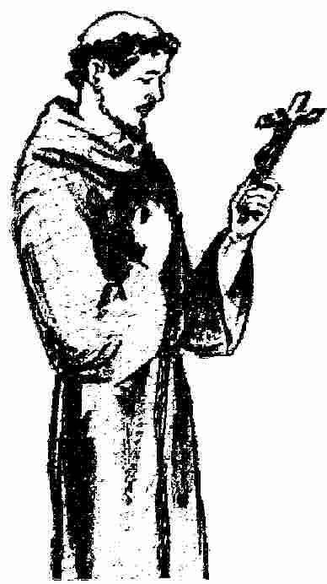
Formation . . .
In this context, formation is to help brothers and sisters to discover the novelty and vitality in their own call as a gift of the Spirit in following Jesus in the manner of Saint Francis of Assisi.

Slide 6
There are four pillars on which our
Secular Franciscan way of life is built.

Slide 7
The four pillars give us the aim in which we want our professed members to develop their vocation.
It is crucial to include all the pillars in the total formation program.

Slide 8
Formation . . .
Orientation

Slide 9
Formation . . .
Orientation
Initial formation

Slide 10
Formation . . .
Orientation
Initial formation
Ongoing formation

Slide 11
Orientation . . .
Orientation is a time for determining a person’s interest, eligibility and disposition to enter into the initial formation process.
[cf. Guidelines for Initial Formation in the Secular Franciscan Order in the United States (hereafter Guidelines for Initial Formation), page 25].
NAFRA Statutes, Article 19, 1a.

Slide 12
Orientation . . .
The period of orientation shall consist of
not less than three (3) months.
NAFRA Statutes, Article 19, 1b.

Slide 13
Initial Formation . . .
Inquiry
Candidacy

Slide 14
Initial Formation . . .
The period of Inquiry begins with the Ceremony of Introduction and Welcoming
[cf. Ritual, page 9]
The period of Candidacy begins with the Rite of Admission
[cf. Ritual, page 11]
NAFRA Statutes, Article 19, 2a, b.

Slide 15
Initial Formation . . .
The period of Inquiry shall consist of not less than six (6) months.
The period of Candidacy shall consist of not less than eighteen (18) months and not more than thirty-six (36) months.
NAFRA Statutes, Article 19, 2a, b.

Slide 16
Initial Formation . . .
These times may be extended but not shortened.
Time should be allowed for the aspirants and candidates to integrate the four pillars.
The aspiring inquirer or candidate and those responsible for evaluating these people will determine the readiness of the aspiring inquirer or candidate to proceed in the process.

Slide 17
Initial Formation . . .
What is the objective of our formation program? Is the aim to have the individuals both internalize and integrate the four basic elements of our Franciscan life?
If this is true, then in our understanding of “chronos” versus “Kairos” as facts of time and growth, we must abandon the external pressure of having to “finish initial formation” in a fixed amount of time.

Slide 18
Initial Formation . . .
Our goal is to provide a strong formation for a firm foundation for living our Secular Franciscan way of life by giving guidance. We should seek to move from a time-framed consideration to a reality-lived mode of formation.
What does this mean?

Slide 19
Initial Formation . . .
When an individual aspirant, along with those responsible for their evaluation, believes the aspirant is ready to move to the next phase of formation, then and only then should that individual enter the next phase. The aspirant should demonstrate a certain level of engagement in living out the four pillars.

Slide 20
Initial Formation . . .
The classroom approach almost always creates a defined and uniform beginning and ending time frame, thus the expectation of a designated “ending moment.”
We know from experience that the human spirit (and Spirit!)
do not operate on such timetables. For an individual to truly internalize and integrate elements of a way of life that call for life adjustments, it does not happen on a prescribed timetable.

Slide 21
Initial Formation . . .
If the individual is lacking, he or she is to be further mentored in living out the integration of the four pillars of the Franciscan charism.
Formation should be a journey of becoming more personal and individual-based rather than communal and classroom-based.

Slide 22
Initial Formation . . .
The sources for these evaluations are The Rule and the General Constitutions. Additionally, two documents, “Interview – Preparation for Admission” and “Interview – Preparation for Profession” will assist those responsible for evaluation of this readiness to proceed in the process.

Slide 23
Initial Formation . . .
All persons in initial formation, in addition to attending their formation sessions, must participate in the meetings of the local fraternity as this is an indispensable presupposition for initiation into community prayer and into fraternity life.
[cf. General Constitutions, article #40.3]
NAFRA Statutes, Article 19, 2c.

Slide 24
Initial Formation Requirements . . .
To be admitted to the OFS in the United States, a person must be a fully initiated member of the Catholic Church (i.e., having received the Sacraments of Baptism, Chrismation/Confirmation and Holy Eucharist) in addition to being an actively practicing Catholic.
NAFRA Statutes, Article 19, 2d.

Slide 25
Profession . . .
The minimum age for perpetual profession as a Secular Franciscan in the United States is twenty-one (21) years.
The minimum age for temporary profession as a Secular Franciscan in the United States is eighteen (18) years.
NAFRA Statutes, Article 19, 3a, b.

Slide 26
ONGOING Formation . . .
Whose job
IS it?

Slide 27
ONGOING Formation . . .
Currently, initial formation is relegated for the most part to the formation director or team.
Ongoing formation is the domain of the council.
This communicates a specific idea that formation is relegated to certain individuals.
Not so!

Slide 28
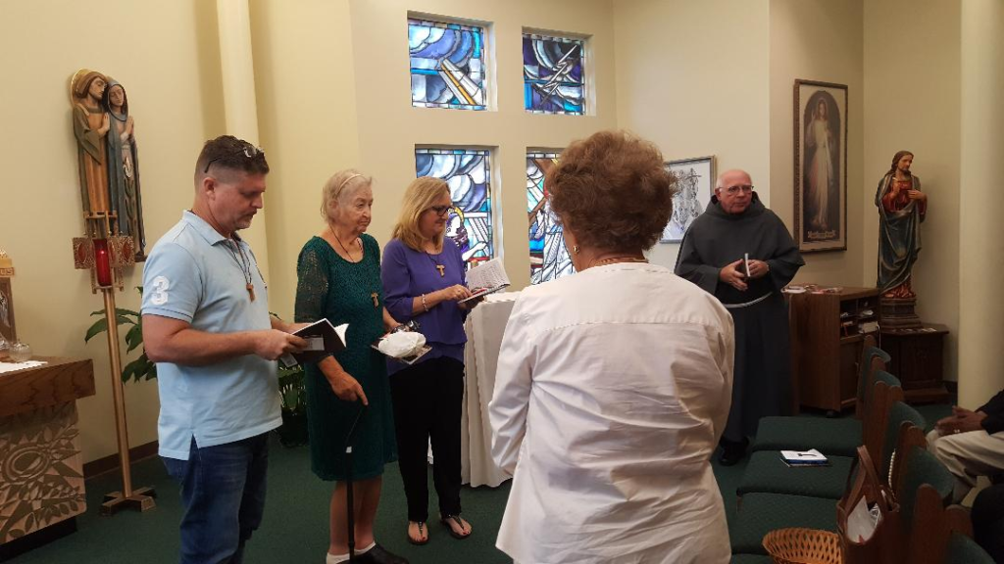
ONGOING Formation . . .
Ongoing formation is the responsibility of all professed members consonant with article #44 of the General Constitutions.
NAFRA Statutes, Article 19, 4.

Slide 29
ONGOING Formation . . .
“Begun by the preceding stages, the formation of the brothers and sisters takes place in a permanent and continuous way. It should be understood as an aid in the conversion of each and everyone, and in the fulfilment of their proper mission in the Church and in society.”
General Constitutions, Article 44, 1.

Slide 30
ONGOING Formation . . .
“The Fraternity has the duty to give special attention to the formation of the newly professed and of the temporarily professed, to help them become more mature in their vocation and develop a true sense of belonging.”
General Constitutions, Article 44, 2.

Slide 31
ONGOING Formation . . .
“Permanent [on-going] formation –[is] accomplished by means of courses, gatherings, and the sharing of experience – [and] aims
to assist the brothers and sisters:
General Constitutions, Article 44, 3.

Slide 32
ONGOING Formation . . .
Rule 4. - in listening to and meditating on the Word of God, “going from Gospel to life and from life to Gospel”;
in reflecting on events in the Church and in society in the light of faith and with the help of the documents of the Magisterium consequently taking consistent positions;
in updating and deepening their Franciscan vocation by studying the writings of Saint Francis, Saint Clare and Franciscan authors.
General Constitutions, Article 44, 3.

Slide 33
ONGOING Formation . . .
We suggest that every member of the fraternity prepare, present and facilitate Franciscan
teachings for ongoing formation.
Include those individuals in the Orientation, Inquiry and Candidacy Phases of formation. Encourage them to share about their formation experiences.

Slide 34
ONGOING Formation . . .
This is a time when the individual members can continue to
discern their calling to the
Secular Franciscan way of life.
Are we “Still on the Way” with Francis and our fraternity?

Slide 35
What does this look like?
There is a wealth of information available for formation programs.
Keep in mind that NAFRA recommends approximately one hour of ongoing formation at every monthly fraternity gathering.

Slide 36
What does this look like?
Promote variety rather than sameness, e.g., scripture, storytelling, book reviews, crafts, instrumental music, singing, and small group dialogue.
Discern and encourage the “teaching gifts” of the members.

Slide 37
What does this look like?
Include dialogue with presentations.
Dialogue is preferred rather than lectures.
Discuss TAU-USA Ongoing Formation articles.
Plan to have an Annual Renewal of
Franciscan Commitment as a special ceremony on a specific day every year – perhaps near October 3rd.

Slide 38
What does this look like?
“This formation should consist of frequent meetings for study and prayer and with concrete experiences of service and of apostolate. These meetings should be held, as far as possible and feasible, in common with the candidates of
other Fraternities.”
General Constitutions, Article 40, 1.

Slide 39
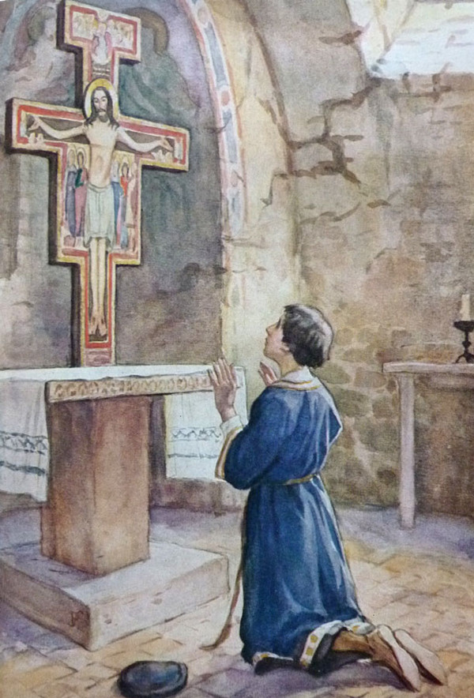
Focus on vocation
and discernment of
vocation to the
Franciscan way of
Secular Life

Slide 40
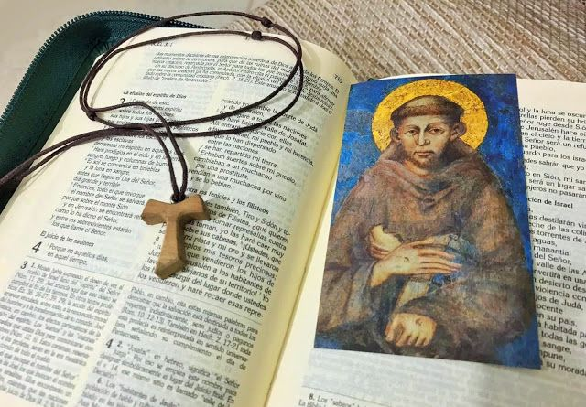
Focus on
commitment
and the
penitential
way of life

Slide 41
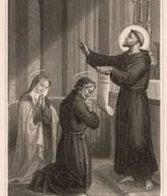
Focus on
Gifts of the Spirit
in the life of
Solemn Profession

Slide 42
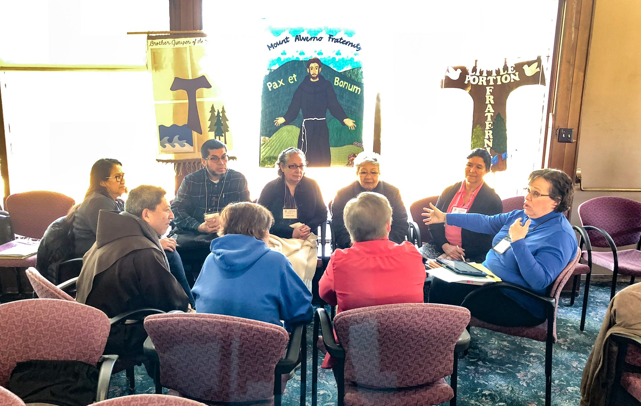
“Opportunities for
fraternities to
meet together
for the purposes of
common ongoing and
initial formation
shall occur whenever
possible at all
levels of fraternity.”
NAFRA Statutes, article 19, 5;
General Constitutions, article 44, 1.

Slide 43
Ongoing formation
“Ongoing Formation in the Secular Franciscan Order is lifelong and continuous, with the purpose of offering Secular Franciscans an ever growing richer and intensive spiritual life, accompanying them in their faith path, to consolidate their Franciscan discipleship, updating it continually in line with the teaching of the Church and to allow it to evolve in the daily interchange with our Society.”
The Presidency of the International Council of the Secular
Franciscan Order, “Guidelines for the Formation of the SFO,” Rome, 2001.

Slide 44
Initial Formation . . .
Who does it?
When is it done?
What materials are used?
On-Going Formation . . .
Who does it?
When is it done?
What materials are used?
What formats are used?
How are the topics chosen?

Slide 45
Some final thoughts . . .
“Formation does not consist in just sending or having ‘material.’ Don’t confuse ‘formation’ with ‘Formation Materials’.”

Slide 46
Some final thoughts . . .
“Formation is the transmission of emotions, vital knowledge, vibrations coming from real living experiences which involve our whole being. It’s not just reading.”

Slide 47
Some final thoughts . . .
“We can no longer afford to accept programs which settle for a bare smattering of notions to enter the Order, though seasoned with a healthy pinch of ‘Franciscan devotions.’ We cannot settle for the bare minimum.”

Slide 48
Some final thoughts . . .
“We must shun superficiality, carelessness, living from day to day without adequate preparation and most of all we must aim at living what we transmit and transmit what we live with love and passion.”

Slide 49
Some final thoughts . . .
“If we understand our Vocation, Charism and Mission we will better be able to help others discern theirs.”
“…and the purpose? For salvation - to become holier, more beautiful, stronger in faith and capable to cope with the mandate and the heritage received by St. Francis and the expectations of the Church.”
From Members of the 2008 Presidency Formation Commission; National Formation Commission;
2018 Regional Formation Director Handbook

