Slide 1
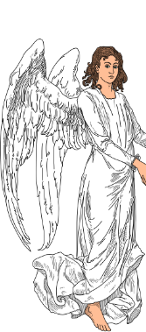
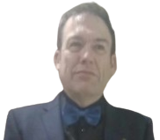
B2 c1 Speaking values.B2 c1 values
A presentation not for the faint-hearted.
Picture credits and licenses: slide 15

Slide 2
What are the important things in life?
c1 values
Generally, are rich people happier? Why / not? Give examples if you can.
Picture credits and licenses: slide 15

Slide 3
“My family is my strength and my weakness”.
Explain. Is it true?
c1 values
What is a system of personal values?
Are we born with values?
What influences our values?
Picture credits and licenses: slide 15

Slide 4
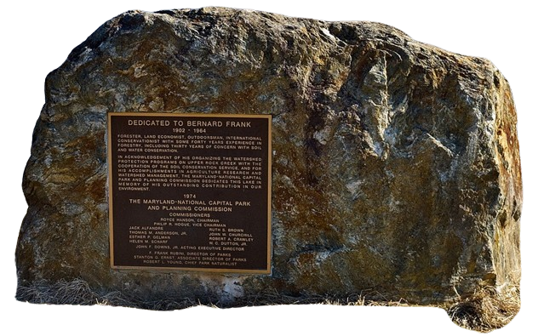
Values are individual beliefs that motivate people to act one way or another. They serve as a guide for human behaviour. Generally, people are predisposed to adopt the values that they are raised with. People also tend to believe that those values are “right” because they are the values of their particular culture.
(https://ethicsunwrapped.utexas.edu (adapted))
Picture credits and licenses: slide 15

Slide 5
Click for video
Watch the video.
Do you agree in general with what the man says?
What would you do in the example he mentions?
Picture credits and licenses: slide 15

Slide 6
What do you think about what he said? Are there any parts you don’t agree with?
What would you do in the example he mentioned?
In general, is a young child to blame for the ‘bad’ values they have? Are we just a product of our upbringing?
Describe some typical situations when feelings and values are in conflict.
Picture credits and licenses: slide 15

Slide 7
Explain the dilemmas.
What would you do?
Picture credits and licenses: slide 15

Slide 8
You are selling your car. It is basically OK, but sometimes it doesn’t start; it was also involved in a minor accident some years previously. Do you disclose everything to your potential buyer? If no, would you lie if they asked you these questions directly?
c1 values
Should young teens’ social media use be monitored by a parent?
Picture credits and licenses: slide 15

Slide 9
Your friend commits a crime. You are the only one they can trust with their confession. Later, you read that someone has been arrested for your friend’s crime. Do you report them? They refuse to go to the police.
c1 values
Should you tell your friend if their partner is cheating?
*
Would you tell your friend’s partner if your friend was cheating?
Picture credits and licenses: slide 15
Picture credits and licenses: slide 15

Slide 10
Who is the most ‘value-led’ person you know? What kind of a person is he/she?
Did people in the past have better values than now?
Why/why not?
Have you ever been surprised – positively or negatively – by a friend’s / family member’s values? Give some examples.
Do you think, in general, people pair up with others with a similar value system to their own? Can a relationship work if the value systems are radically different?
Picture credits and licenses: slide 15

Slide 11
c1 values
Is it okay to take supplies from your workplace or school / university? Toilet rolls, pens etc.
Should you lie to a sick loved one?
Picture credits and licenses: slide 15

Slide 12
You're involved in a two-car crash. You also accidentally hit and seriously injure a pedestrian.
As you get out of the car, you are intercepted by the other tearful motorist who seems to think that they hit the pedestrian. You're not sure why they think they hit the person, but they are 100% convinced.
You saw the impact, though, and you know it was you and your car. There's only you, the tearful other driver, and the person you hit on the road, who is badly hurt but awake and did not see anything; there are no witnesses.
Do you take the blame?
Picture credits and licenses: slide 15

Slide 13
You are on a cruise ship and encounter a violent storm. The passengers are told to head to the lifeboats and abandon ship. As people begin to line up, you realise some lines have fewer people, some have families, and some have younger, single people. You are strong and capable, and a good swimmer.
Do you choose to queue with a line composed of three families with young children, a group of seniors who could obviously use your help, or the line of young, strong people, with whom you might have a better chance of survival?
Picture credits and licenses: slide 15

Slide 14
Bye-bye
Picture credits and licenses: slide 15

Slide 15
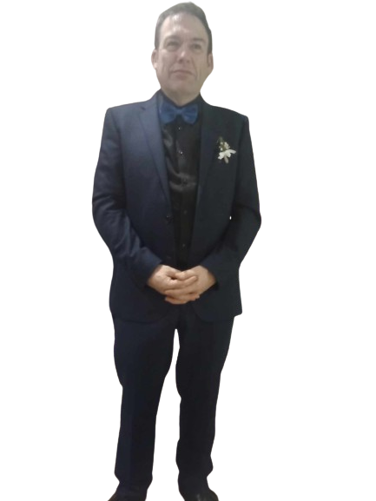
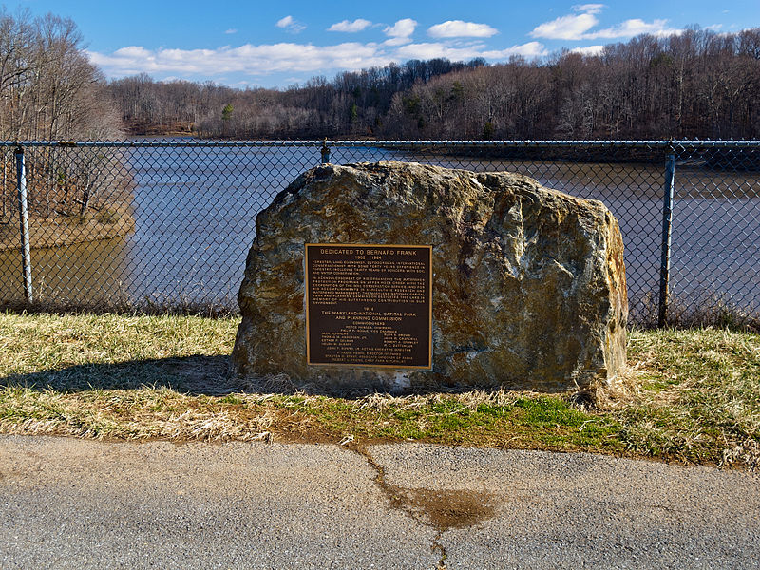
Picture licenses
All pictures in this presentation are copyright-free or in the public domain.
This file is made available under the Creative Commons CC0 1.0 Universal Public Domain Dedication
This file is made available under the Creative Commons CC0 1.0 Universal Public Domain Dedication
Author’s own photo
This file is made available under the Creative Commons CC0 1.0 Universal Public Domain Dedication
Clker-Free-Vector-ImagesFree-Vector-Images (https://commons.wikimedia.org/wiki/File:Devil-307138.svg), „Devil-307138“, https://creativecommons.org/publicdomain/zero/1.0/legalcode
Thommy (https://commons.wikimedia.org/wiki/File:Royal_coat_of_arms_of_the_Kingdom_of_Hungary_(1896-1915;_angels).svg), „Royal coat of arms of the Kingdom of Hungary (1896-1915; angels)“, cropped by Alex Elwood, https://creativecommons.org/publicdomain/zero/1.0/legalcode
Bonnachoven (https://commons.wikimedia.org/wiki/File:Bernard_Frank_Dedication_Stone.jpg), „Bernard Frank Dedication Stone“, cropped by Alex Elwood, https://creativecommons.org/publicdomain/zero/1.0/legalcode

Slide 16
You might like these similar presentations
(click for link):
Free
€3

Slide 18
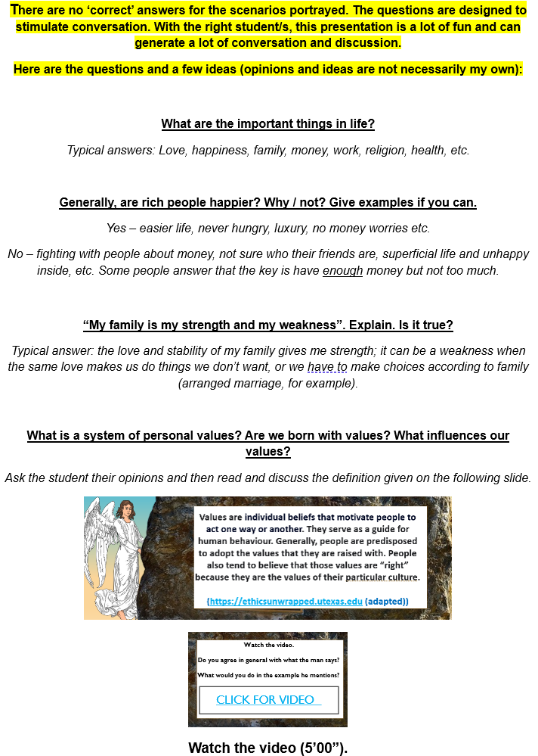
Copy and paste teacher’s notes into Word and print
(4 pages)
(pages 1 & 2)

Slide 19
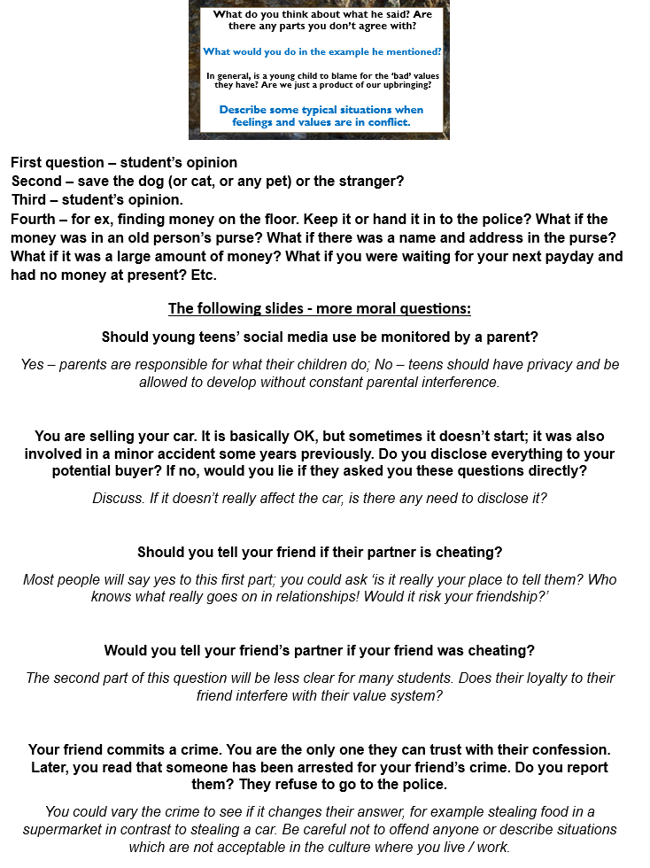
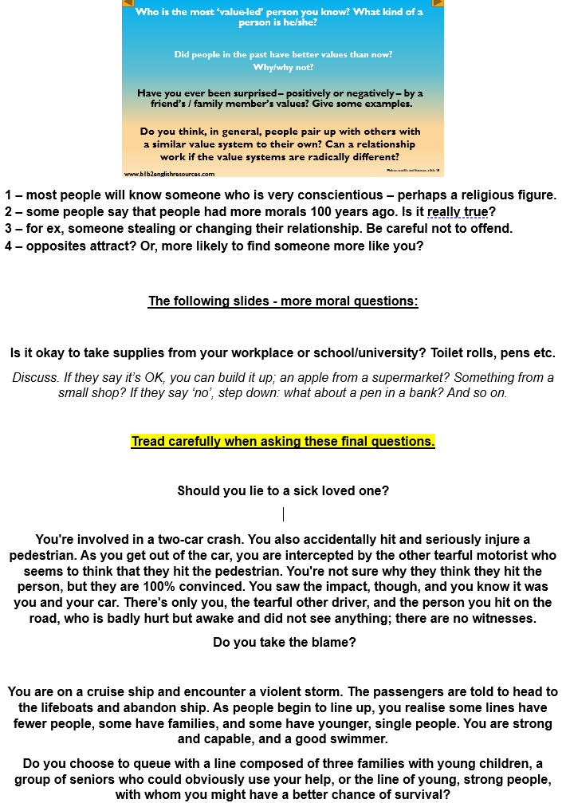
Copy and paste teacher’s notes into Word and print
(4 pages)
(pages 3 & 4)

Slide 20
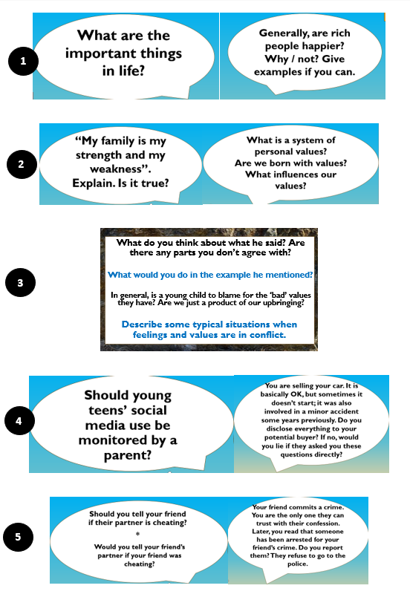
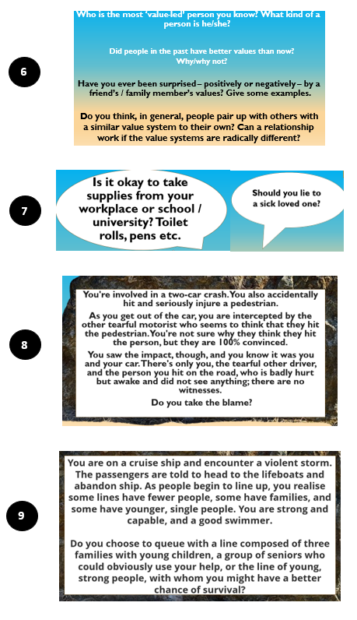
Copy and paste Class notes into Word and print
(2 pages)
(pages 1 & 2)

